Slide 1
Principal Components Analysis (PCA)
BIOE 210

Slide 2
Classification vs. Understanding
The SVM algorithm used training data to classify unknown samples.
We do not always understand how the SVM classifier makes decisions.
In biology we are often interested in understanding the differences between two classes, not assigning new samples to classes.
Understanding is difficult in high-dimensional systems.

Slide 3
Are high-dimensional data really high-dimensional?
Imagine you measured gene expression levels for multiple subtypes of a tumor.
There are often hundreds of genes that are differentially expressed.
Is it reasonable to think that the subtypes differ by hundreds of independent processes?
Usually there are a small number of differential functions that each involve lots of genes.

Slide 4
Dimensionality Reduction
Dimensionality reduction converts lots of individual variables into a smaller number of composite variables.
The components of the composite variables function together. - Composite variables are linearly independent. - Variables inside a composite variable are dependent.
Our goal is to find the fewest composite variables that explain the maximum amount of the data.

Slide 5
Principal Component Analysis
Principal Component Analysis (PCA) chooses composite variables from a matrix of data.
The composite variables (principal components) are always mutually orthogonal.
PCA also calculates the importance of each component, i.e. the amount of explained variance in the data.

Slide 6
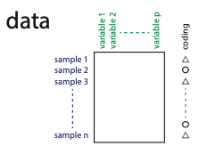
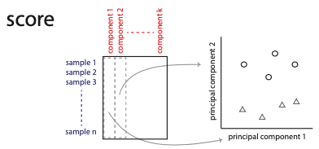
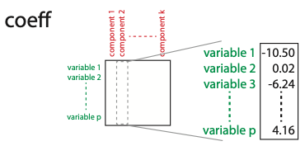
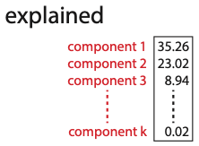

Slide 7

How do we calculate Principal Components?
[coeff,score,~,~,explained] = pca(X)
$X=UΣV^{T}$ (the SVD)
score = $UΣ$
explained = diag($Σ$), normalized to 100%
coeff = $V$

Slide 8
Example: Fluoride effects on the Microbiome
OTUs
data
samples
Study examined mice given no, low, or high levels of fluoride in drinking water for 12 weeks.
Microbiome samples taken from mouth and stool were sequenced to identify changes in microbial composition.
Variables are the abundances of species in the samples (called OTUs, or operational taxonomic units). ~10,000-30,000 OTUs are commonly seen in human microbiome samples.
Source: Yasuda K, et al. 2017. Fluoride depletes acidogenic taxa in oral but not gut microbial communities in mice. mSystems 2: e00047-17. https://doi.org/10.1128/mSystems.00047-17.
PCs
score
samples
PCs
coeff
OTUs

Slide 9
Many species (OTUs) vary between the oral and gut microbiomes.
OTUs
data
samples
PCs
score
samples
PCs
coeff
OTUs

Slide 10
The microbiomes can be separated by the 1st P.C.
OTUs
data
samples
PCs
score
samples
PCs
coeff
OTUs

Slide 11
The loadings of PC1 identify differentially abundant species.
OTUs
data
samples
PCs
score
samples
PCs
coeff
OTUs

Slide 12
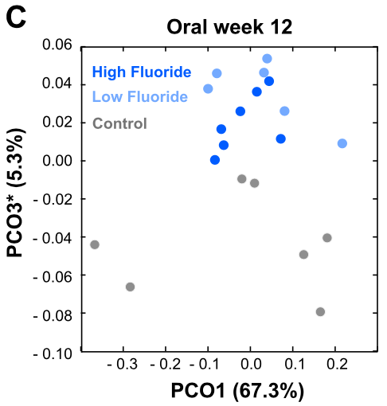
Result 2: Fluoride changes oral microbiome composition
PCs 1&3 explain 67.3 + 5.3 = 72.3% of the total variance in the dataset.
PC1 & PC2 do not separate the samples by fluoride levels.
PC3 does, however PC2 explains only 5.3% of the total variation.
The variables loaded in PC3 explain differences between fluoride levels, but the total effect is not large; the effects of PC1 must be removed first.
The authors confirmed several of the species loaded onto PC3 were affected by fluoride levels.

Slide 13
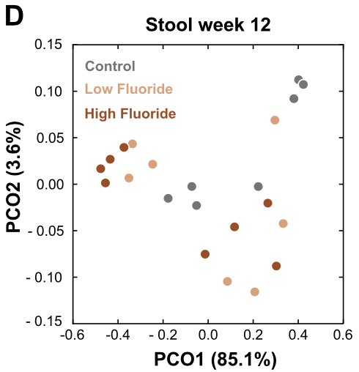
Result 3: Fluoride changes are limited to the oral cavity
Neither PC1 or PC2 separate the stool microbiome samples by fluoride levels.
Since these PCs explain 85.1 + 3.6 = 88.7% of the total variation, any effects of fluoride on the stool microbiome must be very small.

Slide 14
Summary
The number of independent components is usually far smaller than the number of variables.
PCA finds orthogonal combinations of variables of decreasing importance.
Visualizing “lesser” components can identify signals that are lost in the full dataset.

Slide 15
Standard PCA Workflow
Make sure data are rows=observations and columns=variables.
Convert columns to Z-scores. (optional, but recommended)
Run [coeff,score,latent,tsquared,explained] = pca(X)
Using the %variance in “explained”, choose k = 1, 2, or 3 components for visual analysis.
Plot score(:,1), ..., score(:,k) on a k-dimensional plot to look for clustering along the principal components.
If clustering occurs along principal component j, look at the loadings coeff(:,j) to determine which variables explain the clustering.

Slide 16
Principal Components Analysis in Matlab [coeff,score,latent,tsquared,explained] = pca(X)
X: input data
Matrix with n rows and p columns
Each row is an observation or sample
Each column is a predictor variable
All columns must be zero-centered X(:,i) = X(:,i) – mean(X(:,i))
pca will zero-center automatically, but any reconstructed output will not match X
Recommended that you scale the variance of columns to 1 by converting X to Z-scores [...] = pca(zscore(X))

Slide 17
Principal Components Analysis in Matlab [coeff,score,latent,tsquared,explained] = pca(X)
coeff: coefficients (loadings) for each PC
Square pxp matrix
Each column is a principal component
Each entry -- coeff(i,j) -- is the loading of variable i in principal component j
The matrix is orthonormal and each column is a right singular vector of X; coeff is the matrix V from the SVD of X.
The first column explains the most variance. The variance explained by each subsequent column decreases.

Slide 18
Principal Components Analysis in Matlab [coeff,score,latent,tsquared,explained] = pca(X)
score: Data (X) transformed into PC space
Rectangular nxp matrix
Each row corresponds to a row in the original data matrix X.
Each column corresponds to a principal component.
If row i in X was decomposed over the principal component vectors, the coefficients would be score(i,j): X(i,:) = score(i,1)*coeff(:,1) + score(i,2)*coeff(:,2) + ... + score(i,p)*coeff(:,p)

Slide 19
Principal Components Analysis in Matlab [coeff,score,latent,tsquared,explained] = pca(X)
latent: Variance explained by each PC
explained: % of total variance explained by each PC
Both latent and explained are vectors of length p (one entry for each PC
explained = latent/sum(latent) * 100
Variance explained is used when deciding how many PCs to keep.

Slide 20
Principal Components Analysis in Matlab [coeff,score,latent,tsquared,explained] = pca(X)
tsquared: Hotelling’s T-squared statistic
Vector of length n, one entry for every observation in X.
Statistic measuring how far each observation is from the “center” of the entire dataset.
Useful for identifying outliers.

