Slide 2
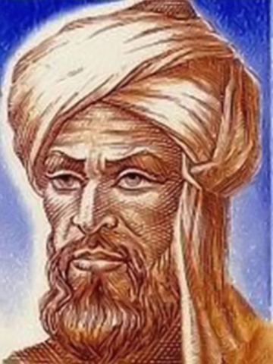
Muhammad ibn Musa al-Khwarizmi c. 780 - 850

Slide 3
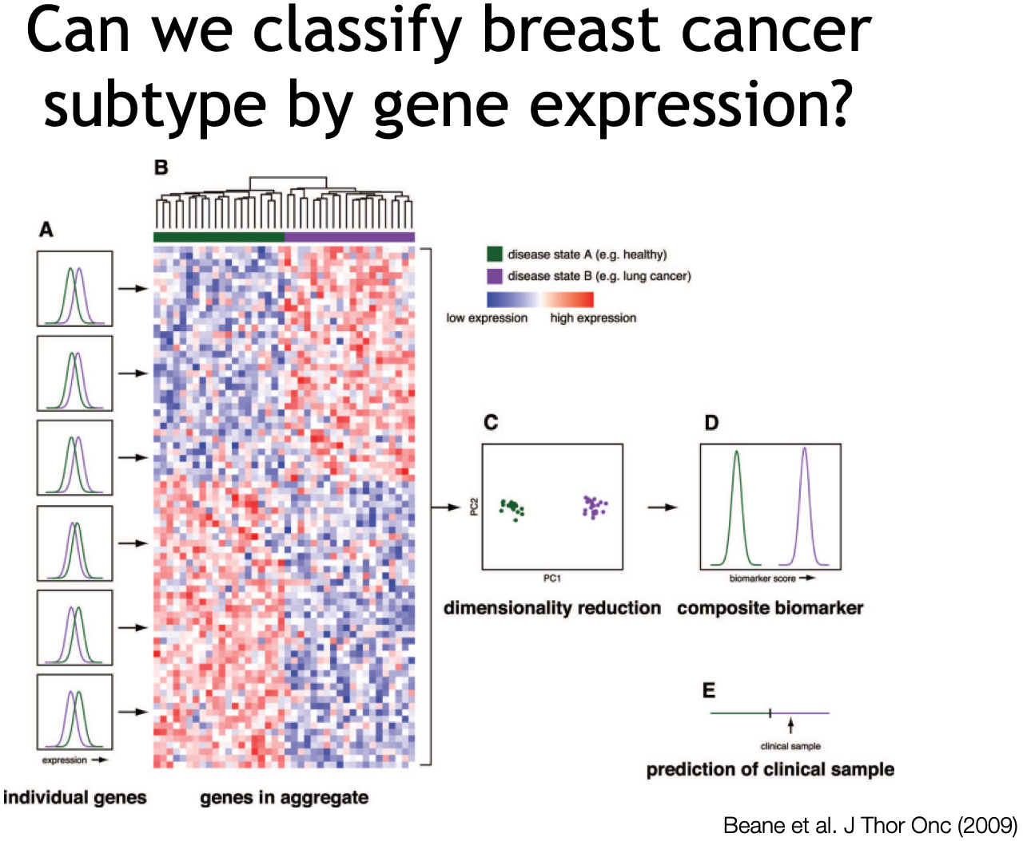
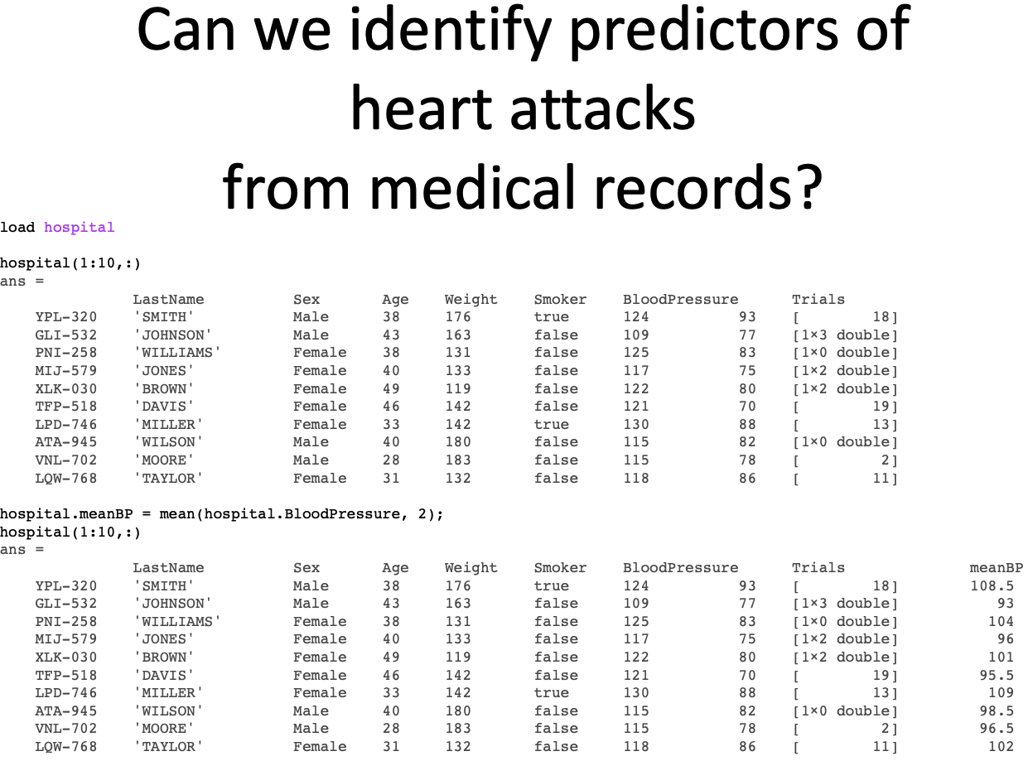
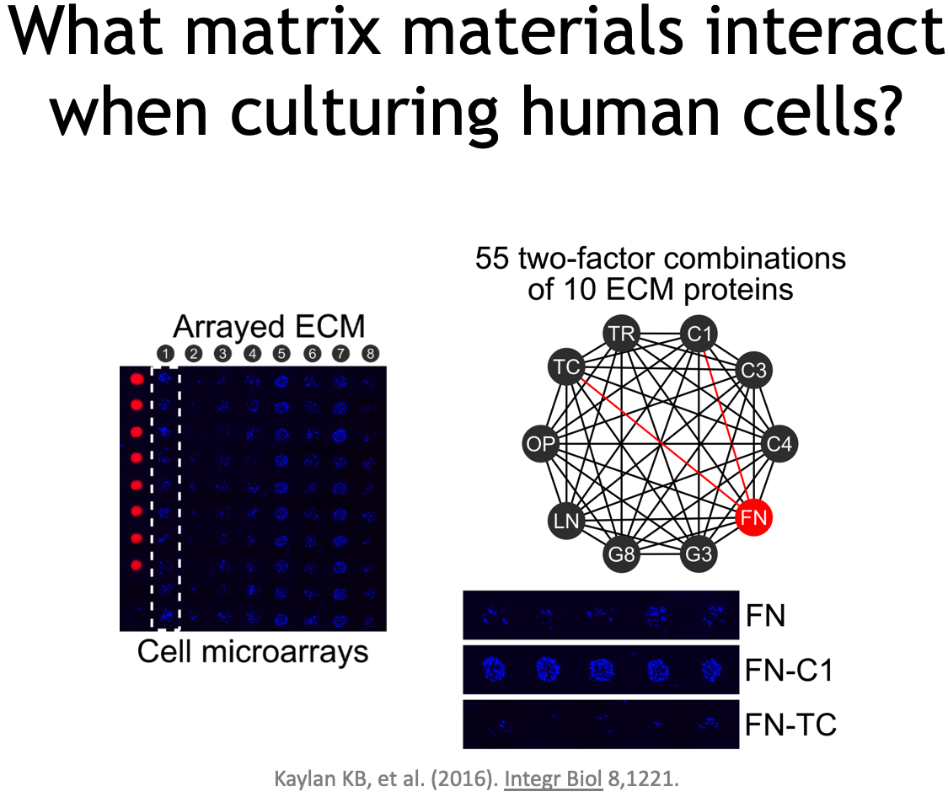
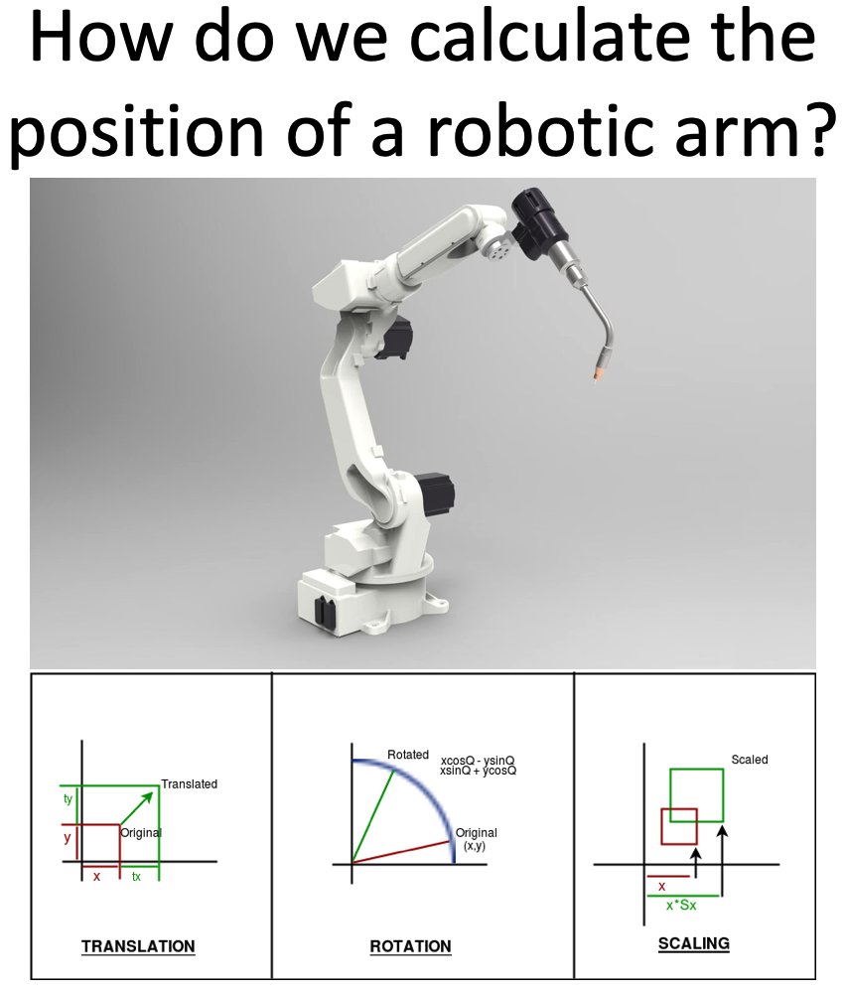
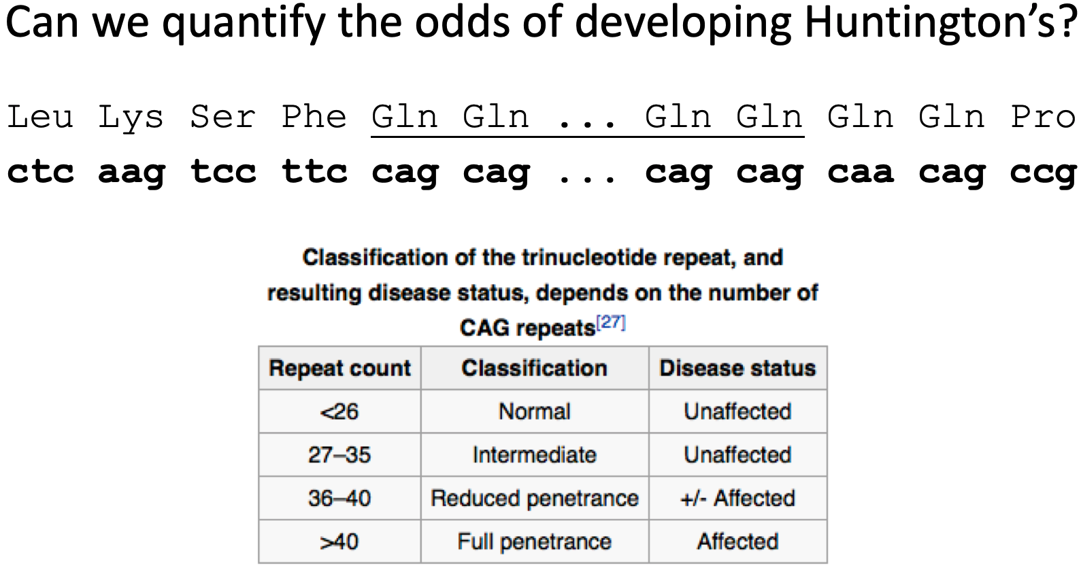
BIOE 210 is a core course, not a computational track elective.
These questions (and more)
are homework problems from Spring 2020.

Slide 4
What’s in BIOE 210?
Part I: Linear Systems Field axioms Norms & dot products Multiplication Translation matrices Gaussian Elimination Inverses, solvability, & rank Finite differences Linear regression
Part II: Nonlinear Systems Root finding Optimization & convexity Gradient descent Regularization Geometry Support Vector Machines Artificial Neural Networks
Part III: High-Dimensional Systems Basis vectors Orthogonality Eigenvectors/values SVD / PCA / Low-rank approximations Image compression Recommender systems

Slide 5
What’s not in BIOE 210?
Several classes use linear algebra or related topics. These topics are referenced, but not covered in BIOE 210:
Linear systems (state space), Laplace & Fourier transforms [BIOE 205]
Probability & statistics, clustering [BIOE 310]
Design of experiments, reinforcement learning [BIOE 498 PJ]
Topics in other linear algebra courses (MATH 415/416)
Subspaces, quadratic forms, heavy use of the determinant, operator and spectral theory.
These are replaced with more applied topics: statistical models, machine learning, and numerical methods.

Slide 6
Class Structure
Three exams
February 23, March 25, May 4 (last day of class)
Six homework sets
Includes analytical and machine problems.
All work submitted on Gradescope.
Stay tuned to the class website
http://bioe210.github.io

Slide 7
Class Rules
You do not need to come to class.
If you come to class, you will be respectful of your colleagues.
If you have any questions on Rule #2, see Rule #1.
Lectures cover the material in the book. Lectures are your chance to ask questions and participate.
The lectures are not recorded, and you are not allowed to record your classmates (or the instructor).
You do not need to take notes. Try just listening and participating!

Slide 8
Succeeding in BIOE 210
Linear algebra is powerful, elegant, and beautiful. Trust me.
Everything you need to know is in the book. I’m not trying to keep this stuff a secret.
If you can’t find something, look deeper before you look wider.
There will be no surprises:
Textbook
Lecture
Practice problems
Homework problems
Office hours
Practice exams
Exams

Slide 9
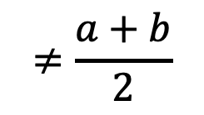
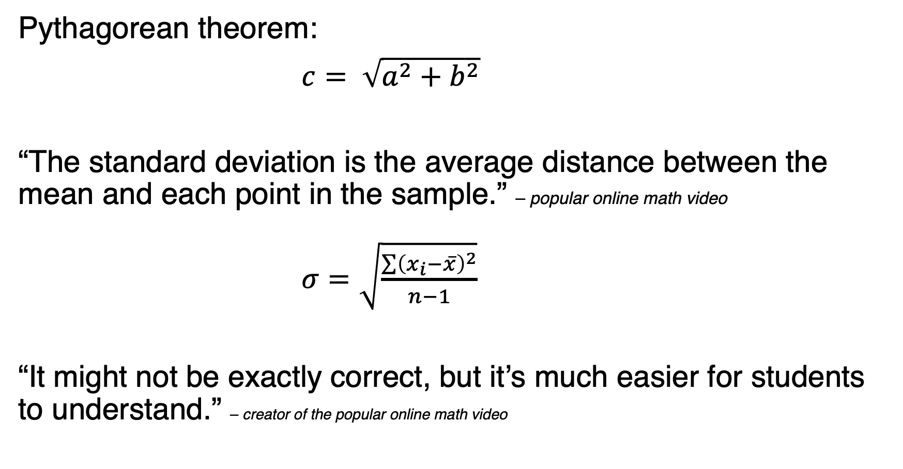
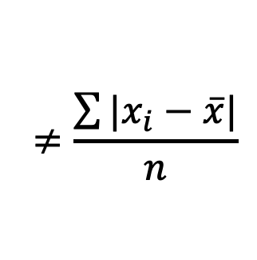
Be careful on the internet
Pythagorean theorem:
$c= \sqrt{a^{2}+b^{2}}$
“The standard deviation is the average distance between the mean and each point in the sample.” – popular online math video
$σ=\sqrt{\frac{\sum{{\left(x_{i}−\overline{x}\right)}^{2}}}{n−1}}$
“It might not be exactly correct, but it’s much easier for students to understand.” – creator of the popular online math video
$$≠\frac{a+b}{2}$$
$$≠\frac{\sum{|x_{i}−\overline{x}|}}{n}$$

Slide 10
The BIOE 210 Philosophy
“Everything should be made as simple as possible,
but no simpler.”
1. The course is designed around tools that are useful to bioengineers.
2. The course omits topics that are not essential for these tools.
3. We favor understanding fewer topics over surveying many topics.

