Slide 1
Factorial Designs

Slide 2
Why do we use factorial designs?
Factorial designs find better optima.
Factorial designs are more efficient.
Factorial designs make better estimates of effect sizes.

Slide 3
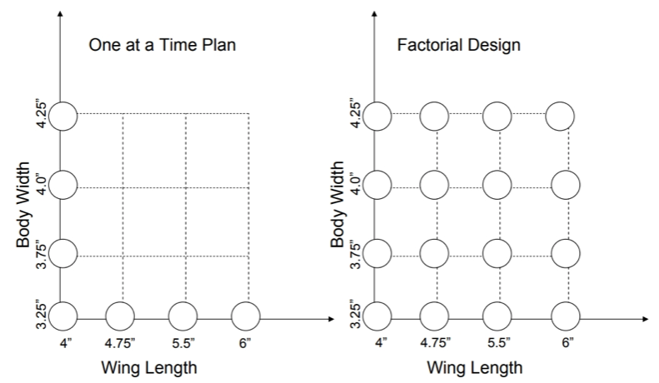
What is a factorial design?

Slide 4
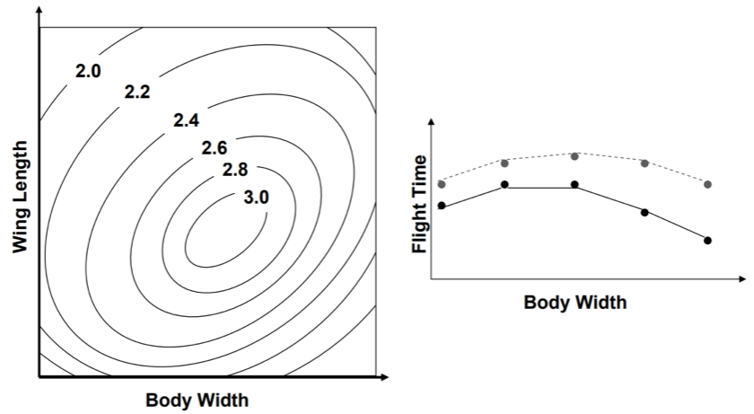
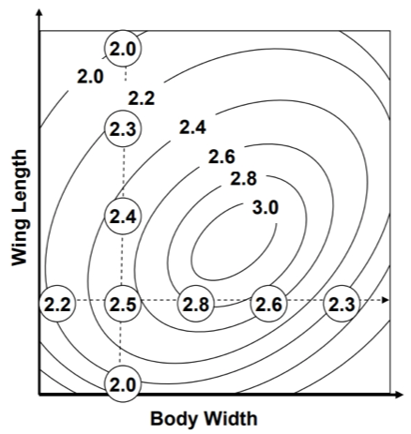
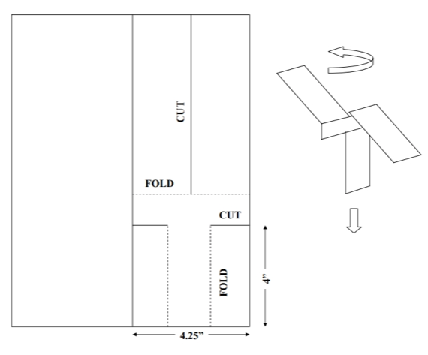
Factorial designs find better optima.

Slide 5
Interactions are the problem.

Slide 6
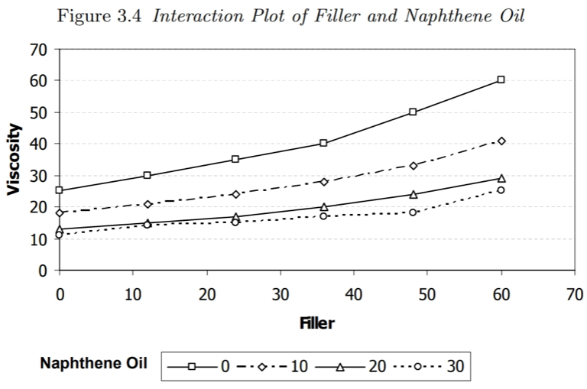
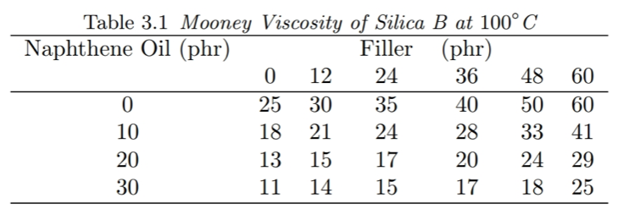
Interaction plots for diagnosis.

Slide 7
Why do we use factorial designs?
Factorial designs find better optima.
Factorial designs are more efficient.
Factorial designs make better estimates of effect sizes.

Slide 8
Factorial designs seem less efficient.
Imagine an experiment with four variables, each with two levels (0, +). We want three replicates for each level.
One-at-a-time Design 3 runs at level 0 4 variables x 3 runs at level + 15 total experiments
Factorial design 2⁴=16 levels x 3 runs 48 total experiments?

Slide 9
One-at-a-time design
+ 0 0 0 + 0 0 0 + 0 0 0 0 + 0 0 0 + 0 0 0 + 0 0 0 0 + 0 0 0 + 0 0 0 + 0 0 0 0 + 0 0 0 + 0 0 0 + 0 0 0 0 0 0 0 0 0 0 0 0 0 0 0 0

Slide 10
One-at-a-time design
+ 0 0 0 + 0 0 0 + 0 0 0 0 + 0 0 0 + 0 0 0 + 0 0 0 0 + 0 0 0 + 0 0 0 + 0 0 0 0 + 0 0 0 + 0 0 0 + 0 0 0 0 0 0 0 0 0 0 0 0 0 0 0 0
Factorial Design 0 0 0 0 + 0 0 0 0 + 0 0 + + 0 0 0 0 + 0 + 0 + 0 0 + + 0 + + + 0 0 0 0 + + 0 0 + 0 + 0 + + + 0 + 0 0 + + + 0 + + 0 + + + + + + +

Slide 11
Factorial designs give more replicates per additional run.
Imagine a design with p variables with k levels.
After the initial design, adding another replicate requires pk runs for a one-at-a-time design k runs for a factorial design

Slide 12
Why do we use factorial designs?
Factorial designs find better optima.
Factorial designs are more efficient.
Factorial designs make better estimates of effect sizes.

Slide 13
One-at-a-time design
+ 0 0 0 + 0 0 0 + 0 0 0 0 + 0 0 0 + 0 0 0 + 0 0 0 0 + 0 0 0 + 0 0 0 + 0 0 0 0 + 0 0 0 + 0 0 0 + 0 0 0 0 0 0 0 0 0 0 0 0 0 0 0 0
Factorial Design 0 0 0 0 + 0 0 0 0 + 0 0 + + 0 0 0 0 + 0 + 0 + 0 0 + + 0 + + + 0 0 0 0 + + 0 0 + 0 + 0 + + + 0 + 0 0 + + + 0 + + 0 + + + + + + +

Slide 14

What do the effect sizes quantify?
In one-at-a-time designs, $β_{i}$ is the effect of moving x_{i} from 0 to + while all other variables held at 0.
In factorial designs, $β_{i}$ is the average effect of moving x_{i} from 0 to + across the entire design space.

Slide 15
Factorial Design 0 0 0 0 + 0 0 0 0 + 0 0 + + 0 0 0 0 + 0 + 0 + 0 0 + + 0 + + + 0 0 0 0 + + 0 0 + 0 + 0 + + + 0 + 0 0 + + + 0 + + 0 + + + + + + +
when x₃ = 0: 0 0 0 0 + 0 0 0 0 + 0 0 + + 0 0 0 0 0 + + 0 0 + 0 + 0 + + + 0 +
when x₃ = +: 0 0 + 0 + 0 + 0 0 + + 0 + + + 0 0 0 + + + 0 + + 0 + + + + + + +

