Slide 1
Welcome to Experiment Design & Optimization
BIOE 498 PJ
BIOE 598 PJ

Slide 2
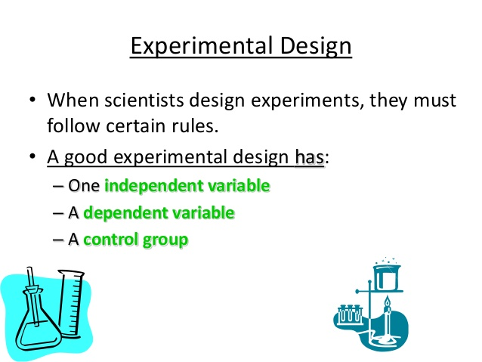
https://www.slideshare.net/stubeck/the-scientific-method-and-experimental-design-9th-grade-biology

Slide 3
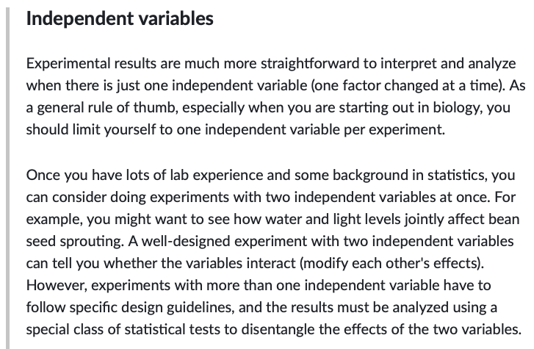
https://www.khanacademy.org/science/high-school-biology/hs-biology-foundations/hs-biology-and-the-scientific-method/a/experiments-and-observations

Slide 4
What was in this course?
1. DOE
2. RSM
3. Surrogate optimization
4. RL

Slide 5
Lesson 1: Any design is better than no design.
Scientists agree on two things:
1. You need a proper experiment design.
2. You need statistics to analyze your data.
Why not use an experiment design that is optimized
for statistical power?

Slide 6
Lesson 2: DOE requires modeling.
“All models are wrong; some are useful.” – G.P. Box
“Everyone trusts an experiment except the person who did it. No one trusts a model except the person who built it.”

Slide 7
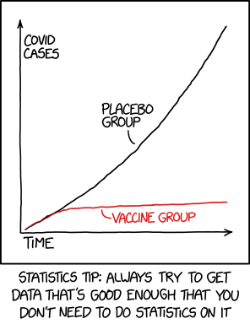
Lesson 3: Don’t rearrange deck chairs with statistics.
https://xkcd.com/2400/

Slide 8
Lesson 4: Screen.
Effective screening means
starting with more factors
and ending with fewer factors
than you originally thought.

Slide 9
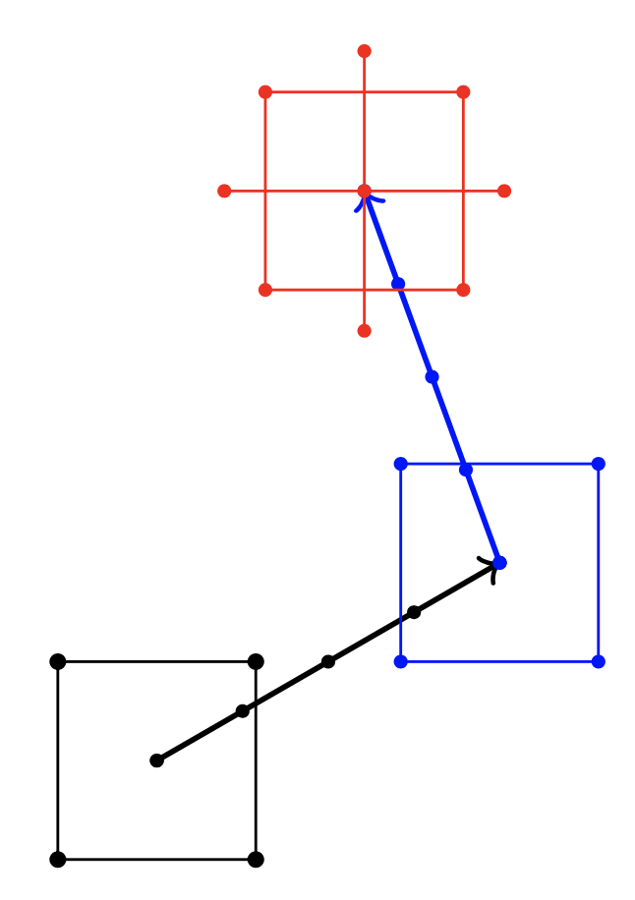
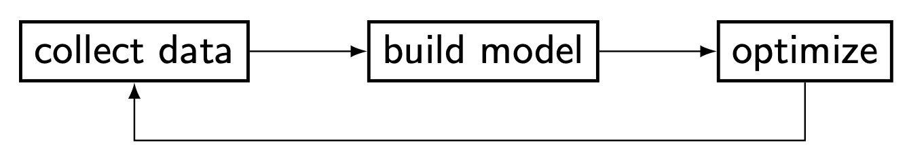
Lesson 5: DOE is an iterative process.

Slide 10
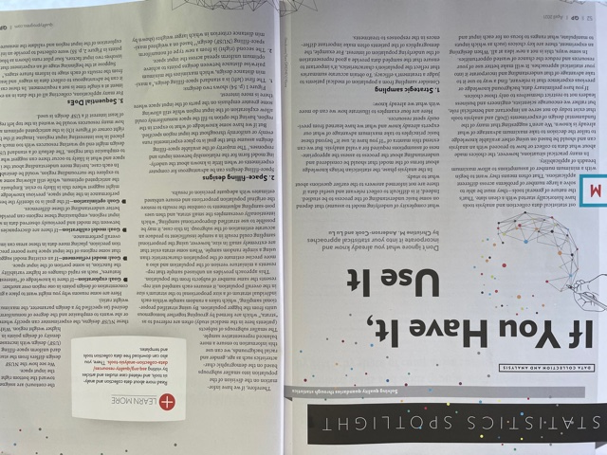
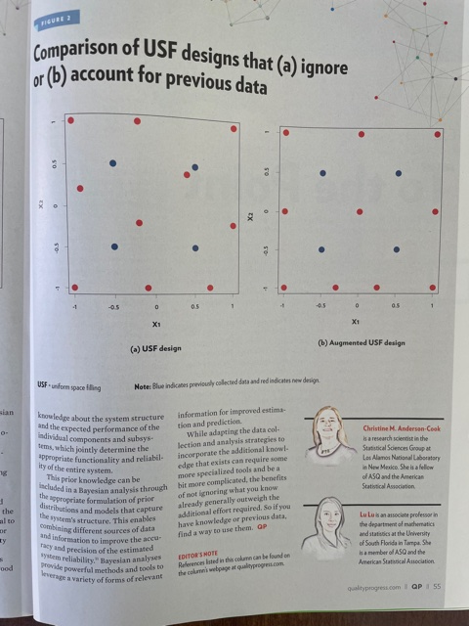
Lesson 6: Surrogate optimization is the future?

Slide 11
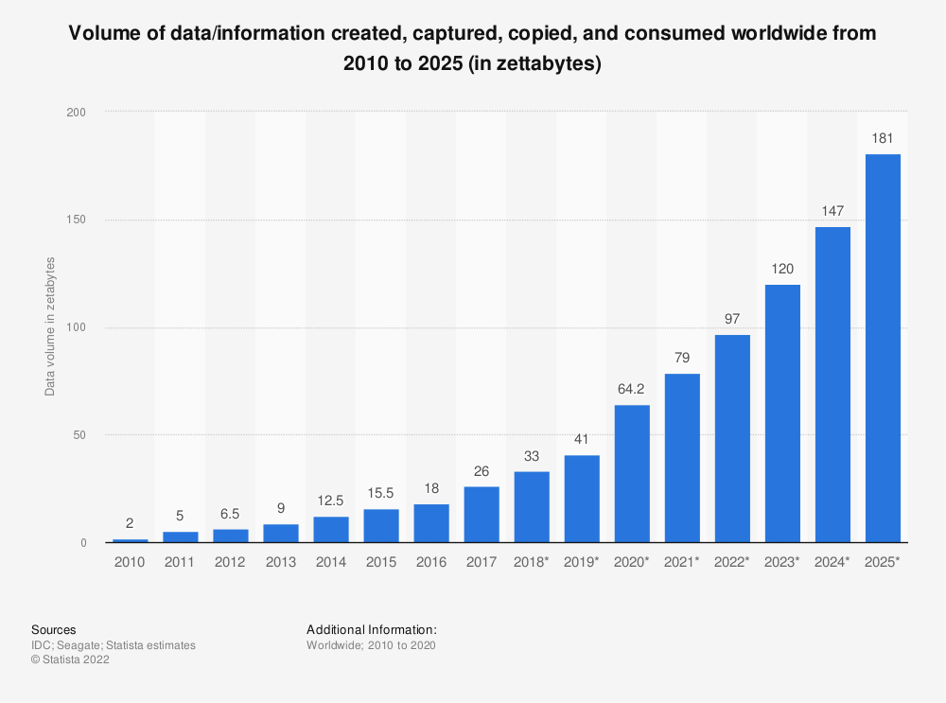
Lesson 7: Ignore the sunk cost of data.

Slide 12
Lesson 8: The race for AI is a race for data.
“Advancing AI by collecting huge personal profiles is laziness,
not efficiency” – Tim Cook, CEO of Apple

Slide 13
That’s it.
Thanks for a fun semester of in person learning.
Your first DOE consultation is on the house.
pjens@umich.edu

