Slide 1
Welcome to Experiment Design & Optimization
BIOE 498 PJ
BIOE 598 PJ
BIOE 598 PJO

Slide 2
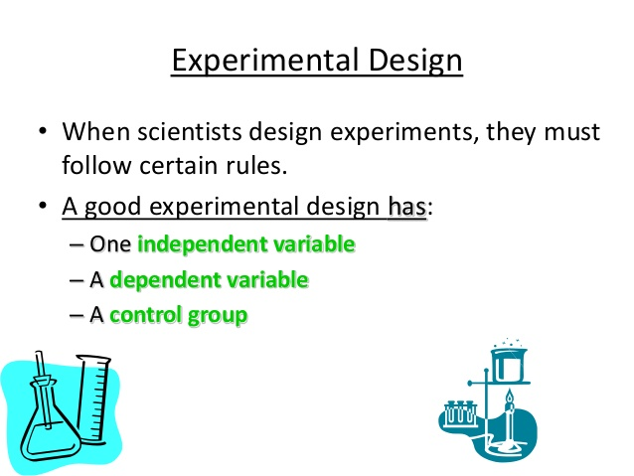
https://www.slideshare.net/stubeck/the-scientific-method-and-experimental-design-9th-grade-biology

Slide 3
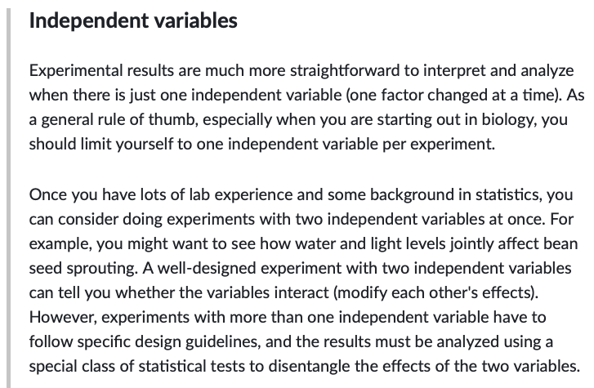
https://www.khanacademy.org/science/high-school-biology/hs-biology-foundations/hs-biology-and-the-scientific-method/a/experiments-and-observations

Slide 4
Resources
Website: http://bioe498.github.io
Lecture slides and code
Assessments posted on website, submitted on Gradescope
Textbooks
Design and Analysis of Experiments with R by John Lawson; CRC Press. (required)
Regression and Other Stories by Andrew Gelman, Jennifer Hill, & Aki Vehtari; Cambridge. (optional)
Reinforcement Learning: An Introduction, 2nd edition by Richard Sutton & Andrew Barto; MIT Press (optional, available for free online)

Slide 5
Assessments
Case studies (3 x 15% = 45%)
Homework-style
Graded in part on communication (slides)
Challenge Projects (2 x 15% = 30%)
Open-ended
Graded in part on performance
Exams (2 x 12.5% = 25%)

Slide 6
Overview
Part 0: Statistical Modeling
summary statistics, t-tests, confidence intervals, bootstrap

Slide 7
Overview
Part 0: Statistical Modeling
summary statistics, t-tests, confidence intervals, bootstrap
Part 1: Design of Experiments (DOE)
Factorial Designs
Fractional Factorial Designs
Response Surface Methodology (RSM)
Other designs (Crossover, Mixtures, Split-Plot)

Slide 8
https://en.wikipedia.org/wiki/{Francis Galton;Karl_Pearson;Ronald Fisher}

Slide 9
Rothamsted Experimental Station
England
https://www.rothamsted.ac.uk/history-and-heritage

Slide 10
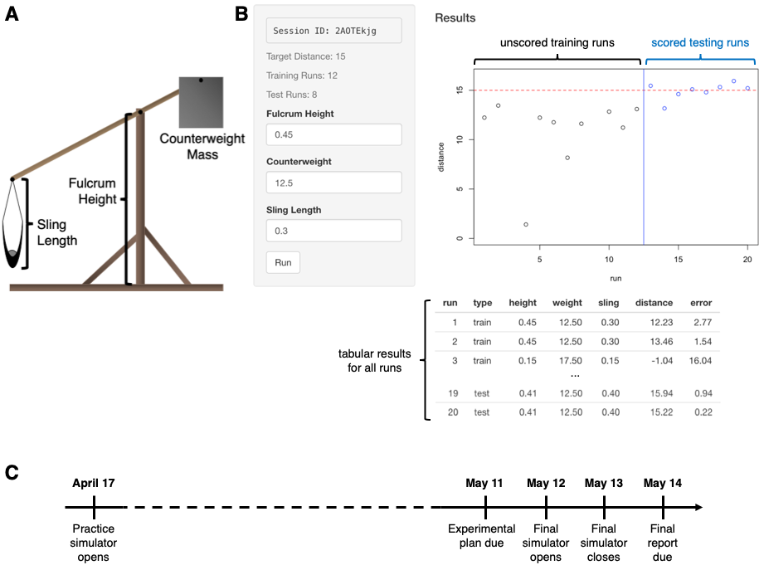
Challenge Project 1: The trebuchet simulator

Slide 11
Overview
Part 0: Statistical Modeling
summary statistics, t-tests, confidence intervals, bootstrap
Part 1: Design of Experiments (DOE)
Factorial Designs
Fractional Factorial Designs
Response Surface Methodology (RSM)
Other designs (Crossover, Mixtures, Split-Plot)
Part 2: Reinforcement Learning (RL)

Slide 12
https://www.youtube.com/watch?v=UuhECwm31dM

Slide 13
What is Reinforcement Learning (RL)?
Supervised learning mimics relationships in existing training data.
RL combines data collection and learning into one process.
RL mimics how animals learn through trial and error.
Supervised learning
Babies listen to adults talking for years.
Babies begin speaking in complete sentences.
Reinforcement learning
Babies make lots of noises.
Adults react positively to noises that sound like words.
Babes repeat the rewarded sounds.

Slide 14
Overview
Part 0: Statistical Modeling
summary statistics, t-tests, confidence intervals, bootstrap
Part 1: Design of Experiments (DOE)
Factorial Designs
Fractional Factorial Designs
Response Surface Methodology (RSM)
Other designs (Crossover, Mixtures, Split-Plot)
Part 2: Reinforcement Learning (RL)
Markov Decision Processes
Model-based Learning
Policy-based Learning
Q-learning

Slide 15
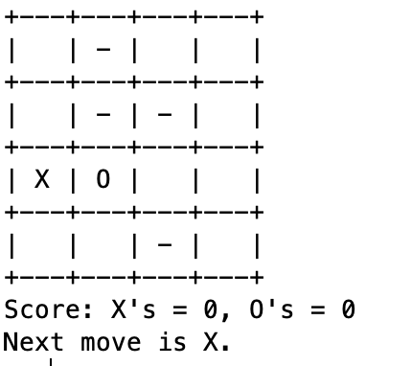
Challenge Project 2: Mastering Tic-Tac-Go
Actions
Rollout Simulations
Reward
1
3
4
1
.343
5
8
…
11
12
13
14
16
13
.820
…
.115
16

Slide 16
Things to do
Read the syllabus and ask questions on Wednesday
Register for Gradescope after receiving code
Birthday poll
Next time: Statistics, from the ground up!

