Slide 1
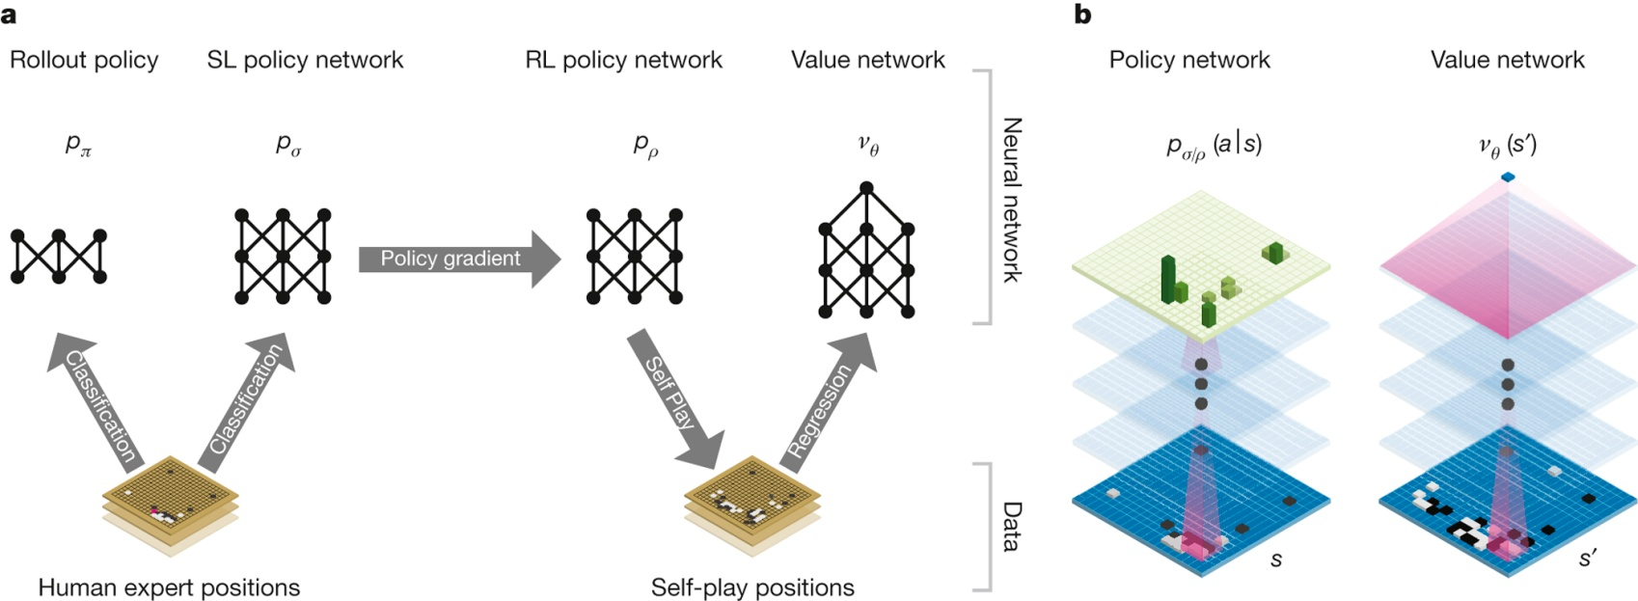
Neural network training pipeline and architecture
D Silver et al. Nature 529, 484–489 (2016) doi:10.1038/nature16961

Slide 2
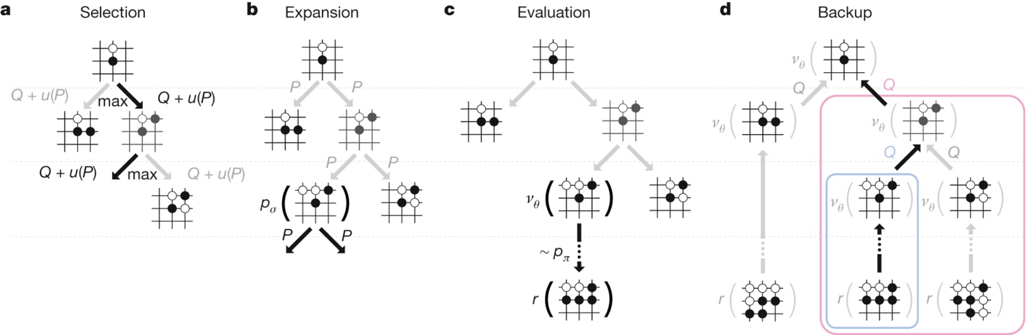
Monte Carlo tree search in AlphaGo
D Silver et al. Nature 529, 484–489 (2016) doi:10.1038/nature16961

Slide 3
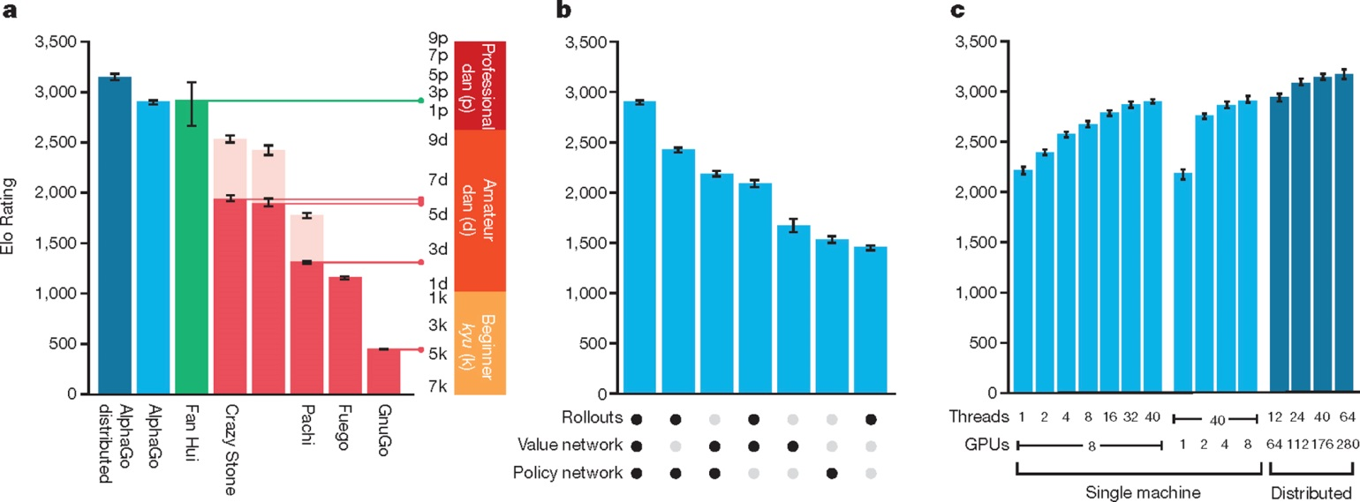
Tournament evaluation of AlphaGo
D Silver et al. Nature 529, 484–489 (2016) doi:10.1038/nature16961

Slide 4
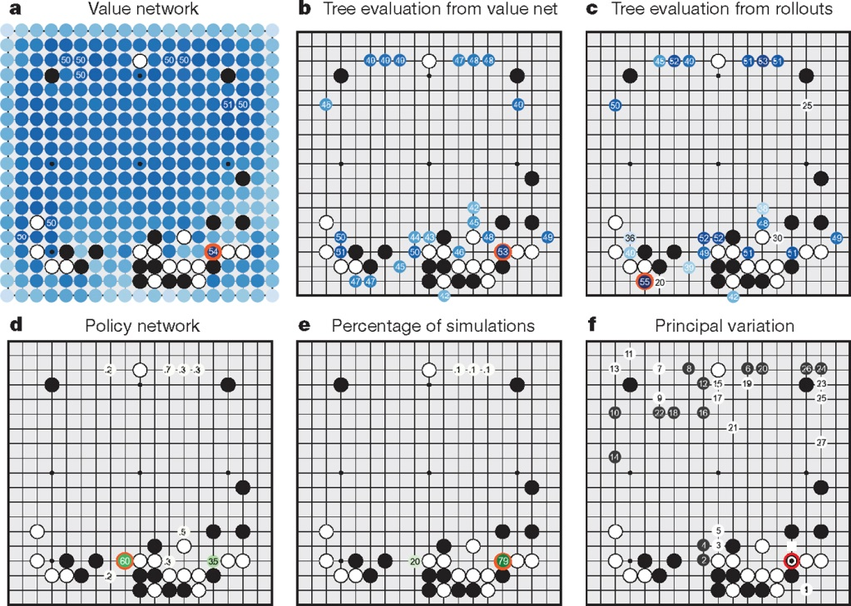
How AlphaGo (black, to play) selected its move against Fan Hui
D Silver et al. Nature 529, 484–489 (2016) doi:10.1038/nature16961

