Slide 1
Alternative Fractional Designs
Plackett-Burman Designs and Orthogonal Arrays

Slide 2
Review
A full factorial design with k factors requires 2^{k} runs.
A fractional factorial design uses only 2^{k-p} runs.
Begin with a base design.
Set the remaining factors equal to interactions (generator, E=AB)
Compute the defining relation (I = ...) and confounding/alias structure. Remember to include all combinations of relations.

Slide 3
Plackett-Burman Designs
Resolution III designs are the “go to” designs for screening.
The plan is often to minimize runs to identify important factors and perform a secondary screen.
The # of runs in a fractional factorial design is always a power of two (2³=8, 2⁴=16, 2⁵=32).
Plackett-Burman designs allow run sizes in multiples of four regardless of the number of factors.
PB designs have no generators or defining relation (pro & con).

Slide 4
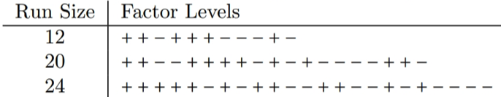
Creating a PB design
1. Start with the first run from Table 6.9
2. Cycle the factor levels by one to get run 2. Repeat for 11 runs.
3. Set run 12 to all low.
4. If # of factors k < 11, select the first k columns.

Slide 5
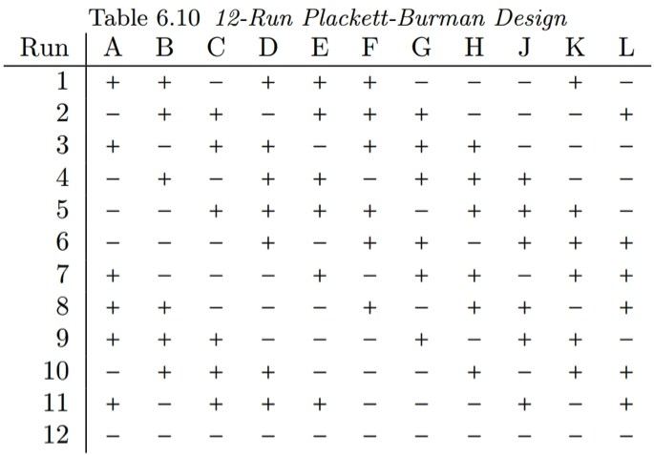

Slide 6
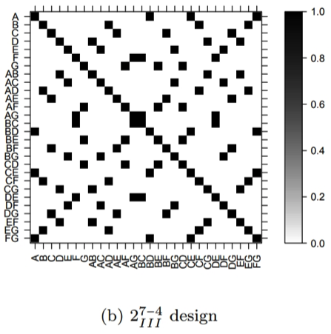
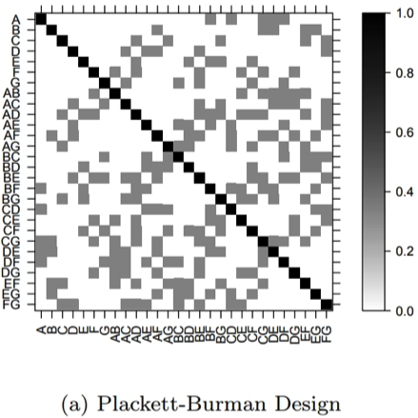
Confounding in PB designs
In FF designs, factors are confounded (perfectly correlated).
In PB designs, factors are partially correlated (complex aliasing).

Slide 7
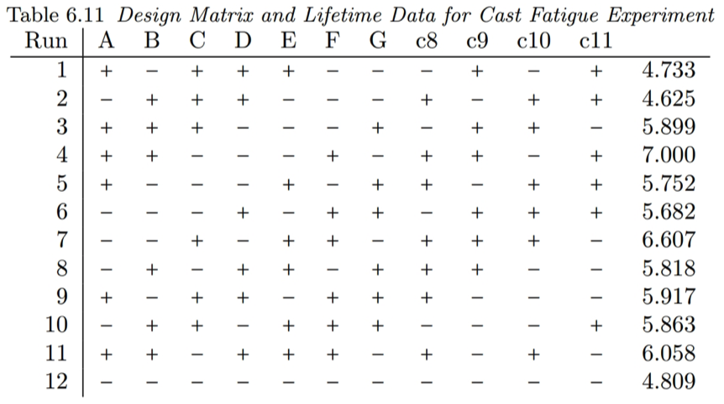
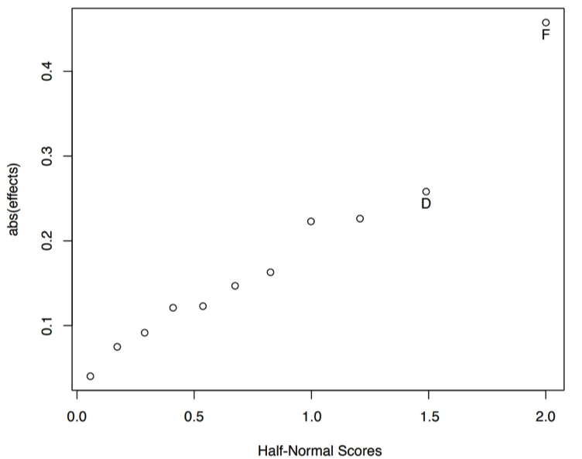
Example PB design: Cast fatigue
The unassigned columns are left in; their effects are confounded groups of interactions.

Slide 8
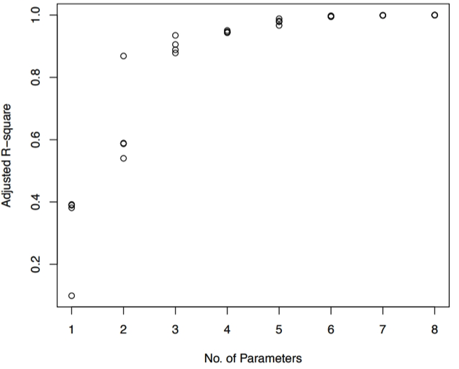
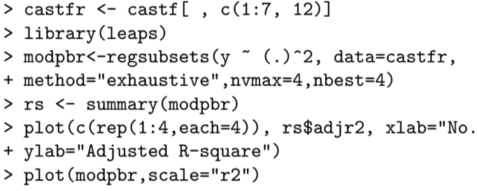
PB designs have the hidden projection property
The complex aliasing of PB designs allow us to fit models with main and TWI terms provided the number of terms is small.
We use subset selection to find good models with few terms.

Slide 9
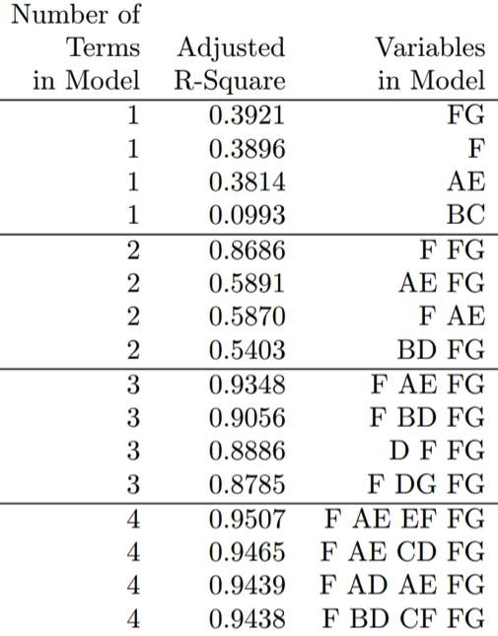
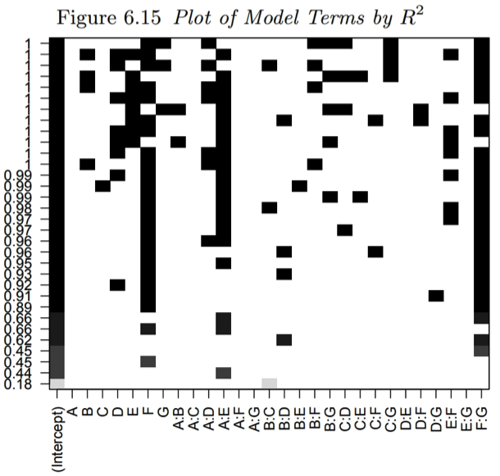
Output of All-Subsets Regression

Slide 10
Mixed Level Factorials
Fractional factorial and PB designs use two level factors (+/-).
The theory does not extend simply to multi-level factors.
One solution is Orthogonal Array Designs (OAs).
OAs are ”hand-crafted” for mixtures of 2- and 3-level factors.
Software packages choose OA designs from catalogs.
Analysis of OAs is similar to PB designs:
Resolution III, no defining relation
Complex aliasing, hidden projection, model robust.
Models with few parameters can be first directly to the data.

Slide 11
What you should always remember:
Fractional designs are the most efficient method to screen large numbers of factors.
Factors are confounded, but the alias structure is known.
Resolution III is most common; we can clear main effects by augmenting.
Use PB designs if
1.) a specific # of runs is needed, or
2.) you don’t want a secondary experiment
Factors with >2 factors require OA designs.

Slide 12
After the exam
We know how to use DOE to learn how much each factor affects the response.
Response Surface Methodology will tell us what combination of factors optimizes the response.

