Slide 1
Fractional Factorial Designs
Lower-order factorials and augmented designs

Slide 2
Review
A full factorial design with k factors requires 2^{k} runs.
A half factorial design uses only 2^{k-1} runs.
Begin with a base design.
Set the remaining factor equal to an interaction (generator, E=AB)
Compute the defining relation (I = ...) and confounding/alias structure.
We can define quarter- or eighth-factorial designs!

Slide 3
The Quarter Factorial (2^{k-2}) design
Let’s design a 2⁵⁻² design (factors ABCDE).
Start with a base 2³ design (factors ABC).
Define D=AB and E=AC.
D² = I = ABD E² = I = ACE
Also, I² = I = (ABD)(ACE) = BCDE
Defining relation: I = ABD = ACE = BCDE

Slide 4
Confounding in a 2⁵⁻² design
Defining relation: I = ABD = ACE = BCDE
A(I) + A(ABD) + A(ACE) + A(BCDE)
A + BD + CE + ABCDE
B + AD + ABCE + CDE
C + ABCD + AE + BDE
D + AB + ACDE + BCE
E + ABDE + AC + BCD
BC + ACD + ABE + DE
BE + ADE + ABC + CD

Slide 5
Eight-fractional design: 2⁶⁻³
Factors A, B, C, D=AB, E=AC, F=BC
I = ABD = ACE = BCF
Also, all combinations:
I² = I = (ABD)(ACE) = BCDE
I² = I = (ABD)(BCF) = ACDF
I² = I = (ACE)(BCF) = ABEF
I³ = I = (ABD)(ACE)(BCF) = DEF
Defining relation: I = ABD = ACE = BCF = BCDE = ACDF = ABEF = DEF

Slide 6
Which generator should I choose?
A generator’s optimality is assessed with three criteria:
Resolution: difference in the level of confounding.
Aberration: the multiplicity of the worst confounding.
Clarity: # of confounded main effects or two-way interactions.

Slide 7
Design Resolution
The resolution of a fractional design is the length of the shortest word in the defining relation.
For the 2⁴⁻² design generated by D=AB and E=AC is I = ABD = ACE = BCDE
This is a resolution III design.
A resolution R design has no i-level interaction aliased with effects lower than R – i.
Resolution III
Main effects (i=1) are confounded with secondary (3 – 1 = 2) interactions.
Resolution IV
Main effects (i=1) are confounded with tertiary (4 – 1 = 3) interactions.

Slide 8
Design Resolution
A design with resolution R contains a full factorial design for any subset of k = R – 1 factors.
If after the fractional experiments you drop to k factors you can re-analyze the data for all the interactions.

Slide 9
Design Aberration
The length of the shortest word in the defining relation is the resolution.
The number of words with length equal to the resolution is the aberration.
I = ABCDF = ABCEG = DEFG resolution IV, aberration 1
I = ABCF = ADEG = BCDEFG resolution IV, aberration 2
The design with the lower aberration will have fewer main effects confounded with low-order interactions.

Slide 10
Clear effects
A main effect or two-way interaction effect is clear if it is only confounded with higher order terms.
The experimenter needs to decide the tradeoff in clear effects.
For a 2⁶⁻² design:
I = ABCE = ABDF = CDEF 6 main effects clear
I = ABE = ACDF = BCDEF 3 main effects + 6 TWI clear

Slide 11
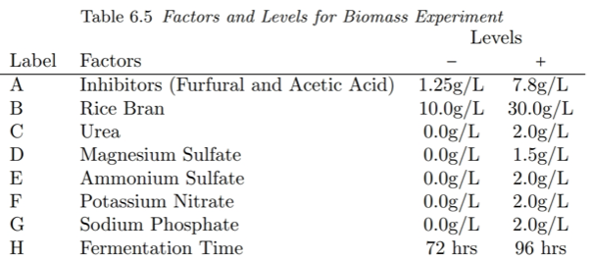
Example: biomass of P. variotii

Slide 12
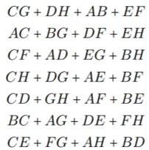
Design: 2⁸⁻⁴
E = BCD, F = ACD, G = ABC, H = ABD
Resolution IV, minimum aberration
All main effects clear.

Slide 13
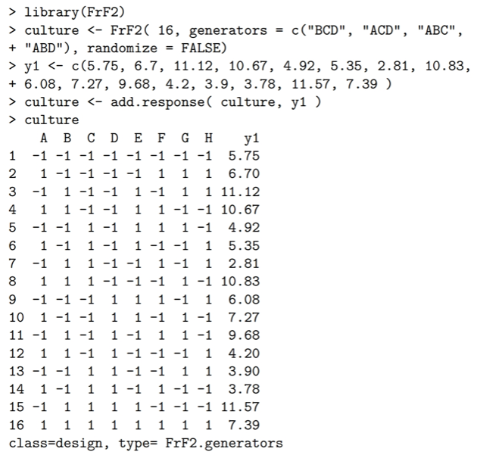

Slide 14
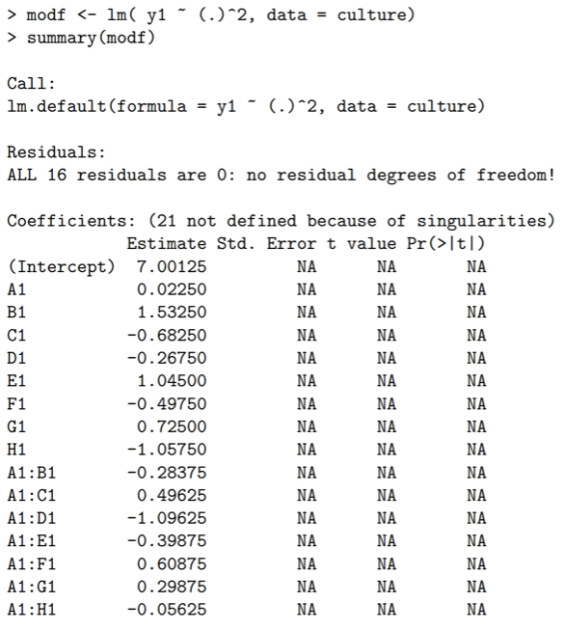

Slide 15
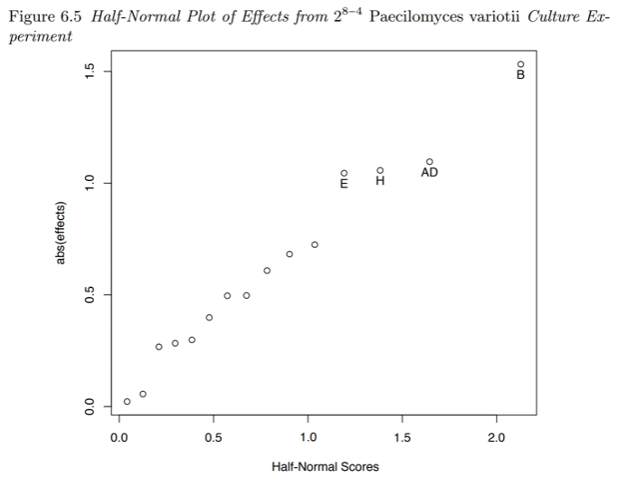

Slide 16
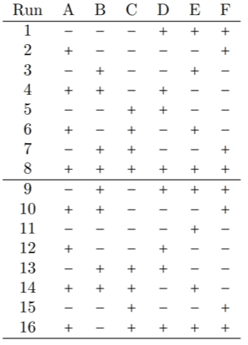
Foldover Designs
Imagine a 2⁶⁻³ resolution III design with D=AB, E=AC, F=BC.
I = ABD = ACE = BCF = DEF = BCDE = ACDF = ABEF
Let’s say B and D are significant. Since D=AB, maybe the significance of D is due to B.
We can augment by doubling the runs with B flipped.
B and its interactions are now clear.

Slide 17
Mirror image designs
If we combine a Resolution III design with its mirror image (all factors flipped), we have a Resolution IV design with all main effects clear.
If we add a blocking factor we can perform the experimental batches sequentially.
Mirror image designs are only necessary if more than one main effect is significant.

