Slide 1
Welcome to Experiment Design & Optimization
BIOE 498 PJ
BIOE 598 PJ

Slide 2
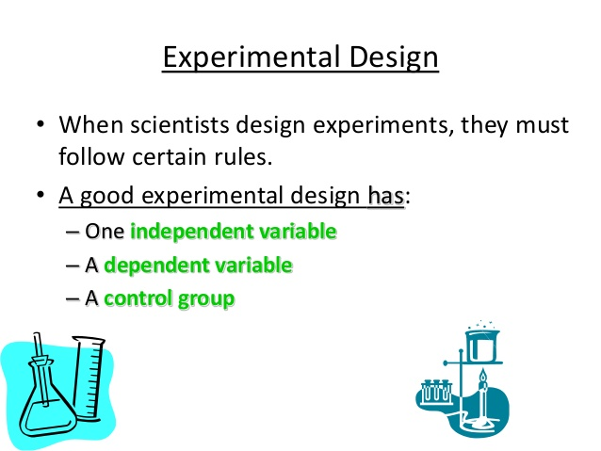
https://www.slideshare.net/stubeck/the-scientific-method-and-experimental-design-9th-grade-biology

Slide 3
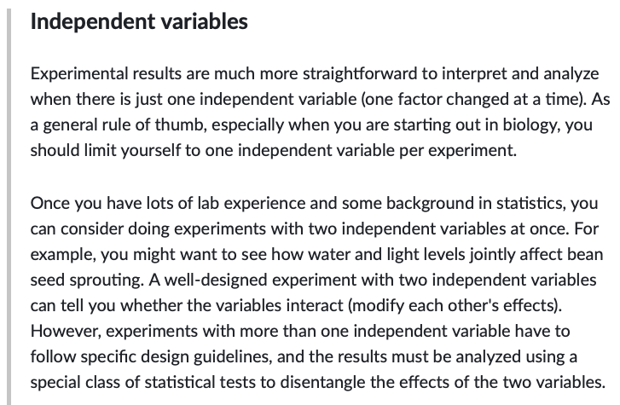
https://www.khanacademy.org/science/high-school-biology/hs-biology-foundations/hs-biology-and-the-scientific-method/a/experiments-and-observations

Slide 4
Resources
Website: http://bioe498.github.io
Lecture slides and code
Assessments posted on website, submitted on Gradescope
Textbooks
Design and Analysis of Experiments with R by Lawson
R for Data Science by Wickham & Grolemund
Surrogates by Gramacy
Reinforcement Learning: An Introduction, 2nd edition by Sutton & Barto

Slide 5
Assessments
Case studies (5 x 15% = 75%)
Homework-style
Graded in part on communication (slides)
Exams (2 x 12.5% = 25%)

Slide 6
Overview
Part 0: Statistical Modeling
summary statistics, t-tests, confidence intervals, bootstrap
Part 1: Design of Experiments (DOE)
Factorial Designs
Fractional Factorial Designs
Response Surface Methodology (RSM)
Part 2: Surrogate Optimization
Sequential Nonparametric Bayesian Modeling
Exploration vs. Exploitation
Part 3: Reinforcement Learning
Model-based learning
Q-learning

Slide 7
Any finite body of data contains only a limited amount of information... [T]his limit is set by the nature of the data themselves and cannot be increased by any amount of ingenuity expended in their statistical examination.
Ronald Fisher
https://en.wikipedia.org/wiki/{Francis Galton;Karl_Pearson;Ronald Fisher}

Slide 8
Rothamsted Experimental Station
England
https://www.rothamsted.ac.uk/history-and-heritage

Slide 9
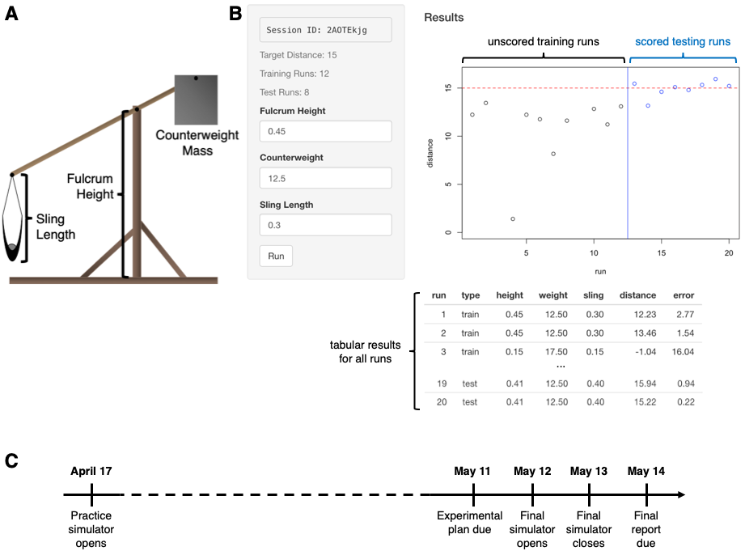
Challenge Project 1: The trebuchet simulator

Slide 10
https://www.youtube.com/watch?v=UuhECwm31dM

Slide 11
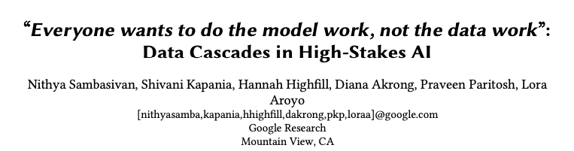
Is this really an AI course?

