Slide 1
Mathematical Model of Kin Selection and Herd Immunity
Loafing in theoretical biology

Slide 2
“There is no correct model, but some of them are meaningful.”
–Hanna Kokko

Slide 3
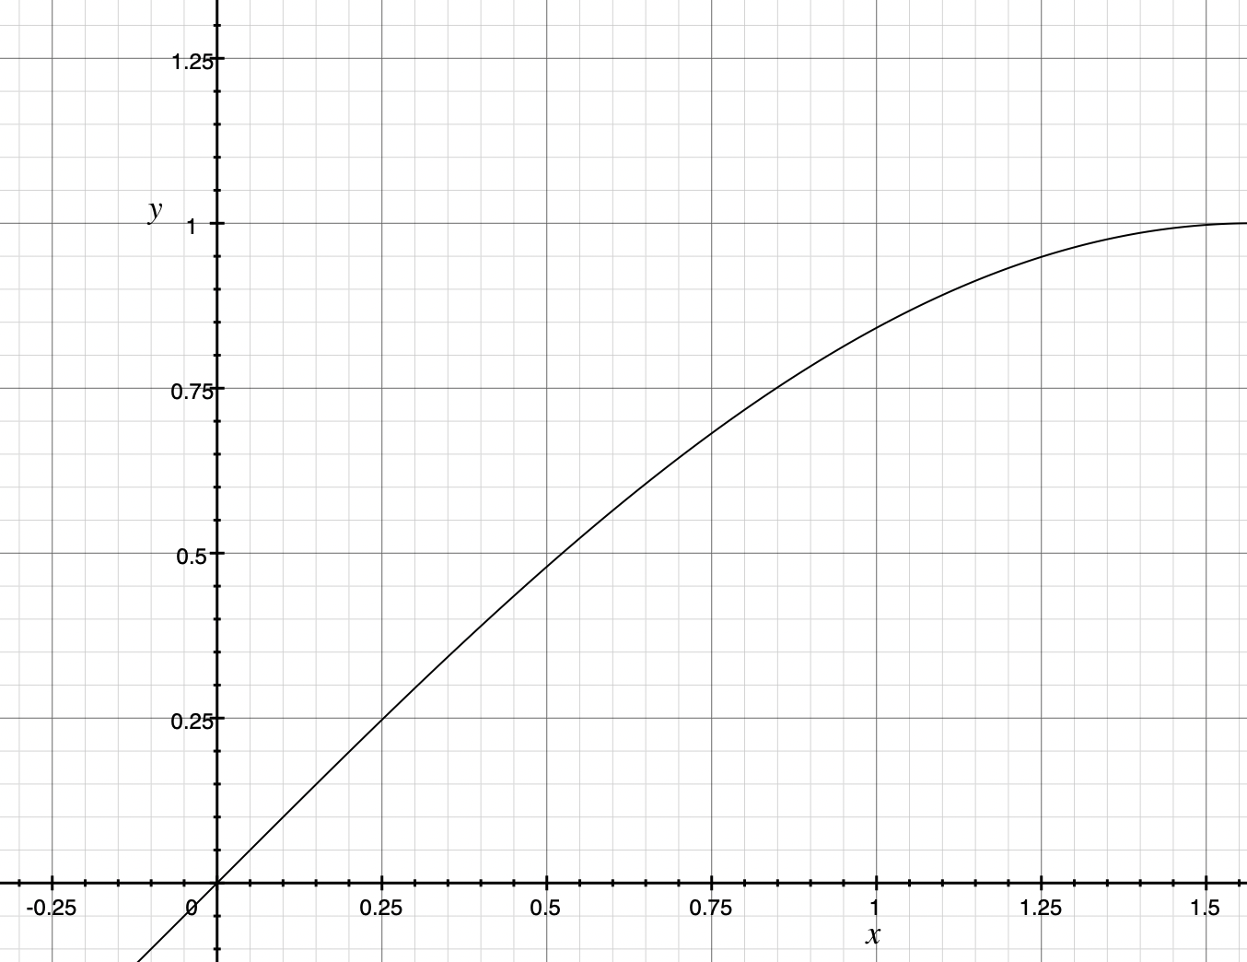
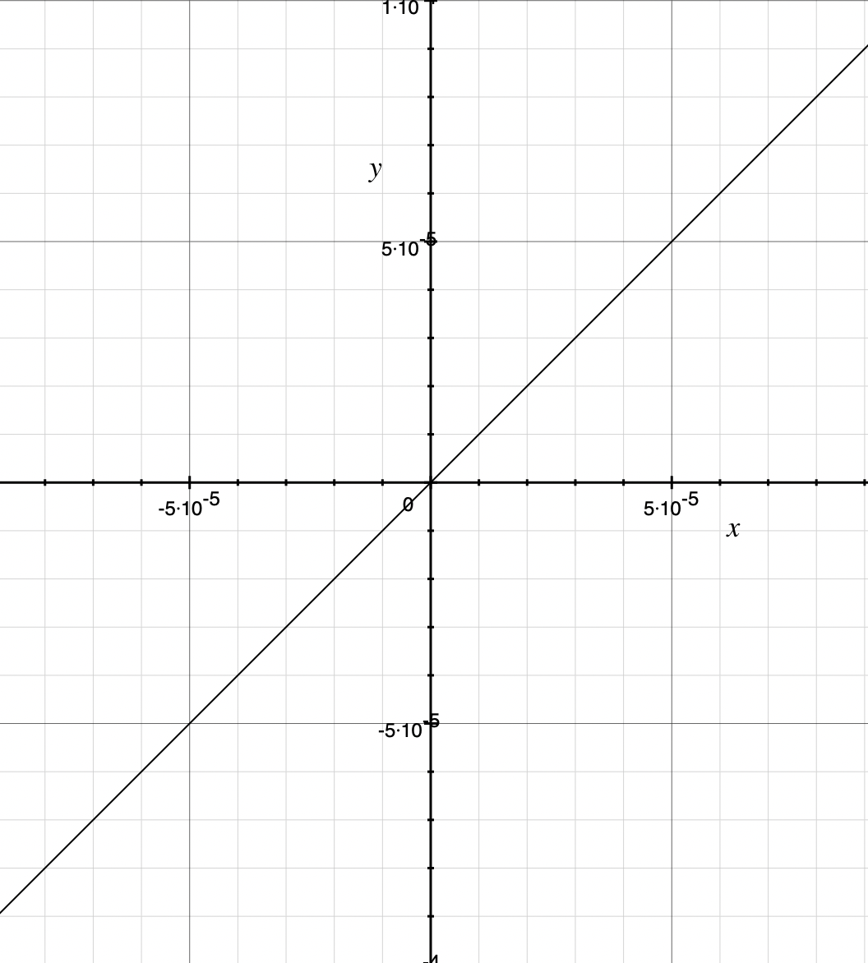
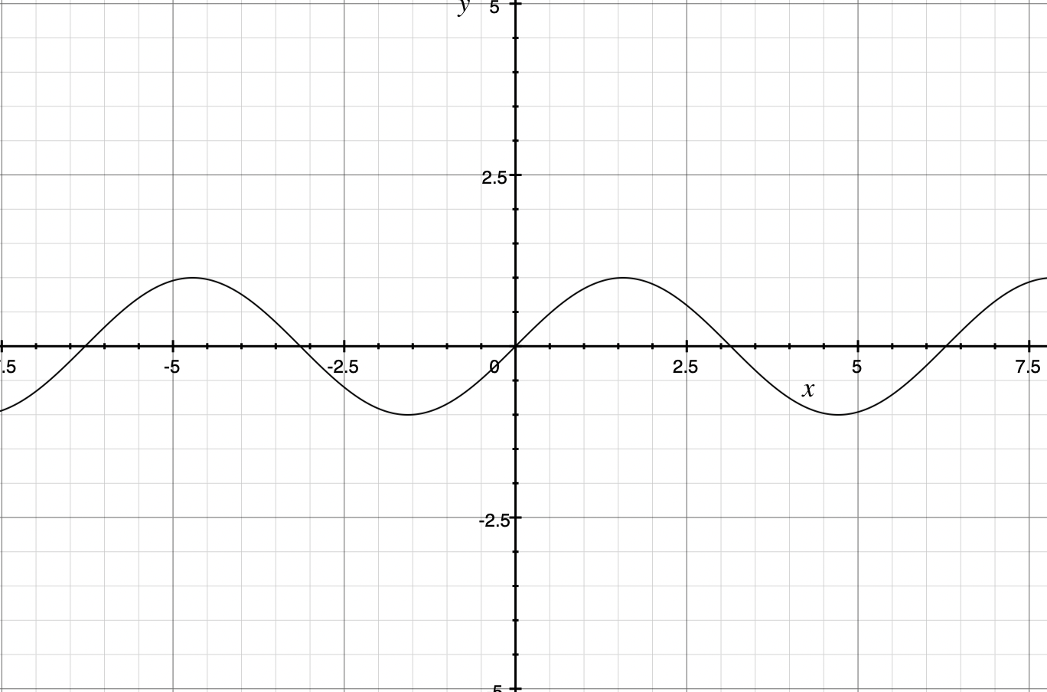
How to describe it?

Slide 4
Attack and Defence
Attacks are ubiquitous in nature.
Multiple type of enemies causes multiple effects:
Predator, parasite, pathogen…
Non-biological?
Defence

Slide 5
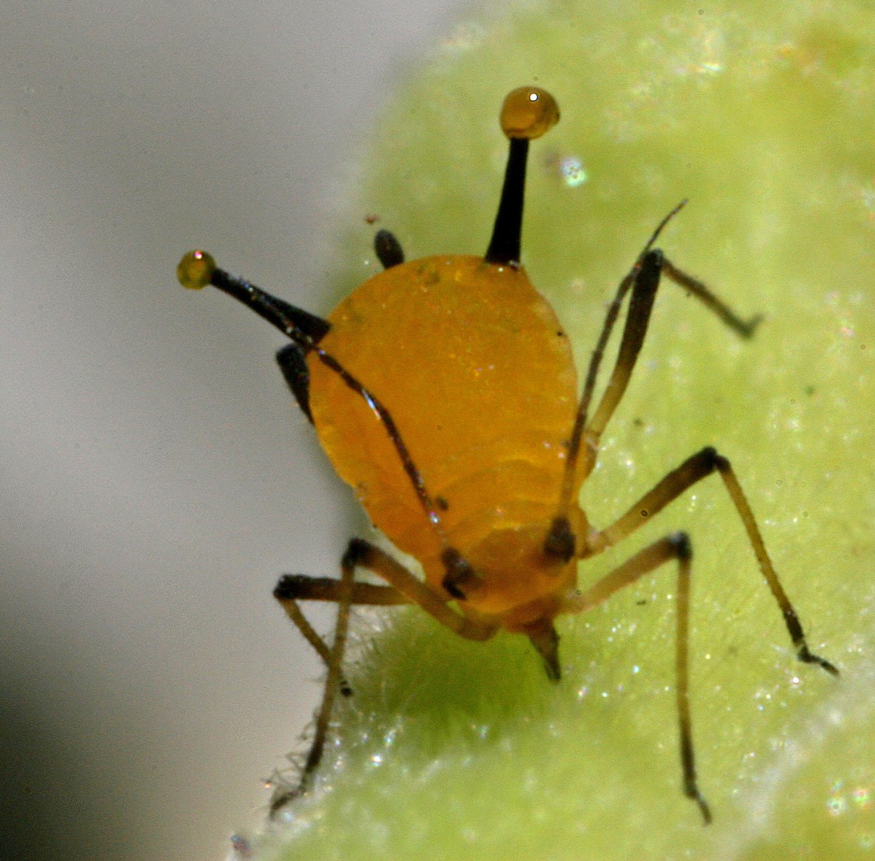
Who are they defending for?
Defence can be costly.
Toxin, hair…
Ineffective.
Some toxin releases only when the prey is killed.
Wax secreted by aphids.
Individual hardly gain any fitness.

Slide 7
How do they evolve?
Personal fitness + inclusive fitness;
Selfishness vs. group fitness.
Group protection leads to cheating.
Multiple driving force in evolution.
How to balance selfishness and group fitness?
Kin selection model by Steve Frank(1998).

Slide 8
Assumptions
The probability of an individual inducing a defence is a phenotype, which can be represented as a continuous variable.
Phenotypes of individuals are so closely related that it can be seen as a continuous function.
The change in phenotype is vanishingly small in a relatively short period of time, such as in tens of generations.

Slide 9
The Storyline of Frank(1998)
Preparation
A sign of possible attack appears
Individuals either induce a defence or not, with the probability, y.
Action
Pick someone to attack
Kill the undefended
Not kill the defended

Slide 10
Average y
Factor of cost
Group protection
$$W(y,z)=(1-c⋅y)⋅[1-a⋅(1-y)⋅f(z)]$$
Individual phenotype
(Probability of defence)
Rate of attack.

Slide 11
Limitations
Defended individuals are excluded from attack (unrealistic).
Attacks are perfect for undefended individuals (unrealistic).
Undefended individuals are absolutely susceptible (might not be true).
Defence is permanent (unrealistic).
Make it persuasive.

Slide 12
New Storyline
Preparation
Invest a defence = higher tolerance to attack
Not invest a defence = lower tolerance to attack
Action
Attack, attack, attack……(with an expectation)
Who get killed?

Slide 13
I DON’T HAVE TIME, ASK ME LATER!!!
$$W(y,z)=(1-c⋅y)⋅[(1-y)⋅p_{1}+y⋅p_{2}]⋅g(z)$$
$$p=\overset{k}{\underset{i=0}{∑}}e^{-λ}⋅\frac{λ^{i}}{i!}$$
$$p_{1}=p|_{k=k_{1}}$$
$$p_{2}=p|_{k=k_{2}}$$
What is the chance of the number of attack not reaching k?

Slide 14
Rate of change
Make a connection between the two variables.
Analyse the optimal state of the two variables as a whole.
At some point the rate of change is 0.

Slide 15
Assumptions
The probability of an individual inducing a defence is a phenotype, which can be represented as a continuous variable.
Phenotypes of individuals are so closely related that it can be seen as a continuous function.
The change in phenotype is vanishingly small in a relatively short period of time, such as in tens of generations.

Slide 16
$$\frac{dW}{dx}=\frac{∂W}{∂y}⋅\frac{dy}{dx}+\frac{∂W}{∂z}⋅\frac{dz}{dx}$$
W - fitness
x - group genotype
y - individual phenotype
z - group average of phenotype

Slide 17
$$\frac{dW}{dx}=\frac{∂W}{∂y}⋅\frac{dy}{dx}+\frac{∂W}{∂z}⋅\frac{dz}{dx}$$
$$\frac{dW}{dy}=\frac{∂W}{∂y}+\frac{∂W}{∂z}⋅\frac{dz}{dy}$$
$$r=\frac{dz}{dy}$$

Slide 18
Assumptions
The probability of an individual inducing a defence is a phenotype, which can be represented as a continuous variable.
Phenotypes of individuals are so closely related that it can be seen as a continuous function.
The change in phenotype is vanishingly small in a relatively short period of time, such as in tens of generations.

Slide 19
$$\frac{dW}{dy}=\frac{∂W}{∂y}+\frac{∂W}{∂z}⋅r=0$$
$$r=\frac{dz}{dy}$$
Constant

Slide 20
$$\frac{dW}{dy}=[p_{1}(2cy-c-1)+p_{2}(1-2cy)]g(z)+r(1-cy)[p_{1}(1-y)+p_{2}y]g^{′}(z)$$
We still have two variables.
How to solve it?

Slide 21
If the best choice for one individual is not being the average, the best choice for everyone is not being the average.
Then active selection is happening.
Thus at equilibrium, hidden rule y*=z*.

Slide 22
$$\frac{dW}{dy}=[p_{1}(2cy-c-1)+p_{2}(1-2cy)]g(y)+r(1-cy)[p_{1}(1-y)+p_{2}y]g^{′}(y)$$

Slide 23
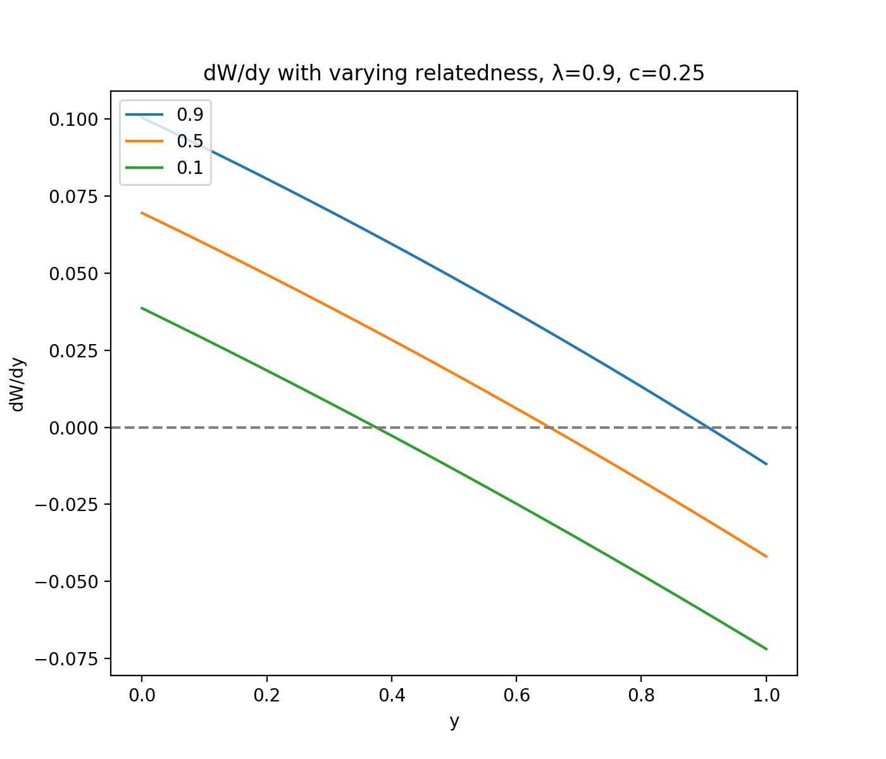
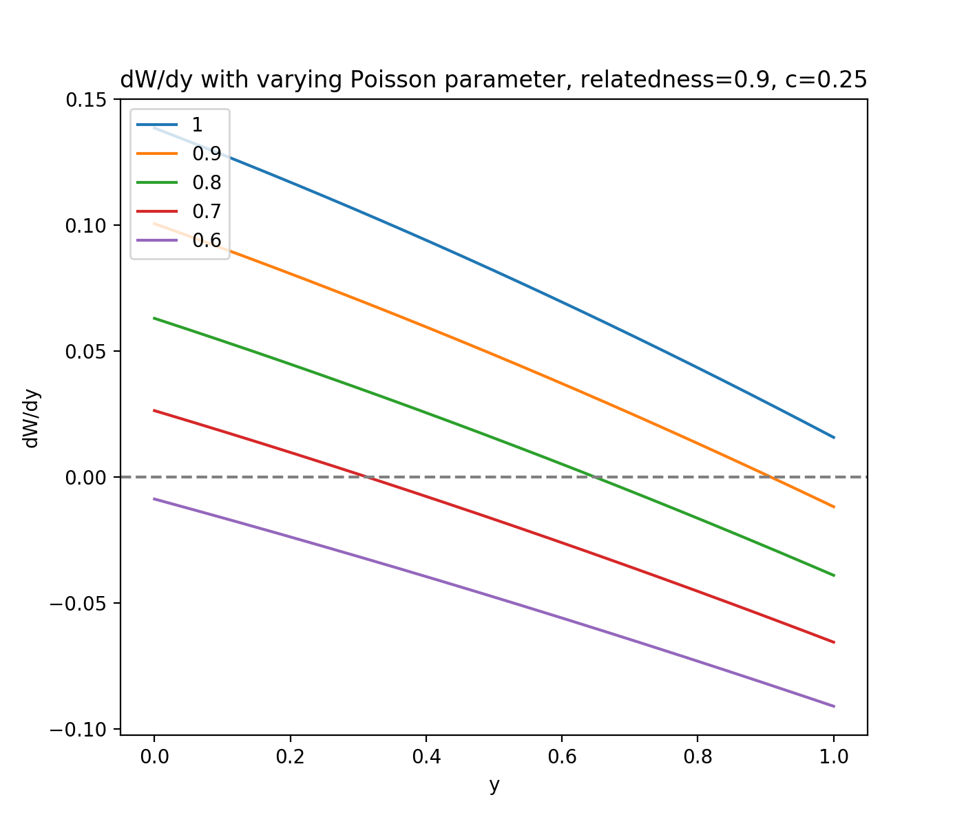
No error bar!

Slide 24
Conclusion
The goal is achieved. We made a more general model.
Result accord with the original model.
Possible applications in public health and economy.

Slide 25
“A theory is the more impressive the greater the simplicity of its premises is, the more different kinds of things it relates, and the more extended is its area of applicability.”
–Albert Einstein

Slide 26
Reference
Frank, S. A. 1998. Inducible defence and the social evolution of herd immunity. Proceedings of the Royal Society of London. Series B: Biological Sciences, 265 (1408), 1911-1913.
Hamilton, W. D. 1964b. The genetical evolution of social behaviour. II. Journal of Theoretical Biology, 7 (1), 17-52.
Hamilton, W. D. 1972. Altruism and Related Phenomena, Mainly in Social Insects. Annual Review of Ecology and Systematics, 3 (1), 193-232.
Ruxton, G. D., Sherratt, T. N. and Speed, M. P. 2004. Avoiding Attack, Oxford University Press.
S. Jones, R., C. Davis, S. and Speed, M. P. 2013. Defence Cheats Can Degrade Protection of Chemically Defended Prey. Ethology, 119 (1), 52-57.Taylor, P. D. and Frank, S. A. 1996. How to make a kin selection model. Journal of Theoretical Biology, 180 (1), 27-37.
Wu, G. M., Boivin, G., Brodeur, J., Giraldeau, L. A. and Outreman, Y. 2010. Altruistic defence behaviours in aphids. BMC Evolutionary Biology, 10 (1), 19.

