Slide 1


FALL 2014 ROTATION : SEBAT LAB
Investigation of Novel CNV-Gene Associations Amongst 43,000 Individuals, Some Exhibiting Traits of Schizophrenia
Jamison M McCorrison

Slide 2
FALL 2014 ROTATION : SEBAT LAB Investigation of Novel CNV-Gene Associations Amongst 43k Individuals, Some Exhibiting Traits of Schizophrenia
CNV GWAS Association Studies
Sebat Lab (Background):
Human Molecular Genomics, Investigating Neuropsychiatric Diseases
Copy number variants (CNVs) are structural alterations of DNA created by the replication of a section of sequence many times (duplication) or when a section is removed (deletions.)
Duplicated content in CNV regions tend to be stable and are inherently present in inherited genetic sequence.
It is shown in prior literature (Sebat et. al) that rare CNVs, those not commonly observed as inherited, are often those with the most pronounced linkage to cases of neurological disease such as Autism and Schizophrenia.
GWAS (genome-wide association studies) use deep sequencing to develop high confidence variation calls which are compared amongst many individuals to identify variations deemed statistically relevant to the development of the case phenotype.

Slide 3
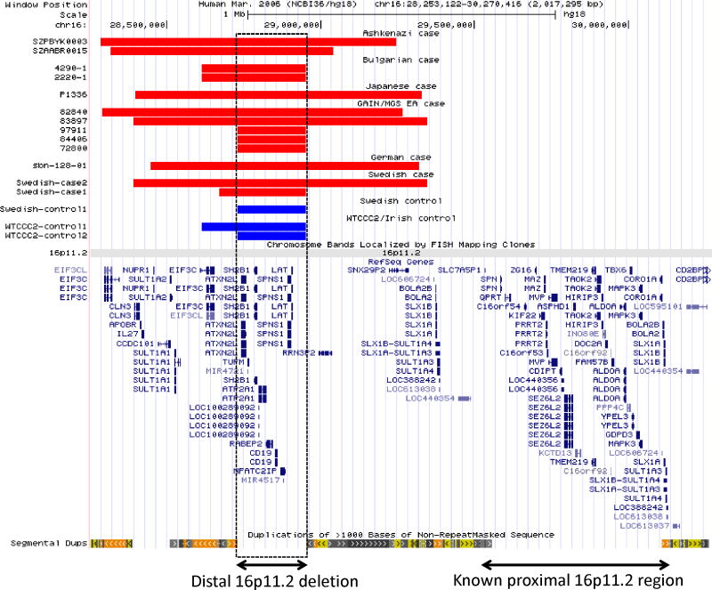
FALL 2014 ROTATION : SEBAT LAB Investigation of Novel CNV-Gene Associations Amongst 43k Individuals, Some Exhibiting Traits of Schizophrenia
CNV GWAS Association Studies
5 significant loci previously identified as highly correlated with the schizophrenic phenotype
One example:
Implication of a rare deletion at distal 16p11.2 in schizophrenia. (Guja, Sebat et. al, 2013)
Red = cases
Each block of red indicates shared geographical source location
Blue = controls
Bars (below) = annotations
Statistically relevant deletion–type CNVs found Localized below known causal CNV loci 16p11.2

Slide 4
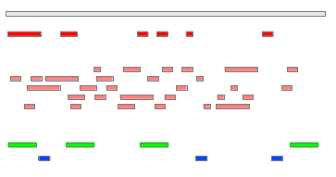
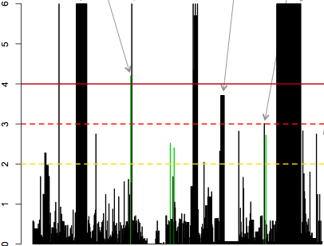
FALL 2014 ROTATION : SEBAT LAB Investigation of Novel CNV-Gene Associations Amongst 43k Individuals, Some Exhibiting Traits of Schizophrenia
CNV GWAS Association Studies (Example)
INPUT *
Genome
* Mutations
(CNVs: Deletions, Insertions)
* Annotations (Exons)
OUTPUT
Pseudomanhattan plot of positive association –Log10 p-values.
And identify major discrepancies between empirical and null results.)
And update from gene set based analysis to single-gene-based analysis.

Slide 5
FALL 2014 ROTATION : SEBAT LAB Investigation of Novel CNV-Gene Associations Amongst 43k Individuals, Some Exhibiting Traits of Schizophrenia
Previous analysis: Inspiration for this Project
INPUT *
Dataset of 43,765 individuals, approximately half of which exhibit phonological traits of schizophrenia
Groups of genes (“gene sets”) with shared function in a transmission network
Sequence metadata (covariates) for use in regression tests to remove experimental sample bias.
OUTPUT
Statistically relevant gene sets for which additive (duplications) or reductive (deletions) modifications in the sequence promote the observation of the schizophrenic phenotype.
RESULTS : No novel loci found for gene set-associated causal CNVs
All results validate 5 gene sets already identified in literature.

Slide 6
FALL 2014 ROTATION : SEBAT LAB Investigation of Novel CNV-Gene Associations Amongst 43k Individuals, Some Exhibiting Traits of Schizophrenia
New Experiment
INPUT *
Dataset of 43,000 individuals, approximately half of which exhibit phonological traits of schizophrenia
Individual gene IDs and coordinates
Covariate metadata removed (to comply with memory restraints)
OUTPUT
Statistically relevant individual genes for which additive (duplications) or reductive (deletions) modifications in the sequence promote the observation of the schizophrenic phenotype.
IDEAL RESULTS: Identify new causal, rare CNV relationships with individual genes

Slide 7
FALL 2014 ROTATION : SEBAT LAB Investigation of Novel CNV-Gene Associations Amongst 43k Individuals, Some Exhibiting Traits of Schizophrenia
Data Accumulation
Required Input Methods:
CNV Metadata
Reflect coordinates of observed duplications or deletions
Accumulate from files built over many years, students, collaborators
Update formatting for merge and cross-comparison
CNV Sample Set Reduced in Complexity by by Removing
Non-European ancestry (2715 samples)
Residual phenotype > 3 or < -3 (13 samples)
The residual phenotype is calculated by subtracting off an baseline term and estimates of any specified covariates.
Resulting sample size: approx. 43765 (22065 cases, 21700 controls)
Gene/Exon Coordinates
Built from existing subset of UCSC HG18 Gene IDs
Only use exons related to neurological development
Only use exons which contain underlying CNVs

Slide 8
FALL 2014 ROTATION : SEBAT LAB Investigation of Novel CNV-Gene Associations Amongst 43k Individuals, Some Exhibiting Traits of Schizophrenia
CNV/Gene Association Pseudocode
Logistic Regression Test: (no correction, x1 GAIN + x1 LOSS)
Unit: Subject
Tested variable: Count of aligned within gene coordinates
Test type: Deviance test (generalized linear model)
Goals:
Predict the expected probability of a dependent variable taking the value 1 or 0, given experimental caveats.
Does a significant relationship exist between the dependent variable (differential expressions) and the independent variables (covariates?)
Covariates:
Log R Ratio of Aligned Sequence
Gender
Multiple Affy Array Platforms
Test Profiles {1..5}

Slide 9
FALL 2014 ROTATION : SEBAT LAB Investigation of Novel CNV-Gene Associations Amongst 43k Individuals, Some Exhibiting Traits of Schizophrenia
CNV/Gene Association Pseudocode
# IMPORT
Parse input CNV metadata/covariate (phenotype) table
Parse input gene sets
Parse raw CNV del/dup tables and mark known loci
# COMPARE
Test for genes with overlapping CNV and Known Loci coordinates in the duplication,, deletion, and dup+del tables
Remove all mention to check of ALL loci, replace with only the loci with underlying genes with CNV overlaps
# EVALUATE SIGNIFICANCE
Count the number of CNVs present within each gene
Remove use of genes with 0 CNV counts (in case there’s no controls?)
Define covariates and run permutation tests to determine the relative significance of CNVs underlying all provided genes
Report the –log10 p-association values for both 1) duplications and 2) deletions underlying each gene (and plot)

Slide 10
FALL 2014 ROTATION : SEBAT LAB Investigation of Novel CNV-Gene Associations Amongst 43k Individuals, Some Exhibiting Traits of Schizophrenia
Experimental Road Blocks
Updates to legacy code base
Reverse engineer existing R tools developed by previous collaborator
Re-configure data structures, import and analysis methods for new gene-based implementation and execution in the UCSD processing environment. *
* Rate limiting step
Utilize new experiment base, “43k+”
Data Sizes and Memory Requirements
Imported data space occupies approx. 31 MB of space in R
Gene-set-based evaluation reduced the required number of iterations to the count of gene sets , (49 instances of permutation testing)
Approx. execution time = 1-4 days on 8 GB RAM host
New individual gene-based analyses used one gene per gene set and require approx. 4,500 instances of permutation testing.
Execution time before speed increase = 17 days on 8 GB RAM host (in swap)
Ideal RAM use shown to be > 128 GB
Run time predicted by on partial execution status
After speed increase by unecessary code reduction
Execution time before speed increase = 9 hours on 32 GB RAM host

Slide 11
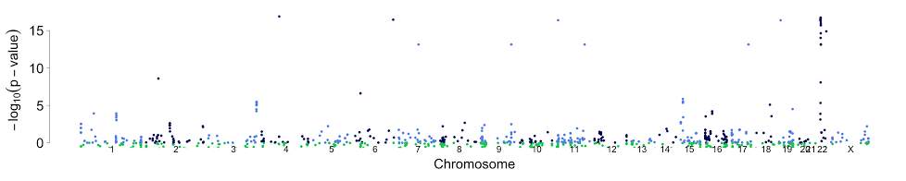
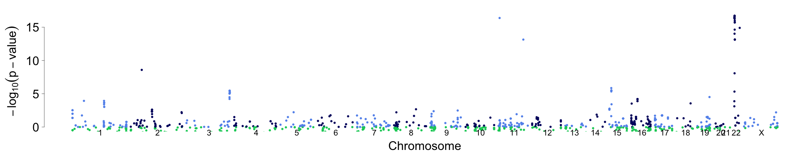
FALL 2014 ROTATION : SEBAT LAB Investigation of Novel CNV-Gene Associations Amongst 43k Individuals, Some Exhibiting Traits of Schizophrenia
Visualization and Noise Removal
New result interpretation (shown for LOSS/Deletion type CNVs) :
Using the entrez ID in Daniele’s table, add 3 new columns to the del and dup results tables: hg18 chrom, start and end.
Using the start position & Pval_dev_S generate a manhattan plot (one for dels and one for dups)
Evaluated and remove falsely assigned peaks * and identify new peaks in risk regions *
4. (Ongoing) Investigate and investigate genes underlying novel gene peaks within risk regions.

Slide 12
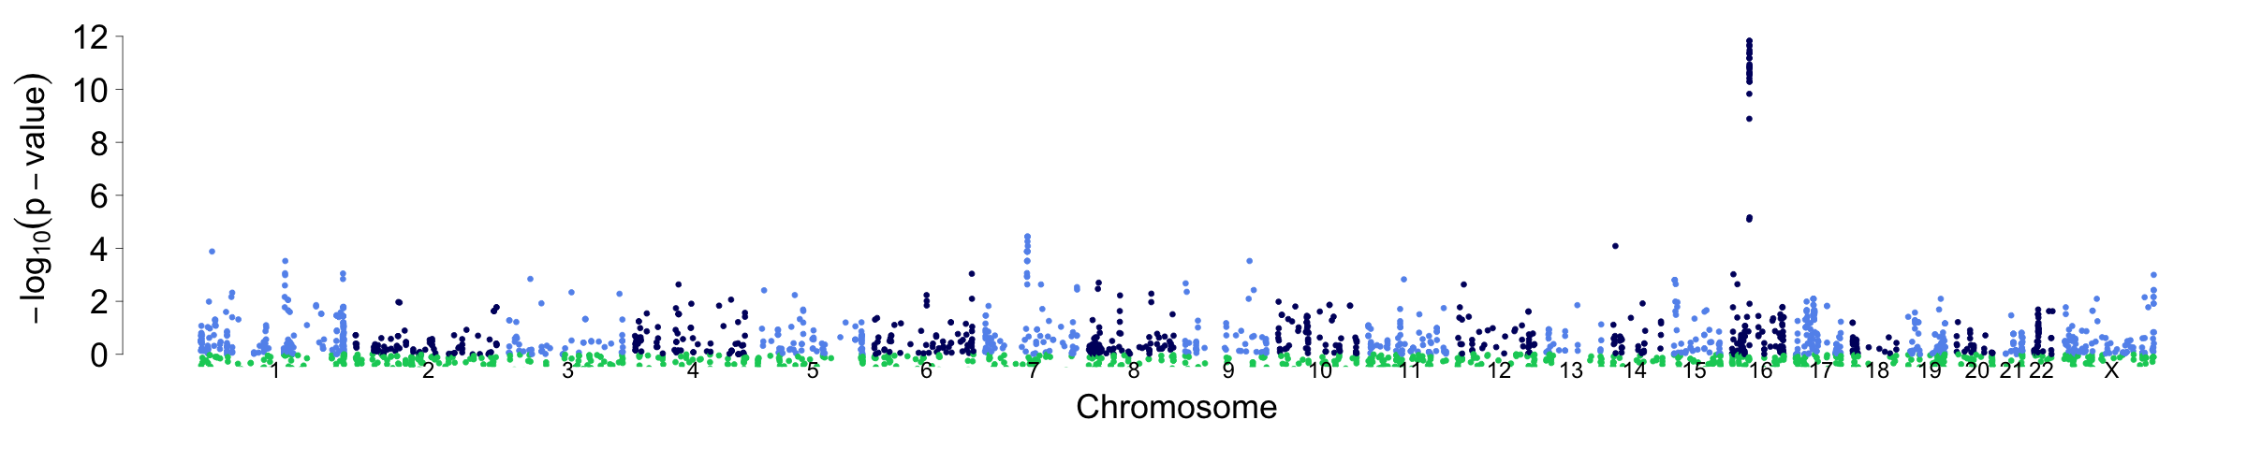
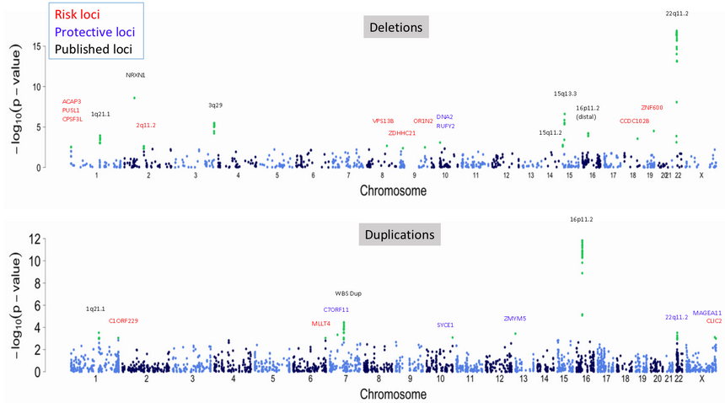
FALL 2014 ROTATION : SEBAT LAB Investigation of Novel CNV-Gene Associations Amongst 43k Individuals, Some Exhibiting Traits of Schizophrenia
Visualization Report (After Cleanup)
Before :
Deletions:
Duplications:
After :
Deletions:
Duplications:

Slide 13
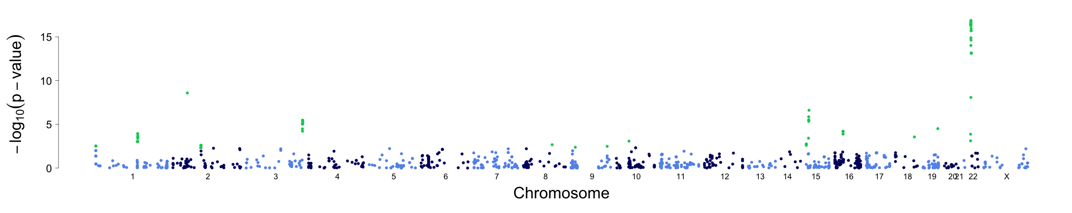
FALL 2014 ROTATION : SEBAT LAB Investigation of Novel CNV-Gene Associations Amongst 43k Individuals, Some Exhibiting Traits of Schizophrenia
Results: Deletions
Risk loci
Protective loci
Published loci
Deletions
22q11.2
NRXN1
ACAP3 PUSL1 CPSF3L
15q13.3
3q29
DNA2 RUFY2
16p11.2 (distal)
ZNF600
1q21.1
VPS13B
OR1N2
CCDC102B
2q11.2
ZDHHC21
15q11.2

Slide 14
FALL 2014 ROTATION : SEBAT LAB Investigation of Novel CNV-Gene Associations Amongst 43k Individuals, Some Exhibiting Traits of Schizophrenia
Results: Deletions
Risk loci
Presence of CNV over Loci Results in Increased Risk of Schizophrenic Phenotype
Protective loci
Presence of CNV over Loci Results in Decreased Risk of Schizophrenic Phenotype
Published Loci
CNV over Loci already has known associations with Risk
22q11.2
NRXN1
ACAP3 PUSL1 CPSF3L
15q13.3
3q29
DNA2 RUFY2
16p11.2 (distal)
ZNF600
1q21.1
VPS13B
OR1N2
CCDC102B
2q11.2
ZDHHC21
15q11.2
Chromosome 1 -> 22 + X

Slide 15
FALL 2014 ROTATION : SEBAT LAB Investigation of Novel CNV-Gene Associations Amongst 43k Individuals, Some Exhibiting Traits of Schizophrenia
Results: Deletions: CCDC102B (risk)
Coiled-coil domain-containing protein 102B

Slide 16
FALL 2014 ROTATION : SEBAT LAB Investigation of Novel CNV-Gene Associations Amongst 43k Individuals, Some Exhibiting Traits of Schizophrenia
Results: Deletions: CCDC102B (risk)
Genome Coordinates: (chr18 pictured)
Deletion CNVs (cases)
Deletion CNVs (controls)
Reference DB Gene Calls
(+Duplication CNVs, if they exist)

Slide 17
FALL 2014 ROTATION : SEBAT LAB Investigation of Novel CNV-Gene Associations Amongst 43k Individuals, Some Exhibiting Traits of Schizophrenia
Results: Deletions: ACAP3/PUSL1/CPS3F3L (risk)

Slide 18
FALL 2014 ROTATION : SEBAT LAB Investigation of Novel CNV-Gene Associations Amongst 43k Individuals, Some Exhibiting Traits of Schizophrenia
Results: Deletions: 2q11.2 microdeletion syndrome (risk)

Slide 19
FALL 2014 ROTATION : SEBAT LAB Investigation of Novel CNV-Gene Associations Amongst 43k Individuals, Some Exhibiting Traits of Schizophrenia
Results: Deletions: VPS13B (risk)

Slide 20
FALL 2014 ROTATION : SEBAT LAB Investigation of Novel CNV-Gene Associations Amongst 43k Individuals, Some Exhibiting Traits of Schizophrenia
Results: Deletions: ZDHHC21 (risk) (concentrated in clm2 batch 7)

Slide 21
FALL 2014 ROTATION : SEBAT LAB Investigation of Novel CNV-Gene Associations Amongst 43k Individuals, Some Exhibiting Traits of Schizophrenia
Results: Deletions: OR1N2 (risk) (artifact due to platform difference in probe coverage)

Slide 22
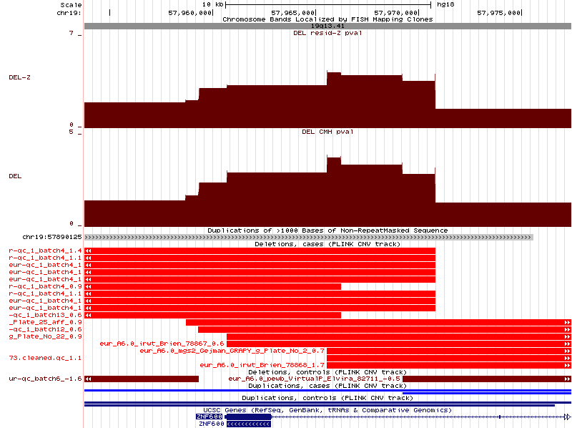
FALL 2014 ROTATION : SEBAT LAB Investigation of Novel CNV-Gene Associations Amongst 43k Individuals, Some Exhibiting Traits of Schizophrenia
Results: Deletions: ZNF600 (risk)
2 alleles w/ SegDup between them
‘A’ allele on left
‘B’ allele on right

Slide 23
FALL 2014 ROTATION : SEBAT LAB Investigation of Novel CNV-Gene Associations Amongst 43k Individuals, Some Exhibiting Traits of Schizophrenia
Results: Deletions: RUFY2/DNA2 (protective) (all from clo3 sample)

Slide 24
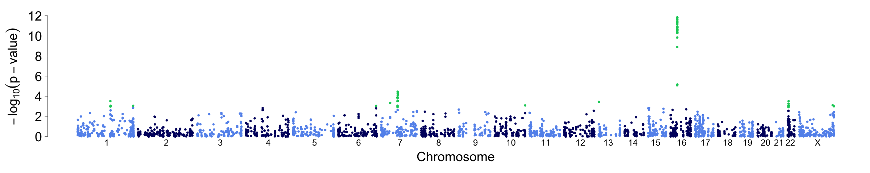
FALL 2014 ROTATION : SEBAT LAB Investigation of Novel CNV-Gene Associations Amongst 43k Individuals, Some Exhibiting Traits of Schizophrenia
Results: Duplications
Risk loci
Protective loci
Published loci
Duplications
16p11.2
WBS Dup
1q21.1
C7ORF11
MAGEA11
C1ORF229
MLLT4
SYCE1
ZMYM5
22q11.2
CLIC2

Slide 25
FALL 2014 ROTATION : SEBAT LAB Investigation of Novel CNV-Gene Associations Amongst 43k Individuals, Some Exhibiting Traits of Schizophrenia
Results: Duplications: C1orf229 (risk)

Slide 26
FALL 2014 ROTATION : SEBAT LAB Investigation of Novel CNV-Gene Associations Amongst 43k Individuals, Some Exhibiting Traits of Schizophrenia
Results: Duplications: MLLT4 (risk)

Slide 27
FALL 2014 ROTATION : SEBAT LAB Investigation of Novel CNV-Gene Associations Amongst 43k Individuals, Some Exhibiting Traits of Schizophrenia
Results: Duplications: CLIC2 (Xq28) (risk)

Slide 28
FALL 2014 ROTATION : SEBAT LAB Investigation of Novel CNV-Gene Associations Amongst 43k Individuals, Some Exhibiting Traits of Schizophrenia
Results: Duplications: C7ORF11 (protective)

Slide 29
FALL 2014 ROTATION : SEBAT LAB Investigation of Novel CNV-Gene Associations Amongst 43k Individuals, Some Exhibiting Traits of Schizophrenia
Results: Duplications: SYCE1 (protective)

Slide 30
FALL 2014 ROTATION : SEBAT LAB Investigation of Novel CNV-Gene Associations Amongst 43k Individuals, Some Exhibiting Traits of Schizophrenia
Results: Duplications: ZMYM5 (protective)

Slide 31
FALL 2014 ROTATION : SEBAT LAB Investigation of Novel CNV-Gene Associations Amongst 43k Individuals, Some Exhibiting Traits of Schizophrenia
Results: Duplications: MAGEA11 (Xq28) (protective)

Slide 32
FALL 2014 ROTATION : SEBAT LAB Investigation of Novel CNV-Gene Associations Amongst 43k Individuals, Some Exhibiting Traits of Schizophrenia
What’s next?
22q11.2
NRXN1
ACAP3 PUSL1 CPSF3L
3q29
DNA2 RUFY2
15q13.3
16p11.2 (distal)
ZNF600
1q21.1
2q11.2
VPS13B
OR1N2
CCDC102B
ZDHHC21
15q11.2
16p11.2
WBS Dup
1q21.1
C1ORF229
C7ORF11
ZMYM5
22q11.2
CLIC2
MLLT4
SYCE1
Novel observed gene associations will contribute to ongoing investigation of observed loci of interest in ongoing research at the Sebat lab.
Improvements and to this analysis would include:
Execution with a more complicated dataset (including global sample sourcing)
Utilization of a greater number of covariates
Re-execution with larger CNV data sets (constantly increasing)

Slide 33
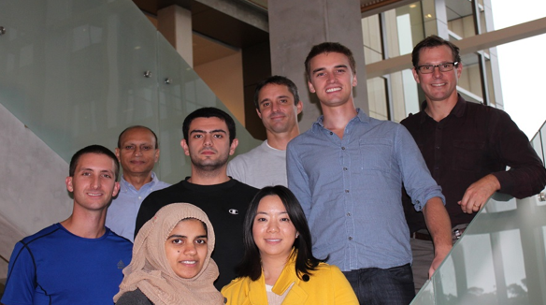
FALL 2014 ROTATION : SEBAT LAB Investigation of Novel CNV-Gene Associations Amongst 43k Individuals, Some Exhibiting Traits of Schizophrenia
Questions?
22q11.2
NRXN1
ACAP3 PUSL1 CPSF3L
3q29
DNA2 RUFY2
15q13.3
16p11.2 (distal)
ZNF600
1q21.1
2q11.2
VPS13B
OR1N2
CCDC102B
ZDHHC21
15q11.2
16p11.2
WBS Dup
1q21.1
C1ORF229
C7ORF11
ZMYM5
22q11.2
CLIC2
MLLT4
SYCE1
Thank You
Prof. Jonathan Sebat and Team →
Special thanks to…
Danny Antakli (R mentor)
William Brandler (R/visualization mentor)
Madhusudan Gujral (TSCC processing support)
Daniele Merico (TCAG)

