Slide 1
BIOHACKATHON JAPAN 2026 · MATSUYAMA
Building an HLA Typer Using
Asian-Specific Pangenomes
A whole-MHC pangenome graph across 754 Asian- and Arab-enriched haplotypes, and a first honest test of graph-based HLA genotyping
github.com/biohackathon-japan/BH26-asian-hla · 18 September 2026

Slide 2
INTRODUCTION
Why an Asian- and Arab-enriched HLA pangenome
• HLA/MHC on chr6 is the most polymorphic part of the genome — drives transplant compatibility, drug hypersensitivity, autoimmune & infectious-disease risk
• Existing typers (HLA*LA, T1K, SpecHLA) are tuned on reference panels enriched for European/African/admixed-American ancestries
• Middle Eastern and East/Southeast Asian populations are comparatively under-represented — despite strongly population-specific allele frequencies
• Goal at BioHackathon Japan 2026: an HLA genotyping method built on our own Asian- and Arab-enriched pangenome graph

Slide 3
INTRODUCTION
What we did this week
• 1. Extended our Asian/Arab HLA haplotype panel to 754 haplotypes
• 2. Built a whole-MHC Minigraph-Cactus pangenome graph from it
• 3. Tested a first, direct graph-based genotyping approach — align, call, phase, consensus, annotate — against T1K and real experimental truth
• 4. Used what we learned to start building the actual typer: a PanGenie-based genotyper on graph bubbles
  – Parts are complete and validated; the typer itself is in progress — reported honestly below

Slide 4
01
Methods

Slide 5
METHODS
The 754-haplotype panel
Cohort / stratum | Haplotypes | Population | Source
APR | 106 | Arab (UAE) | Assembly
HPRC r2 – Japanese | 32 | Japanese (1000G JPT) | Assembly
HPRC r2 – Jewish | 2 | Ashkenazi (HG002 only) | Assembly
HPRC r2 – East Asian | 70 | CHB/CHS/CDX/KHV, HG005 | Assembly
HPRC r2 – Rest | 360 | Mixed | Assembly
JaSaPaGe – Saudi | 18 | Arab (Saudi) | Assembly
JaSaPaGe – Japanese | 20 | Japanese (1000G JPT) | Assembly
K-PanRef | 28 | Korean | Graph path
CPC | 116 | Chinese | Graph path
GRCh38 / CHM13 | 2 | Reference | Reference

Slide 6
METHODS
New this round: K-PanRef & CPC
• 144 new haplotypes from two projects whose raw assemblies aren't public yet:
  – K-PanRef — Korean pangenome, 28 haplotypes / 14 individuals
  – CPC — Chinese Pangenome Consortium Phase 1, 116 haplotypes / 58 individuals
• MHC sequence pulled directly from their own published Minigraph-Cactus graphs (vg paths -F / odgi), not from raw assemblies
• Kept only if minimap2 asm20 alignment ≥ 50 kb matching bases, MAPQ ≥ 20 vs GRCh38 MHC
• Caveat: graph paths are Minigraph-Cactus–clipped — haplotype-private insertions can be shortened relative to the true assembly
• 742 haplotypes from 371 name-reconciled donors remain for donor-level analyses after de-duplication

Slide 7
METHODS
Extraction, annotation, whole-MHC graph
• Unchanged core CWL workflow (hla_pangenome.cwl) re-run on the enlarged panel
  – pgr-tk pgr-query extracts GRCh38 chr6:28,510,120–33,480,577 ± 100 kb per haplotype
  – Immuannot v3 (IPD-IMGT/HLA 3.55, IPD-KIR 2.13, RefSeq C4) calls gene structure + allele identity
• Whole-MHC graph built with cactus-pangenome (Cactus 3.3.0, Minigraph-Cactus algorithm), referenced against GRCh38 + CHM13
  – NIG supercomputer, 32 cores / 240 GB — built in 3 h 43 min
  – 417,896 nodes · 579,137 edges · 5.89 Mb of sequence · vg Giraffe indexes for short-read alignment
• Graph validation: HG00096 MHC reads vs graph — 99.5% pairs aligned, 95.2% at MAPQ ≥ 20, in 26 s / 8 threads

Slide 8
METHODS
Does graph genotyping beat a direct-read typer?
• First test pipeline: vg giraffe align → vg call → WhatsHap read-backed phase → bcftools consensus (hap1/hap2 FASTA) → Immuannot re-annotation
• i.e. use the graph to build a personal phased pseudo-assembly, then type it exactly like the main assembly panel
• Compared against:
  – T1K — types directly from raw reads, no graph or consensus step
  – Real experimental truth — Gourraud et al. 2014 Sanger/SSO typing, 955 overlapping donors
• Two independent T1K runs (noise check); re-annotated against both IPD-IMGT/HLA 3.55.0 and fresh 3.65.0
• Concordance scored at 1-field and 2-field resolution, 9 classical genes (A/B/C/DRA/DRB1/DQA1/DQB1/DPA1/DPB1)

Slide 9
METHODS
RCCX/C4 structural prototypes (exploratory)
• Two lightweight, held-out-validated approaches to genotype the RCCX module (C4A/C4B copy number & long/short structure) without full HLA calling:
  – k-mer / marker-counting matched against graph paths — 106 donors (18 pilot + 88 held out)
  – Dedicated 299-probe targeted dosage assay — benchmarked against published C4Investigator on 24 held-out donors
• Both use donor-level, family-disjoint held-out splits

Slide 10
METHODS
The typer in progress: PanGenie on graph bubbles
• Consensus-based pipeline loses resolution (see Results) — so the real typer avoids an explicit consensus step entirely
• Closer to PanGenie / SpecHLA's personalized-reference philosophy: genotype graph bubbles directly from k-mers in raw reads
• 1. vg deconstruct → bubble-level VCF relative to GRCh38
• 2. 5 donor-disjoint, family-disjoint, population-balanced folds; "full" panel vs "HPRC-only" panel per fold
• 3. PanGenie genotypes each held-out donor against both panels
• Initial cohort: 40 1000 Genomes donors (20 East Asian + 20 South Asian); same donors also run through T1K and SpecHLA
  – Status: all 120 jobs (40 donors × 4 methods) complete with verified output integrity — accuracy scoring against truth is the next step

Slide 11
02
Results

Slide 12
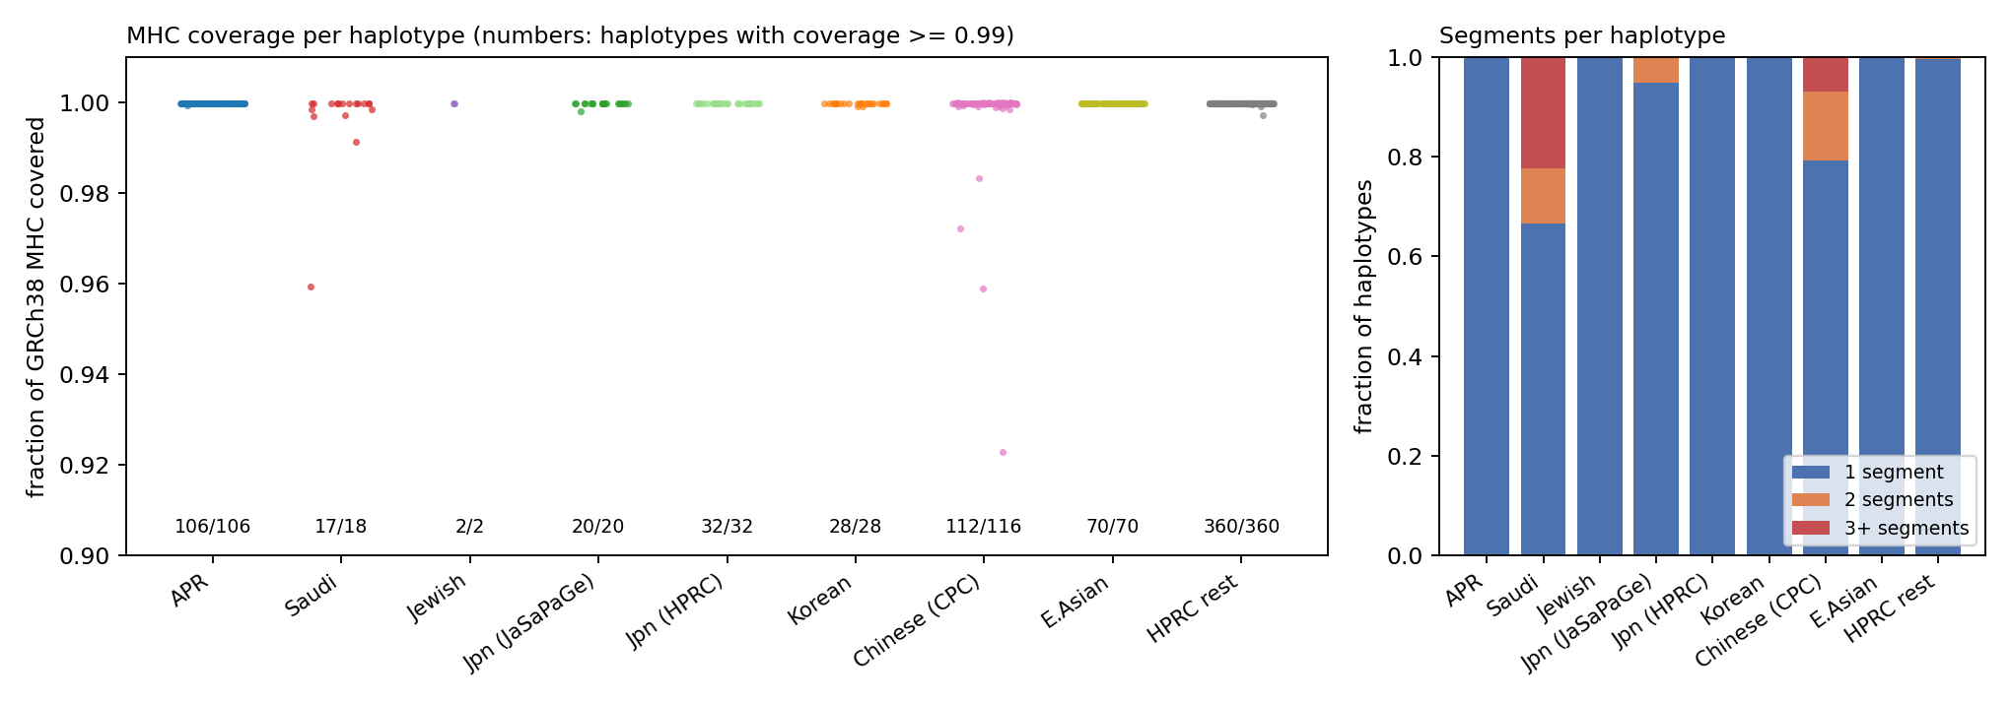
RESULTS
The MHC still comes out complete
747 / 752
haplotypes ≥ 0.99 coverage
720 / 752
on a single segment
Lower tail: 4 CPC + 1 JaSaPaGe-Saudi haplotypes
MHC extraction across 752 non-reference haplotypes of the enlarged, 9-stratum panel. Left: coverage of the GRCh38 MHC interval. Right: extracted segments per haplotype.

Slide 13
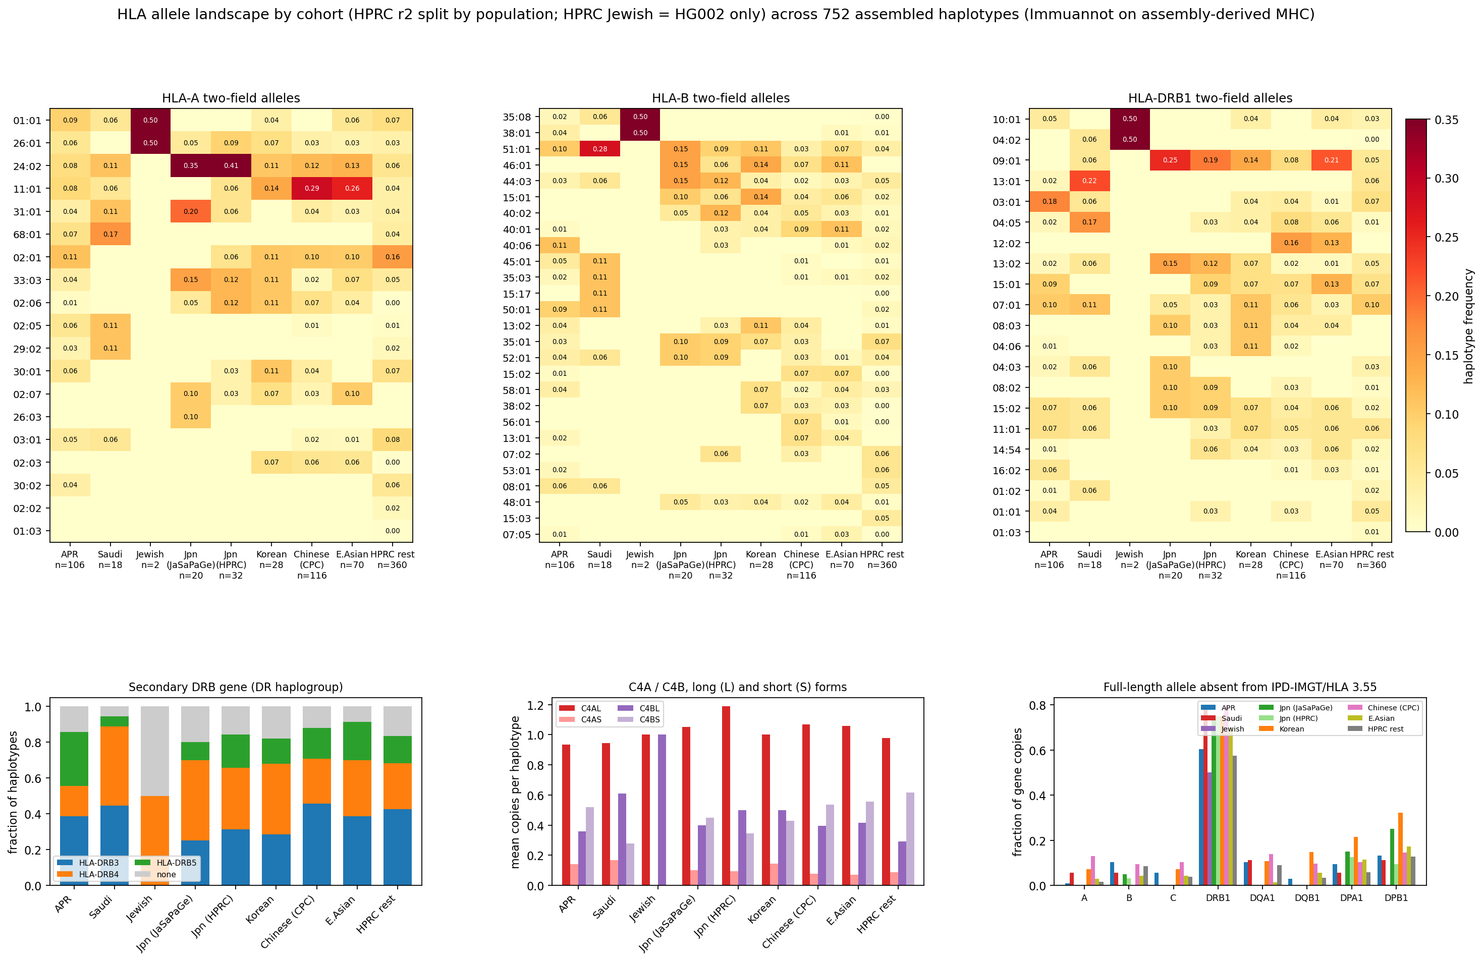
RESULTS
Nine strata, distinct allele signatures
A*11:01
29% CPC-Chinese
DRB1*12:02
16% CPC-Chinese
DRB1 gap
57–79% of copies have no full-length DB match
HLA allele landscape across 752 haplotypes, split into 9 cohorts/strata. Top: HLA-A/-B/-DRB1 frequencies. Bottom: secondary DRB, C4A/C4B forms, fraction absent from IPD-IMGT/HLA 3.55.

Slide 14
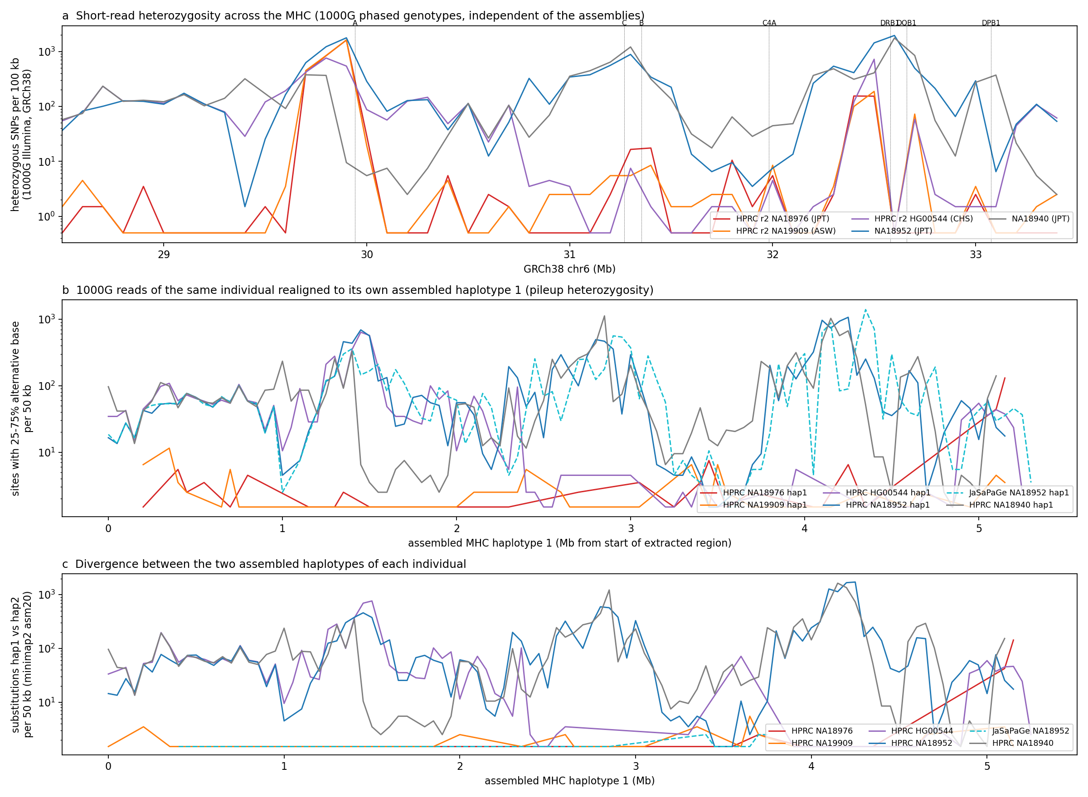
RESULTS
Two genuine homozygotes, one duplicated assembly
NA18976 / NA19909
<100 het SNPs/100kb — genuine
NA18952 (JaSaPaGe)
same haplotype assembled twice
MHC homozygosity and haplotype-duplication check using 1000G read data external to the assemblies themselves.

Slide 15
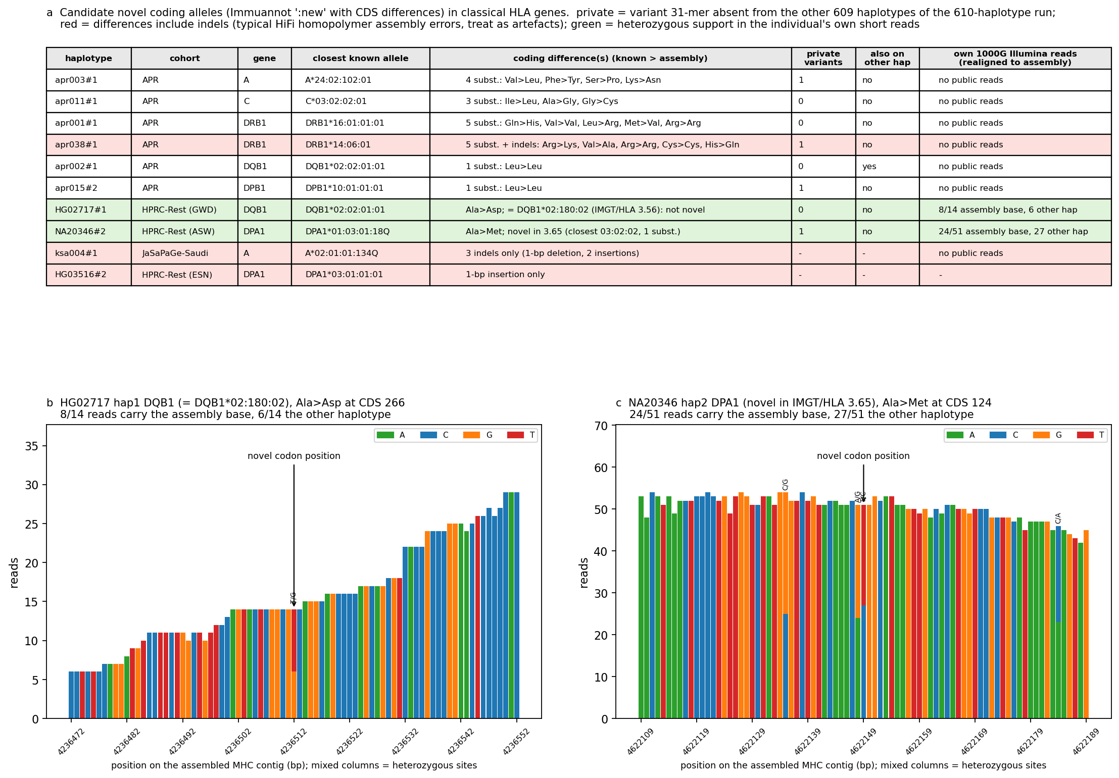
RESULTS
One correction, one novel allele confirmed
HG02717 DQB1
resolved: DQB1*02:180:02
NA20346 DPA1
still novel, 24/51 reads support
Candidate novel coding alleles and their read support, rechecked against IPD-IMGT/HLA 3.65.

Slide 16
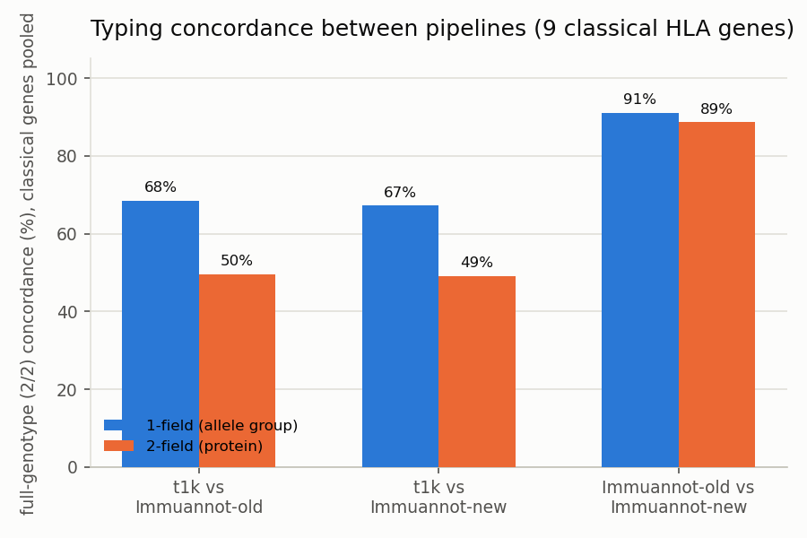
RESULTS
Graph-consensus vs direct-read typer: internal concordance
Immuannot old vs new DB
91% (1-field) / 89% (2-field)
T1K vs Immuannot
only 49–50% at 2-field
DRB1
10–25% in every comparison
Pairwise typing concordance between the graph-consensus pipeline (Immuannot, 2 DB versions) and T1K (2 independent runs), pooled over 9 classical genes.

Slide 17
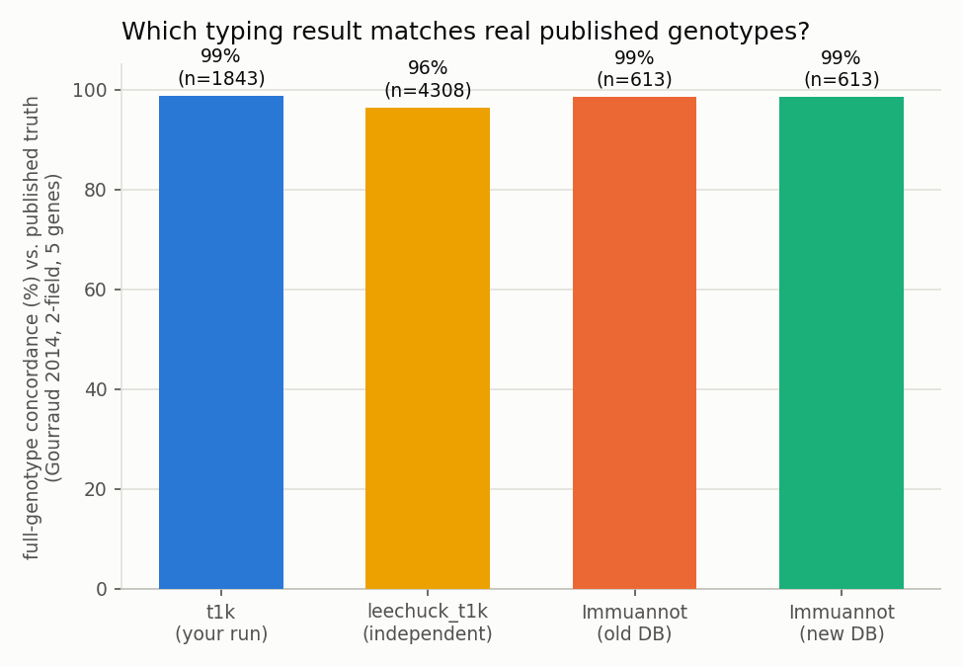
RESULTS
Same accuracy, far less resolution — the key finding
Accuracy tied
98.8% T1K vs 98.5% graph-consensus
Resolution gap
T1K 90% vs graph-consensus 33%
→ motivates PanGenie bubble typer
Genotype concordance against real published truth (Gourraud et al. 2014, 2-field, 5 classical genes).

Slide 18
RESULTS
RCCX/C4 prototypes: an honest negative result
• Marker-counting prototype: recovered RCCX gene content trivially (106/106) but only 38–64/106 full structural-signature pairs correctly
  – Calibrated plain read depth tied its best copy-number variant — no graph-specific benefit established
• Targeted 299-probe assay: matched but did not beat a plain-depth baseline on total C4 dosage (24/24 both)
  – 21/24 on full RCCX structural pairs — slightly worse than a pre-existing simpler method (22/24)
• Reported as a genuine, disclosed negative result: RCCX/C4 structure is genuinely hard to call from short reads regardless of method

Slide 19
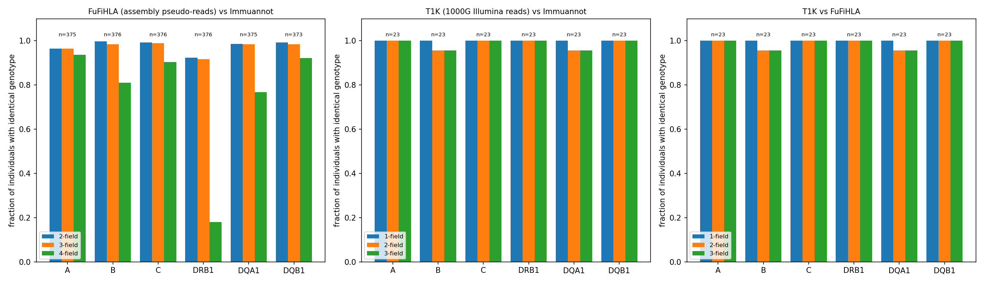
RESULTS
Classical calls remain concordant at the enlarged scale
vs Gourraud 2014
62–64/64 A,B; 58–59/63 C,DRB1
FuFiHLA vs Immuannot
92–100% 2-field, n=373–376
Typing concordance between FuFiHLA, Immuannot and T1K on the same assembled individuals, at 1–4 field resolution.

Slide 20
RESULTS
PanGenie typer: infrastructure complete, scoring pending
• 5 folds × {full, HPRC-only} bubble-level reference panels — built and verified
• 40-donor call generation (T1K, SpecHLA, PanGenie-full, PanGenie-HPRC-only): all 120 jobs finished successfully
  – 3,250,704 VCF records (full-panel PanGenie) vs 3,504,632 (HPRC-only) — integrity verified
• Accuracy scoring against truth has not been run yet — explicit next step
• One completed sub-analysis (structural signature representation): full panel and HPRC-only panel represent the same RCCX/DRB classes for this initial 40-donor cohort
  – Does not mean the Asian-specific haplotypes are uninformative — accuracy scoring, not representation counting, is the real test

Slide 21
03
Discussion

Slide 22
DISCUSSION
What's real and usable now
• An Asian- and Arab-enriched HLA haplotype panel that has tripled its non-HPRC diversity in one week: 754 haplotypes, 9 population strata
• A whole-MHC Minigraph-Cactus graph built from that panel, with validated short-read mapping
• A rigorous demonstration of why the obvious first approach — align, call, phase, consensus, annotate — does not beat T1K on accuracy, and specifically loses resolution at the paralog-rich loci (DRB1 above all) that most need a better reference
• That negative result is not a detour — it is what redirected the typer toward genotyping graph bubbles directly with PanGenie

Slide 23
DISCUSSION
Immediate next steps
• 1. Finish accuracy scoring: 40-donor PanGenie/T1K/SpecHLA comparison, full panel vs HPRC-only, against Gourraud 2014
• 2. Extend the benchmark cohort to the Arabian stratum once data access allows
• 3. Add HLA*LA and the long-read SpecImmune/HLAminer arm from the study plan
• 4. Investigate whether K-PanRef/CPC's graph-derived haplotypes constrain the bubble panel less than expected
• 5. Revisit HLA-DRB1 phasing specifically — worst-performing locus in every comparison, including database-version-only checks

Slide 24
ACKNOWLEDGEMENTS
Thanks
• DBCLS BioHackathon Japan 2026 organisers, and the NIG supercomputer BioHackathon node for compute access
• Arab Pangenome Reference (MBRU), K-PanRef, CPC, HPRC and JaSaPaGe project teams for assemblies and pangenome graphs
• pgr-tk, Immuannot, pggb, odgi, minimap2, Cactus/Minigraph-Cactus, vg/Giraffe, WhatsHap, PanGenie, T1K, C4Investigator

Slide 25
Thank you
github.com/biohackathon-japan/BH26-asian-hla

