Slide 1

Transistors
Student Lecture by:
Giangiacomo Groppi
Joel Cassell
Pierre Berthelot
September 28th 2004

Slide 2
Lecture outline
Historical introduction
Semiconductor devices overview
Bipolar Junction Transistor (BJT)
Field Effect Transistors (FET)
Power Transistors

Slide 3
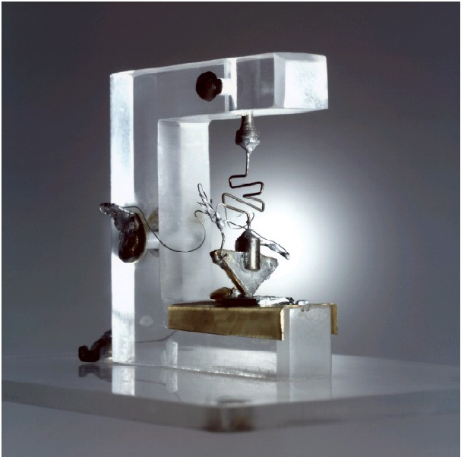

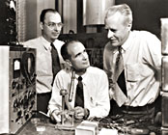
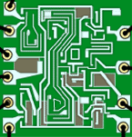
Transistor History
Invention: 1947,at Bell Laboratories.
John Bardeen, Walter Brattain, and William Schockly developed the first model of transistor (a Three Points transistor, made with Germanium)
They received Nobel Prize in Physics in 1956 "for their researches on semiconductors and their discovery of the transistor effect"
First application: replacing vacuum tubes (big & inefficient).
Today: millions of Transistors are built on a single silicon wafer in most common electronic devices
First model of Transistor

Slide 4

What is a transistor ?
The Transistor is a three-terminal, semiconductor device.
It’s possible to control electric current or voltage between two of the terminals (by applying an electric current or voltage to the third terminal). The transistor is an active component.
With the Transistor we can make amplification devices or electric switch. Configuration of circuit determines whether the transistor will work as switch or amplifier
As a miniature electronic switch, it has two operating positions: on and off. This switching capability allows binary functionality and permits to process information in a microprocessor.

Slide 5
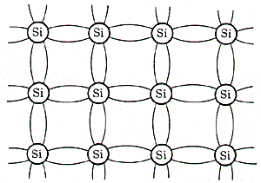
Semiconductors
Most used semiconductor:
Silicon
  Basic building material of most integrated circuits
  Has four valence electrons, in its lattice there are 4 covalent bonds.
  Silicon crystal itself is an insulator: no free electrons
  Intrinsic concentration (n_{i}) of charge carriers: function of Temperature (at room temp. 300K n_{i} = 10¹⁰ /cm³)

Slide 6
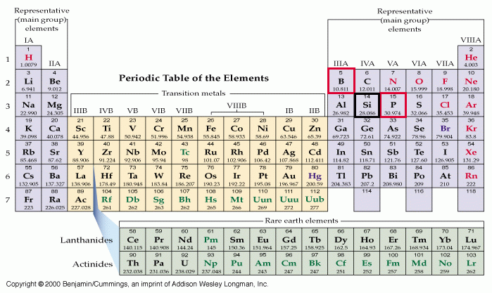
Semiconductors 2
Electric conductibility in the Silicon crystal is increased by rising the temperature (not useful for our scope) and by doping.
Doping consists in adding small amounts of neighbor elements.

Slide 7
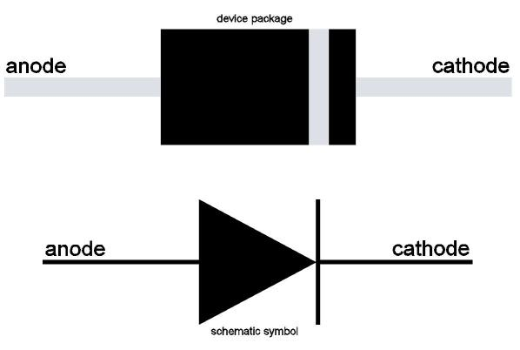
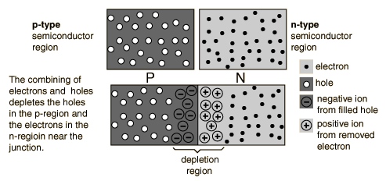
The simplest example: p-n junction
It’s also called Junction Diode
Allows current to flow from P to N only.
Because of the density gradient, electrons diffuse to the p region, holes to the n region.
Because of the recombination, the region near the junction is depleted of mobile charges.
Two types of behavior: Forward and Reverse biased.

Slide 8
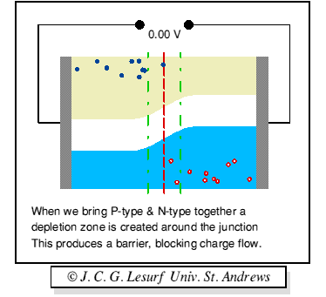
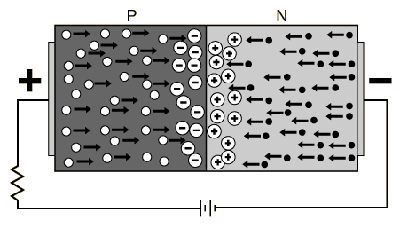

Forward bias
Forward biasing:
    The external Voltage lowers the potential barrier at the junction.
    The p-n junction drives holes (from the p-type material) and electrons (from the n-type material) to the junction.
    A current of electrons to the left and a current of holes to the right: the total current is the sum of these two currents.

Slide 9
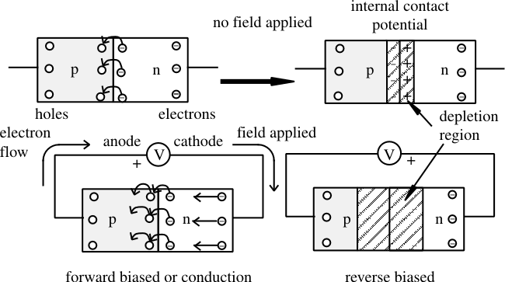
Reverse bias
Reverse biasing:
    Reverse voltage increases the potential barrier at the junction.
    There will be a transient current to flow as both electrons and holes are pulled away from the junction.
    When the potential formed by the widened depletion region equals the applied voltage, the current will cease except for the small thermal current. It’s called reverse saturation current and is due to hole-electrons pairs generated by thermal energy.

Slide 10
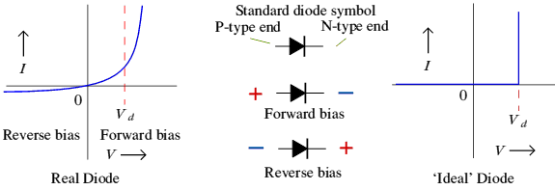
Diode characteristics
Forward biased (on)- Current flows
  It needs about 0.7 V to start conduction (V_{d} )
Reversed biased (off)- Diode blocks current
  Ideal: Current flow = 0
  Real : I_{flow}= 10⁻⁶ Amps (reverse saturation current)
V threshold

Slide 11
BJT

Slide 12
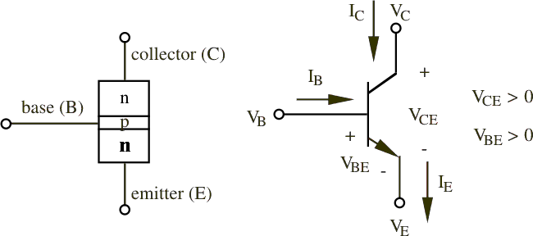
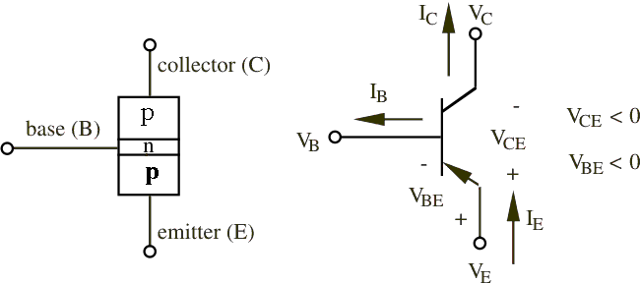
Bipolar Junction Transistor (BJT)
3 adjacent regions of doped Si (each connected to a lead):
  Base. (thin layer,less doped).
  Collector.
  Emitter.
2 types of BJT:
  npn.
  pnp.
Most common: npn (focus on it).
npn bipolar junction transistor
Developed by Shockley (1949)
pnp bipolar junction transistor

Slide 13
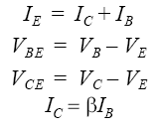

BJT npn Transistor
1 thin layer of p-type, sandwiched between 2 layers of n-type.
N-type of emitter: more heavily doped than collector.
With V_{C}>V_{B}>V_{E}:
  Base-Emitter junction forward biased, Base-Collector reverse biased.
  Electrons diffuse from Emitter to Base (from n to p).
  There’s a depletion layer on the Base-Collector junction →no flow of e⁻ allowed.
  BUT the Base is thin and Emitter region is n⁺ (heavily doped) → electrons have enough momentum to cross the Base into the Collector.
  The small base current I_{B} controls a large current I_{C}

Slide 14
FET

Slide 15
Field Effect Transistors
1955 : the first Field effect transistor works
Increasingly important in mechatronics.
BJT Terminal | FET Terminal
Base | Gate
Collector | Drain
Emitter | Source
Similar to the BJT:
  Three terminals,
  Control the output current

Slide 16
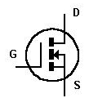
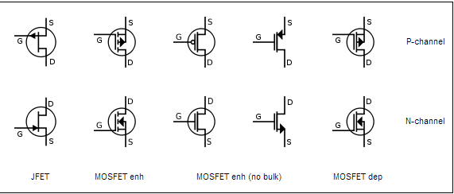
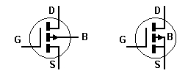
NMOS Vs PMOS
  Symbols:

Slide 17
NMOS uses
High-current voltage-controlled switches
Analog switches
Drive DC and stepper motor
Current sources
Chips and Microprocessors
CMOS: Complementary fabrication

