Slide 1
This presentation can be downloaded here:
https://github.com/xulman/tools-iuc/tree/trackastra_fixes/tools/trackastra/presentation

Slide 2
The Goal
To show a tracking pipeline on OME-zarr image data.
Pipeline is open source & license, freely accessible, in Python (nearly FAIR :)
https://github.com/xulman/tools-iuc/tree/trackastra_fixes/tools/trackastra
Based on the popular (one-click) Cellpose3 and Trackastra
Credits to the original Authors: Carsen Stringer, Marius Pachitariu, Martin Weigert
Status as of 18th March 2026:
  Aspirant for a proper Galaxy node
  Whatever you learn today, it applies to the future node
  … It is perhaps a little resources hungry…
    Still usable?
    Yeah, you can run in free tier of Galaxy!
    That's why we are here today :)

Slide 3
The Grand Scheme of Things
(remote)
OME-zarr
dataset
usegalaxy.eu
”big” server
commands
User
- at work/home
- on laptop

Slide 4
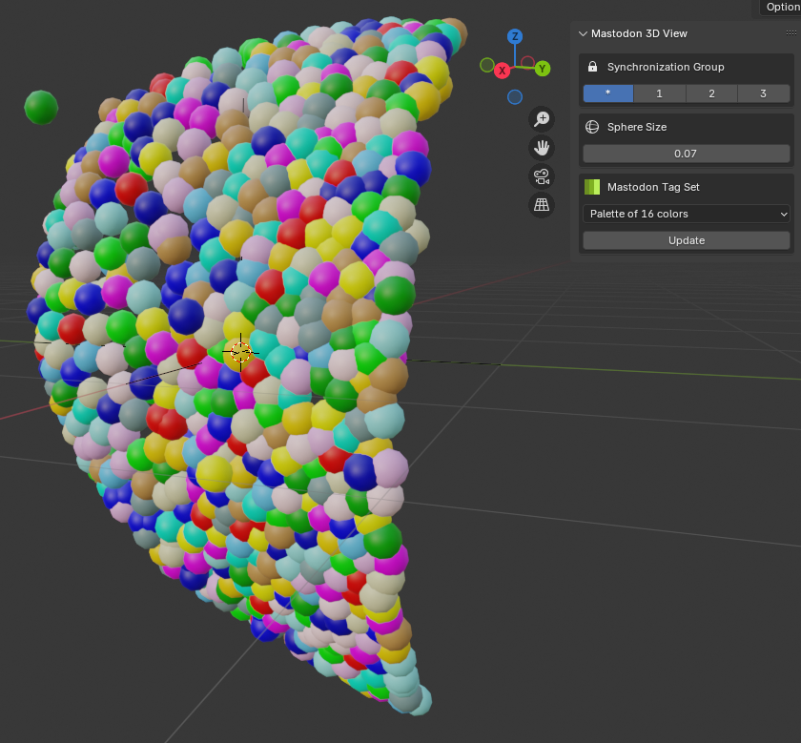
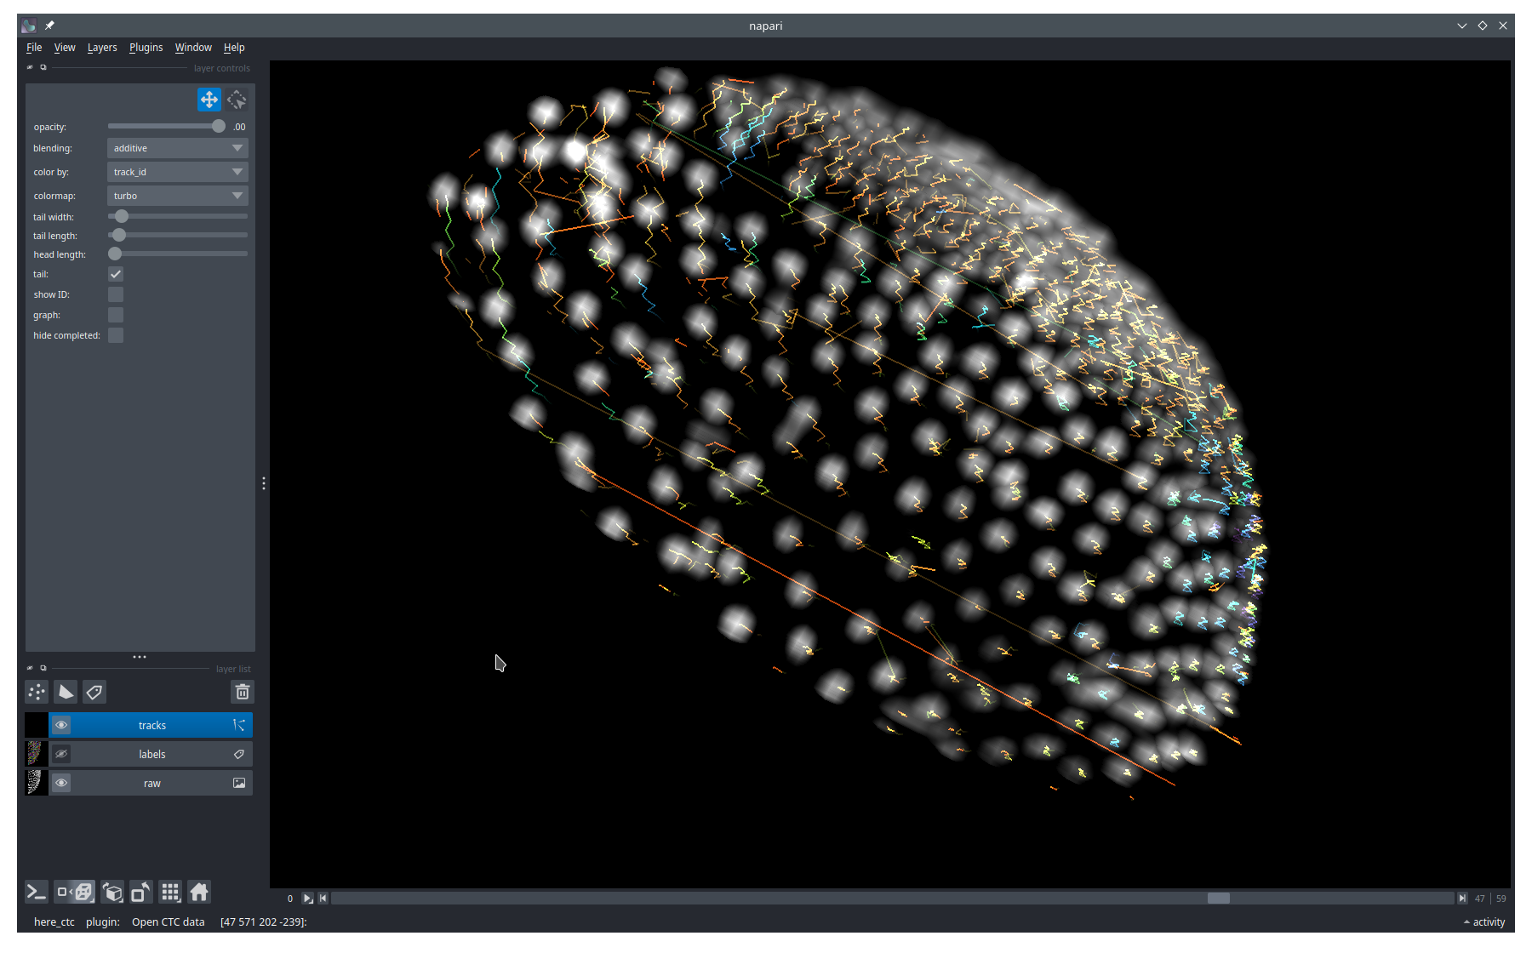
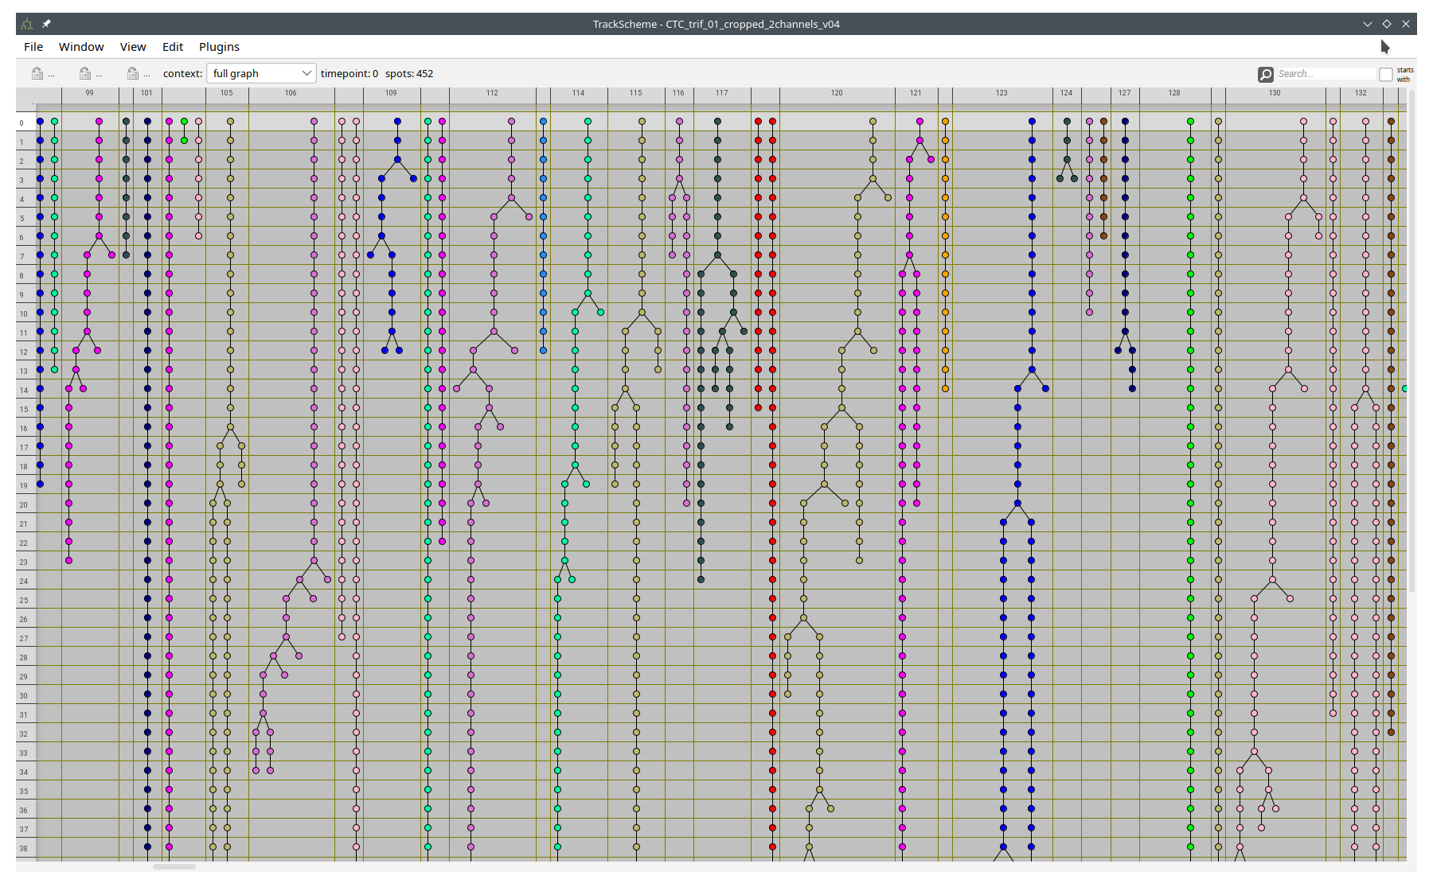
The Grand Scheme of Things
(remote)
OME-zarr
dataset
usegalaxy.eu
”big” server
commands
User
- at work/home
- on laptop
downloads results
Downstream analysis
based on the tracking data
in Napari or Fiji

Slide 5
Trackastra
AI-including cell (and nuclei) tracker for 2D+t and 3D+t
Homepage: https://github.com/weigertlab/trackastra
Inputs:
  Mask images – to show subjects of tracking
  Raw images – to help tracker find pairs
  Loaded fully as numpy data
Outputs:
  Napari tracks (object as such), directly inside Napari
  Graph Exchange File Format (GEFF) https://github.com/live-image-tracking-tools/geff
  Cell Tracking Challenge https://celltrackingchallenge.net/
  GEFF & CTC formats hold masks internally

Slide 6
Cellpose v3
AI-based cell (and nuclei) segmenter for 2D and 3D
Homepage: https://github.com/MouseLand/cellpose
Using v3 (prior v4 – SAM-enabled), it is feasible on CPUs (no GPUs)
Available in this pipeline for cases when only raw images are provided
  On-the-fly segmentation for Trackastra
  Results not stored aside (TODO: Should be)
  In our hands: Needs objects diameter information
  It can be compute heavy
  Considered for emergency cases
    Better to segment properly outside this

Slide 7
Controls of this Pipeline
Input URL
Input resolution level
Raw images channel
Mask images channel
Output folder
Tracking Options → → → →
Tracking Options object
  downscale_factor_x: 1.0
  downscale_factor_y: 1.0
  downscale_factor_z: 1.0
  start_from_tp: 0
  end_at_tp: -1
  segmentation_model: 'cyto3' or ‘nuclei’
  objects_diameter_px : 25
  tracking_model: 'ctc'
These all will be parameters
of the future Galaxy node.

Slide 8
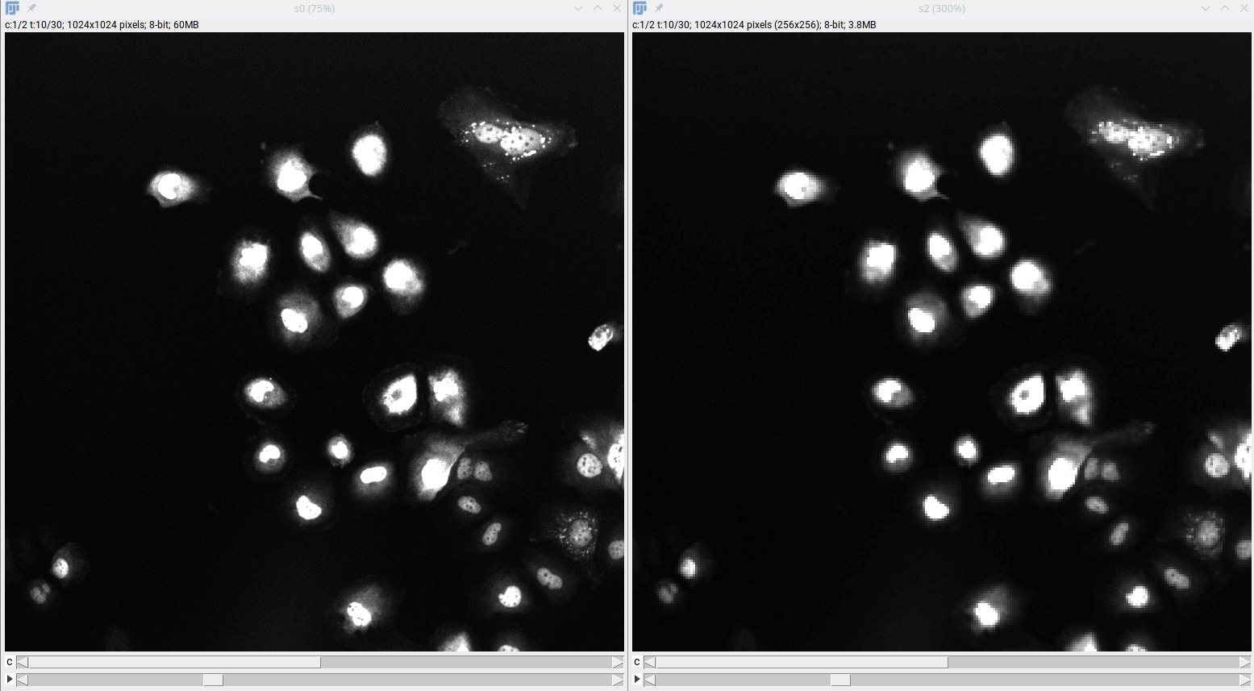
Controls of this Pipeline
Input resolution level
Why downscaling?
Trackastra reads the full input.
Spatial extent is good to know,
but less important...
Tracking Options object
  downscale_factor_x: 1.0
  downscale_factor_y: 1.0
  downscale_factor_z: 1.0
  start_from_tp: 0
  end_at_tp: -1
  segmentation_model: 'cyto3' or ‘nuclei’
  objects_diameter_px : 25
  tracking_model: 'ctc'
15x smaller
Fiji > File > Import > HDF5/N5/Zarr/OME-NGFF…
objects_diameter here too...

Slide 9
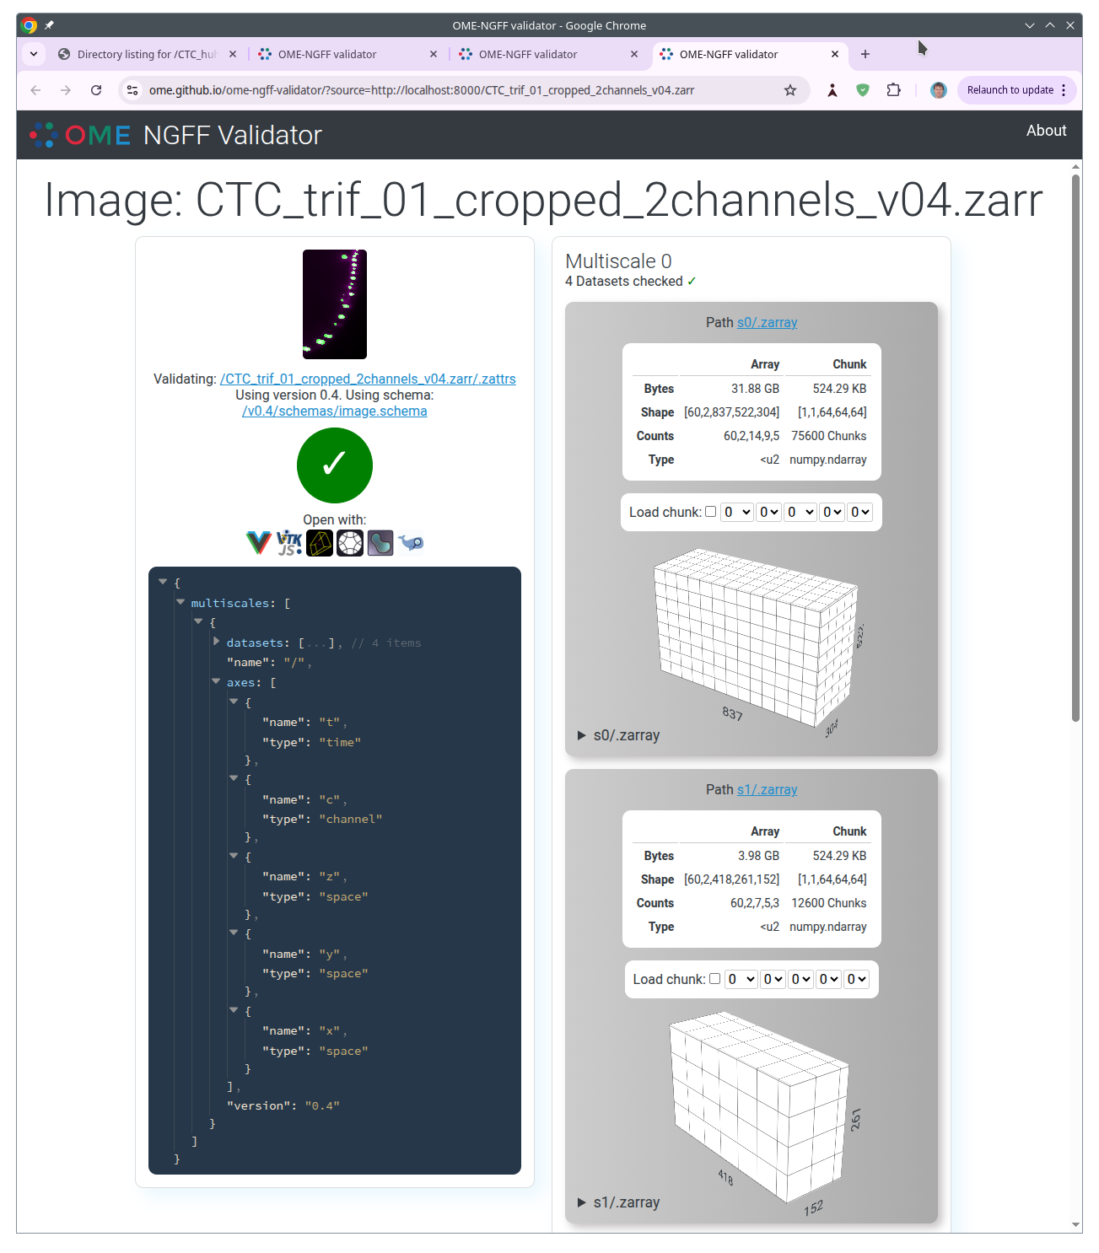
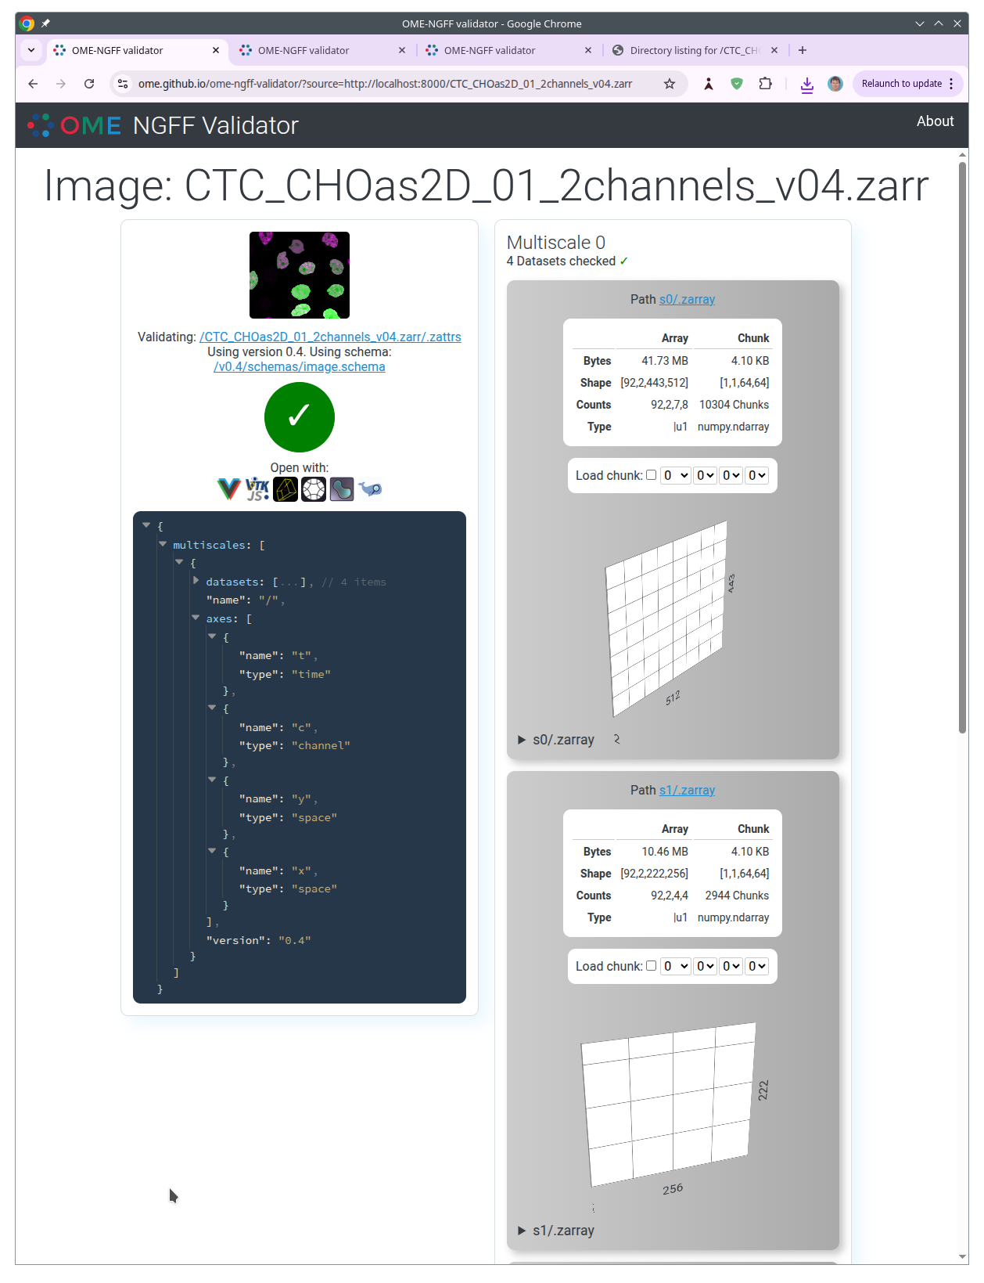
Geometry of OME-zarr

Slide 10
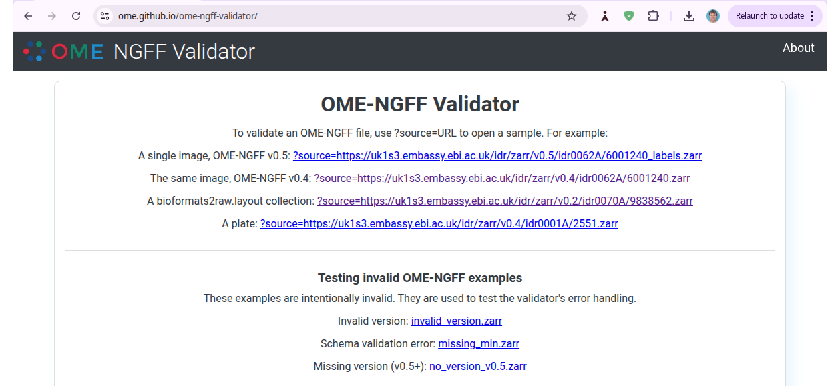
Geometry of OME-zarr
pixi init; pixi add ome-zarr; pixi run ome_zarr view /path/to/dataset.zarr
...turns local path to “network” URL
https://ome.github.io/ome-ngff-validator/?source=YOUR_URL

Slide 11
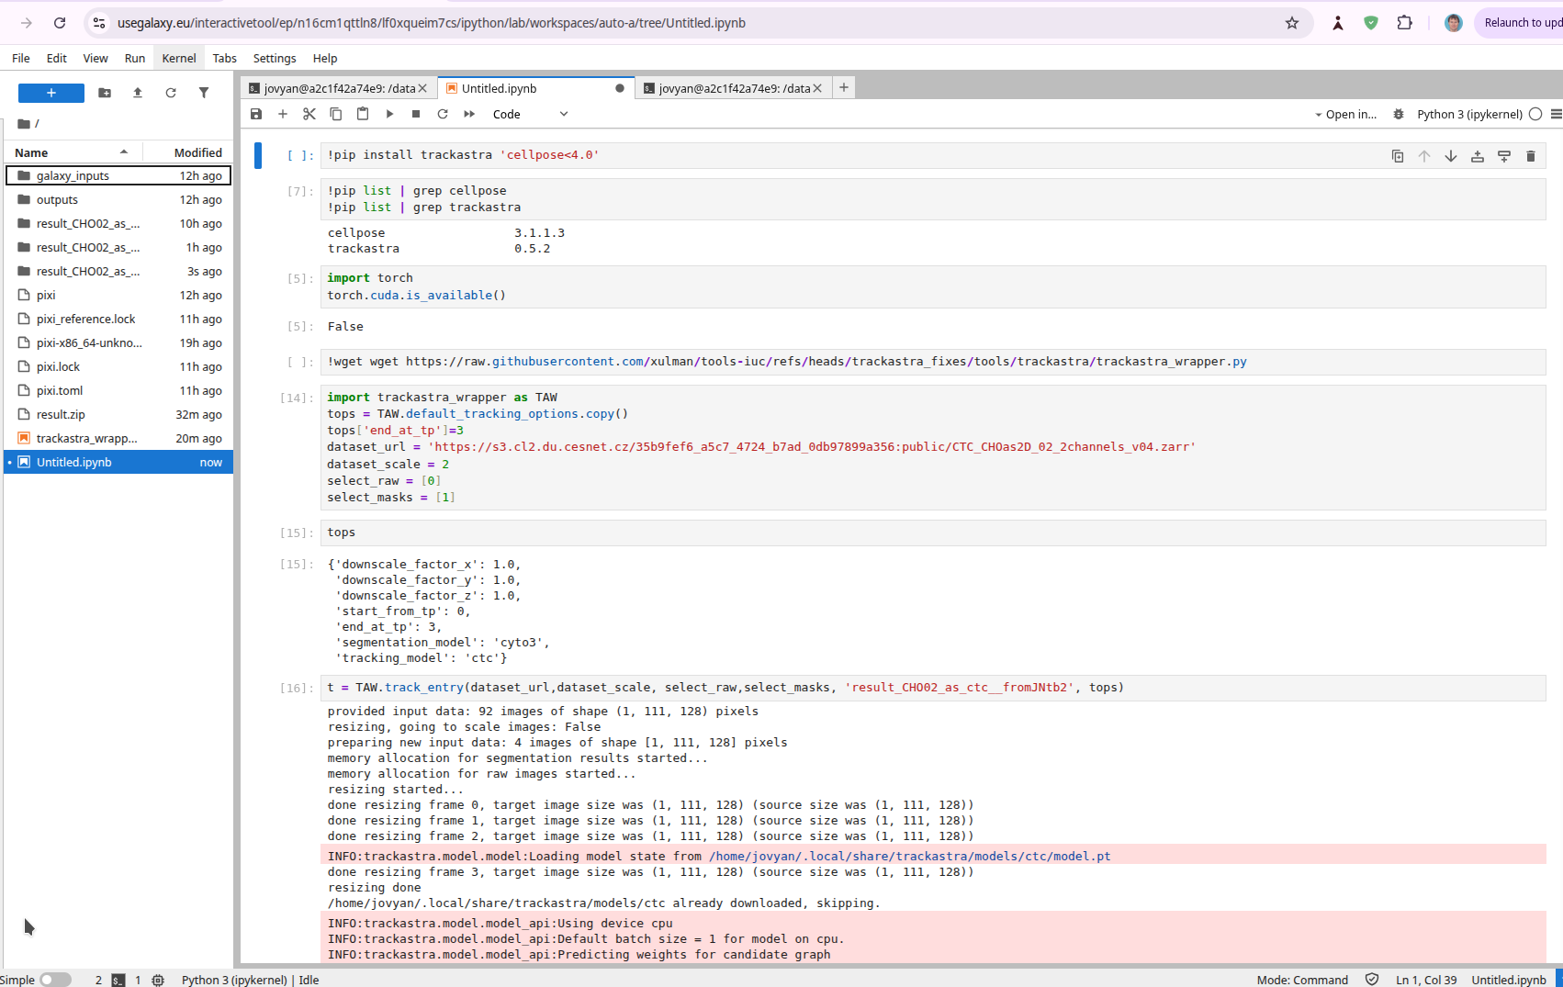
On Galaxy via Interactive Jupyter (Notebook)

Slide 12
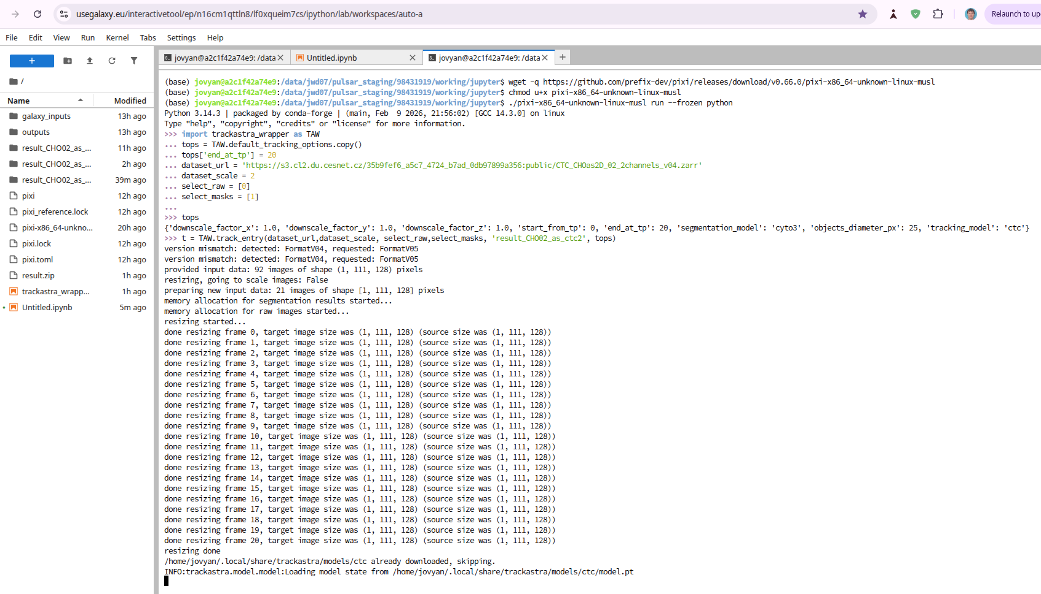
On Galaxy via Interactive Jupyter (Terminal)

Slide 13
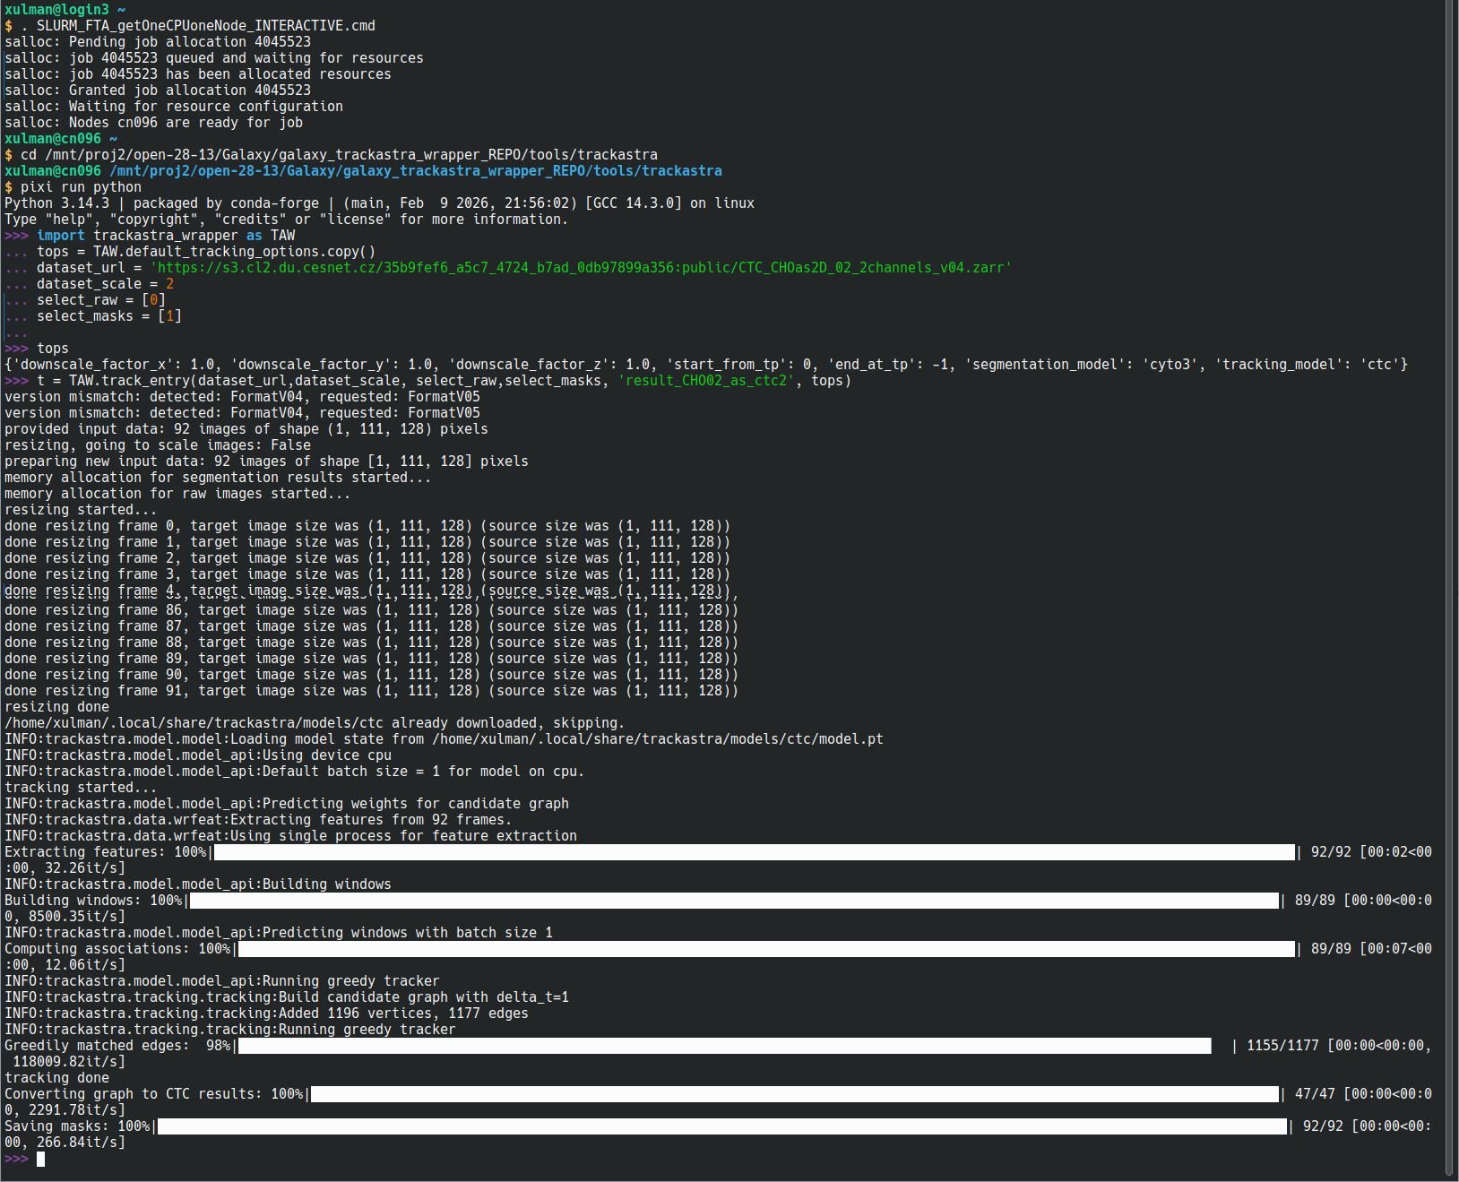
On Linux Terminal (of a Strong Workstation)

Slide 14
When tracking is done...
Napari available as interactive node on Galaxy
...I suggest to download and inspect locally
  Tracking data is (usually) not super large
  Desktop apps more powerfull than “in-browsering”
For Napari:
pip install napari pyqt napari-ome-zarr napari-ctc-opener
File → New img from clipboard
(Ctrl+N)
Console:
viewer.open('URL_to/dataset.zarr', plugin='napari-ome-zarr')
viewer.open('/path_to/result_as_ctc', plugin='napari-open-ctc')
For Fiji:
Enable update sites:
Mastodon (and/or Trackmate), CellTrackingChallenge
Mastodon launcher, OME-NGFF,
Create .mastodon project, Open it
Plugins → CTC → Import...
View → Coloring → By track

Slide 15
Free Demo Datasets
https://s3.cl2.du.cesnet.cz/35b9fef6_a5c7_4724_b7ad_0db97899a356:public/CTC_CHOas2D_01_2channels_v04.zarr
https://s3.cl2.du.cesnet.cz/35b9fef6_a5c7_4724_b7ad_0db97899a356:public/CTC_CHOas2D_02_2channels_v04.zarr
https://s3.cl2.du.cesnet.cz/35b9fef6_a5c7_4724_b7ad_0db97899a356:public/CTC_huh7_01_2channels_v04.zarr
https://s3.cl2.du.cesnet.cz/35b9fef6_a5c7_4724_b7ad_0db97899a356:public/CTC_huh7_02_2channels_v04.zarr
https://s3.cl2.du.cesnet.cz/35b9fef6_a5c7_4724_b7ad_0db97899a356:public/CTC_trif_01_cropped_2channels_v04.zarr
https://s3.cl2.du.cesnet.cz/35b9fef6_a5c7_4724_b7ad_0db97899a356:public/CTC_trif_02_cropped_2channels_v04.zarr

