Slide 1
Sequence assembly
Jose Blanca
COMAV institute
bioinf.comav.upv.es

Slide 2
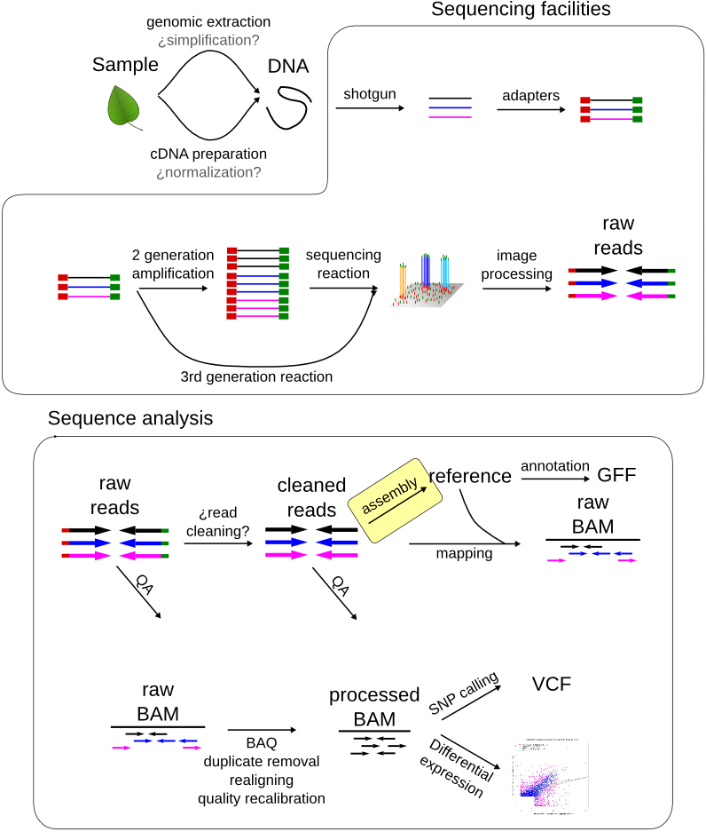

Slide 3
Assembly project
Unknown sequence
{
read 1
read 4
experimental
evidence
read 2
read 5
read 3
read 6
read 7
result

Slide 4
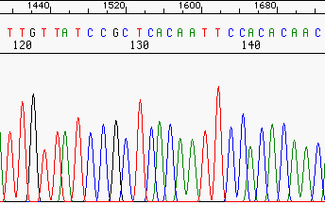
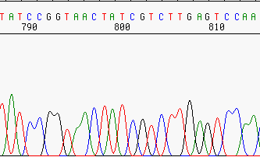
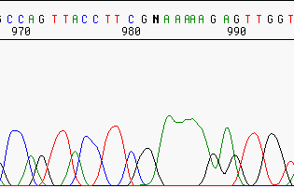
Read cleaning
    Some assemblers choke with: bad quality stretches, adapters, low complexity regions, contamination.
Bad quality
vector
Unknown sequence
Trim
Trim or mask

Slide 5
The repeat assembly problem
    Only one read is usually not capable of producing the complete sequence.
    Even if the problem sequence is short one read might have sequencing errors.
repeats
Unknown sequence
Reads
Contigs / scaffolds
Reasons for the gaps
contig5 (repeat)
contig1
contig2
contig3
contig4
Repeated region
no coverage

Slide 6
The repetitive problem is unsurmontable
repeat
copy1
repeat
copy2

Slide 7
Long reads

Slide 8
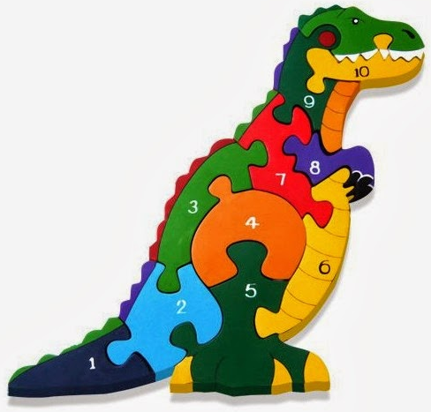

Read size influence
In the ideal case each piece would be a chromosome or a transcript

Slide 9
Mate pairs and paired-ends
    Read length is critical, but constrained by sequencing technology, we can sequence molecule ends.
    Useful for dealing with repetitive genomic DNA and with complex transcriptome structure.
    Paired-ends: Illumina can sequence from both ends of the molecules. (150-500 bp)
    Mate-pairs: Can be generated from libraries with different lengths (2-20 Kb).
    BAC-ends: Usually sequenced with Sanger.
Clone (template)
reads

Slide 10
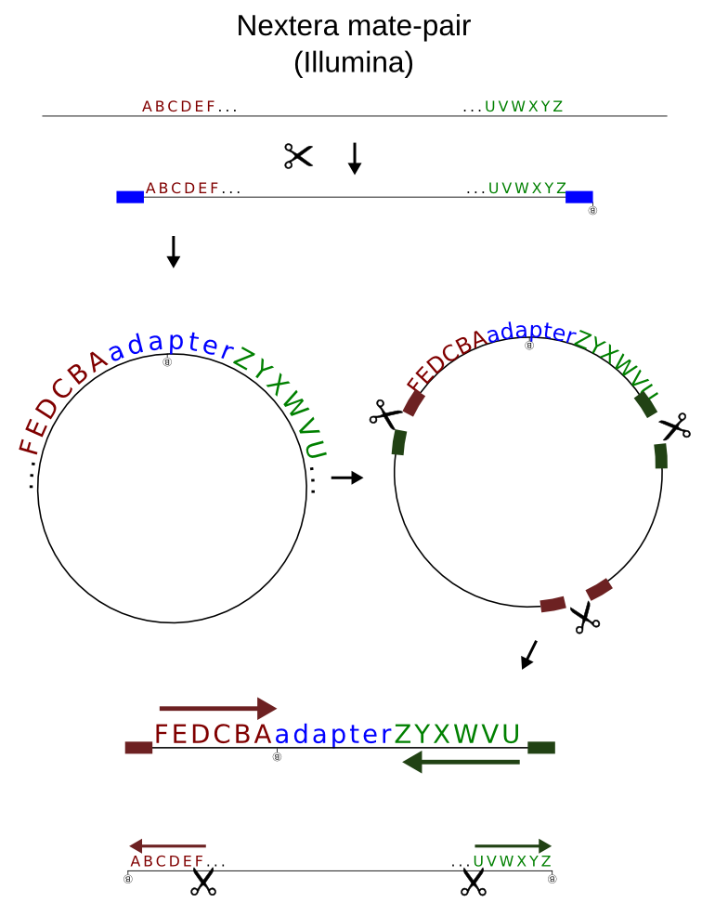
Mate-pairs
Notes:
Data Processing of Nextera Mate Pair Reads
on Illumina Sequencing Platforms

Slide 11
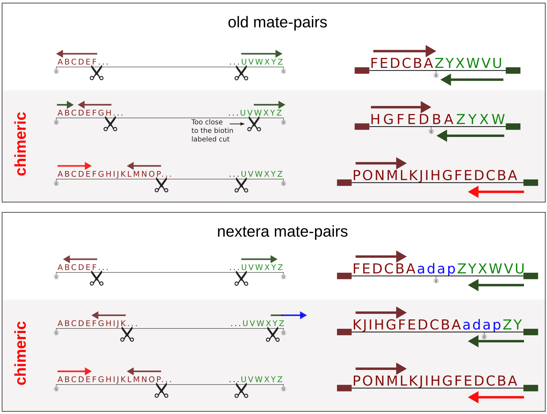
Illumina mate-pair chimeras

Slide 12
Long reads
    Pacbio:
      Standard
      HiFi
    Nanopore:
      Long
      Ultralong

Slide 13
Library types
    Single reads
    Illumina Pair Ends (150-500 pb)
    Mate Pairs (2-10 kb)
      Illumina

Slide 14
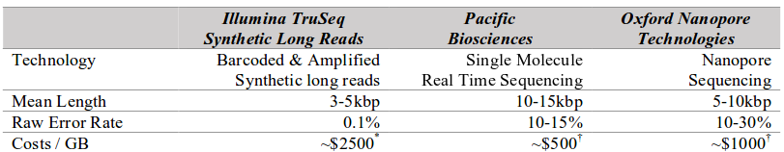
Long reads
Third-generation sequencing and the future of genomics. Lee et al.

Slide 15
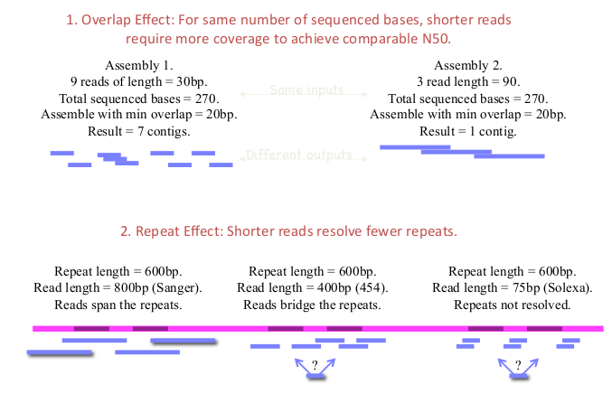
Short reads are harder to assemble
Taken from Jason Miller

Slide 16
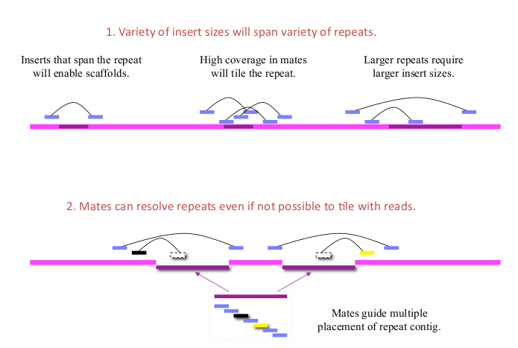
The need for paired reads
Taken from Jason Miller

Slide 17
Algorithm I
Overlap – Layout - Consensus

Slide 18
Overlap – Layout - Consensus
    Algorithm:
      Overlap: All-against-all, pair-wise read comparison.
      Layout: construction of an overlap graph with approximate read layout.
clean reads
Overlaps detection
All vs all alignment
1
2
3
4
1
2
3
4
Reads graph

Slide 19
Overlap – Layout - Consensus
    Algorithm:
      All-against-all, pair-wise read comparison.
      Construction of an overlap graph with approximate read layout.
      Consensus: Multiple sequence alignment (MSA) determines the consensus sequence.
clean reads
Overlaps detection
All vs all alignment
MSA
1
2
3
4
1
2
3
4
Reads graph
Consensus

Slide 20
Overlap assumption
    We are assuming:
      1) Two reads originated from the same region will overlap
      2) Two reads that overlap come from the same region
1
2

Slide 21
Overlap problems
    Two reads are similar if they have a good overlap.
    We assume that overlap implies common origin in the genome.
    This goodness depends on the overlap quality and similarity.
    But several things might go wrong
Vector contamination or repetitive
repetitive
Too many sequencing errors
false positive
Chimeric clone
false negative
Short overlap

Slide 22
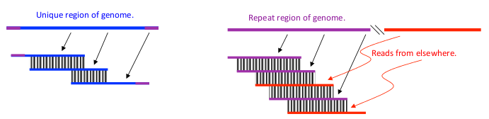
Overlap problems
    False positives will be induced by chance and repeats
    Avoid false positives with stringent criteria:
      Overlaps must be long enough
      Sequence similarity must be high (identity threshold)
      Overlaps must reach the ends of both reads
      Ignore high-frequency overlaps (repetitive regions in genomic?)
    But stringency will induce false negatives.

Slide 23
Assembly terminology
Consensus
Scaffolds = Contigs + Parings
(gap lengths derived from pairings)
Contigs = Reads + Overlaps
Overlaps
Reads & Pairing
ACTGATTAGCTGACGNNNNNNNNNNTCGTATCTAGCATT
Taken from Jason Miller

Slide 24
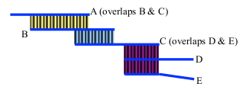
Contigs
    Contigs:
      High-confidence overlaps
      Maximal contigs with no contradiction (or almost no contradiction) in the data
      Ungapped
      Contigs capture the unique stretches of the genome.
      Usually where unitigs end, repeats begin
Contig example. The ideal Contig is A, B, C.
C, D and E have a repetitive sequence.

Slide 25
Scaffolds
    Build with mate pairs
      Mate pairs help resolve ambiguity in overlap patterns
    Scaffolds
      Every contig is a scaffold
      Every scaffold contains one or more contigs
      Scaffolds can contain sequence gaps of any size (including negative)

Slide 26
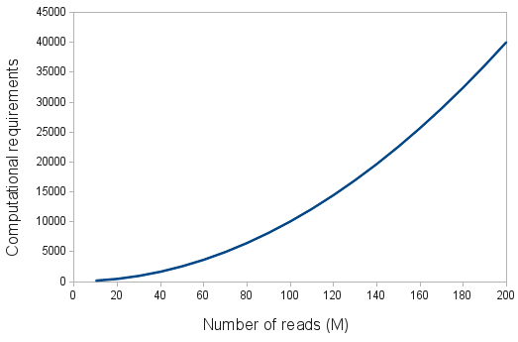
Overlap-Consensus-Layout limitation
    30 Million 5Kb (long) reads
    Number of alignments: 30 M reads x 30 M reads = 900 trillion alignments (It does not scale!!)
    Main requirements:
    Memory.
    Time.
    The kmer-based assemblers requirements depend on the genome complexity and not so much on the reads.

Slide 27
Algorithm II kmer-based

Slide 28
K-mer based assembly
Seq ACTGGTCAT
K-mers 5pb ACTGG
CTGGT
TGGTC
GGTCA
GTCAT

Slide 29
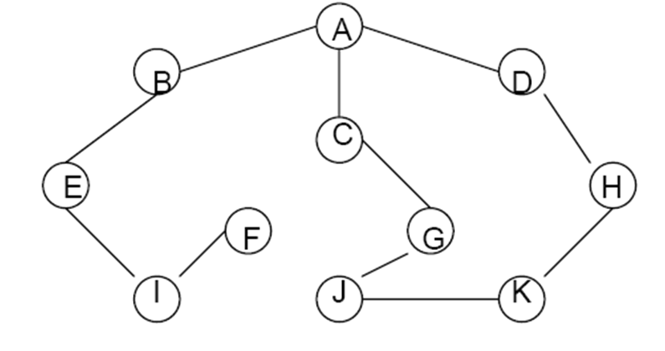
K-mer based assembly
    K-mer graphs are de Bruijn graphs.
nodes
edges

Slide 30
K-mer based assembly
    K-mer graphs are de Bruijn graph.
    Nodes represent all K-mers.
    Edges join consecutive K-mers.
    Assembly is reduced to a graph reduction problem.
Read 1 AACCGG
Read 2 CCGGTT
Graph: AACC -> ACCG -> CCGG -> CGGT -> GGTT
K-mer length = 4

Slide 31
K-mer based assembly
    K-mer graphs derived from reads and genome is very similar
    From the graph we can recreate the genome sequence
    K-mer graph size depends, mostly on genome size, not on number of reads
    Reads are only read once to prepare the kmer graph
Read 1 AACCGG
Read 2 CCGGTT
Graph: AACC -> ACCG -> CCGG -> CGGT -> GGTT
Genome: AACCGGTT

Slide 32
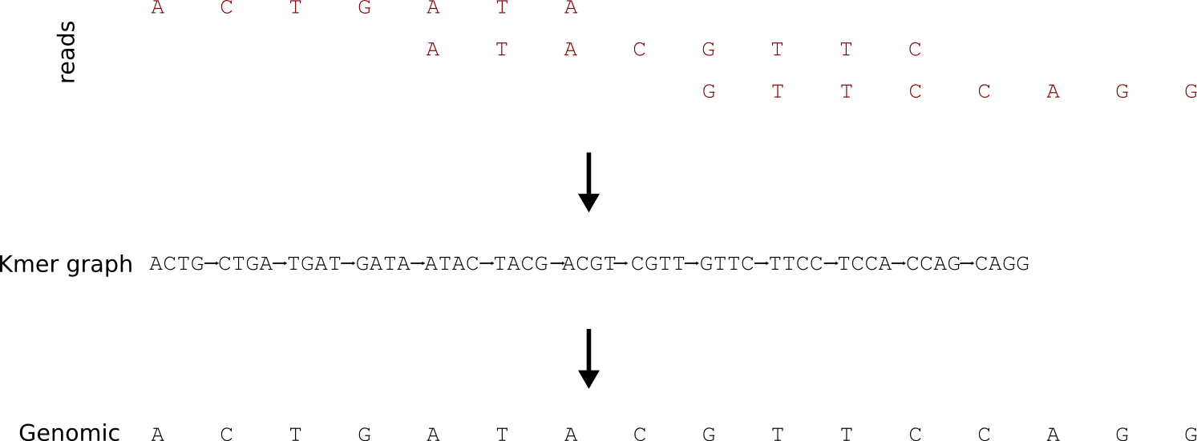
K-mer based assembly
Notes:
if we sequence billions of short reads uniformly representing the entire genome and construct a giant de Bruijn graph from those short reads, that de Bruijn graph will look identical to the de Bruijn graph of the genome. Therefore, our challenge will be to go back to the genome sequence from its de Bruijn graph.

Slide 33
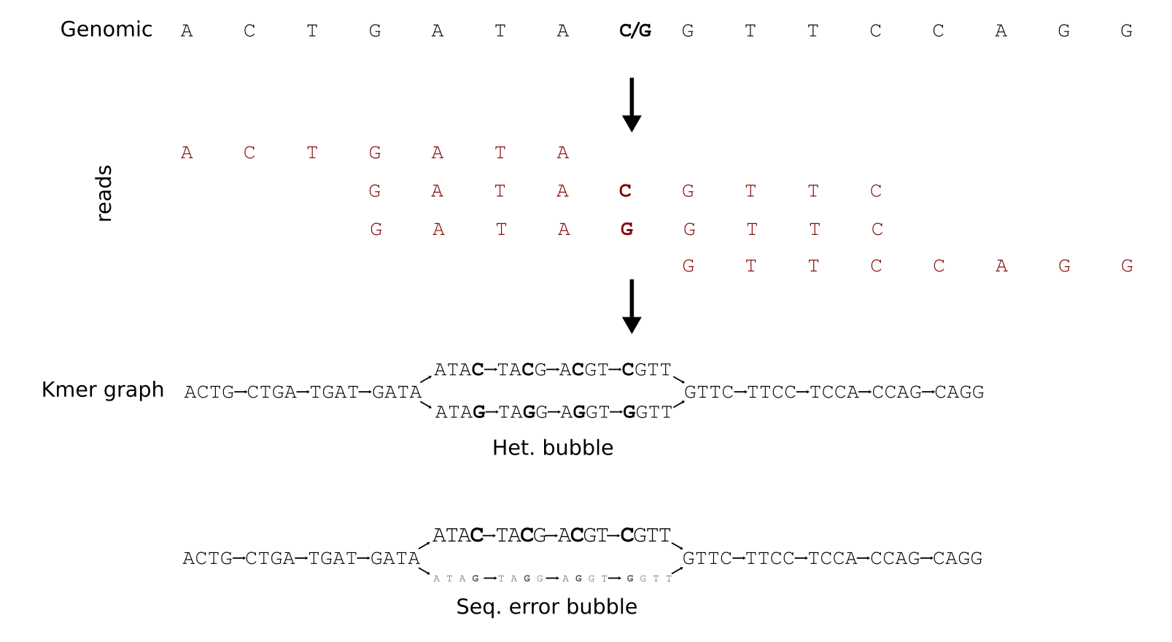
K-mer bubbles
Notes:
if some K-mers have low occurrence, they likely originate from sequencing errors.

Slide 34
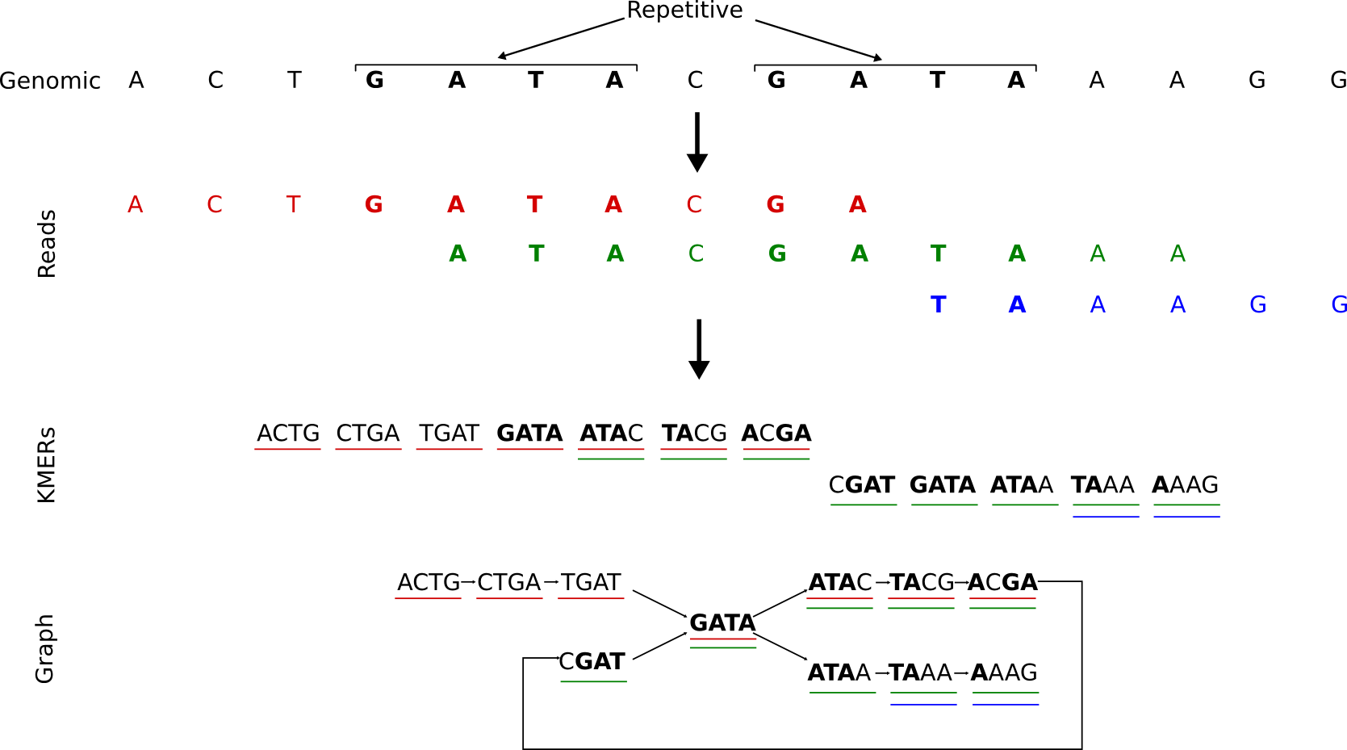
K-mer repetitive
Notes:
If almost all nodes of the de Bruijn graph are visited by 50 short reads, but a small subset of nodes visited by 200 short reads, one can argue that the underlying sequence near those subset of nodes constitute repetitive regions of the genome, and they are present 4 times in the genome. So, instead of avoiding repeats, as done by traditional assemblers, de Bruijn graphs allow one to estimate the repeat frequencies of repetitive regions during assembly.

Slide 35
Graph problems
    Repeats, sequencing errors and polymorphisms increase graph complexity, leading to tangles difficult to resolve
    K-mer graphs are more sensitive to repeats and sequencing errors than overlap based methods.
    Optimal graph reductions algorithms are NP-hard, so assemblers use heuristic algorithms
Polymorphism
Sequencing error
Repeat

Slide 36
Quality Assessment

Slide 37
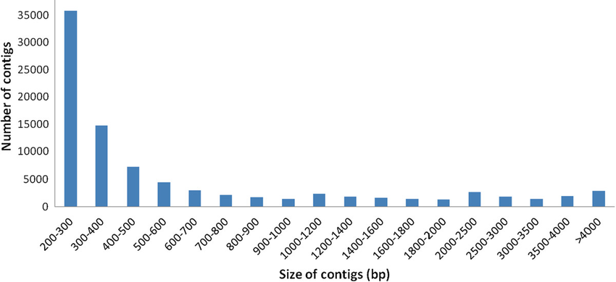
N50
    N50 is defined as the contig length such that using equal or longer contigs produces half the bases of the assembly.
      NG50: 50% of the genome (if available)
    The N50 statistic is a measure of the average length of a set of sequences, with greater weight given to longer sequences.
    It is widely used in genome assembly
N50
Taken from Wikipedia

Slide 38
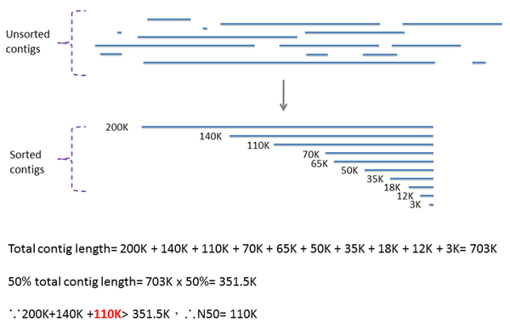
N50

Slide 39
N50
short N50
Long N50

Slide 40
N50 for scaffolds and contigs
Long
Scaffold
N50
Short
Contig
N50
short
Scaffold
N50
Long
Contig
N50

Slide 41
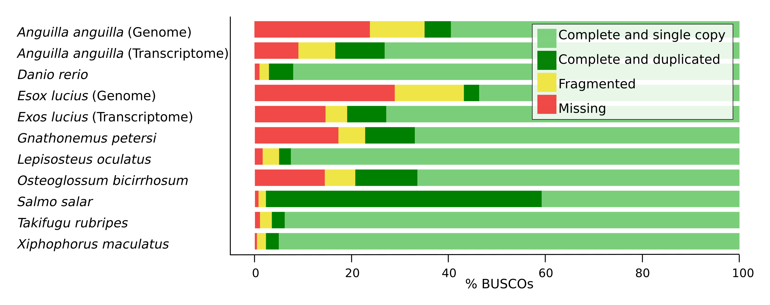
BUSCO orthologs
    http://busco.ezlab.org/

Slide 42

Mapping reads against the assembly
    Reads used to create the assembly
    Other reads from the same species
    Percentage of reads mapped
      Most reads should properly map
Taken from REAPR paper: https://doi.org/10.1186/gb-2013-14-5-r47

Slide 43
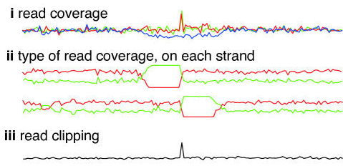
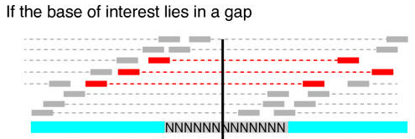
Mapping reads against the assembly
    Properly paired
    Orphaned
    Reads only
    partially aligned
    REAPR corrected N50
Taken from REAPR paper: https://doi.org/10.1186/gb-2013-14-5-r47

Slide 44
Main assembly hurdles
    Main Problems:
      Short, inaccurate sequence reads
      genomic repeats
        Difficulty of the assembly depends a lot on the genome: easy for bacteria, very difficult for long highly repetitive polyploids
    Main solutions:
      Long reads
      Low sequencing error rates:
        Simplify graph problem
        Complex graphs typically yield worse assemblies
        Allow to differentiate between repeats

Slide 45
Common assembly errors
    Collapsed repeats
      Align reads from distinct (polymorphic) repeat copies
      Fewer repeats in assembly than in genome
      Fewer tandem repeat copies in assembly than genome
    Missed joins
      Missed overlaps due to sequencing error
      Contradictory evidence from overlaps
      Contradictory or insufficient evidence from pairs
    Chimera
      Enter repeat at copy 1 but exit repeat at copy 2
      Assembly joins unrelated sequences

Slide 46
Ingredients for Good Assembly
  Coverage and read length
      20X for (corrected) PacBio, 150X for Illumina
Paired reads
      Read lengths long enough to place uniquely
      Inserts longer than long repeats
      Pair density sufficient to traverse repeat clusters
      Tight insert size variance
      Diversity of insert sizes
  Read Quality:
      Sequencing errors
      No vector contamination
      Contamination: mitochondrial or chloroplastic
  The requirements depend greatly on the quality: it is not the same a draft that high quality genome.

Slide 47
Common assemblers
    Genomic
      SOAPdenovo, Illumina
      Canu: Pacbio and Illumina
    Staden for Sanger reads.
    Transcriptomic assemblers are specialized software

Slide 48
Assembly comparison
    Empirical evaluation of methods for de novo genome assembly
      https://peerj.com/articles/cs-636/
    The best assemblers and parameters depend a lot on the genome and on the information available
    Arabidopsis thaliana:
      SOAPdenovo2 produces much larger contigs than any other assembler
      it has many assembly errors
      SPAdes appeared to be preferable
    Bacillus cereus
      SOAPdenovo2 has the fewest contigs, as well as a low N50 value
      its error rate was among the best
    Human genome
      HiFiasm outperformed other assemblers
      problems with mismatches and misassemblies.
    Flye has consistently demonstrated superior output based on contig size, with the trade-off between scale and error rate. Hinge and Canu, though they demonstrate more errors than Flye, both performed reasonably well too.

Slide 49
K-mer analysis

Slide 50
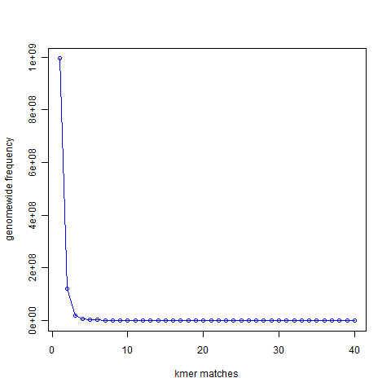
K-mer analysis
    21-mer distribution of sea urchin (Strongylocentrotus purpuratus) genome (900 Mbase long)
unique
repetitive
Notes:
994,401,729 21-mers were present only once in the genome. That is the number you see for x=1 in the following graph. 122,161,264 21-mers were present twice (x=2). 20,077,544 21-mers were present thrice (x=3)

Slide 51
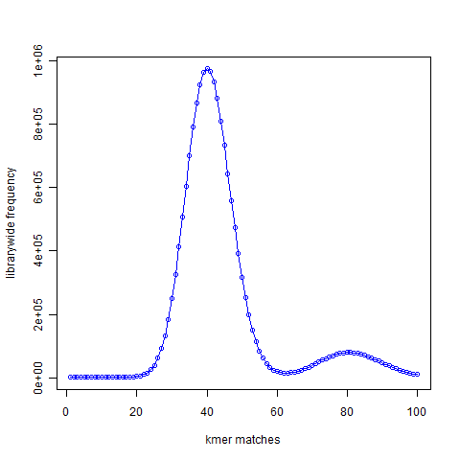
K-mer analysis
    K-mer distribution
    Simulated reads.
    40X coverage
    No errors
Genome
reads
unique
Repetitive (duplication)
Notes:
994,401,729 21-mers were present only once in the genome. That is the number you see for x=1 in the following graph. 122,161,264 21-mers were present twice (x=2). 20,077,544 21-mers were present thrice (x=3)

Slide 52
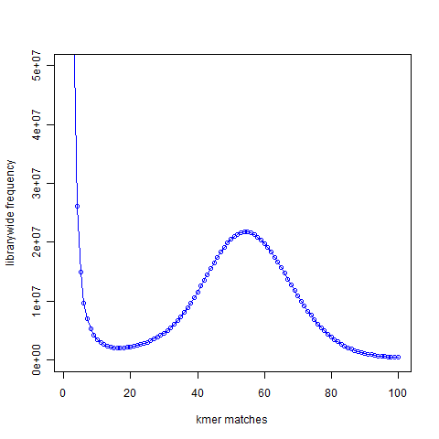
K-mer analysis
    K-mer distribution
    real reads.
    50X coverage
    With errors
Genome
Real reads (with errors)
noise
Simulated reads (no error)
signal
Notes:
Why is the noise peak so big? Think about this – every time a read has one nucleotide error, it can result in 21 erroneous 21-mers. Thus, when we look at the k-mer distribution of all reads, errors appear magnified k times. However, there is also memory cost to having those errors
a good strategy for cleaning data would be to reduce the noise peak as much as possible. When we trim 3′ edges, it makes sense to check what trimming is doing to the noise peak. If cutting one additional nucleotide does not reduce amount of noise, it is not helping the assembly. I think checking the k-mer distribution is a better measure than using the pre-assigned quality scores from the sequencer.

Slide 53
From scafflods to chromosomes

Slide 54
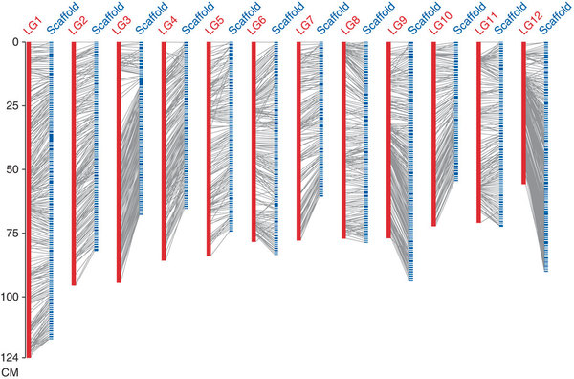
Genetic maps

Slide 55
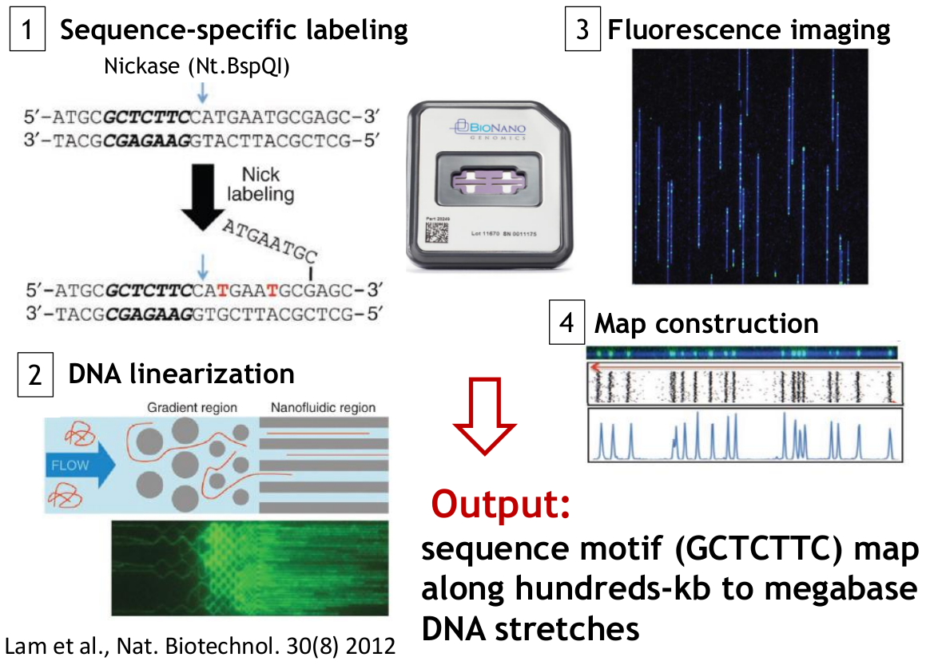
Bionano

Slide 56
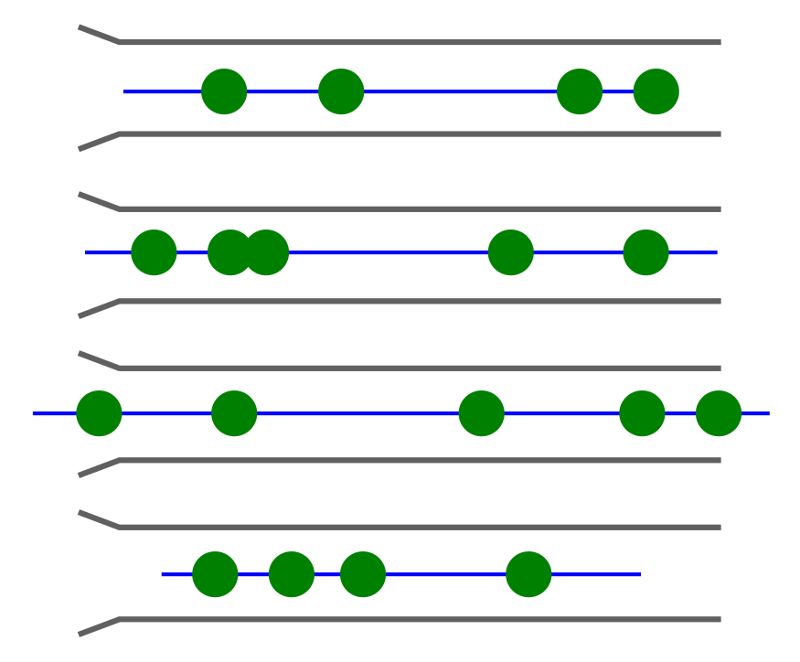
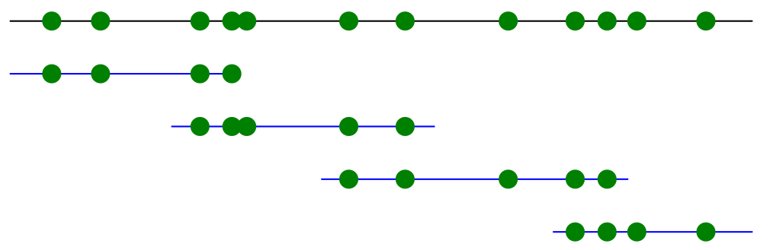
Bionano
Bionano helps you solve long range structures
(although not chromosome wide assemblies)
1
2

Slide 57
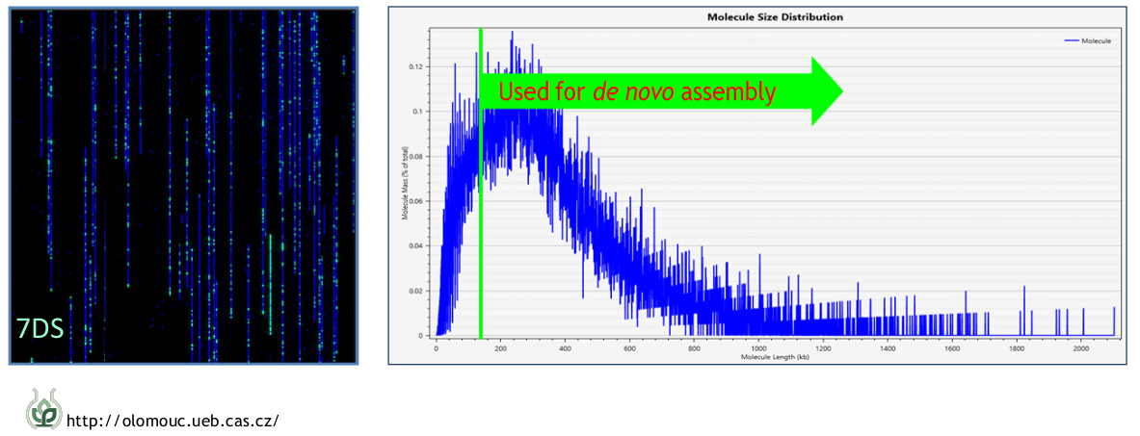
Bionano

Slide 58
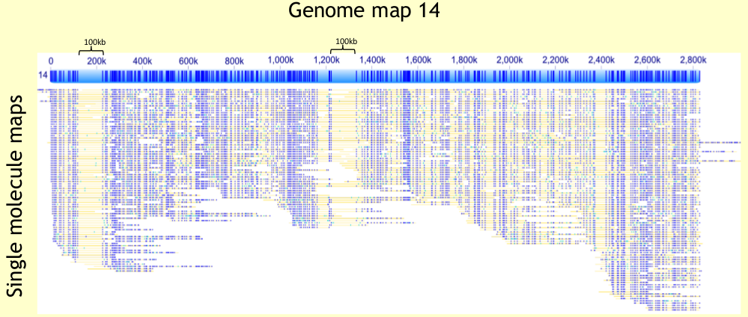
Bionano

Slide 59
10X linked reads
    Reads generated from the same long DNA sequence are tagged with the same index and sequenced using Illumina
    Reads with the same index convey medium range information (Up to 100Kb)

Slide 60
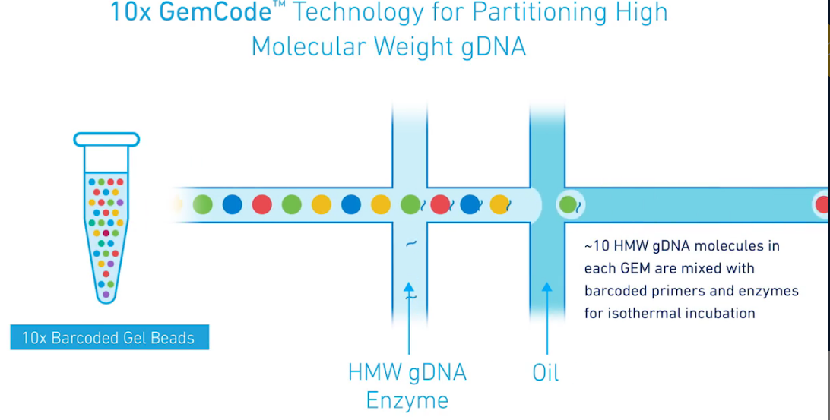
10X GemCode

Slide 61
10X linked reads assembly

Slide 62
10x possible uses
    De novo genome assembly
    Haplotype phasing
    Structural Variants:
      Linked read sequencing resolves complex genomic rearrangements in gastric cancer metastases (https://doi.org/10.1186/s13073-017-0447-8)
      Integrative analysis of genomic alterations in triple-negative breast cancer in association with homologous recombination deficiency. (DOI: 10.1371/journal.pgen.1006853)

Slide 63
Tomato assembly example
 | PacBio | 10X | PacBio-Bionano | 10X-Bionano
N75 | 1.789.934 | 813.655 | 16.105.568 | 6.758.801
L75 | 141 | 288 | 18 | 40
N’s per 100 Kb | 0 | 6071 | 2325 | 14885
Cost | $$$ | $ | $$$$ | $$

Slide 64
Pacbio HiFi vs Nanopore ultralong
    Comparison of the two up-to-date sequencing technologies for genome assembly: HiFi reads of Pacific Biosciences Sequel II system and ultralong reads of Oxford Nanopore
      https://doi.org/10.1093/gigascience/giaa123
    Comparison with rice genome
    ONT ultralong:
      92 Gb data (230×) with an N50 of 41,473 bp
      higher contiguity
        18 contigs of which 10 were assembled into a single chromosome compared to 394 contigs and 3 chromosome-level contigs for the PacBio assembly
        prevented assembly errors caused by long repetitive regions. PacBio assembly: over- or underestimation of the gene families
    Pacbio HiFi:
      20 Gb HiFi reads (50×) average length 13,363 bp
      fewer errors at the level of single nucleotides and small insertions and deletions

Slide 65
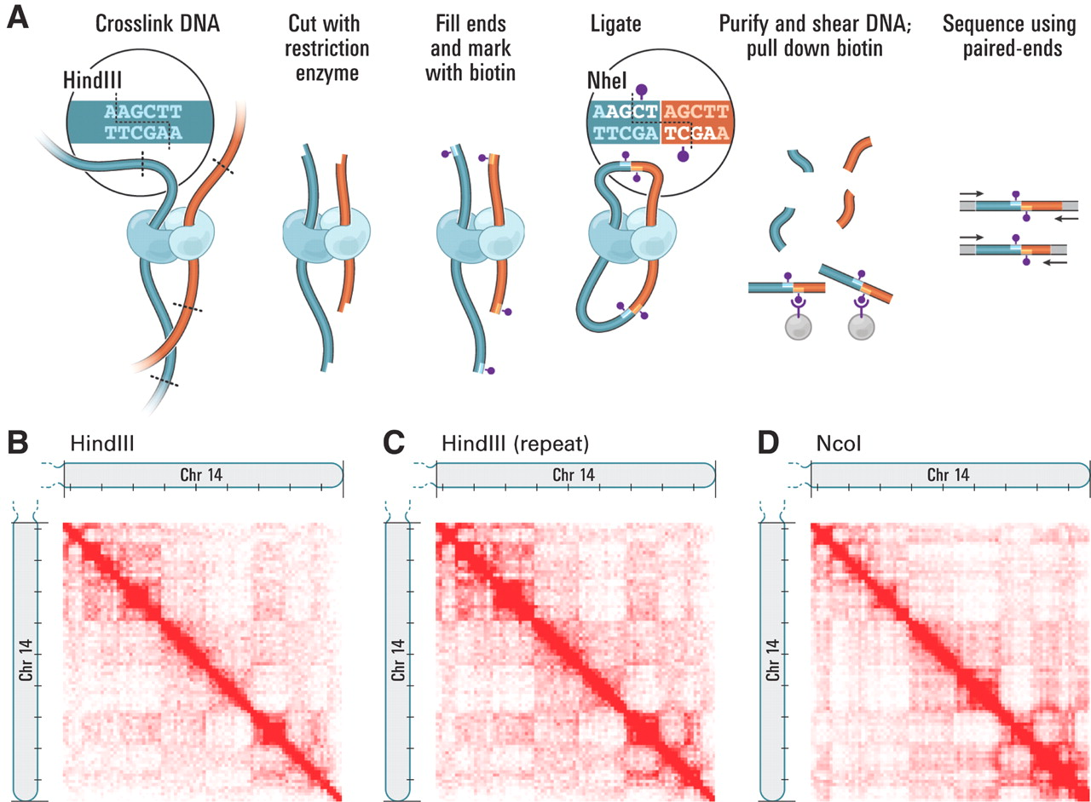
Hi-C
    Comprehensive Mapping of Long-Range Interactions Reveals Folding Principles of the Human Genome. (DOI: 10.1126/science.1181369)

Slide 66
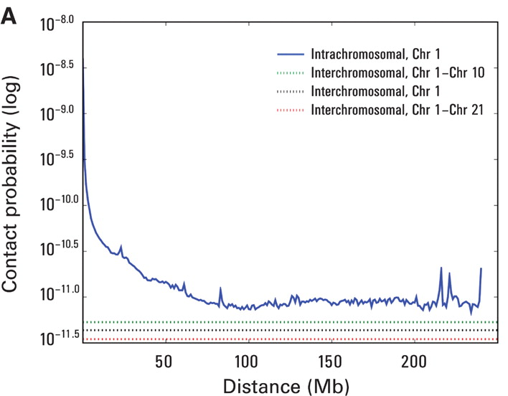
Hi-C

Slide 67
Hi-C Assembly
    De novo assembly of the Aedes aegypti genome using Hi-C yields chromosome-length scaffolds. (DOI: 10.1126/science.aal3327)
    Hi-C data provide links across a variety of length scales
    Unlike mate-pair and pair-end reads Hi-C contact spans an unknown length and may connect loci on different chromosomes
    Human genome assembly:
      Pair-end Illumina reads (67X coverage)
      Hi-C data (6.7 coverage)
      23 scaffold that span the 99.5% of the 23 human chromosomes
      Errors remain in the ordering of short distances than could be fixed by mate-pairs, long reads or bionano

Slide 68
Haplotypes

Slide 69
The haplotype problem
Haplotype 1
A
C
reads
A
G
T
C
Haplotype 2
T
G

Slide 70
The haplotype problem
Haplotype 1
A
C
reads
Standard assembly
A
G
T
C
Haplotype 2
T
C
T
G

Slide 71
The haplotype problem
Ideal assembly
Haplotype 1
A
A
C
C
Haplotype 2
T
G
T
G

Slide 72
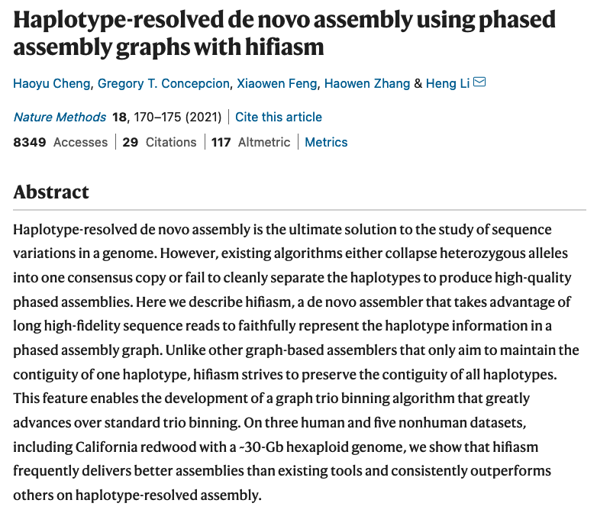
Source of info 1: Good quality long reads
A
C
T
G

Slide 73
Long distance haplotype info
    10X
    Hi-C
    Single strand seq

Slide 74
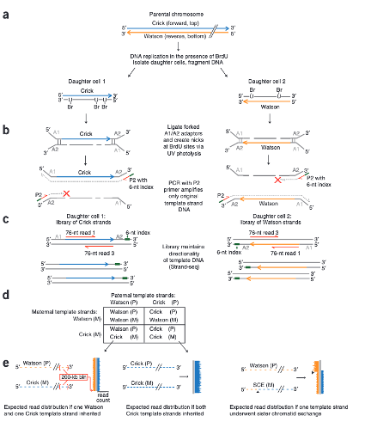
Single strand seq
    short-read, single-cell sequencing method
    tymidine analog (BrdU) to selectively label and remove one of the DNA strands
    References:
      Fully phased human genome assembly without parental data using single-cell strand sequencing and long reads
      Single-cell template strand sequencing by Strand-seq enables the characterization of individual homologs

Slide 75
Long distance haplotype info: parental trio

Slide 76
Haplotype assembly with hifiasm
    Additional short read data:
      Hi-C pair ends or Strand-seq
        improves contiguity and phasing accuracy
      Parental trios
        Improves phasing accuracy
        Advisable specially for high heterozygosity
    Hifiasm does not perform scaffolding for now
    Checked with human and California redwood with a ~30-Gb hexaploid genome
    Similar to HiCanu
    Haplotype-resolved de novo assembly using phased assembly graphs with hifiasm. Nat Methods, 18:170-175. https://doi.org/10.1038/s41592-020-01056-5

Slide 77
  This work is licensed under the Creative Commons Attribution 3.0 Unported License. To view a copy of this license, visit http://creativecommons.org/licenses/by/3.0/ or send a letter to Creative Commons, 171 Second Street, Suite 300, San Francisco, California, 94105, USA.
Jose Blanca
COMAV institute
bioinf.comav.upv.es

