Slide 1
Sequencing technologies
Jose Blanca
COMAV institute
bioinf.comav.upv.es

Slide 2
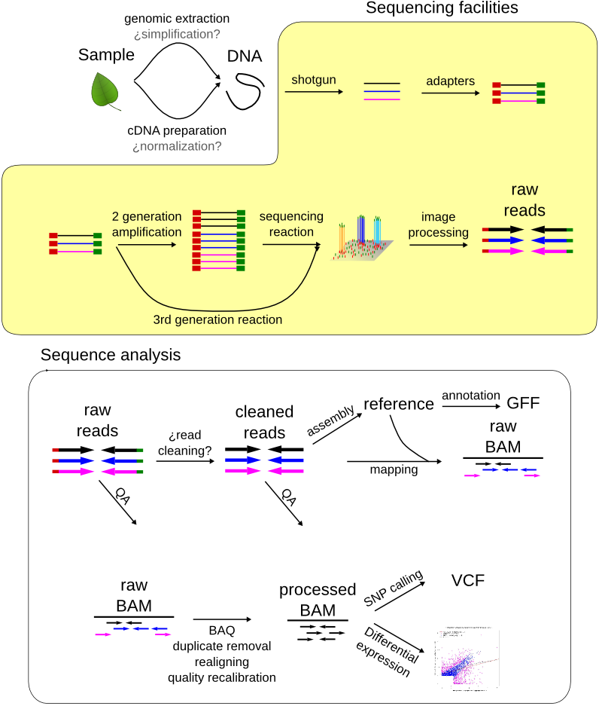

Slide 3
Outline
    Sequencing technologies:
      Sanger
      2nd generation sequencing:
        454
        Illumina
        SOLiD
        Ion Torrent
      3er generation sequencing:
        PacBio
        Nanopore
      General considerations
    Reducing the complexity

Slide 4
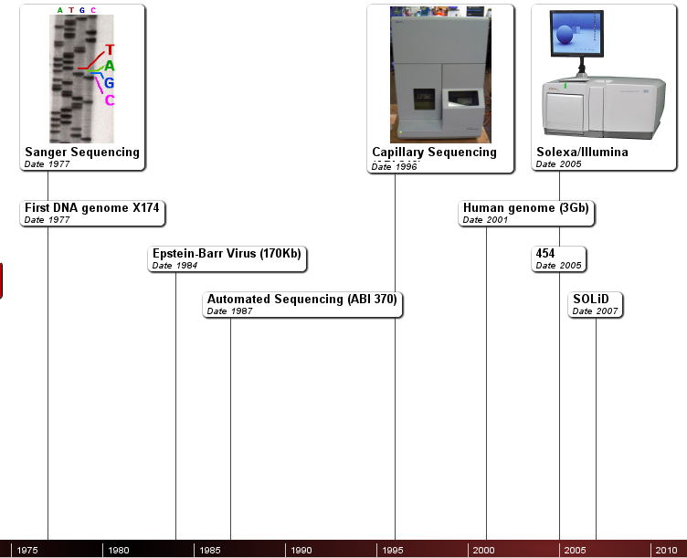

Slide 5
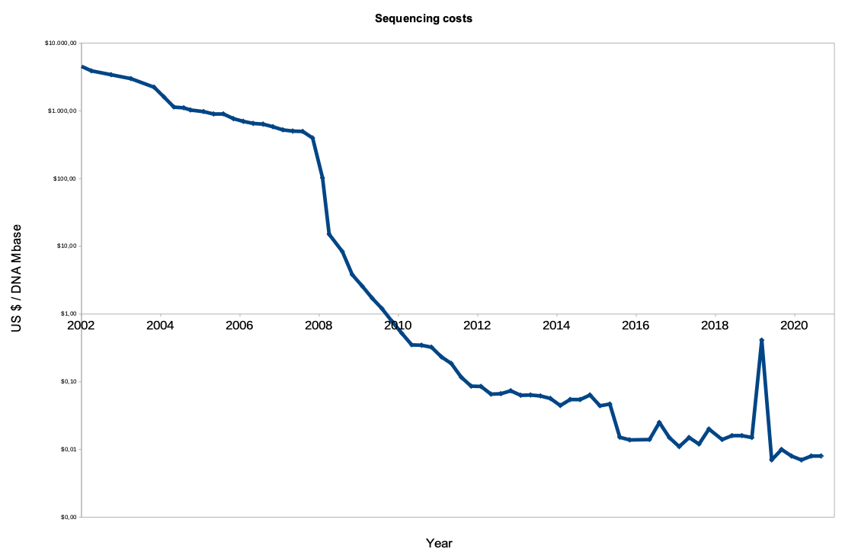
genome.gov/sequencingcosts
3000M$
Public US project
1000$

Slide 6
Sanger sequencing

Slide 7
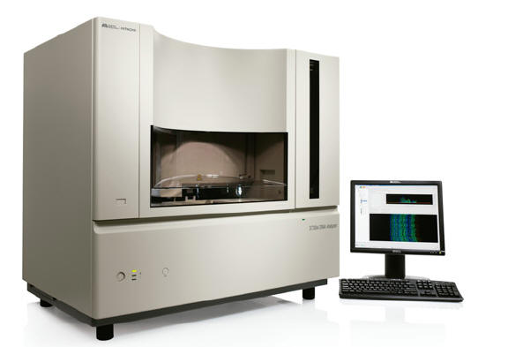
Sanger sequencing
    Traditional DNA sequencing method
    Ideal for small sequencing projects
    Read length around 600-800 bp
    Around 5-10$ per reaction
    384 reactions in parallel at most
    Applied Biosystems is the main technological provider

Slide 8
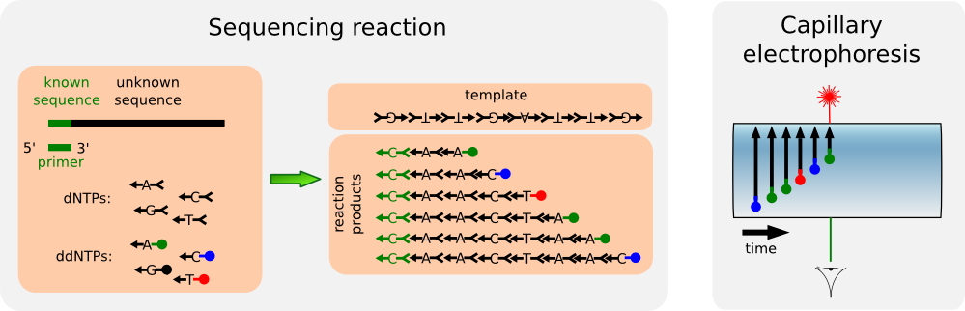
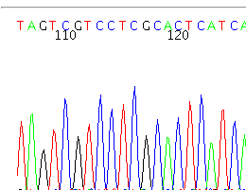
Sanger sequencing

Slide 9
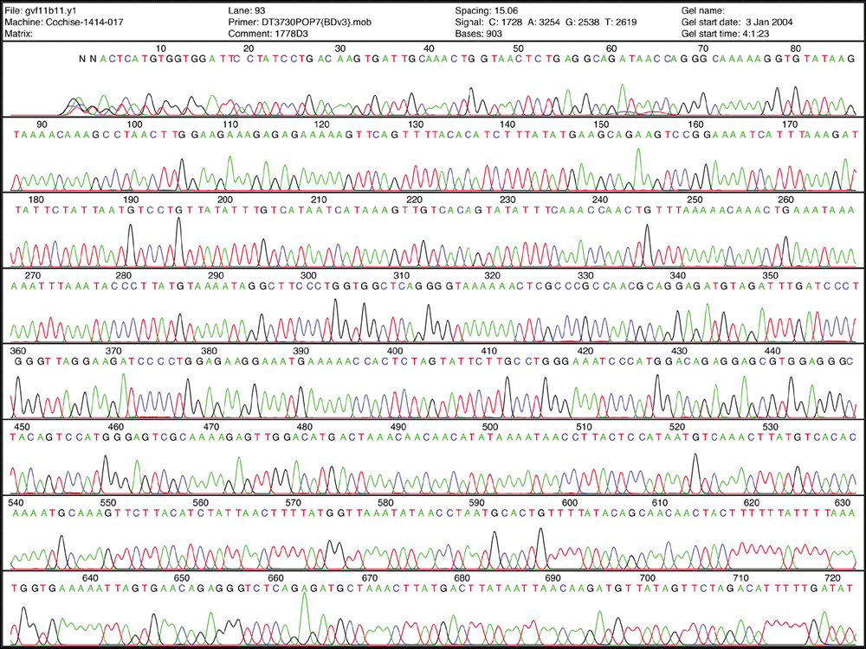
Sanger sequencing

Slide 10
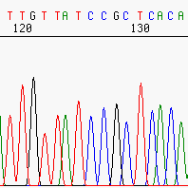
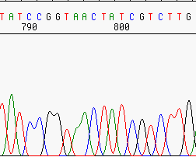
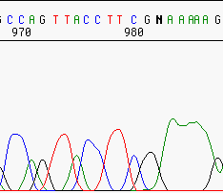
Sequence and quality
    Due to technical limitations different technologies have different errors patterns.

Slide 11
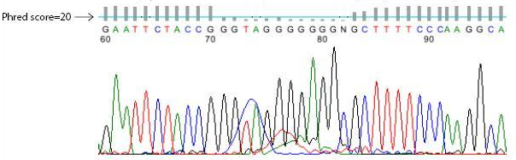
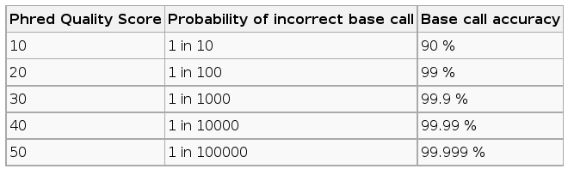
Sequence and quality
    Phred score = - 10 log (prob error)

Slide 12
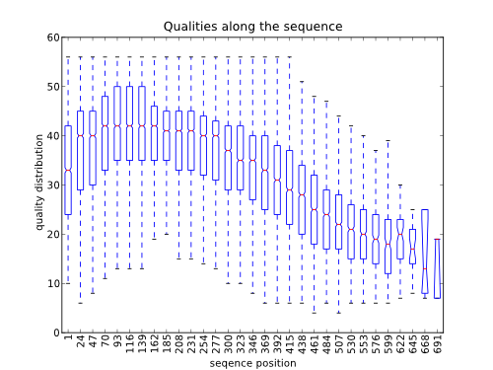
Sanger sequencing
    In Sanger quality is worst at the beginning and at the end.

Slide 13
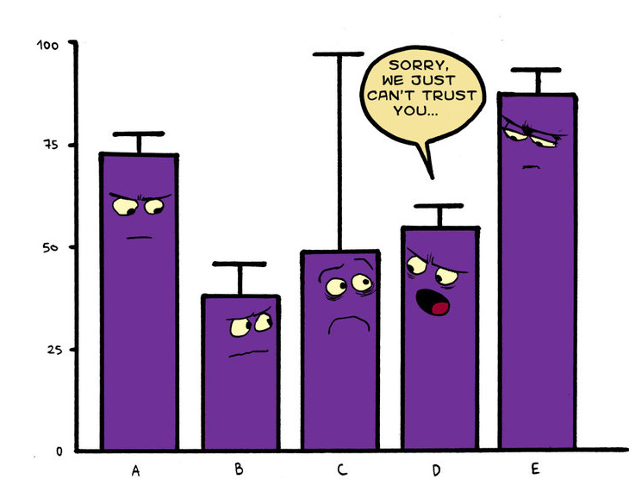
Any evidence has error bars
Any conclusion has error bars

Slide 14
Other sources of error
    Pre-sequencing:
      PCR mutation-like errors
      Polymerase slippage (low complexity regions)
      PCR primers (e.g. hexamers in random priming)
      Cloning artifacts, chimeric molecules
      Sample contamination
      Index/flag assignment errors
    Post-sequencing:
      Assembly artifacts
      Alignment errors due to:
        Reference
        Alignment algorithms
      SNV calling software

Slide 15
2nd generation sequencing

Slide 16
Sanger vs NGS sequencing
 | Sanger | NGS
Num. sequences per reaction | 1 clone | Millions of molecules
Max. parallelization | 384 | Several millions
Sequence quality | High | Low
Sequence length | 600-800 bp | 35-20000 (depends on the platform)
Throughtput | Low | High

Slide 17
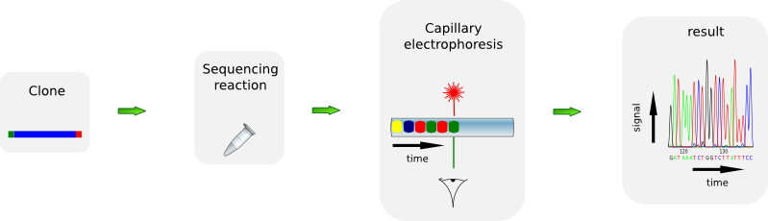
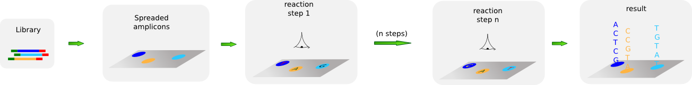
Sanger vs NGS

Slide 18
Library preparation
    Fragmentation
      Sonication
      Nebulization
      Shearing
    Size selection
    End repair
    Sequencing adaptor ligation
    Purification

Slide 19
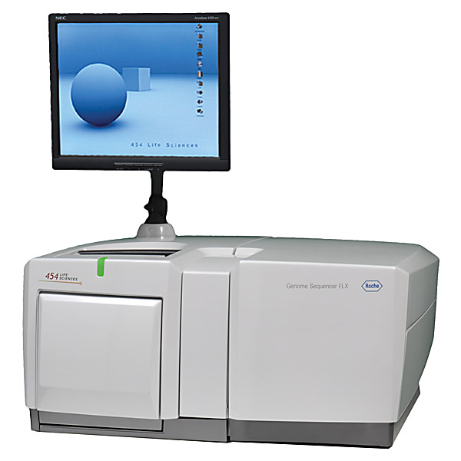
454
    First NGS platform (and first to be phased out)
    Pirosequencing based chemistry
    Long reads (400-700bp)
    Owned by Roche
    >1 million reads
    Obsolete

Slide 20
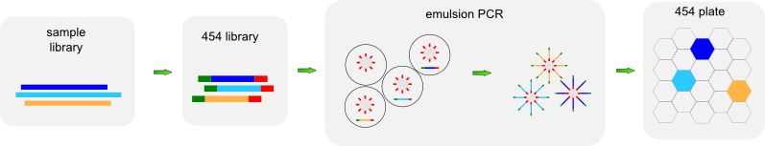
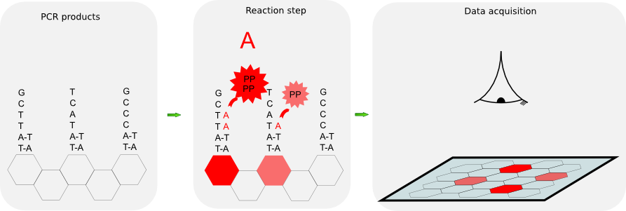
454

Slide 21
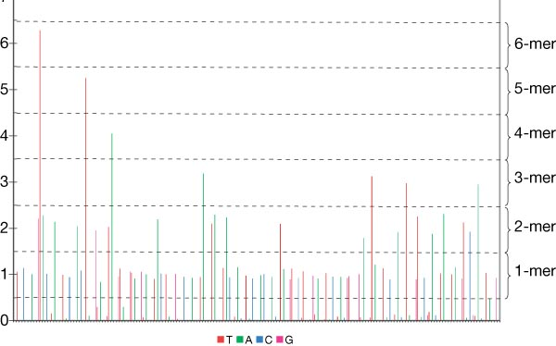
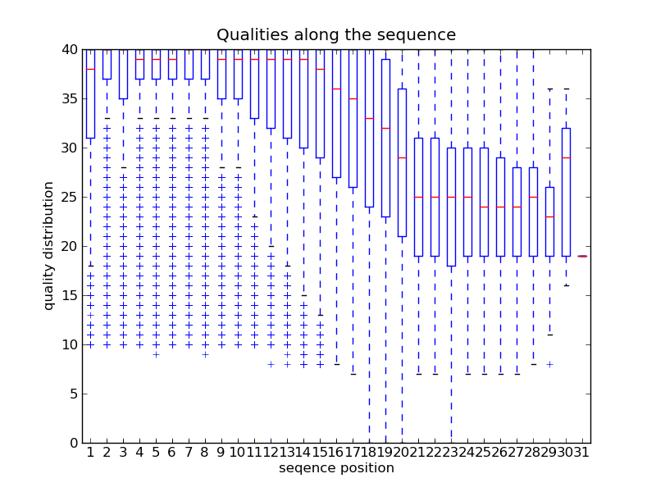
454 quality
    The lengthiest the homopolymer the less quality.
    It is very difficult to differentiate AAAAAA from AAAAA.
    Quality diminishes with the sequence length.

Slide 22
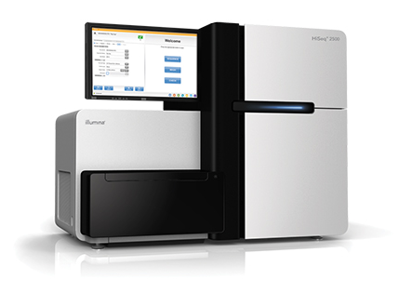
Illumina
    Previously known as Solexa
    Reversible terminators based sequencing technique
    Short reads (50 or 250bp depending on the version)
    Lowest cost per base
    Ideal for resequencing projects
    Highest throughput
    Runs divided in 8 lanes
    Up to 4000 million reads
    Can sequence both ends of the molecules (paired ends)

Slide 23
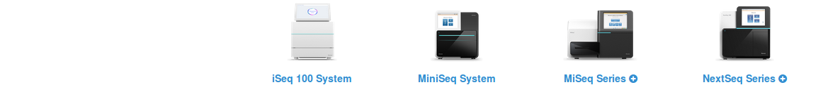
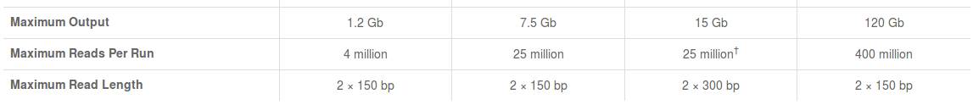
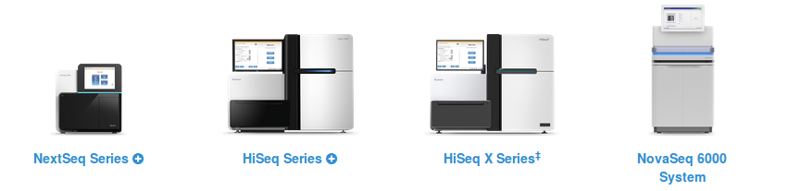
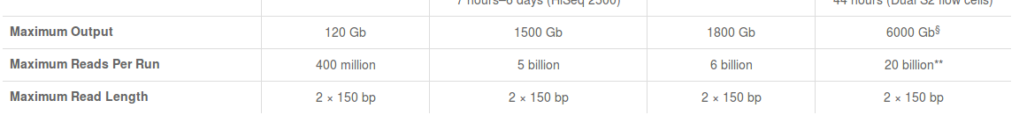
Illumina instruments

Slide 24
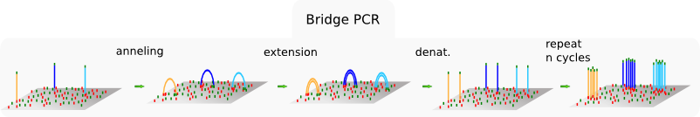
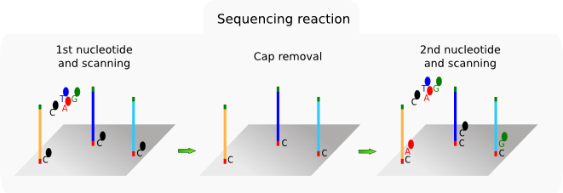
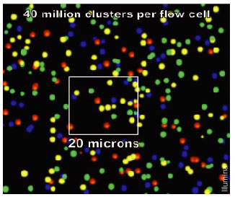
Illumina

Slide 25
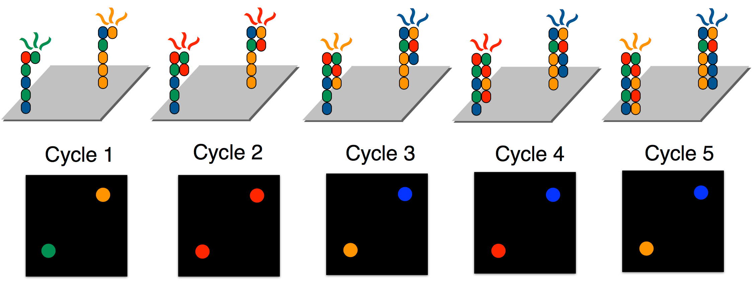
Illumina

Slide 26
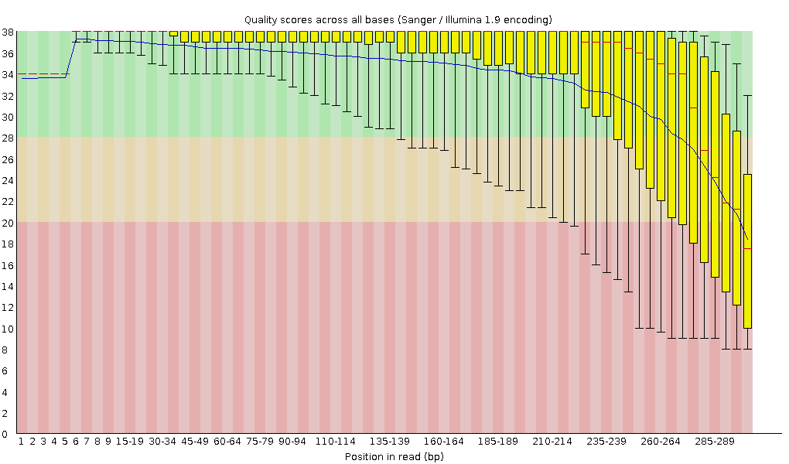
Illumina
    Quality diminishes with sequence length.
    No homopolymer problem, mainly substitution errors.

Slide 27
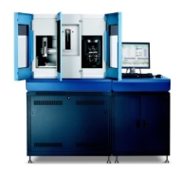
SOLiD
    Ligation based sequencing chemistry
    Short reads (35 - 75bp depending on the version)
    Only for resequencing projects
    It used to produce color sequences, not nucleotides
    Color sequences have poor quality, but nucleotide sequences have high quality
    115 or 320 million reads

Slide 28
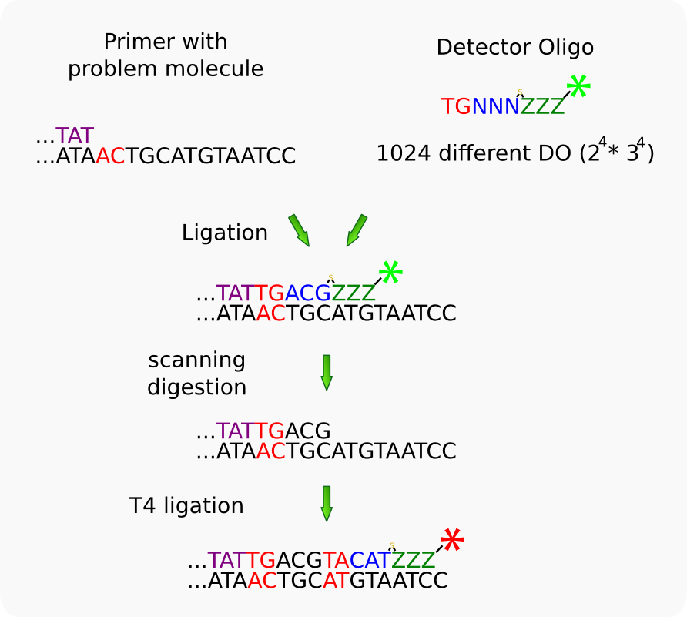
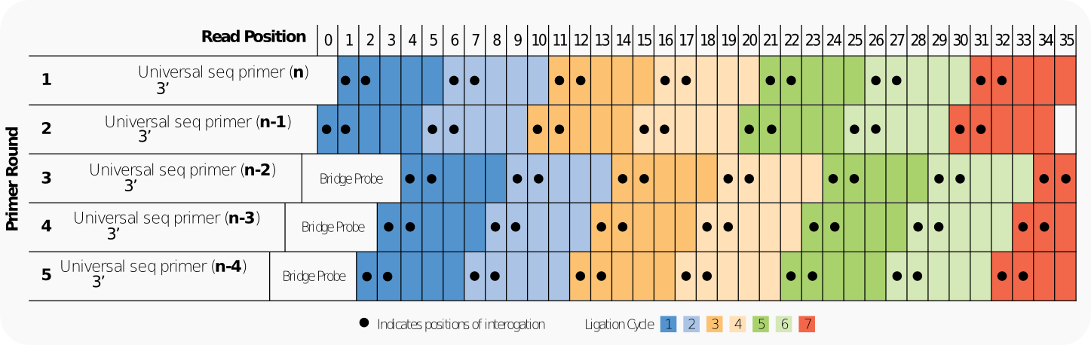
SOLiD

Slide 29
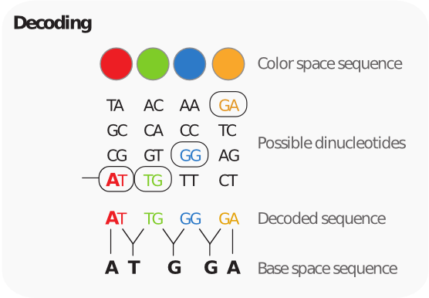
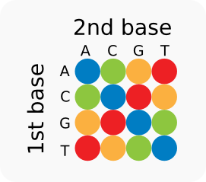
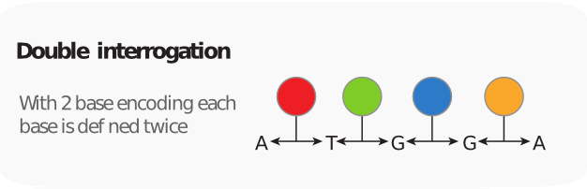
SOLiD
Really?

Slide 30
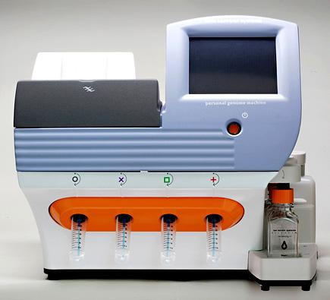
Ion Torrent
    Around 60-80 M reads.
    200 pb length.
    Sequences based on H+ production
    Error rates higher than other 2nd generation
    Error pattern similar to 454, with homopolymer problem.
    Belongs to Life technologies (Applied Biosystems)

Slide 31
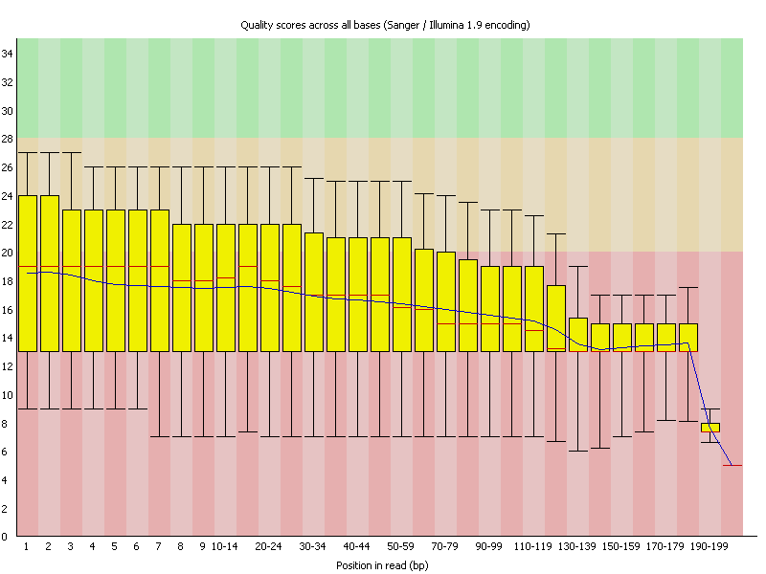
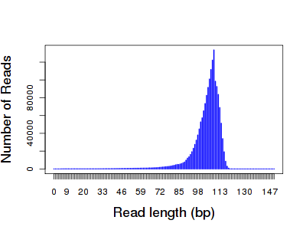
Ion Torrent

Slide 32
3rd generation sequencing

Slide 33
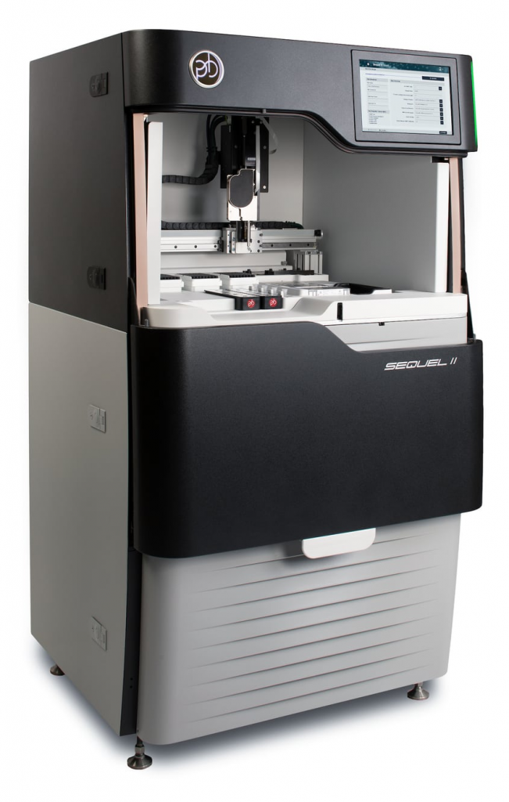
PacBio
    3rd generation platform (single molecule)
    Polymerase based chemistry (SMRT)
    Long reads (typically 5 to 60 kb)
    Very high error rate for the standard mode
      It has a HiFi platform with low error rate
    Ideal for de novo sequencing projects
    Not many reads

Slide 34
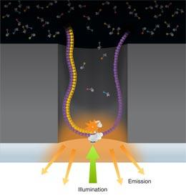
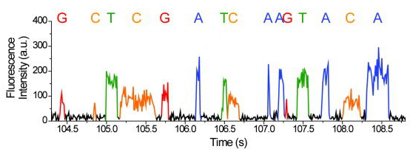
PacBio
    3rd generation, single molecule detection. No amplification step required.
    Nucleotides labeled on the phosphate removed during the polymerization.
    Sequencing based on the time required by the polymerase to incorporate a nucleotide (Polymerase requires milliseconds versus microseconds for the stochastic diffusion)

Slide 35
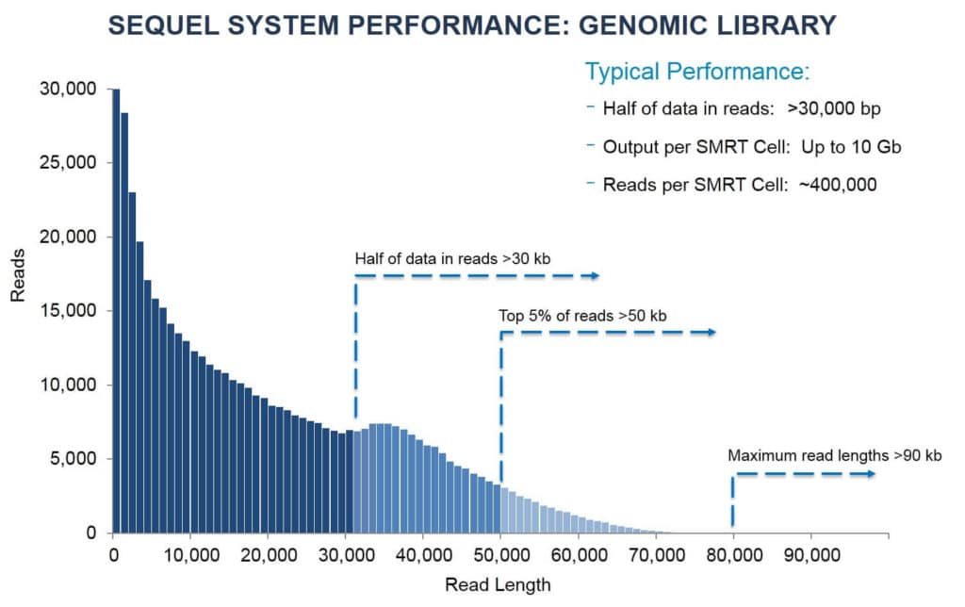
PacBio length distribution
Taken from pacbio

Slide 36
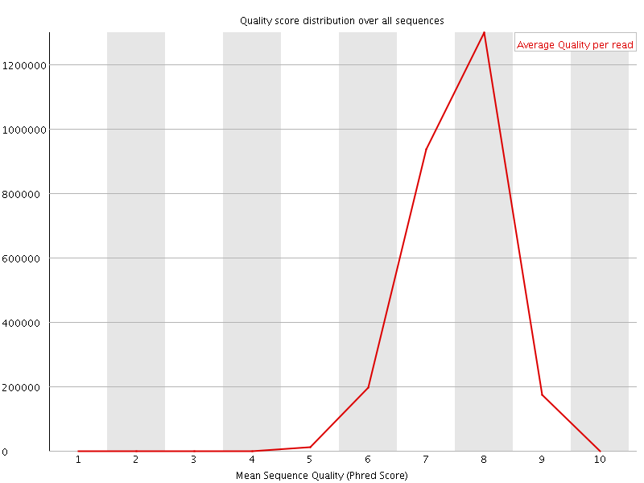
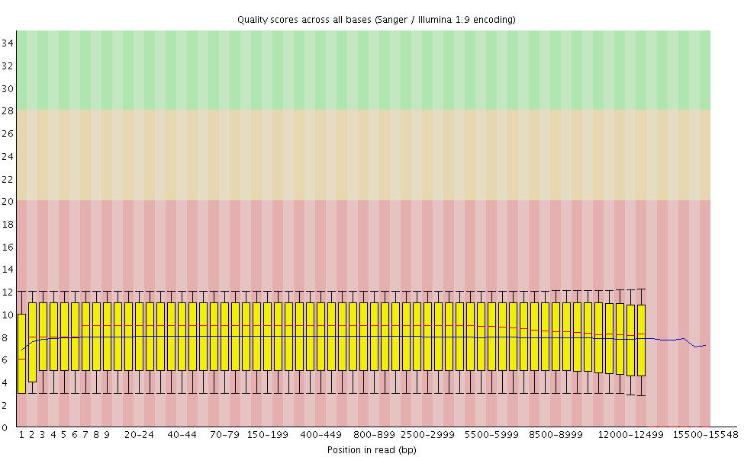
PacBio quality distribution
Distributions for standard sequencing.
85-90 % error rate
Taken from flxlexblog.wordpress.com

Slide 37
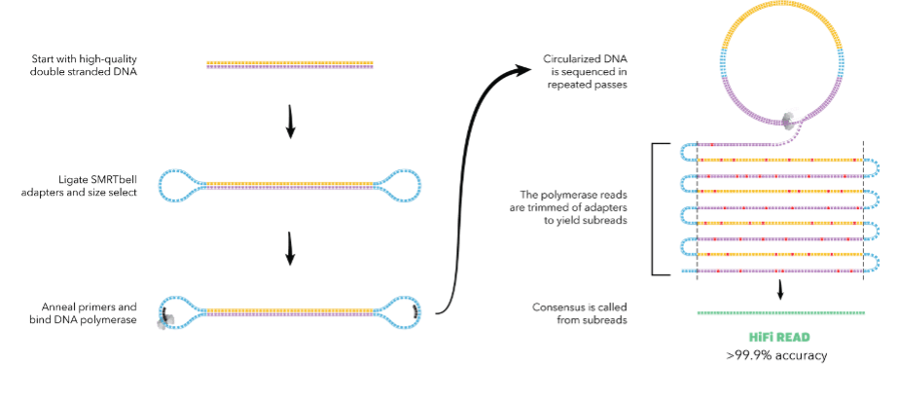
Pacbio High Fidelity (HiFi)
Circular consensus sequencing
https://www.nature.com/articles/s41587-019-0217-9
    Long reads and high quality: 99% error rate
    Compared with standard mode:
      smaller read lengths: 10-30 kb
      Lower yields

Slide 38
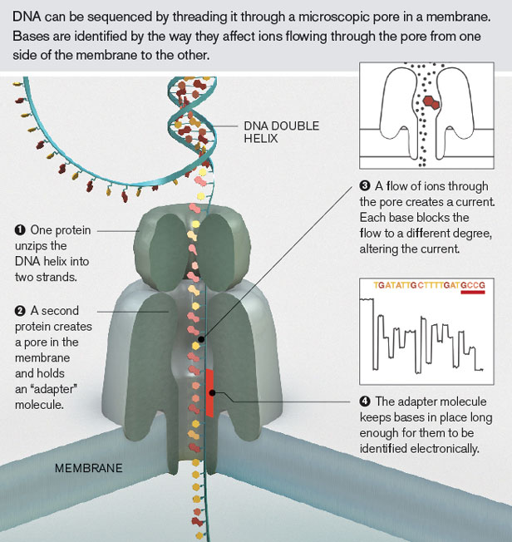
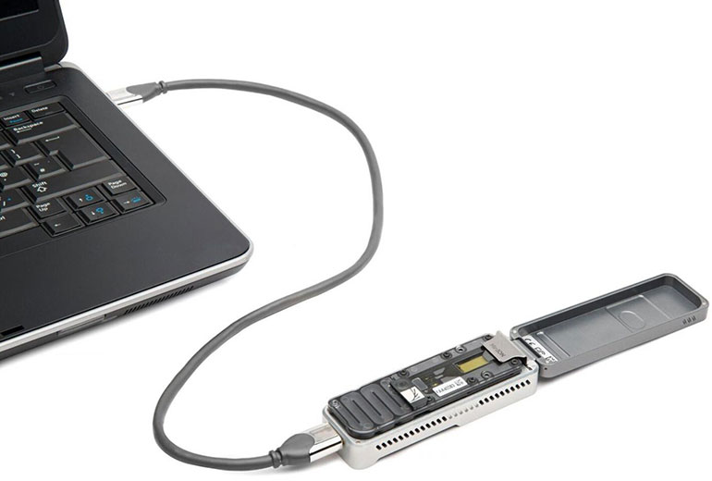
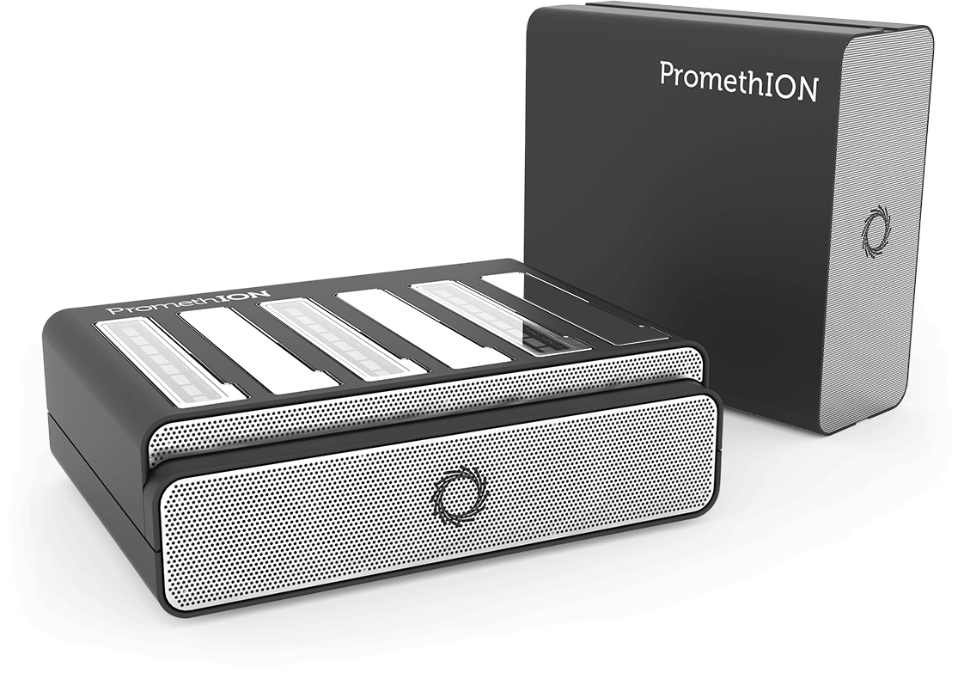
Nanopore
Senses differences in ion flow
miniION

Slide 39

Nanopore-first data
Not very reliable ¿yet?

Slide 40


Nanopore read length and quality
Reads are typically 10–100 kb in length and 87–98% accurate
Taken from nanopore
https://melbourne.figshare.com/articles/figure/Nanopore_read_length_distribution/12652034/2

Slide 41
Nanopore ultra long reads
    Typically longer than 100Kb
      Reads one order of magnitude longer than Pacbio reads
      Main limiting factor is DNA extraction
    Low accuracy: 87–98%
    Lower yield than standard nanopore reads

Slide 42

Nanopore alignments

Slide 43

Nanopore accuracy

Slide 44

Nanopore-Illumina hybrid error correction

Slide 45

Long NGS reads comparison

Slide 46


Slide 47


Slide 48

Bioinformatic challenges
    Huge data files handling.
    Beefy computers required.
    Software still being developed or missing.
    Ad-hoc software required during the analysis.
    Existing software tailored to experienced bioinformaticians.
    Dollar for dollar rule proposed
EDSAC by Computer Laboratory Cambridge

Slide 49


Bioinformatic challenges
Amount of data managed on a small transcriptome assembly

Slide 50


Slide 51
Reducing the complexity

Slide 52

Genome
    Pros:
      Finest resolution
      Reproducible
    Cons:
      Expensive ($600 per sample)
      Lots of information will be lost if no reference is available, especially in the repetitive regions.
Notes:
For most applications is an overkill. Too expensive and most of the information is not relevant. Most of the genome is gene poor and does not recombine.

Slide 53

RNASeq
    Pros:
      Cheaper than whole genome sequencing ($300)
      Well proven methodologies
      Reproducible
      Follows gene density
    Cons:
      RNA handling
      For many samples is pricier than GBS
      Follows gene density

Slide 54

Exome

Slide 55

Exome

Slide 56
Exome
    Pros:
      More complete representation than RNASeq
      More reproducible than RNASeq
    Cons:
      Exome capture platforms only available in model species
      Pricier than RNASeq

Slide 57
Sequence capture
    Targeted sequence capture as a powerful tool for evolutionary analysis
    Am. J. Bot doi: 10.3732/ajb.1100323
    Hibridization against designed probes
    From several targeted loci to over a million target regions
    It is expensive to design and create the probe set
    Costs per sample will depend on the number of probes

Slide 58


Genotyping by Sequencing (GBS)
doi: 10.1534/genetics.112.147710
GBS review: Nature Reviews Genetics 12, 499-510 (July 2011) | doi:10.1038/nrg3012

Slide 59


Genotyping by Sequencing (GBS)
    Pros:
      Cheap ($50 per sample)
      Lots of variation
    Cons:
      Prone to artifacts (e.g. false SNPs due to repetitive DNA) if no reference genome is available.
      Degree of coverage along the genome depends on the Restriction Enzyme chosen
      How reproducible is it?
      Patent trolls
GBS based SNPs in Soy
doi: 10.1534/genetics.112.147710

Slide 60

K-seq

Slide 61

El fracaso RAPD

Slide 62

Inestabilidad térmica de los cebadores cortos
Thermus aquaticus
Funciona entre 50-72ºC
Polimerasa Taq
CTAGCTAGCTGACGTAGCTGATGCTATCTAGCTACGTAGCTACTACGAGTCGATGCTAGTCATGTCGTA
||||||||
TAGCTACG

Slide 63

Klenow
E. coli
Funciona a 37ºC
Se destruye a 95ºC
Polimerasa klenow
CTAGCTAGCTGACGTAGCTGATGCTATCTAGCTACGTAGCTACTACGAGTCGATGCTAGTCATGTCGTA
||||||||
TAGCTACG

Slide 64
K-seq

Slide 65

GBS vs K-seq

Slide 66


Reproducibilidad
% SNPs genotipados en tres muestras independientes

Slide 67

Reproducibilidad
% SNPs con el mismo genotipo en las repeticiones de tres muestras

Slide 68



Funciona en especies cercanas con los mismos cebadores
Cebadores solanaceas: tomate, patata, pimiento, berenjena, petunia

Slide 69
Amplicons
    Pros:
      Cheap for few genes
      Amplicon sets can be ordered, but the design is expensive
    Cons:
      Not scalable for lots of genes
      Previous sequence information is required

Slide 70
  This work is licensed under the Creative Commons Attribution 3.0 Unported License. To view a copy of this license, visit http://creativecommons.org/licenses/by/3.0/ or send a letter to Creative Commons, 171 Second Street, Suite 300, San Francisco, California, 94105, USA.
Jose Blanca
COMAV institute
bioinf.comav.upv.es

