Slide 1
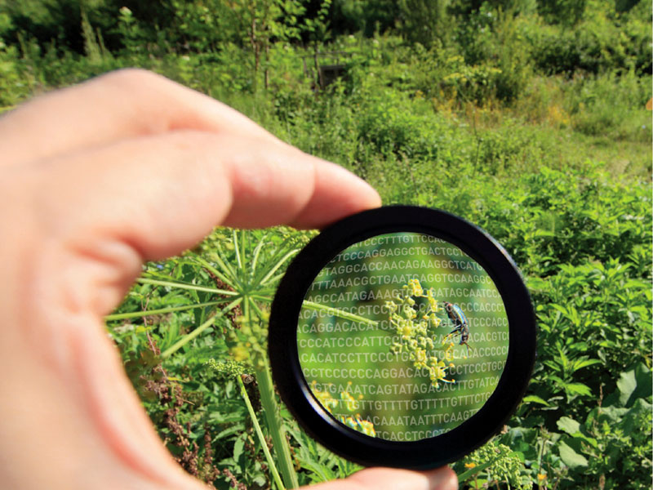
Bioinformatics

Slide 2


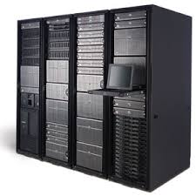
Some data
Lots of data
Huge amount
of data

Slide 3
Looking for a mutation in BRCA1
exon1
exon2
exon3
exon4
Reference sequence
Patient sequence

Slide 4

Search in database

Slide 5
Looking for a mutation in BRCA1
BRCA1 gene sequence (partial)
GTACCTTGATTTCGTATTCTGAGAGGCTGCTGCTTAGCGGTAGCCCCTTGGTTTCCGTGGCAACGGAAAA
GCGCGGGAATTACAGATAAATTAAAACTGCGACTGCGCGGCGTGAGCTCGCTGAGACTTCCTGGACGGGG
GACAGGCTGTGGGGTTTCTCAGATAACTGGGCCCCTGCGCTCAGGAGGCCTTCACCCTCTGCTCTGGGTA
AAGTTCATTGGAACAGAAAGAAATGGATTTATCTGCTCTTCGCGTTGAAGAAGTACAAAATGTCATTAAT
GCTATGCAGAAAATCTTAGAGTGTCCCATCTGTCTGGAGTTGATCAAGGAACCTGTCTCCACAAAGTGTG
ACCACATATTTTGCAAATTTTGCATGCTGAAACTTCTCAACCAGAAGAAAGGGCCTTCACAGTGTCCTTT
ATGTAAGAATGATATAACCAAAAGGAGCCTACAAGAAAGTACGAGATTTAGTCAACTTGTTGAAGAGCTA
TTGAAAATCATTTGTGCTTTTCAGCTTGACACAGGTTTGGAGTATGCAAACAGCTATAATTTTGCAAAAA
AGGAAAATAACTCTCCTGAACATCTAAAAGATGAAGTTTCTATCATCCAAAGTATGGGCTACAGAAACCG
TGCCAAAAGACTTCTACAGAGTGAACCCGAAAATCCTTCCTTGCAGGAAACCAGTCTCAGTGTCCAACTC
TCTAACCTTGGAACTGTGAGAACTCTGAGGACAAAGCAGCGGATACAACCTCAAAAGACGTCTGTCTACA
TTGAATTGGGATCTGATTCTTCTGAAGATACCGTTAATAAGGCAACTTATTGCAGTGTGGGAGATCAAGA
ATTGTTACAAATCACCCCTCAAGGAACCAGGGATGAAATCAGTTTGGATTCTGCAAAAAAGGCTGCTTGT
GAATTTTCTGAGACGGATGTAACAAATACTGAACATCATCAACCCAGTAATAATGATTTGAACACCACTG
AGAAGCGTGCAGCTGAGAGGCATCCAGAAAAGTATCAGGGTAGTTCTGTTTCAAACTTGCATGTGGAGCC
ATGTGGCACAAATACTCATGCCAGCTCATTACAGCATGAGAACAGCAGTTTATTACTCACTAAAGACAGA
ATGAATGTAGAAAAGGCTGAATTCTGTAATAAAAGCAAACAGCCTGGCTTAGCAAGGAGCCAACATAACA
GATGGGCTGGAAGTAAGGAAACATGTAATGATAGGCGGACTCCCAGCACAGAAAAAAAGGTAGATCTGAA
TGCTGATCCCCTGTGTGAGAGAAAAGAATGGAATAAGCAGAAACTGCCATGCTCAGAGAATCCTAGAGAT
ACTGAAGATGTTCCTTGGATAACACTAAATAGCAGCATTCAGAAAGTTAATGAGTGGTTTTCCAGAAGTG
ATGAACTGTTAGGTTCTGATGACTCACATGATGGGGAGTCTGAATCAAATGCCAAAGTAGCTGATGTATT
GGACGTTCTAAATGAGGTAGATGAATATTCTGGTTCTTCAGAGAAAATAGACTTACTGGCCAGTGATCCT
CATGAGGCTTTAATATGTAAAAGTGAAAGAGTTCACTCCAAATCAGTAGAGAGTAATATTGAAGACAAAA
TATTTGGGAAAACCTATCGGAAGAAGGCAAGCCTCCCCAACTTAAGCCATGTAACTGAAAATCTAATTAT
AGGAGCATTTGTTACTGAGCCACAGATAATACAAGAGCGTCCCCTCACAAATAAATTAAAGCGTAAAAGG
AGACCTACATCAGGCCTTCATCCTGAGGATTTTATCAAGAAAGCAGATTTGGCAGTTCAAAAGACTCCTG
AAATGATAAATCAGGGAACTAACCAAACGGAGCAGAATGGTCAAGTGATGAATATTACTAATAGTGGTCA
TGAGAATAAAACAAAAGGTGATTCTATTCAGAATGAGAAAAATCCTAACCCAATAGAATCACTCGAAAAA
GAATCTGCTTTCAAAACGAAAGCTGAACCTATAAGCAGCAGTATAAGCAATATGGAACTCGAATTAAATA
TCCACAATTCAAAAGCACCTAAAAAGAATAGGCTGAGGAGGAAGTCTTCTACCAGGCATATTCATGCGCT
TGAACTAGTAGTCAGTAGAAATCTAAGCCCACCTAATTGTACTGAATTGCAAATTGATAGTTGTTCTAGC
AGTGAAGAGATAAAGAAAAAAAAGTACAACCAAATGCCAGTCAGGCACAGCAGAAACCTACAACTCATGG
AAGGTAAAGAACCTGCAACTGGAGCCAAGAAGAGTAACAAGCCAAATGAACAGACAAGTAAAAGACATGA
CAGCGATACTTTCCCAGAGCTGAAGTTAACAAATGCACCTGGTTCTTTTACTAAGTGTTCAAATACCAGT
GAACTTAAAGAATTTGTCAATCCTAGCCTTCCAAGAGAAGAAAAAGAAGAGAAACTAGAAACAGTTAAAG
TGTCTAATAATGCTGAAGACCCCAAAGATCTCATGTTAAGTGGAGAAAGGGTTTTGCAAACTGAAAGATC
TGTAGAGAGTAGCAGTATTTCATTGGTACCTGGTACTGATTATGGCACTCAGGAAAGTATCTCGTTACTG
GAAGTTAGCACTCTAGGGAAGGCAAAAACAGAACCAAATAAATGTGTGAGTCAGTGTGCAGCATTTGAAA
ACCCCAAGGGACTAATTCATGGTTGTTCCAAAGATAATAGAAATGACACAGAAGGCTTTAAGTATCCATT
GGGACATGAAGTTAACCACAGTCGGGAAACAAGCATAGAAATGGAAGAAAGTGAACTTGATGCTCAGTAT
TTGCAGAATACATTCAAGGTTTCAAAGCGCCAGTCATTTGCTCCGTTTTCAAATCCAGGAAATGCAGAAG
AGGAATGTGCAACATTCTCTGCCCACTCTGGGTCCTTAAAGAAACAAAGTCCAAAAGTCACTTTTGAATG
TGAACAAAAGGAAGAAAATCAAGGAAAGAATGAGTCTAATATCAAGCCTGTACAGACAGTTAATATCACT
GCAGGCTTTCCTGTGGTTGGTCAGAAAGATAAGCCAGTTGATAATGCCAAATGTAGTATCAAAGGAGGCT
CTAGGTTTTGTCTATCATCTCAGTTCAGAGGCAACGAAACTGGACTCATTACTCCAAATAAACATGGACT
TTTACAAAACCCATATCGTATACCACCACTTTTTCCCATCAAGTCATTTGTTAAAACTAAATGTAAGAAA
AATCTGCTAGAGGAAAACTTTGAGGAACATTCAATGTCACCTGAAAGAGAAATGGGAAATGAGAACATTC
CAAGTACAGTGAGCACAATTAGCCGTAATAACATTAGAGAAAATGTTTTTAAAGAAGCCAGCTCAAGCAA
TATTAATGAAGTAGGTTCCAGTACTAATGAAGTGGGCTCCAGTATTAATGAAATAGGTTCCAGTGATGAA
AACATTCAAGCAGAACTAGGTAGAAACAGAGGGCCAAAATTGAATGCTATGCTTAGATTAGGGGTTTTGC
AACCTGAGGTCTATAAACAAAGTCTTCCTGGAAGTAATTGTAAGCATCCTGAAATAAAAAAGCAAGAATA
TGAAGAAGTAGTTCAGACTGTTAATACAGATTTCTCTCCATATCTGATTTCAGATAACTTAGAACAGCCT
ATGGGAAGTAGTCATGCATCTCAGGTTTGTTCTGAGACACCTGATGACCTGTTAGATGATGGTGAAATAA
AGGAAGATACTAGTTTTGCTGAAAATGACATTAAGGAAAGTTCTGCTGTTTTTAGCAAAAGCGTCCAGAA
AGGAGAGCTTAGCAGGAGTCCTAGCCCTTTCACCCATACACATTTGGCTCAGGGTTACCGAAGAGGGGCC
AAGAAATTAGAGTCCTCAGAAGAGAACTTATCTAGTGAGGATGAAGAGCTTCCCTGCTTCCAACACTTGT
TATTTGGTAAAGTAAACAATATACCTTCTCAGTCTACTAGGCATAGCACCGTTGCTACCGAGTGTCTGTC
TAAGAACACAGAGGAGAATTTATTATCATTGAAGAATAGCTTAAATGACTGCAGTAACCAGGTAATATTG
GCAAAGGCATCTCAGGAACATCACCTTAGTGAGGAAACAAAATGTTCTGCTAGCTTGTTTTCTTCACAGT
GCAGTGAATTGGAAGACTTGACTGCAAATACAAACACCCAGGATCCTTTCTTGATTGGTTCTTCCAAACA
AATGAGGCATCAGTCTGAAAGCCAGGGAGTTGGTCTGAGTGACAAGGAATTGGTTTCAGATGATGAAGAA
AGAGGAACGGGCTTGGAAGAAAATAATCAAGAAGAGCAAAGCATGGATTCAAACTTAGGTGAAGCAGCAT
CTGGGTGTGAGAGTGAAACAAGCGTCTCTGAAGACTGCTCAGGGCTATCCTCTCAGAGTGACATTTTAAC
CACTCAGCAGAGGGATACCATGCAACATAACCTGATAAAGCTCCAGCAGGAAATGGCTGAACTAGAAGCT
GTGTTAGAACAGCATGGGAGCCAGCCTTCTAACAGCTACCCTTCCATCATAAGTGACTCTTCTGCCCTTG
AGGACCTGCGAAATCCAGAACAAAGCACATCAGAAAAAGATTCGCATATACATGGCCAAAGGAACAACTC
CATGTTTTCTAAAAGGCCTAGAGAACATATATCAGTATTAACTTCACAGAAAAGTAGTGAATACCCTATA
AGCCAGAATCCAGAAGGCCTTTCTGCTGACAAGTTTGAGGTGTCTGCAGATAGTTCTACCAGTAAAAATA
AAGAACCAGGAGTGGAAAGGTCATCCCCTTCTAAATGCCCATCATTAGATGATAGGTGGTACATGCACAG
TTGCTCTGGGAGTCTTCAGAATAGAAACTACCCATCTCAAGAGGAGCTCATTAAGGTTGTTGATGTGGAG
GAGCAACAGCTGGAAGAGTCTGGGCCACACGATTTGACGGAAACATCTTACTTGCCAAGGCAAGATCTAG
AGGGAACCCCTTACCTGGAATCTGGAATCAGCCTCTTCTCTGATGACCCTGAATCTGATCCTTCTGAAGA
CAGAGCCCCAGAGTCAGCTCGTGTTGGCAACATACCATCTTCAACCTCTGCATTGAAAGTTCCCCAATTG
AAAGTTGCAGAATCTGCCCAGAGTCCAGCTGCTGCTCATACTACTGATACTGCTGGGTATAATGCAATGG
AAGAAAGTGTGAGCAGGGAGAAGCCAGAATTGACAGCTTCAACAGAAAGGGTCAACAAAAGAATGTCCAT
GGTGGTGTCTGGCCTGACCCCAGAAGAATTTATGCTCGTGTACAAGTTTGCCAGAAAACACCACATCACT
Patient sequence
ACTGAAGATGTTCCTTGGATAACACTAAATAGCAGCATTCAGAAAGTTAATGAGTGGTTTTCCAGAAGTGATGAACTGTTAGGTTCTGATGACTCACATGATGGGGAGTCTGAATCAAATGCCAAAGTAGCTGATGTATT
GGACGTTCTAAATGAGGTAGATGAATATTCTGGTTCTTCAGAGAAAATAGACTTACTGGCCAGTGATCCTCATGAGGCTTTAATATGTAAAAGTGAAAGAGTTCACTCCAAATCAGTAGAGAGTAATATTGAAGACAAAA
TATTTGGGAAAACCTATCGGAAGAAGGCAAGCCTCCCCAACTTAAGCCATGTAACTGAAAATCTAATTATAGGAGCATTTGTTACTGAGCCACAGATAATACAAGAGCGTCCCCTCACAAATAAATTAAAGCGTAAAAGG
AGACCTACATCAGGCCTTCATCCTGAGGATTTTATCAAGAAAGCAGATTTGGCAGTTCAAAAGACTCCTGAAATGATAAATCAGGGAACTAACCAAACGGAGCAGAATGGTCAAGTGATGAATATTACTAATAGTGGTCA
TGAGAATAAAACAAAAGGTGATTCTATTCAGAATGAGAAAAATCCTAACCCAATAGAATCACTCGAAAAAGAATCTGCTTTCAAAACGAAAGCTGAACCTATAAGCAGCAGTATAAGCAATATGGAACTCGAATTAAATA
TCCACAATTCAAAAGCACCTAAAAAGAATAGGCTGAGGAGGAAGTCTTCTACCAGGCATATTCATGCGCTTGAACTAGTAGTCAGTAGAAATCTAAGCCCACCTAATTGTACTGAATTGCAAATTGATAGTTGTTCTAGC
AGTGAAGAGATAAAGAAAAAAAAGTACAACCAAATGCCAGTCAGGCACAGCAGAAACCTACAACTCATGGAAGGTAAAGAACCTGCAACTGGAGCCAAGAAGAGTAACAAGCCAAATGAACAGACAAGTAAAAGACATGA
CAGCGATACTTTCCCAGAGCTGAAGTTAACAAATGCACCTGGTTCTTTTACTAAGTGTTCAAATACCAGTGAACTTAAAGAATTTGTCAATCCTAGCCTTCCAAGAGAAGAAAAAGAAGAGAAACTAGAAACAGTTAAAG
TGTCTAATAATGCTGAAGACCCCAAAGATCTCATGTTAAGTGGAGAAAGGGTTTTGCAAACTGAAAGATCTGTAGAGAGTAGCAGTATTTCATTGGTACCTGGTACTGATTATGGCACTCAGGAAAGTATCTCGTTACTG
GAAGTTAGCACTCTAGGGAAGGCAAAAACAGAACCAAATAAATGTGTGAGTCAGTGTGCAGCATT

Slide 6
Looking for a mutation in BRCA1
Reference vs patient alignment
Query 2291 CAGACAAGTAAAAGACATGACAGCGATACTTTCCCAGAGCTGAAGTTAACAAATGCACCT 2350
||||||||||||||||||||||||||||||||||||||||||||||||||||||||||||
Sbjct 961 CAGACAAGTAAAAGACATGACAGCGATACTTTCCCAGAGCTGAAGTTAACAAATGCACCT 1020
Query 2351 GGTTCTTTTACTAAGTGTTCAAATACCAGTGAACTTAAAGAATTTGTCAATCCTAGCCTT 2410
||||||||||||||||||||||||||||||||||||||||||||||||||||||||||||
Sbjct 1021 GGTTCTTTTACTAAGTGTTCAAATACCAGTGAACTTAAAGAATTTGTCAATCCTAGCCTT 1080
Query 2411 CCAAGAGAAGAAAAAGAAGAGAAACTAGAAACAGTTAAAGTGTCTAATAATGCTGAAGAC 2470
||||||||||||||||||||||||||||||||||||||||||||||||||||||||||||
Sbjct 1081 CCAAGAGAAGAAAAAGAAGAGAAACTAGAAACAGTTAAAGTGTCTAATAATGCTGAAGAC 1140
Query 2471 CCCAAAGATCTCATGTTAAGTGGAGAAAGGGTTTTGCAAACTGAAAGATCTGTAGAGAGT 2530
|||||||||| |||||||||||||||||||||||||||||||||||||||||||||||||
Sbjct 1141 CCCAAAGATCCCATGTTAAGTGGAGAAAGGGTTTTGCAAACTGAAAGATCTGTAGAGAGT 1200
Query 2531 AGCAGTATTTCATTGGTACCTGGTACTGATTATGGCACTCAGGAAAGTATCTCGTTACTG 2590
||||||||||||||||||||||||||||||||||||||||||||||||||||||||||||
Sbjct 1201 AGCAGTATTTCATTGGTACCTGGTACTGATTATGGCACTCAGGAAAGTATCTCGTTACTG 1260
Query 2591 GAAGTTAGCACTCTAGGGAAGGCAAAAACAGAACCAAATAAATGTGTGAGTCAGTGTGCA 2650
||||||||||||||||||||||||||||||||||||||||||||||||||||||||||||
Sbjct 1261 GAAGTTAGCACTCTAGGGAAGGCAAAAACAGAACCAAATAAATGTGTGAGTCAGTGTGCA 1320
Query 2651 GCATT 2655
|||||
Sbjct 1321 GCATT 1325

Slide 7
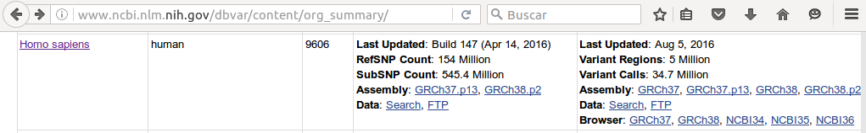
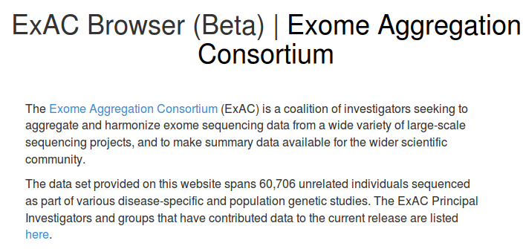
Looking for a mutation in BRCA1
    Comparing with tens of thousands of sequenced genomes and exomes

Slide 8

Data deluge

Slide 9
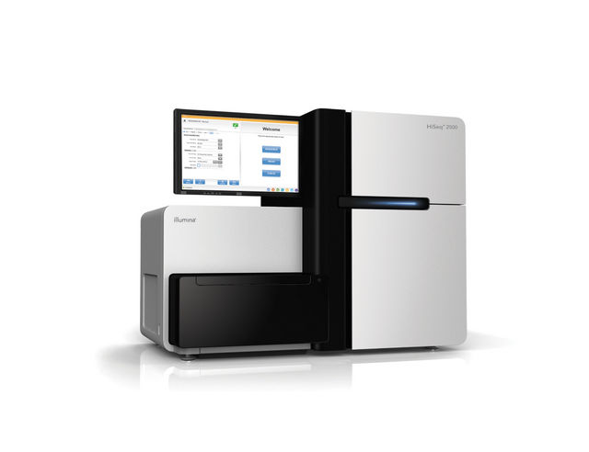
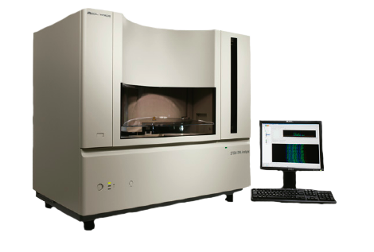
Sequencing Revolution
Sanger
sequencing
NGS

Slide 10
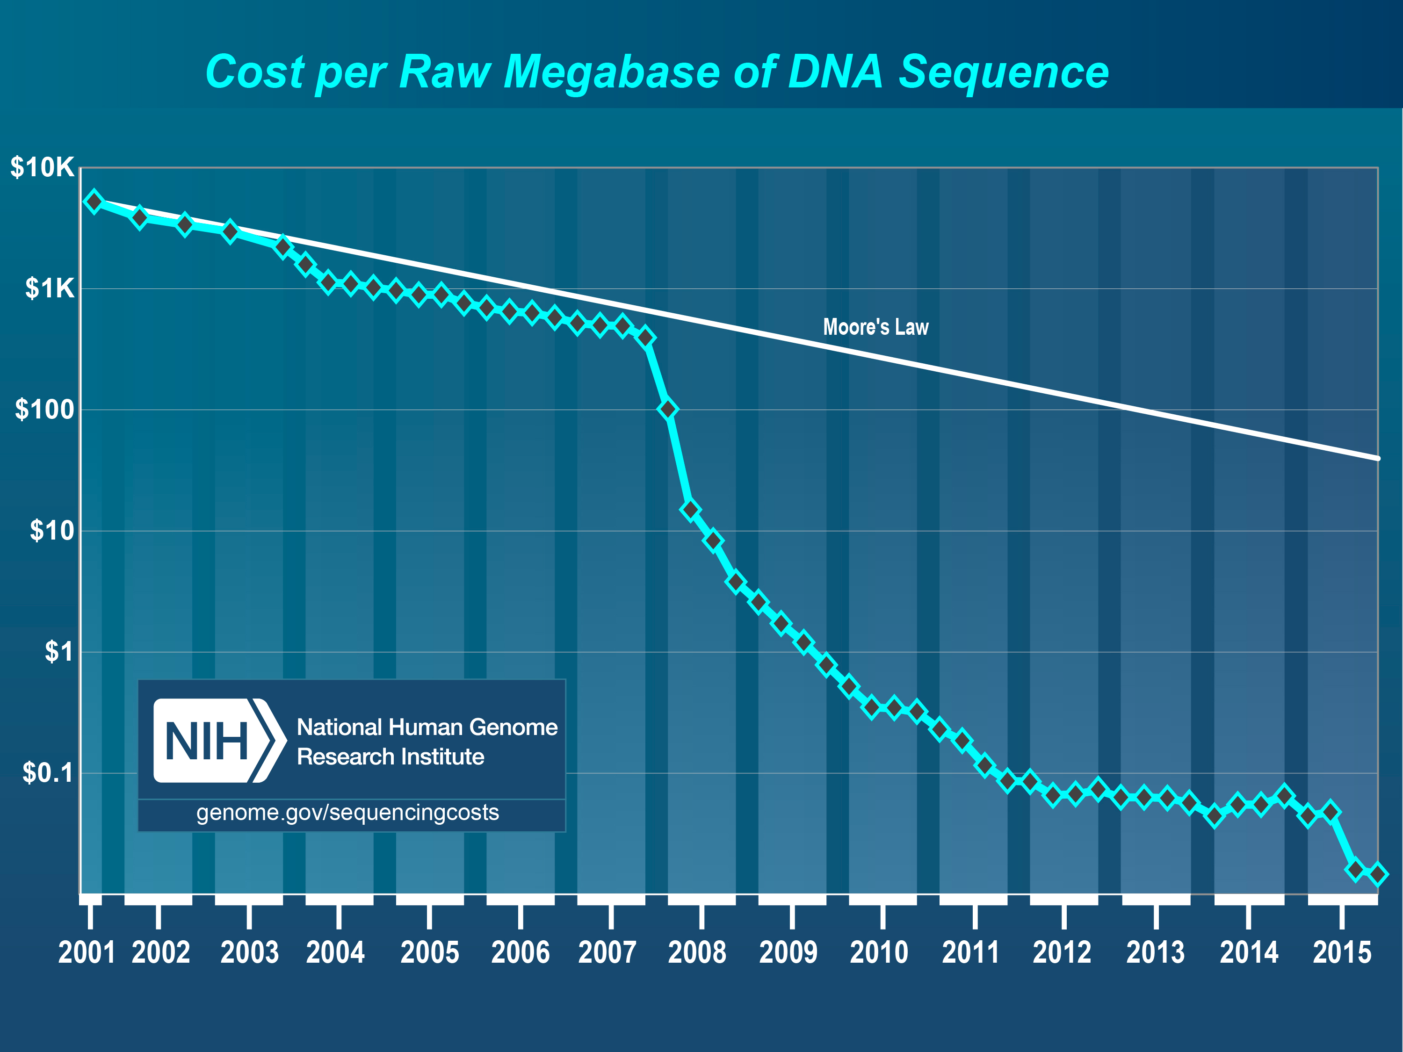
3000M$
Public US project
NGS
1000$

Slide 11
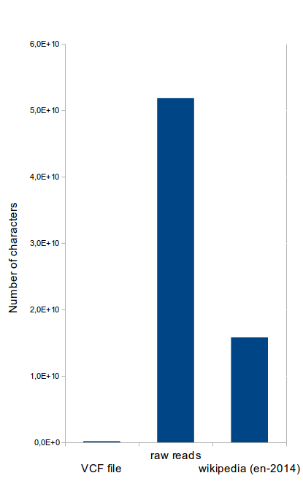
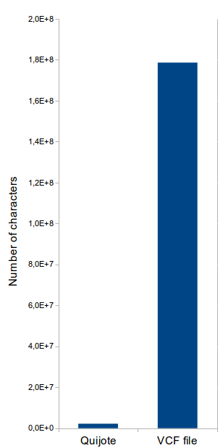

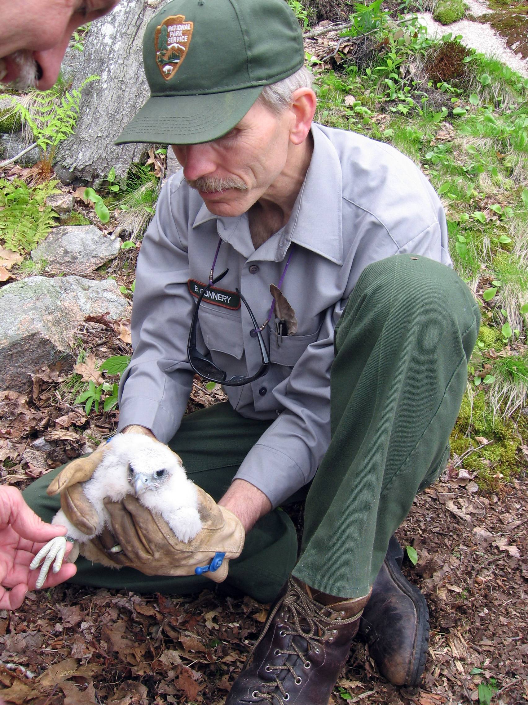
Data deluge
Small experiment
Result
Raw data

Slide 12
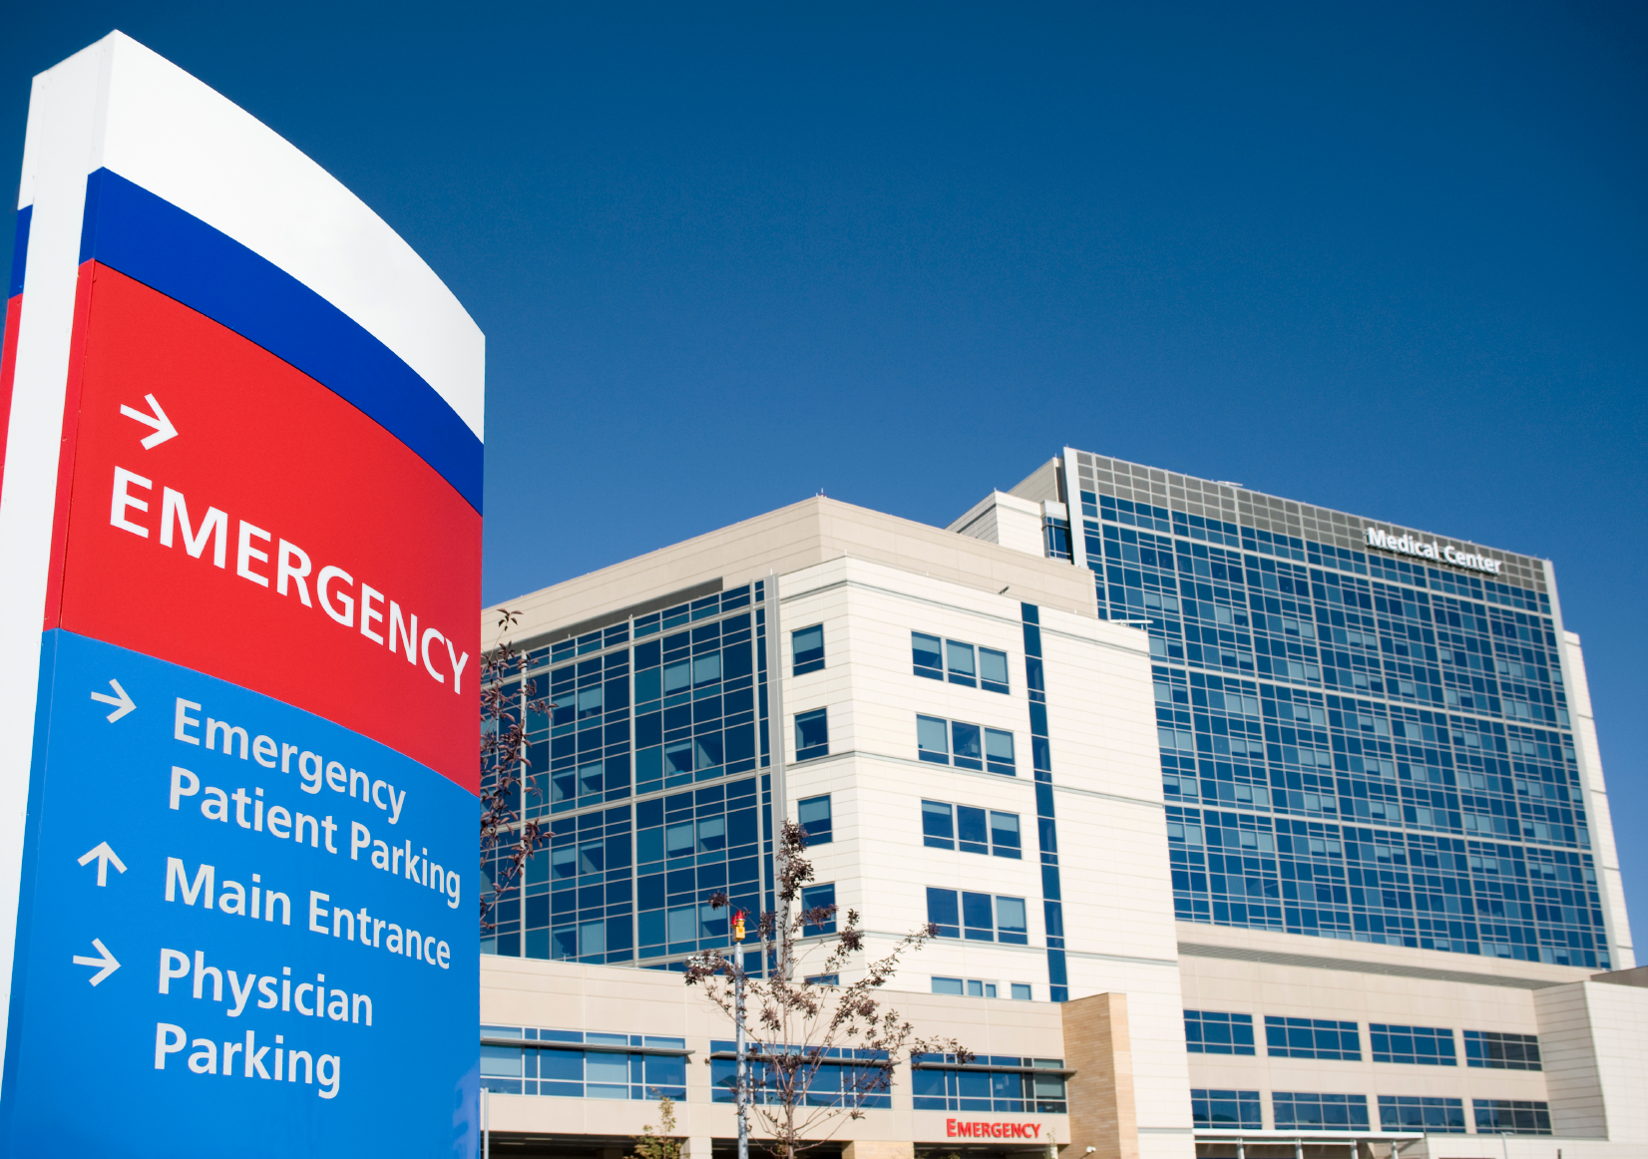
Data deluge
1 genome
3000$
many
genomes

Slide 13

The biology pillars
Biological system

Slide 14
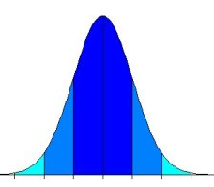
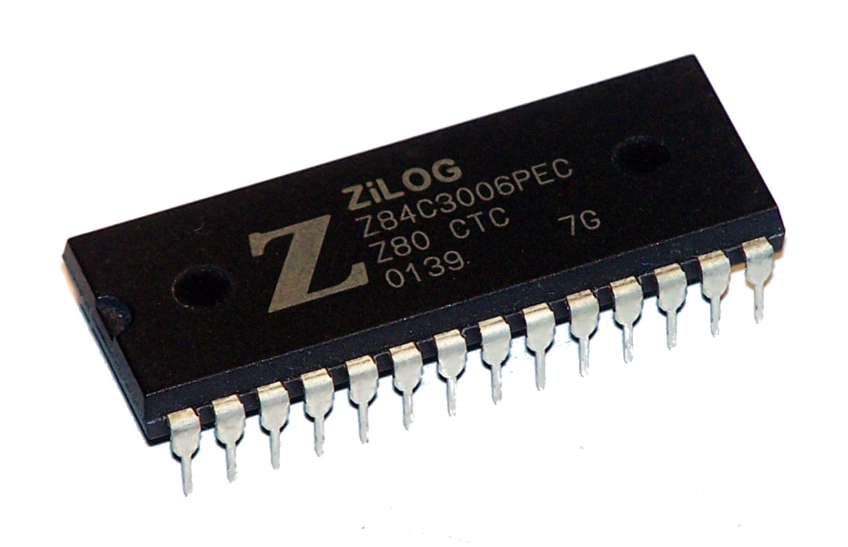

The biology pillars
Biological system
statistics
computing

Slide 15
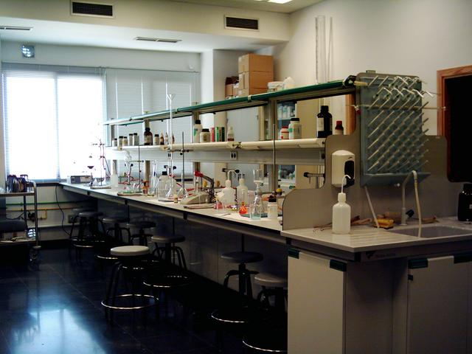
Bioinformatics in the wet lab
    Literature search
    Search for similar sequences in databases
    Phylogeny
    Gene structure determination
    Prediction of the effect of a mutation

Slide 16
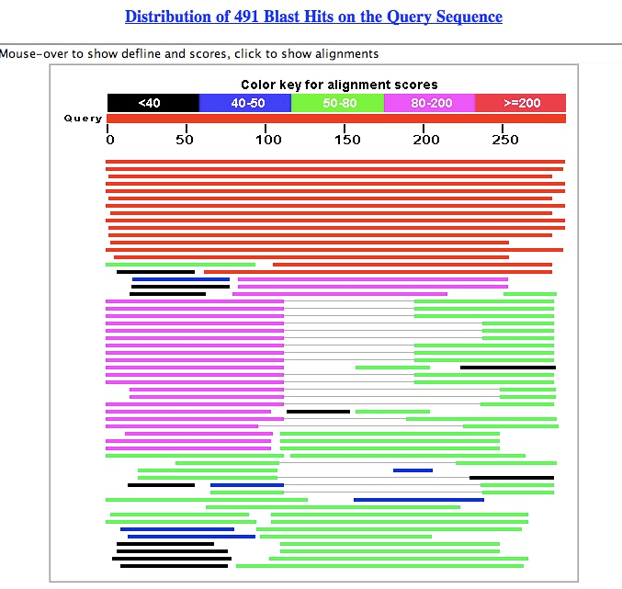
Bioinformatics, areas
    Main areas
      Searches in databases
      Sequence alignments
      Phylogeny
      Gene annotations
    Practical approach
      Usefulness
      Limitations of the algorithms

Slide 17
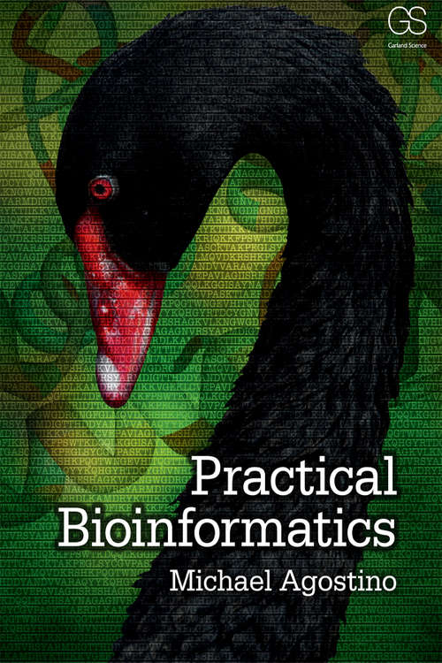
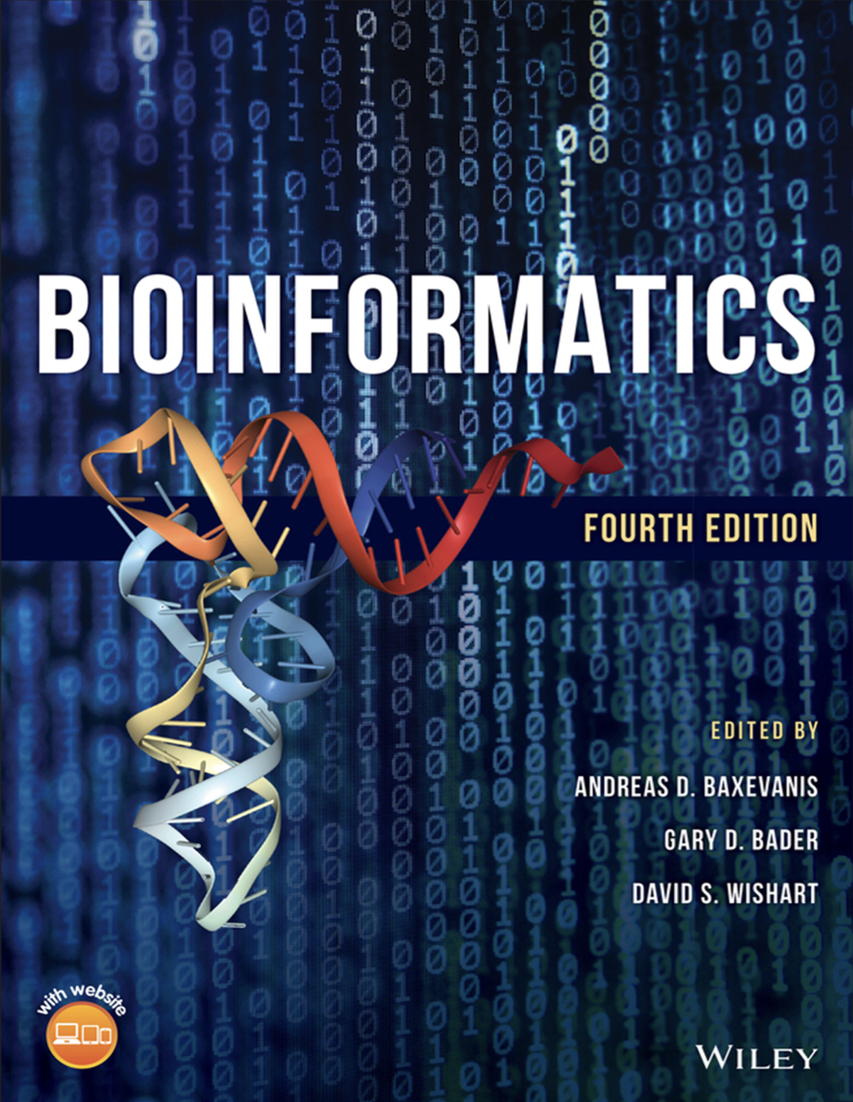
Bibliography

Slide 18
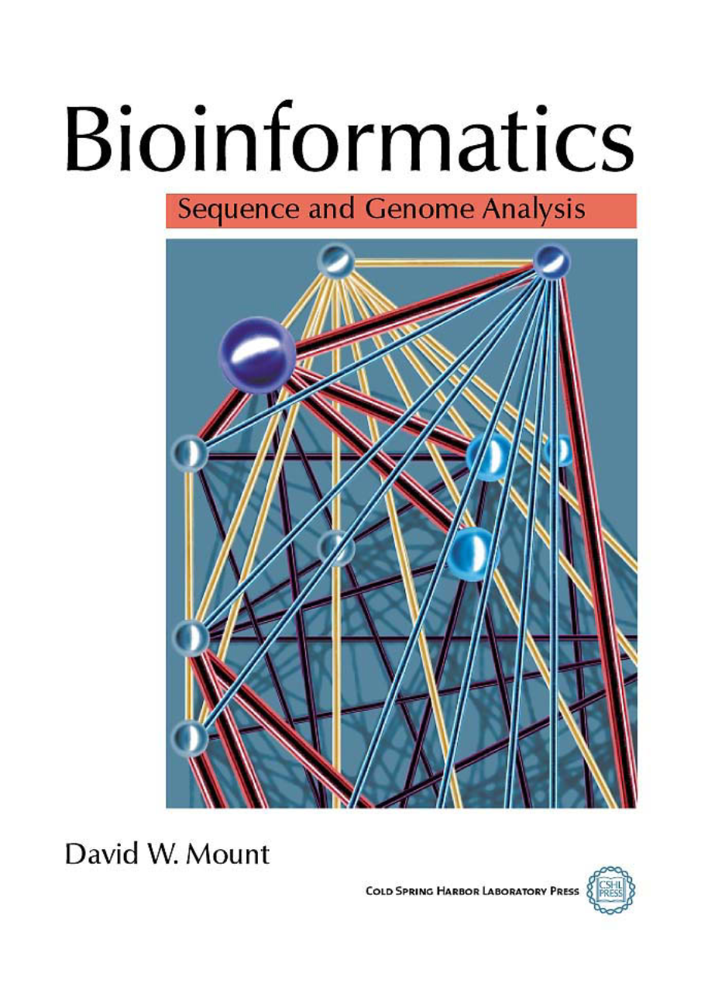

Bibliography

Slide 19


Bioinformatics, programming
    Automation of repetitive data

Slide 20
Some applications

Slide 21

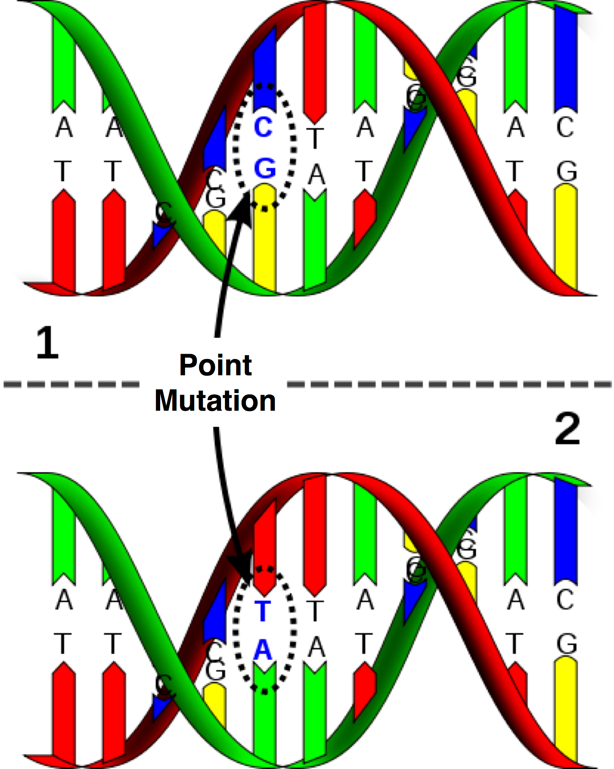
Genetic disease: mutation detection

Slide 22
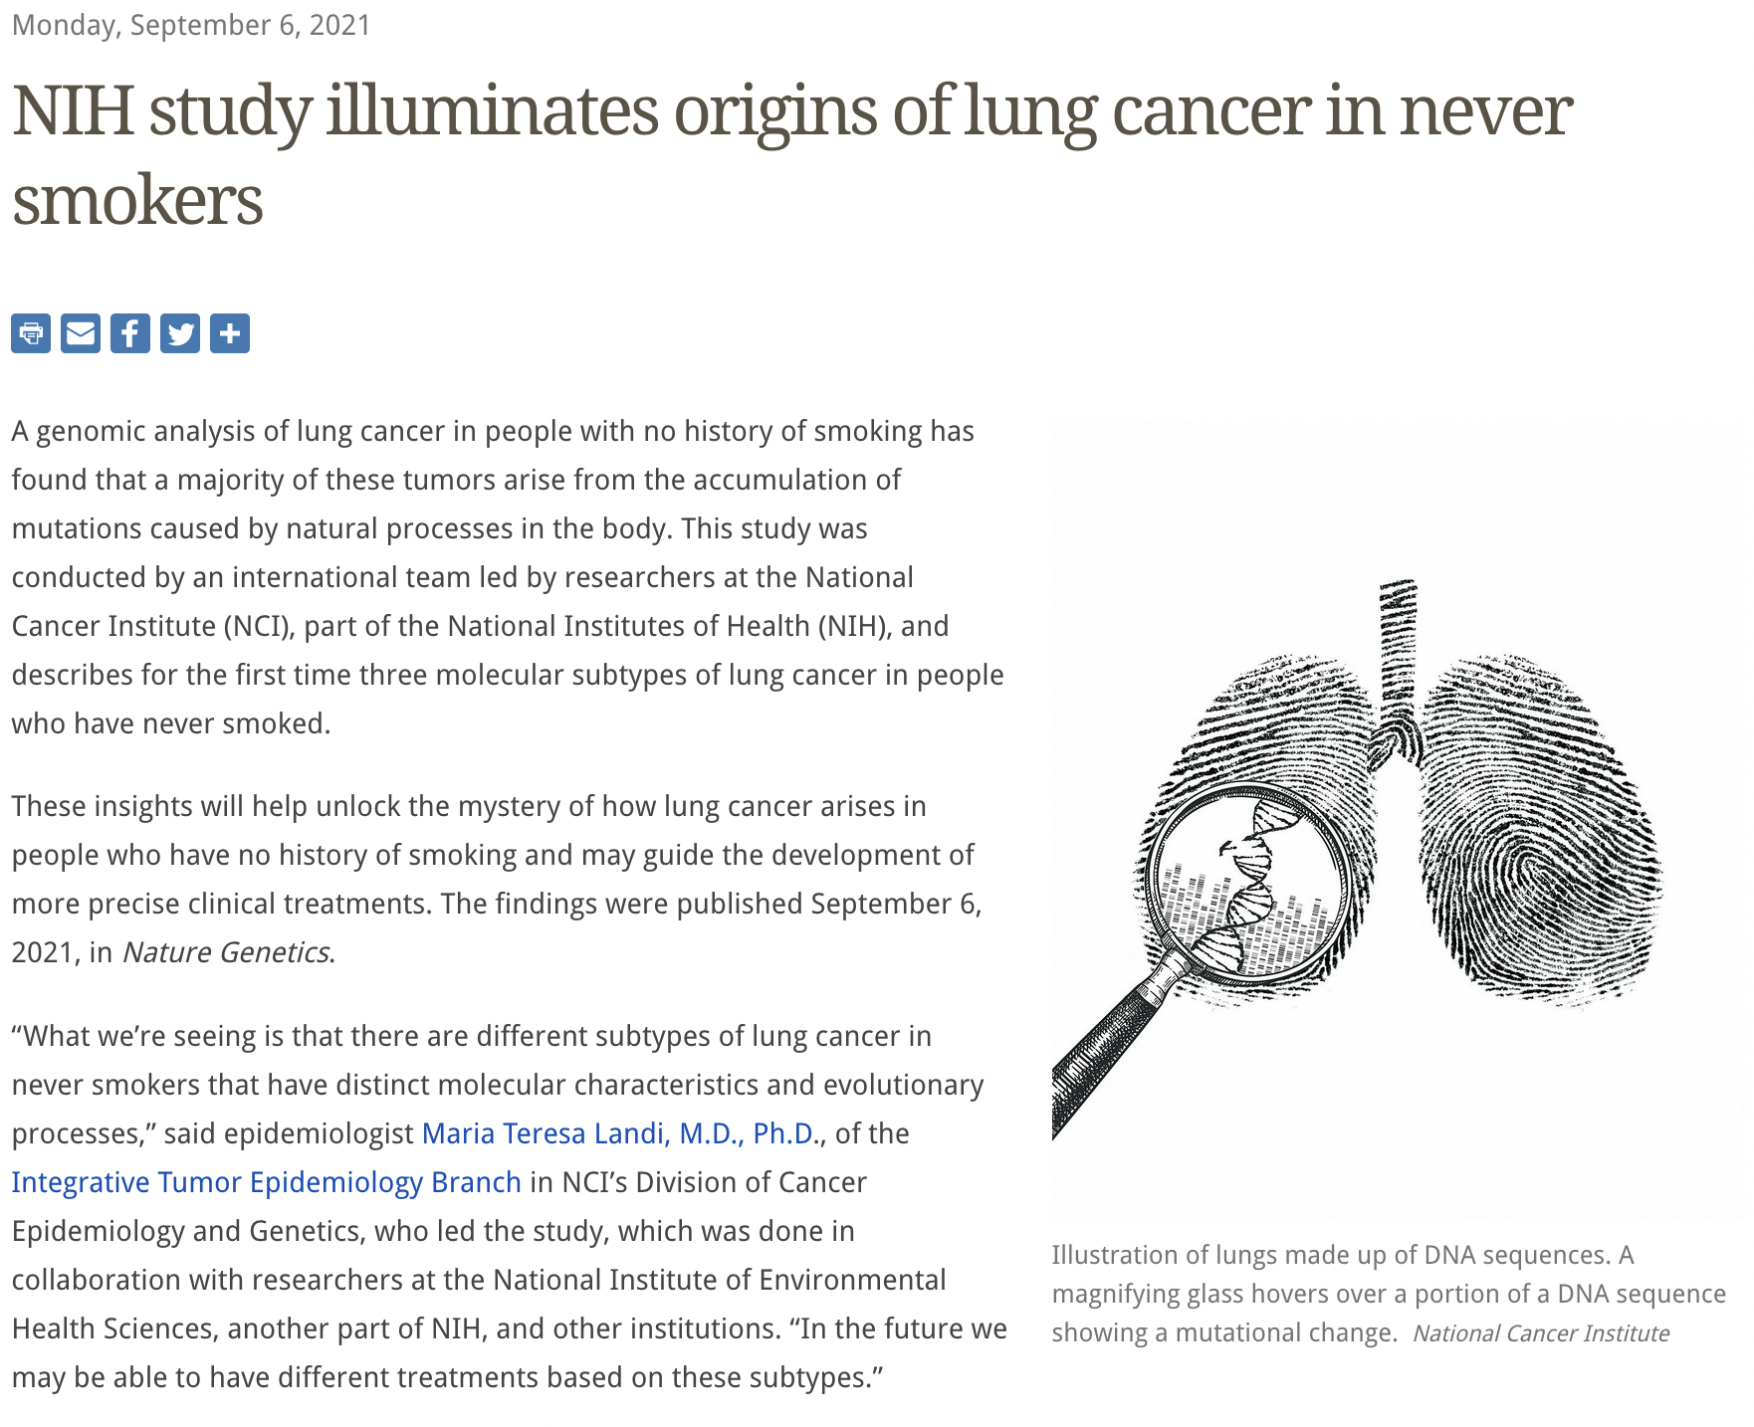
Genetic disease: mutation detection

Slide 23
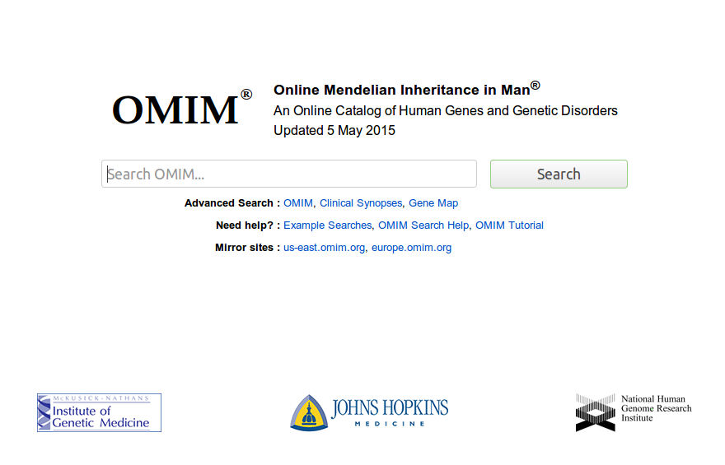
Genetic variation & disease

Slide 24
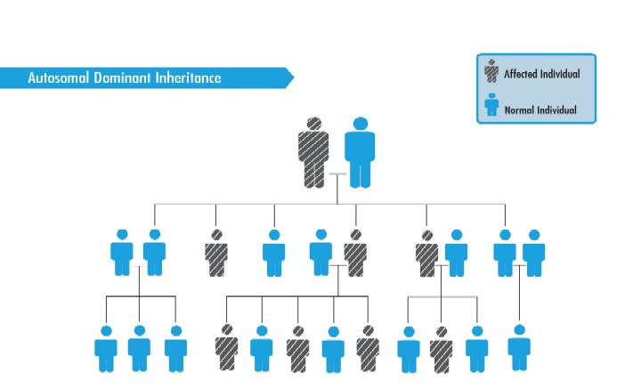
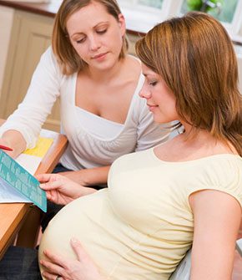
Genetic counseling

Slide 25
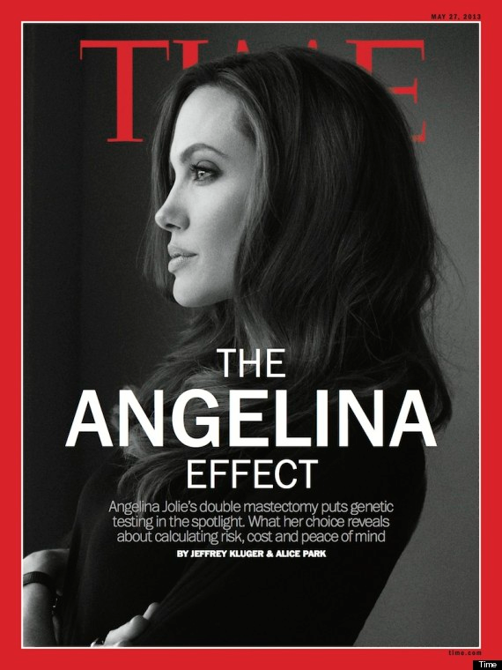
Genetic counseling
Notes:
Sirve también para el colesterol

Slide 26
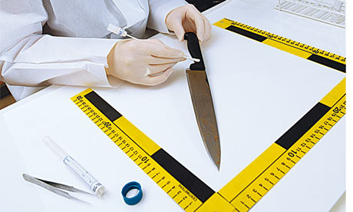
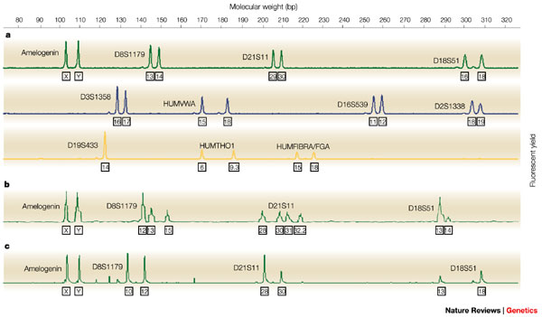
Forensic analysis

Slide 27
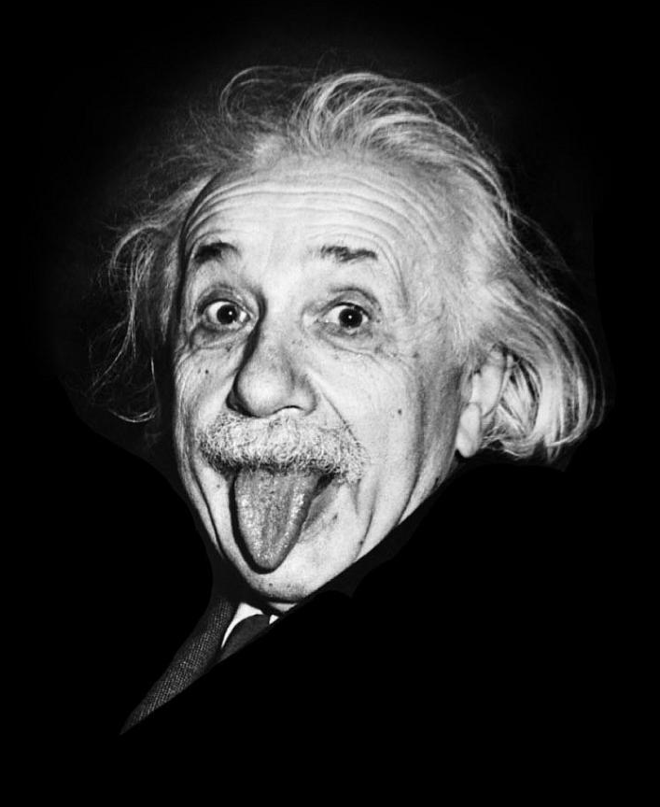
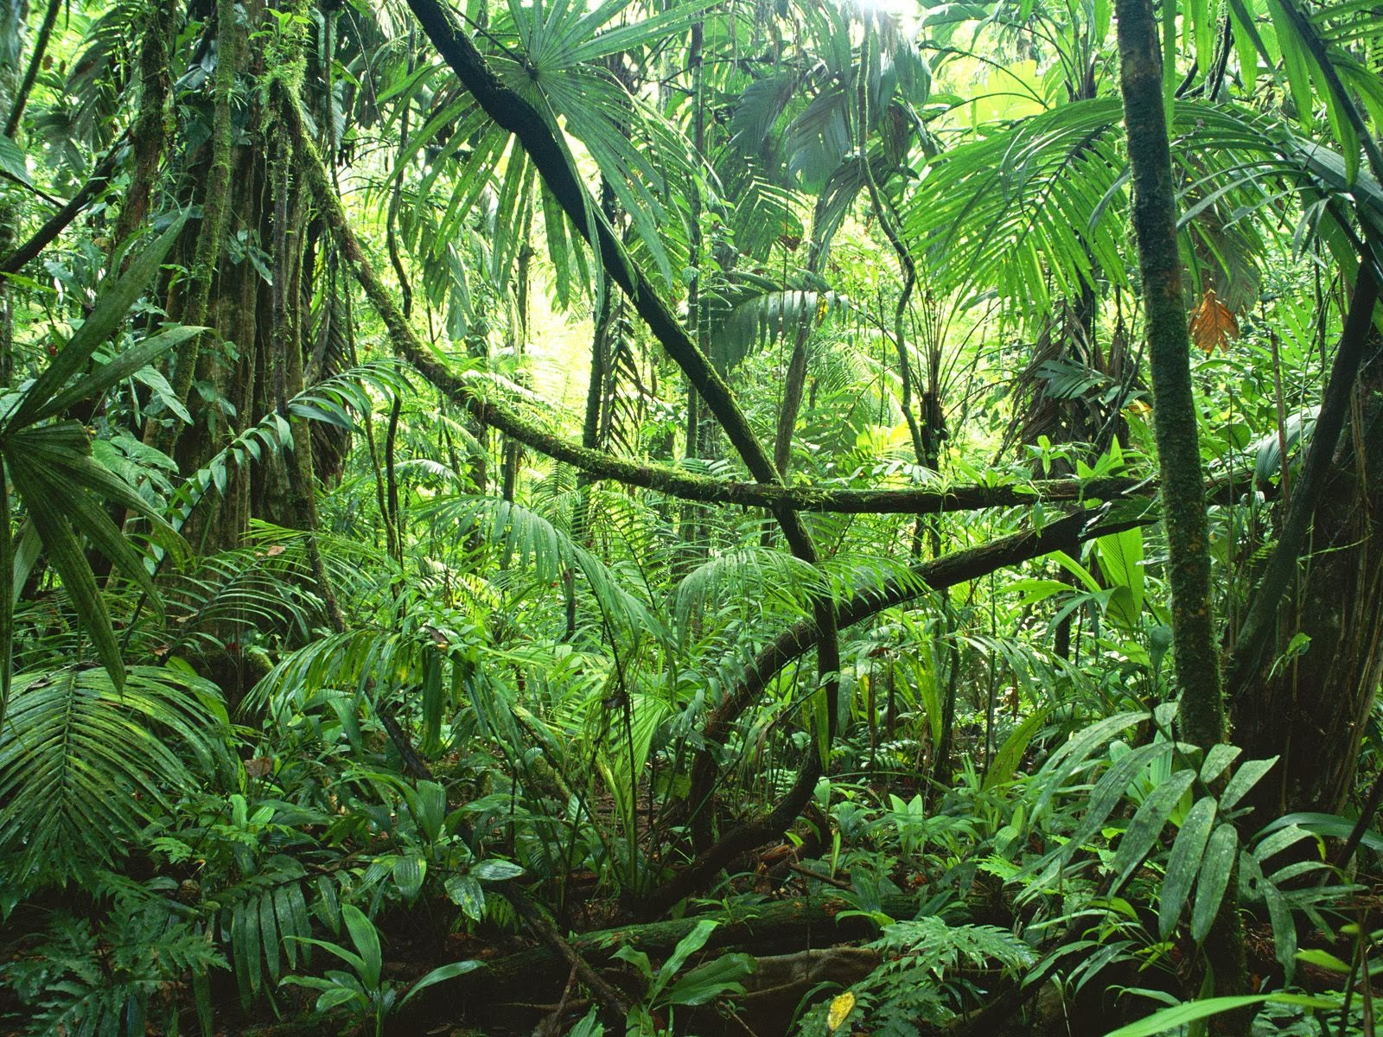
Metagenomics

Slide 28
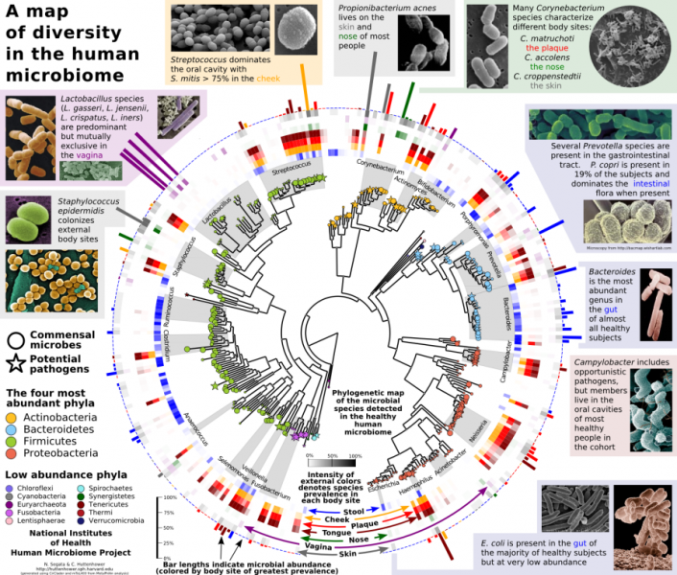

Slide 29
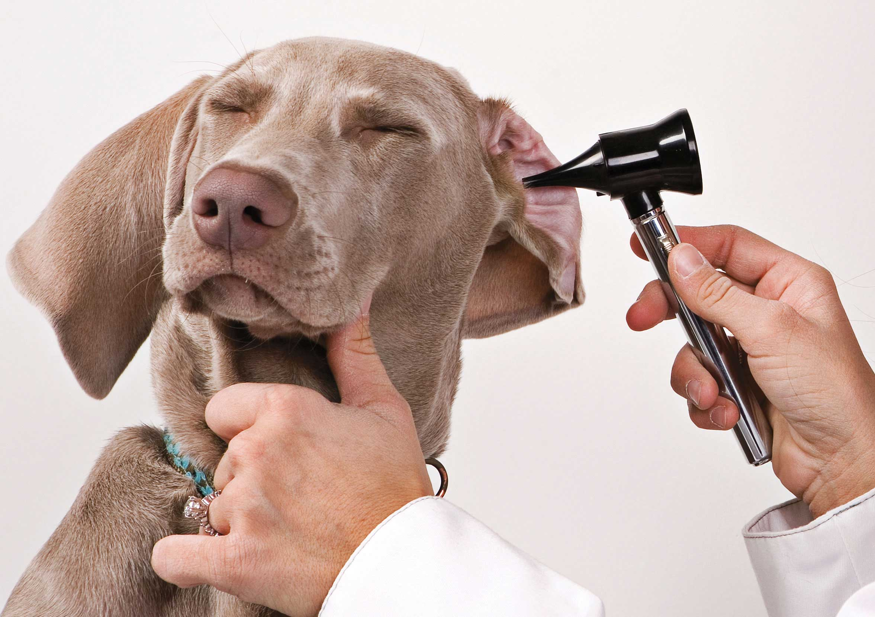
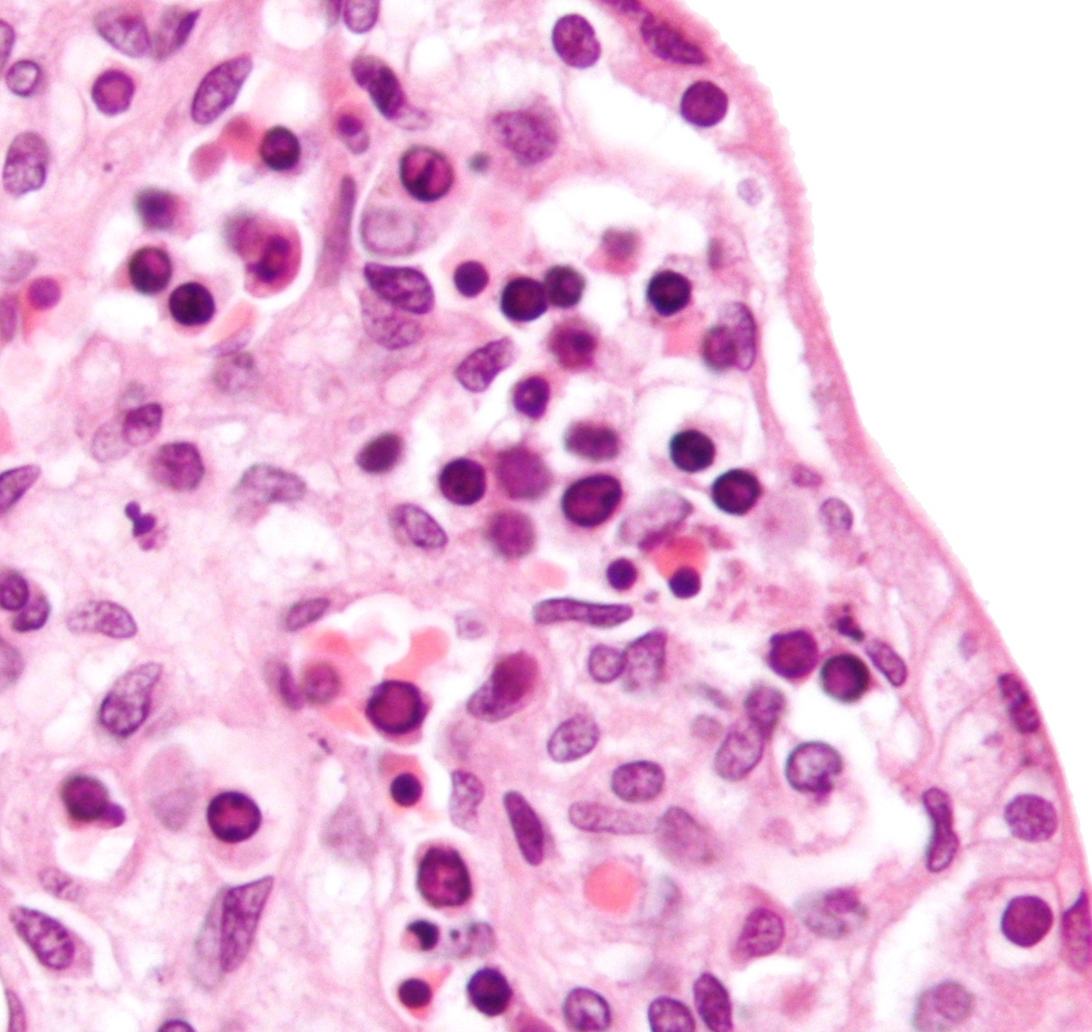
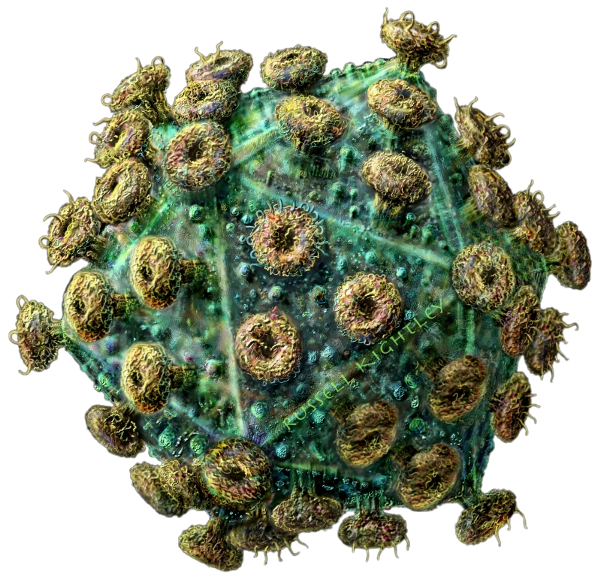
Pathogen detection
HIV:
ACTCTTTGGCAACGACCCCTCGTCACAATAAAG
ATAGGGGGGCAACTAAAGGAAGCTCTATTAGAT
GAGCAGATGATACAGTATTAGAAGAAATGAGTT
TGCCAGGAAGATGGAAACCAAAAATGATAGGGG
TGGAGGTTTTATCAAAGTAAGACAGTATGATCA
GATACTCATAGAAATCTGTGGACATAAAGCTAT
ACAGTATTAGTAGGACCTACACCTGTCAACATA
ATTGGAAGAAATCTGTTGACTCAGATTGGTTGC

Slide 30
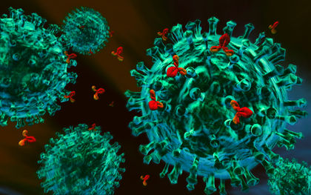
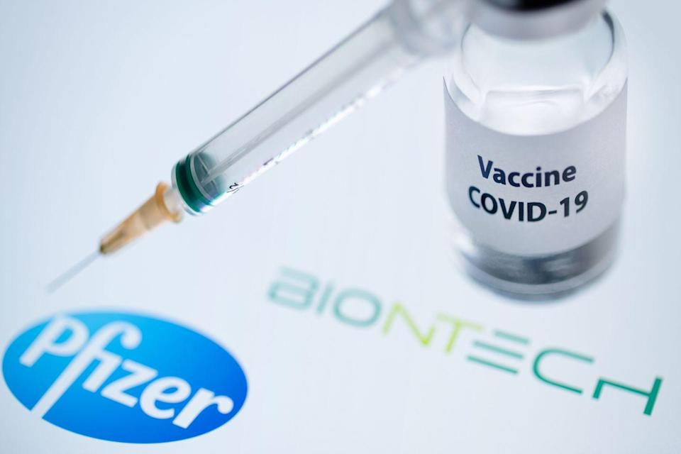
Biotechnology
  Applications
      Diagnostics
      Pharmacy
      Nutrition
      Cosmetics
  Technologies
      Protein synthesis
      Vegetable extraction
      Synthesis by bio-catalysis
      Microbiology
antibodies
vaccines

Slide 31
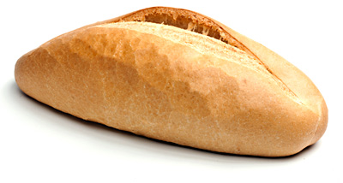

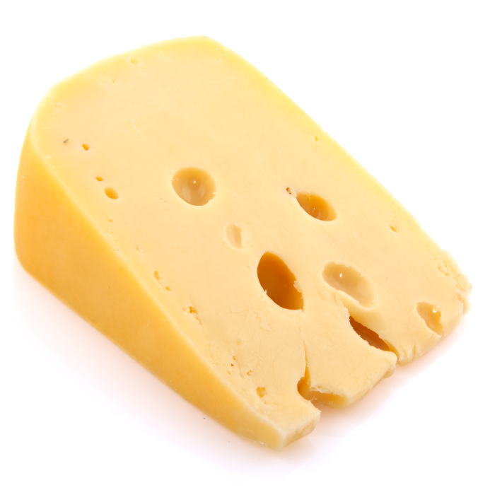
Biotechnology

Slide 32

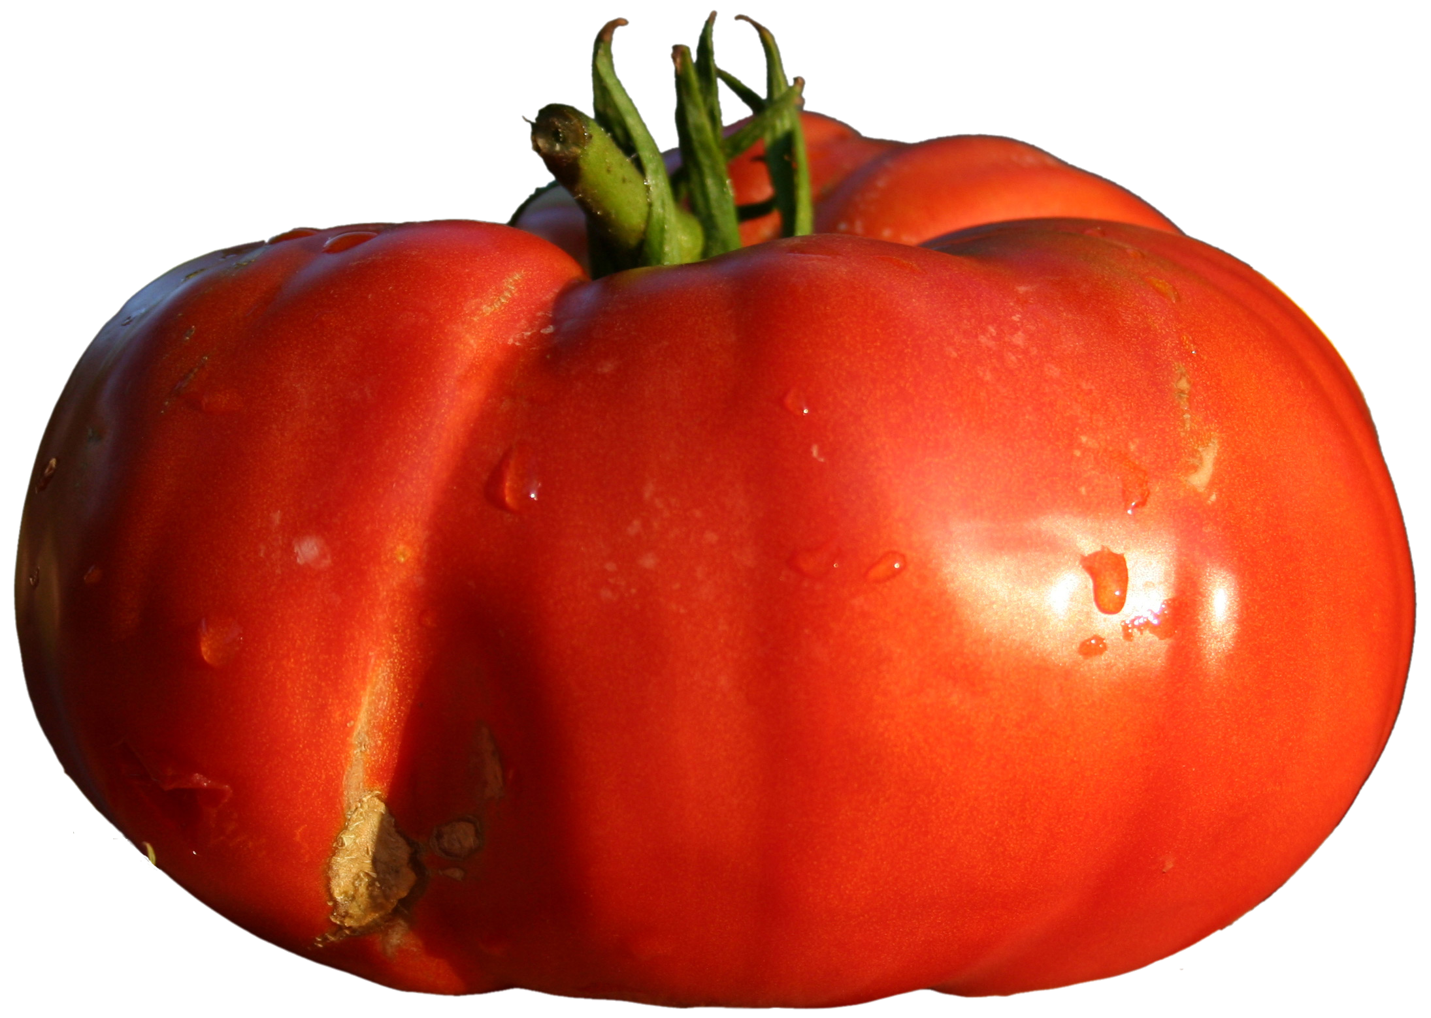
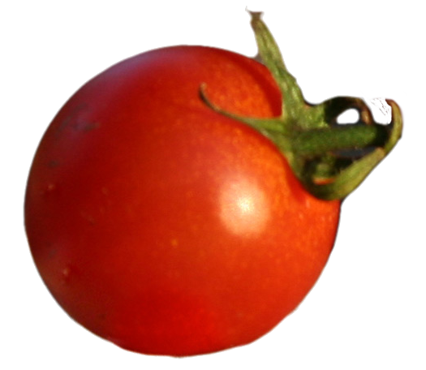
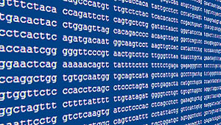
Agronomy
Traditional breeding
Molecular breeding
Genomic breeding
Faster time to market

Slide 33
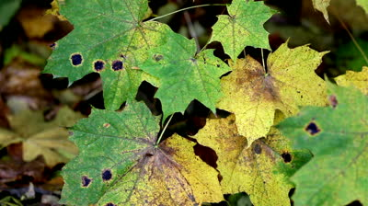
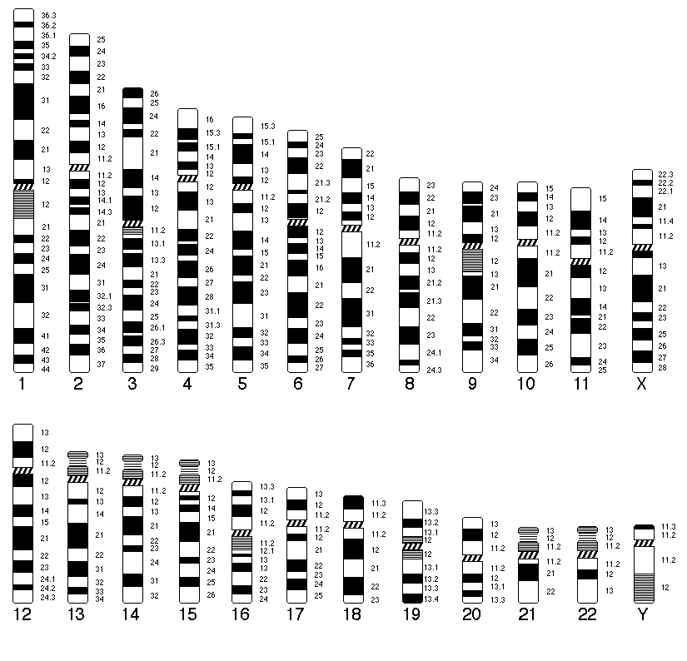
Gene location

Slide 34
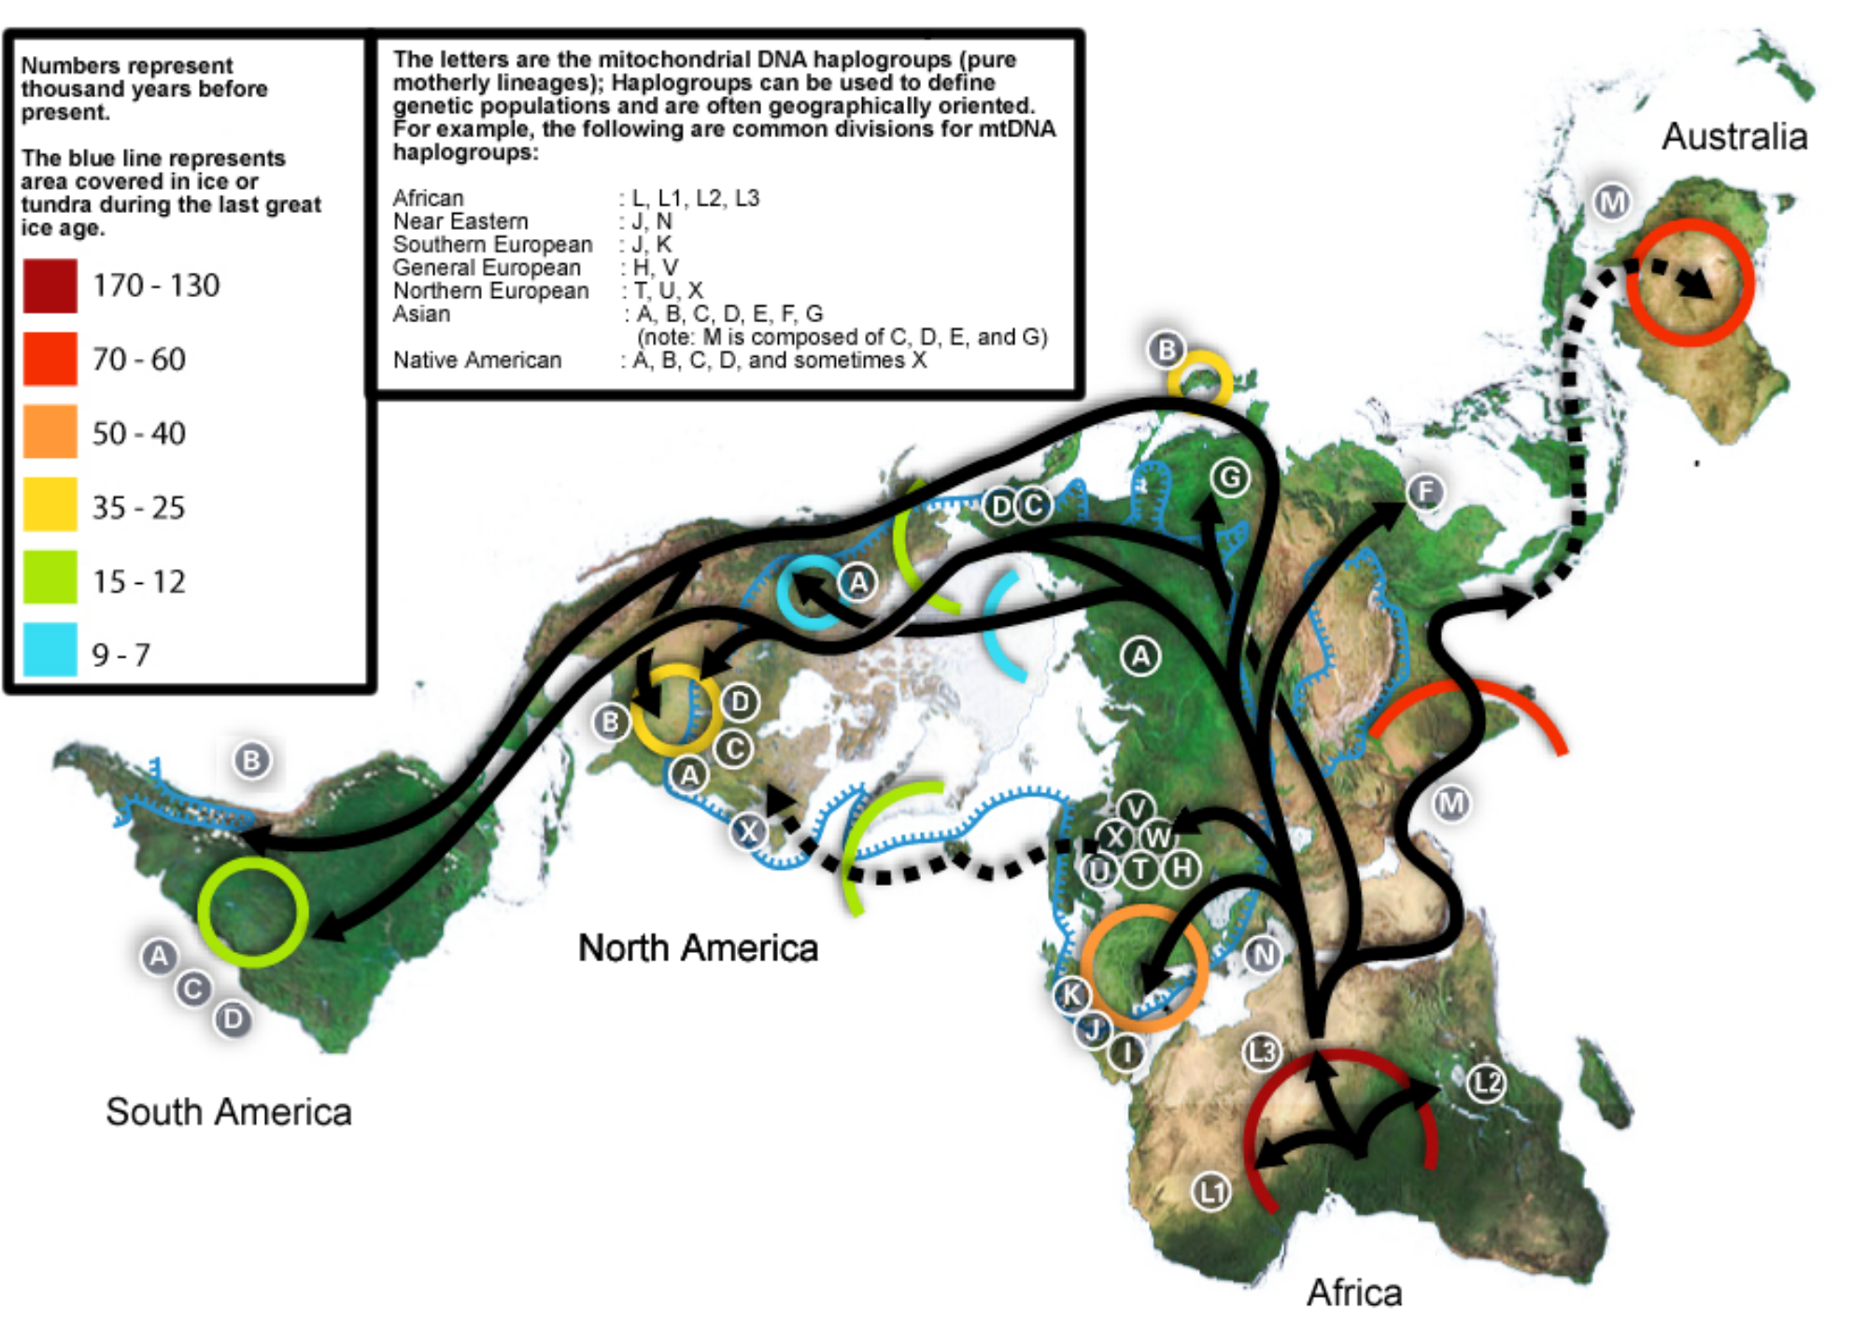
Population genetics: history is in the genome

Slide 35
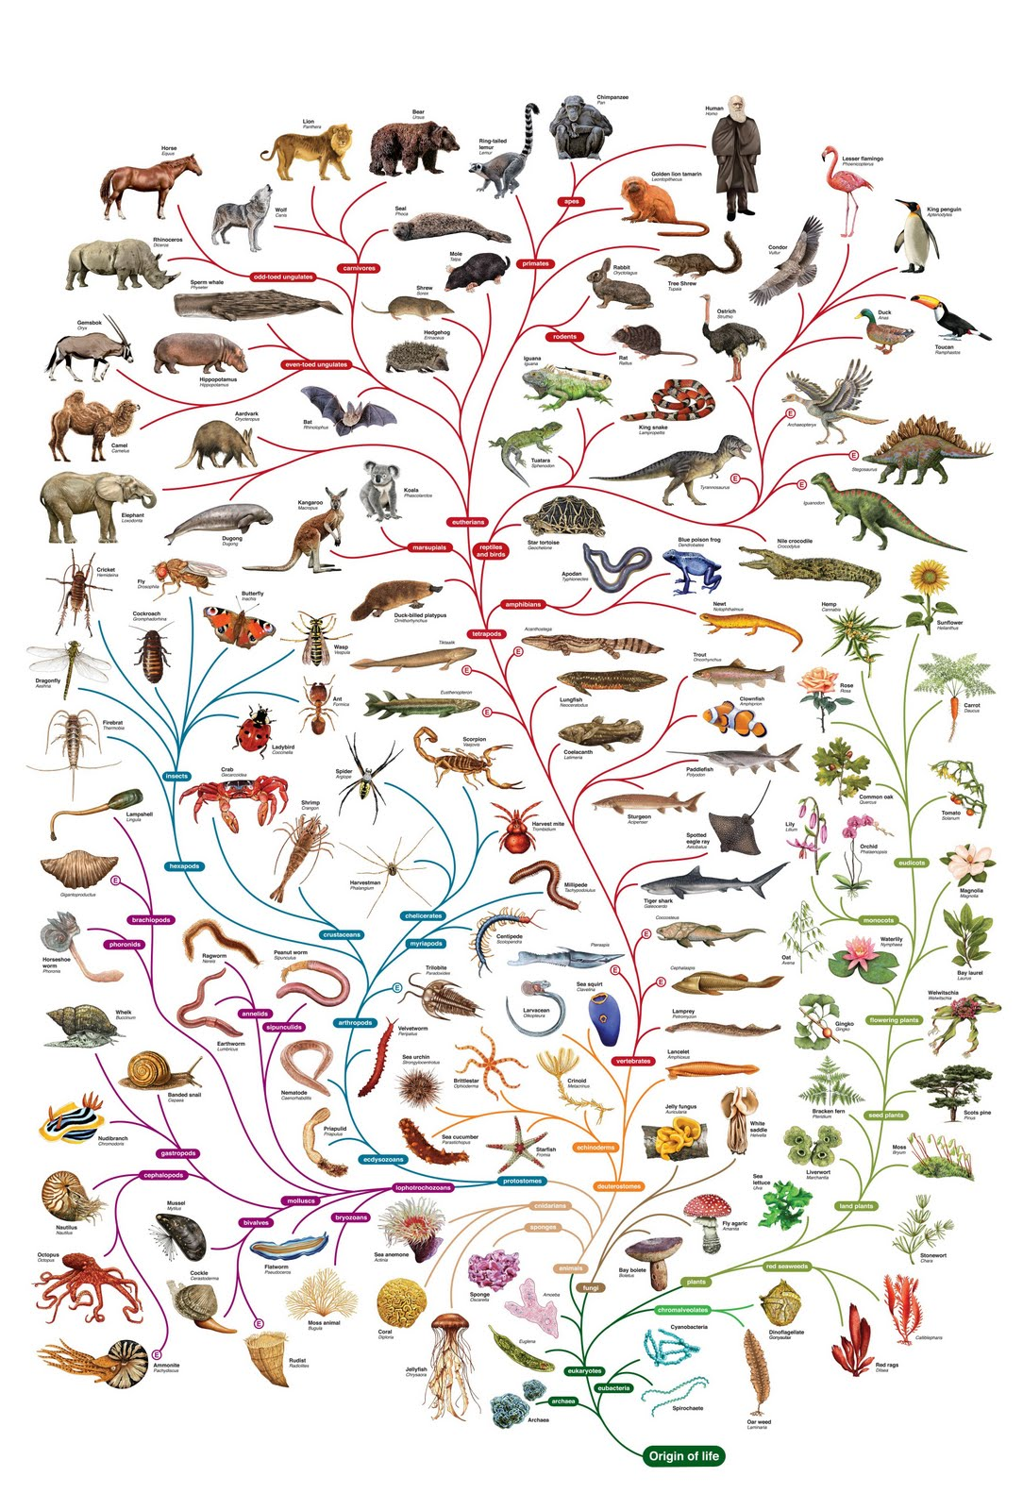
Phylogeny

Slide 36
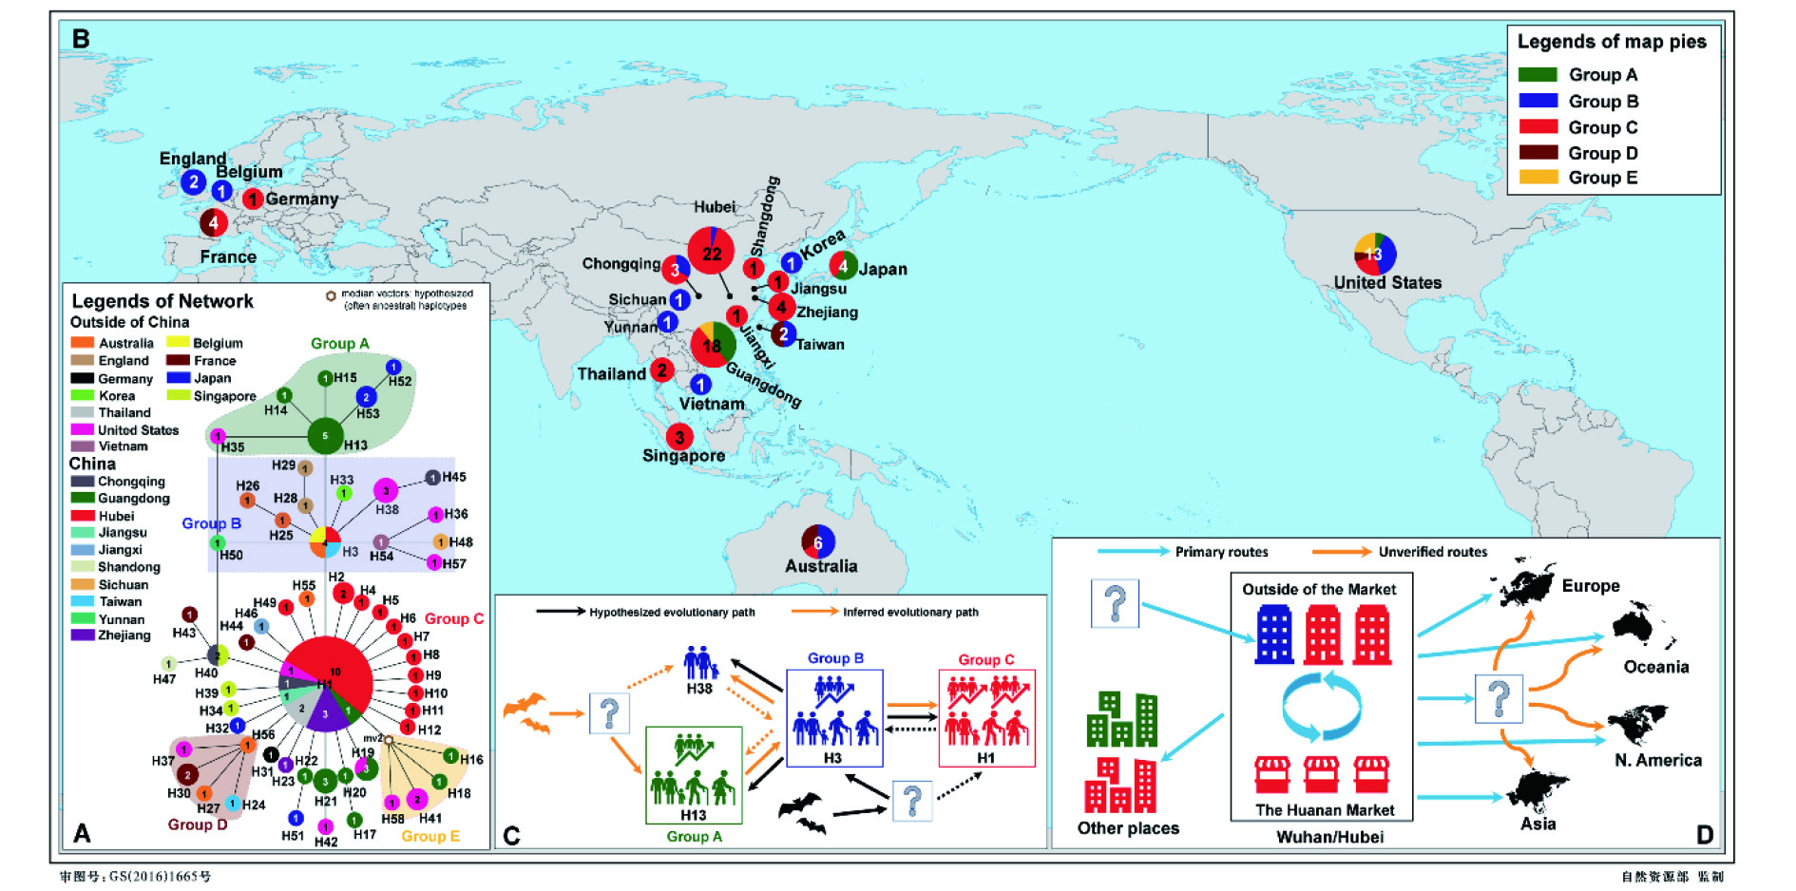
Sars-cov-2 initial evolution

