Slide 1
Sequencing technologies
Jose Blanca
COMAV institute
bioinf.comav.upv.es

Slide 2
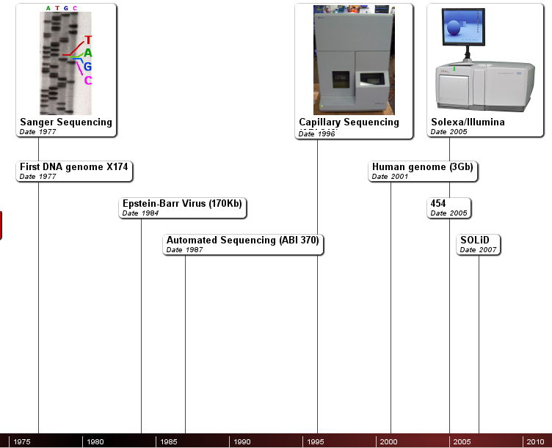

Slide 3
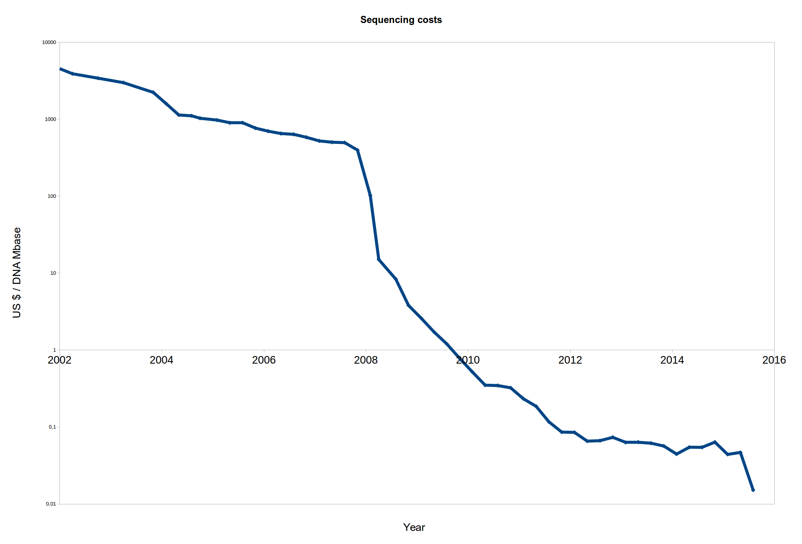
Genome.org/sequencingcosts
3000M$
Public US project
1000$

Slide 4
Sanger sequencing

Slide 5
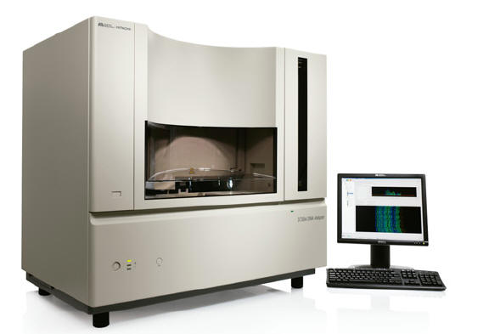
Sanger sequencing
    Traditional DNA sequencing method
    Ideal for small sequencing projects
    Read length around 600-800 bp
    Around 5-10$ per reaction
    384 reactions in parallel at most
    Applied Biosystems is the main technological provider

Slide 6
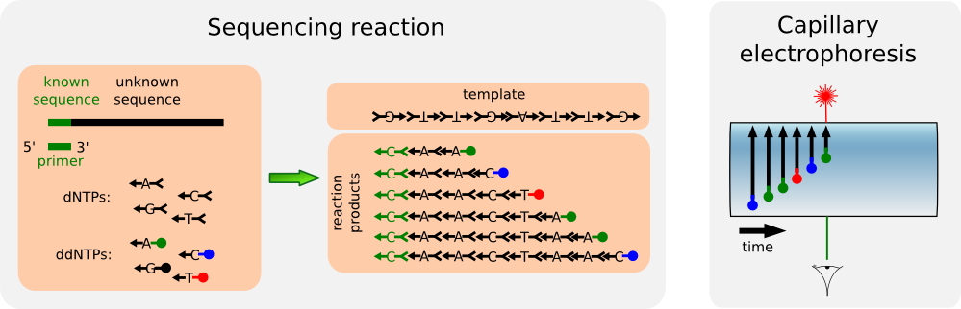
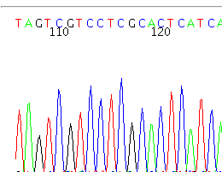
Sanger sequencing

Slide 7
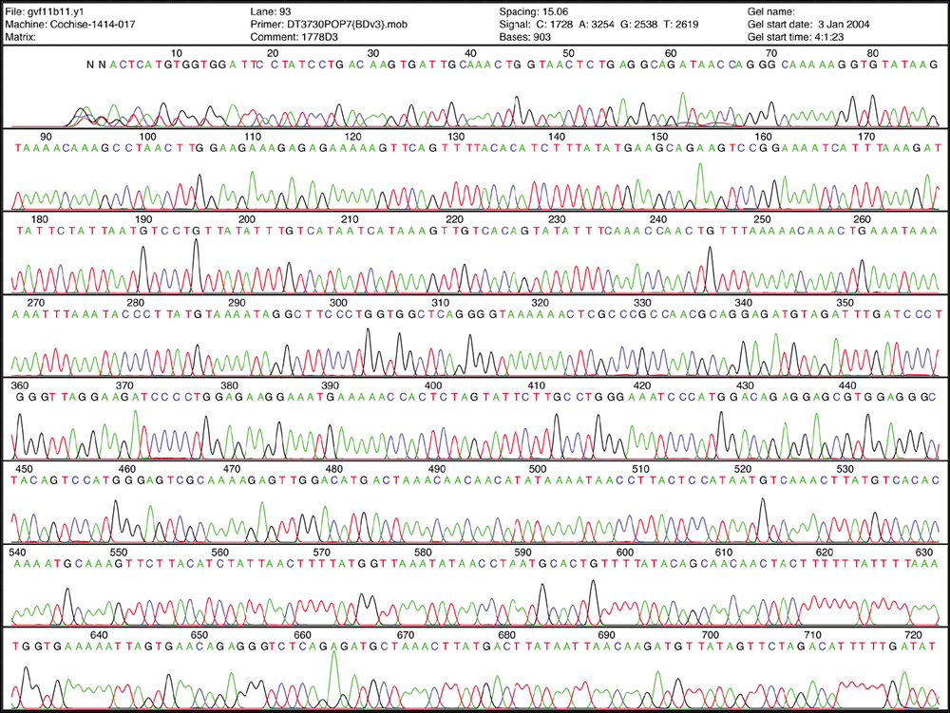
Sanger sequencing

Slide 8
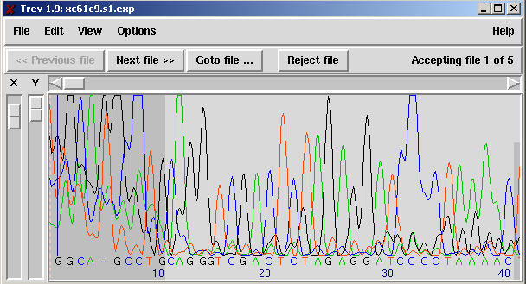
ABI files
    Sequences are usually delivered as ABI files.
      Binary files.
      Contain real signal, chromatogram and called sequence and quality
      They can be opened with:
        chromas (win) (www.technelysium.com.au/chromas.html)
        Sequence scanner (win) (Applied Biosystems)
        FinchTv (win, mac, linux) (www.geospiza.com/Products/finchtv.shtml)
        trev (win, mac, linux) (part of Staden).
      Usually they have a .ab1 extension.

Slide 9
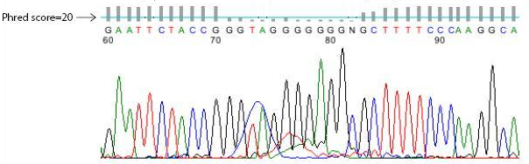
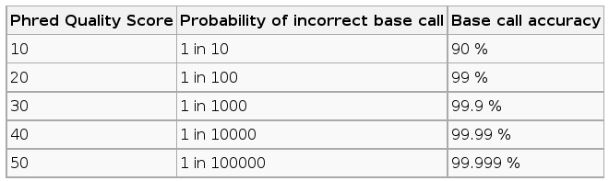
Sequence and quality
    Phred score = - 10 log (prob error)

Slide 10
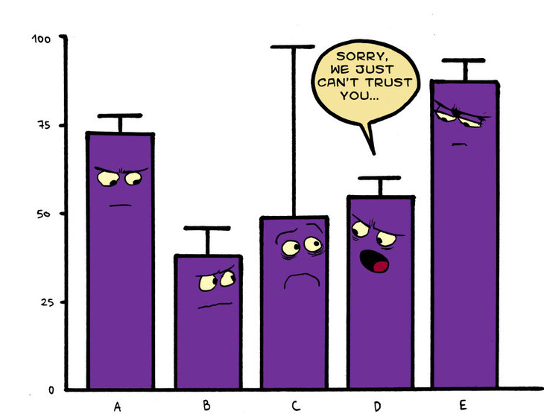
Any evidence has error bars
Any conclusion has error bars

Slide 11
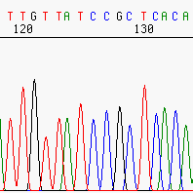
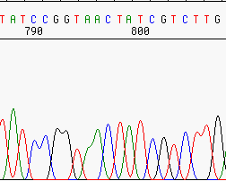
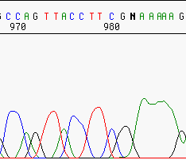
Sequence and quality
    Due to technical limitations different technologies have different errors patterns.

Slide 12
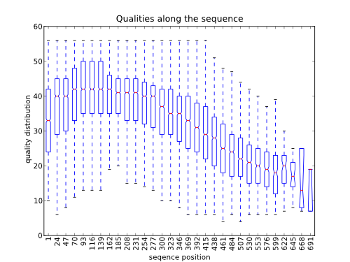
Sanger sequencing
    Quality is worst at the beginning and at the end.

Slide 13
Other sources of error
    Pre-sequencing:
      PCR mutation-like errors
      PCR primers (e.g. hexamers in random priming)
      Cloning artifacts, chimeric molecules
    Post-sequencing:
      Assembly artifacts
      Alignment errors due to:
        Reference
        Alignment algorithms
      SNV calling software

Slide 14
2nd generation sequencing

Slide 15
Sanger vs NGS sequencing
 | Sanger | NGS
Num. sequences per reaction | 1 clone | Millions of molecules
Max. parallelization | 384 | Several millions
Sequence quality | High | Low
Sequence length | 600-800 bp | 35-20000 (depends on the platform)
Throughtput | Low | High

Slide 16
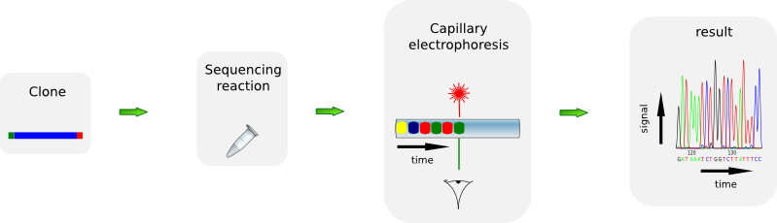
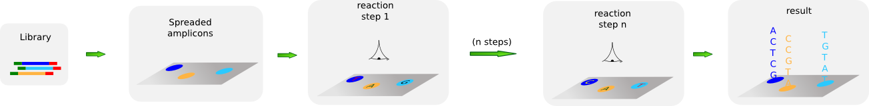
Sanger vs NGS

Slide 17
Library preparation
    Fragmentation
      Sonication
      Nebulization
      Shearing
    Size selection
    End repair
    Sequencing adaptor ligation
    Purification

Slide 18
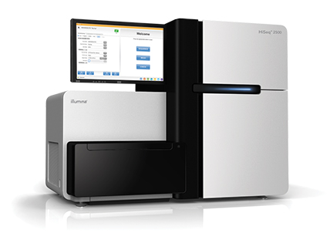
Illumina
    Previously known as Solexa
    Reversible terminators based sequencing technique
    Short reads (50 or 250bp depending on the version)
    Lowest cost per base
    Ideal for resequencing projects
    Highest throughput
    Runs divided in 8 lanes
    Up to 4000 million reads
    Can sequence both ends of the molecules (paired ends)
    HiSeq2500, NextSeq 500 and MiSeq

Slide 19
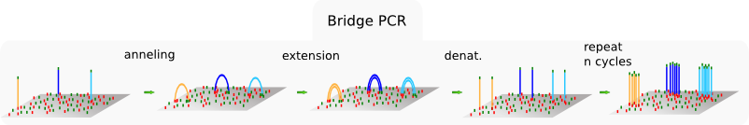
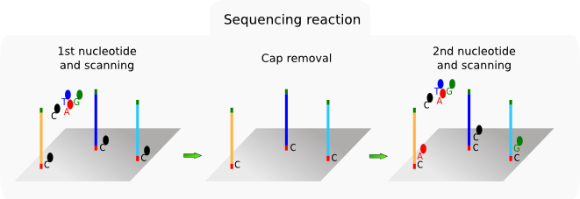
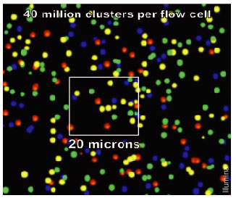
Illumina

Slide 20
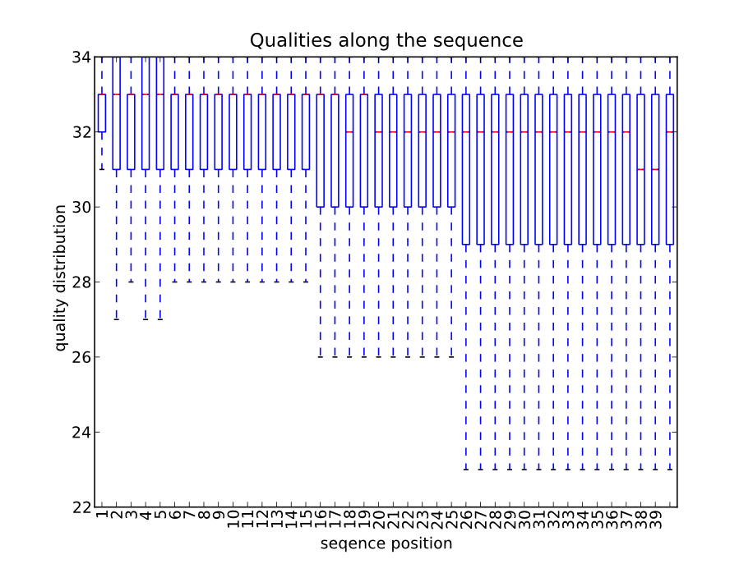
Illumina
    Quality diminishes with sequence length.
    No homopolymer problem, mainly substitution errors.

Slide 21
3rd generation sequencing

Slide 22
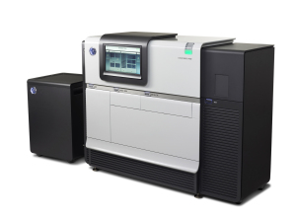
PacBio
    3rd generation platform (single molecule)
    Polymerase based chemistry (SMRT)
    Longest NGS reads (up to 20,000bp)
    Very high error rate
    Ideal for de novo sequencing projects
    45000 reads

Slide 23
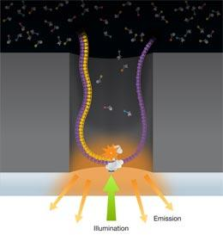
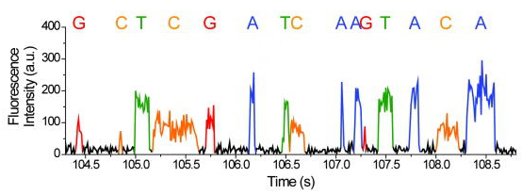
PacBio
    3rd generation, single molecule detection. No amplification step required.
    Nucleotides labeled on the phosphate removed during the polymerization.
    Sequencing based on the time required by the polymerase to incorporate a nucleotide (Polymerase requires milliseconds versus microseconds for the stochastic diffusion)

Slide 24
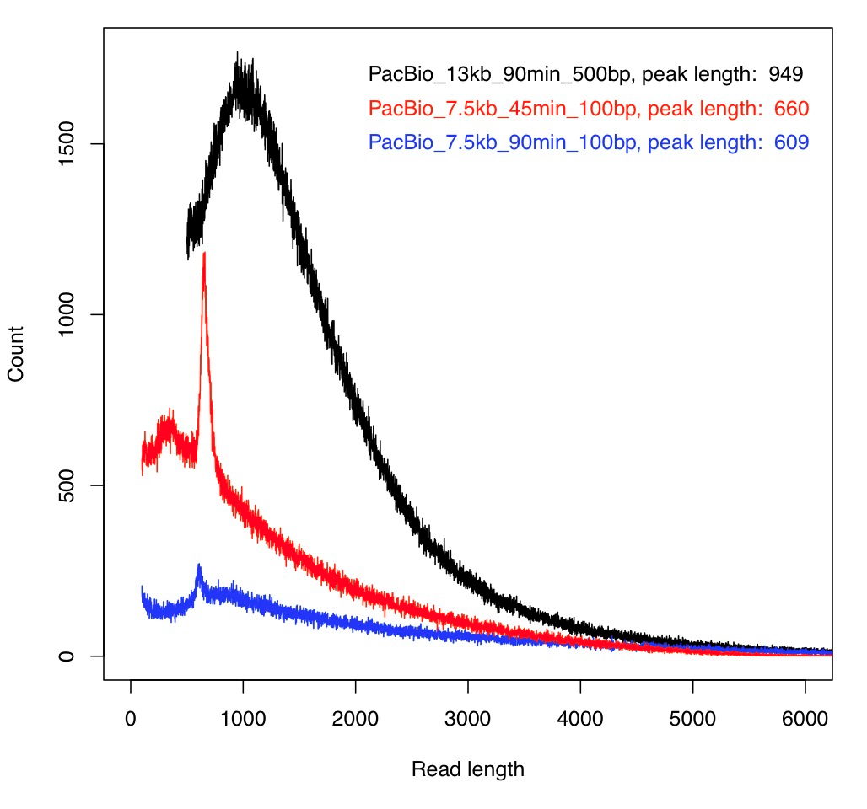

PacBio length distribution
Longest lengths
Limited by the polymerase damages
due to the laser
Sequencing strategies
Standard
Circular consensus
Taken from flxlexblog.wordpress.com
Distributions for standard sequencing, for circular the mean is
around 250 pb.

Slide 25
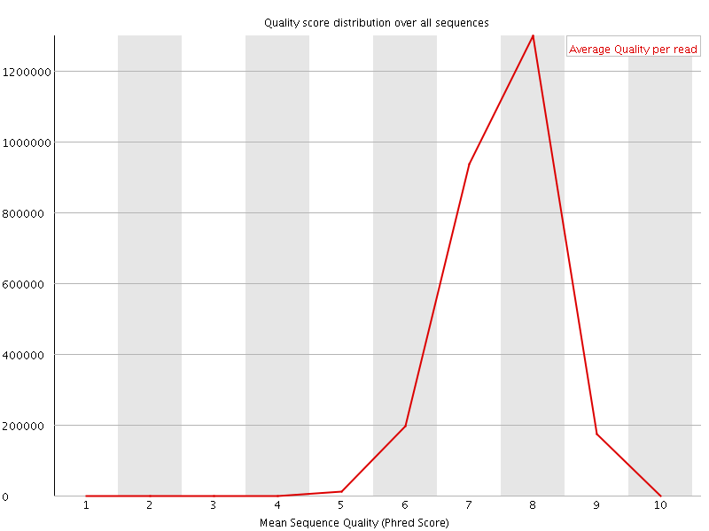
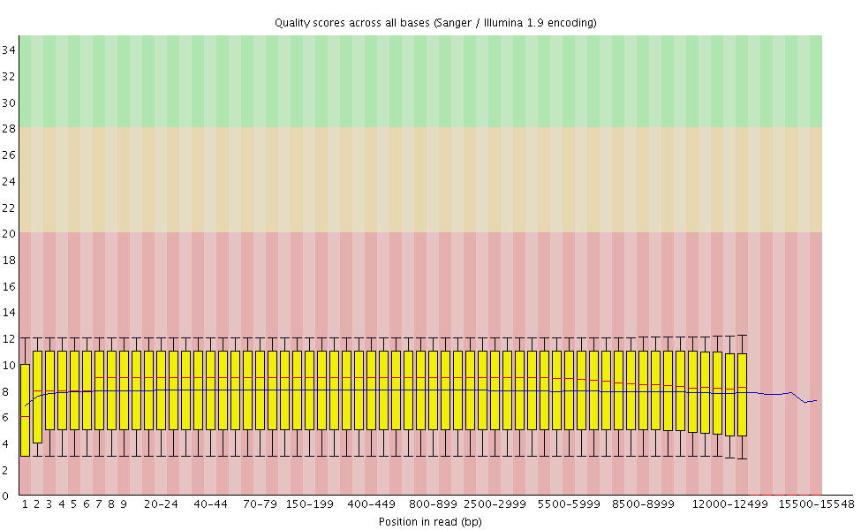
PacBio quality distribution
Distributions for standard sequencing.
For circular sequencing the quality
is at least 99.9%
Taken from flxlexblog.wordpress.com

Slide 26
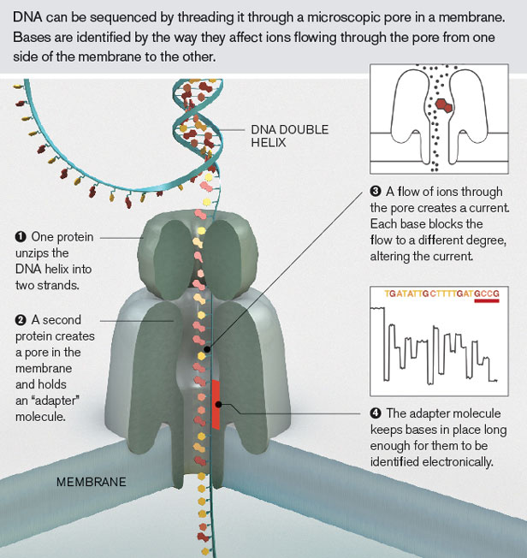
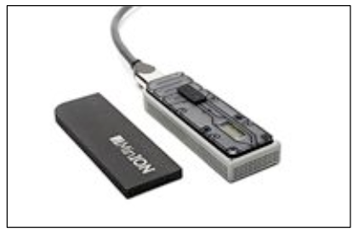
Nanopore
Senses differences in ion flow
USB powered

Slide 27
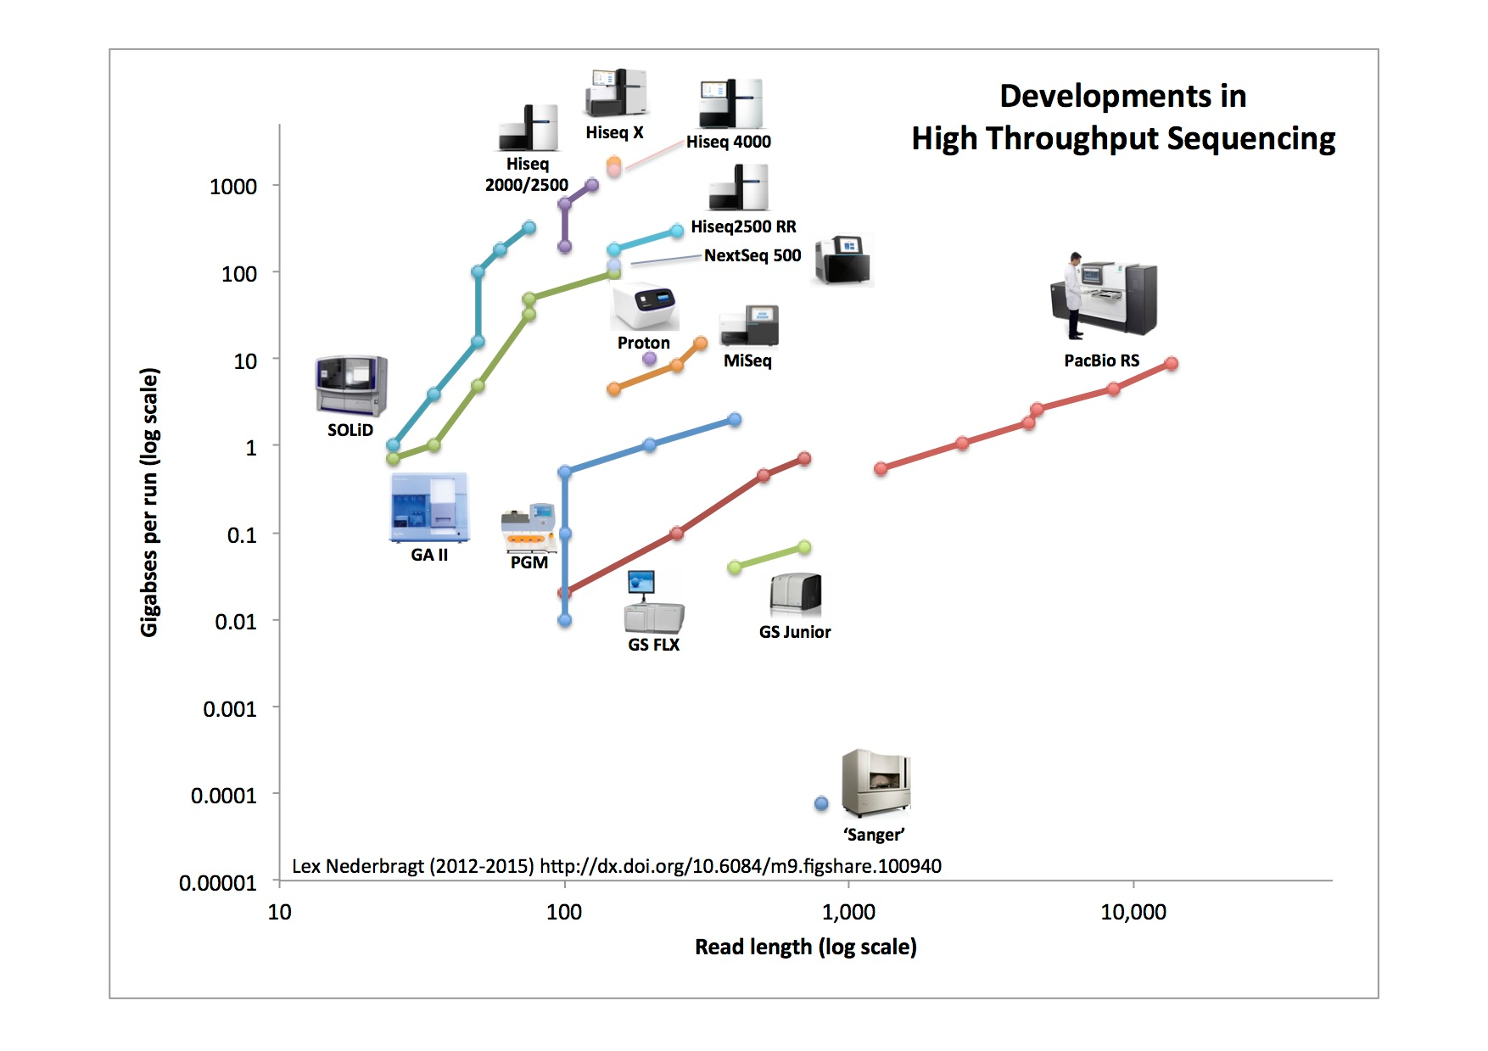

Slide 28
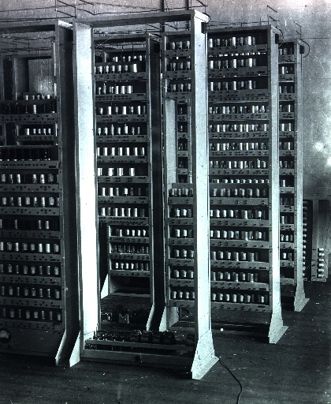
Bioinformatic challenges
    Huge data files handling.
    Beefy computers required.
    Software still being developed or missing.
    Ad-hoc software required during the analysis.
    Existing software tailored to experienced bioinformaticians.
    Dollar for dollar rule proposed
EDSAC by Computer Laboratory Cambridge

Slide 29
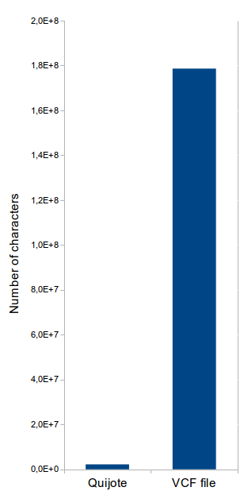
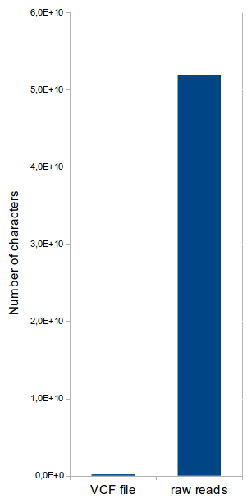
Bioinformatic challenges
Amount of data managed on a typical transcriptome assembly

Slide 30
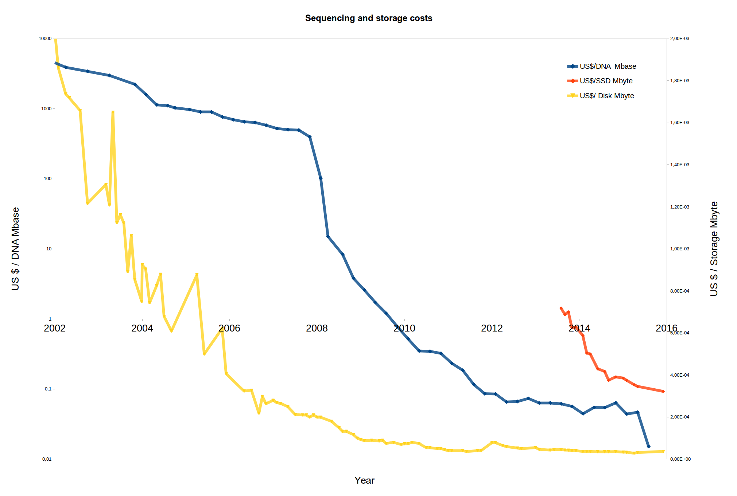
Genome.org/sequencingcosts

Slide 31
  This work is licensed under the Creative Commons Attribution 3.0 Unported License. To view a copy of this license, visit http://creativecommons.org/licenses/by/3.0/ or send a letter to Creative Commons, 171 Second Street, Suite 300, San Francisco, California, 94105, USA.
Jose Blanca
COMAV institute
bioinf.comav.upv.es

