Slide 1
Sequence assembly
Jose Blanca
COMAV institute
bioinf.comav.upv.es

Slide 2
Sequencing project
Unknown sequence
{
read 1
read 4
experimental
evidence
read 2
read 5
read 3
read 6
read 7
result

Slide 3

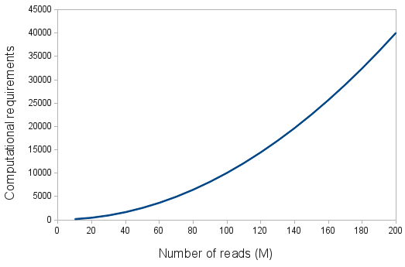
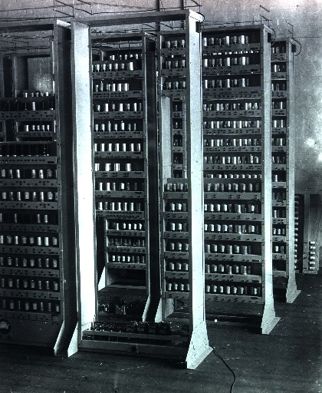
Computational requirements
mykl_roventine@flickr
    Main requirements:
      Memory.
      Time.
    The kmer-based assemblers requirements depend on the genome complexity and not so much on the reads.

Slide 4
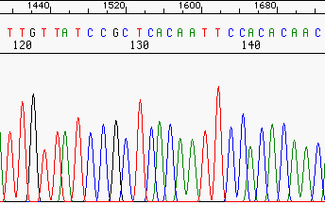
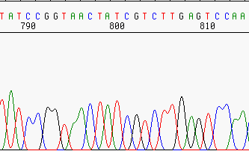
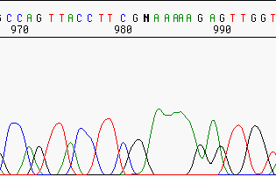
Read cleaning
    Some assemblers choke with: bad quality stretches, adapters, low complexity regions, contamination.
Bad quality
vector
Unknown sequence
Trim
Trim or mask

Slide 5
The assembly problem
    Only one read is usually not capable of producing the complete sequence.
    Even if the problem sequence is short one read might have sequencing errors.
repeats
Unknown sequence
Reads
Contigs / scaffolds
Reasons for the gaps
contig5 (repeat)
contig1
contig2
contig3
contig4
Repeated region
no coverage

Slide 6
Long reads

Slide 7
Mate pairs and paired-ends
    Read length is critical, but constrained by sequencing technology, we can sequence molecule ends.
    Useful for dealing with repetitive genomic DNA and with complex transcriptome structure.
    Paired-ends: Illumina can sequence from both ends of the molecules. (150-500 bp)
    Mate-pairs: Can be generated from libraries with different lengths (2-20 Kb).
    BAC-ends: Usually sequenced with Sanger.
Clone (template)
reads

Slide 8
Library types
    Single reads
    Illumina Pair Ends (150-500 pb)
    Mate Pairs (2-10 kb)
      Illumina

Slide 9
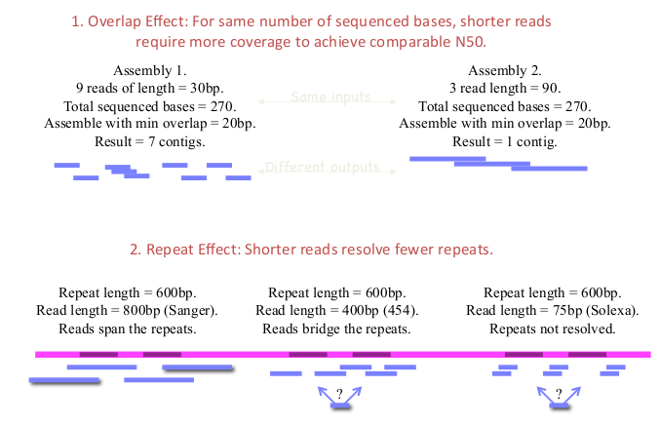
Short reads are harder to assemble
Taken from Jason Miller

Slide 10
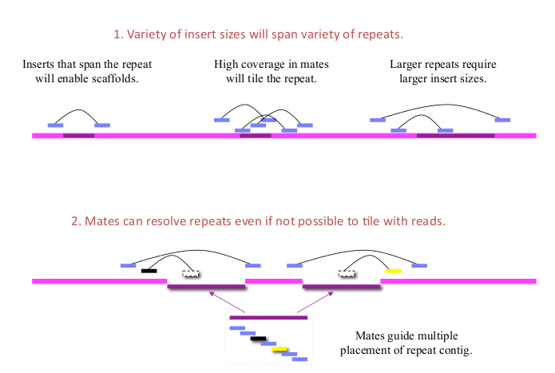
The need for paired reads
Taken from Jason Miller

Slide 11
Algorithm I
Overlap – Layout - Consensus

Slide 12
Overlap – Layout - Consensus
    Algorithm:
      All-against-all, pair-wise read comparison.
      Construction of an overlap graph with approximate read layout.
      Multiple sequence alignment determines the precise layout and the consensus sequence.
clean reads
Overlaps detection
All vs all alignment
Contigs
Consensus

Slide 13
Overlap problems
    Two reads are similar if they have a good overlap.
    We assume that overlap implies common origin in the genome.
    This goodness depends on the overlap quality and similarity.
    But several things might go wrong
Vector contamination or repetitive
repetitive
Too many sequencing errors
false positive
Chimeric clone
false negative
Short overlap

Slide 14
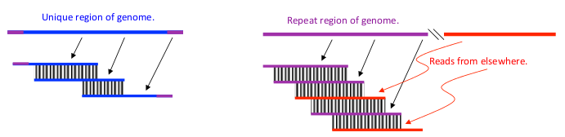
Overlap problems
    False positives will be induced by chance and repeats
    Avoid false positives with stringent criteria:
      Overlaps must be long enough
      Sequence similarity must be high (identity threshold)
      Overlaps must reach the ends of both reads
      Ignore high-frequency overlaps (repetitive regions in genomic?)
    But stringency will induce false negatives.

Slide 15
Assembly terminology
Consensus
Scaffold = Contigs + Parings
(gap lengths derived from pairings)
Contigs = Reads + Overlaps
Overlaps
Reads & Pairing
ACTGATTAGCTGACGNNNNNNNNNNTCGTATCTAGCATT
Taken from Jason Miller

Slide 16
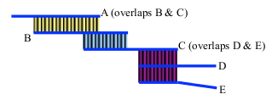
Unitigs
    Contigs:
      High-confidence overlaps
      Maximal contigs with no contradiction (or almost no contradiction) in the data
      Ungapped
      Contigs capture the unique stretches of the genome.
      Usually where unitigs end, repeats begin
Contig example. The ideal Contig is A, B, C.
C, D and E have a repetitive sequence.

Slide 17
Scaffolds
    Build with mate pairs
      Mate pairs help resolve ambiguity in overlap patterns
    Scaffolds
      Every contig is a scaffold
      Every scaffold contains one or more contigs
      Scaffolds can contain sequence gaps of any size (including negative)

Slide 18
Overlap-Consensus-Layout limitation
    30 Million 5Kb (long) reads
    Number of alignments: 30 M reads x 30 M reads = 900 trillion alignments
    It does not scale

Slide 19
Algorithm II kmer-based

Slide 20
K-mer based assembly
    K-mer graphs are de Bruijn graph.
    Nodes represent all K-mers.
    Edges represent fixed-length overlaps between consecutive K-mers.
    Assembly is reduced to a graph reduction problem.
Read 1 AACCGG
Read 2 CCGGTT
Graph: AACC -> ACCG -> CCGG -> CGGT -> GGTT
K-mer length = 4

Slide 21
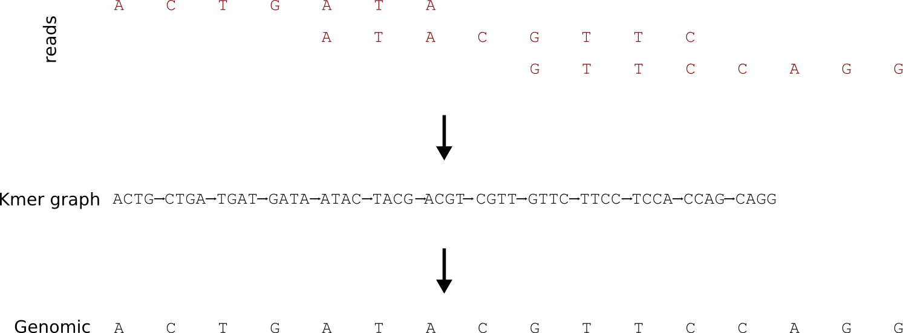
K-mer based assembly
Notes:
if we sequence billions of short reads uniformly representing the entire genome and construct a giant de Bruijn graph from those short reads, that de Bruijn graph will look identical to the de Bruijn graph of the genome. Therefore, our challenge will be to go back to the genome sequence from its de Bruijn graph.

Slide 22
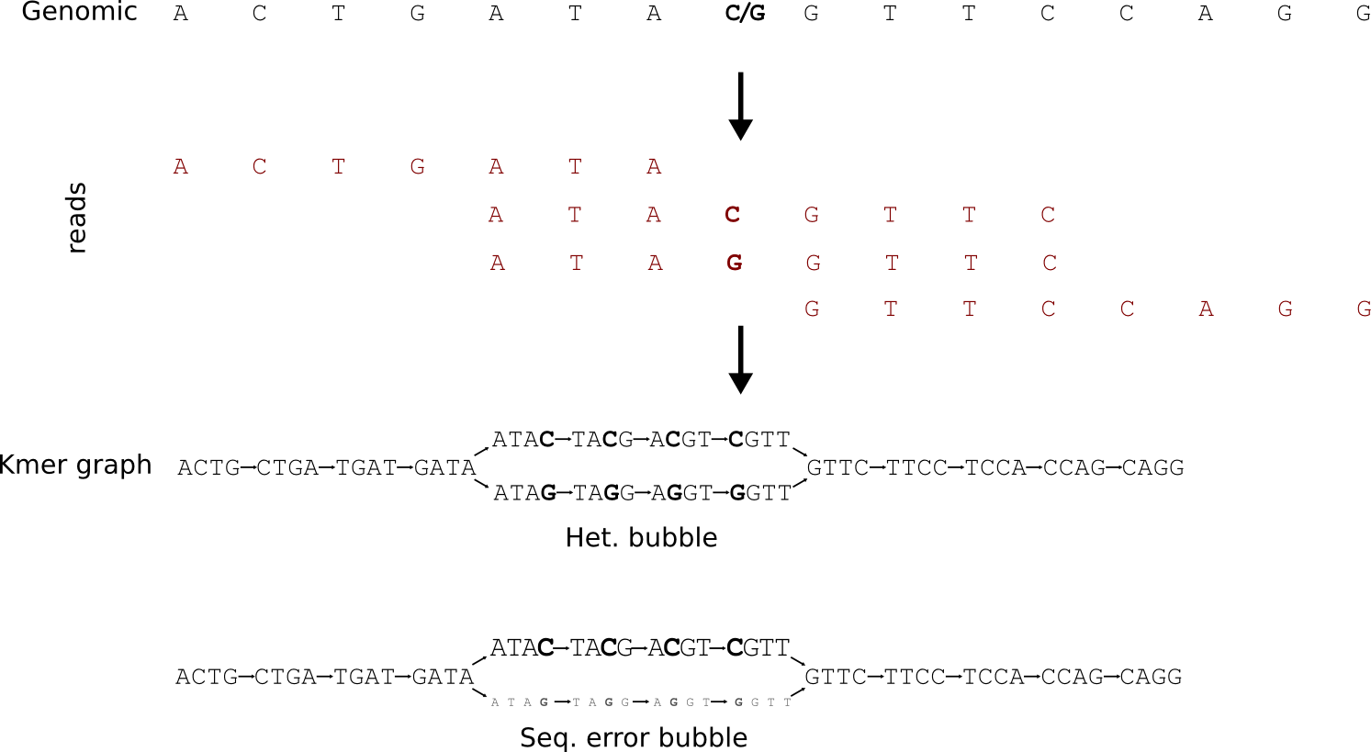
K-mer bubbles
Notes:
if some K-mers have low occurrence, they likely originate from sequencing errors.

Slide 23
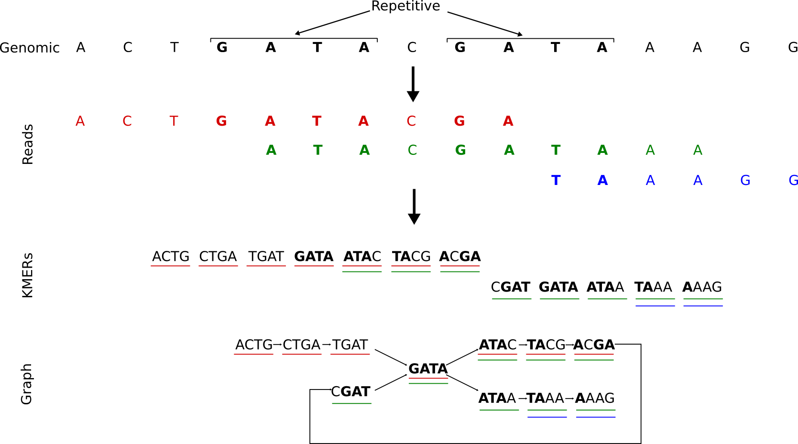
K-mer repetitive
Notes:
If almost all nodes of the de Bruijn graph are visited by 50 short reads, but a small subset of nodes visited by 200 short reads, one can argue that the underlying sequence near those subset of nodes constitute repetitive regions of the genome, and they are present 4 times in the genome. So, instead of avoiding repeats, as done by traditional assemblers, de Bruijn graphs allow one to estimate the repeat frequencies of repetitive regions during assembly.

Slide 24
Graph problems
    Repeats, sequencing errors and polymorphisms increase graph complexity, leading to tangles difficult to resolve
    K-mer graphs are more sensitive to repeats and sequencing errors than overlap based methods.
    Optimal graph reductions algorithms are NP-hard, so assemblers use heuristic algorithms
Polymorphism
Sequencing error
Repeat

Slide 25
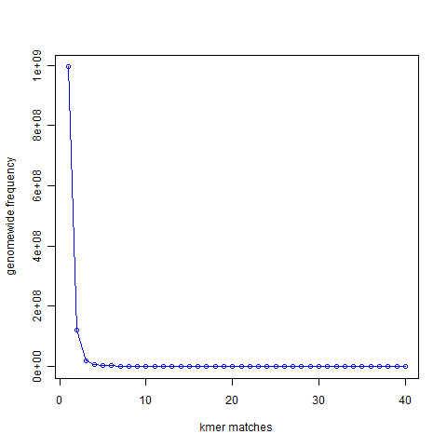
K-mer analysis
    21-mer distribution of sea urchin (Strongylocentrotus purpuratus) genome (900 Mbase long)
unique
repetitive
Notes:
994,401,729 21-mers were present only once in the genome. That is the number you see for x=1 in the following graph. 122,161,264 21-mers were present twice (x=2). 20,077,544 21-mers were present thrice (x=3)

Slide 26
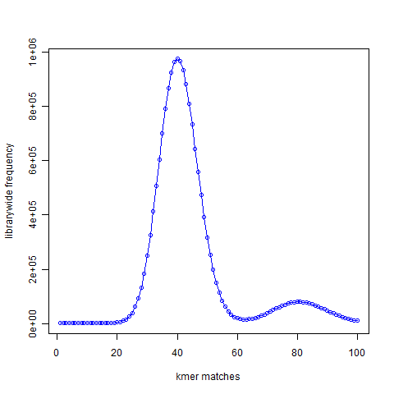
K-mer analysis
    K-mer distribution
    Simulated reads.
    50X coverage
    No errors
Genome
reads
unique
Repetitive (duplication)
Notes:
994,401,729 21-mers were present only once in the genome. That is the number you see for x=1 in the following graph. 122,161,264 21-mers were present twice (x=2). 20,077,544 21-mers were present thrice (x=3)

Slide 27
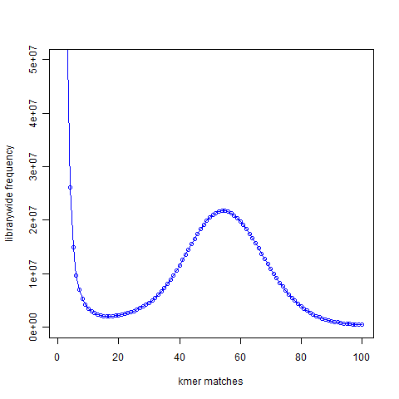
K-mer analysis
    K-mer distribution
    real reads.
    50X coverage
    With errors
Genome
Real reads (with errors)
noise
Simulated reads (no error)
signal
Notes:
Why is the noise peak so big? Think about this – every time a read has one nucleotide error, it can result in 21 erroneous 21-mers. Thus, when we look at the k-mer distribution of all reads, errors appear magnified k times. However, there is also memory cost to having those errors
a good strategy for cleaning data would be to reduce the noise peak as much as possible. When we trim 3′ edges, it makes sense to check what trimming is doing to the noise peak. If cutting one additional nucleotide does not reduce amount of noise, it is not helping the assembly. I think checking the k-mer distribution is a better measure than using the pre-assigned quality scores from the sequencer.

Slide 28
Final remarks

Slide 29
N50
    N50 is defined as the contig length such that using equal or longer contigs produces half the bases of the genome.
    The N50 statistic is a measure of the average length of a set of sequences, with greater weight given to longer sequences.
    It is widely used in genome assembly
N50: 10829 N95: 20 minimum: 100 maximum: 146,370 average: 1618.01 num. seqs.: 141503
[ 100 , 7414[ (131545): ************************************************************************
[ 7414 , 14728[ ( 6247): ***
[ 14728 , 22042[ ( 2353): *
[ 22042 , 29356[ ( 842):
[ 29356 , 36670[ ( 324):
[ 36670 , 43984[ ( 118):
[ 43984 , 51298[ ( 42):
[ 51298 , 58612[ ( 13):
[ 58612 , 65926[ ( 10):
[ 65926 , 73240[ ( 4):
[ 73240 , 80554[ ( 0):
[ 80554 , 87868[ ( 1):
[ 87868 , 95182[ ( 0):
[ 95182 , 146380[ ( 4):
Taken from Wikipedia

Slide 30
Common assembly errors
    Collapsed repeats
      Align reads from distinct (polymorphic) repeat copies
      Fewer repeats in assembly than in genome
      Fewer tandem repeat copies in assembly than genome
    Missed joins
      Missed overlaps due to sequencing error
      Contradictory evidence from overlaps
      Contradictory or insufficient evidence from pairs
    Chimera
      Enter repeat at copy 1 but exit repeat at copy 2
      Assembly joins unrelated sequences

Slide 31
Ingredients for Good Assembly
  Coverage and read length
      20X for (corrected) PacBio, 150X for Illumina
Paired reads
      Read lengths long enough to place uniquely
      Inserts longer than long repeats
      Pair density sufficient to traverse repeat clusters
      Tight insert size variance
      Diversity of insert sizes
  Read Quality:
      Sequencing errors
      No vector contamination
      Contamination: mitochondrial or chloroplastic
  The requirements depend greatly on the quality: it is not the same a draft that high quality genome.

Slide 32
Common assemblers
    Genomic
      SOAPdenovo, Illumina
      CABOG: Celera assembler, 454 and few Illumina
    Staden for Sanger reads.
    Transcriptomic assemblers are specialized software

Slide 33
  This work is licensed under the Creative Commons Attribution 3.0 Unported License. To view a copy of this license, visit http://creativecommons.org/licenses/by/3.0/ or send a letter to Creative Commons, 171 Second Street, Suite 300, San Francisco, California, 94105, USA.
Jose Blanca
COMAV institute
bioinf.comav.upv.es

