Slide 1
Sequence analysis software
Jose Blanca
COMAV institute
bioinf.comav.upv.es

Slide 2
NGS answers
    For all your NGS questions there's one place to go, the seqanswers forum.
  http://seqanswers.com/
    seqanswers is a community site with thousands of members.
    In seqanswers there are news, questions and answers, discussions, etc.
    Most of the content is organized around a forum and a wiki.

Slide 3

NGS software
… is moving fast
ryanhartkopf

Slide 4
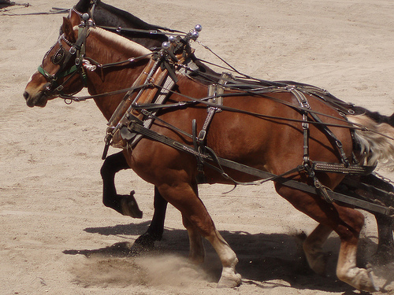
NGS workhorses
    The most used applications are usually Linux and Command Line based.
assemblers
SOAPdenovo
CABOG
Trinity
Mira
Velvet
Preprocessing
Fastqc
Fastx
Prinseq
sff_extract (seq_crumbs)
mappers
Bowtie2
BWA
Tophat
GMAP
SAM processing
samtools
picard
GATK
formats
fastq
SAM/BAM (samtools)
vcf/bcf (vcftools)
Bed (bedtools)
GFF

Slide 5
seq_crumbs
  Main features:
      Focused on fastx processing
      Unix design:
        Small utilities
        Pipe friendly
      Supports gzip, bzip2, and bgzf
      Pair aware.
  Trimming:
      trim_by_case
      trim_edges
      trim_quality
      trim_blast_short (for oligonucleotides)
  Filtering:
      filter_by_quality
      filter_by_length
      filter_by_name
      filter_by_blast
      filter_by_bowtie2
      filter_by_complexity
  Pairing:
      split_matepairs (with a linker e.g. 454)
      pair_matcher
      interleave_pairs
      deinterleave_pairs
    Other:
      sff_extract
      convert_format
      guess_seq_format
      seq_head
      sample_seqs
      change_case
      count_seqs
  Similar software:
      PRINSEQ
      fastx
      FastqMcf

Slide 6



NGS GUI applications
    Galaxy:
      Web frontend on top of the standard applications (bwa, samtools, etc.)
      Somewhat clunky interface, but easy once you know what to do.
      Free software
      The computation of large files in the Galaxy server can be difficult.
      A local server can be set up (informatician required).
    Commercial software:
      Very easy to use.
      Windows, Linux and Mac OS versions.
      Costly and proprietary.
      CLC genomic workbench and LaserGene are examples.

Slide 7
NGS pipelines
    The pipelines are tailored to an specific set of problems.
    Usually Linux and with a Command Line Interface.
    Examples:
      Tophat/cufflinks.
        NGS based expression quantification.
      Gigabayes.
        SNP calling.
      ngs_backbone.
        SNP calling and functional annotation.

Slide 8
  This work is licensed under the Creative Commons Attribution 3.0 Unported License. To view a copy of this license, visit http://creativecommons.org/licenses/by/3.0/ or send a letter to Creative Commons, 171 Second Street, Suite 300, San Francisco, California, 94105, USA.
Jose Blanca
COMAV institute
bioinf.comav.upv.es

