Slide 1
NGS application examples
Jose Blanca
Joaquin Cañizares
COMAV institute
bioinf.comav.upv.es

Slide 2
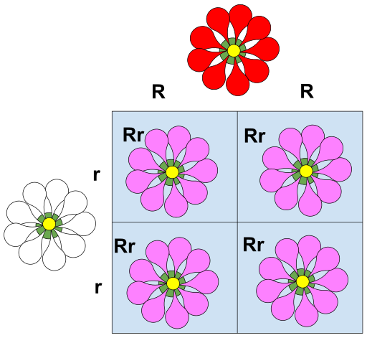
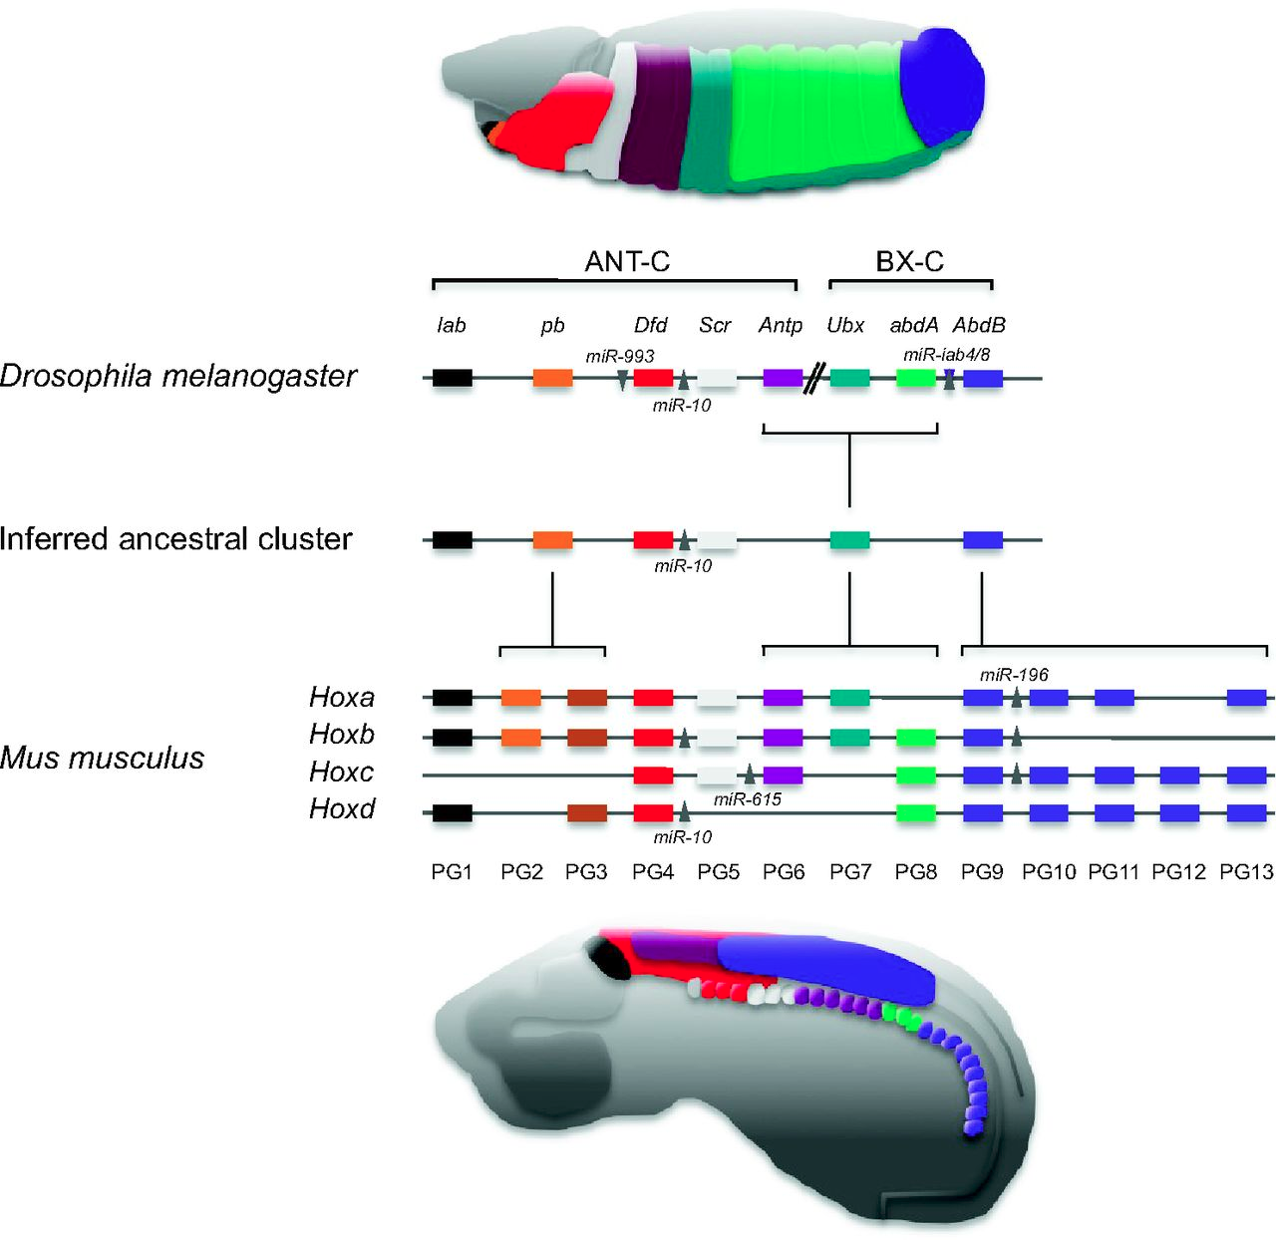
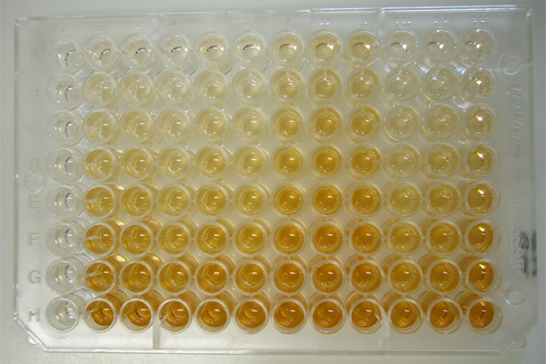
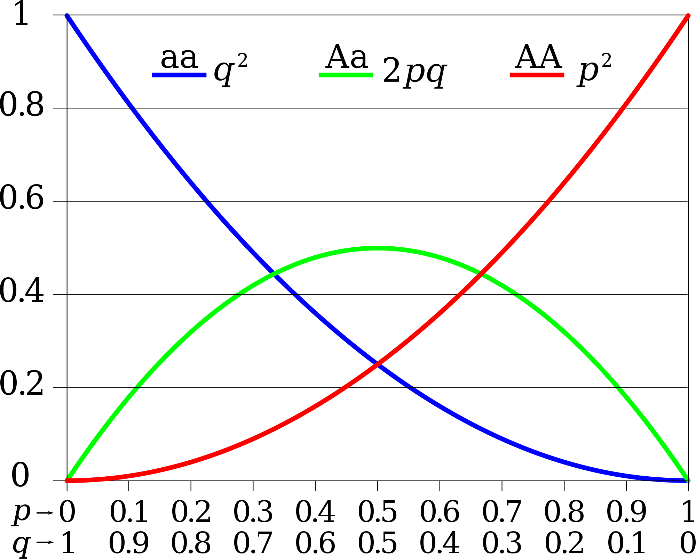
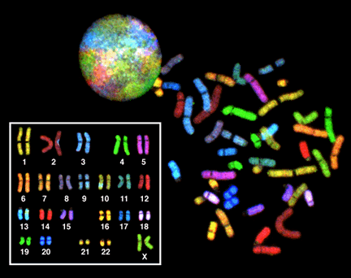
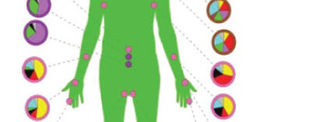
What can do with NGS?

Slide 3
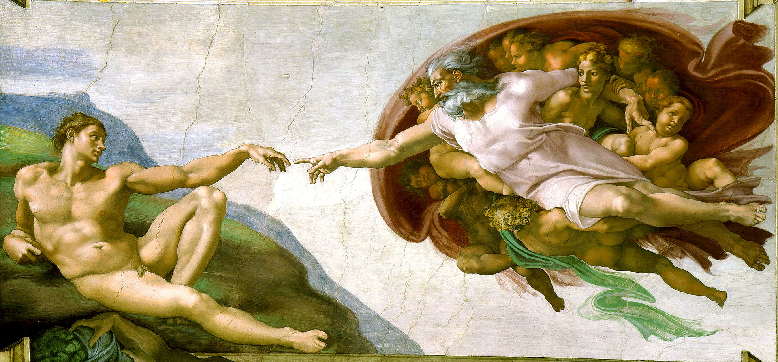
Is the NGS restricted to model organisms?

Slide 4
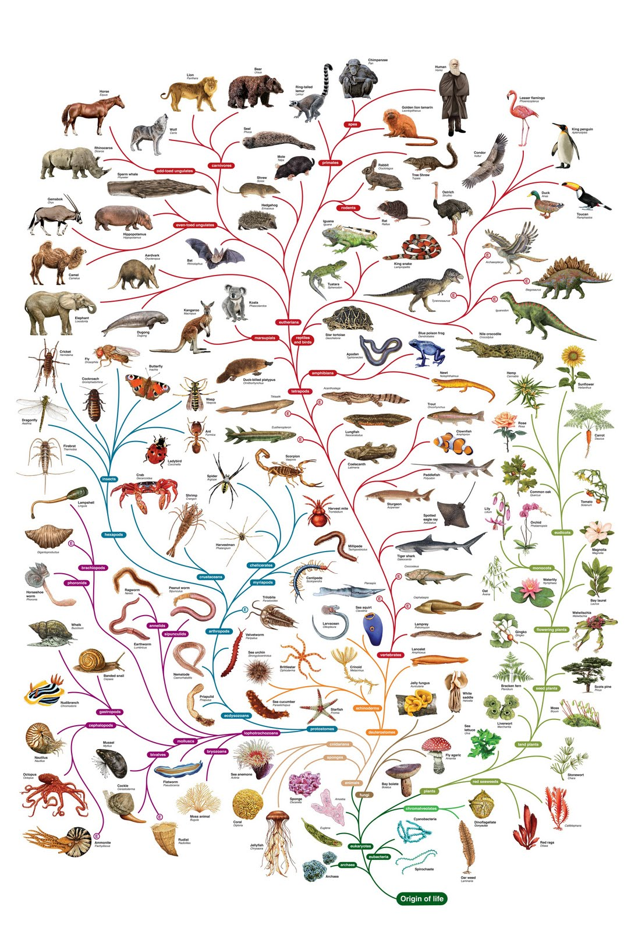
Is the NGS restricted to model organisms?

Slide 5
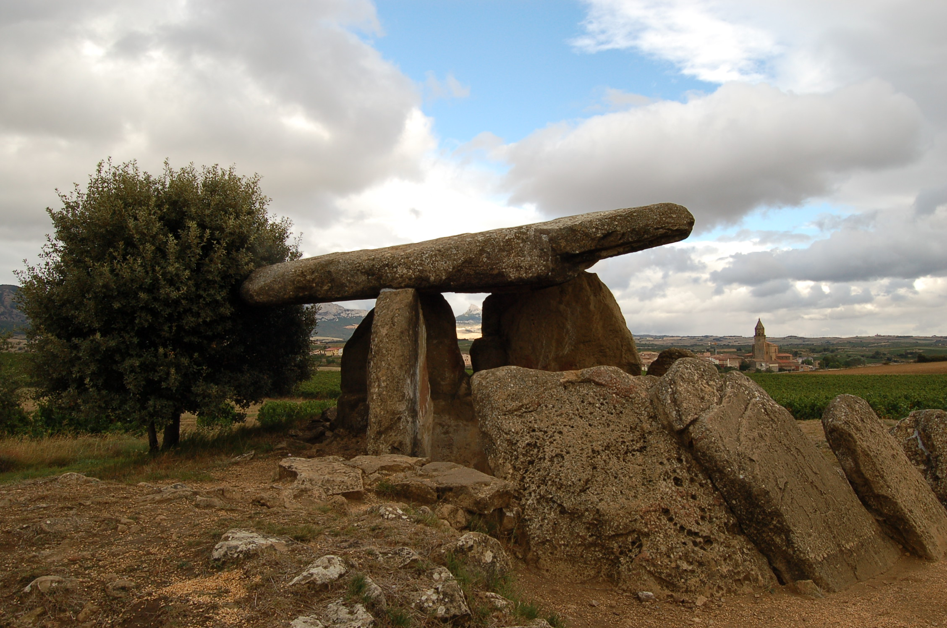

Is the NGS restricted to model organisms?

Slide 6
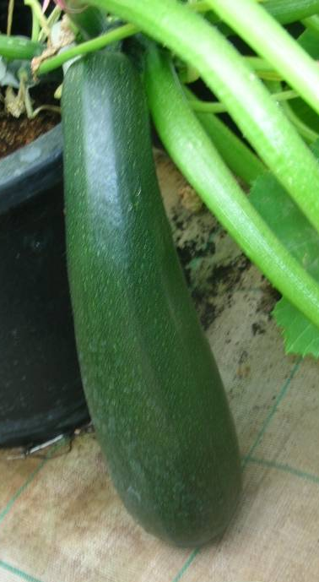
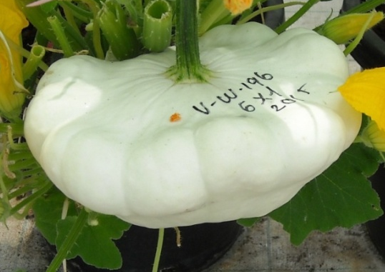
Marker discovery in C. pepo accessions
  Materials
subsp. pepo cv. Zucchini
MU16
subsp. ovifera cv Scallop
UPV196
454 RNA-Seq
2 accessions
SNPs
SSRs
CAPs
  Method
Transcriptome
Notes:
- SNP calling is routine

Slide 7
Marker discovery in C. pepo
Zucchini MU16: 407,723 reads
Scallop UPV196: 392,370 reads
49,610 annotated transcripts
1,935 potential SSRs
(86.7% polymorphic)
19,980 SNPs 1,174 INDELs
3,538 SNPs high quality and easy to use
144 CAPs (80% validation rate)
Notes:
- SNP calling is routine

Slide 8
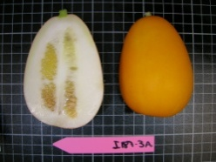
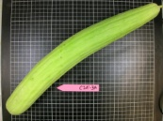
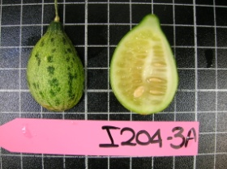
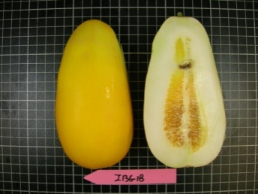
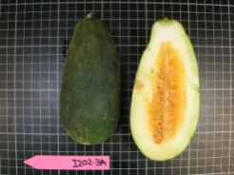
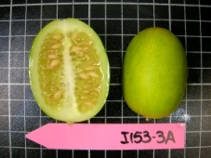
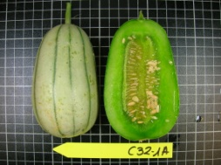
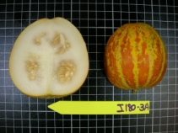
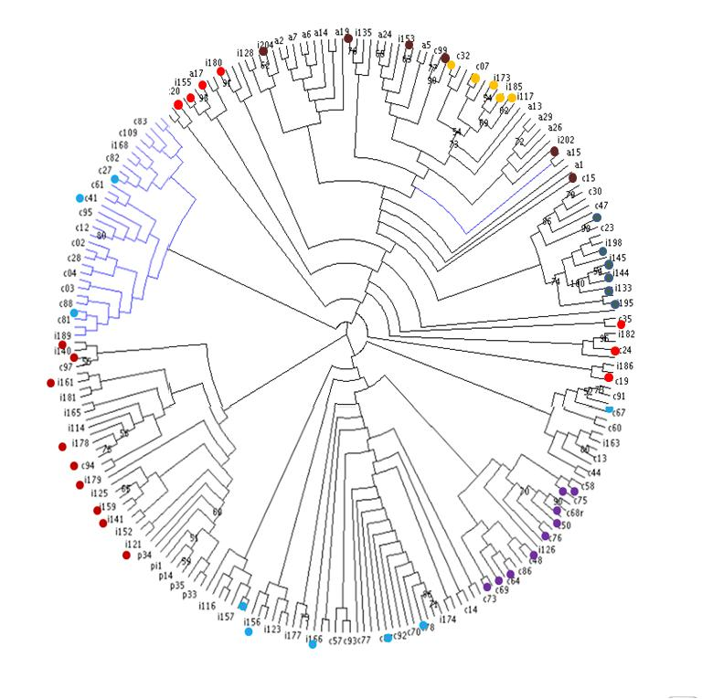
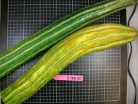
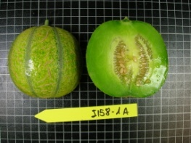
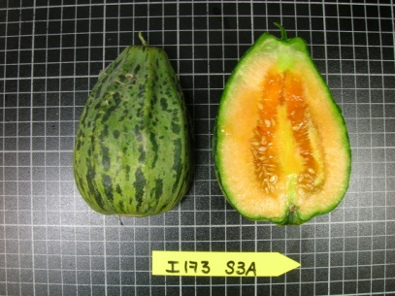
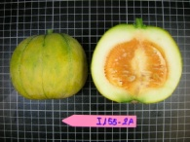
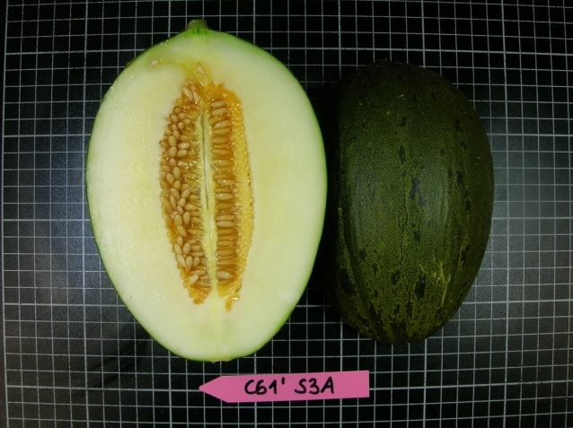
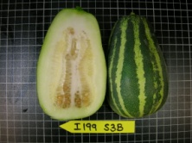
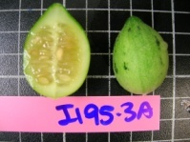
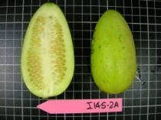
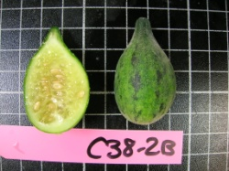
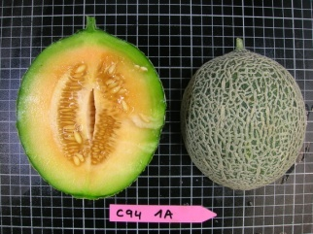
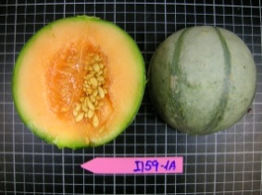
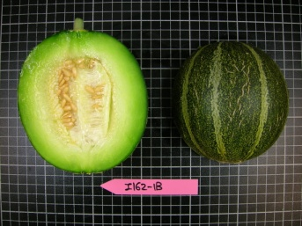
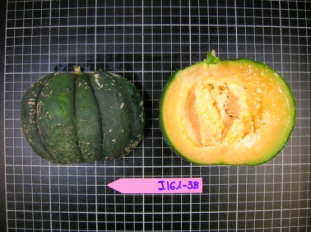
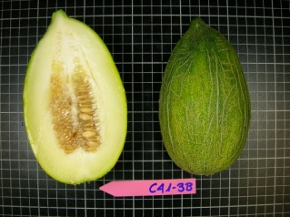
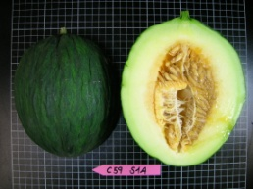
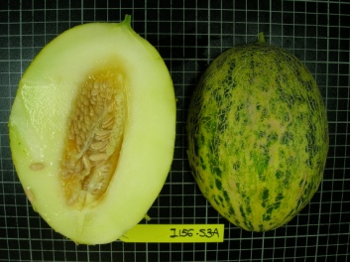
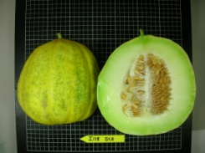
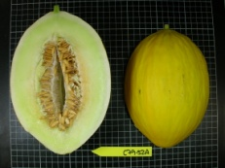
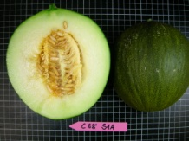
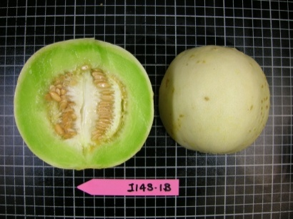
SNP mining in melon
Dudaim, momordica y flexuosus
India, Iran Iral, Afganistan, Arabia
Agrestis, acidulus
India
Conomon, makuwa, chinensis
Japon, corea
Inodorus: Piel de sapo
Piel de sapo S. Fito
Agrestis, tibish
Africa
Cantalupensis
Cantalupos S.Fito
Europa, Asia America
Inodorus,ameri, chandalak, adana
Este de europa-Asia
Inodorus (Amarillo, tendral Rochet)
Amarillos.S.Fito
España

Slide 9
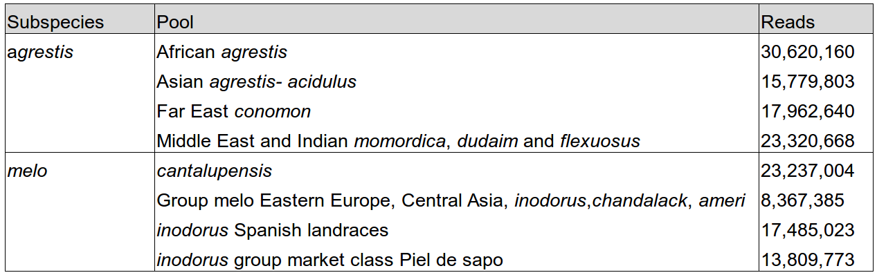
Marker discovery in C. melo pools

Slide 10
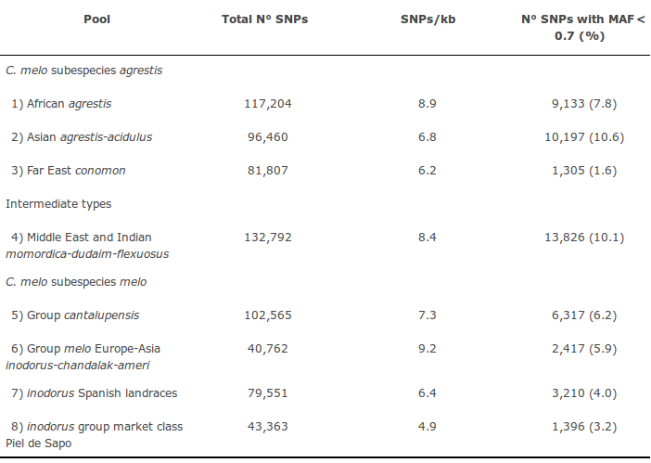
Marker discovery in C. melo pools
260 million SOLiD reads
303,883 SNPs and Indels
(18.8 SNVs per gene)
28,996 easy to use SNPs
(92% validation rate)
Notes:
Hay que filtrar mucho los SNPs para conseguir los buenos.
La tasa de validación es muy buena.
Distintos SNPs en distintos grupos.

Slide 11
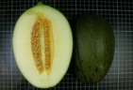
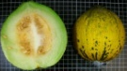
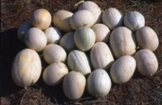

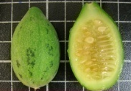


Marker discovery in C. melo pools
None shared SNPs between agrestis and melo
43,363
Pool 8
21,566 (50/16)
40,762
Pool 6
23,488
(58/18)
102,565
Pool 5
52,514
(51/40)
132,792
Pool 4
79,551
Pool 7
40,668
(51/31)
117,204
Pool 1
46,865
(40/35)
96,460
Pool 2
47,491
(49/36)
81,807
Pool 3
38,384
(47/29)
Notes:
Hay que filtrar mucho los SNPs para conseguir los buenos.
La tasa de validación es muy buena.
Distintos SNPs en distintos grupos.

Slide 12
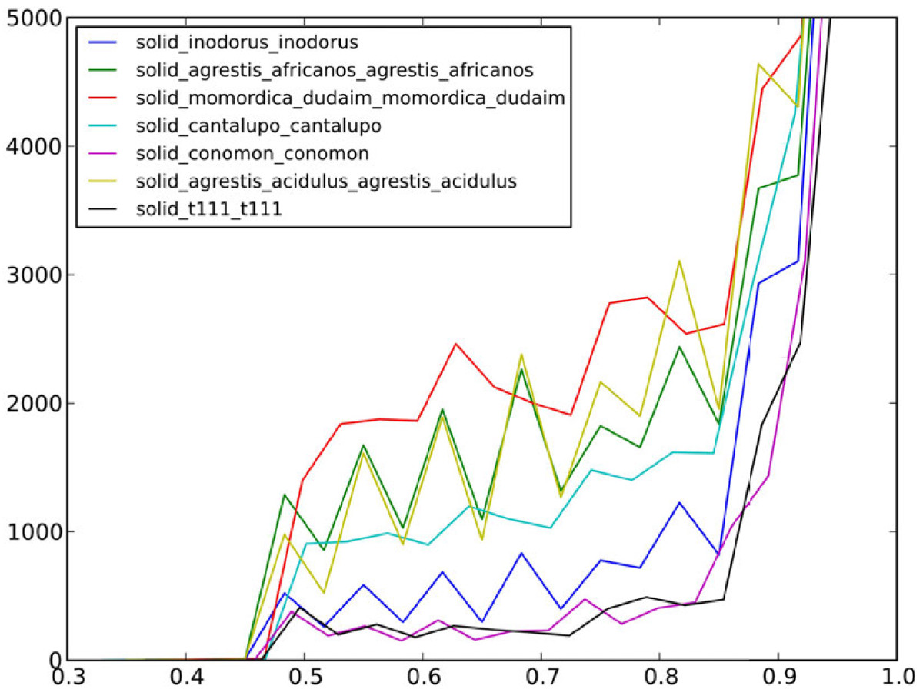
Marker discovery in C. melo pools
Sequencing pools we get allele frequencies not genotypes
Num. SNPs
MAF
Notes:
SNPs are more or less useful depending on the population.
If a SNP genotyping platform is not be created or some SNPs are going to be used extensively to reduce costs we need the most polymorphic SNPs.
Polymorphism depends on the population, so we have to evaluate the MAF in the materials of interest

Slide 13
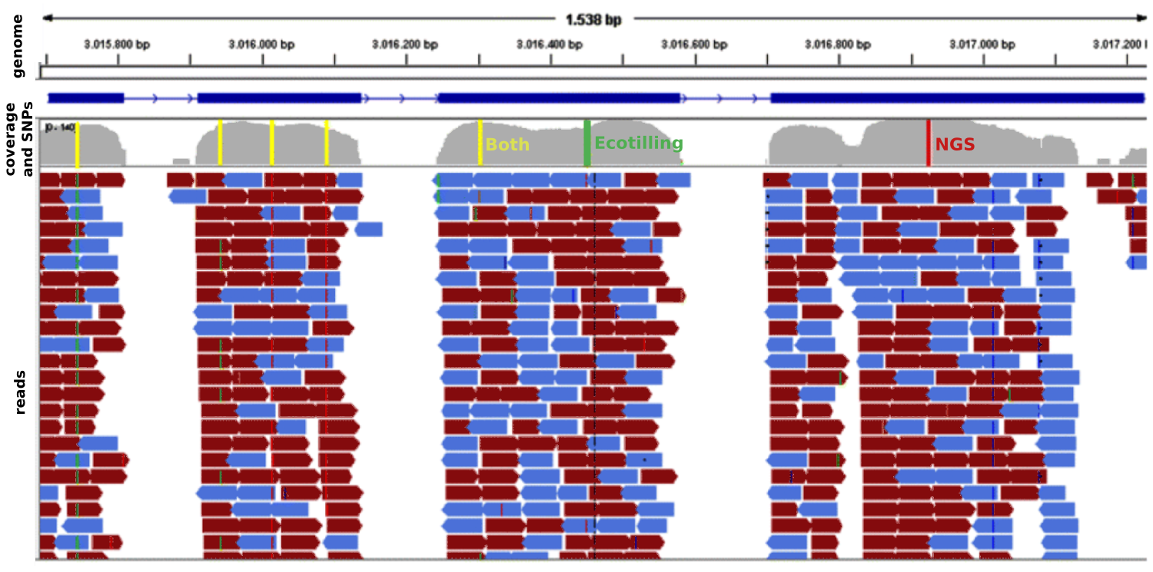
NGS Ecotilling in melon ACO-1
    150M 44pb SOLiD processed reads
    RNASeq
    212 melon accessions in 8 pools
Notes:
Ecotilling uses:
EcoTilling:
- Búsqueda nuevos alelos. Pimiento, melón
- Catalogación de la variación en el presente.
SNPs detected by SOLiD and EcoTILLING are represented by colored bars in the different exons (red, green and yellow for mutations detected only by SOLiD, only by EcoTILLING and by both methods

Slide 14
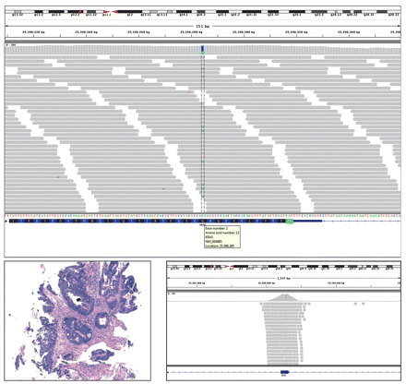
Cancer mutation identification
KRAS mutation in colorectal cancer
CRC cases with a G12V KRAS
Hiseq2000 of 182 genes
formalin-fixed, paraffin-embedded sample
Ross JS, Cronin M. Whole cancer genome sequencing by next-generation methods.
Am J Clin Pathol. 2011 Oct;136(4):527-39

Slide 15
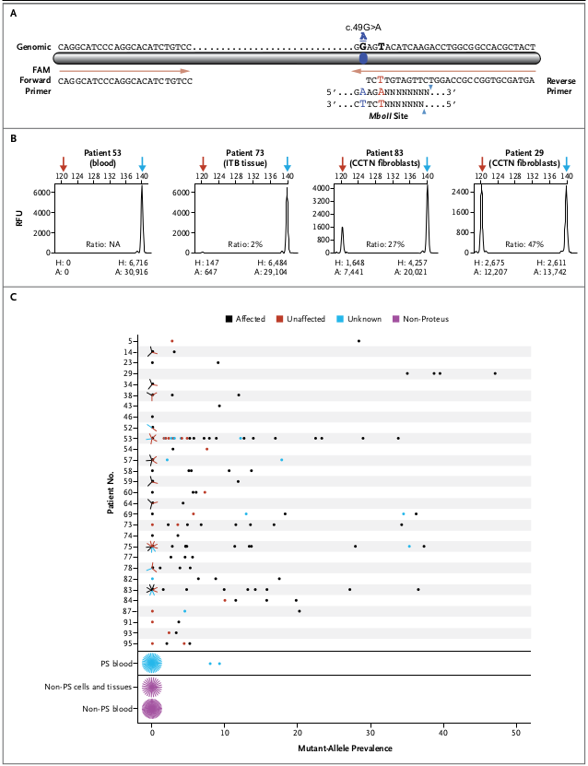
Somatic mutation identification
Proteus Syndrome
Sequencing of exome of normal and affected tissues
Agilent All Exon kit
26/29 analyzed patients had a somatic activating mutation (c.49G→A, p.Glu17Lys) in the oncogene AKT1
Lindhurst MJ, Sapp JC, Teer JK, Johnston JJ, Finn EM, Peters K, Turner J,
Cannons JL, Bick D, Blakemore L, Blumhorst C, Brockmann K, Calder P, Cherman N Deardorff MA, Everman DB, Golas G, Greenstein RM, Kato BM, Keppler-Noreuil KM,Kuznetsov SA, Miyamoto RT, Newman K, Ng D, O'Brien K, Rothenberg S,
Schwartzentruber DJ, Singhal V, Tirabosco R, Upton J, Wientroub S, Zackai EH,
Hoag K, Whitewood-Neal T, Robey PG, Schwartzberg PL, Darling TN, Tosi LL,
Mullikin JC, Biesecker LG. A mosaic activating mutation in AKT1 associated with the Proteus syndrome. N Engl J Med. 2011 Aug 18;365(7):611-9.

Slide 16

Fetal Plasma mutation identification
753 pregnant at high risk for fetal trisomy 21
Plasma maternal DNA sequencing
Genome Analyzer IIx
Percentage at 8-plex: 79.1% of the trisomy
Percentage at 2-plex: 100% of the trisomy
Hahn S, Lapaire O, Tercanli S, Kolla V, Hösli I. Determination of fetal
chromosome aberrations from fetal DNA in maternal blood: has the challenge
finally been met? Expert Rev Mol Med. 2011 May 4;13:e16.

Slide 17

Population studies. 1000 genomes
2,504 human genomes
26 populations
Tech:
Low coverage whole sequence
Deep exome
Dense microarray
Results:
SNPs: 84.7M
>99% SNPs with freq > 1%
Short Indels: 3.6M
Structural variants: 60.000
Nature 526 (2015) doi:10.1038/nature15393
http://www.1000genomes.org/

Slide 18

Population studies. 1000 genomes (SVs)
2,504 human genomes
Illumina 100pb reads, 7.4X
Structural Variant analysis
42,279 deletions
6,025 duplications
2,929 multi allelic CNVs
786 inversions
168 nuclear mitochondrial insertions
16,631 mobile element insertions
Nature 526 (2015) doi:10.1038/nature15394
http://www.1000genomes.org/

Slide 19

360 tomato genomes
360 accessions
Whole genome ~5X
11,620,517 SNPs
1,303,213 small indels
Lin T, Zhu G, Zhang J, Xu X, Yu Q, Zheng Z, Zhang Z, Lun Y, Li S, Wang X,
Huang Z, Li J, Zhang C, Wang T, Zhang Y, Wang A, Zhang Y, Lin K, Li C, Xiong G,
Xue Y, Mazzucato A, Causse M, Fei Z, Giovannoni JJ, Chetelat RT, Zamir D, Städler
T, Li J, Ye Z, Du Y, Huang S. Genomic analyses provide insights into the history
of tomato breeding. Nat Genet. 2014 Nov;46(11):1220-6. doi: 10.1038/ng.3117. Epub
2014 Oct 12. PubMed PMID: 25305757.

Slide 20

360 tomato genomes
Domestication signals
Association mapping
Population structure
Phylogenomics

Slide 21

Genetic mapping: SSRs vs NGS
    Thousands of polymorphic markers between parents are needed
    Problem:
    SSRs:
      High PIC :)
      non automatable :(
    SNPs:
      Low PIC :(
      automatable :)
    Strategy 1:
      Look for SNPs between parents by sequencing (e. g. transcriptome).
      Genotyping with Illumina array.
  Strategy 2:
      GBS for all samples

Slide 22


QTL mapping in tomato
    Parthenocarpy in tomato
    RP75/59 mutant:
      Robust fruit set rate
      Phenotyped F2: RP75/59 x UC82
    No reference genome (2009), only transcriptome
    Cost:
      Sequencing: 3000$
      Genotyping: 12,000$

Slide 23


QTL mapping in tomato
Low coverage Illumina pooled (RP75/59 and UC82) RNASeq
384 high quality SNPs
F2 Veracode Genotyping

Slide 24
QTL mapping in tomato
Low coverage Illumina RNASeq
    SNP discovery:
      Sequencing:
        Normalized cDNA library
        14.2 M 75bp Illumina reads
        276,039 Sanger ESTs
      Mapping against the transcriptome:
        Illumina: 8.5 coverage
        Sanger: 4.2 coverage
      SNP calling:
        33.306 SNPs
        6.934 easy to use (85% validation rate by HRM)
        Subset of 291 easy to use highly polymorphic set. 0.28 PIC in 37 tomato varieties.
    F2 genotyping:
      384 SNPs (Veracode-Illumina)
      85% success rate
384 high quality SNPs
Genotyping: 85% success rate
Notes:
Done in 2009. No reference genome yet.

Slide 25




QTL mapping in tomato
fruit set QTL
fruit size QTLs
Lod: 12.1
Lod: 3.1
Lod: 4.0

Slide 26


GBS-based genetic map in C. pepo
    C. pepo population
    Reference genome
    (assembled by us)
    GBS for all 143 individuals → 38,424 SNPs
    Sequencing Cost: 143 * $50 = $7150
    269M reads
    38,424 SNPs
    with less than 5% missing data

Slide 27

GBS-based genetic map in C. pepo

Slide 28

Genetic populations studies.

Slide 29

BSA
Notes:
Genética sencilla

Slide 30

BSA: Spodoptera resistance to Bt toxin
Xen-R (resistant) x FRA (susceptible)
F1 x Xen-R
BC (resistant individuals)
Illumina sequencing
Notes:
Not having the dead ones was a handicap.
No siempre se llega al gen, a veces hasta la región

Slide 31

BSA: Spodoptera resistance to Bt toxin
    Sequencing:
      1 Illumina lane, half for each parent (355M reads)
      1 Illumina lane for the resistant individuals in BC1 (360M reads)
    Analysis:
      Transcriptome assembly: 96,676 unigenes
      Synteny with Bombyx mori
        Same infraorden different superfamily
      B. mori orthologs: 15,116 unigenes
      437,815 SNPs and 80,246 indels
      Resistance skewness allele ratio along the genome
Notes:
Not having the dead ones was a handicap.
No siempre se llega al gen, a veces hasta la región

Slide 32

BSA: Spodoptera resistance to Bt toxin
ABCC2 transporter
(checked with transgene)
    Cost:
        Sequencing: $6000
        Analysis: 2 months
Notes:
Not having the dead ones was a handicap.
No siempre se llega al gen, a veces hasta la región

Slide 33
BSA whitout NGS?
Analyzed SNPs: 268,000
Samples: 3
Not viable
Alternatives:
SNP platform: small number of markers, expensive for only 3 samples
AFLPs: Hundreds of combinations, no genetic map, not synteny

Slide 34

Genome wide association (GWA)
Chengsong Zhu, Michael Gore, Edward S. Buckler and Jianming Yu. Status and Prospects of Association Mapping in Plants. Plant Genome 2008. Vol. 1 No. 1, p. 5-20

Slide 35

GWAs vs GRs
Tsuji S. Genetics of neurodegenerative diseases: insights from high-throughput resequencing. Hum Mol Genet. 2010 Apr 15;19(R1):R65-70.
Notes:
GR: Genome resequencing
Sequenciación completa cuando hay pocos individuos porque el efecto es grande. GWAs cuando hay muchos individuos porque el efecto de cada SNP es grande.

Slide 36


GWAs non-model organism
GWAs in Heterobasidion annosum
Pathogenic fungi
23 haploid isolates sequenced (4-10X)
Assembly of draft fungi genome :
      Size: 30,5 Mb
      N50: 40Kb
      Coverage: 38,7X
Tested in Pine and Spruce
12 SNPs detected in 7 contigs
Candidate genes and concordance
with known genes and QTLs
Dalman K, Himmelstrand K, Olson Å, Lind M, Brandström-Durling M, et al. (2013) A Genome-Wide Association Study Identifies Genomic
Regions for Virulence in the Non-Model Organism Heterobasidion annosum s.s. PLoS ONE 8(1): e53525. doi:10.1371/journal.pone.0053525

Slide 37
Copy number variations. CNVs
Referencia
Referencia
Muestra
Muestra
Referencia
Referencia
Muestra
Muestra
Notes:
Con mate pairs o por cobertura.

Slide 38

Exome. CNVs
Exome capture and 454
8 cell cancer lines
1,9 millions reads/ sample
Coverage 7,3X
95% concordance with Affymetrix SNP Array 6.0
2,779 potential novel sequence variations/mutations per cell line.
Chang H, Jackson DG, Kayne PS, Ross-Macdonald PB, Ryseck RP, Siemers NO. Exome
sequencing reveals comprehensive genomic alterations across eight cancer cell
lines. PLoS One. 2011;6(6).

Slide 39

RNA-seq
Rice and blast fungus
Expression in infected leaves at 24 dpi
Genome Analyzer IIx
Duplicated samples
1 line/ samples
Kawahara Y, Oono Y, Kanamori H, Matsumoto T, Itoh T, Minami E. Simultaneous
RNA-Seq Analysis of a Mixed Transcriptome of Rice and Blast Fungus Interaction.
PLoS One. 2012;7(11)

Slide 40

miRNA. P53
Identification miRNA en p53 tumors
H1299 lung cancer cells
Small RNA library.
454. GS20
31 miRNA activated
16 suppressed.
miR-34a induces apoptosis and cell cycle arrest
Tarasov V, Jung P, Verdoodt B, Lodygin D, Epanchintsev A, Menssen A, Meister G, Hermeking H. Differential regulation of microRNAs by p53 revealed by massively parallel sequencing: miR-34a is a p53 target that induces apoptosis and G1-arrest. Cell Cycle. 2007 Jul 1;6(13):1586-93

Slide 41

ChIP-seq
Detects promoters regulated by specific transcription factors, RNA pol binding and modified histone and DNA regions.
Cullum R, Alder O, Hoodless PA. The next generation: using new sequencing
technologies to analyse gene regulation. Respirology. 2011 Feb;16(2):210-22

Slide 42


DNA methylation
Figure 4 Technologies for detection of genome-wide methylation.
Emes R D , Farrell W E J Mol Endocrinol 2012;49:R19-R27

Slide 43

DNA Methylation
DNA methylation patterns in select prostate tissues and cell lines.
MethylPlex–next generation sequencing (M-NGS) methodology.
68,000 methylated regions per sample.
Differences between benign and tumor cells:
* Increased in promotor regions
* Differentially in transcription start sites
* Differentially in repeat element methylation
Kim JH, Dhanasekaran SM, Prensner JR, Cao X, Robinson D, Kalyana-Sundaram S Huang C, Shankar S, Jing X, Iyer M, Hu M, Sam L, Grasso C, Maher CA, Palanisamy N, Mehra R, Kominsky HD, Siddiqui J, Yu J, Qin ZS, Chinnaiyan AM. Deep sequencing reveals distinct patterns of DNA methylation in prostate cancer. Genome Res. 2011 Jul;21(7):1028-41

Slide 44

Pathogen identification
    3 transplanted patients from the same donor
    Negative identification with traditional techniques
    RNA sequencing with 454 FLX 103,632 sequences
    Identified sequences of a new virus related with
    Old World arenavirus
Palacios G, Druce J, Du L, Tran T, Birch C, Briese T, Conlan S, Quan PL, Hui
J, Marshall J, Simons JF, Egholm M, Paddock CD, Shieh WJ, Goldsmith CS, Zaki SR,
Catton M, Lipkin WI. A new arenavirus in a cluster of fatal transplant-associated
diseases. N Engl J Med. 2008 Mar 6;358(10):991-8.

Slide 45

De novo assembly
Main limitations:
Computers
Bioinformatics skills
Experimental:
Low prices
New approaches (long sequences)

Slide 46

Cucurbita transcriptome
    454 libraries C. pepo:
      Mu16:
        407.723 reads
      Upv196:
        392.370 reads
    Illumina libraries (leaves, fruits, flowers and roots):
      Upv196:
        111.986.136 reads
      Mu16:
        116.484.480 reads

Slide 47

Transcriptome annotation
    Unigenes Clusters: 73.239
    Number transcribed clusters: 108.062
    Features annotated:
      ORFs: 65.990
      Cucumber orthologues: 29.632
      255.554 GO terms

Slide 48

Cucurbita genome
Libraries:
2 lines Pair-end
1 line: 3 and 5Kb mate pair
1 line: 20 Kb mate pair
Genome Size: 280Mb
7986 scaffolds
N50 1,85 Mb.
Linked to genetic map with 9350 markers

Slide 49


Tigger genome
Nature Communications 4, Article number:2433 doi:10.1038/ncomms3433

Slide 50




Metagenomics
Study of genomes of environmental samples without previous culture.
Foto Luis Miguel Bugallo Sánchez en wikipedia.org
Lauretta Burke

Slide 51

Oral microbiomas related with caries
    Eight oral samples with different level of caries
    2 million 454 GLX Titanium sequences
    Using Human Microbiome Project and the
    Human Oral Database
    Have mapped 1,2 millions in 1150 genomes
    The samples with caries are clustered
Alcaraz LD, Belda-Ferre P, Cabrera-Rubio R, Romero H, Simón-Soro A, Pignatelli
M, Mira A. Identifying a healthy oral microbiome through metagenomics. Clin
Microbiol Infect. 2012 Jul;18 Suppl 4:54-7

Slide 52
Future
What are you doing or planning?

Slide 53
  This work is licensed under the Creative Commons Attribution 3.0 Unported License. To view a copy of this license, visit http://creativecommons.org/licenses/by/3.0/ or send a letter to Creative Commons, 171 Second Street, Suite 300, San Francisco, California, 94105, USA.
Jose Blanca
Joaquin Cañizares
COMAV institute
bioinf.comav.upv.es

