Slide 1
Mapping
Reference
read
Jose Blanca
COMAV institute
bioinf.comav.upv.es

Slide 2
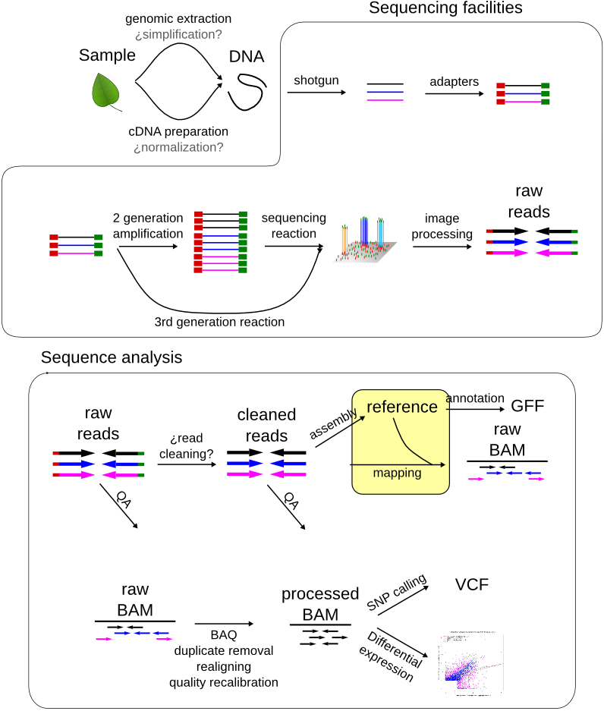

Slide 3
Assembly vs mapping
contig1
contig2
assembly
all vs all
reads
mapping
all vs reference
Reference

Slide 4
Mapping
Reference genome / transcriptome
...GTGGGCCGGCAATTCGATATCGCGCATATATTTCGGCGCATGCTTAGC...
1
GCATATATTT
2
GCATATATTT
3
TGGGCCGGCA
4
ATTCGATATC
Reads
(unmapped)
5
ATATTTCGGC
6
CCGGCAATTC
7
TCGCGCATAT
8
CATGCTTAGC
9
GATATCGCGC

Slide 5
Mapping
Reference genome / transcriptome
...GTGGGCCGGCAATTCGATATCGCGCATATATTTCGGCGCATGCTTAGC...
TGGGCCGGCA
GCATATATTT
CATGCTTAGC
CCGGCAATTC
ATATTTCGGC
ATTCGATATC
GCATATATTT
Reads
(mapped)
TCGCGCATAT
GATATCGCGC

Slide 6
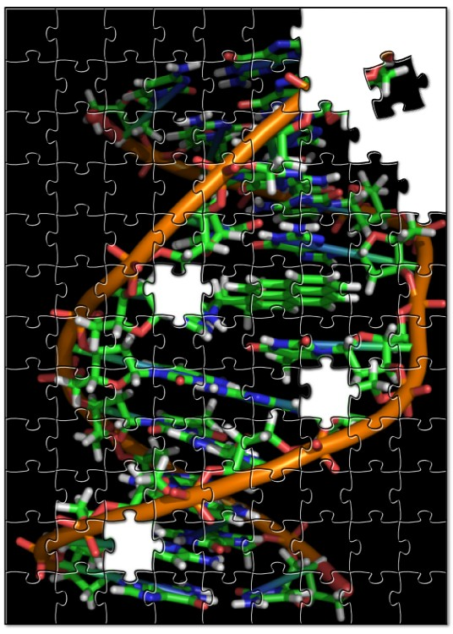
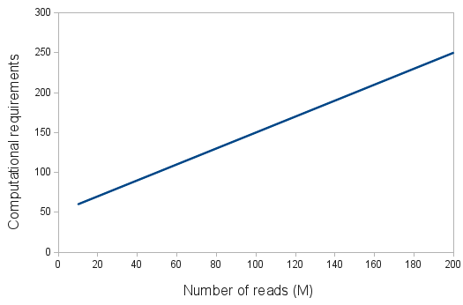
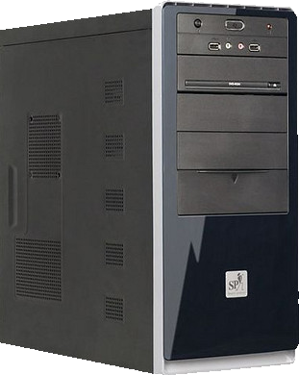
Computational requirements
wikipedia
    Main requirements:
      Hard drive.
      Time.
jmerelo@flickr

Slide 7
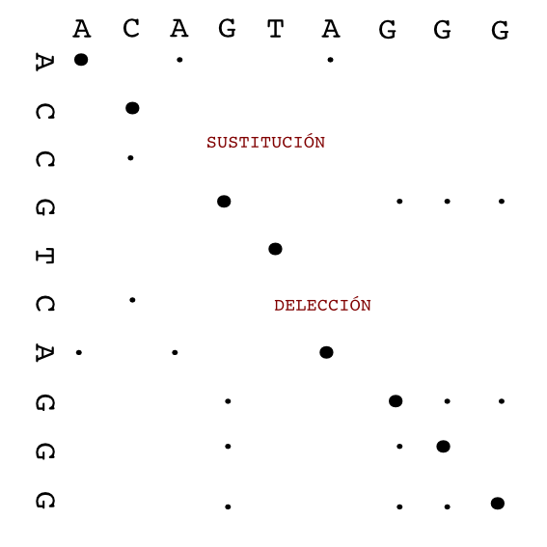
Alignment algorithms
  Smith and Waterman:
      guaranteed to find the optimal local alignment (sensitive)
      Requires O(nm) time (too slow)
      Usually used to refine alignments
dotplot

Slide 8
Mapping sensitivity
Mapper/aligner performance
sensitivity
Time/memory
    Not all reads that should be mapped (aligned) will be mapped.
    Highly polymorphic regions or large insertions or deletions are difficult to detect.

Slide 9
NGS alignment algorithms
  Seed/hash methods:
      Used by BWA mem
      Methodology:
        find matches for short subsequences assuming that at least one seed in a read will perfectly match
        Align with a sensitive method like SW
      Tend to be more sensitive than BWT
  Burrows Wheeler Transform:
      Used by BWA and Bowtie
      Faster than hash methods at the same sensitivity level
      compact the genome into a data structure that is very efficient when searching for perfect matches
      performance decreases exponentially with number of mismatches

Slide 10
BWA vs Bowtie2 vs minimap2
  BWA mem
      Reads from 70 bp up to few megabases
      Seeded algorithm plus Smith and Waterman
      Local alignment
      Allows gaps up to tens of bp in 100 bp reads and split alignment
      Reports chimeric alignments
      Fast, even for long reads
      Paired-end
  Bowtie2
      One of the fastest alignment software for short reads (< 500pb)
      Gapped alignment, but not long gaps
      Global or local
      Paired‐end

Slide 11
minimap2
    bwa-mem replacement (same author)
      Li, H. (2018). Minimap2: pairwise alignment for nucleotide sequences. Bioinformatics, 34:3094-3100. doi:10.1093/bioinformatics/bty191
    Hash seed algorithm
    It does split-read alignment
    General-purpose:
      Noisy PacBio or Oxford Nanopore reads
      Illumina single- or paired-end reads
      splice-aware alignment of PacBio Iso-Seq or Nanopore cDNA or Direct RNA reads against a reference genome
      finding overlaps between long reads with error rate up to ~15%
      full-genome alignment between two closely related species with divergence below ~15%.
    Same base algorithm for all applications, but different parameters

Slide 12
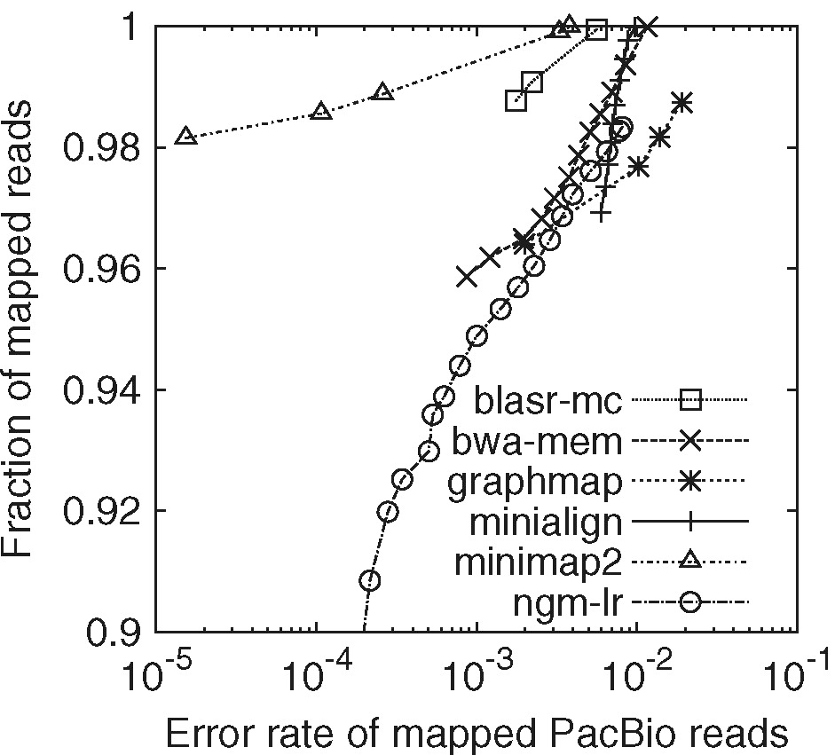
minimap2 long reads
    tens of times faster than mainstream long-read mappers such as BLASR, BWA-MEM, NGMLR and GMAP

Slide 13
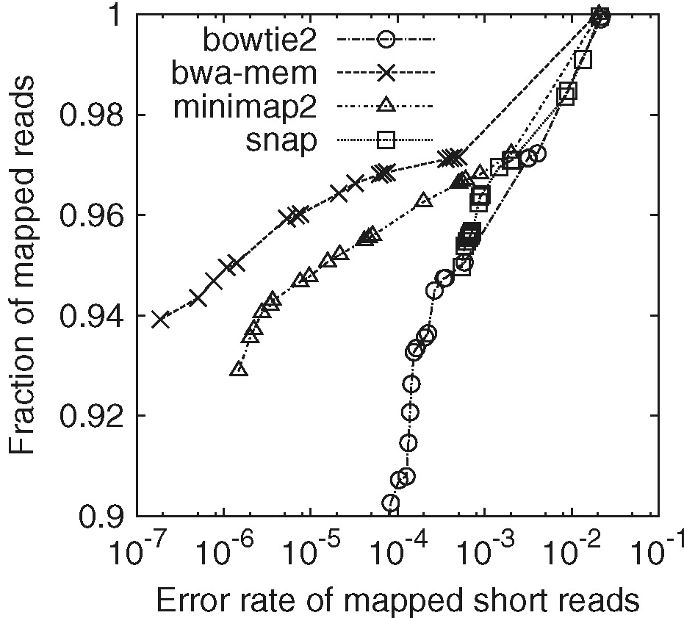
minimap2 Illumina reads
    Less accurate than bwa-mem, but that might be fixed in newer versions

Slide 14
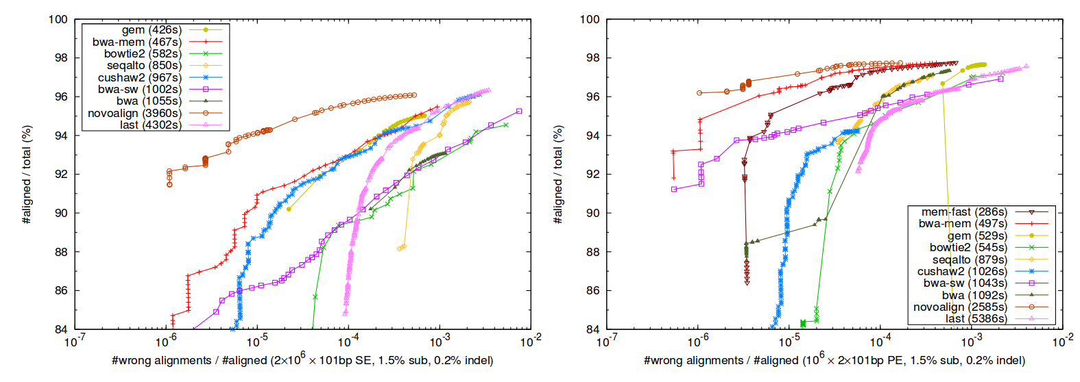
Mappers comparison
Single reads
Paired-ends
From bwa mem paper Li, H.
Simulated reads from human genome. 1.5% substitutions and 0.2% indels
Notes:
Percent mapped reads as a function of the false alignment rate under different mapping quality cutoff.
1e6 pairs of 101bp reads are simulated from the human reference genome using wgsim (http://bit.ly/wgsim2) with 1.5% substitution errors and 0.2% indel variants. The insert size follows a
normal distribution N (500; 50).

Slide 15
Gobal vs local alignment
    If the mapper does global alignments some alignments can be missed.
    Features affecting global alignments:
      Bad quality tracks (common at the end of the reads).
      Non removed adapter or vector .
      EST read spanning a splice juntion.
      Read spanning a re-arrangement event.
global
local
Reference ...ATCGACTGCGTCTAGTTACGATACGTTCATCGTATCGAT...
Read tcaACGACTAGTTACGATACGTTacg

Slide 16
Mapping sensitivity
    Sensitivity related mapper characteristics:
      Algorithm
      maximum edit distance (num. Mismatches)
        Highly polymorphic regions are difficult to align
        Interspecific mappings could be problematic
      allow large gaps
        Introns
        Structural variants
Mapper performance
sensitivity
Time/memory

Slide 17
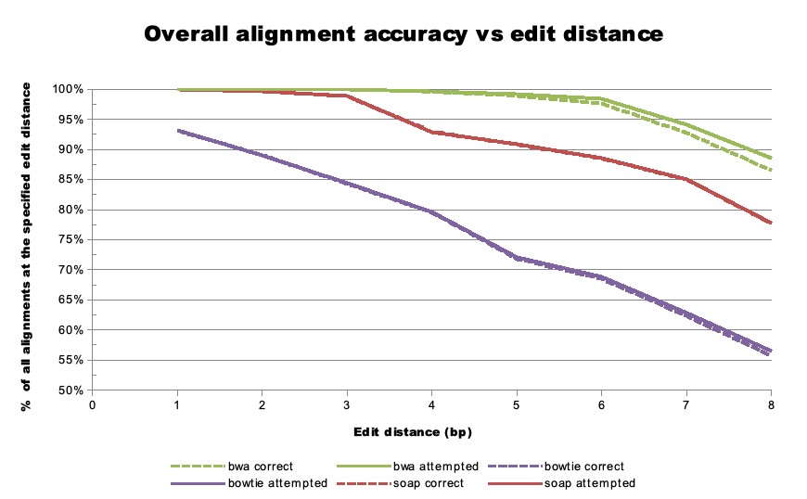
Sensitivity vs edit distance
Michael Stromberg@bioinformatcis.ca

Slide 18
Sensitivity
    Mapping against A. thaliana col. as reference
Species | Accession | SRA | % Mapped Reads
A. thaliana | Col | SRR513732 | 75%
 | Ler | SRR392121 | 71%
 | C24 | SRR392124 | 72%
A. lyrata |  | SRR072809 | 69%
Brassica rapa |  | ERR037339 | 20%
Reads were preprocessed with Q20 L30. Mapping tool: Bowtie2
Taken from Aureliano Bombarely

Slide 19
One alignment?
    A read might be aligned to 0, 1 or more regions in the genome.
    When several alignment are found we could classify them in two groups.
      Best alignments: alignments with best score
      Other alignments.
    We can choose to report:
      All alignments.
      All best alignments.
      One of the best alignments at random.
      All alignments above a score threshold
Reference
read

Slide 20
Mapping score (MAPQ)
    MAPQ reflects the probability that the read originated from the region of the genome where it maps.
    The mapping score of one alignment depends on:
      how similar the read is to the reference and,
      how many alignments have been found.
    The mapping score is usually given as a phred score.
locus1
locus2
locus3
read
Read ACGTCTAGTTACGATACGTT
Locus1 ACGACTAGTTACGATACGTT → score1
Locus2 ACGTCTAGCTACGCTAGGTT → score2
Locus3 ACGACTAGTTACGATACGTT → score1

Slide 21
MAPQ aims at removing duplicated regions
Low MAPQ
region
Low MAPQ
region
repeat
repeat
repeat
MAPQ
filtering
repeat
repeat

Slide 22
Repeat blindness
Duplicated regions are usually not analyzed:
      Repetitive elements (transposons, retrotransposons)
      Gene families
      Genes with pseudo-genes
    This problem can be alleviated using pair-ends

Slide 23
MAPQ depends on the reference
reference
sample
duplication
duplication
    Structrual Variants
    Do not map against a region of the genome

Slide 24
Regions not found in the reference
    Reads that correspond to regions not found in the reference won’t be mapped
      Incomplete genome reference
        Specially relevant in transcriptomes
      Insertions in the sample relative to the reference
      Pathogens infecting the sample
      Chloroplast and mitochondrion
      Contamination

Slide 25
Many alignments vs multiple alignment
    Mappers do many alignments, but they do not do multiple alignments.
    Doing many pairwise alignments is computationally more feasible.
    There's one drawback.
Ref ...aggttttataaaacaattaagtctacagagcaacta...
Read1 ...aggttttataaaacaaAtaa

Slide 26
Many alignments vs multiple alignment
    Mappers do many alignments, but they do not do multiple alignments.
    Doing many pairwise alignments is computationally more feasible.
    There's one drawback.
Ref ...aggttttataaaacaattaagtctacagagcaacta...
Read1 ...aggttttataaaacaaAtaa
Ref ...aggttttataaaac----aattaagtctacagagcaacta...
Sample ...aggttttataaaacAAATaattaagtctacagagcaacta...
Read1 ...aggttttataaaac****aaAtaa

Slide 27
Many alignments vs multiple alignment
    Mappers do many alignments, but they do not do multiple alignments.
    Doing many pairwise alignments is computationally more feasible.
    There's one drawback.
Ref ...aggttttataaaacaattaagtctacagagcaacta...
Read1 ...aggttttataaaacaaAtaa
Ref ...aggttttataaaac----aattaagtctacagagcaacta...
Sample ...aggttttataaaacAAATaattaagtctacagagcaacta...
Read1 ...aggttttataaaac****aaAtaa
Ref ...aggttttataaaac----aattaagtctacagagcaacta...
Sample ...aggttttataaaacAAATaattaagtctacagagcaacta...
Read1 ...aggttttataaaac****aaAtaa
Read2 ....ggttttataaaac****aaAtaaTt
Read3 ........ttataaaacAAATaattaagtctaca.............
read4 CaaaT****aattaagtctacagagcaac......
read5 aaT****aattaagtctacagagcaact.....
read6 T****aattaagtctacagagcaacta....
many alignments

Slide 28
Many alignments vs multiple alignment
Ref ...aggttttataaaac----aattaagtctacagagcaacta...
Sample ...aggttttataaaacAAATaattaagtctacagagcaacta...
Read1 ...aggttttataaaac****aaAtaa
Read2 ....ggttttataaaac****aaAtaaTt
Read3 ........ttataaaacAAATaattaagtctaca.............
read4 CaaaT****aattaagtctacagagcaac......
read5 aaT****aattaagtctacagagcaact.....
read6 T****aattaagtctacagagcaacta....
many alignments
Ref ...aggttttataaaac----aattaagtctacagagcaacta...
Sample ...aggttttataaaacAAATaattaagtctacagagcaacta...
Read1 ...aggttttataaaacAAATaa
Read2 ....ggttttataaaacAAATaatt
Read3 ........ttataaaacAAATaattaagtctaca............
Read4 cAAATaattaagtctacagagcaac.....
read5 AATaattaagtctacagagcaact....
read6 Taattaagtctacagagcaacta...
Multiple alignment

Slide 29
Many alignments vs multiple alignment
    Strategies to mitigate this problem:
      Fix the problem.
        GATK, GLIA realignment.
        It realigns the problematic regions (lots of SNPs or some indels).
        Computationally slow.
        It does not fix all problems.
      Avoid using the misaligned positions.
        Samtools BAQ (calmd).
        For each position It calculates the probability of being misaligned.
      Most problematic regions are:
        Low complexity
        At the ends of reads

Slide 30
SAM format
    Sequence Alignment/Map (http://samtools.sourceforge.net/)
    File describing reads aligned to a reference genome.
    Standard file format.
    Not meant for human consumption, although can be opened with a text editor:
    Its binary version is more common (BAM)
    Input for genome browsers (e.g., IGV) and SNP callers.
    It is usually found with the reads sorted along the reference
    There are some differences in the output between mappers. For instance bwa represent multiple hits with an optional tag (XA) and bowtie with multiple lines (one per hit).

Slide 31
SAM format
Structure:
      HEADER
        Version
        Program parameters
        Genome:
          Chrom1 size
          Chrom2 size
          Chrom3 size
        Groups:
          Group1: sample 1, library 1, platform
          Group2: sample 2, library 2, platform
      BODY
        Read 1, group1
        Read 2, group1
        Read 3, group2
    Example:
      @HD VN:1.0
      @SQ SN:chr20 LN:62435964
      @RG ID:L1 PU:SC_1_10 LB:SC_1 SM:NA12891
      @RG ID:L2 PU:SC_2_12 LB:SC_2 SM:NA12891
      read_28833_29006_6945 99 chr20 28833 20 10M1D25M = 28993 195 AGCTTAGCTAGCTACCTATATCTTGGTCTTGGCCG \ \ <<<<<<<<<<<<<<<<<<<<<:<9/,&,22;;<<< NM:i:1 RG:Z:L1
      read_28701_28881_323b 147 chr20 28834 30 35M= 28701 -168 ACCTATATCTTGGCCTTGGCCGATGCGGCCTTGCA \ \ <<<<<;<<<<7;:<<<6;<<<<<<<<<<<<7<<<< MF:i:18 RG:Z:L2

Slide 32
Alignment section fields
Col | Field | Brief description
1 | QNAME | Query template NAME
2 | FLAG | bitwise FLAG
3 | RNAME | Reference sequence NAME
4 | POS | 1-based leftmost mapping POSition
5 | MAPQ | MAPping Quality
6 | CIGAR | CIGAR string
7 | RNEXT | Ref. Name of the mate/next read
8 | PNEXT | Position of the mate/next read
9 | TLEN | Observed Template LENgth
10 | SEQ | segment SEQuence
11 | QUAL | ASCII of Phred-scaled base QUALity+33

Slide 33
SAM flag
1
1
1
1
1
1
1
1
1
1
1
template having multiple segments in sequencing
each segment properly aligned according to the aligner
segment unmapped
next segment in the template unmapped
SEQ being reverse complemented
SEQ of the next segment in the template being reversed
the first segment in the template
the last segment in the template
secondary alignment
not passing quality controls
PCR or optical duplicate
    Template: DNA/RNA which is sequenced on a sequencing machine or assembled from raw sequences.
    Segment: contiguous (sub)sequence on a template which is sequenced or assembled.
    Read: raw sequence that comes off a sequencing machine. A read may consist of multiple segments.

Slide 34
SAM QA
    Flag statistics (samtools flagstats):
      Number of mapped and unmapped reads per read group
    MAPQ distribution
    Coverage distribution

Slide 35
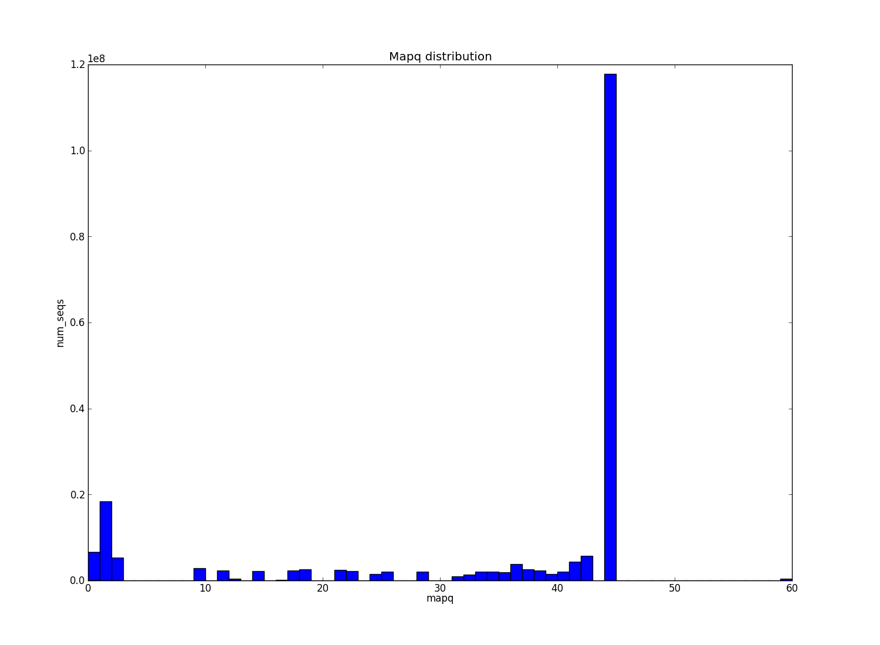
MAPQ distribution

Slide 36
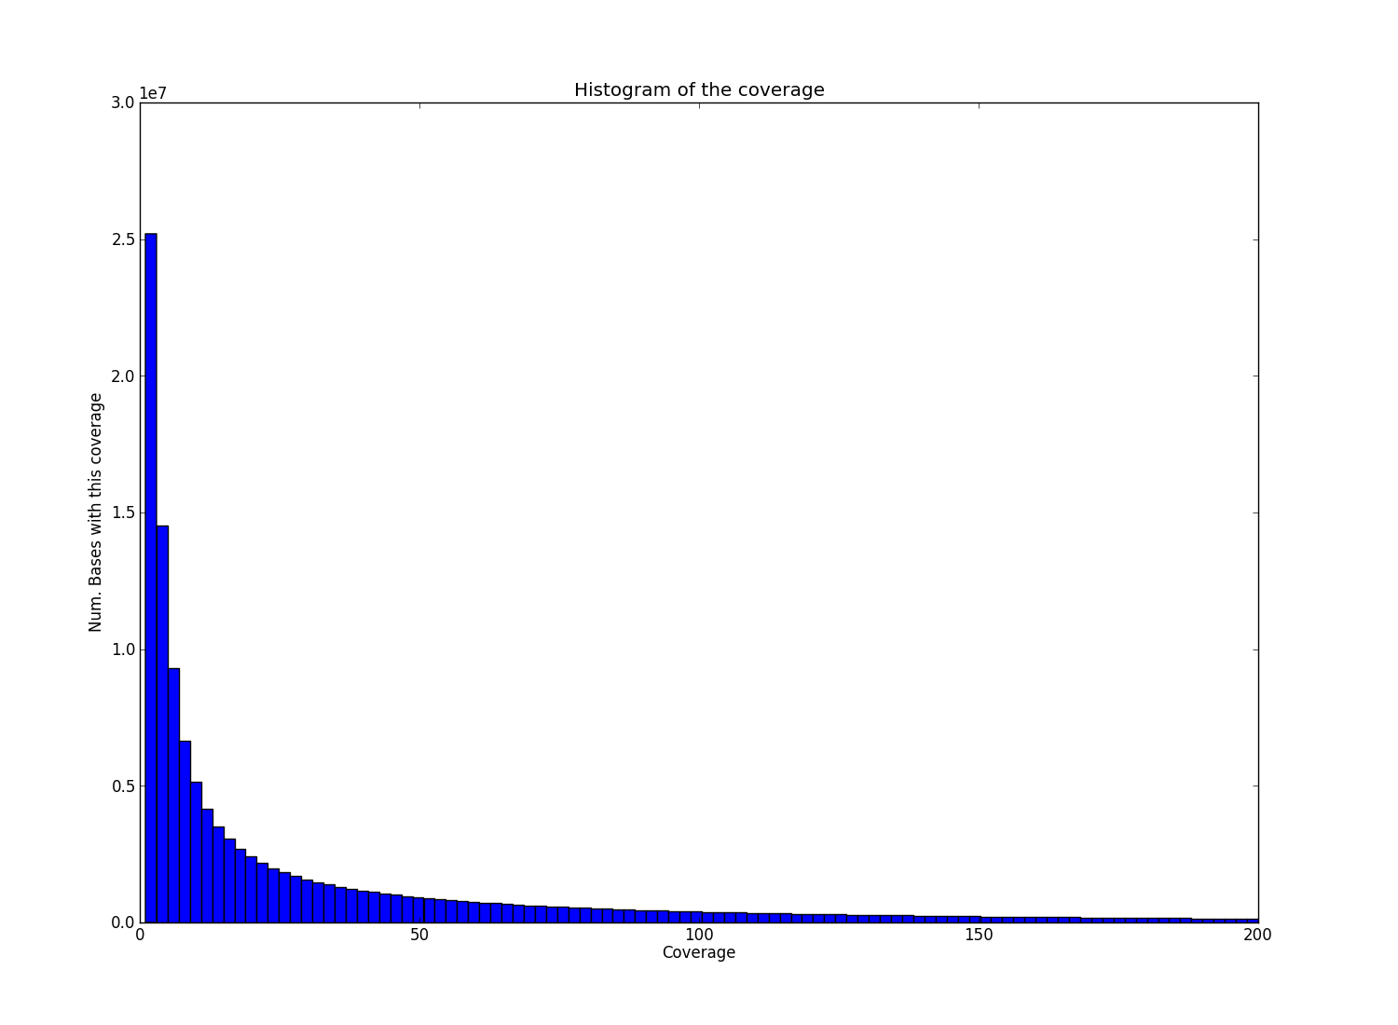
Coverage

Slide 37
SAM processing
    Algorithms:
      Sorting
      Indexing
      Filtering
      Merging
      Read group modifications
      Duplicate location and removal
      Realignment
      BAQ
    Software:
      Samtools
      Picard
      GATK

Slide 38
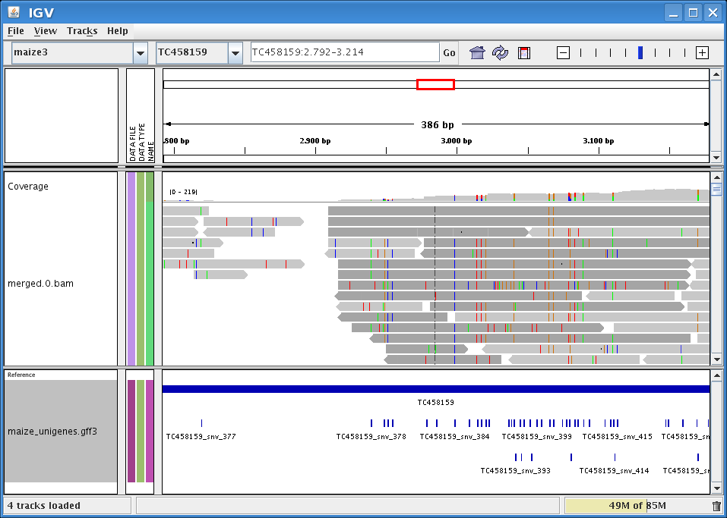
IGV viewer
    Visualization tool for interactive exploration of large, integrated datasets.
    Supports a wide variety of data types including: alignments, microarrays, and genomic annotations.

Slide 39
  This work is licensed under the Creative Commons Attribution 3.0 Unported License. To view a copy of this license, visit http://creativecommons.org/licenses/by/3.0/ or send a letter to Creative Commons, 171 Second Street, Suite 300, San Francisco, California, 94105, USA.
Jose Blanca
COMAV institute
bioinf.comav.upv.es

