Slide 1
SNP calling
Jose Blanca
COMAV institute
bioinf.comav.upv.es

Slide 2
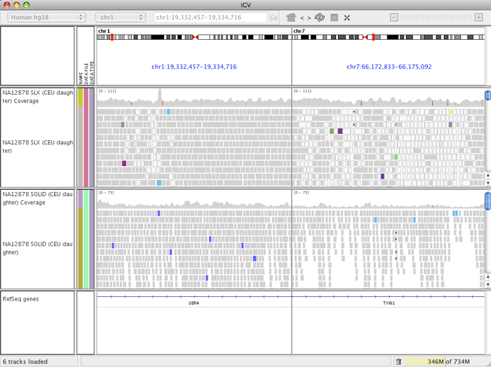
SNP calling

Slide 3
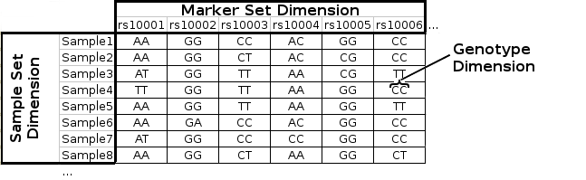
Genotype matrix
  Genotype matrix: Samples x SNPs

Slide 4
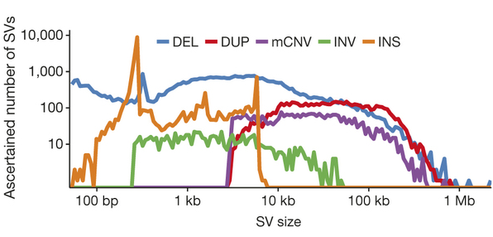
SNPs and errors
    A change in a read may due to:
      Sample contamination
      Cloning or PCR artifacts
        Homopolymer stuttering
        Hexamers in RNASeq libraries
      Sequencing errors
      Mapping errors
        Problems related to structural variants
        Alignment errors
      Reference genome errors
      Real SNVs
    Two kinds of errors:
      False positives
      False negatives
Structural variants
are frequent!!!
Human SVs

Slide 5
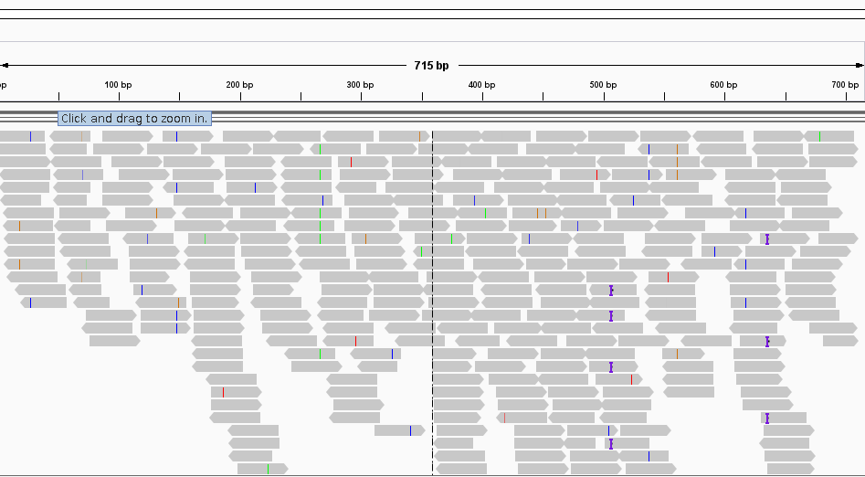
SNP calling errors
In a Hiseq 2500 line there are
if Q= 30:
- 150 millions of sequencing errors

Slide 6
SNP calling alignment errors
Ref ...aggttttataaaac----aattaagtctacagagcaacta...
Sample ...aggttttataaaacAAATaattaagtctacagagcaacta...
Read1 ...aggttttataaaac****aaAtaa
Read2 ....ggttttataaaac****aaAtaaTt
Read3 ........ttataaaacAAATaattaagtctaca.............
read4 CaaaT****aattaagtctacagagcaac......
read5 aaT****aattaagtctacagagcaact.....
read6 T****aattaagtctacagagcaacta....
    Strategies to mitigate this problem:
      Fix the problem.
        GATK, GLIA realignment.
        It realigns the problematic regions (lots of SNPs or some indels).
        Computationally slow.
        It does not fix all problems.
      Avoid using the misaligned positions.
        Samtools BAQ (calmd).
          For each position It calculates the probability of being misaligned.
        Avoid read ends

Slide 7
SNP callers
    Simple algorithms based on:
      Allele counts in reads
      Allele rate
      Total coverage
    Complex bayesian algorithms add
      Hardy-Weimberg equilibrium
      Linkage disequilibrium
    More common SNP callers:
      GATK
      Freebayes

Slide 8
SNP calling
Brad Chapman has a very interesting piece comparing the use of aligners and SNP callers.
de-duplication with Picard MarkDuplicates, GATK base quality score recalibration and GATK realignment
Minimal post-processing, with de-duplication using samtools rmdup and no realignment or recalibration.
FreeBayes (v0.9.9.2-18): A haplotype-based Bayesian caller from the Marth Lab.
GATK UnifiedGenotyper (2.7-2): GATK’s widely used Bayesian caller.
GATK HaplotypeCaller (2.7-2): GATK’s more recently developed haplotype caller which provides local assembly around variant regions

Slide 9
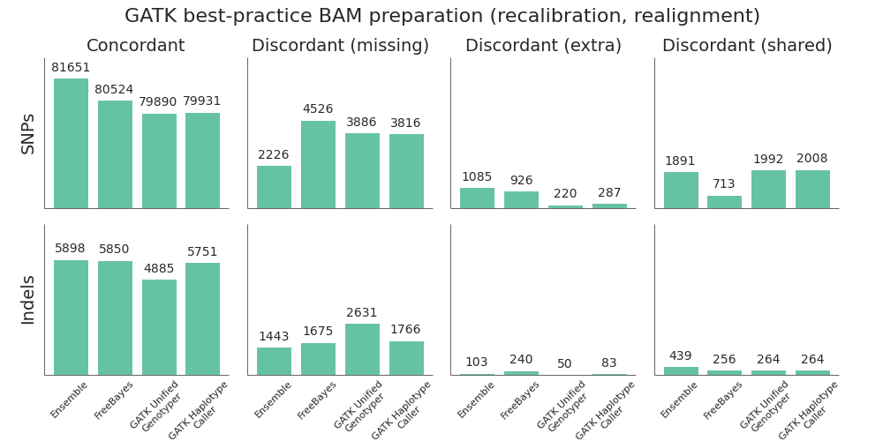
SNP calling
http://bcbio.wordpress.com/

Slide 10
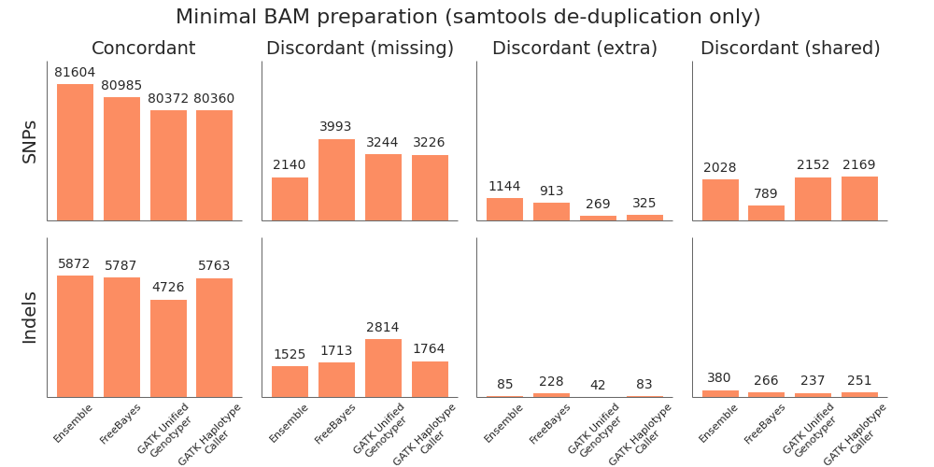
SNP calling
http://bcbio.wordpress.com/

Slide 11
Required coverage
    Depends:
      Confidence required
        SNP vs Genotypes
        Clinical diagnosis vs marker search
      Sample complexity
        Diploid
        Polyploid
        Pooled samples
        Heterogeneous cancer
      Ploidy
      Population structure
        e.g. F2 population vs random mating population

Slide 12
SNP quality assesment
% of missing calls per SNP
SNP depth or Genotype depth
SNP observed heterozygosity
SNP quality
SNP density
Sample depth
% of missing calls per sample
Sample observed heterozygosity

Slide 13
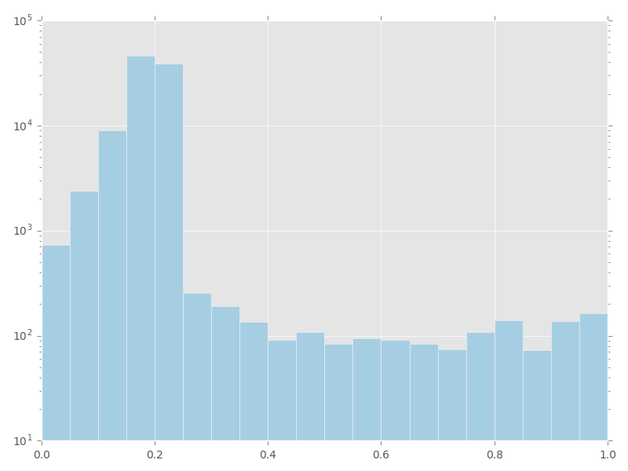
SNP quality assesment
Number of SNPs called at different missing rates

Slide 14
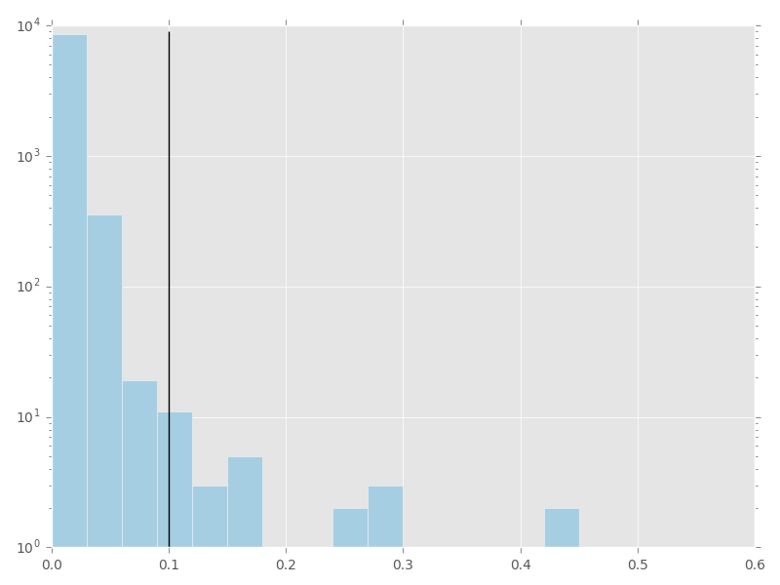
SNP quality assesment
Number of SNPs with different observed heterozygosities

Slide 15
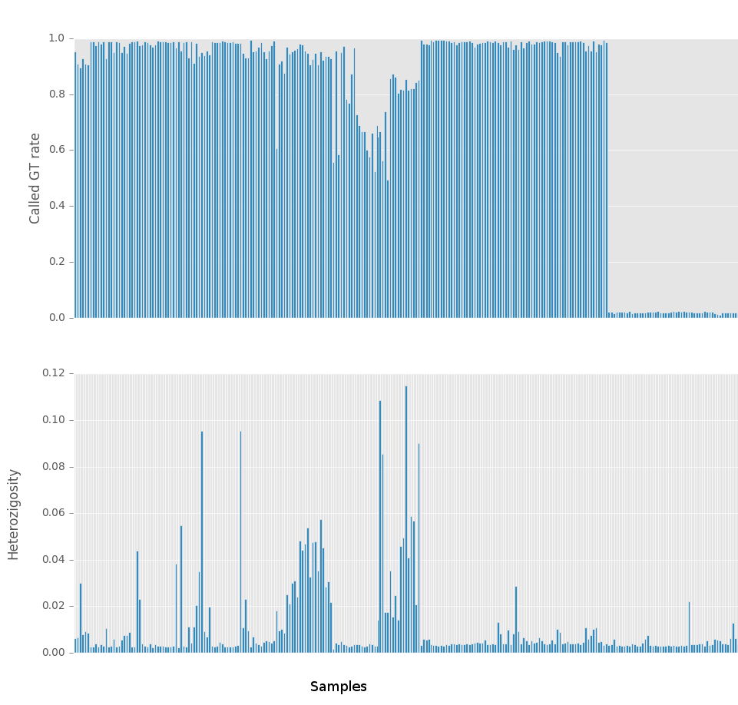
SNP quality assesment
Observed heterozygosity and called GT rate per sample

Slide 16
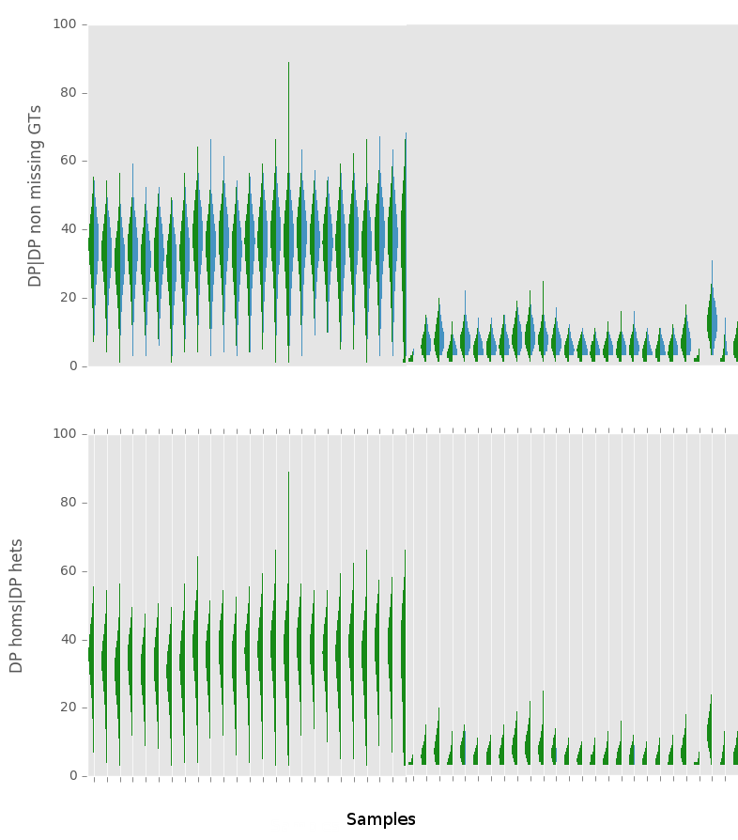
SNP quality assesment
Depth distributions per sample for all genotype calls and for the non-missing genotype calls

Slide 17
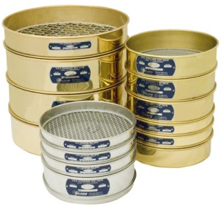
SNP filtering
Filtering the SNPs after the SNP calling is a critical task.
The objetive is to remove false positives, but keeping the correct SNPs.
The filters and parameteres depend of the data and the application.
Vcftools, vcffilter, Annovar…
Home-made filters

Slide 18
SNP filtering
SNPs Low quality:
SNP callers usually assign a quality (probability) to the SNPs. We can filter out the SNPs with lower qualities.
Genotype Low quality:
It is also possible to filter out not SNPs, but genotypes. In this case the genotype is usually set to not determined
Missing data:
We could filter the SNPs with large amount of missing genotypes.

Slide 19
SNP filtering
Number of alleles:
It is possible to remove the monomorphic SNPs or to filter out the SNPs that are not biallelic.
Minor (or Major) Allele Frequency (MAF):
Observed Heterozygosity:
High heterozygosities in populations are suspicious

Slide 20
SNP filtering
High Coverage:
SNPs with an excessive coverage can be false positives due to duplicated regions in the sequenced sample not found in the reference genome.
Highly Variable Region:
Having regions with too many SNPs it is also a sign that we are piling up reads from repeated regions.
Low Complexity Region:
It has been shown that due to problems with the PCR and the alignment the low complexity regions are particularly prone to false positive SNPs.

Slide 21
SNP filtering
Linkage Disequilibrium:
If we have genotype a segregant population it could be useful to filter out the SNPs that are not in linkage disequilibrium with their closest SNPs.
Kind
We can filter the SNVs according to its type: SNV, indel, complex or structural variation.

Slide 22
SNP filtering
Aminoacid change:
We can select the SNPs with large impacts in the coded proteins.
By genome localization:
We can choose SNPs in a determinate region or kind of features (exon, UTR….)

Slide 23
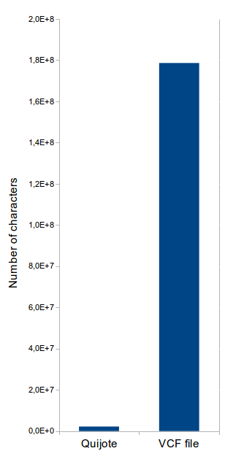
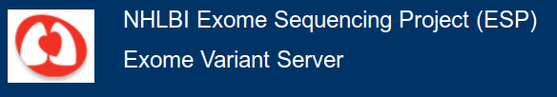
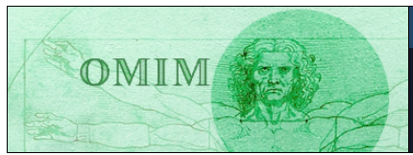



SNP annotation
filter

Slide 24

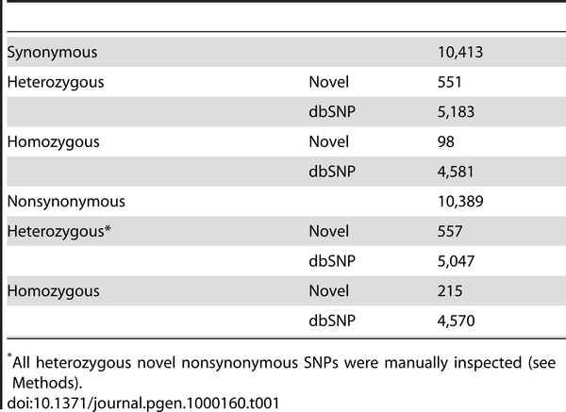
SNP annotation

Slide 25

Mutation filtering
NEW
filter

Slide 26
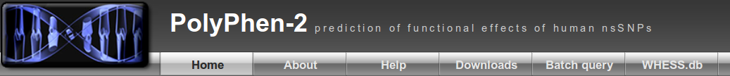

Mutation filtering
New

Slide 27
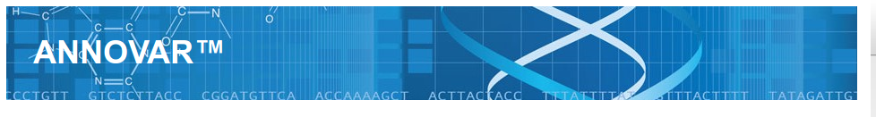


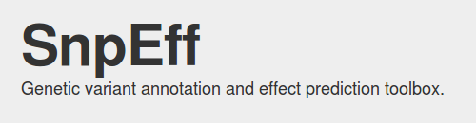
Mutation filtering
analysis

Slide 28
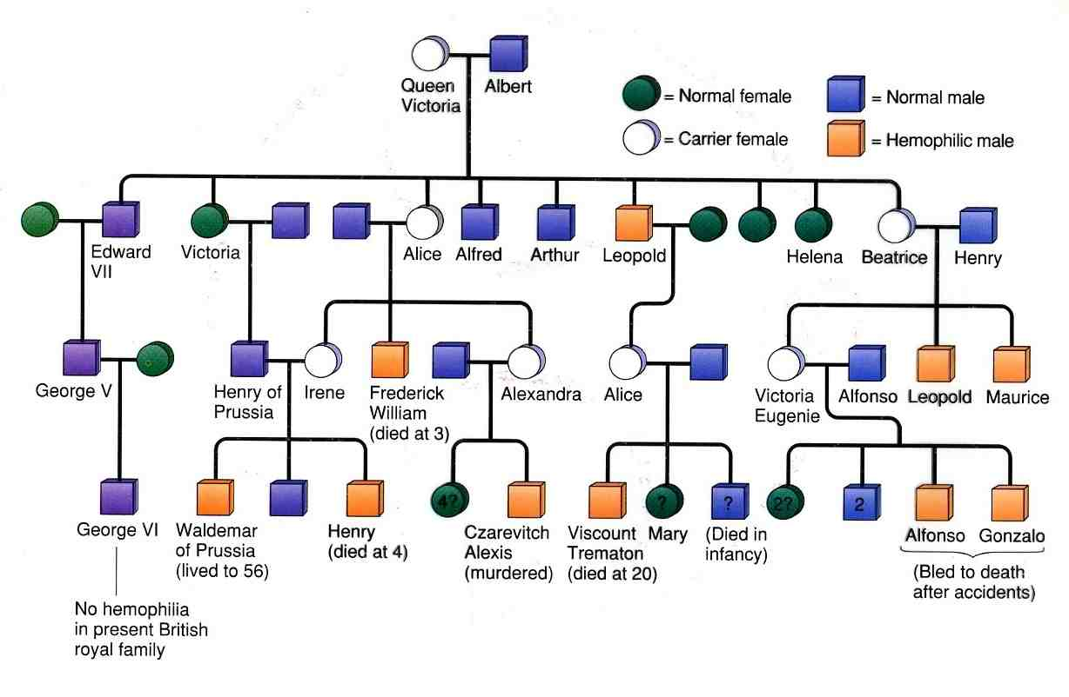

Mutation filtering
Candidate

Slide 29
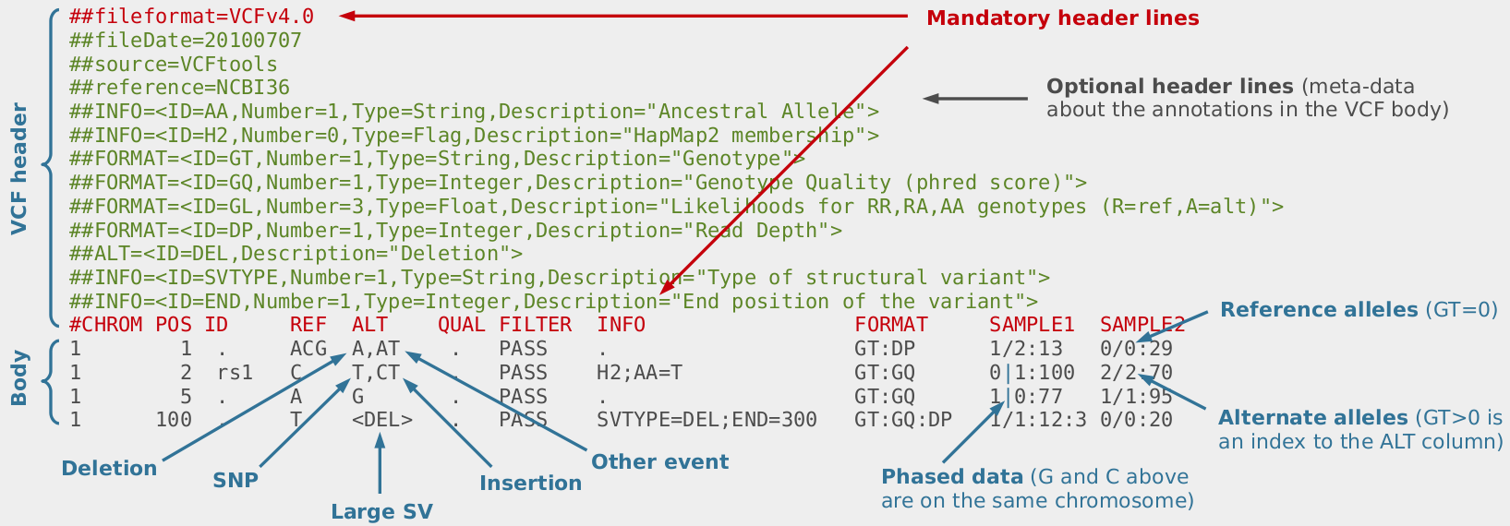
File format: VCF

Slide 30
File format: VCF
SNPs
Alignment VCF representation
ACGT POS REF ALT
AtGT 2 C T
Insertions
Alignment VCF representation
AC-GT POS REF ALT
ACtGT 2 C CT
Deletions
Alignment VCF representation
ACGT POS REF ALT
A--T 1 ACG A
Complex events
Alignment VCF representation
ACGT POS REF ALT
A-tT 1 ACG AT
Large structural variants
VCF representation
POS REF ALT INFO
100 T <DEL> SVTYPE=DEL;END=300

Slide 31
File format: GFF
Based on a sequence ontology
Annotation of regions in sequences
##gff-version 3
##sequence-region ctg123 1 1497228
ctg123 . gene 1000 9000 . + . ID=gene00001;Name=EDEN
ctg123 . TF_binding_site 1000 1012 . + . ID=tfbs00001;Parent=gene00001
ctg123 . mRNA 1050 9000 . + . ID=mRNA00001;Parent=gene00001;Name=EDEN.1

Slide 32
File format: BED
Annotation of regions in sequences
chr22 1000 5000 cloneA 960 + 1000 5000 0 2 567,488, 0,3512
chr22 2000 6000
The BED format uses 0-based coordinates for the starts and 1-based for the ends. So the 1st base on chromosome 1 would be:
chr1 0 1 first_base

