Slide 1
RNA-Seq
Jose Blanca
COMAV institute
bioinf.comav.upv.es

Slide 2
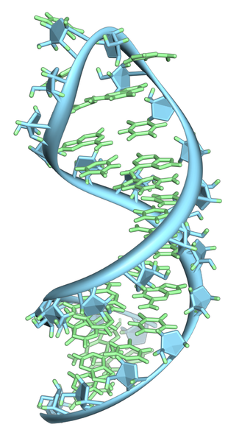
Transcriptome
  RNA-seq is the analysis of the transcriptome:
      coding RNAs
      non-coding RNAS
    Includes:
      Transcriptome assembly
      Expression quantification
      Alternative splicing
      Antisense expression
      Extragenic expression
      post-transcriptional modifications
      Alternative 5' and 3' usage
      Detection of fusion transcripts
    Outline:
      ESTs Mapping and assembly
      Transcriptomic expression
RNA by Wossman

Slide 3
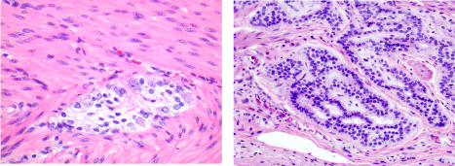
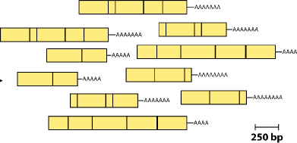
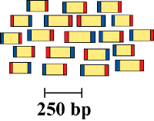
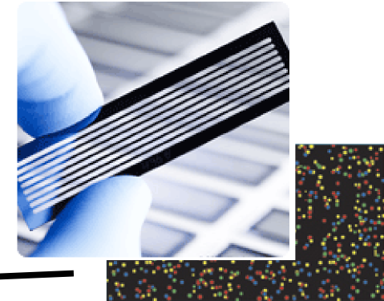
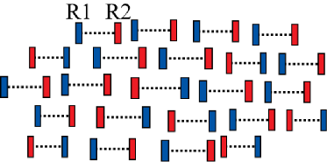
RNA-Seq
CDNA, fragment, size select, add linkers
Samples
Isolate RNAs
normal
tumor
Sequence
Reads
Analyze

Slide 4
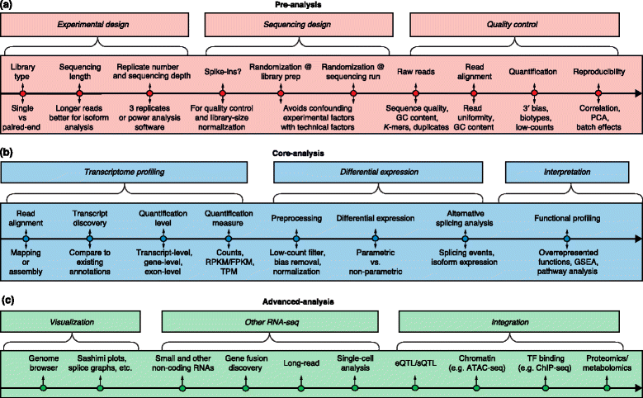
A possible road map
A survey of best practices for RNA-seq data analysis. Conesa et al. 2016

Slide 5
Transcriptome mapping and assembly

Slide 6
Mapping: spliced aligners
exon
exon
read
    BWT (Hisat):
      Methodology
        Modified bowtie2.
      The fastest currently available.
      Equal or better accuracy than any other method.
    Seed-extend (GSNAP):
      Methodology
        Break reads into short seeds, which are placed onto the genome to localize the alignment.
        Align with a sensitive algorithm, such as Smith-Waterman
      Requires more computational resources.

Slide 7
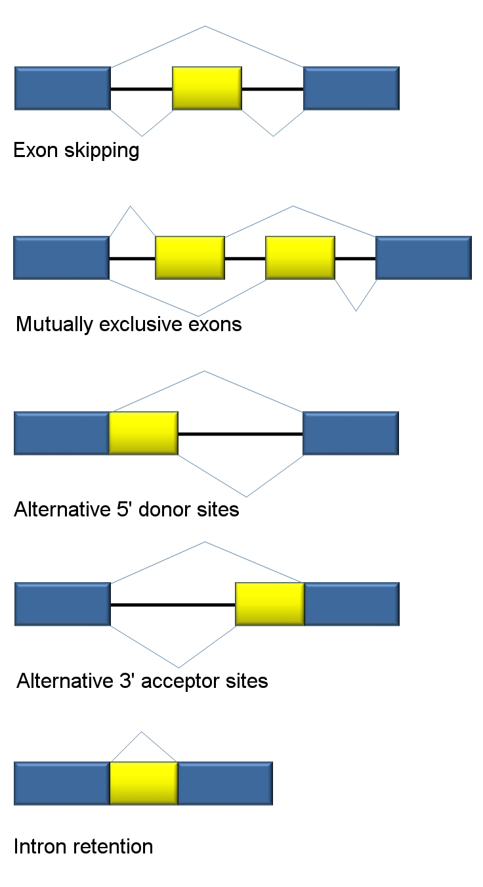
Transcriptome assembly
    Genomic assemblers do not work well:
      we do not expect unique regions but sets of transcripts
      a read can match several transcripts, specially short reads
      read abundance from different genes and transcripts spans several orders of magnitude and are not consequence of repetitive DNA
      experiments can be strand-specific
      reads originate from the mature mRNA as well as from the incompletely spliced precursor RNA
Agathman@wikipedia

Slide 8
Assembly strategy
    Reference based
      Compare reads with previous genomic reference
    de novo
      assemble EST reads with no previous information
    combined

Slide 9
Reference based assembly
    RNA-seq reads are aligned to a reference
    Overlapping reads from each locus are clustered to build a graph representing all possible isoforms
    Traversing the graph to resolve individual isoform
    Common software implementation: Cufflinks, StringTie

Slide 10
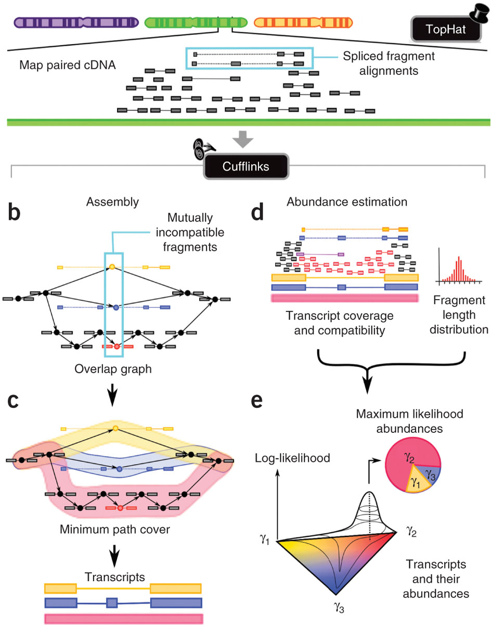
Hisat
StringTie
Taken from Nature Biotechnology 28, 511–515 (2010) doi:10.1038/nbt.1621

Slide 11
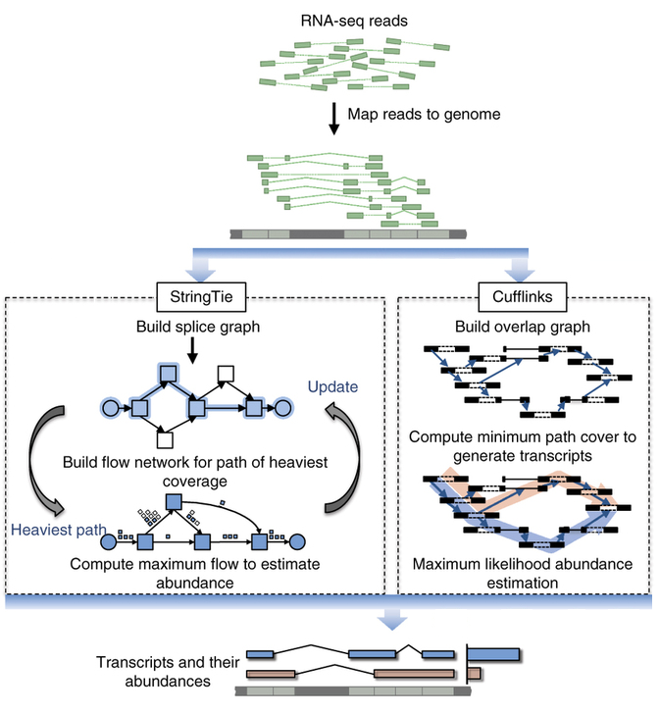
StringTie
    Cufflinks parsimony-based minimal number of transcripts that will explain reads.
    StringTie uses flow network.
    StringTie was better than cufflinks, especially at genes with:
      low abundance
      more exons
      multiple isoforms.
    Cufflinks and StringTie eliminate transcripts with low abundance (by default 10% under most expressed in the gene), but StringTie performs better with low abundance.
    Memory requirements: between 2 gigabytes (GB) and 12 GB.

Slide 12
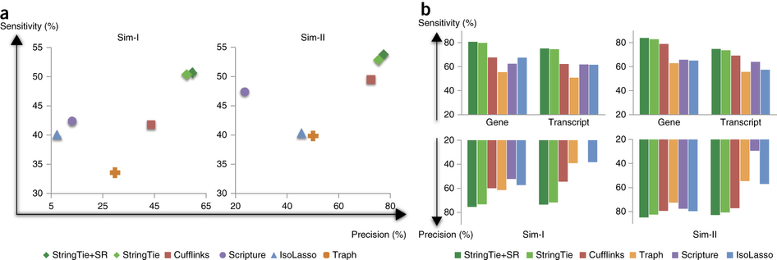
StringTie sentitivity, simulated data
All transcripts
Transcripts completely
covered by reads
Sensitivity (%)
Precision (%)
Sensitivity: number of transcripts that are identified correctly out of all the ones that were expressed
Precision: percentage of predicted transcripts that matched the true transcripts
Modified from: doi:10.1038/nbt.3122

Slide 13
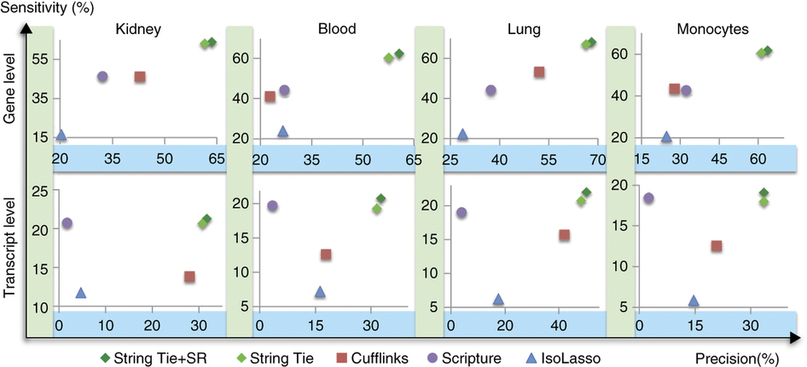
StringTie sensitivity, real human data

Slide 14
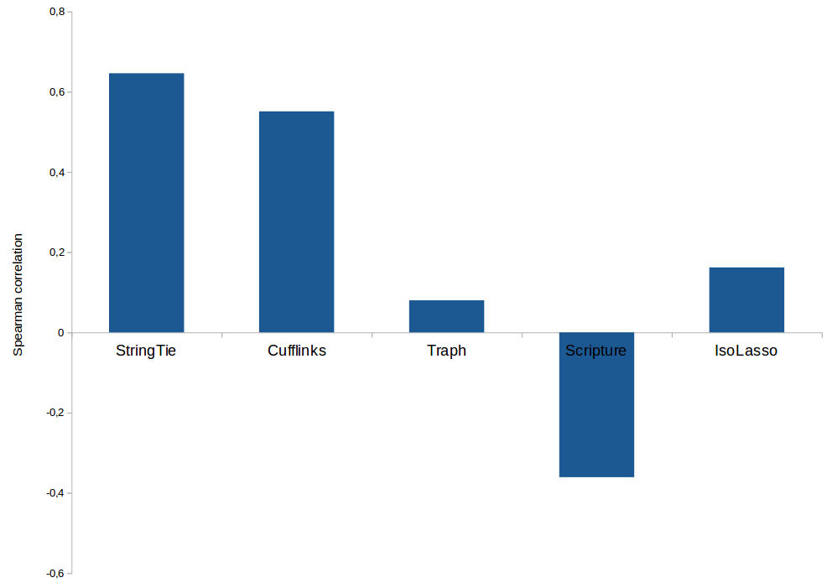
Isoform abundance estimation
Spearman correlation between the abundance estimation and the real (simulated data) abundance.

Slide 15
Reference based assembly
Advantages:
      Low computational resources:
        Can be easily parallelized
        Not much memory
      very sensitive, even with low abundant transcripts
        small gaps can be filled in with the reference
        generates longer UTRs (usually low coverage)
      Contamination or sequencing artifacts not a major concern (and not detected)
Disadvantages:
      reference genome required
      depends on the quality of reference
        misassemblies of reference can cause misassemblies of transcriptome
        Mismatch between reference used and our sample (e.g. cancer)

Slide 16
de novo assembly
    The challenge is to divide the reads between transcripts.
    Two common assemblers are Trinity and Oases.
Advantages:
      reference genome not required
      It works with transcripts not in reference
        Missing segments
        Exogenous transcripts (e.g. viruses)
        Transcripts from chromosomal rearrangements not a concern.
      long introns are not a concern
Disadvantages:
      Generally less accurate, used mainly when no good reference is available
      More difficult: multicopy gene families, large variations in expression and alternatively spliced variants
      Computationally very resource intensive. (Digital normalization available)
      Higher sequencing coverage required for equivalent result
      More sensitive to sequencing errors and chimeric molecules
      Sensitive to transcripts from highly similar genes (e.g. paralogues)

Slide 17
De novo assembly postprocessing
    Yang and Smith “Optimizing de novo assembly of short-read RNA-seq data for phylogenomics”. BMC Genomics. 2013; 14: 328
    They compare several strategies:
      Number of genes covered
      Amount of chimeric sequences
    One of the best strategies (but not the only one) was:
      Assembly with Trinity
      Cap3 assembly of the transcripts
      Filter out chimeras blasting against similar species
      Select from each gene cluster the transcript with the highest coverage

Slide 18
Our transcriptome assembly protocol
  Read cleaning:
      Illumina adapter filtering
      Quality trimming
      Minimum read length
      Known contaminants
  Assembly:
      Digital normalization (only if assembly fails)
      Trinity
  Post-processing:
      Cap3 redundancy removal (only if library is not directional)
      Transcript filtering
        Low complexity
        Low expression: Read mapping and expression evaluation with RSEM
      Transitive clustering of transcripts into genes
Other protocols can be found: https://khmer-protocols.readthedocs.org/
http://oyster-river-protocol.readthedocs.io/en/latest/

Slide 19
Full length cDNA Pacbio seq
    Pacbio:
      Full length cDNAs
    Nanopore:
      Full length RNAs
    Much better than short reads for transcriptome isoform structure and genome annotation
    Much lower yields than Illumina
      Much more expensive
      Not suitable for expression analyses

Slide 20
Differential expression

Slide 21
RNA-Seq vs Microarrays
    When used to ask exactly the same question, both techniques give the same answer. Comparing expression metrics from array intensities to RNA-Seq density shows a strong congruence.
      Malone and Oliver (2011) in Microarrays, deep sequencing and the true measure of the transcriptome

Slide 22
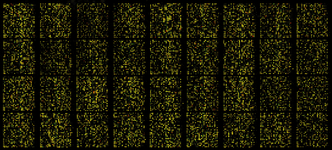
Expression microarrays methodology
    Genome and/or transcriptome knowledge
    Microarray design:
      Oligonucleotide probes for each gene
    RNA extraction
    Sample labeling
    Hybridization
    Scanning
      Light intensity is related to gene expression

Slide 23
Expression microarrays
    Advantages:
      Well known and highly successful
      Biases are well-known
      Analysis methodologies are well established
      small files with mature and easy to use software
    Disadvantages:
      Depend on previous knowledge:
        Not available for lots of organisms
        Genes not in array are ignored (unless tiling arrays)
      gene level, not transcripts.
      cross-hybridization
      sequence content influences measured probe intensities

Slide 24
RNA-Seq methodology
    Library construction:
      RNA extraction
      cDNA synthesis
    Sequencing
    Read mapping or assembly
    Reads classified into gene or transcripts
    Read counts are normalized
    Normalized counts are related with expression levels

Slide 25
RNA-Seq for differential expression
    Advantages:
      No prior knowledge of organism required
      quantification at transcript level possible
      higher sensitivity and dynamic range
      base-pair-level resolution
      lower technical variation (low background)
      More detailed view
        improved detection of alternative splicing
        gene fusions (cancer research)
        Allele-specific expression
        novel promoters, transcription initiation sites
        RNA editing
        non coding RNAS
        sense and antisense transcripts
    Disadvantages:
      High cost for fancy stuff:
        characterization of low-abundance transcripts
        alleles differentially expressed
      Biases still being explored:
        Data analysis methodologies in flux
        Computational tools are not mature
      Datasets are large and complex to manage
      Expensive Informatics (machines and people)

Slide 26
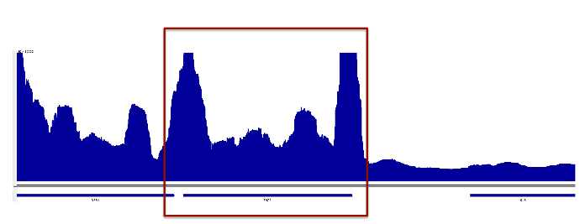
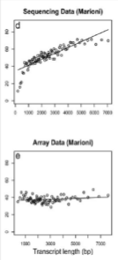
Read count and normalization
Taken from
Ana Conesa
    The reads have to be assign to genes, transcripts or exons:
      Reads can map to several transcripts
      Reads can map in several regions (e. g. paralogs)
      Polymorphism affects mapping (bias)
    Normalization:
      Longer transcripts generate more reads
      Different runs or samples have different number of total reads
      RPKM (reads per kilobase of exon model per million mapped reads) is commonly used
    Gene length bias is an issue in RNA-Seq, changes in longer genes are easier to detected
Microarray RNAseq

Slide 27
RNA-Seq library construction
    Ribosomal RNA removal increases coverage of interesting transcripts
      rRNA hybridization-based depletion methods
      Poly-A selection:
        Effective in eukaryotes
        Removes most non-coding RNAs
    Other library preparation methods:
      Strand-specific RNA-seq to study antisense expression

Slide 28
How many reads?
    “For highly expressed genes, small amounts of sequencing are sufficient, but for the middle and low end of expression levels, it is clear that many reads are needed. In the fly modENCODE samples for example, even after 50 million mapped reads new transcript discovery did not saturate. In our hands, we estimate that 6-8 million mapped reads provide adequate coverage to accurately estimate roughly 80-90% of the head transcriptome in flies.”
      Malone and Oliver (2011) in Microarrays, deep sequencing and the true measure of the transcriptome
    “Experiments whose purpose is to evaluate the similarity between the transcriptional profiles of two polyA+ samples may require only modest depths of sequencing (e.g. 30M pair-end reads of length > 30NT, of which 20-25M are mappable to the genome or known transcriptome.”
    “Experiments whose purpose is discovery of novel transcribed elements and strong quantification of known transcript isoforms... a minimum depth of 100-200 M 2 x 76 bp or longer reads is currently recommended.”
      ENCODE consortium’s Standards, Guidelines and Best Practices for RNA-Seq
      More on: http://www.rna-seqblog.com/information/how-many-reads-are-enough/

Slide 29
Which reads?
    Long reads (at least 100pb) and pair ends:
      Improve ability to link exons belonging to the same transcript.
      Absolutely required for:
        De-novo assembly
        Reference with recent whole genome duplication
    Any read above 35 bp
      Reference without recent duplications

Slide 30
  This work is licensed under the Creative Commons Attribution 3.0 Unported License. To view a copy of this license, visit http://creativecommons.org/licenses/by/3.0/ or send a letter to Creative Commons, 171 Second Street, Suite 300, San Francisco, California, 94105, USA.
Jose Blanca
COMAV institute
bioinf.comav.upv.es

