Slide 1
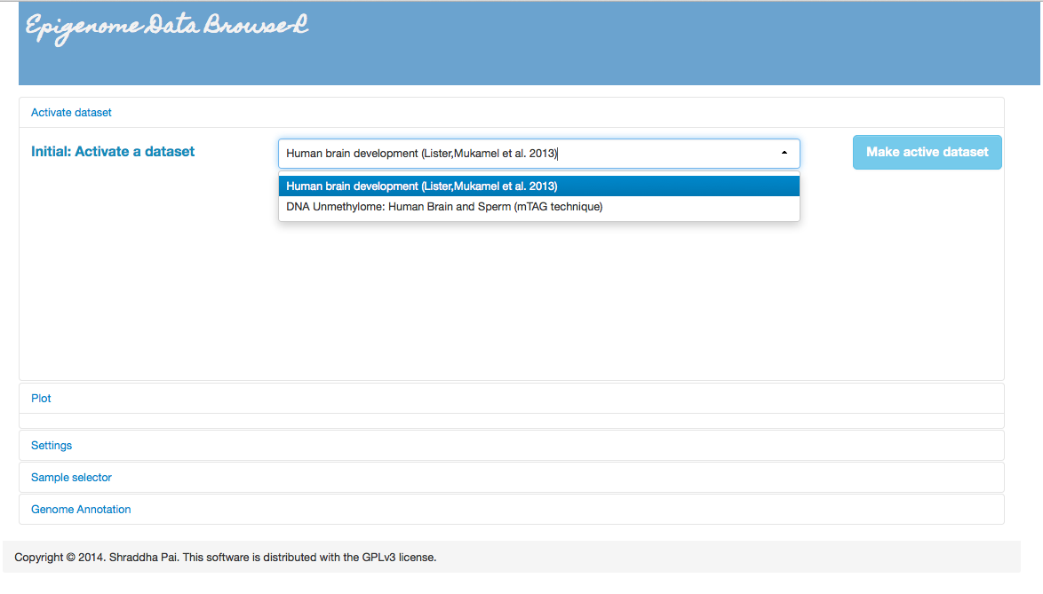
View datasets from different genomes
Plot shows up here
Settings panel: Customize plot view (limits, binning, sample grouping)
Interactive sample selector: limit the subsample for analysis
View data in the context of genomic annotation

Slide 2
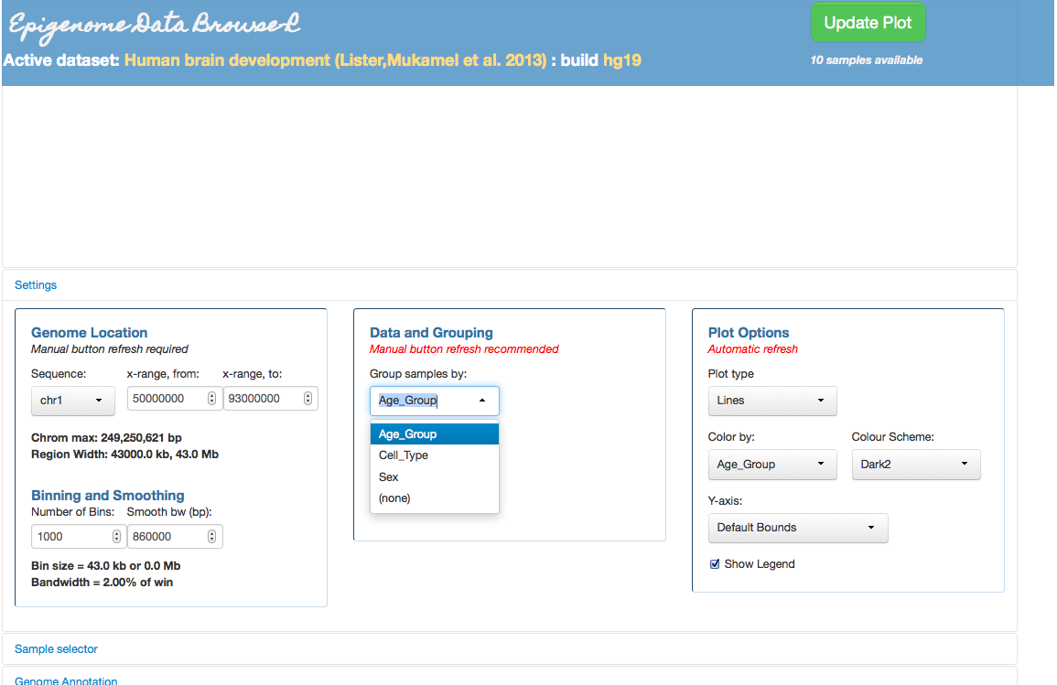
Change how samples are grouped
Colour-code samples by different properties
Change how data is binned and smoothed

Slide 3
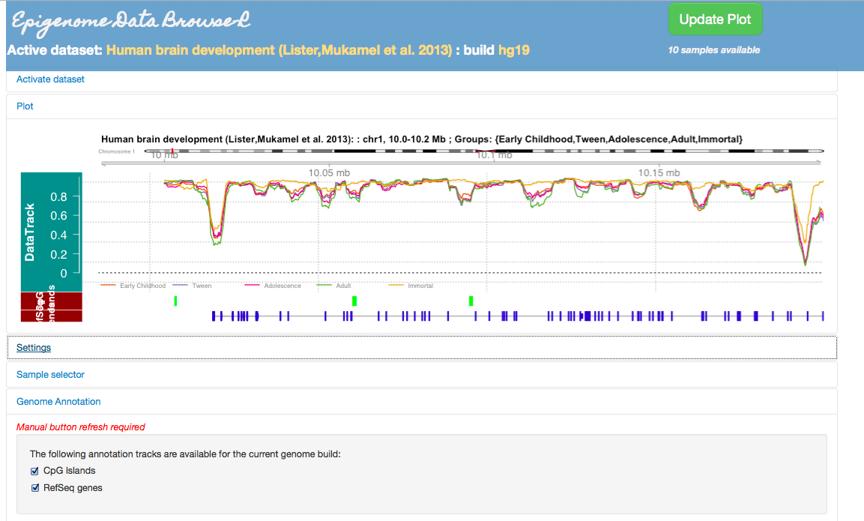
Group samples by property of choice
Specify natural sequence of grouping so temporal order is preserved in colours, say, for a timecourse
One-time load of genome annotation. View data in genomic context.

Slide 4
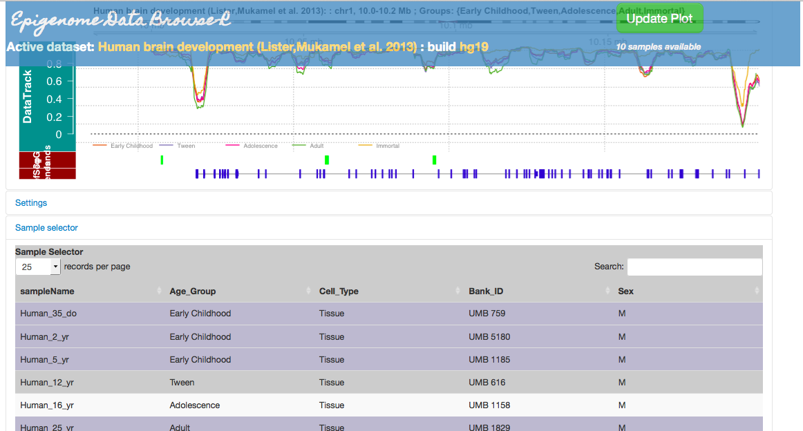
Sample Selector

Slide 5
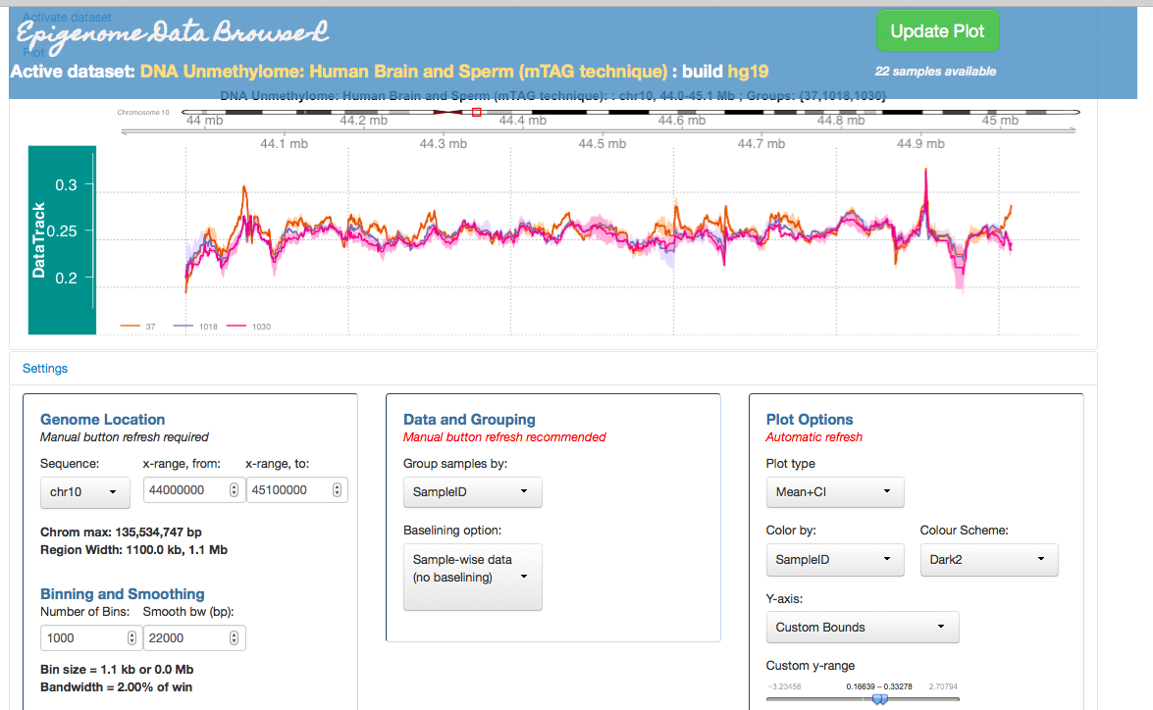
Explore within-group variability

