Slide 1
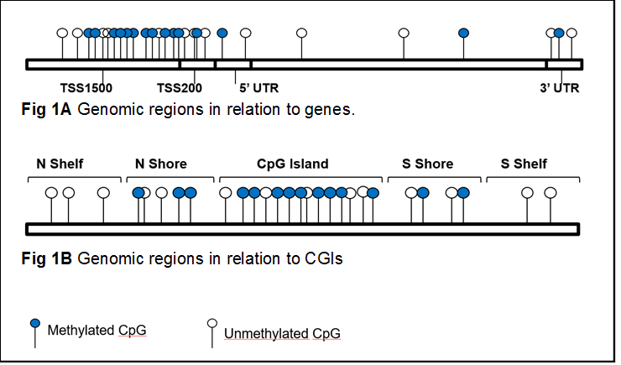

Slide 2
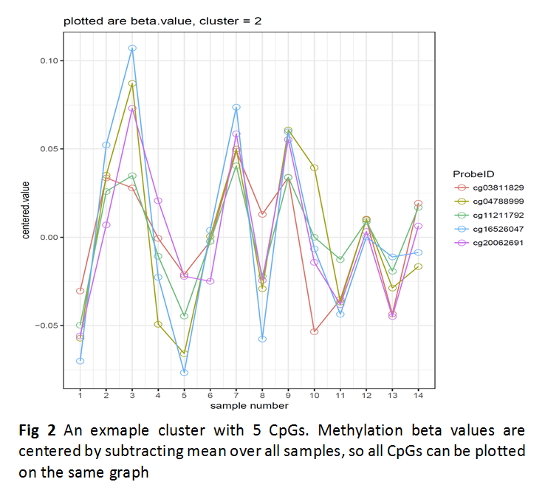

Slide 3
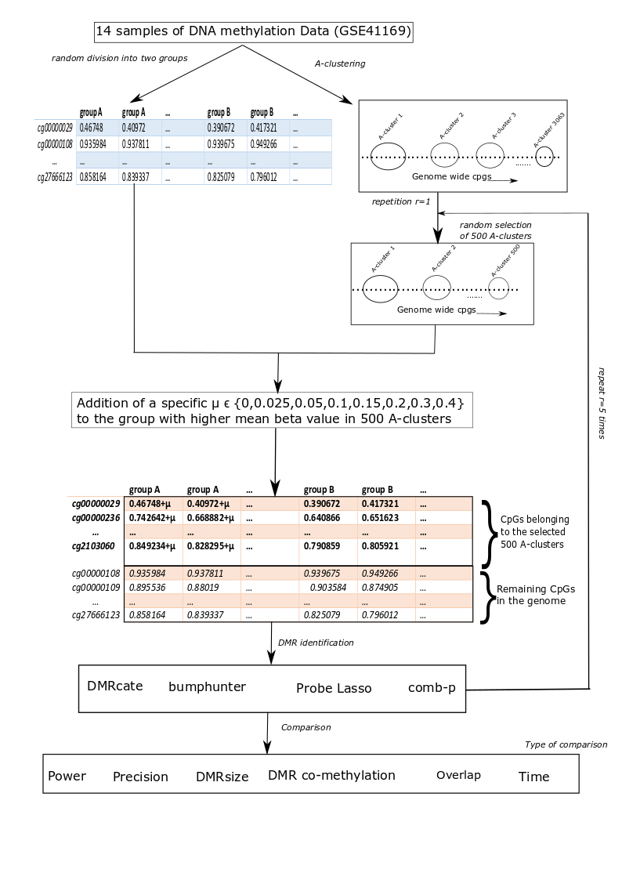
Fig 3 Workflow of simulation study

Slide 4
Fig 4 Power of the methods when different treatment effects (mu) where added to simulation datasets

Slide 5
Fig 5 Precision of the methods when different treatment effects (mu) were added to simulation datasets

Slide 6
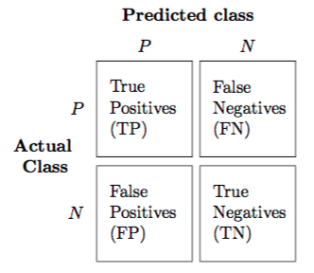
Fig 6 Confusion matrix

