Slide 1
Modified U1 snRNA as splice modulator
Zhen
Sep 5, 2023

Slide 2
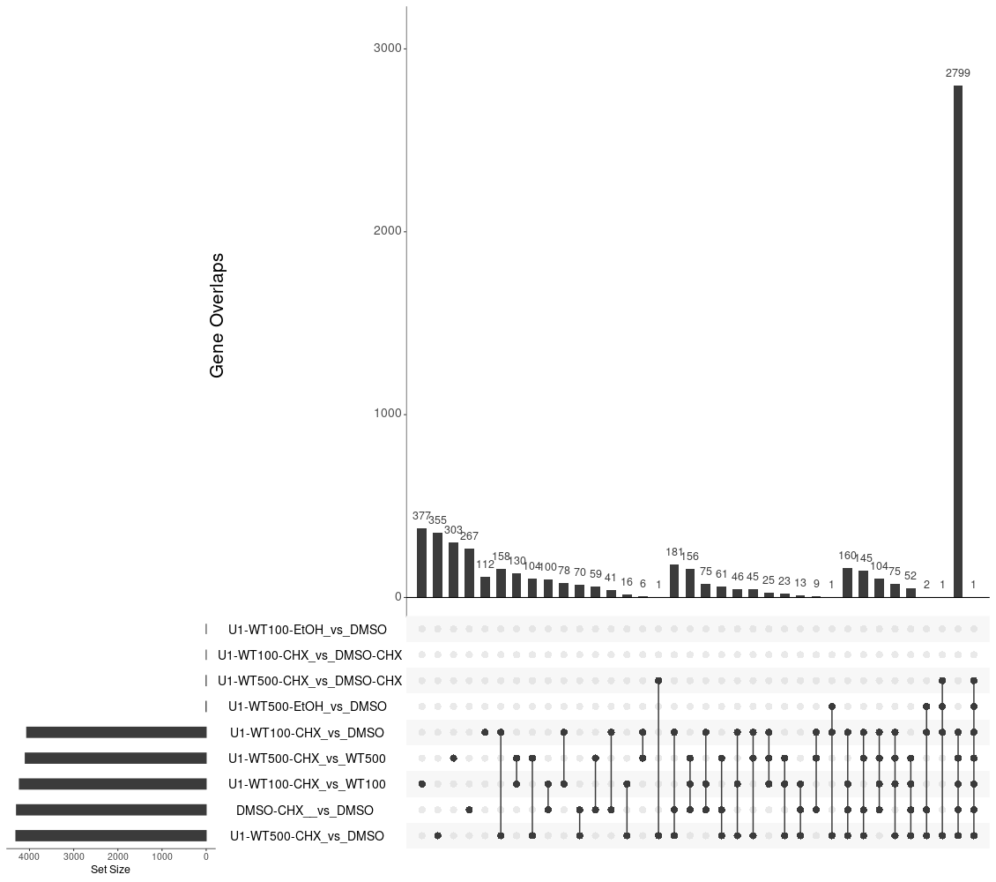
DEG-Group1: DSMO_and_WT
WT-100 and WT-500 has no or nearly no effect in
DEG transcription:
VS DMSO and DMSO-CHX

Slide 3
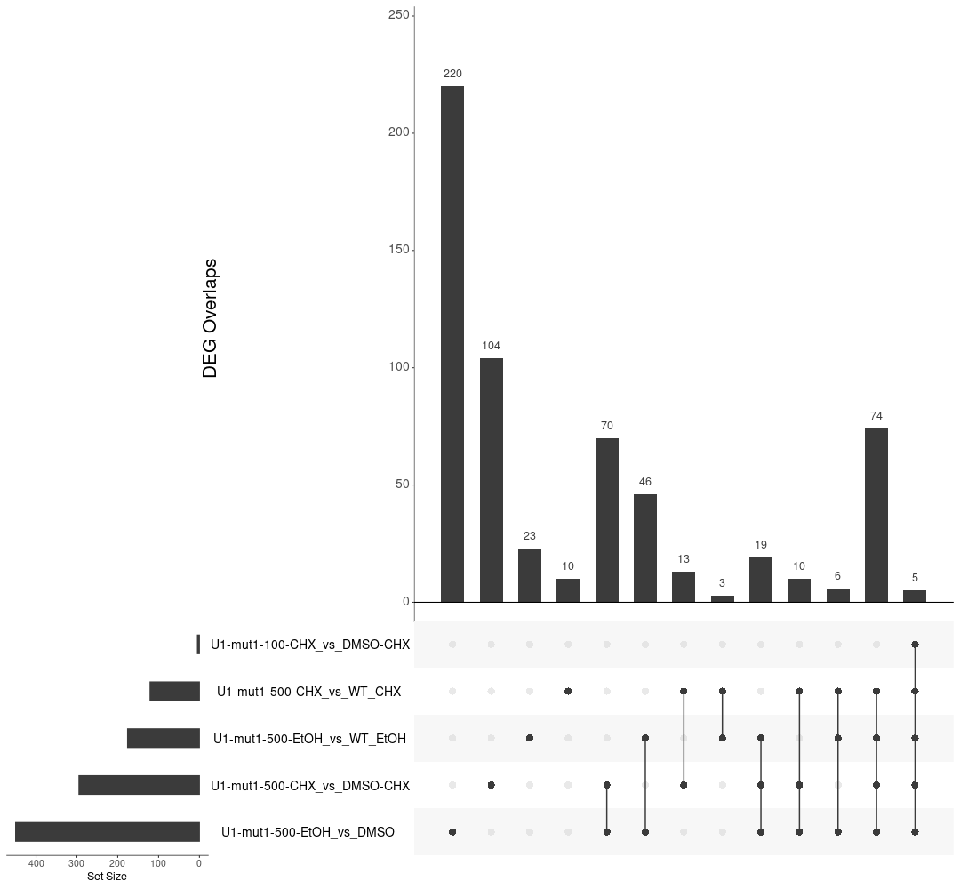
DEG-Group2: WT_mut1
mut1-500 causes DEG transcription, majority of them are through NMD
VS DMSO and DMSO-CHX while Mut1-100 has very week effects

Slide 4
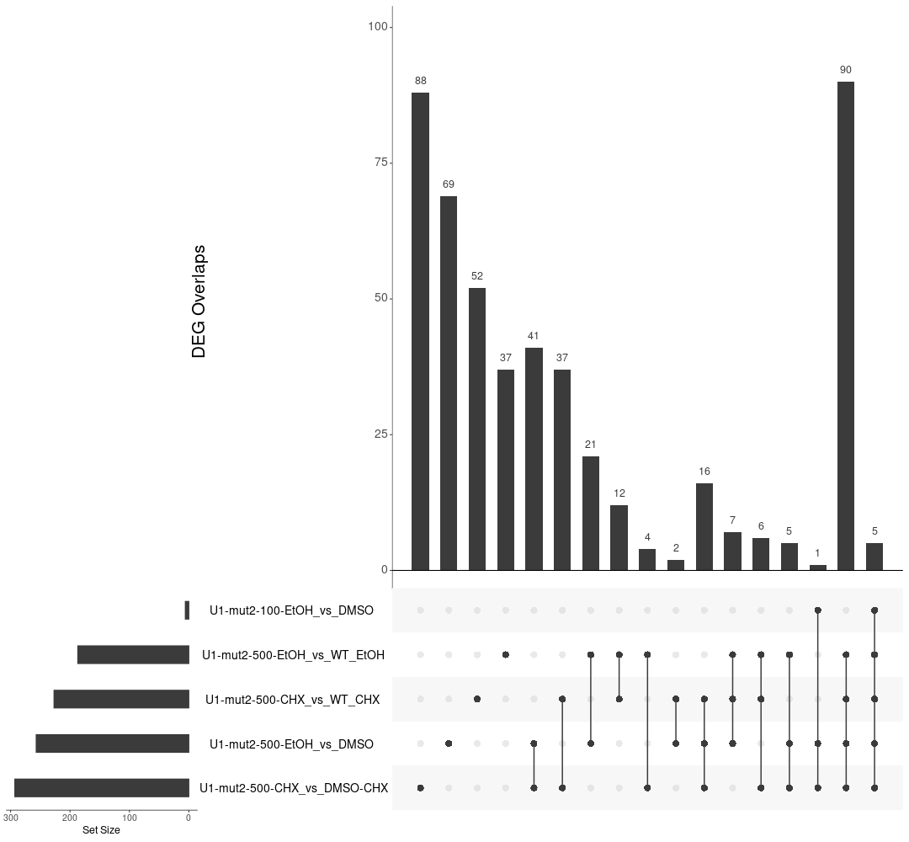
DEG-Group3: WT_mut2
mut2-500 causes few DEG transcription, majority of them are through NMD
VS DMSO and DMSO-CHX while Mut2-100 has no effects

Slide 5
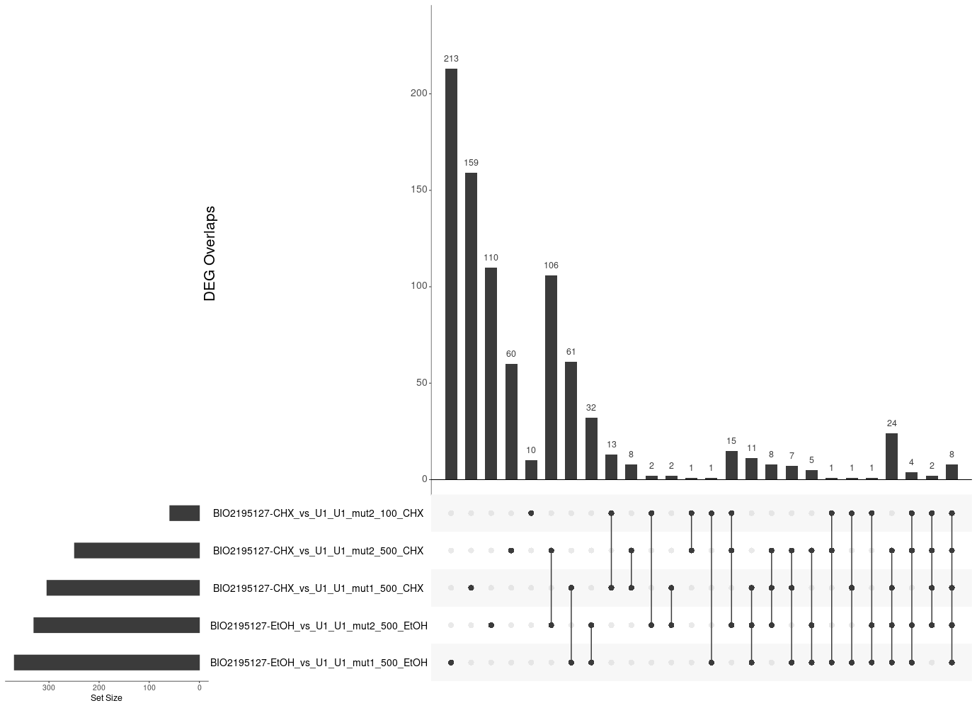
DEG-Group4: BIO5127_and_mut1_mut2
BIO5127 are less different from mut2 than muta1

Slide 6
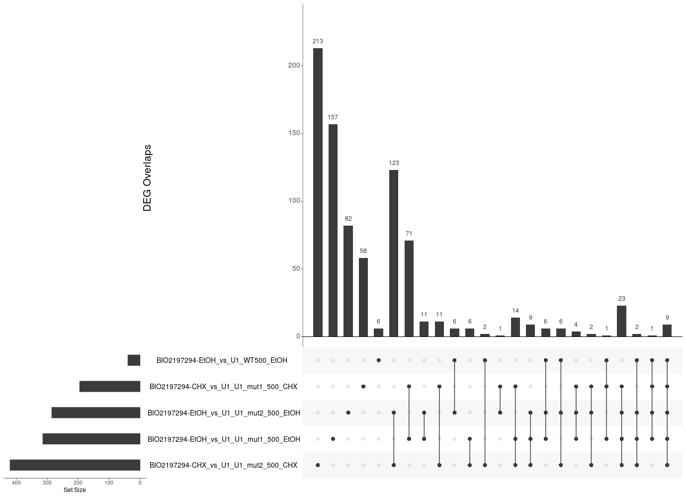
DEG-Group5: PTC518_and_mut1_mut2
PTC518 induced different gene expression from mut2

Slide 7
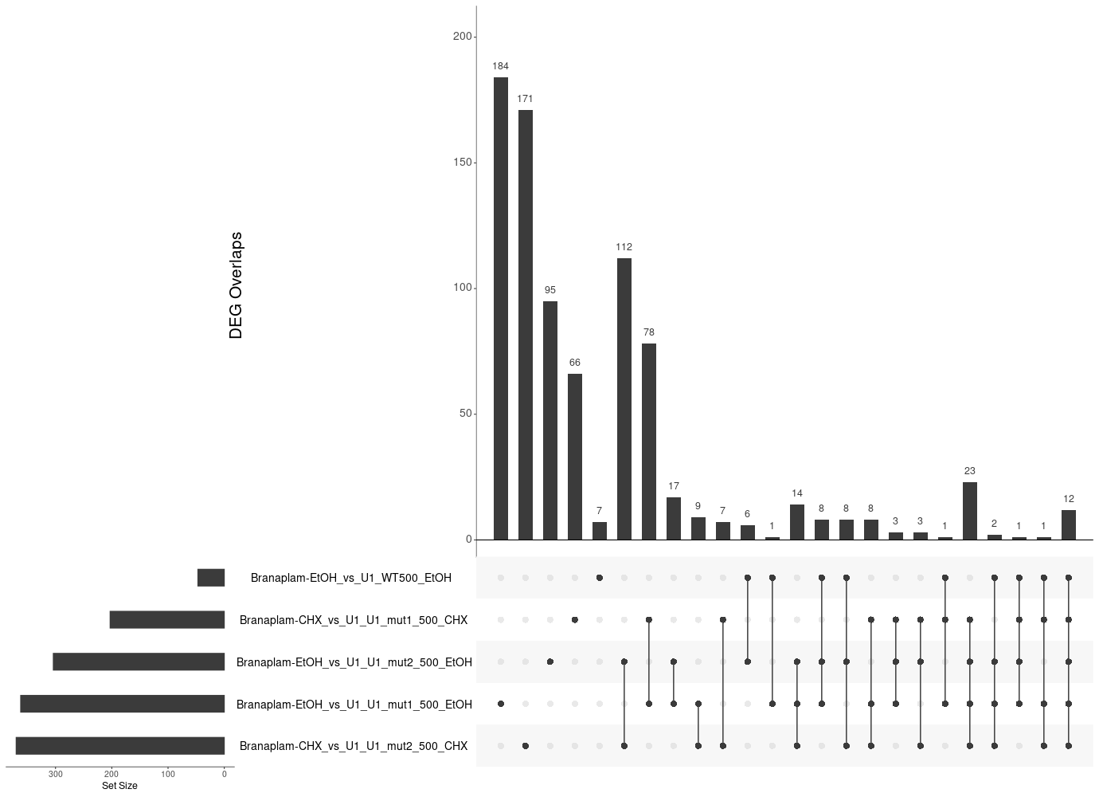
DEG-Group6: Branaplam_and_mut1_mut2
Branaplam induced modest splice changes

Slide 8
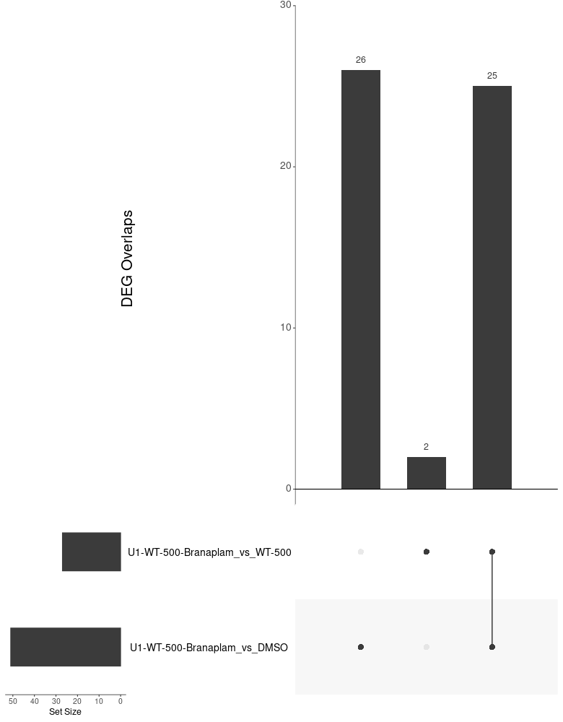
DEG-Group7: PTC518_and_Branaplam_and_WT
PTC518 prone to induced more DSG with high WT

Slide 9
DSG

Slide 10
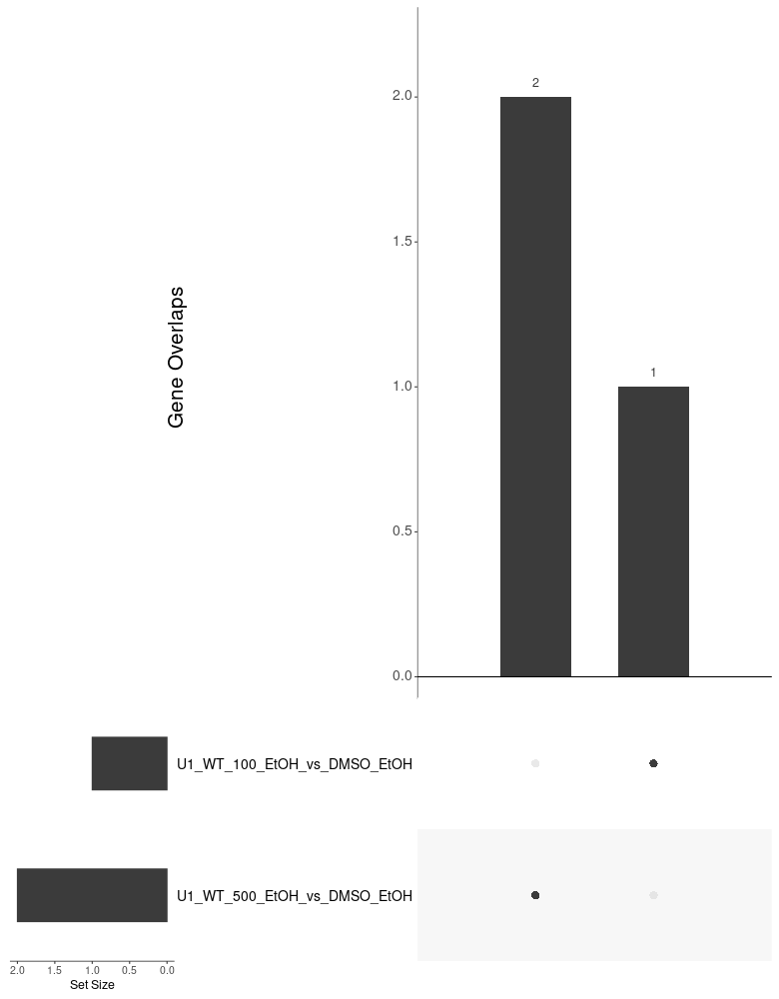
DSG-Group1: DSMO_and_WT
WT-100 and WT-500 has no or nearly no effect in DSG

Slide 11
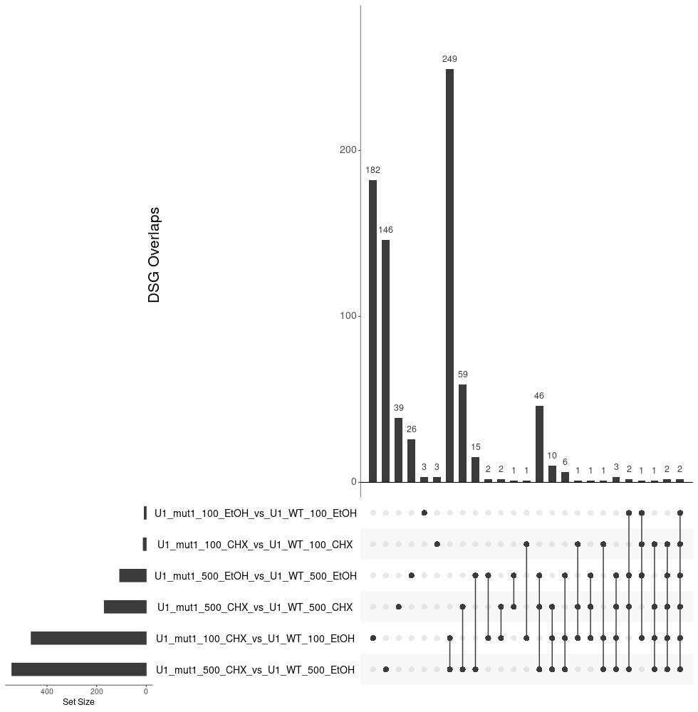
DSG-Group2: WT_mut1
mut1-500 causes modest DSG

Slide 12
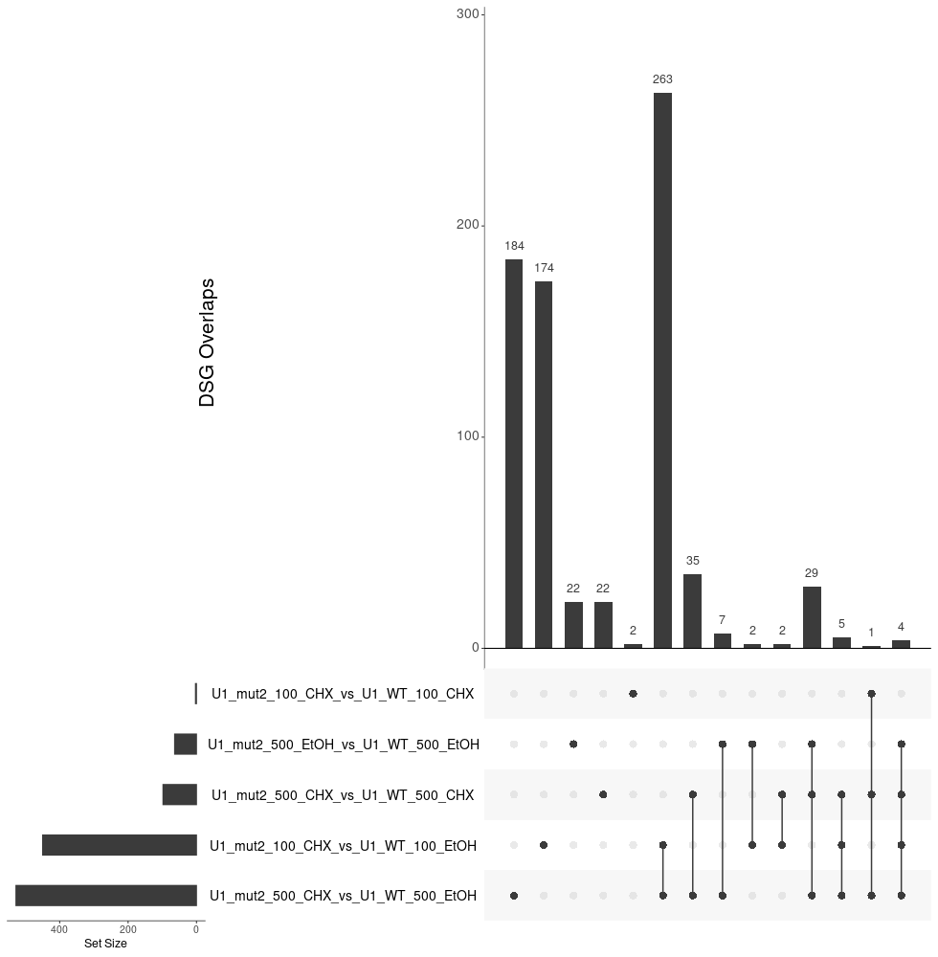
DSG-Group3: WT_mut2

Slide 13
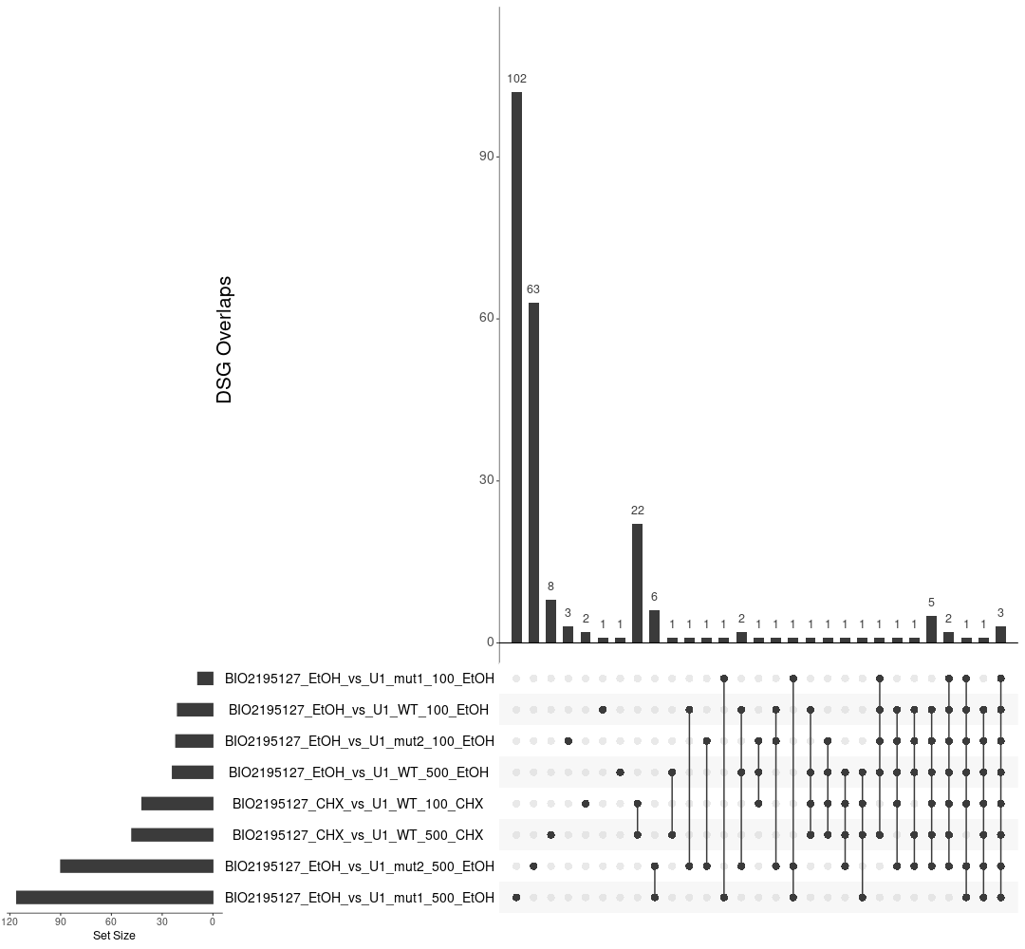
DSG-Group4: BIO5127_and_mut1_mut2

Slide 14
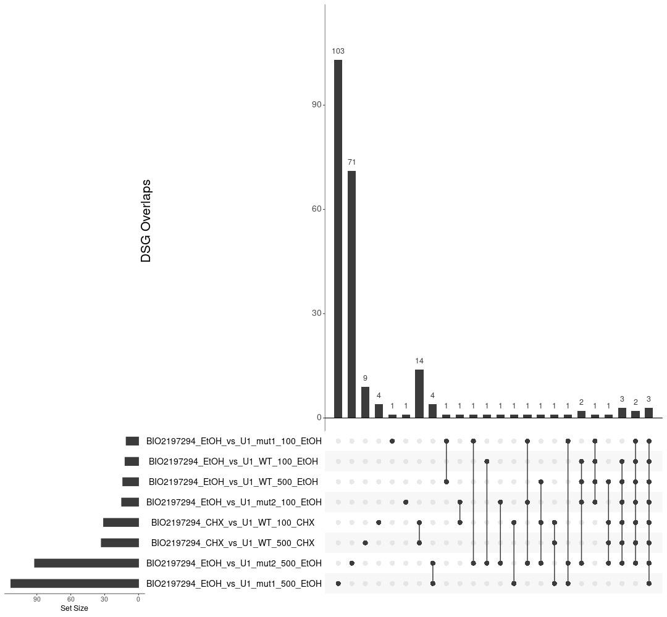
DSG-Group5: PTC518_and_mut1_mut2
PTC518 induced different gene expression from mut2

Slide 15
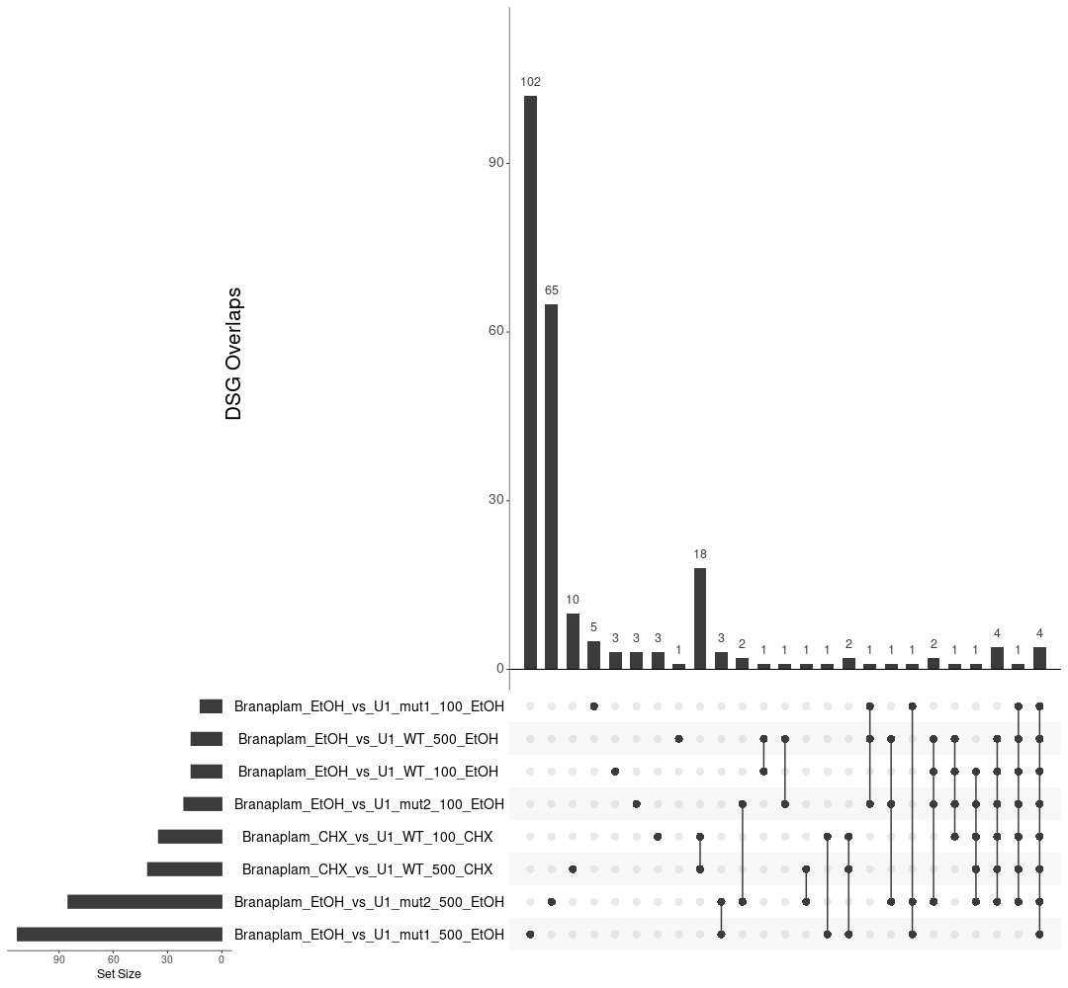
DSG-Group6: Branaplam_and_mut1_mut2
Branaplam induced modest splice changes

Slide 16
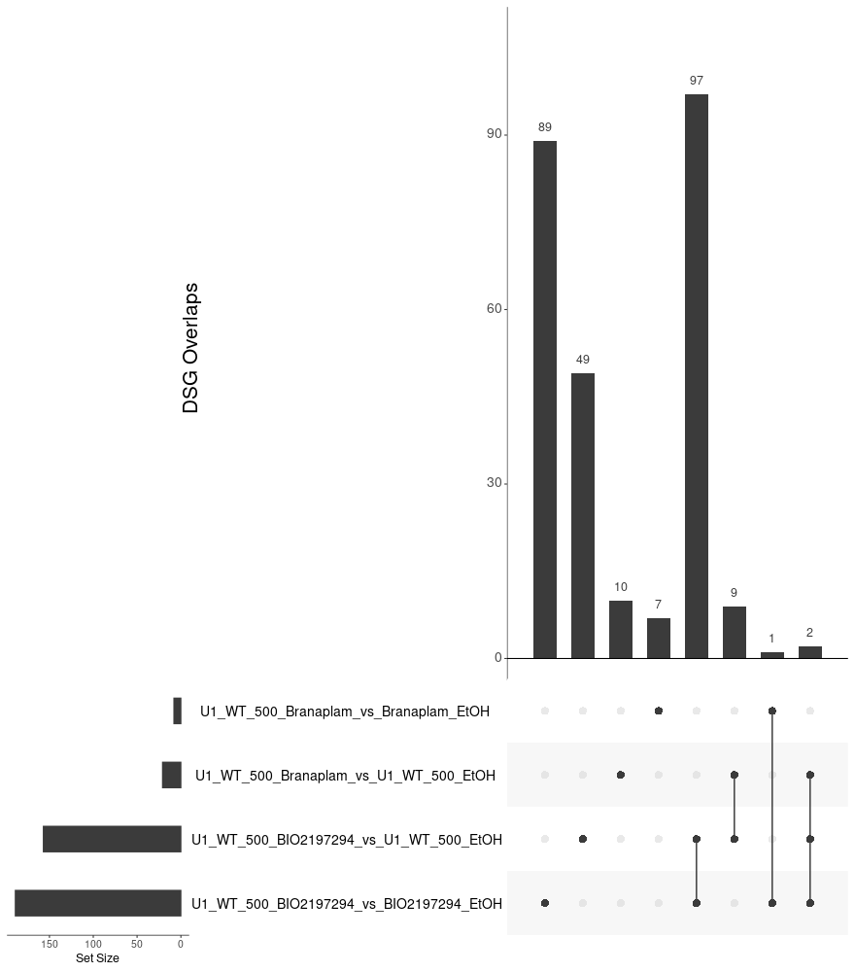
DSG-Group7: PTC518_and_Branaplam_and_WT
PTC518 prone to induced more DSG with high WT

Slide 17
DEG-Group1: DSMO_and_WT
Gene.Name | UniqueID | test | logFC | P.Value | Adj.P.Value
FOXM1 | ENSG00000111206.13 | DMSO-CHX__vs_DMSO | -0.501912754 | 3.74E-06 | 2.75E-05
HTT | ENSG00000197386.12 | DMSO-CHX__vs_DMSO | -1.143263976 | 6.23E-26 | 2.01E-23
MSH3 | ENSG00000113318.11 | DMSO-CHX__vs_DMSO | 0.438024074 | 0.000909037 | 0.004194075
Gene.Name | UniqueID | test | logFC | P.Value | Adj.P.Value
FOXM1 | ENSG00000111206.13 | U1-WT100-EtOH_vs_DMSO | -0.004636 | 1 | 1
HTT | ENSG00000197386.12 | U1-WT100-EtOH_vs_DMSO | -0.1571996 | 0.6220147 | 1
MSH3 | ENSG00000113318.11 | U1-WT100-EtOH_vs_DMSO | -0.0197115 | 1 | 1
FOXM1 | ENSG00000111206.13 | U1-WT500-EtOH_vs_DMSO | 0.00265435 | 1 | 1
HTT | ENSG00000197386.12 | U1-WT500-EtOH_vs_DMSO | -0.0917893 | 1 | 1
MSH3 | ENSG00000113318.11 | U1-WT500-EtOH_vs_DMSO | 0.00542746 | 1 | 1

Slide 18
Gene.Name | UniqueID | test | logFC | P.Value | Adj.P.Value
FOXM1 | ENSG00000111206.13 | U1-mut1-100-EtOH_vs_DMSO | 0.01555806 | 1 | 1
HTT | ENSG00000197386.12 | U1-mut1-100-EtOH_vs_DMSO | -0.2280131 | 0.29248559 | 1
MSH3 | ENSG00000113318.11 | U1-mut1-100-EtOH_vs_DMSO | -0.0339211 | 1 | 1
FOXM1 | ENSG00000111206.13 | U1-mut1-100-CHX_vs_DMSO-CHX | 0.00282535 | 1 | 1
HTT | ENSG00000197386.12 | U1-mut1-100-CHX_vs_DMSO-CHX | -0.0070442 | 1 | 1
MSH3 | ENSG00000113318.11 | U1-mut1-100-CHX_vs_DMSO-CHX | -0.0106693 | 1 | 1

Slide 32
DEG-Group1: DSMO_and_WT
WT-100 and WT-500 has no or nearly no effect in
DEG transcription:
VS DMSO and DMSO-CHX

Slide 33
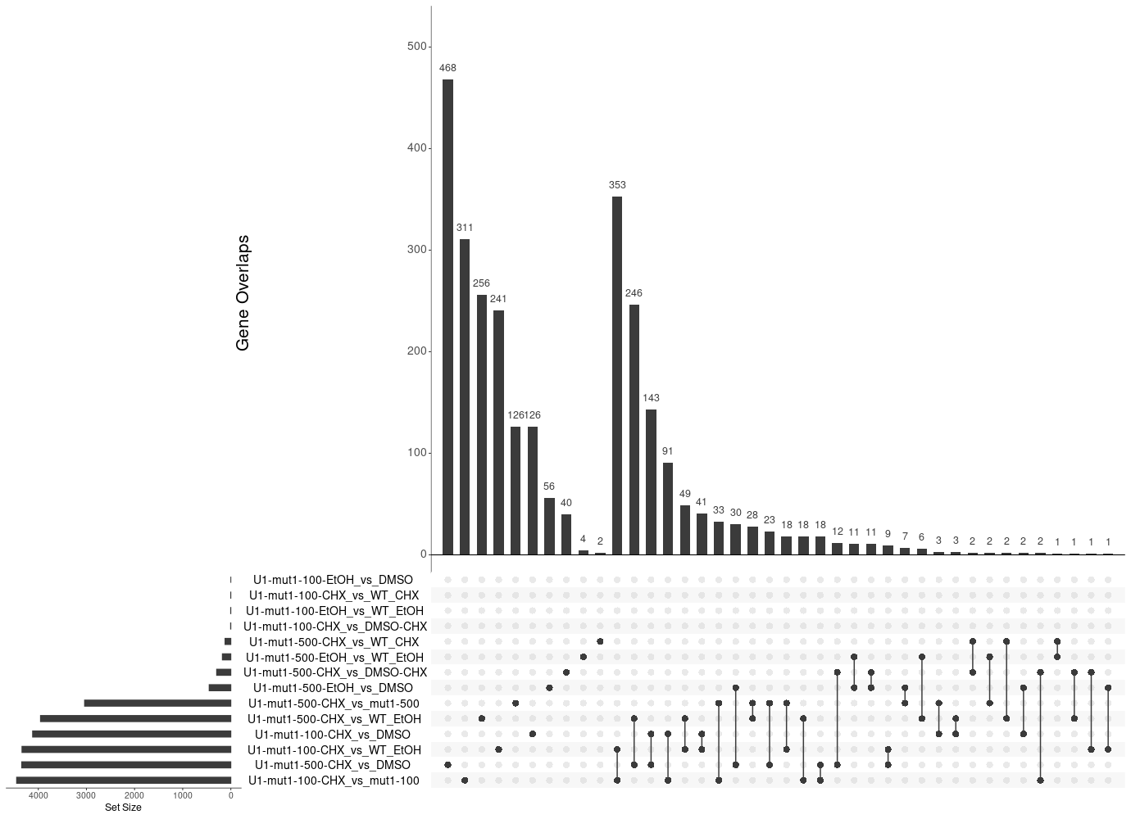
DEG-Group1: WT_mut1
mut1-500 causes DEG transcription, majority of them are through NMD
VS DMSO and DMSO-CHX while Mut1-100 has very week effects

Slide 34
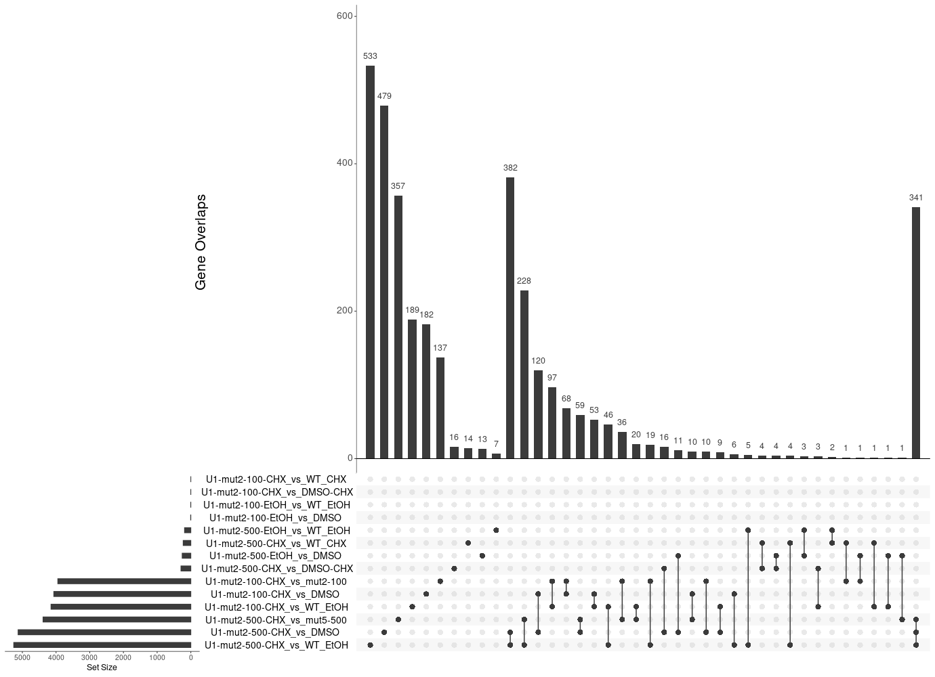
DEG-Group1: WT_mut2
mut2-500 causes few DEG transcription, majority of them are through NMD
VS DMSO and DMSO-CHX while Mut1-100 has no effects

Slide 35
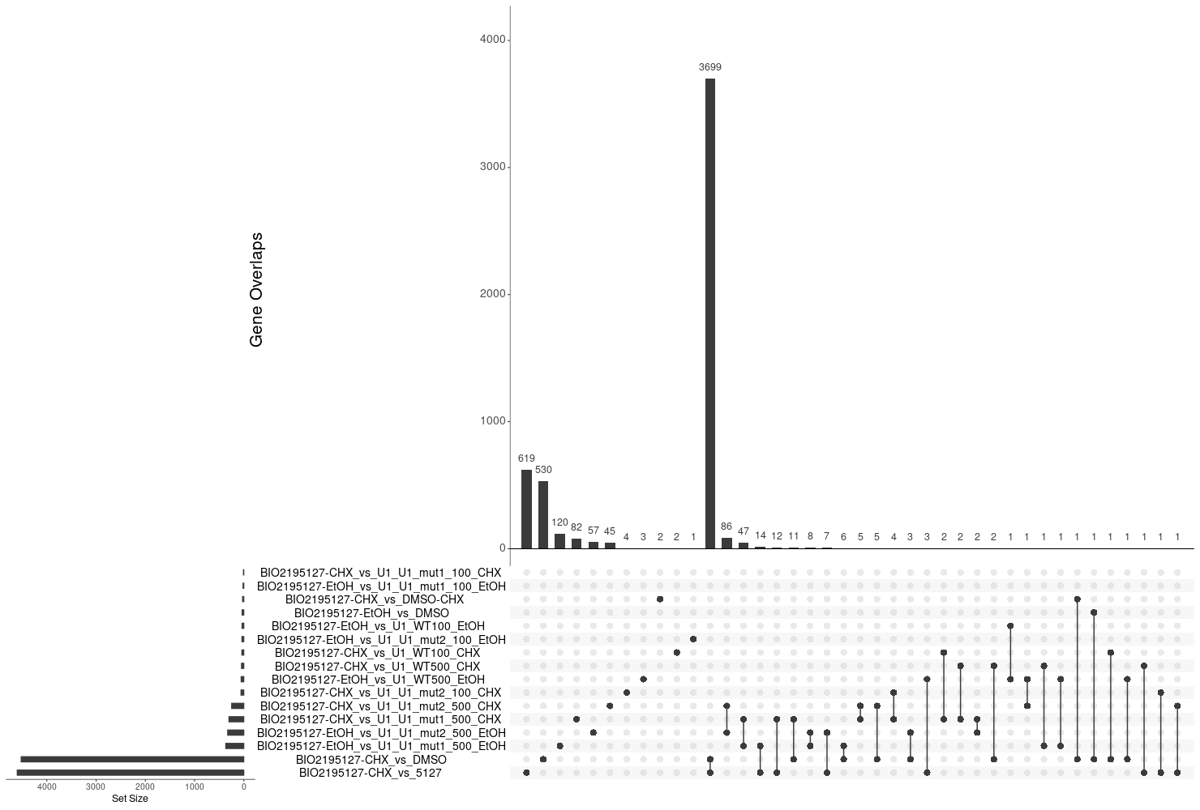
DEG-Group4: BIO5127_and_mut1_mut2
BIO5127 are less different from mut2 than muta1

Slide 36
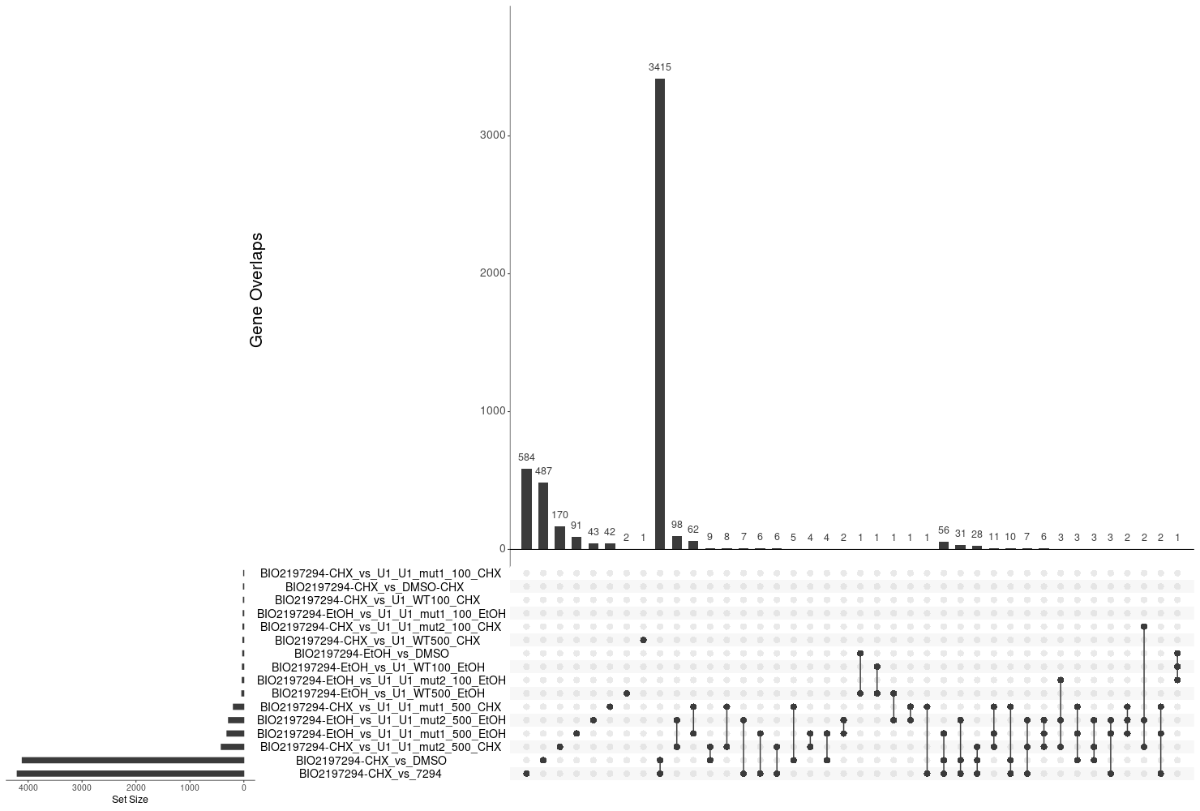
DEG-Group5: PTC518_and_mut1_mut2
PTC518 have different expression from mut2

Slide 37
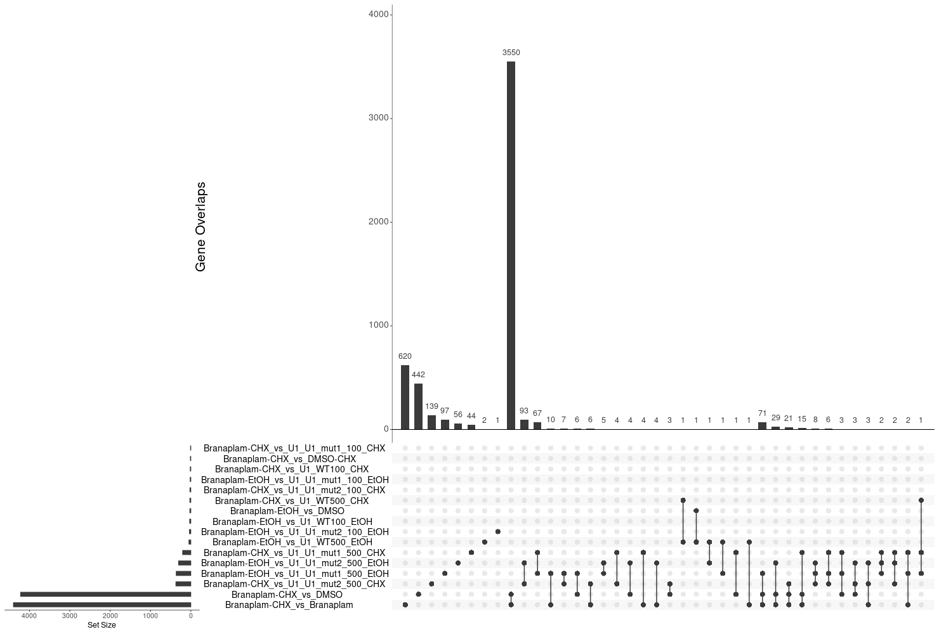
DEG-Group6: Branaplam_and_mut1_mut2

Slide 38
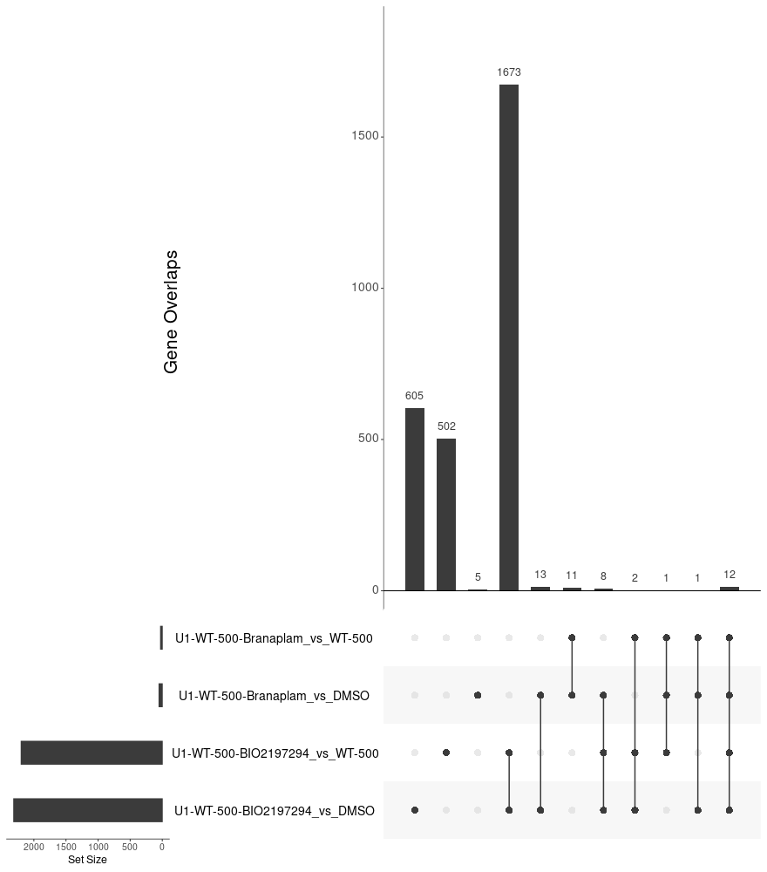
DEG-Group7: PTC518_and_Branaplam_and_WT

Slide 40
DEG-Group1: DSMO_and_WT

Slide 41
DEG-Group1: DSMO_and_WT

Slide 43
Main Goals of the RNAseq
Discover the compounds have fewer off-targets and but strong on-target effects
Determine the common targets among the SM splicing enhancers
Explore potential novel splicing targets
Confirm the system difference between the different cell-systems (iPSC and NGN2)
Seek the best procedure for cross-experiments/cross-cell-systems comparison
Make robust and cost-efficient experimental design, QC etc.
Sep 26, 2022
Zhen, Dann, Catherine, Joon, Magnus, Jessica

Slide 44
DEG-Group6:

