Slide 1
RNAseq for HTT Splicing Enhancers
DEG vs DSG
Zhen, Dann, Catherine, Joon, Magnus, Jessica
July 18, 2023

Slide 2
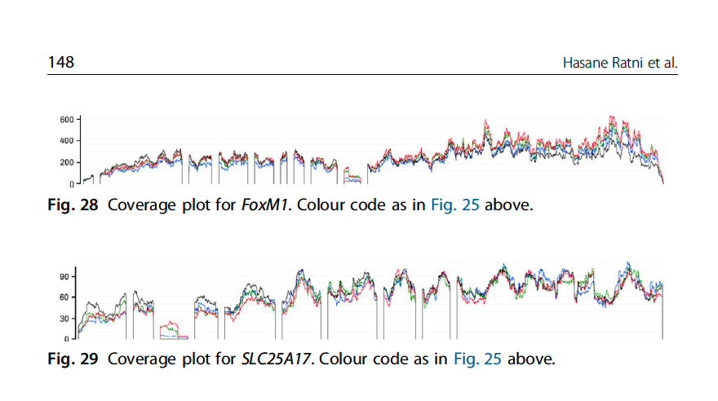
On-Targets and Off-Targets sequences
 | Doner Splice Site Consensus
 | AG|GTRAG
Gene Names | Risdiplam Consensus Binding sequence
HTT | AGA|GTTAG
APLP2 | GA|GTAAG
FOXM1-inside | GA|GTAAG
FOXM1-border | CA|GTAAG
SLC25A17-inside | GA|GTAAG
SLC25A17-border | AG|GTTAA
ref:
Ratni Roche review, Progress Medicinal Chem V58, 2019
Anuradha Bhattacharyya et. Al. Nature Comm. 2021

Slide 3
Main Goals of the RNAseq
Discover the compounds have fewer off-targets and but strong on-target effects
Determine the common targets among the SM splicing enhancers
Explore potential novel splicing targets
Confirm the system difference between the different cell-systems (iPSC and NGN2, Sy5Y)
Seek the best procedure for cross-experiments/cross-cell-systems comparison
Make robust and cost-efficient experimental design, QC etc.

Slide 4
RNA-seq Study #1
Goal: Transcriptome-wide RNA-seq of Benchmark/competitor HTT splice modulators and current BIIB lead compounds in neurons and proliferating cell type for off-target profiling.
Compound | CRL HTRF IC50 (nM) | Internal HTRF IC50 (nM) | Internal iPSC qPCR IC50 (nM) | Internal NGN2 qPCR IC50 (nM) | ~3x IC50 Dose (nM) | Actual X-fold IC50 (iPSC) | Actual X-fold IC50 (NGN2) | ~10x IC50 Dose (nM) | Actual X-fold IC50 (iPSC) | Actual X-fold IC50 (NGN2) | Notes
BIO-1755497 | 121 | 4 | 10.75 | 3.023 | 12 | 1.12 | 3.97 | 40 | 3.72 | 13.23 | Branaplam
BIO-2006152 | 87 | 15 | 14.14 | 7.6185 | 45 | 3.18 | 5.91 | 150 | 10.61 | 19.69
BIO-2059811 | 87 | Expected <100nM | 101.5 | 65.19 | 261 | 2.57 | 4.00 | 870 | 8.57 | 13.35 | PTC different core
BIO-2135644 | 100 | Expected <100nM | 81.68 | 68.31 | 300 | 3.67 | 4.39 | 1000 | 12.24 | 14.64 | PTC different core
BIO-2136770 | 100 | Expected <100nM | 41 | 24.59 | 300 | 7.32 | 12.20 | 1000 | 24.39 | 40.67 | Close PTC518 analog
BIO-1949634 | 1500 | 6200 | 357.55 | 289 | 3000 | 8.39 | 10.38 | 10000 | 27.97 | 34.60 | Risdiplam
BIO-2060573 | 5780 | 670 | 298.2 | 271.5 | 3000 | 10.06 | 11.05 | 10000 | 33.53 | 36.83 | Internal lead/different core
BIO-2070692 | 560 | 50 | 140.4 | 104.4 | 1680 | 11.97 | 16.09 | 5600 | 39.89 | 53.64 | Remix example
BIO-2060884 | 370 | 240 | 113.8 | 105.9 | 3700 | 32.51 | 34.94 | 10000 | 87.87 | 94.43 | Internal lead
DMSO | - | - | - | - | - | - |  | -
 |  |  | Determined after RNAseq study |  |  | Determined after RNAseq study |  |  | Determined after RNAseq study
*Dosed correctly and used as reference across RNAseq studies
7189L WT Cell lines:
iPSCs (100K)
NGN2 (DIV14, 200K)
Treatment:
24hr
Replicates:
3 biological
Total Samples:
114 (9 cpds + DMSO)
Edited From Catherine

Slide 5
RNA-seq Study #2
Goal: Transcriptome-wide RNA-seq of potent BIIB lead compounds in neurons and proliferating cell type for off-target profiling in comparison of competitor compounds.
Compound | Internal HTRF IC50 (nM) | Internal iPSC qPCR IC50 (nM) | Internal NGN2 qPCR IC50 (nM) | ~3x IC50 (iPSC) | ~10x IC50 (iPSC) | ~3x IC50 (NGN2) | ~10x IC50 (NGN2) | Notes
BIO-2006152 | 15.0 | 14.14 | 7.62 | 42 | 141 | 23 | 76 | REFERENCE
BIO-2175420 | 11.5 | 14.50 | 5.28 | 43 | 145 | 16 | 53 | great KPuu imidazopyridine
BIO-2139701 | 38.3 | 19.95 | 5.60 | 60 | 199 | 17 | 56 | imidazopyridine other RHS
BIO-2176866 | 91.7 | 70.41 | 8.83 | 211 | 704 | 26 | 88 | benzimidazole
BIO-2184088 | 21.0 | 26.18 | 11.16 | 79 | 262 | 33 | 112 | sulfur
BIO-2184090 | 65.0 | 49.36 | 30.86 | 148 | 494 | 93 | 309 | sulfur other RHS
BIO-2174714 | 191.0 | 113.90 | 52.60 | 342 | 1139 | 158 | 526 | indazole
BIO-2186960 | 32.9 | 16.77 | 10.18 | 50 | 168 | 31 | 102 | triazole 1
BIO-2186527 | 36.4 | 32.36 | 19.24 | 97 | 324 | 58 | 192 | triazole 2
BIO-2174748 | 74.5 | 37.62 | 22.08 | 113 | 376 | 66 | 221 | oxazole
BIO-2184741 | 56.0 | 147.60 | 96.21 | 443 | 1476 | 289 | 962 | BENCHMARK, Remix cpd
DMSO | - | - | - | - | - | - | -
7189L WT Cell lines:
iPSCs (100K)
NGN2 (DIV14, 200K)
Treatment:
24hr
Replicates:
4 biological
Total Samples:
192 (11 cpds + DMSO)

Slide 6
Structures of Some SM Splicing Enhancers

Slide 7
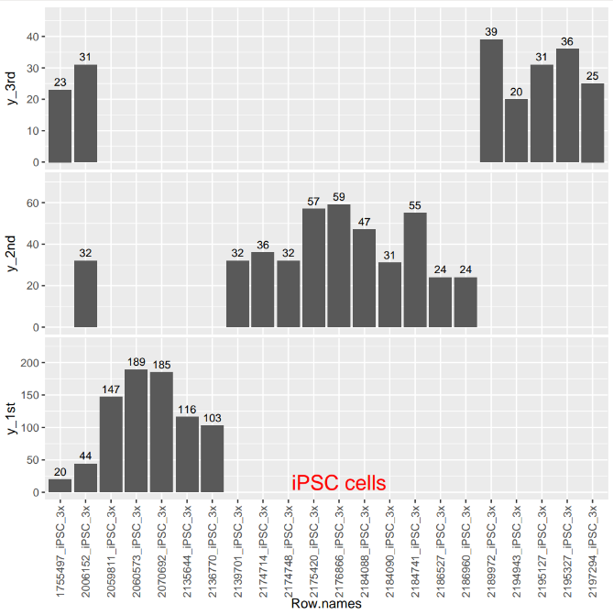
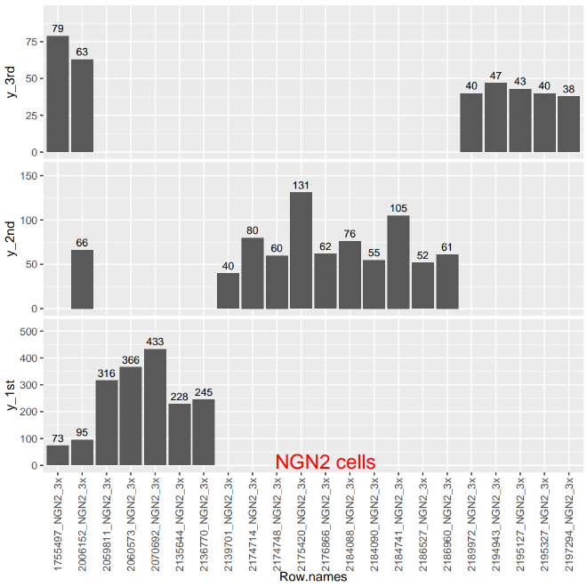
DSG across batch 1&2&3
3 bar graphs comparing the 3 batches of RNA-seq Number of DSGs

Slide 8
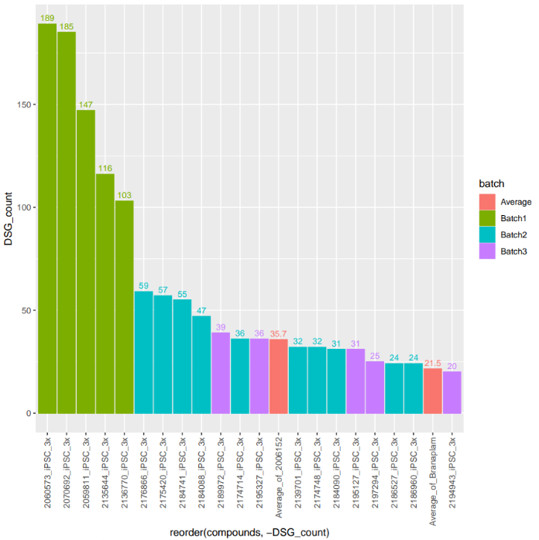
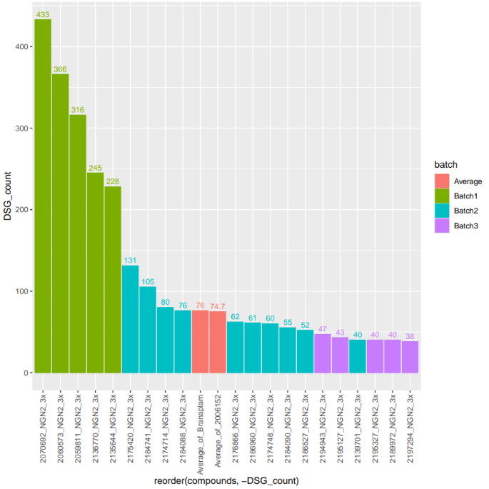
DSG across batch 1&2&3

Slide 9

The DSG Induced by Compounds in the 2 cell systems

Slide 10
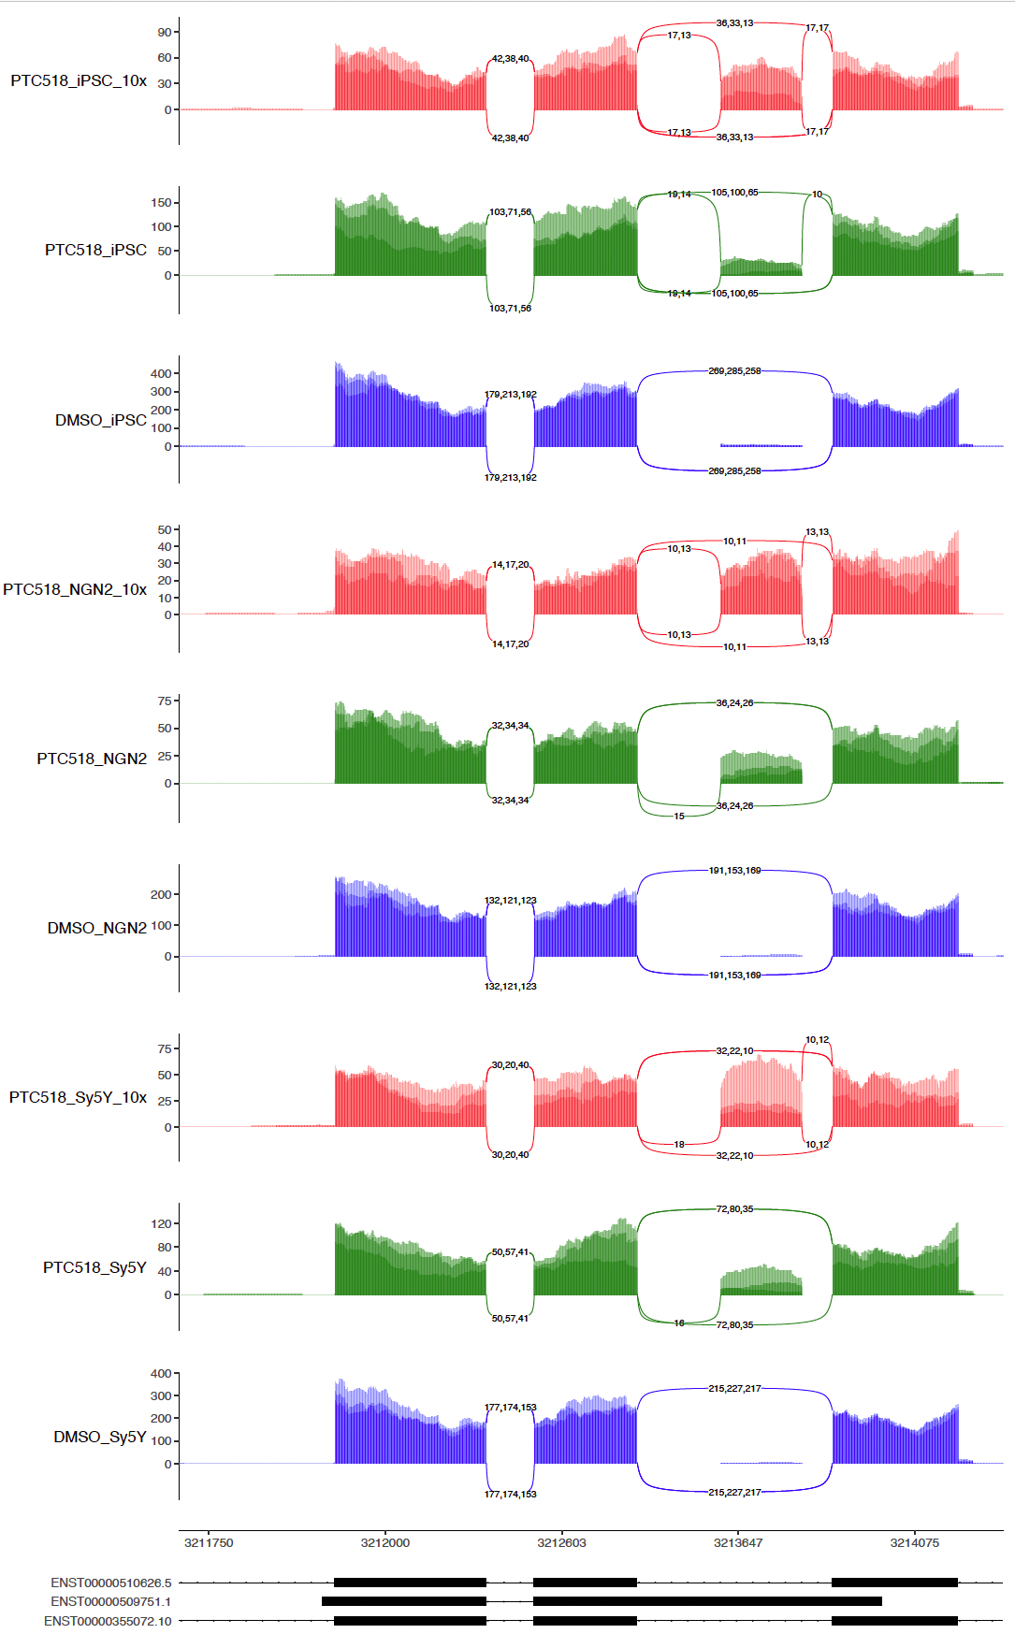
HTT sashimi-plot across 3 cell types

Slide 11
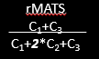
DSG analysis is likely to capture reads left
Canonical splicing
Splicing outcome
5
6
5
Cryptic
6
5
Cryptic
6
5
Cryptic
6
Stable mRNA
Protein with an inserted polypeptide
Stable mRNA
Normal protein
Unstable mRNA
Removed by NMD
SM-promoted
Cryptic splicing
If the inclusion of cryptic exon does NOT promote NMD
If the cryptic exon promotes NMD
Basal state
5
6
5
6
5
Cryptic
6
5
6
5
Cryptic
6
5
6
5
6
5
6
5
Cryptic
6
5
6
5
Cryptic
6
5
6
5
6
5
6
5
Cryptic
6
5
6
5
Cryptic
6
5
6
5
6
5
6
5
6
5
6
5
6
5
6
5
6
5
6
5
Cryptic
6
5
Cryptic
6
Cryptic
6
5
Cryptic
6
5
10 copies of canonically spliced mRNA
5 copies of canonically spliced mRNA
5 copies of cryptically spliced mRNA
5 copies of canonically spliced mRNA
1 copies of cryptically spliced mRNA
4 copies degraded by NMD
PSI = 0
PSI = 0.5
dPSI = 0.5
DSG = Yes
PSI = 0.16
dPSI = 0.16
DSG = No
Edited From Joon

Slide 12
DEG across batch 1&2&3

Slide 13
DEG across batch 1&2&3

Slide 14
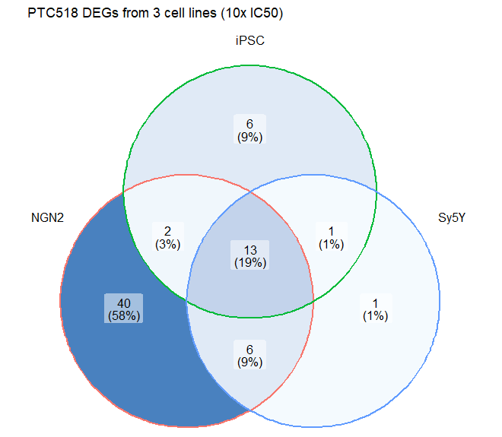
Comparison of Differentially Expressed Genes from 3 cell lines (PTC-518, 10x IC50)
 | AGA | TGA | No PE
NGN2 | 36 | 1 | 24
iPSC | 16 | 1 | 5
SH-Sy5Y | 16 | 1 | 4
Edited From Joon

Slide 15
Short Summary:
1) Both DEG and DSG were getting better from batch 1 , 2, and 3 in all the cell types tested
2) The DEG/DSG are quite different across 3 cell types. Sy5Y and iPSC were more similar
3) The DEG/DSG are only overlapped with very low frequency.
4) The DEG/DSG events have to be considered together in SM induced alternative exon inclusion experiments.
(Good Job from Chemistry Dept !)

Slide 16
Further Consideration
The outcome of Splicing modulator on target splicing could be influenced by
Transcript level : if not expressed, we cannot detect as DEGs
Transcription rate : provides pre-mRNA that could be the substrate of SM
Turnover rate : how fast does the already spliced mRNA clears
Edited From Joon

Slide 17
Design, Description and Aims:
Design:
7 SM compounds + DMSO vehicle (4 internal compounds, 3 competitor benchmark compounds, DMSO)
-2 doses per compound (3x and 10x IC50) -4 biological replicates, and 3 were used in data analysis -3 cell lines (NGN2, iPSC, SH-SY5Y)
Description: -Total number of samples: 180 -Bulk, polyA-selected, stranded, paired-end RNA-seq -75x75 or longer paired end sequencing
Aims: -Explore DSG/DEG difference and relationship
-Comparison between compounds within each cell type to identify common and unique genes/events that are differentially spliced
-Comparison of OT DSGs between cell lines for each compound -Motif analysis for each compound differentially spliced events

Slide 18
The DSG Induced by Compounds in the 2 cell systems

Slide 19
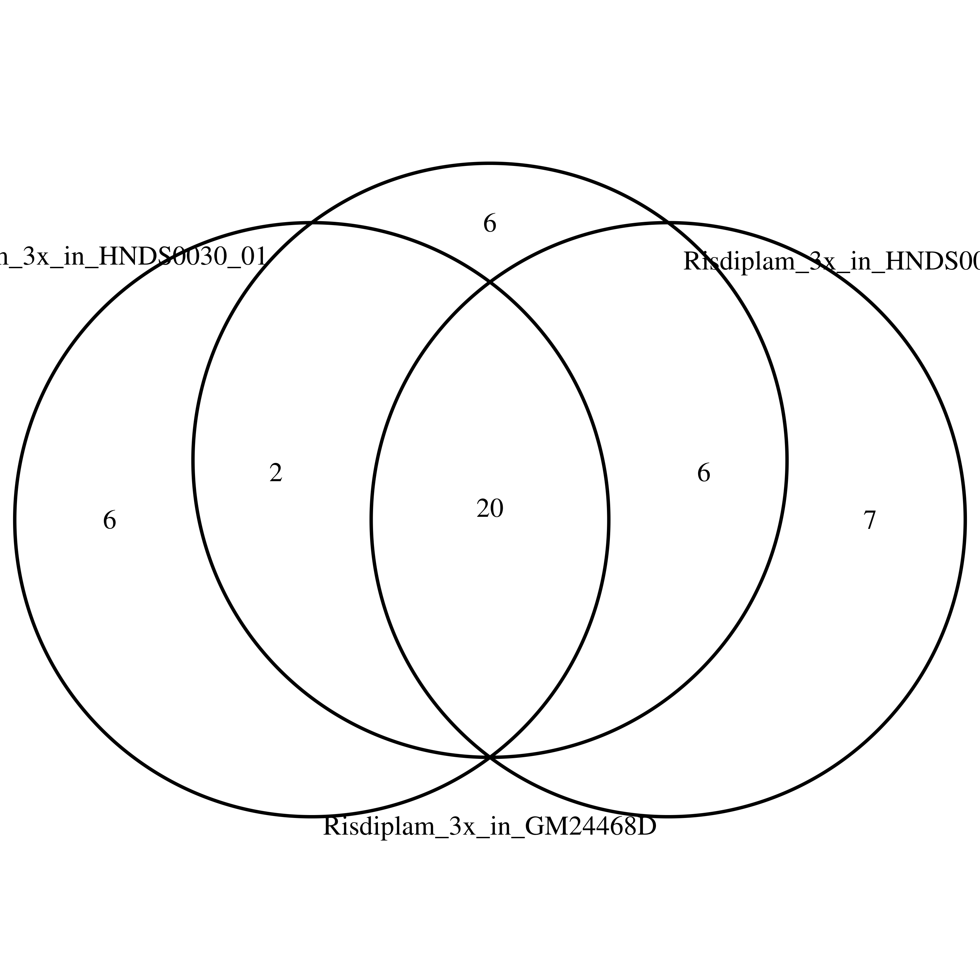
Overlap of Risdiplam induced OT in iPSC-MNs

Slide 20
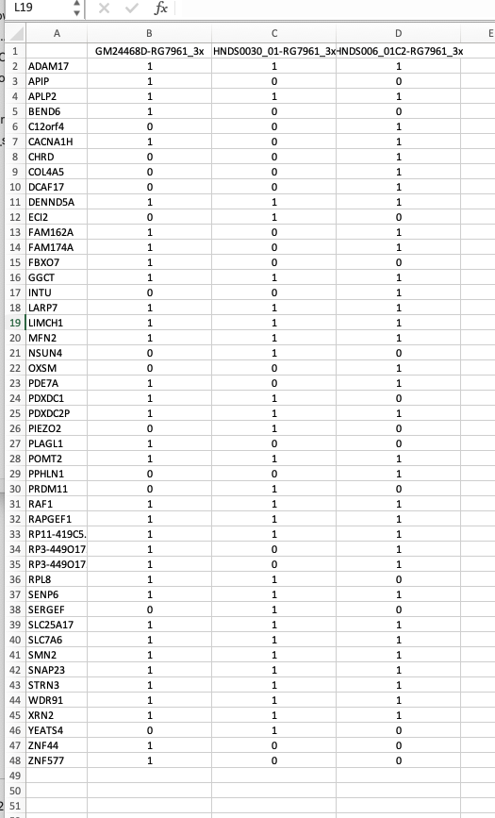
Overlap of Risdiplam induced OT in iPSC-MNs

Slide 21
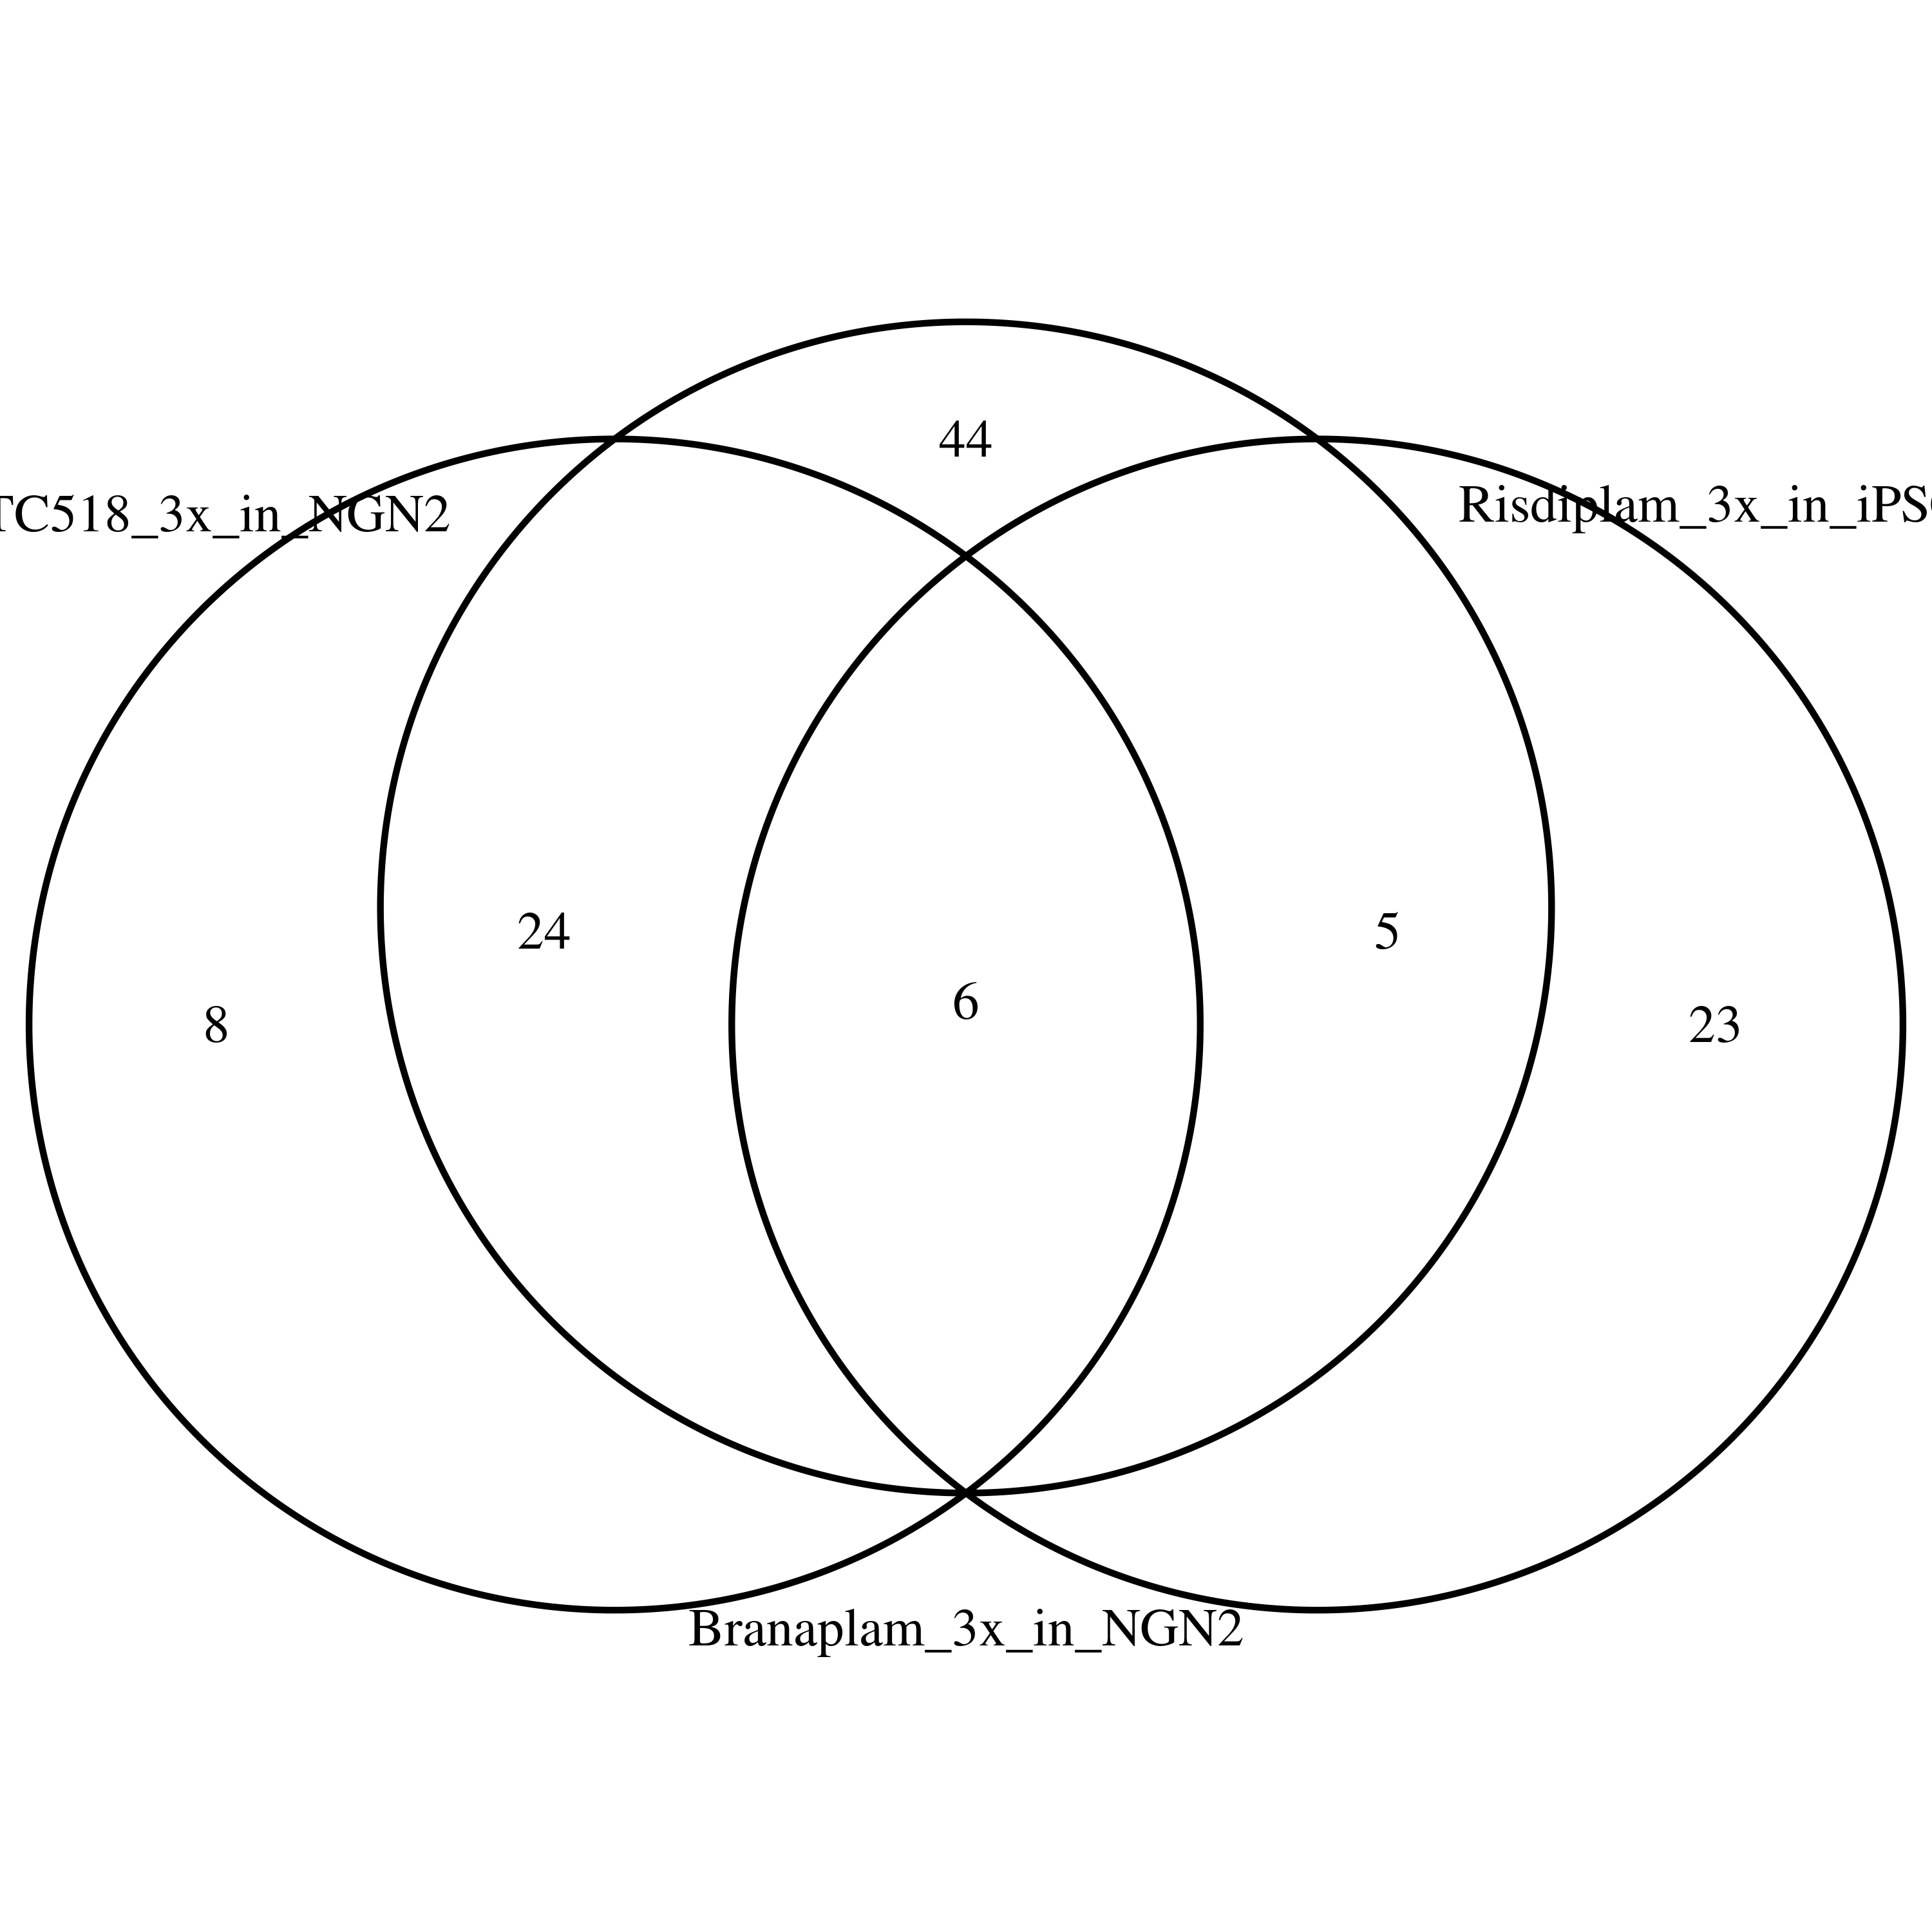
Overlap of PTC518/Branaplam in NGN2 cells and Risdiplam in iPSC-MNs

