Slide 1
RNAseq for HTT Splicing Enhancers
DEG vs DSG --- TST12086
Zhen, Dann, Catherine, Joon, Magnus, Jessica
June 01, 2023

Slide 2
Design, Description and Aims:
Design:
7 SM compounds + DMSO vehicle (4 internal compounds, 3 competitor benchmark compounds, DMSO)
-2 doses per compound (3x and 10x IC50) -4 biological replicates, and 3 were used in data analysis -3 cell lines (NGN2, iPSC, SH-SY5Y)
Description: -Total number of samples: 180 -Bulk, polyA-selected, stranded, paired-end RNA-seq -75x75 or longer paired end sequencing
Aims: -Explore DSG/DEG difference and relationship
-Comparison between compounds within each cell type to identify common and unique genes/events that are differentially spliced
-Comparison of OT DSGs between cell lines for each compound -Motif analysis for each compound differentially spliced events

Slide 3
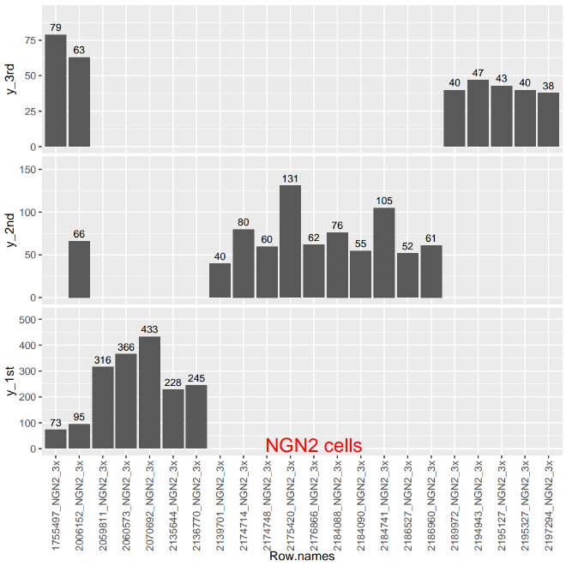
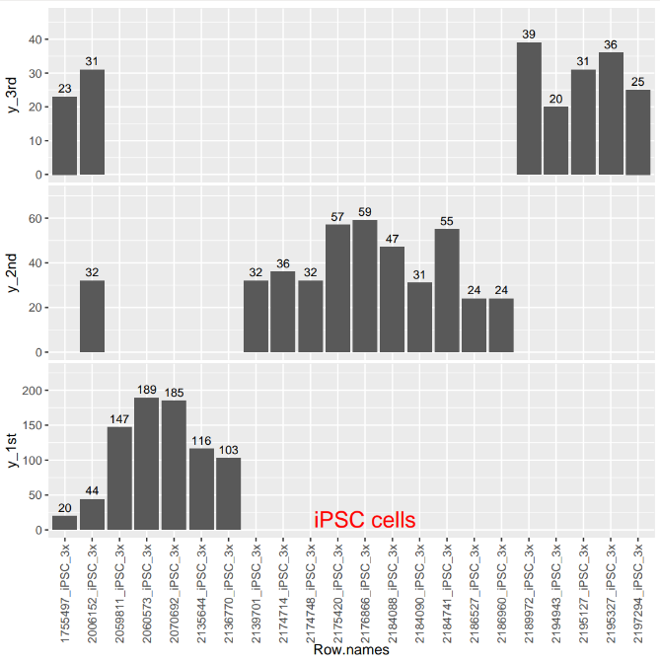
3 bar graphs comparing the 3 batches of RNA-seq
Number of DSGs
Date

Slide 4
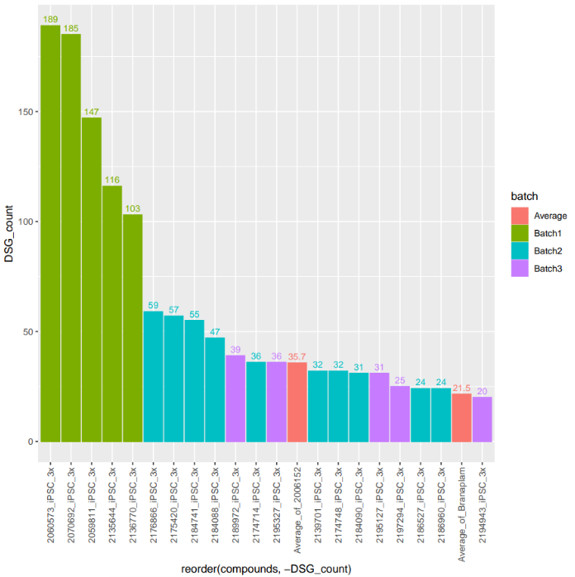
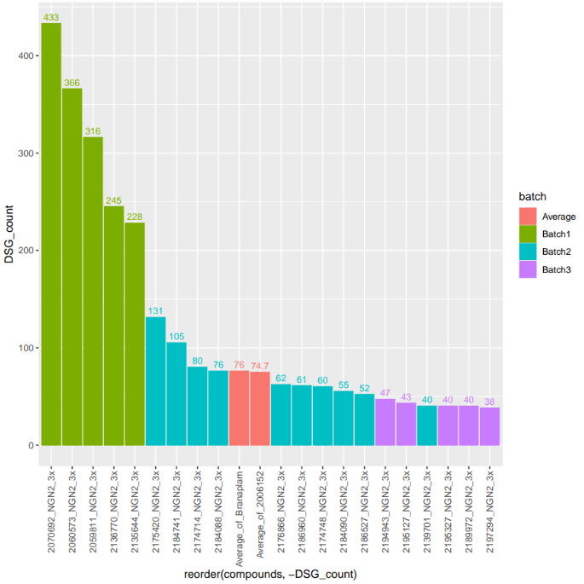

Slide 5
DEG across batch 1&2&3

Slide 6
DEG across batch 1&2&3

Slide 7
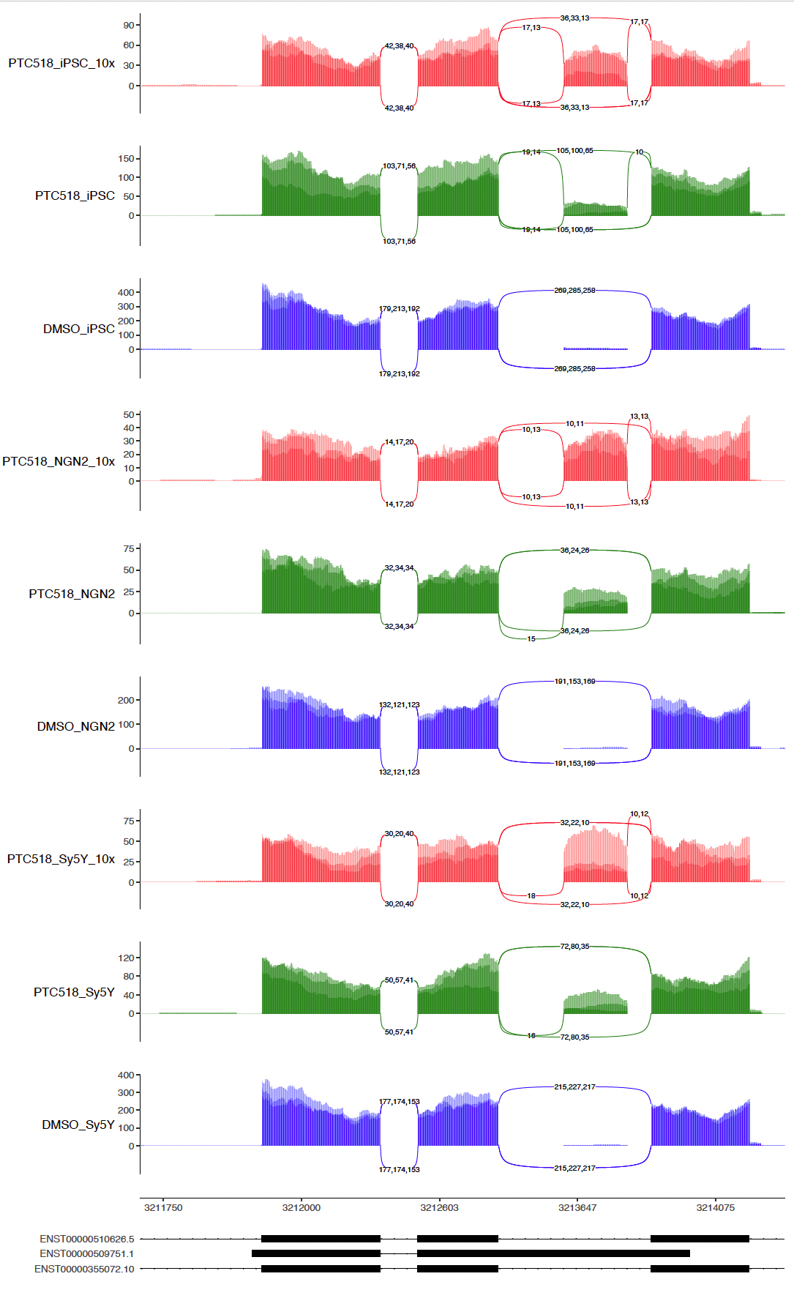
HTT sashimi-plot across 3 cell types

Slide 8
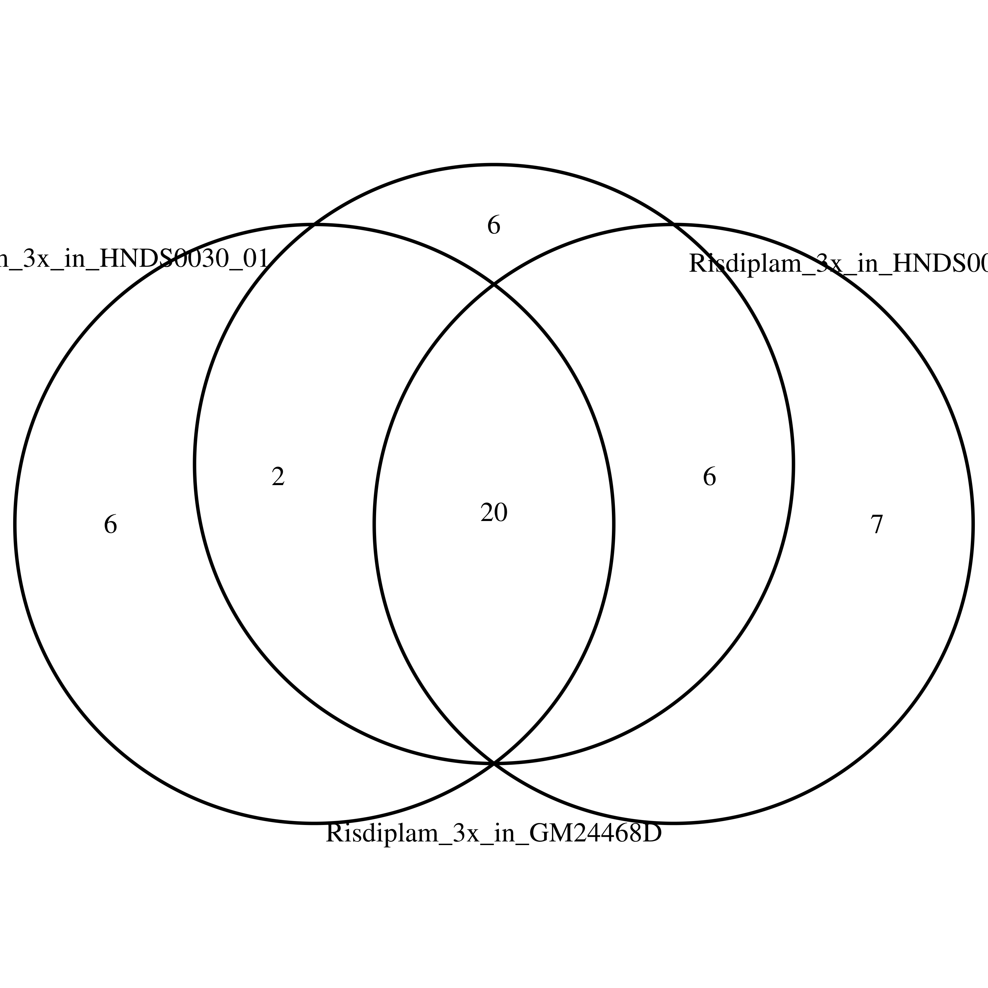
Overlap of Risdiplam induced OT in iPSC-MNs

Slide 9
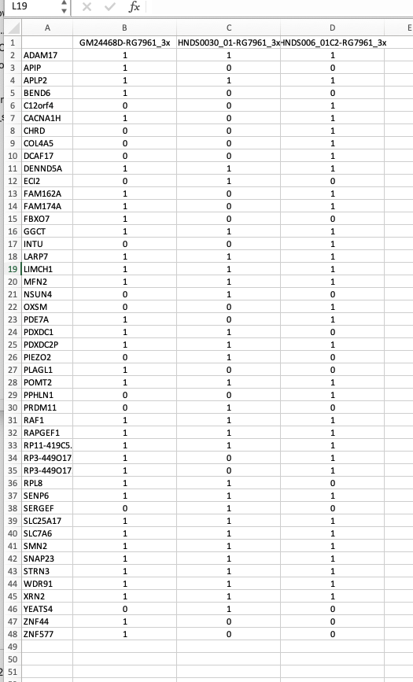
Overlap of Risdiplam induced OT in iPSC-MNs

Slide 10
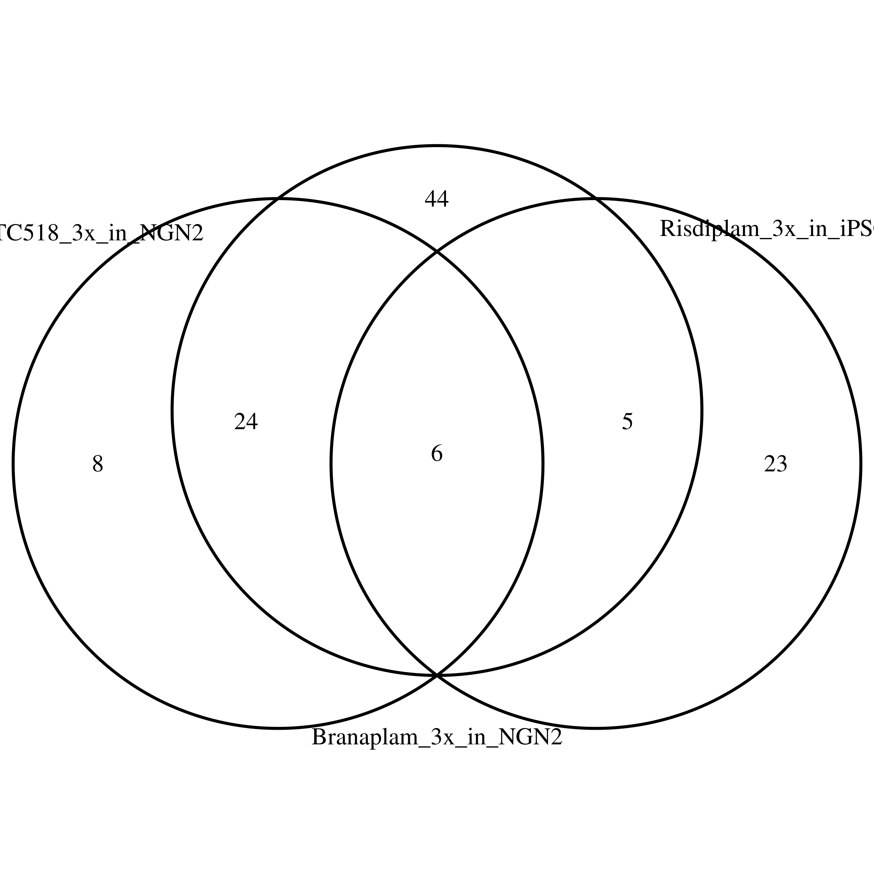
Overlap of PTC518/Branaplam in NGN2 cells and Risdiplam in iPSC-MNs

Slide 11
Summary:
1) Both DEG and DSG were getting better from batch 1 , 2, an 3 in all the cell types tested
2) The DEG/DSG are quite different across 3 cell types. Sy5Y and iPSC were more similar
3) The DEG/DSG are only overlapped with very low frequency.

