Slide 1
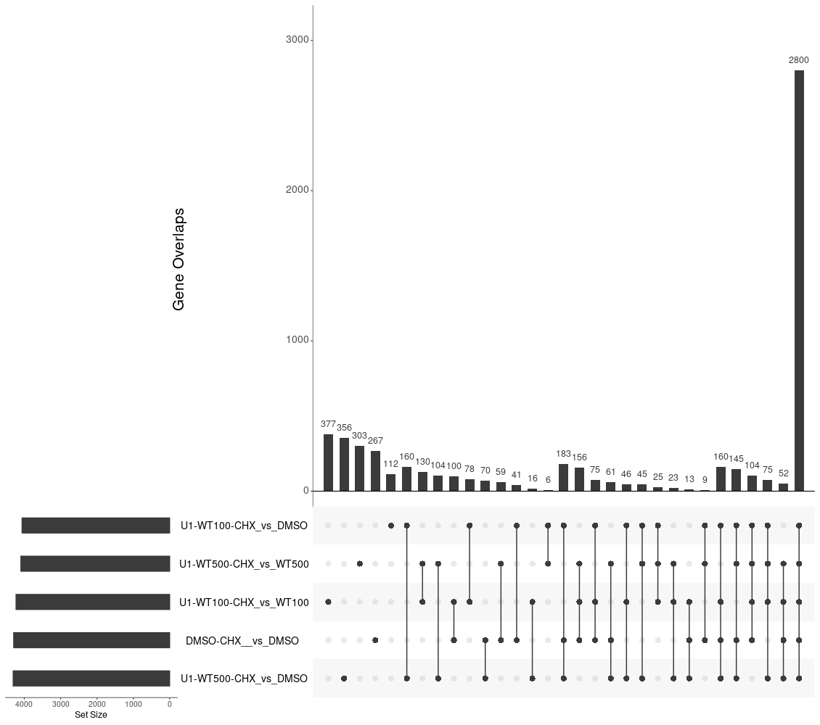
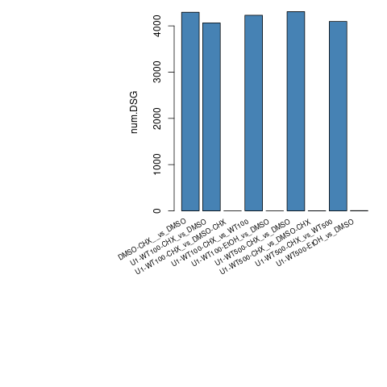
DEG-Group1: DSMO_and_WT

Slide 2
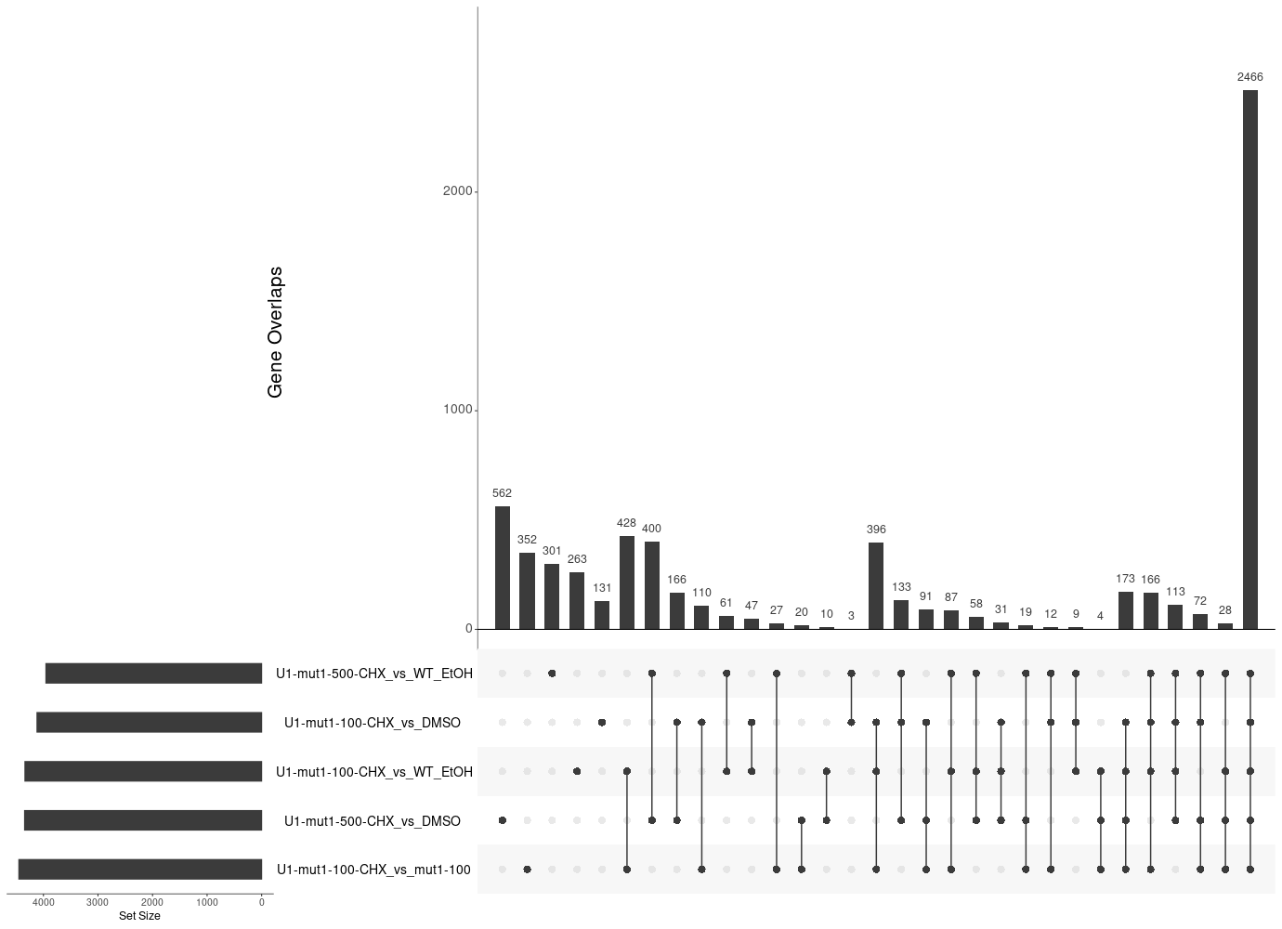
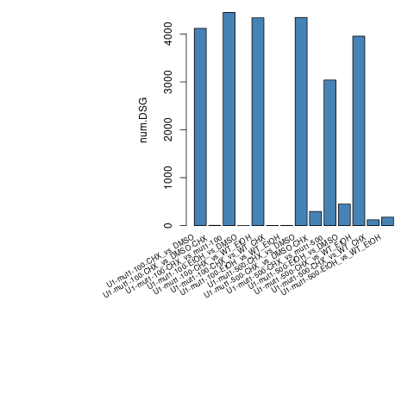
DEG-Group2: WT_mut1

Slide 3
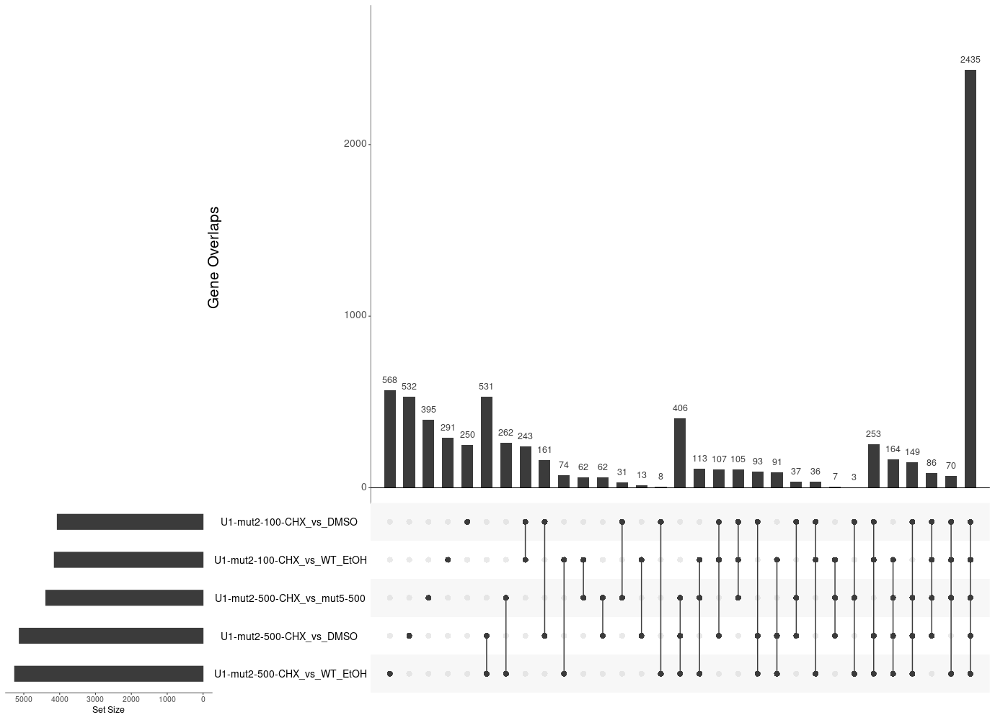
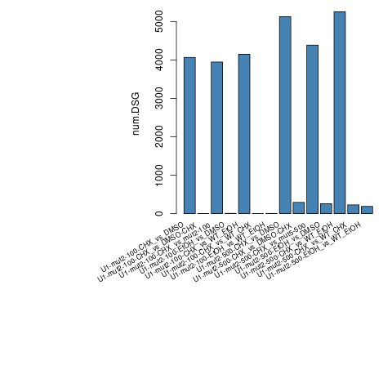
DEG-Group3: WT_mut2

Slide 4
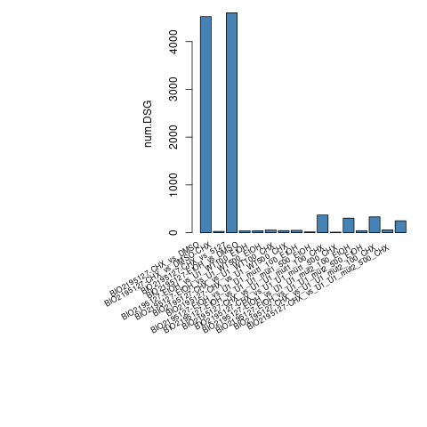
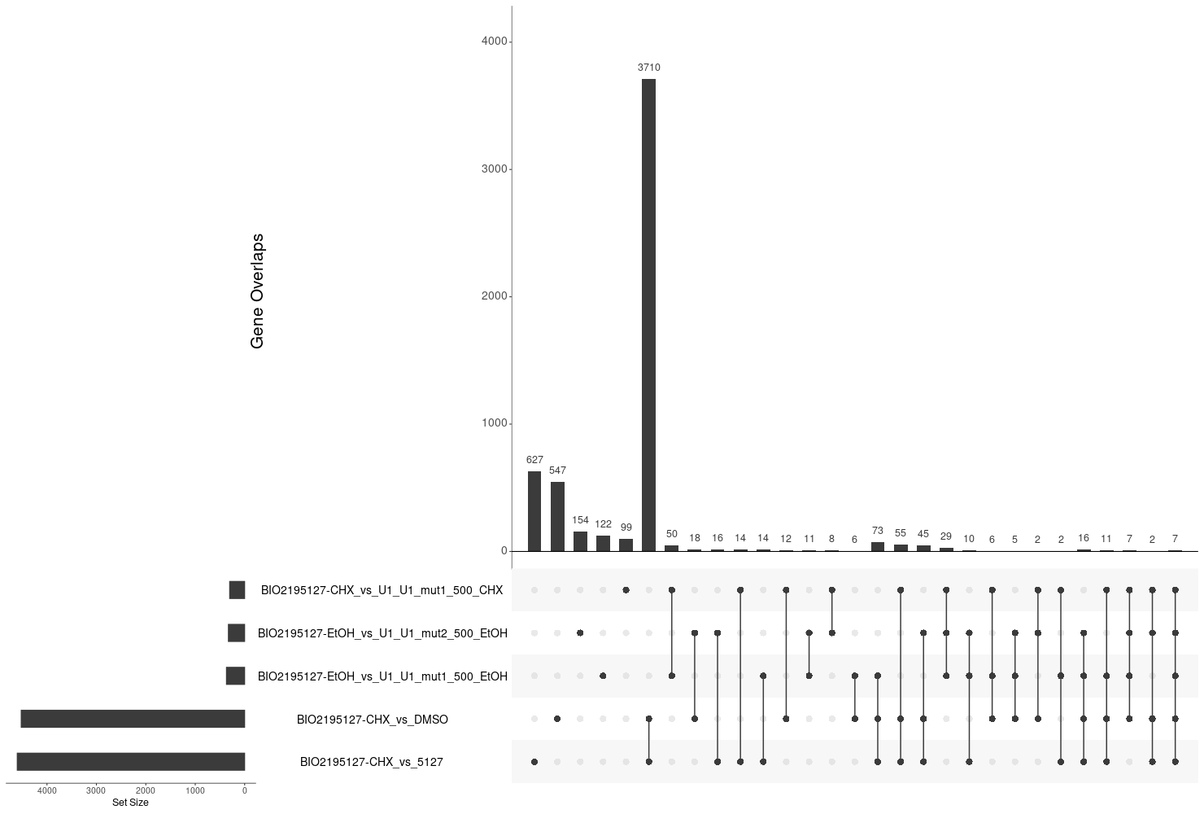
DEG-Group4: BIO5127_and_mut1_mut2

Slide 5
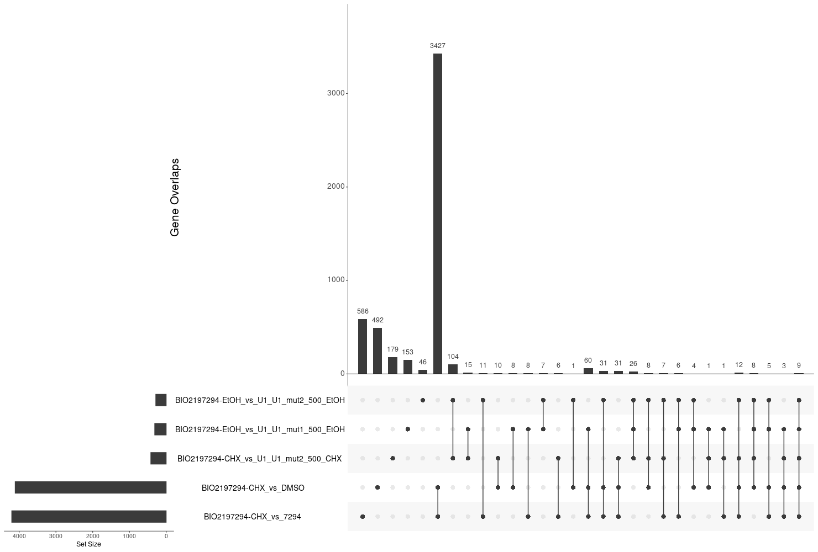
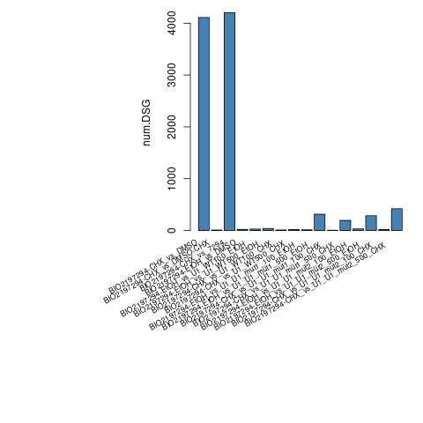
DEG-Group5: PTC518_and_mut1_mut2

Slide 6
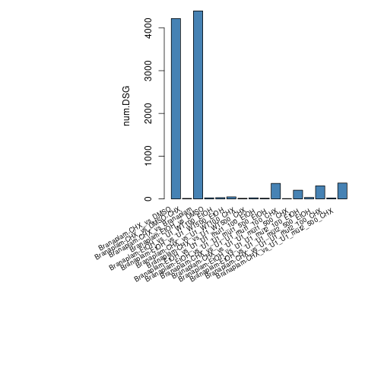
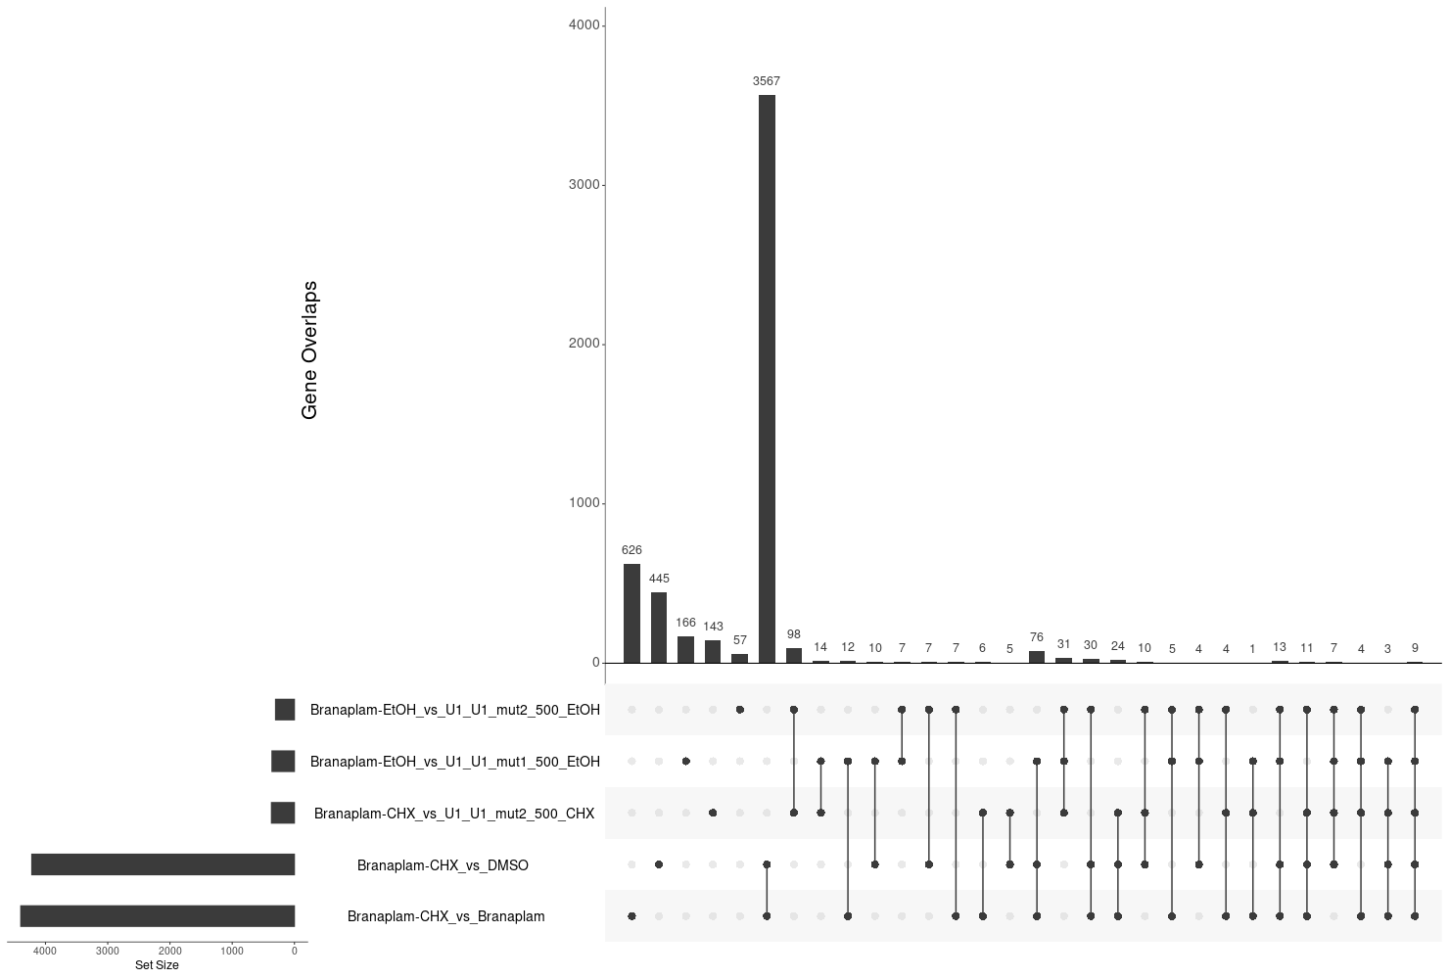
DEG-Group6: Branaplam_and_mut1_mut2

Slide 7
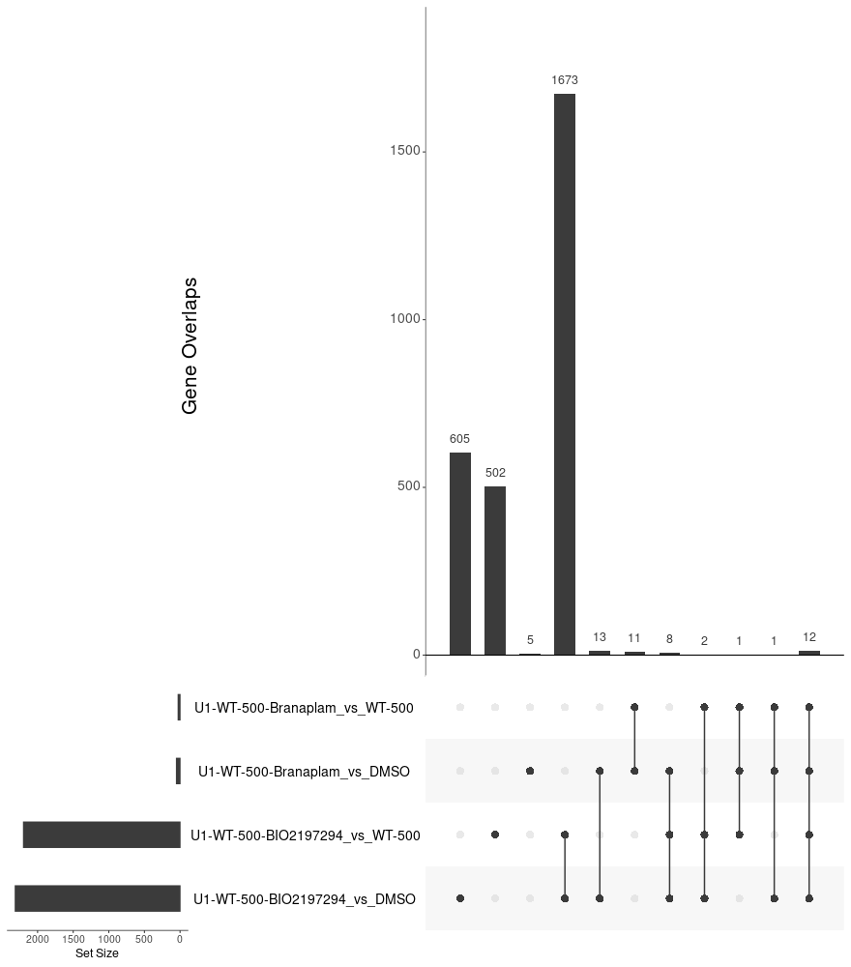
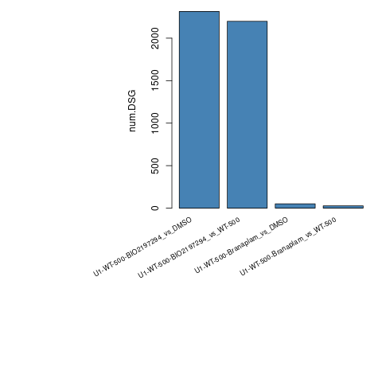
DEG-Group7: PTC518_and_Branaplam_and_WT

Slide 8
DEG-Group1: DSMO_and_WT

Slide 9
DEG-Group1: DSMO_and_WT

Slide 10
DEG-Group1: DSMO_and_WT

Slide 26
DEG-Group1: DSMO_and_WT

Slide 27
DEG-Group1: DSMO_and_WT

Slide 28
DEG-Group6:

