Slide 1
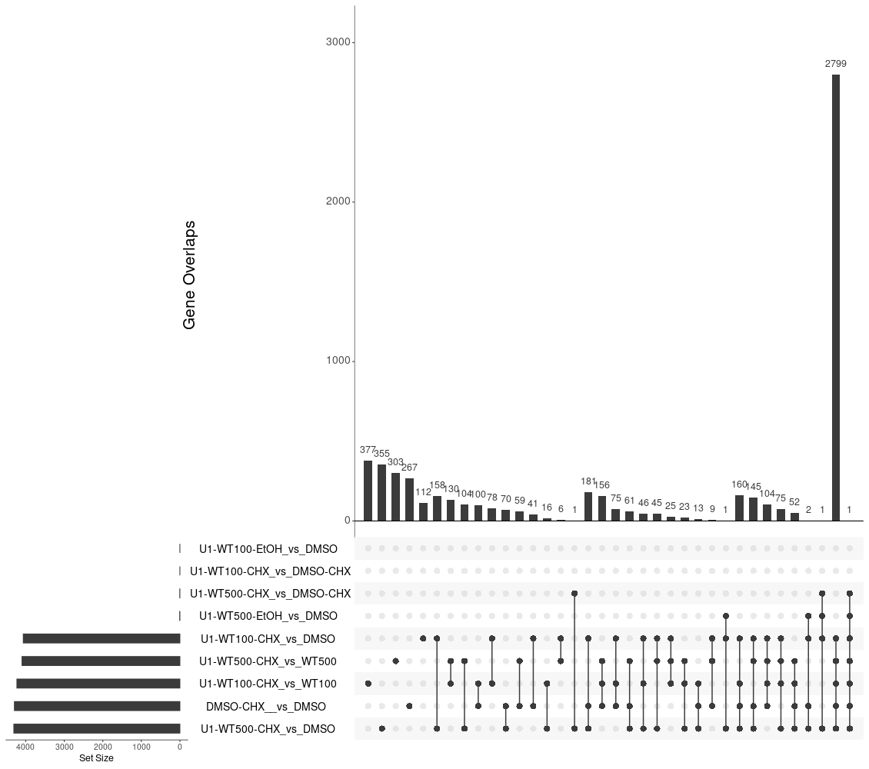
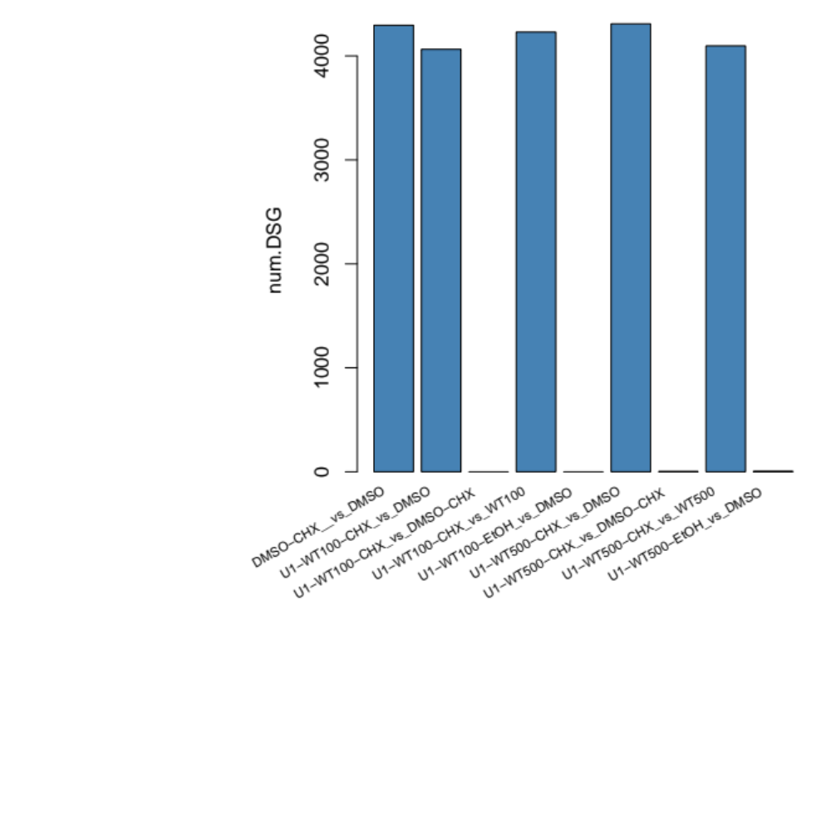
DEG-Group1: DSMO_and_WT
WT-100 and WT-500 has no or nearly no effect in
DEG transcription:
VS DMSO and DMSO-CHX

Slide 2
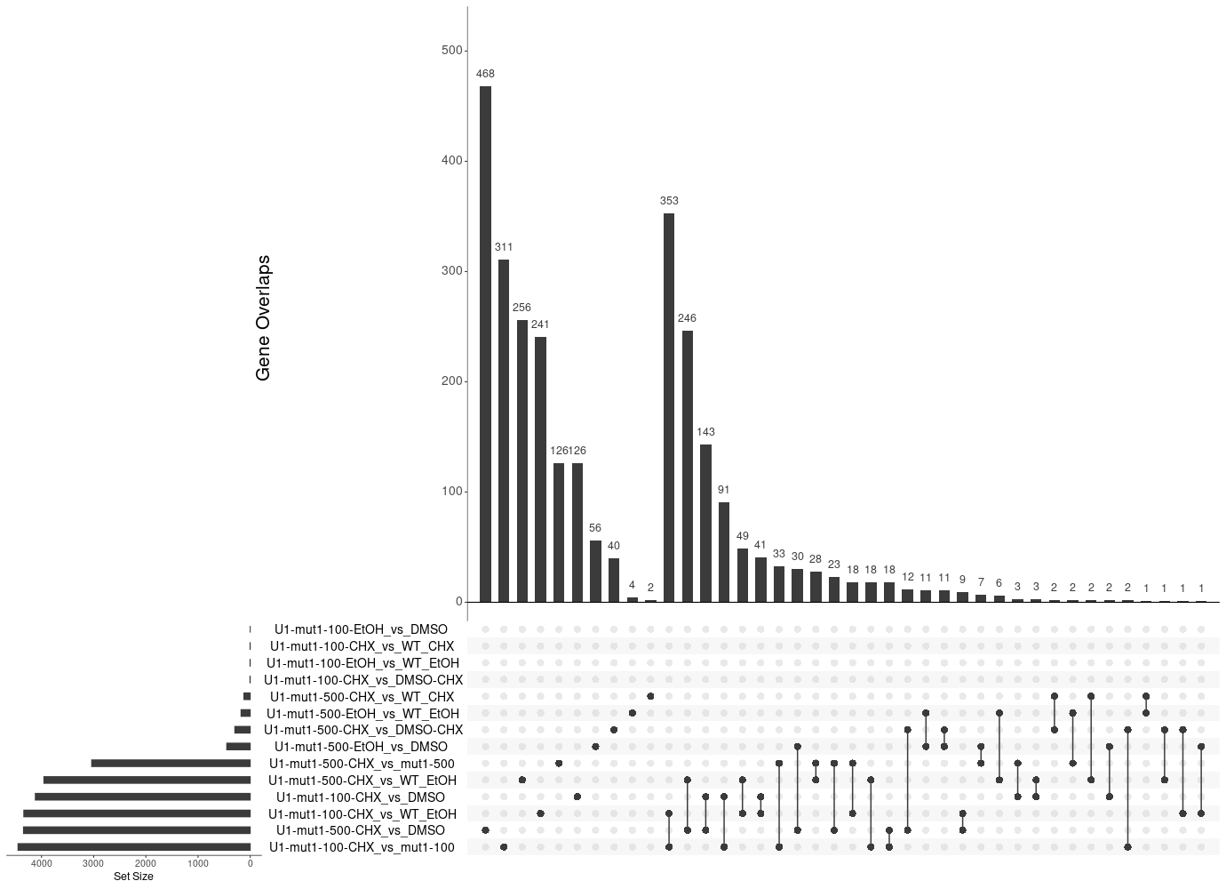
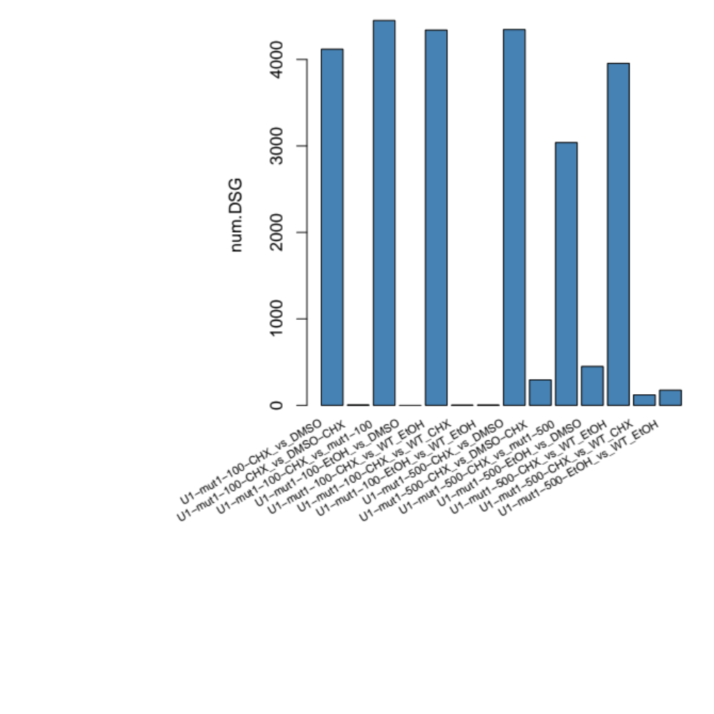
DEG-Group1: WT_mut1
mut1-500 causes DEG transcription, majority of them are through NMD
VS DMSO and DMSO-CHX while Mut1-100 has very week effects

Slide 3
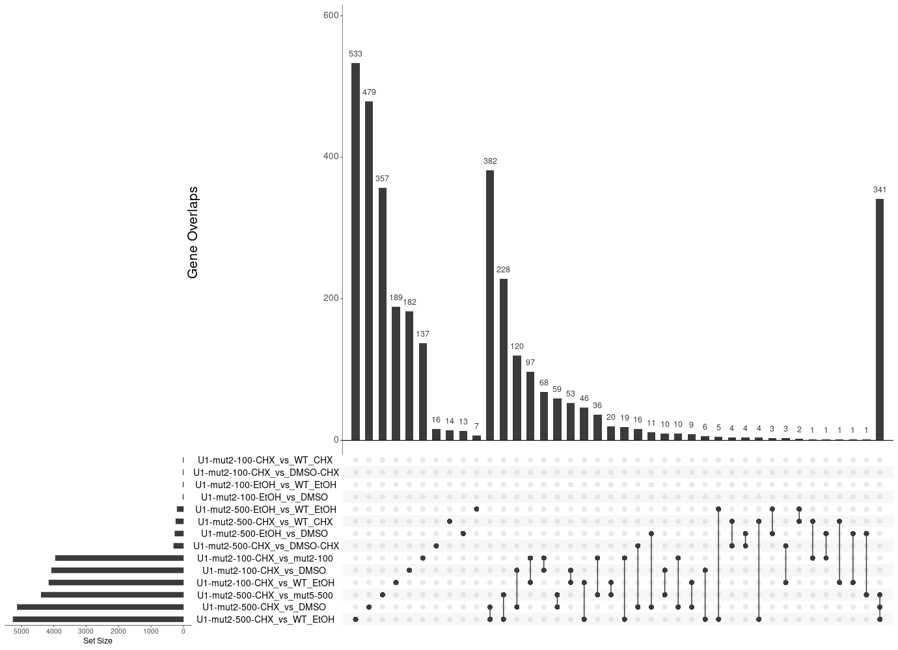
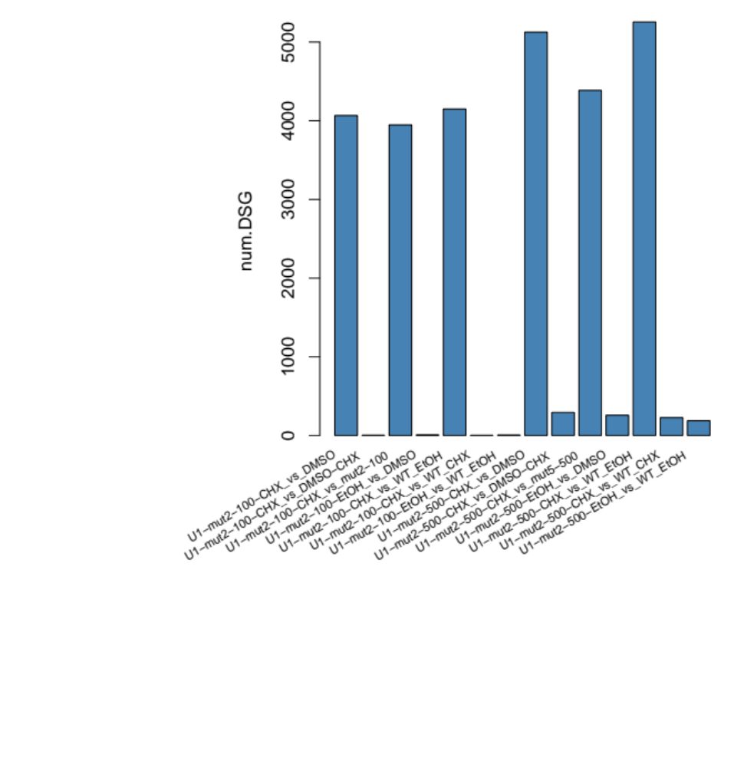
DEG-Group1: WT_mut2
mut2-500 causes few DEG transcription, majority of them are through NMD
VS DMSO and DMSO-CHX while Mut1-100 has no effects

Slide 4
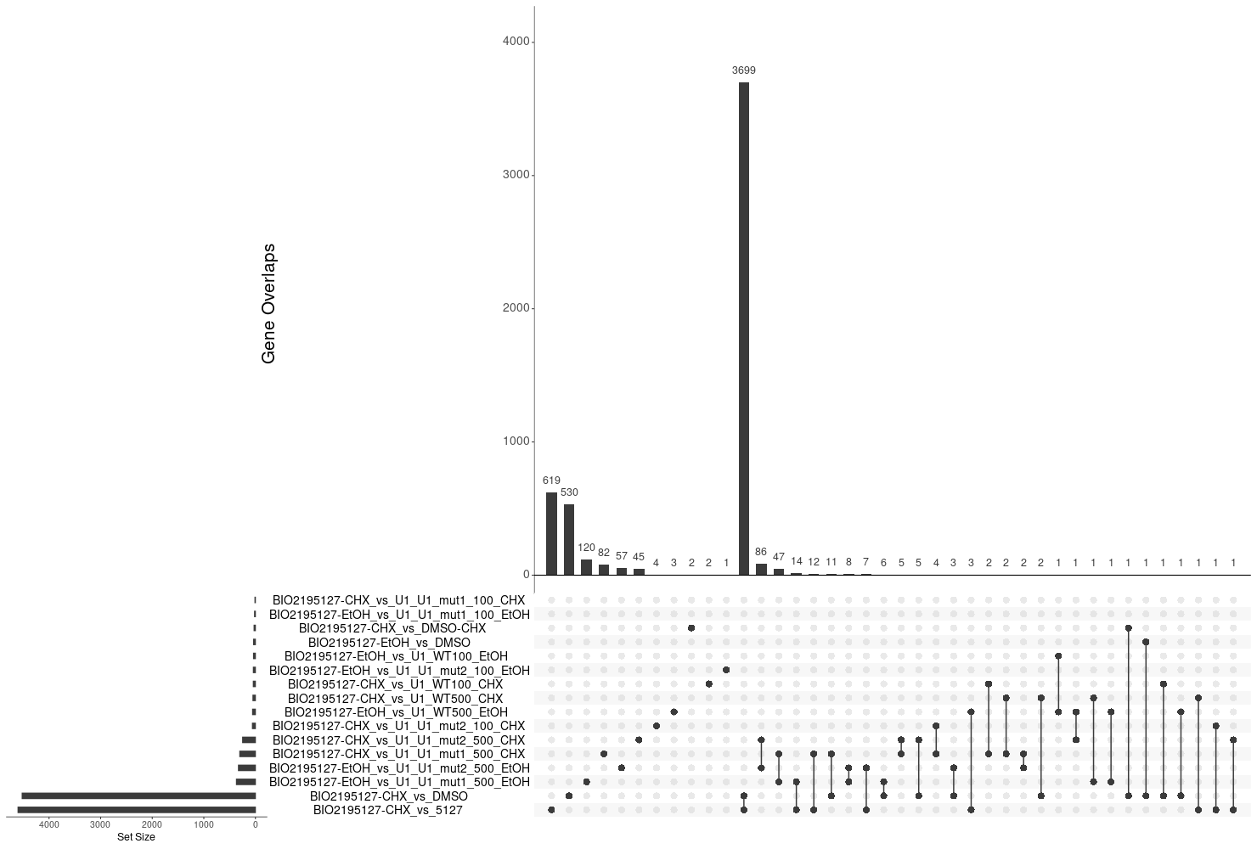
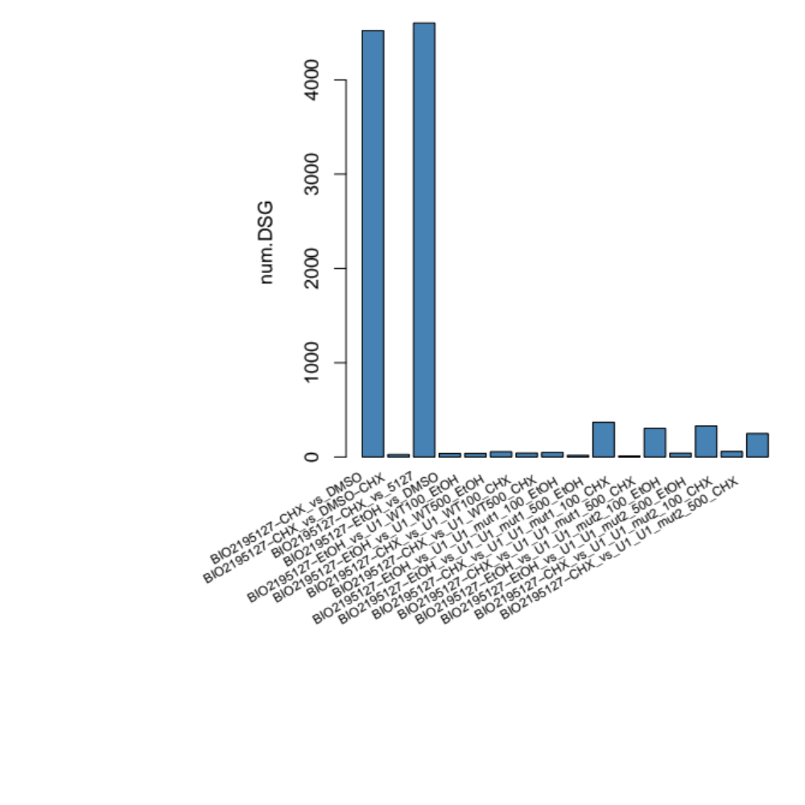
DEG-Group4: BIO5127_and_mut1_mut2
BIO5127 are less different from mut2 than muta1

Slide 5
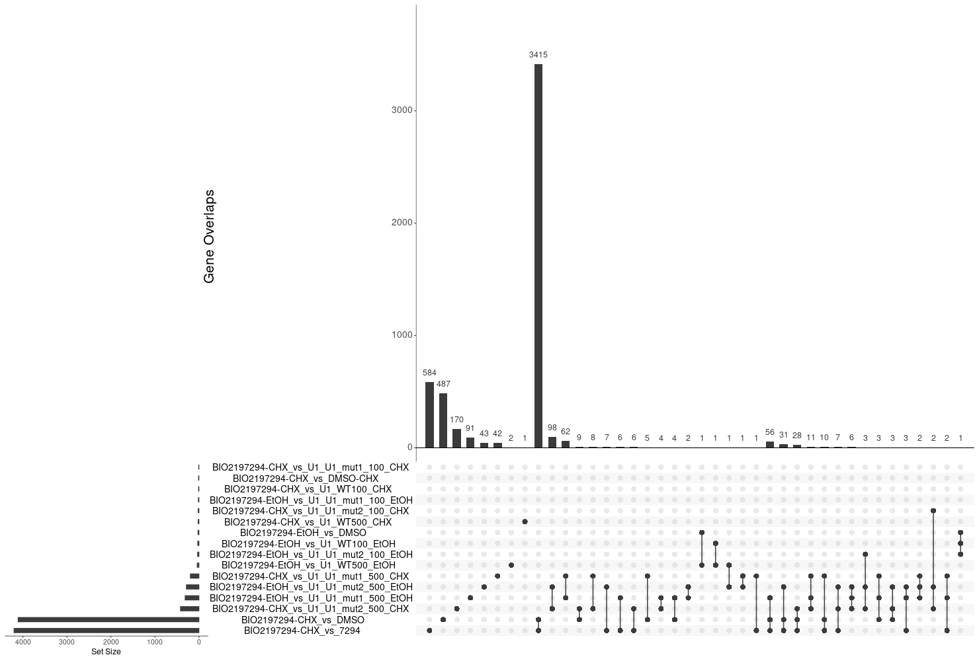
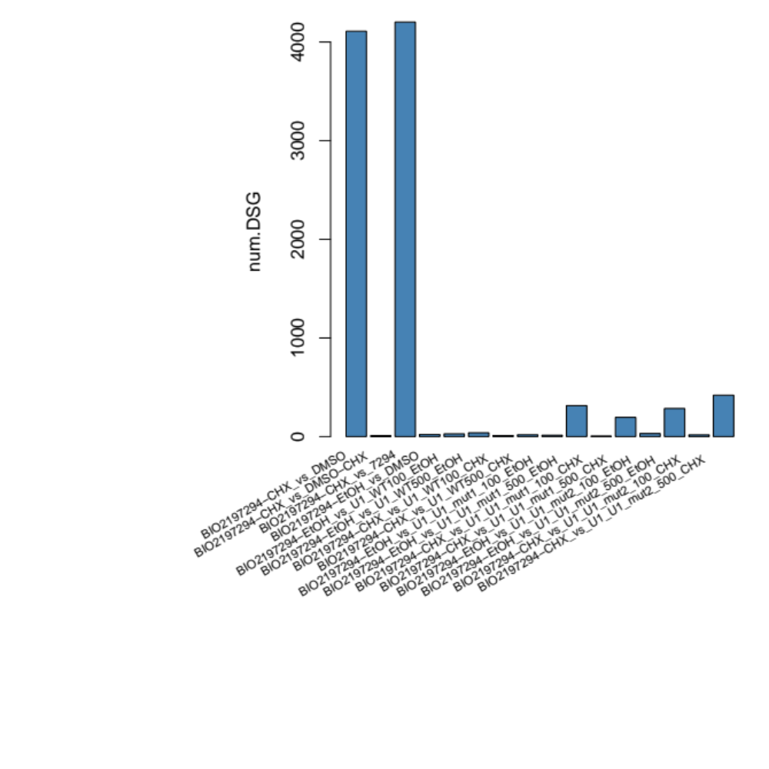
DEG-Group5: PTC518_and_mut1_mut2

Slide 6
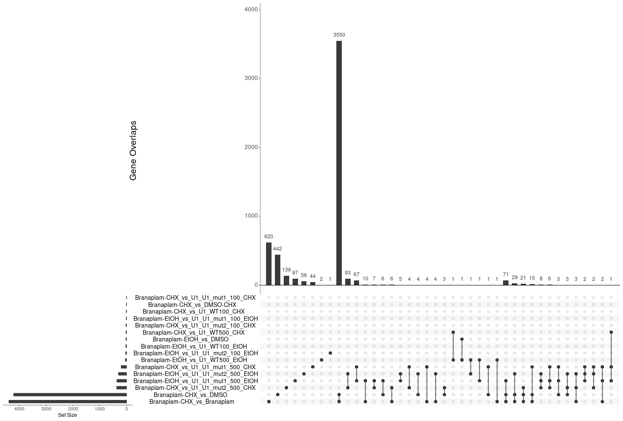

DEG-Group6: Branaplam_and_mut1_mut2

Slide 7
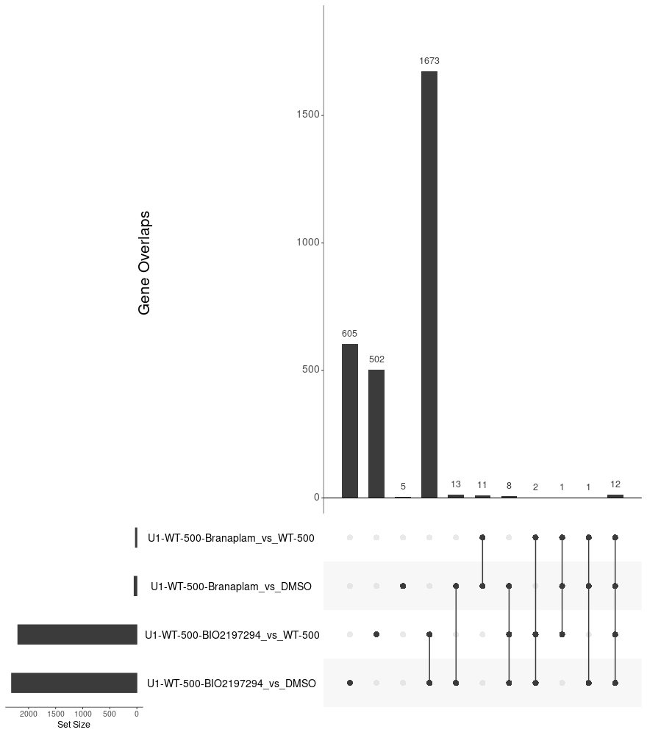
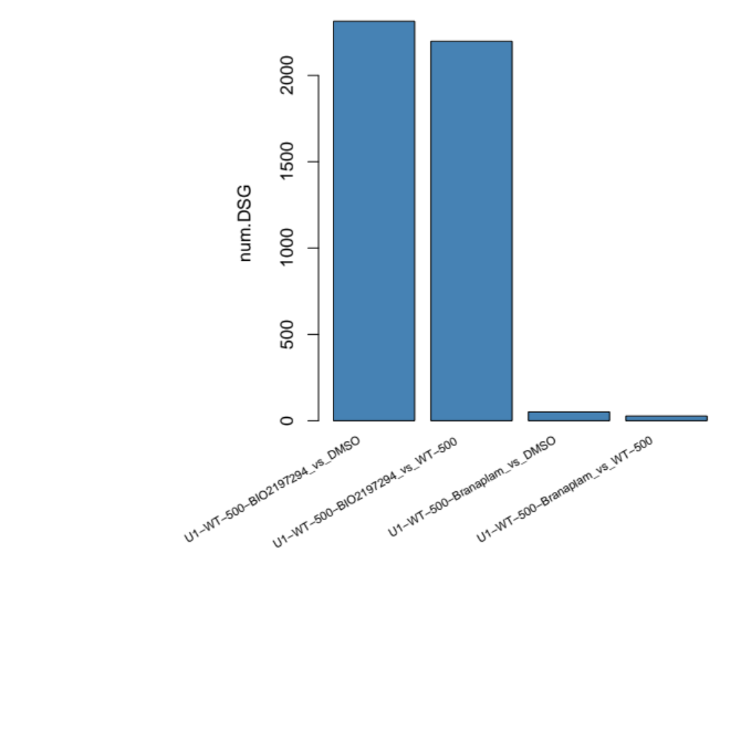
DEG-Group7: PTC518_and_Branaplam_and_WT

Slide 8
DEG-Group1: DSMO_and_WT

Slide 9
DEG-Group1: DSMO_and_WT

Slide 10
DEG-Group1: DSMO_and_WT

Slide 26
DEG-Group1: DSMO_and_WT

Slide 27
DEG-Group1: DSMO_and_WT

Slide 28
DEG-Group6:

