Slide 1
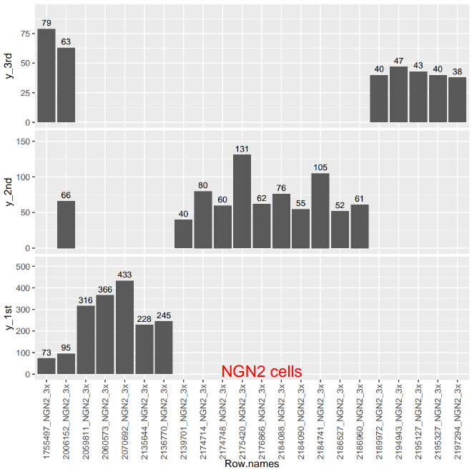
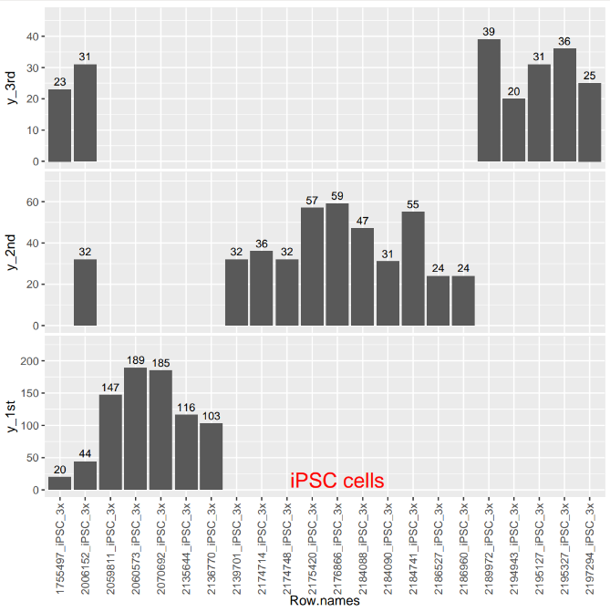
3 bar graphs comparing the 3 batches of RNA-seq
Number of DSGs
Date

Slide 2
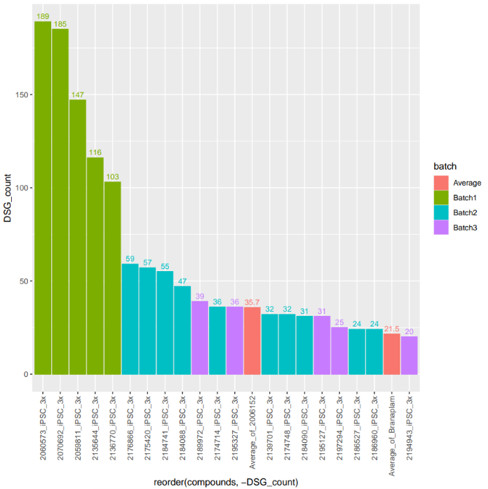
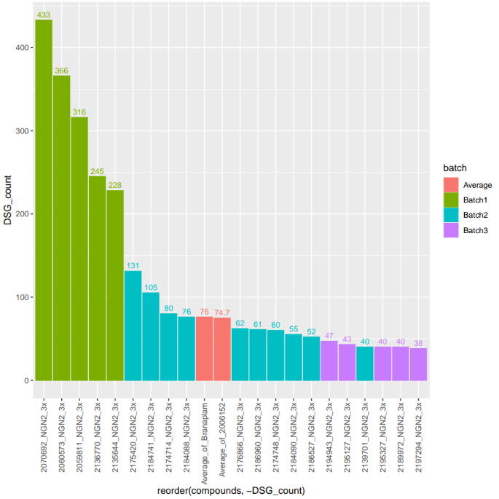
Zhen – Magnus is expecting a DEG table like this

Slide 3
pAdj value < 0.05
Abs(FC)> 0.5

Slide 4
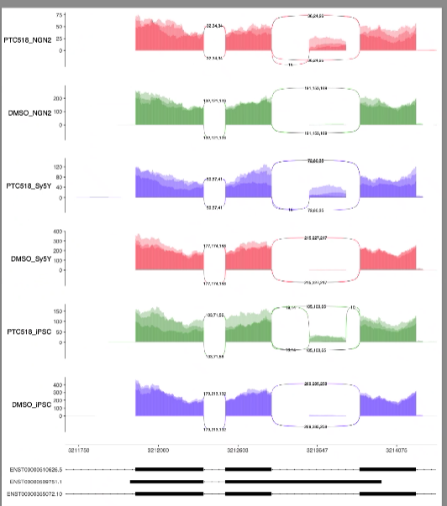
Aim : Check on-target splicing to address the concern that HTT was not detected as a DSG
HTT splicing in three cell lines with 3x IC50 concentration
dPSI values to show the dPSI was just below the threshold
DEG analysis
Log Fold change
Zhen will run DEG analysis with the matched replicates used for DSG analysis.
Update the table – PTC518 off target (high priority)
DEG analysis – similar to slide 1 and 2. (lower priority)
Just for batch3 – how much overlap of DEGs between the 6 compounds?
100 molecules of canonical HTT
50 molecules of canonical HTT
10 molecules of poison exon HTT
Zhen to run PTC RNAseq for DSG analysis (low priority)
10x IC 50 data as well in the next slide

Slide 5
Goal for PTC518 approach is
Working criterion to define high value off targets which need to be researched by PCS.
High value means – big change in splicing or expression
DSG / DEG
DSG for splice changes which does not involve mRNA level change
DEG for splice changes with poison exon inclusion and NMD (RNA level reduction)

Slide 6
Discuss the following:
1) Ven diagrams of BIO-2184090, BIO-2195127 BIO-2186960 àwhat is the percent overlap of off-targets?
2) Compound 6152 was run in all 3 batches, create list of off-targets for iPSC for each run. How much overlap between runs?
3) Why is HTT not picked up as a target?

Slide 7
Table screenshot – ARL15 has two opposite directions
ARL15 gene has two splicing events
May need to demonstrate the splicing complexity
1st exon in the 5’ end shows the splicing change in all three cells
2nd cryptic exon may appear only in 1-2 cell lines

Slide 8
Sashimi – good and bad examples – backup slides
This is to deep dive with the top 20 DSGs (for Colin’s safety assessment)

Slide 9
1) Ven diagrams of BIO-2184090, BIO-2195127 BIO-2186960 àwhat is the percent overlap of off-targets?
Zhen is going to provide list of the DSG binary table for RNAseq batch 3.
Comparison of off-targets by venn diagram
Benchmark 1 – PTC518
7289
upsetR
Overlap- how many genes
List of DSGs per each SM
Benchmark 2 – Branaplam
Internal compounds
All the compounds tested
In 3 cell lines

Slide 10
1) Ven diagrams of BIO-2184090, BIO-2195127 BIO-2186960 àwhat is the percent overlap of off-targets?
Comparison of off-targets by venn diagram
BIO-2184090
7
(11 %)
11
(21 %)
8
(14 %)
, BIO-2195127
BIO-2186960
Batch2 RNAseq – iPSC, NGN2

Slide 11
Batch 1, 2 , 3
gene
heatmap
2) Compound 6152 was run in all 3 batches, create list of off-targets for iPSC for each run. How much overlap between runs?
………….
6152 off-targets
Batch 1
Abs dPSI
DSGs found in all 3 batches
DSGs found in 1,3 batch
Batch 2
Batch 3
DSGs found in 1,2 batch
iPSC and NGN2

Slide 12
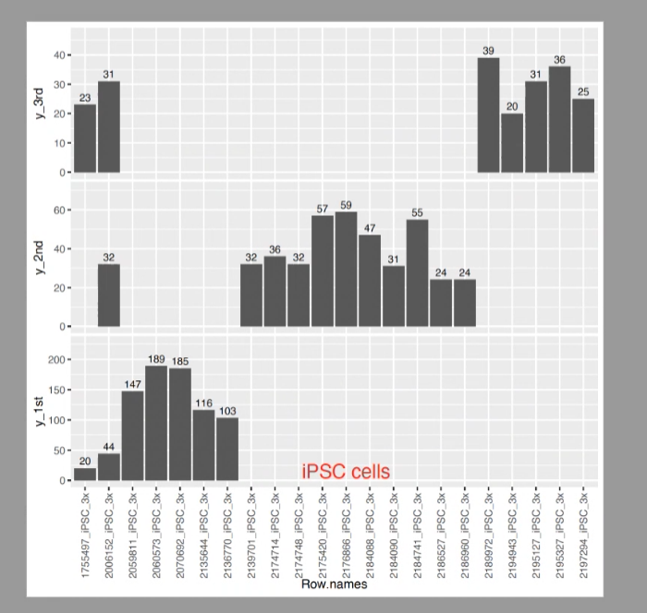
# of DEGs
Comparison of small molecules and cell line
DEG plot like this

Slide 13
May 1st
Is there a value of matching the replicates used for RNA-seq between the DSG and DEG analysis?
Maybe all 4 replicates will give us more statistical power to discover DEGs more sensitively
Joon can continue the exploratory DEG work – but eventually we would like to know -----
How many DEGs have a splicing change – especially with the NGA 5’splise site containing poison exons
How much overlap of DEGs between different small molecules? – Heatmap
High priority is to finish the PTC518 table – providing the FC and P value information (Zhen)

