Slide 1
Zhen Gao’s Self-Introduction & Summary of Research
Zhen Gao
Sep 27, 2023

Slide 2
Zhen Gao’s Resume
Experience:
Computational Biologist
Jan 2022 -
Translational Genomics Science
Biogen
Senior Bioinformatics Scientist
2016 - 2021
Biostatistics Core, Sylvester Comprehensive Cancer Center Miami
Medical Data Scientist
2015 - 2016
AI Drug Discovery Center, Case Western Reserve University Cleveland
Bioinformatician
2015
Horae Gene Therapy Center, UMass Medical School
Worcester
Cancer Informatics Postdoc
2010 - 2012
Dept of Radiation Oncology
Washington University in St. Louis
Education:
MS, Computer and Information System
Boston University
PhD, Cancer Biology
University of Iowa
BS, Pharmaceutical Sciences
Nanjing University

Slide 3
Goals of the Splicing Modulator Research
Discover the compounds/agents keep on-target effects and fewer off-targets effects
Determine the common targets among the SM splicing enhancers
Explore potential novel splicing targets
Confirm the system difference between the different cell-systems for selection
Seek the best procedure for cross-experiments/cross-cell-systems comparison
Make robust and cost-efficient experimental design, QC etc.

Slide 4
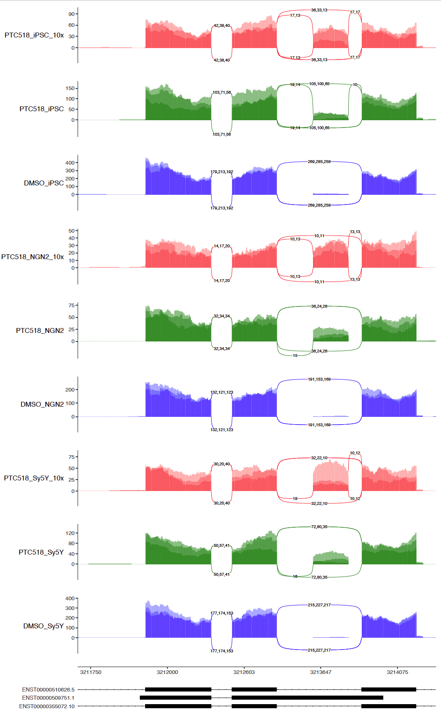
HTT sashimi-plot across 3 cell types
iPSC
NGN2
ShSy5y

Slide 5
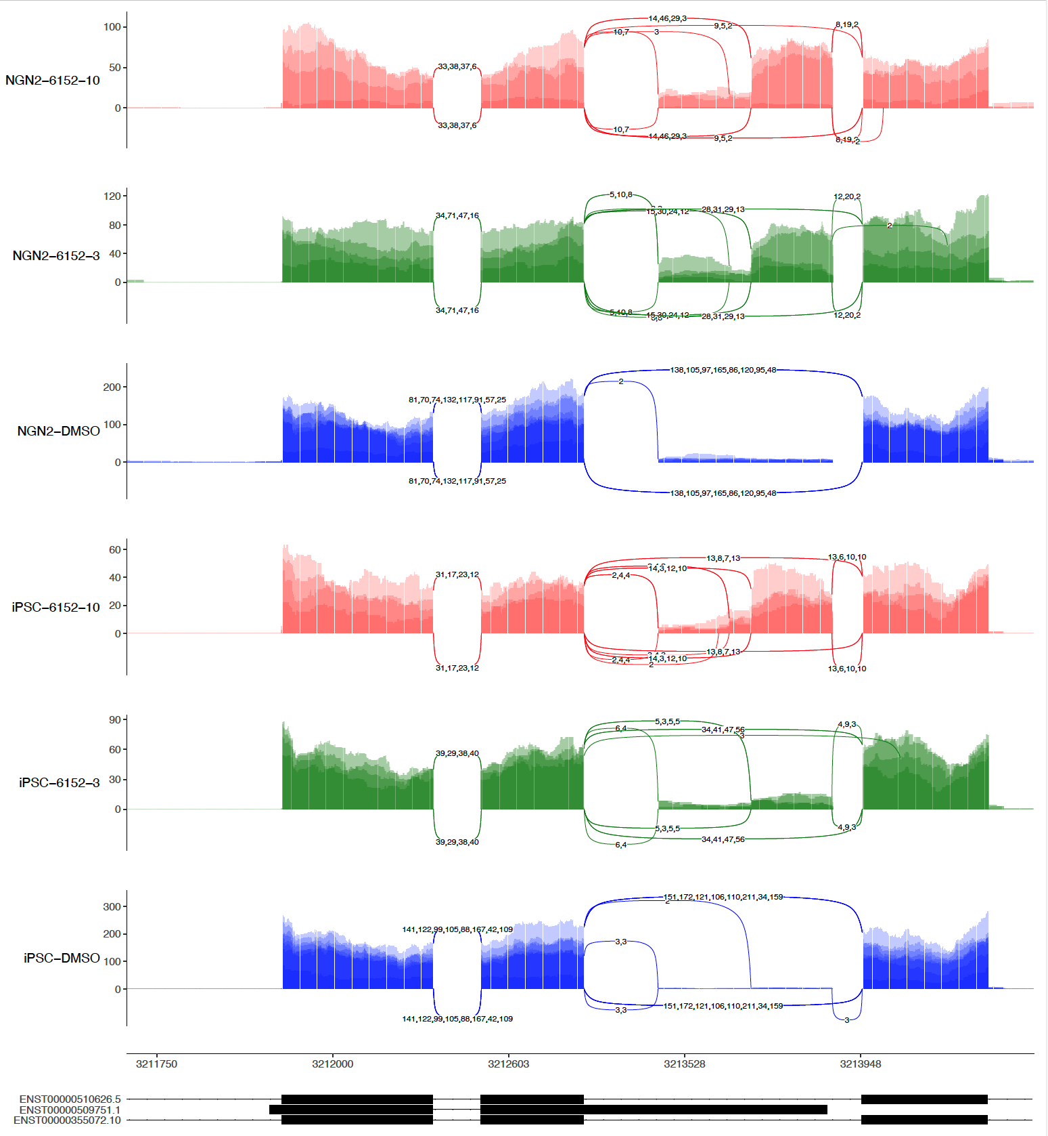
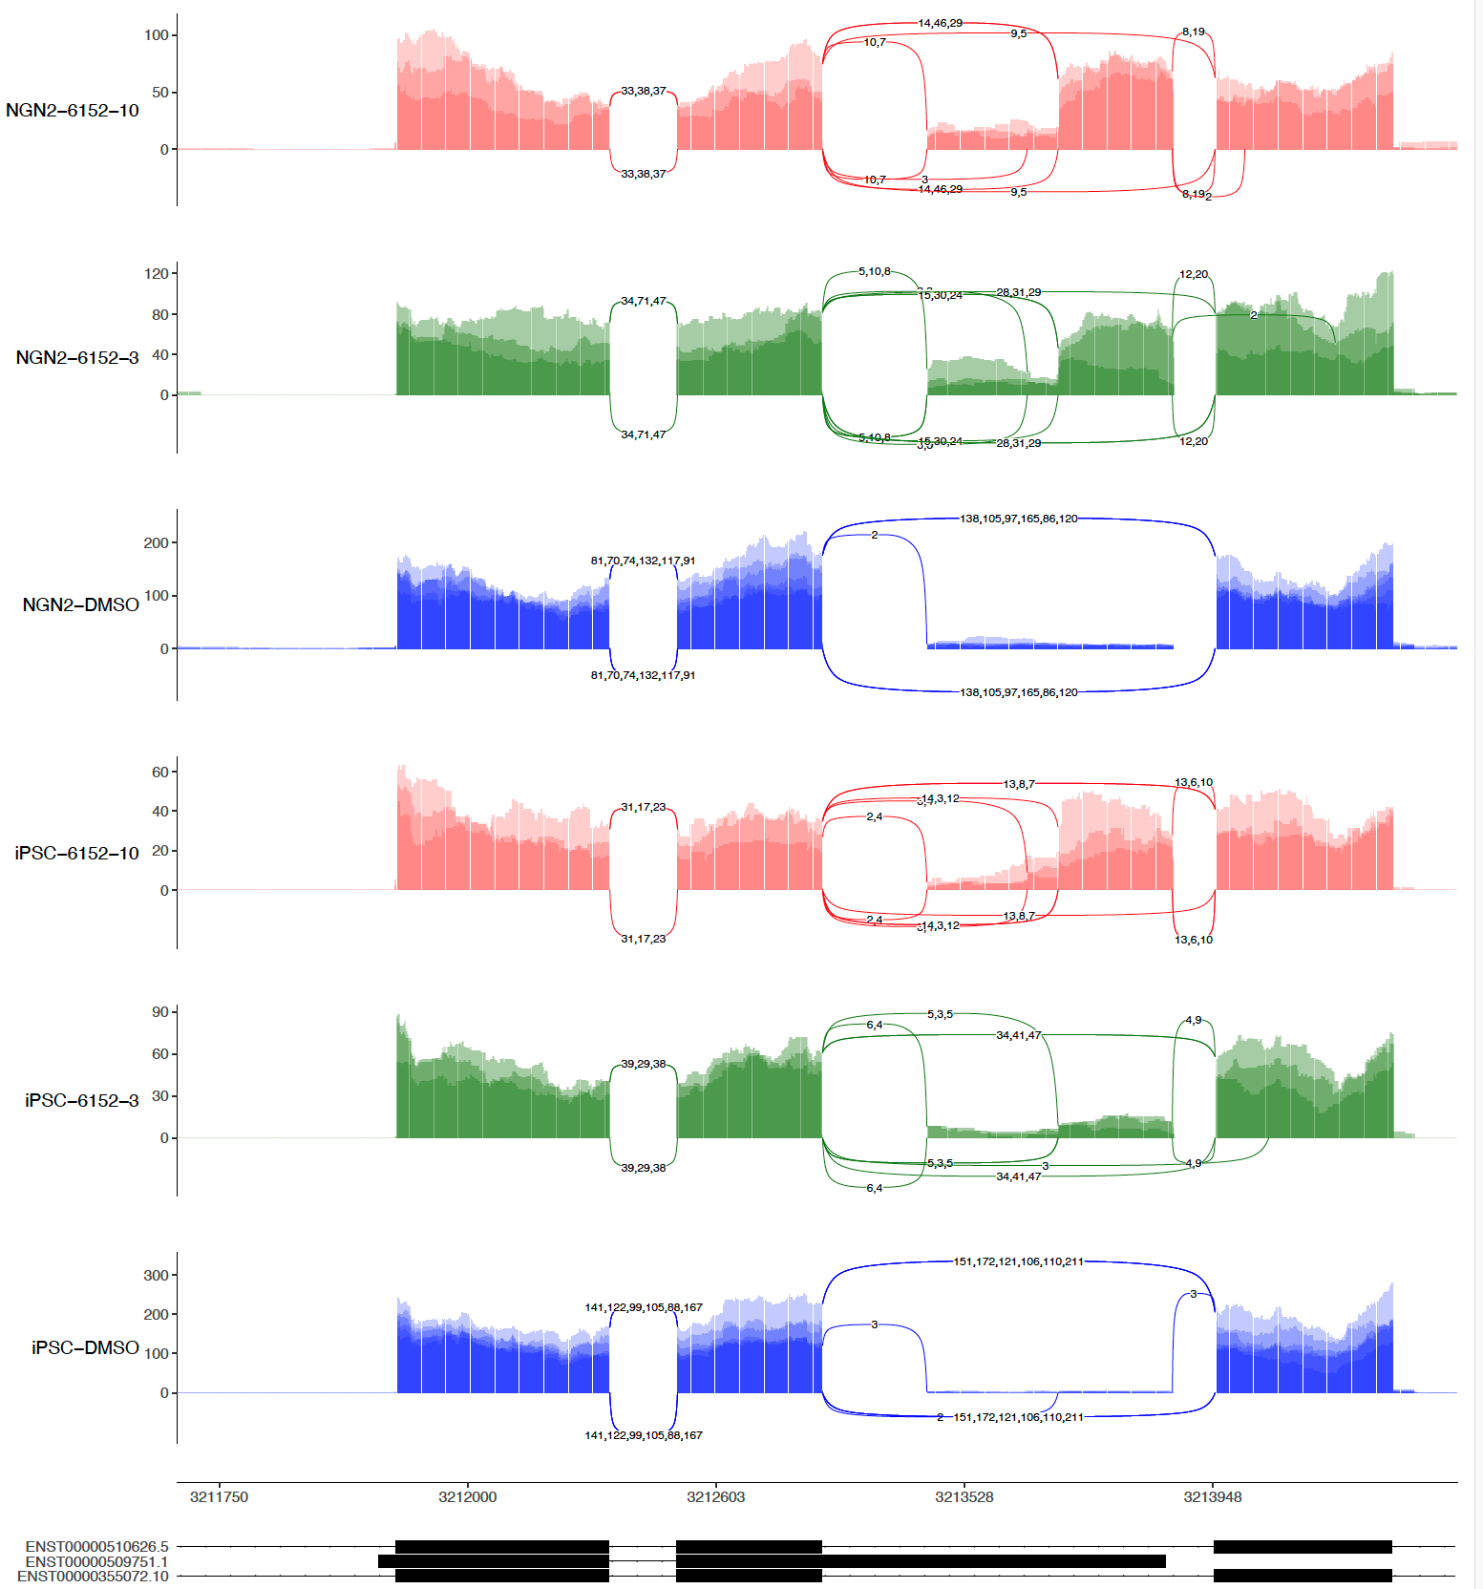
sashimi-plots: Compound 6152

Slide 6
It looks more than poison exon spicing in
Classical toxic exon splicing in type
Ex49N: chr4:3,213,622-3,213,736 (+)
48
49
49N
50
51
Non-Classical but high frequent ones
48
49
49N
50
51
Non-Classical and less frequent ones
48
49
49N
Intron
50
51
Nonsense-mediated mRNA decay (NMD)
Edited from Jessica Plots

Slide 7
DSG analysis under in the NMD condition
Canonical splicing
Splicing outcome
5
6
5
Cryptic
6
5
Cryptic
6
5
Cryptic
6
Stable mRNA
Protein with an inserted polypeptide
Stable mRNA
Normal protein
Unstable mRNA
Removed by NMD
SM-promoted
Cryptic splicing
If the cryptic exon does not promote NMD
If the cryptic exon promotes NMD
Basal state
5
Cryptic
6
5
6
5
Cryptic
6
5
6
5
6
5
6
5
6
5
6
5
Cryptic
6
5
6
5
Cryptic
6
5
6
5
6
5
6
5
Cryptic
6
5
6
5
Cryptic
6
5
6
5
6
5
6
5
6
5
6
5
6
5
6
5
6
5
6
5
Cryptic
6
5
Cryptic
6
Cryptic
6
5
Cryptic
6
5
5 copies of canonically spliced mRNA
5 copies of cryptically spliced mRNA
5 copies of canonically spliced mRNA
1 copies of cryptically spliced mRNA
4 copies degraded by NMD
10 copies of canonically spliced mRNA
PSI = 0
PSI = 0.5
dPSI = 0.5
DSG = Yes
PSI = 0.16
dPSI = 0.16
DSG = No
Edited from Joon Plots

Slide 8
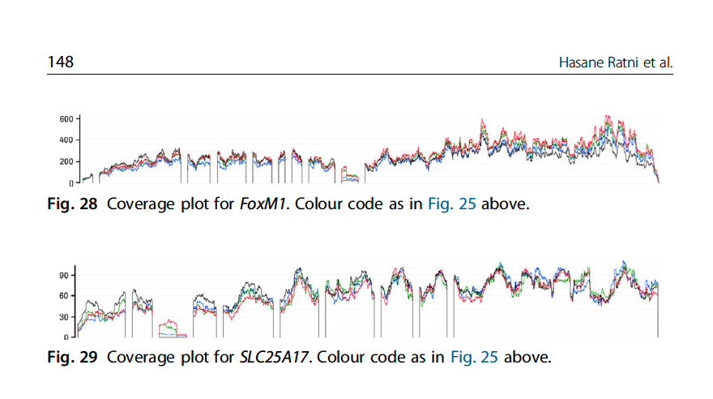
On-Targets and Off-Targets sequences
 | Doner Splice Site Consensus
 | AG|GURAGU
Gene Names | Risdiplam Consensus Binding sequence
SMN2 | GA|GTAAGT
APLP2 | GA|GTAAGT
FOXM1-inside | GA|GTAAGT
FOXM1-border | CA|GTAAGT
SLC25A17-inside | GA|GTAAGA
SLC25A17-border | AG|GTTAAA
(ref: Ratni Roche review, Progress Medicinal Chem V58, 2019)

Slide 9
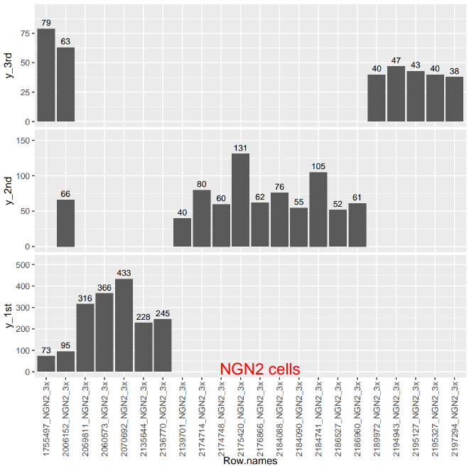
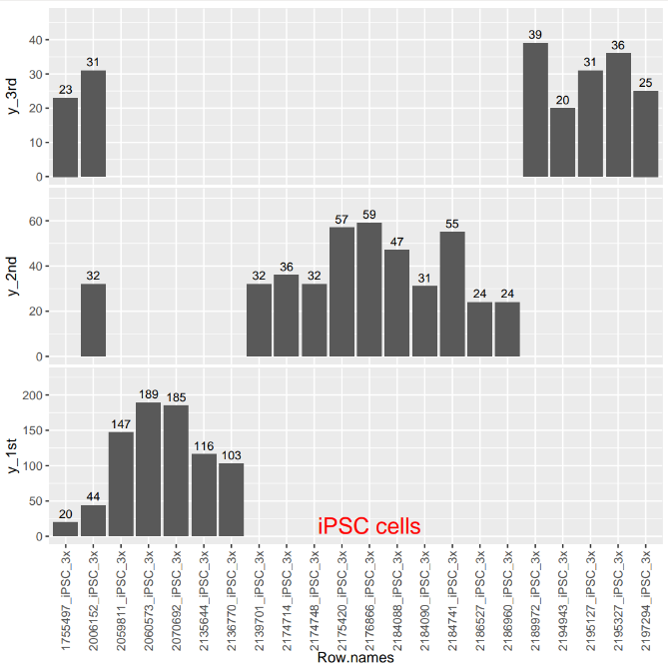
DSG across batch 1&2&3

Slide 10
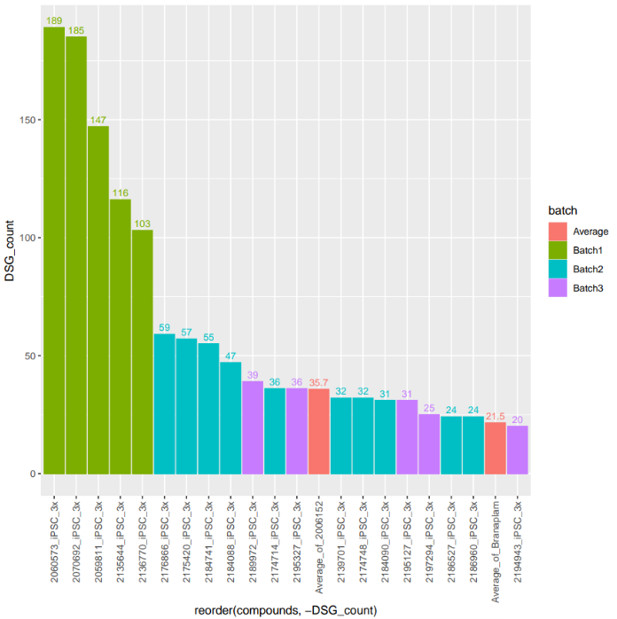
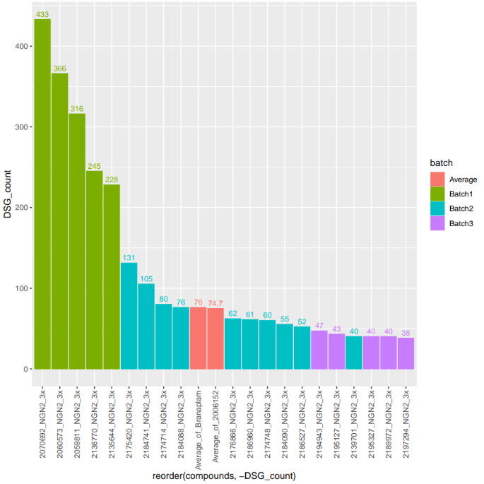
DSG across batch 1&2&3
iPSC
NGN2

Slide 11
DSGs detected from 3 rounds of RNA-seq with lead modulators
3x IC50 dose | #DSG (iPSC) | #DSG (NGN2) | #DSG (SY5Y)
PTC518 | 25 | 38 | 27
Branaplam | 23 | 61 | 40
PTC518
# of DSGs
9
3
1
12
9
0
10
BIO-2186960
Branaplam
High number of off-targets (~55%) are shared across compounds & scaffolds
PTC-518
Modified Zhen Gao’s data

Slide 12
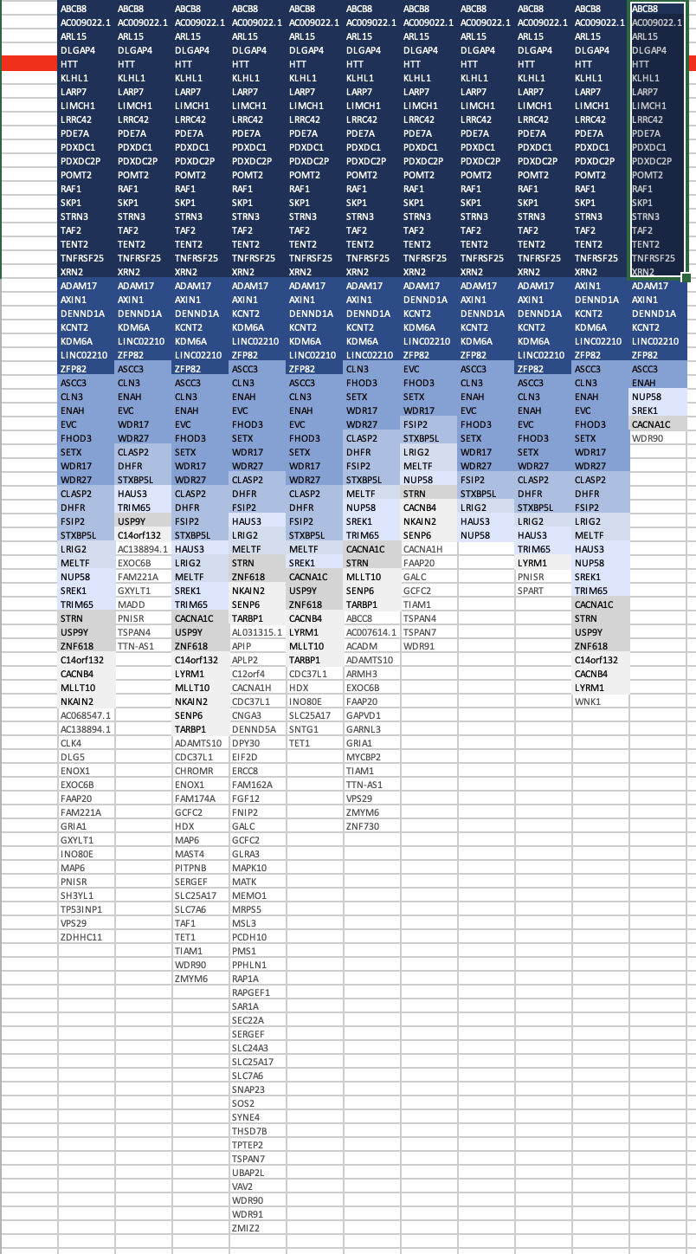
Compounds consistency
DSG across multiple compounds in NGN2 cells

Slide 13
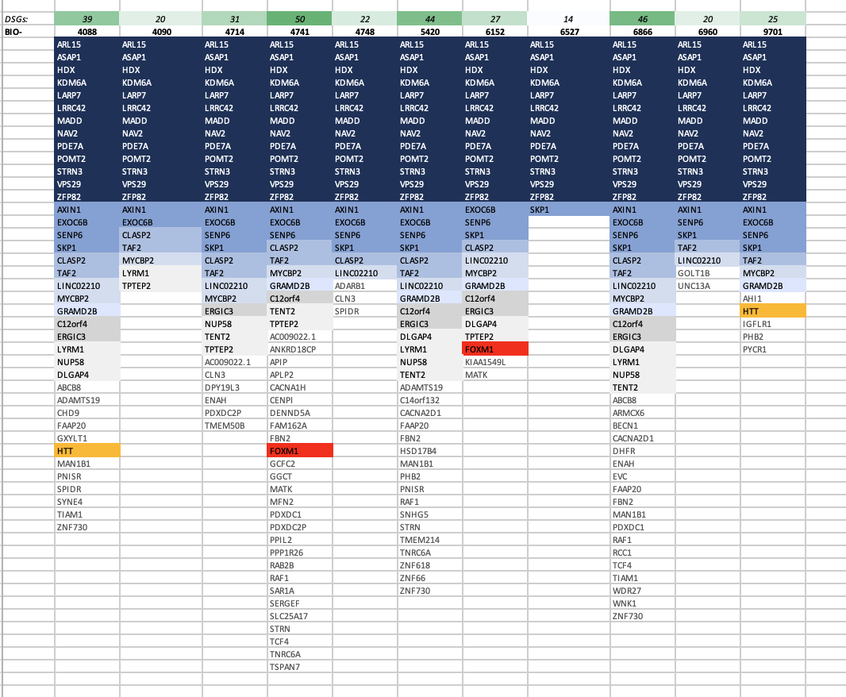
Compounds consistency
DSG across multiple compounds in iPSC cells

Slide 14
The Clustering of Compounds in the 2 cell systems

Slide 15
DEG across batch 1&2&3

Slide 16
DEG across batch 1&2&3

Slide 17
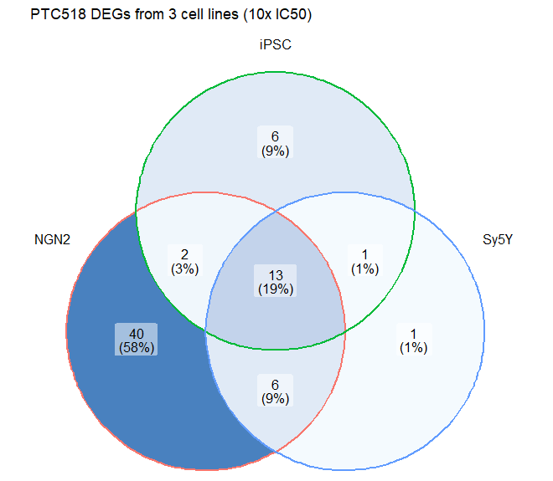
Comparison of Differentially Expressed Genes from 3 cell lines (PTC-518, 10x IC50)
 | AGA | TGA | No PE
NGN2 | 36 | 1 | 24
iPSC | 16 | 1 | 5
SH-Sy5Y | 16 | 1 | 4
Why certain DEGs appear only in a subset of cell lines tested? Expression? Splicing kinetics? NMD kinetics?

Slide 18
SM induced DSG in iPSC, NGN2 and Sy5Y cells

Slide 19
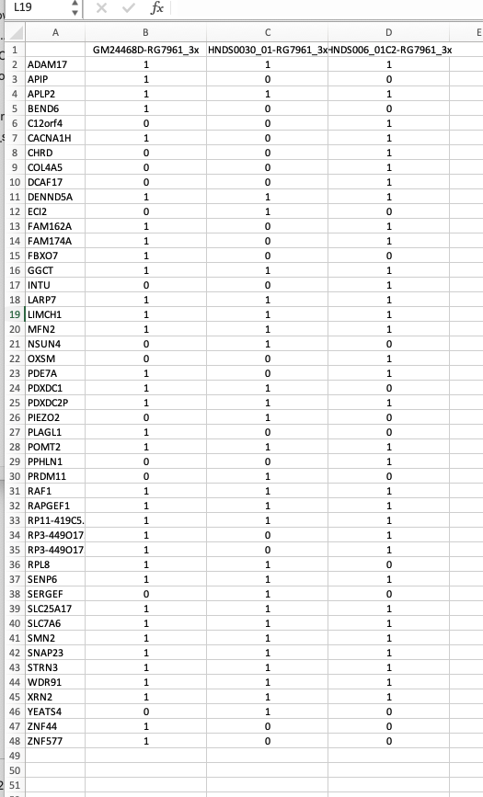
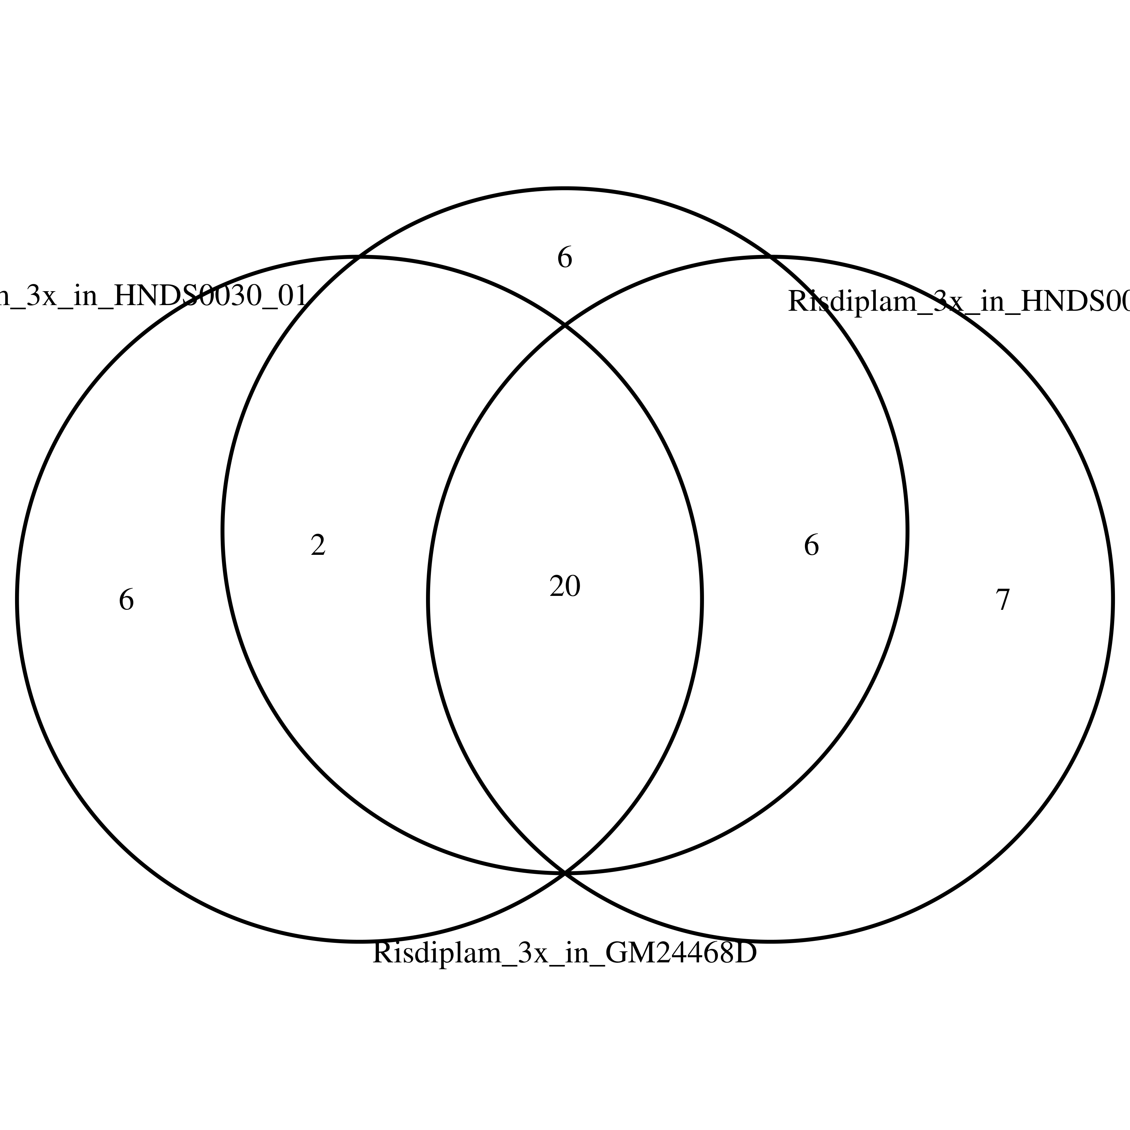
Overlap of Risdiplam induced OT in iPSC-MNs

Slide 20
Summary:
Splicing Algorithms maintainer / night watchman for Biogen
New Events discovered in splicing analysis.
Involved in multiple research projects for progress.
Online and software tools development for Biogen staff
Development of new algorithm to provided more detailed information
Validate new experiments procedure/new target from bioinformatics angle.
Community service to improve Biogen reputation

Slide 21
Thank you, Sandi
Thanks everyone in TS department
Especially Dann

Slide 22
SM induced DSG in NGN2 cells

Slide 23
SM induced DSG in iPSC cells

Slide 24
Future Steps to be established
The common targets/motif among the SM splicing enhancers
Explore potential novel splicing targets
Confirm the system difference between the different cell-systems
Provide a guide for cell system selection for certain conditions/cases
RASLseq primer design for cost-efficient screen

Slide 25
Projects in Biogen
SM RNA Splicing Modulator
HTT
SMA
Gene therapy
U1-snRNA

