Slide 1
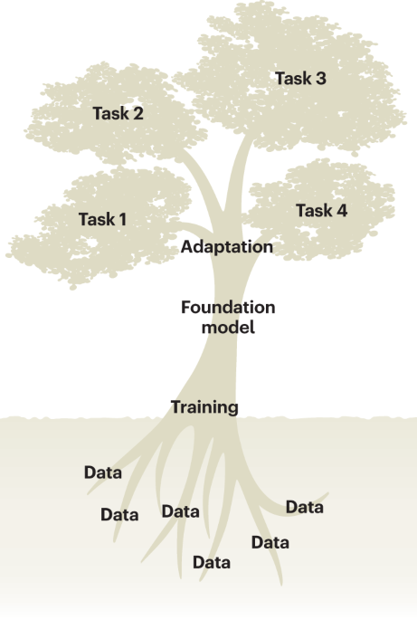
Welcome to the GFM Workshop
From Sequences to Solutions
Ikram Ullah, Staff Scientist
KAUST Bioinformatics Platform
Image taken from – Tang, Lin. "Large models for genomics." Nature Methods 20.12 (2023): 1868-1868.

Slide 2
Instructor Introduction
Ikram Ullah (Staff Scientist)
Member of KAUST Bioinformatics Platform
Stakeholders Support: BCL, Biomedical Platform
Bioinformatics Workflows Setup
Training Workshops
Research Collaboration & Consultations
Research Interests
Molecular Evolution
Gene/species, Cancer
Variant Analysis
Pipeline development, Rare disease
Machine Learning in Biosciences

Slide 3
Participant Introduction
Name
Designation
PhD student, Postdoc, Staff
Research
Topic and domain of research
What organisms/systems do you work with?
What brought you to this workshop?
Specific problem you want to solve?
Skills you want to learn?

Slide 4
Logistics
What you need: A laptop and a Hugging Face access token
GPU access on Ibex: Each student is assigned priority V100 GPU access by the Ibex team
Technical Setup: Check the setup page
Ibex login
Conda env setup
Running Jupyter server
The course contains scientific material from a mix of machine learning, biology and technology
Errors and omissions excepted

Slide 5
Agenda: Day 1
Time | Session | Type
09:10 - 09:25 | Welcome & Introduction
09:30 - 10:15 | Introduction to GFM | Lecture
10:15 - 10:30 | Coffee Break | Break
10:30 - 11:30 | GFM Architecture & Components | Lecture
11:30 - 12:00 | Exploring GFM components | Hands-on
12:00 - 13:00 | Lunch | Break
13:00 - 14:00 | Hugging Face Ecosystem | Lecture
14:00 - 15:00 | HuggingFace Inference API | Hands-on
15:00 - 15:15 | Coffee Break | Break
15:15 - 16:00 | PyTorch for GFM | Hands-on

Slide 6
Agenda: Day 2
Time | Session | Type
09:00 - 10:15 | Fine-Tuning GFMs | Lecture
10:15 - 10:30 | Coffee Break | Break
10:30 - 12:00 | Fine tuning for Sequence Classification | Hands-on
12:00 - 13:00 | Lunch | Break
13:00 - 14:00 | Solving biological problems using GFMs | Lecture
14:00 - 15:00 | K562 H3K27ac Enhancer Classification Pipeline | Hands-on
15:00 - 15:15 | Coffee Break | Break
15:15 - 16:00 | K562 H3K27ac Enhancer Regression Pipeline | Hands-on

Slide 7
Post-Workshop Feedback
At the end of the workshop, please share:
What worked
Which sessions were most valuable?
What concepts clicked?
What can be improved
Pace/Length of Workshop
Difficulty level
Missing topics
Giving back to KAUST
Can you contribute t0 future offerings
Lecture or Hands-on
This will help us tailor next offering of the workshop

Slide 8
Any Questions?

