Slide 1
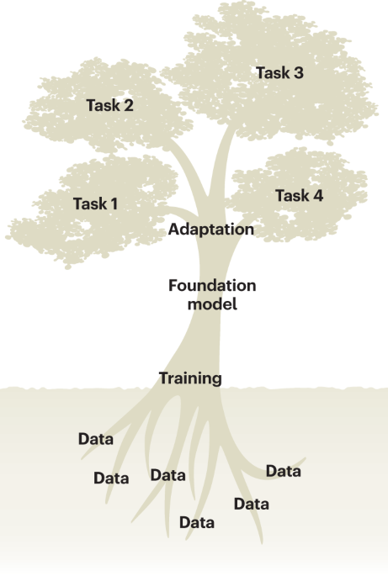
Introduction to Genomic Foundation Models
Ikram Ullah, Staff Scientist
Image taken from – Tang, Lin. "Large models for genomics." Nature Methods 20.12 (2023): 1868-1868.

Slide 2
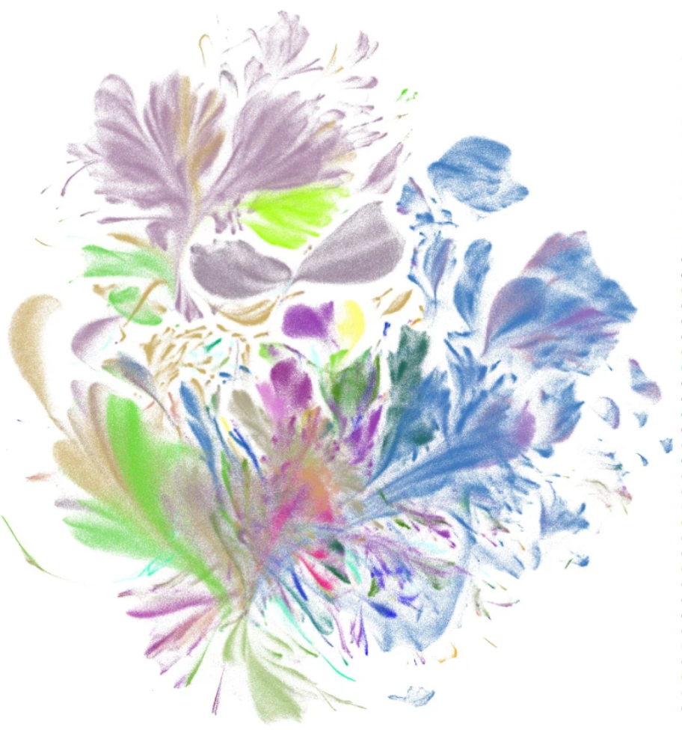
Agenda
What is a Genomic Foundation Model
Traditional ML models vs Genomic Foundation Models
Key Biological Applications & Research Impact
From Simple NN to Large Language Models
Evolution of Genomic Foundation Models
UMAP visualization of the pretrained scGPT cell embeddings (emb; a random 10% subset), colored by major cell types
Cui, Haotian, et al. "scGPT: toward building a foundation model for single-cell multi-omics using generative AI." Nature Methods 21.8 (2024): 1470-1480.

Slide 3
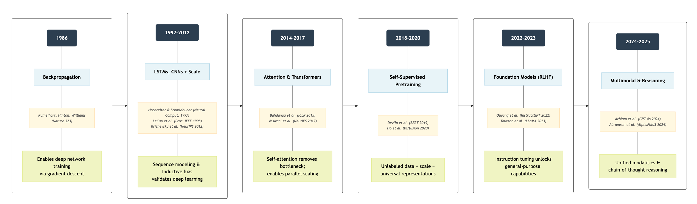
From Simple Neural Networks to LLMs
Notes:
Inductive bias -> locality, Translation equivariance, hierarchical composition

Slide 4
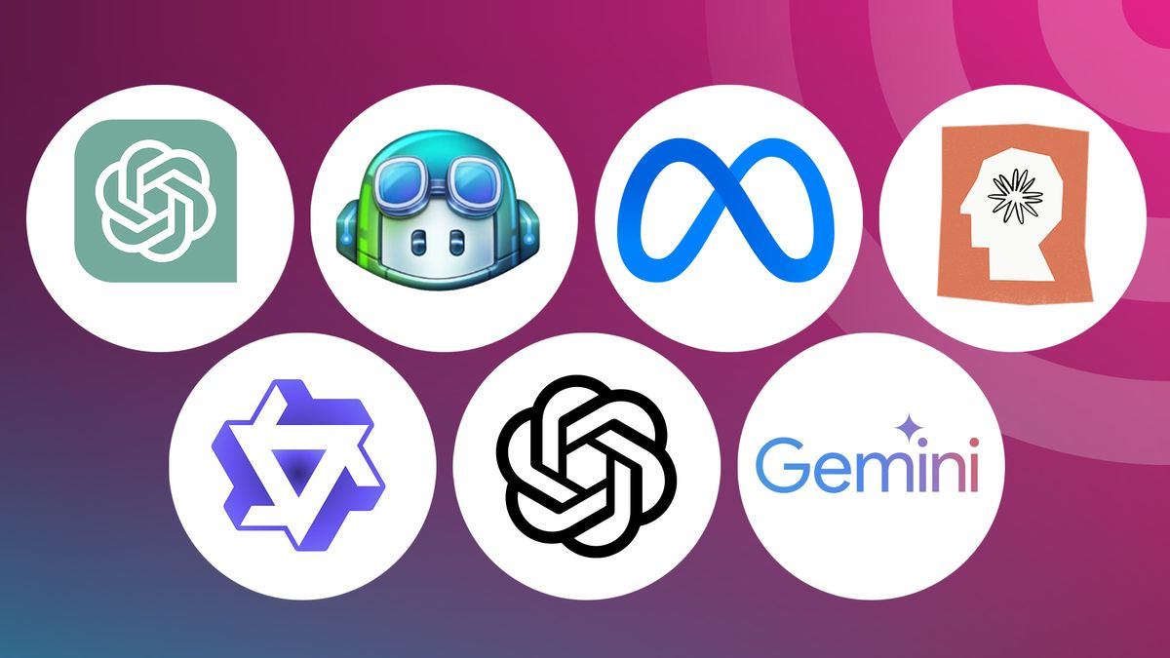
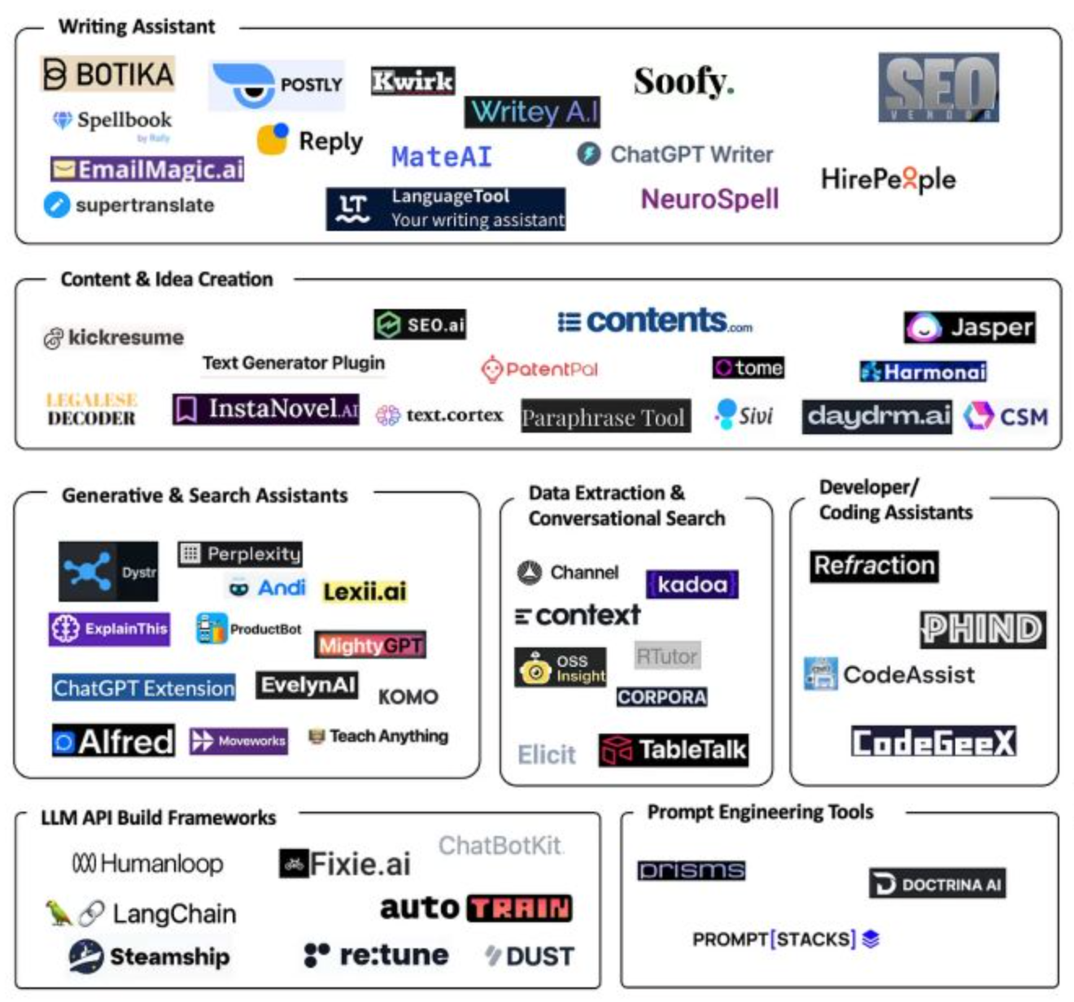
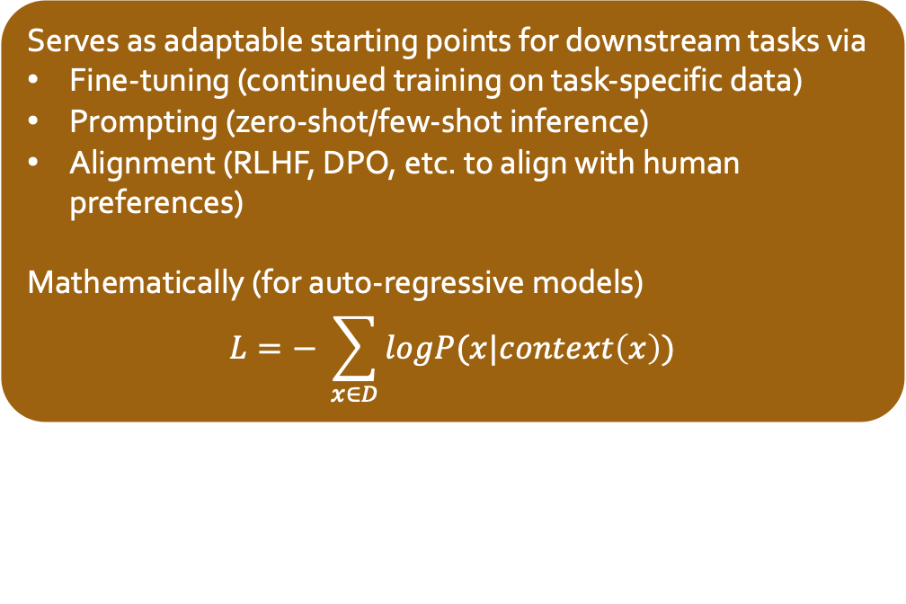
What is a Large Language Model
A Large Language Model (LLM) is a
(Mostly) Transformer-based neural network
Trained on large-scale text (or multimodal) data
Models a probability distribution over tokens
(Typically) by minimizing cross-entropy loss over tokens
Serves as adaptable starting points for downstream tasks via
Fine-tuning (continued training on task-specific data)
Prompting (zero-shot/few-shot inference)
Alignment (RLHF, DPO, etc. to align with human preferences)
Mathematically (for auto-regressive models)
$$L=− \sum_{x∈D}{logP(x|context\left(x\right))}$$
Notes:
DPO (Direct Preference Optimization) is a method for aligning large language models with human preferences without using reinforcement learning (RL)

Slide 5
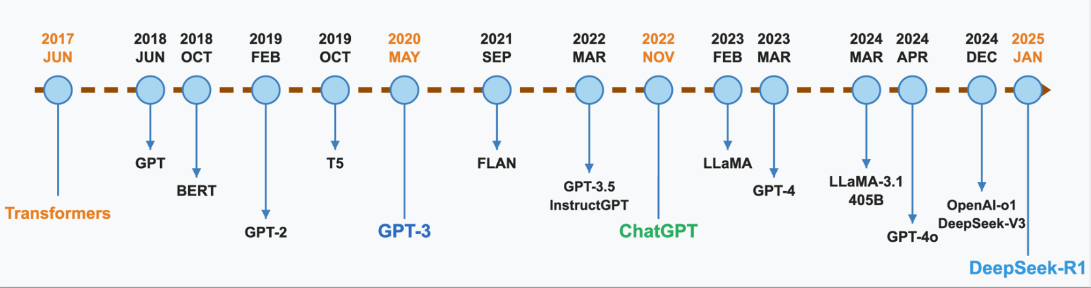
Brief History of Large Language Models
Notes:
Base model → Instruct fine-tuning (SFT) → Preference alignment (RLHF/DPO) → Chat formatting + safety policies

Slide 6
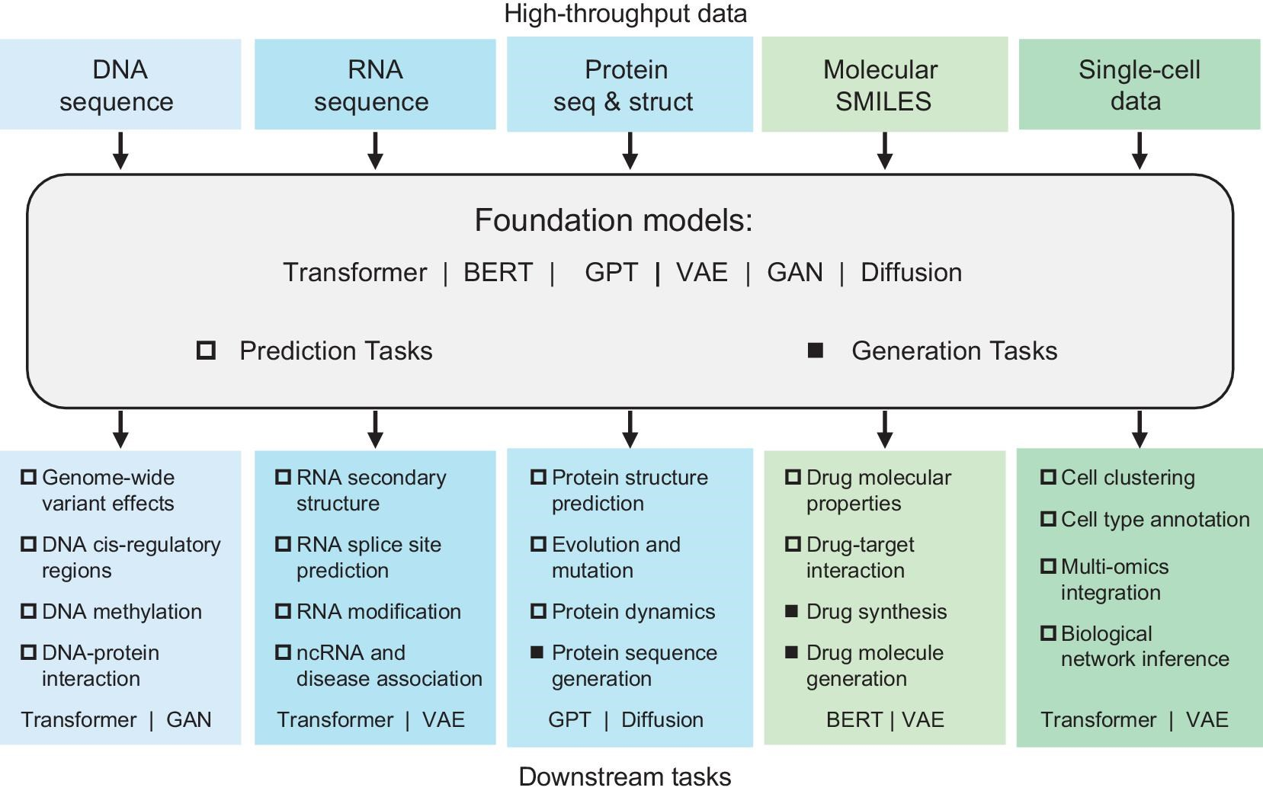
Foundation Models in Bioinformatics
Definition
Foundation Models in Bioinformatics are large-scale machine learning models trained on vast biological datasets (e.g., DNA, protein sequences, single-cell data) that can be adapted to a wide range of downstream tasks with limited additional training
Key Characteristics
Pre-trained on large, diverse multi-omics data
Self-supervised learning objectives
Capture complex biological patterns and relationships
Diverse applications through transfer learning
Guo, Fei, et al. "Foundation models in bioinformatics." National Science Review (2025): nwaf028.

Slide 7
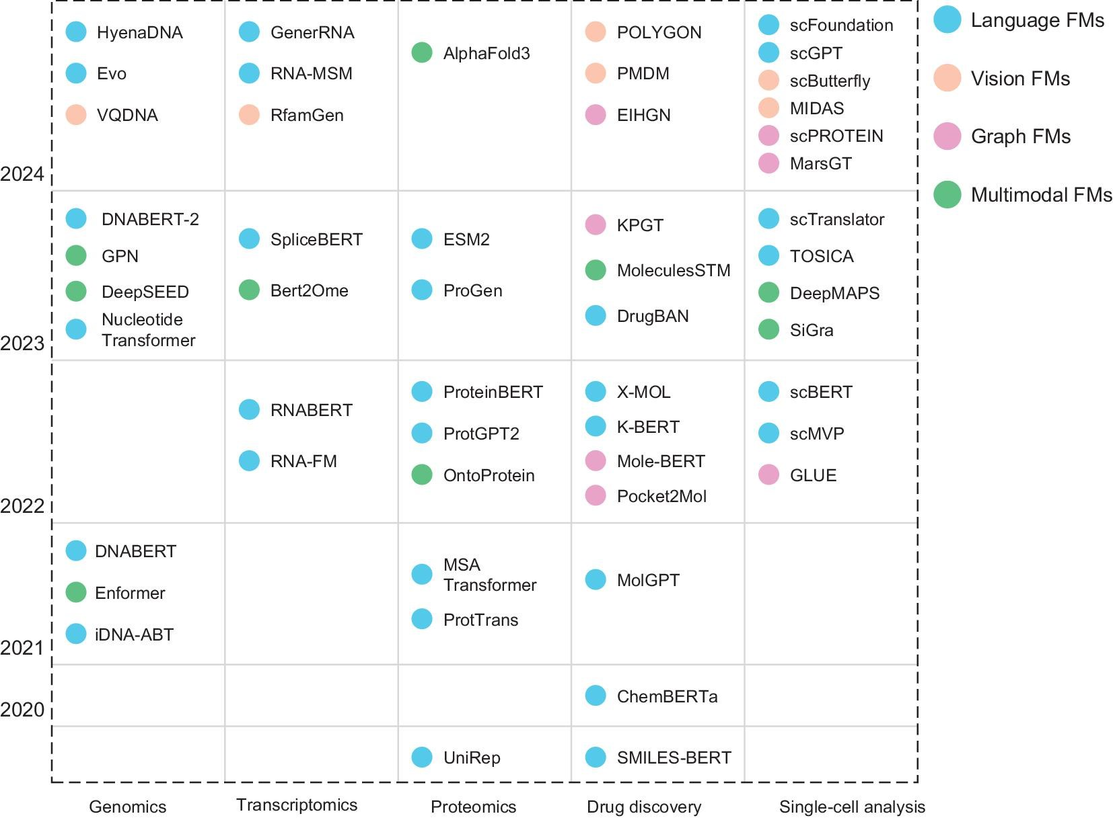
Evolution of Genomic Foundation Models
Evolution from specialized sequence models to multimodal genomic understanding
Increasing ability to model long-range dependencies in genomic data
Transition from prediction to generation capabilities
We will be focusing on genomic foundation models in this workshop
Chen, Ziyu, Lin Wei, and Ge Gao. "Foundation models for bioinformatics." Quantitative Biology 12.4 (2024): 339-344.

Slide 8
Traditional ML vs Genomic Foundation Models

Slide 9
Model Scope: The Fundamental Difference
Traditional ML
Usually one model per genomic task
Random Forest for enhancer prediction
CNN for transcription factor (TF) binding site prediction
SVM for gene expression classification
Foundation Models
One model for many downstream genomic tasks
HyenaDNA: Long-range chromatin profiling and genomic modeling [1]
DNABERT: Local semantic features like promoter prediction and TF binding sites detection [2]
Key Impact
Specialized tools → Swiss Army knife
GFMs require significant infrastructure and expertise to pretrain and serve. A well-designed SVM or RF model is still practical and efficient for small labs

Slide 10
Feature Representation: How Models “See” DNA
Traditional ML
Hand-crafted biological features
k-mers, GC content, Position Weight Matrix (PWM) scores
Typically, 10–100 dimensions
Requires expert biological knowledge
Foundation Models
Learned sequence embeddings
Context-aware, position-informed representations
512–4096+ dimensional dense vectors
Automatically learns hierarchical patterns (e.g., motif grammar, regulatory syntax)"
Key Impact
Humans design features → AI discovers patterns
Supervised Deep Learning (e.g., CNNs) also learns features, but they are task-specific. Foundation Models learn universal representations applicable to many tasks
Notes:
TFs don’t bind to a single exact DNA sequence—they bind to families of similar sequences. A PWM captures this variability and helps score new sequences based on how well they match the known motif.

Slide 11
Training strategy: Annotation to Computation
Traditional ML
Labeled data bottleneck
Supervised training needs curated annotations per task
Difficult to scale across tissues/species
Suffers from class imbalance (e.g., rare enhancer vs. background)
Foundation Models
Unlabeled data advantage
Self-supervised learning (Masked Language Modeling)
Can pretrain on entire genome sequences
Fine-tuning requires relatively smaller labeled data (few-shot learning)
Key Impact
Annotation-hungry → Raw sequence-powered
Larger data processing usually requires larger infrastructure and may not be practical for most research labs

Slide 12
Transfer Learning: Knowledge Sharing Across Contexts
Traditional ML
Context-locked models
Trained separately per tissue, cell type, or species
Little transferability; each new context may need a new model
Computationally and manually intensive
Foundation Models
Cross-context generalization
Pretrained representations work across human, mouse, plant genomes
Learns universal regulatory syntax (e.g., motif logic) shared across evolution
Supports zero-shot or few-shot transfer
Key Impact
Isolated Knowledge → Sharing Knowledge
While traditional transfer learning relied heavily on feature reuse, foundation Models enable model reuse via fine-tuning & prompting

Slide 13
Scalability: Handling Genomic Scale
Traditional ML
Computational limitations
Performance usually stagnates with large datasets
Manual feature engineering doesn’t scale
Typically handles short sequences (≤1000 bp). Examples are SVM, RF
Foundation Models
Genome-scale distributed learning
Uses transformer or efficient variants (e.g., Hyena, Mamba)
Trained on full chromosomes (up to millions of base pairs)
Supports multi-GPU and TPUs for scaling
Key Impact
Hits ceiling quickly → Scales with genomic complexity
Traditional ML models can outperform GFMs in limited data or narrow biological task cases. GFM may overfit or under-perform on small tasks
Notes:
A CNN trained on human liver enhancers (e.g., DeepSEA) typically fails on mouse brain enhancers without retraining because it overfits to species-specific background biases
Bias: Error due to overly simple assumptions (may miss some patterns).
Variance: Error due to sensitivity to the specific training data (may overfit).
So, small, narrow datasets favor models with lower variance, which is why traditional ML sometimes beats GFMs in such cases.

Slide 14
Biological Insight: Interpretability vs Discovery Trade-off
Traditional ML
Explicit interpretability
Feature importance scores are straightforward
Model coefficients and tree structures are inspectable
Easy to trace to known motifs and biological mechanisms
Foundation Models
Emergent understanding
Learns regulatory syntax
Identifies unknown long-range dependencies
Less transparent, but deeper insight when probed (e.g., attention)
Key Impact
Explains the known → Discovers the unknown
Interpretability remains the trust bottleneck for clinical adoption, despite the power of discovery

Slide 15
Quick Check: Biological Foundation Models
What is the primary advantage of biological foundation models over traditional task-specific models?
A. They require less computational resources
B. They eliminate the need for labeled data entirely
C. They learn rich representations transferable to multiple tasks
D. They are always more accurate than specialized models
Answer: C. They learn rich representations transferable to multiple tasks
Foundation models learn generalizable representations from large amounts of data that can be efficiently adapted to multiple downstream tasks through fine-tuning, reducing the need for task-specific data collection and annotation.
Notes:
Answer: C. They learn rich representations transferable to multiple tasks
Foundation models learn generalizable representations from large amounts of data that can be efficiently adapted to multiple downstream tasks through fine-tuning, reducing the need for task-specific data collection and annotation.

Slide 16
Key Biological Applications
DNA
(Sequence)
Genome-wide variant effects DNA cis-regulatory regions DNA methylation DNA-protein interaction
RNA
(Sequence)
RNA secondary structure
Protein
(Seq, Structure)
Protein structure prediction
RNA splice site prediction
RNA modification
ncRNA and disease association
Evolution and mutation
Protein dynamics
Protein sequence generation
Single Cell
(Data)
Cell clustering
Cell type annotation
Multi-omics integration
Biological network
Guo, Fei, et al. "Foundation models in bioinformatics." National Science Review (2025): nwaf028.

Slide 17
Research Impact: Case Studies
Effects of noncoding DNA on gene expression
DNABERT captures transferrable understanding of genomic DNA sequences based on up and downstream nucleotide contexts Predicts promoters, splice sites and TFBS, after fine-tuning using small task-specific labeled data
Repurposing of existing drugs
Tissue-specific gene network dynamics
Geneformer make predictions about tissue-specific gene network dynamics from scRNA data Obtains insights with limited data, like rare diseases and difficult-to-access tissues due to transfer learning
TxGNN trained on a medical knowledge graph to identify potential new purposes for existing drugs
Predictions aligns with current off-label practice, offering a promising exploratory tool for expanding drug indications.
Mutation Prediction
Evo2 achieves state-of-the-art) in zero-shot variant prediction for BRCA1
Capable of designing entire genomes, including mitochondrial DNA and bacterial genomes, with realistic gene structures and regulatory elements
Ji, Yanrong, et al. "DNABERT: pre-trained Bidirectional Encoder Representations from Transformers model for DNA-language in genome." Bioinformatics 37.15 (2021): 2112-2120.
Huang, Kexin, et al. "A foundation model for clinician-centered drug repurposing." Nature Medicine 30.12 (2024): 3601-3613.
Theodoris, Christina V., et al. "Transfer learning enables predictions in network biology." Nature 618.7965 (2023): 616-624.
Notes:
Off-label practice means doctors sometimes use drugs to treat conditions they weren’t originally approved for, based on their experience or new evidence.
Check link for more examples https://watershed.bio/resources/foundation-models-for-biomedical-research

Slide 18
Quick Check: Genomic Foundation Models Applications
Which of these applications would benefit MOST from the long-range dependency modeling capabilities of genomic foundation models?
A. SNP genotyping
B. Enhancer-promoter interaction prediction
C. Basic sequence alignment
D. Simple gene counting
Answer: B. Enhancer-promoter interaction prediction
Enhancer-promoter distance can vary significantly, ranging from a few hundred base pairs to several million base pairs. Traditional models (like CNNs or RNNs) struggle to connect distant genomic elements due to limited receptive fields.

Slide 19
Questions & Comments

Slide 20
Traditional ML vs Genomic Foundations Models
Concept | Traditional ML in Genomics | Genomic Foundation Models
Model Scope | Task-specific models trained independently for each application (e.g., random forests for enhancer prediction, CNNs for TF binding | Pretrained general-purpose models transferable across tasks and contexts (e.g., HyenaDNA for Chromatin Profile Prediction and Species classification)
Feature Representation | Manual or shallow features (e.g., k-mers, GC content, PWM motif scores) | High-dimensional, context-aware sequence embeddings from genomic data
Data Requirements | Requires labeled datasets per task; often constrained by annotation availability and class imbalance | Leverages large-scale unlabeled sequence data via self-supervised learning; needs minimal labeled data for fine-tuning
Transferability | Limited to trained context (e.g., one tissue, one species); retraining needed for new tasks. | Cross-context generalization across cell types, tissues, and even species
Scalability | Computationally bounded; performance often plateaus without task-specific engineering | Scales to full-genome or multi-modal modeling using distributed transformers
Biological Insight | Interpretation via model coefficients, feature importance, or motif matches | Embeddings uncover regulatory logic, long-range interactions, and evolutionary constraints
Notes:
🧠 Traditional ML Models
Kelley et al., 2016 – Basset: Learning the regulatory code of the accessible genome with deep CNNs. Genome Research.
Ghandi et al., 2014 – Enhanced regulatory sequence prediction using gapped k-mer features. PLoS Comput Biol.
Zhou & Troyanskaya, 2015 – Predicting effects of noncoding variants with deep learning-based sequence model. Nature Methods.
Ernst & Kellis, 2012 – ChromHMM: automating chromatin-state discovery and characterization. Nature Methods.
🧬 Foundation Models
Avsec et al., 2021 – Effective gene expression prediction from sequence using Enformer. Nature Methods.
Ji et al., 2021 – DNABERT: pre-trained bidirectional encoder representations from transformers for DNA-language. Bioinformatics.
Nijkamp et al., 2023 – A survey of foundation models for protein and genomic sequences. arXiv.
Ferruz et al., 2023 – Nucleotide Transformer: building and evaluating robust foundation models for human genomics.
Zou et al., 2023 – Toward species-generalizable genomic foundation models.
Zhou et al., 2023 – Biological insights from foundation models of regulatory genomics.

