Slide 1
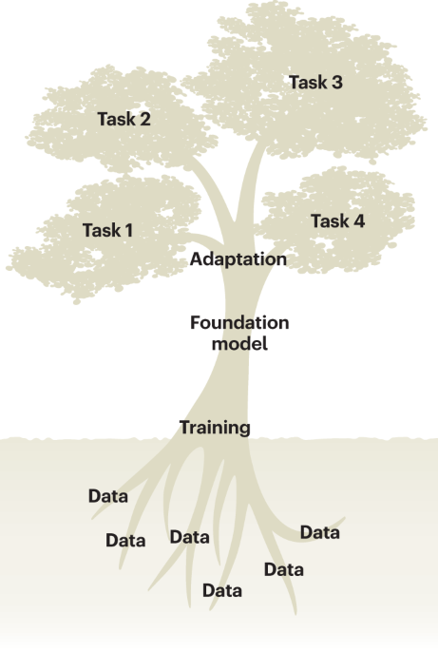
Anatomy of a Typical Genomic Foundation Model
Ikram Ullah, Staff Scientist
Image taken from – Tang, Lin. "Large models for genomics." Nature Methods 20.12 (2023): 1868-1868.

Slide 2

Agenda
High Level Overview
Sequence Tokenization
Neural Network Model
Output Layer
Embedding Layer
Common Training Strategies
Practical: Running a Genomic Foundation Mode
Cui, Haotian, et al. "scGPT: toward building a foundation model for single-cell multi-omics using generative AI." Nature Methods 21.8 (2024): 1470-1480.

Slide 3
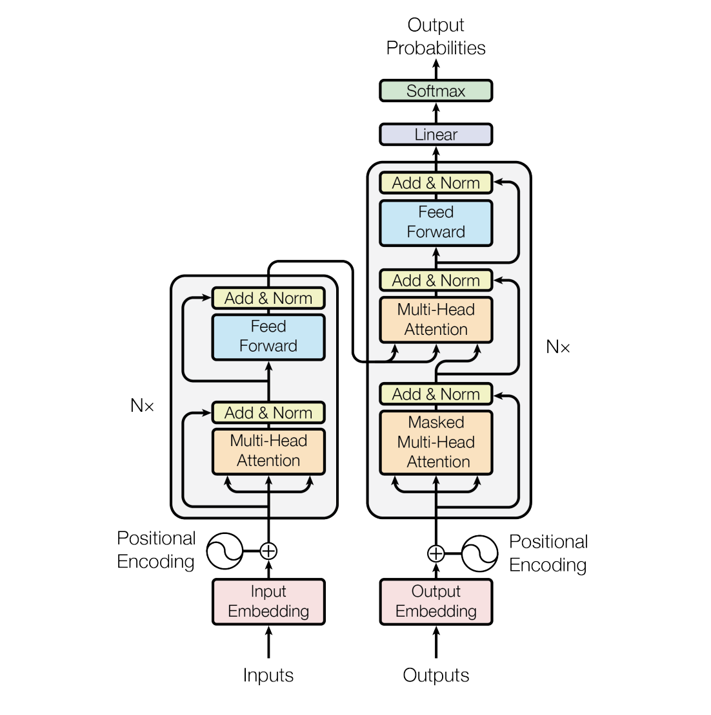
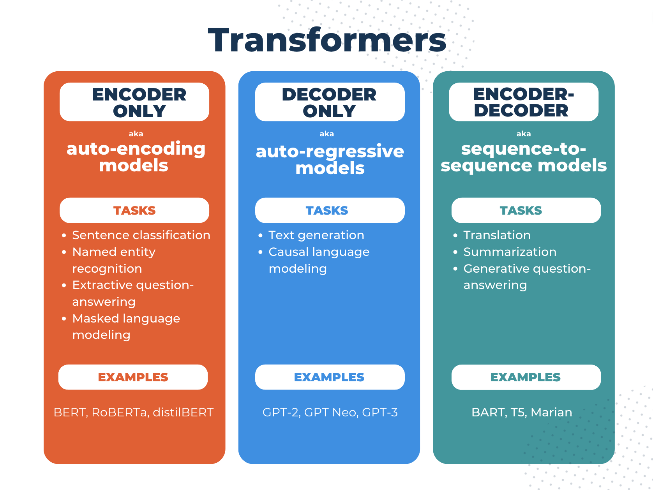
The Transformer Architecture
Attention Mechanism
Query = your search text
Key = each book’s index keywords
Value = the book’s actual content
https://www.comet.com/site/blog/explainable-ai-for-transformers/
Generation & Language Modeling in Transformers library
AutoModelForMaskedLM - Masked language modeling (BERT-style)
AutoModelForCausalLM - Causal (autoregressive) language modeling (GPT-style)
AutoModelForSeq2SeqLM - Sequence-to-sequence tasks (translation, summarization)
Encoder
Decoder
Notes:
QUERY (Q) → "Where is Walmart?" (the question)
KEYS (K) → Each student's "relevance to this question"
(e.g., "I know the area" vs "I'm new here")
VALUES (V) → Each student's actual answer/direction
("2 blocks north", "across the street", etc.)
ATTENTION OUTPUT = Weighted combination of all answers
(mostly trusting the confident locals)
For token i attending to token j:
similarity score:
$$s_{ij}=Q_{i}⋅K_{j}$$
attention weight (after softmax):
$$a_{ij}=\text{softmax}\left(s_{ij}\right)$$
output representation:
$${\text{out}}_{i}=\sum_{j}{a_{ij}}V_{j}$$
So, token i becomes a weighted mix of other tokens’ values.

Slide 4
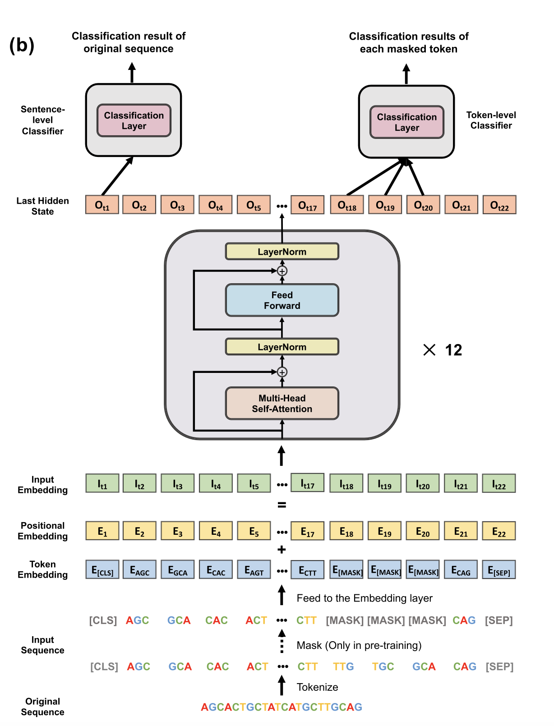
Anatomy of a typical Genomic Foundation Model
DNA Sequence (Input)
Tokenization
Embedding Layer
The raw genomic sequence data
Foundation for all analysis
Breaking down raw DNA sequence into discrete units called tokens
Single nucleotide, kmer, BPE
Converting tokens into a dense vector representation
Capturing semantic meaning and context of token within sequence
Neural Network Model
Core of the DNA Foundation Model, usually based on Transformer architecture (encoder, decoder, or both)
Uses mechanisms like self-attention to learn complex relationships and dependencies between tokens
Output Layer
(Task-Specific)
Language Modeling Head: For predicting masked tokens during pretraining or generating new DNA sequences
Regression/Classification Head: For prediction tasks
Ji, Yanrong, et al. "DNABERT: pre-trained Bidirectional Encoder Representations from Transformers model for DNA-language in genome." Bioinformatics 37.15 (2021): 2112-2120.
Notes:
Masked Token Prediction During Pre-training As established by Ji et al. (2021) in their seminal DNABERT paper, the language modeling head consists of a feed-forward neural network that projects the hidden representations to vocabulary-sized logits.
Next-Token Prediction and Sequence Generation For autoregressive models, Madani et al. (2023) demonstrated that the language modeling head can be configured to predict the next token in a sequence, enabling the generation of novel DNA sequences with specific properties.

Slide 5
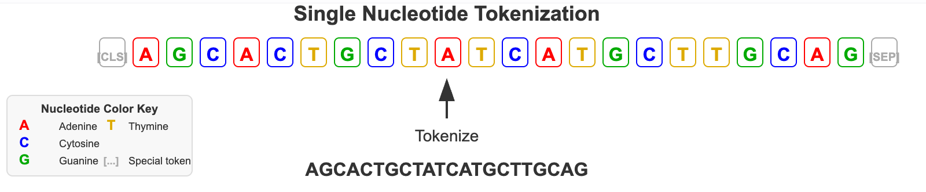
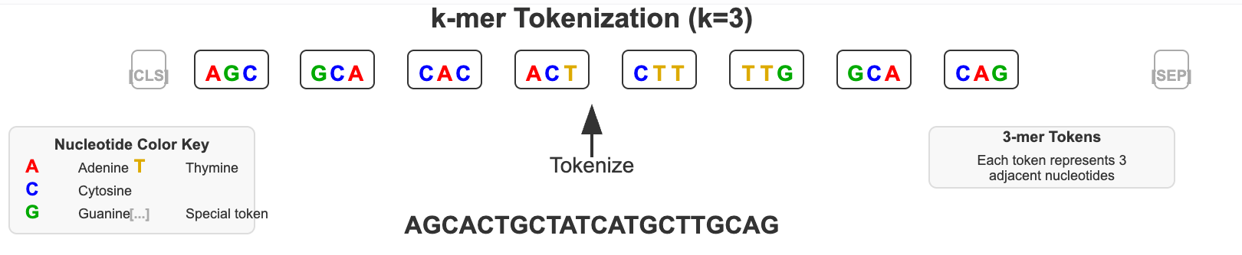
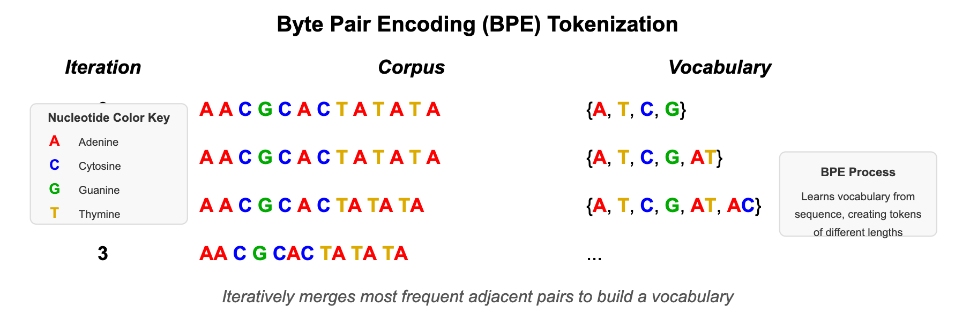
DNA as a Language – Tokenization
Breaking down the continuous DNA sequence into discrete units called tokens
k-mer Tokenization
Dividing the sequence into overlapping or non-overlapping subsequences of length $k$, Biologically interpretable but fixed length
Dividing the sequence into overlapping or non-overlapping subsequences of length 𝑘, Biologically interpretable but fixed length
Used in DNABERT, Nucleotide Transformer
Byte Pair Encoding (BPE)
Iterative algorithm that searches for nucleotides combinations and builds the vocabulary at the same time. Capture longer motifs but large memory requirements
Used in DNABERT-2
Single Nucleotide Tokenization
Treating each nucleotide (A, C, G, T) as an individual token, long context but high computational cost
Used in HyenaDNA
Notes:
CLS token: go-to representation for any classification task you want to perform on the entire sequence.
For example, for language detection
[CLS] Bonjour, comment allez-vous? [SEP] → CLS embedding → Neural network → French/English/Spanish/German
Document Classification
[CLS] Patient shows symptoms of fever and cough... [SEP] → CLS embedding → Neural network → Medical_Emergency/Routine_Checkup
[SEP] Line separator: used to separate different segments within a single input sequence, e.g., [CLS] A T C G A T C G [SEP] → Promoter/Non-promoter classification

Slide 6
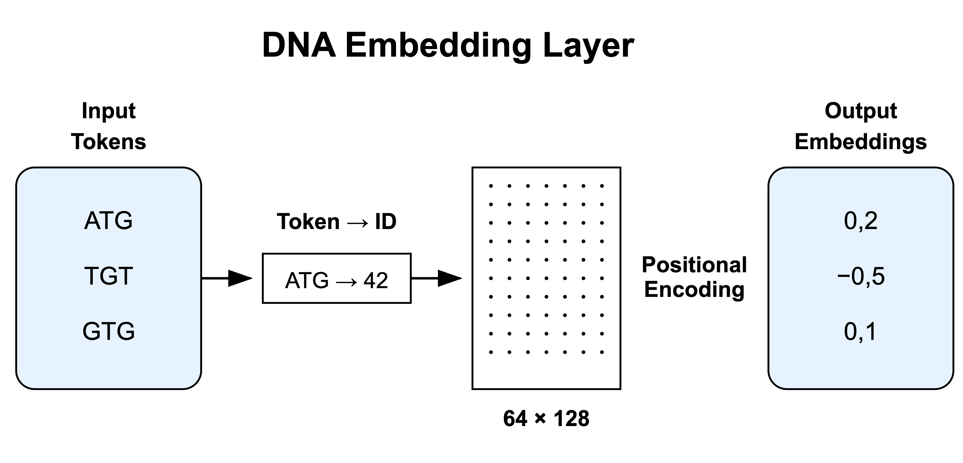
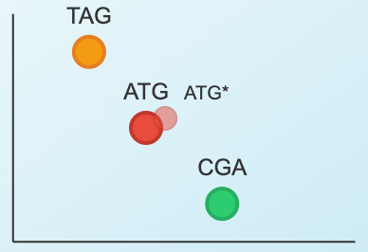
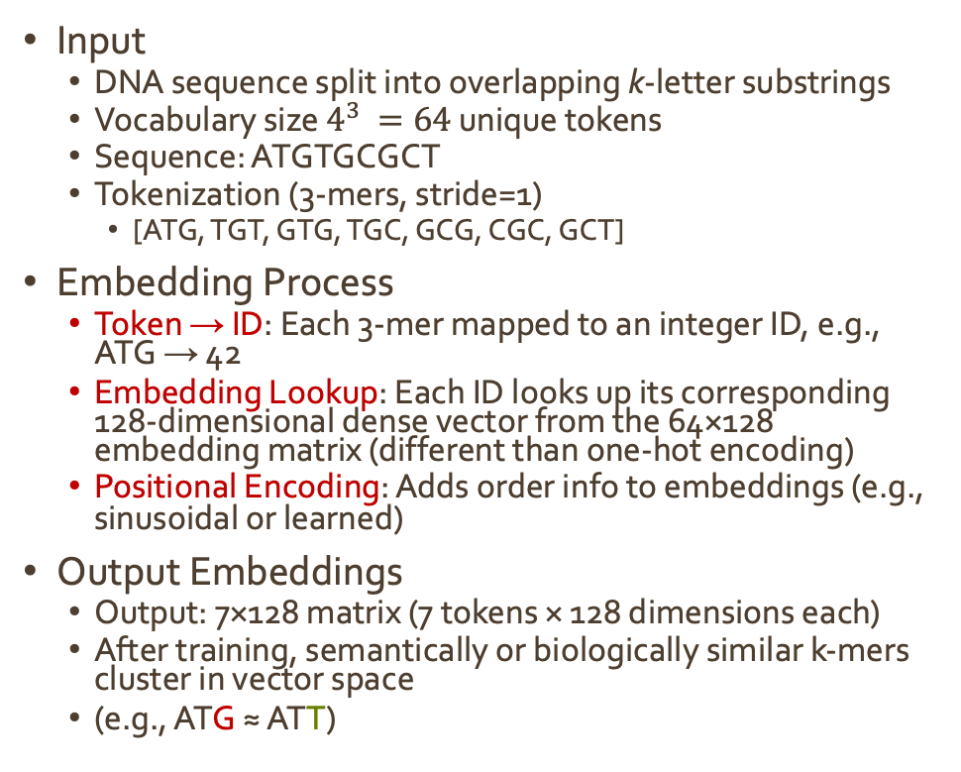
Embedding Layer
Input
DNA sequence split into overlapping k-letter substrings
Vocabulary size $4^{3 }=64$ unique tokens
Sequence: ATGTGCGCT
Tokenization (3-mers, stride=1)
[ATG, TGT, GTG, TGC, GCG, CGC, GCT]
Embedding Process
Token → ID: Each 3-mer mapped to an integer ID, e.g., ATG → 42
Embedding Lookup: Each ID looks up its corresponding 128-dimensional dense vector from the 64×128 embedding matrix (different than one-hot encoding)
Positional Encoding: Adds order info to embeddings (e.g., sinusoidal or learned)
Output Embeddings
Output: 7×128 matrix (7 tokens × 128 dimensions each)
After training, semantically or biologically similar k-mers cluster in vector space
(e.g., ATG ≈ ATT)
https://huggingface.co/InstaDeepAI/nucleotide-transformer-v2-500m-multi-species/blob/main/vocab.txt
Notes:
The 64 × 128 Matrix Represents:
64: Vocabulary size (total number of possible k-mers)
128: Embedding dimension (learned dense representation)
Why 64 for Vocabulary Size?
For 3-mers (k=3) in DNA:
4 nucleotides: A, T, G, C
Total possible 3-mers: 4³ = 64
Examples: AAA, AAT, AAG, AAC, ATA, ATT, ATG, ATC, etc.

Slide 7
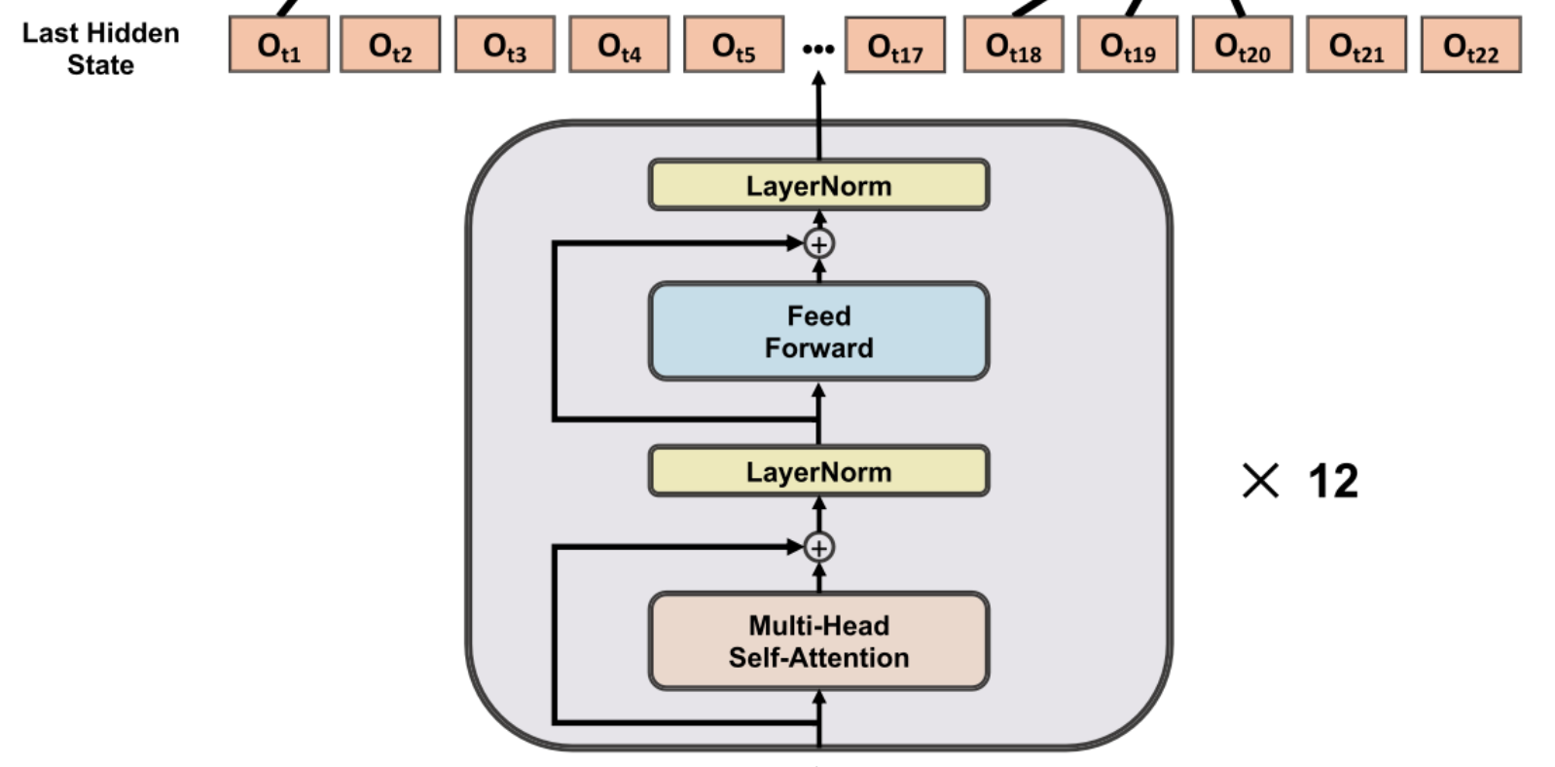
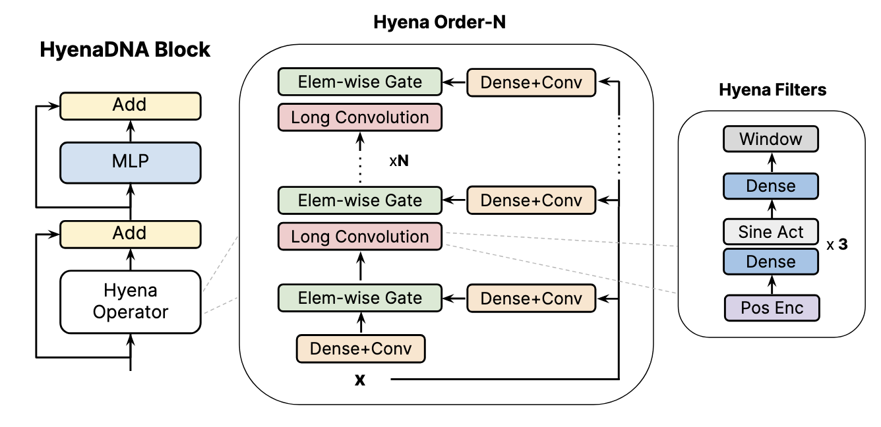
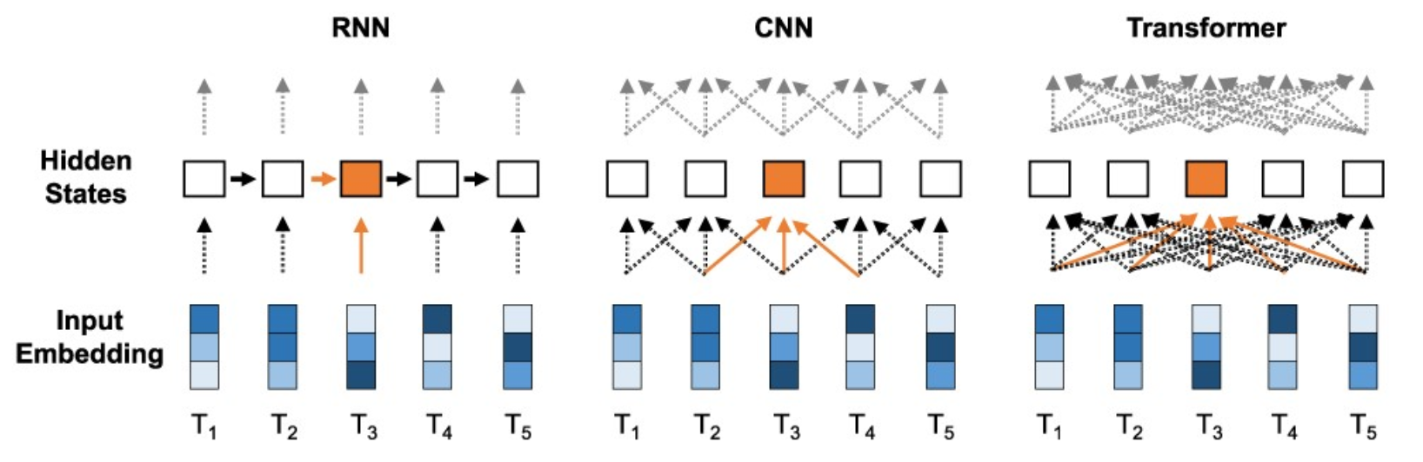
Model Architecture Layer
The “engine” of a Foundation Model
Often based on the Transformer architecture
Self-attention for learning complex relationships and dependencies between tokens
Optimizations: Sliding window (Longformer) CUDA-based (FlashAttention)
Newer models uses architectures like CNN and SSM (Hyena and Mamba)
Necessitated by local pattern learning and long context handling
Transformer model in DNABERT
Hyena model in HyenaDNA
Beltagy, Iz, Matthew E. Peters, and Arman Cohan. "Longformer: The long-document transformer." arXiv preprint arXiv:2004.05150 (2020).
Dao, Tri, et al. "Flashattention: Fast and memory-efficient exact attention with io-awareness." Advances in neural information processing systems 35 (2022): 16344-16359.
Notes:
RNN: The orange box at time $T_{3}$ depends entirely on the hidden state from $T_{2}$ which depends on $T_{1}$
CNN: The orange box at $T_{3}$ aggregates information from a small window of neighbors ($T_{2},T_{3},T_{4})$
Transformer: The orange box at $T_{3}$ is connected to every other position ($T_{1}$ to $T_{5})$
Longformer: Instead of every token attending to every other token, each token only attends to a fixed-size window of neighboring tokens. By stacking multiple layers of this sliding window attention, the "receptive field" expands (similar to CNNs)

Slide 8
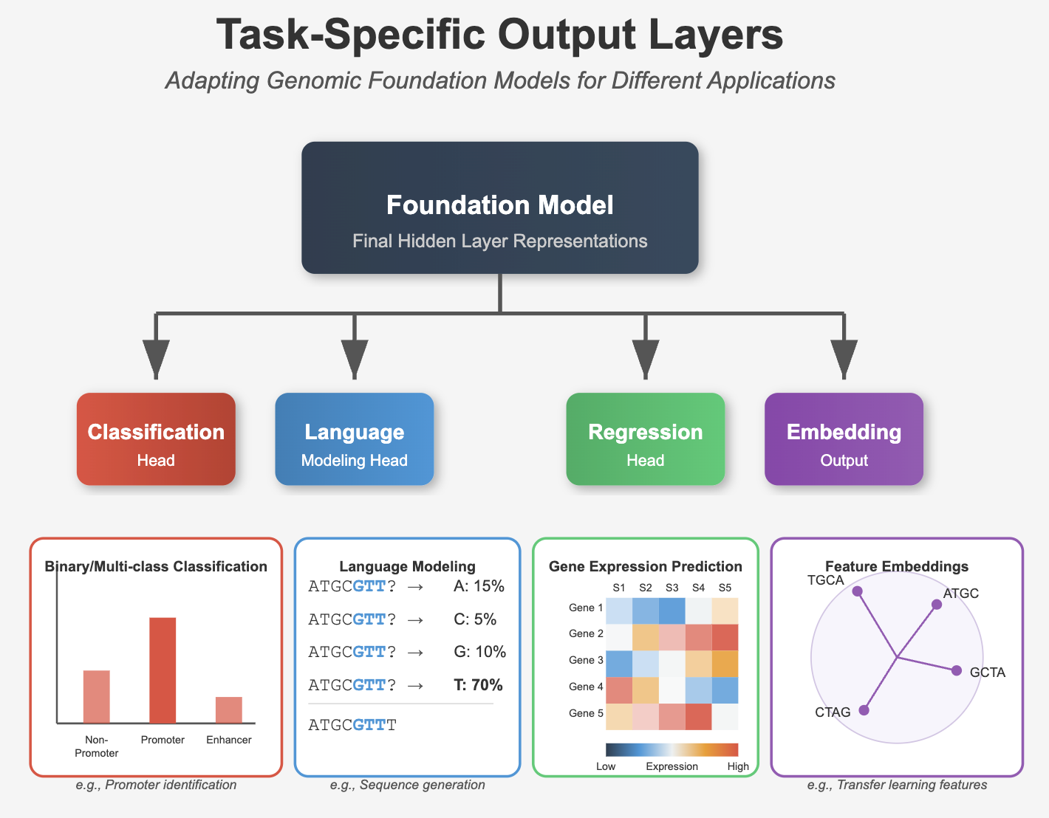
Output Layer (Task-Specific)
The final layer of the model, which is adapted based on the specific task the GFM is designed for.
Classification (Discriminative) Head: For predicting categories (e.g., promoter vs. non-promoter)
Language Modeling (Generative) Head: For predicting masked tokens during pretraining or generating new DNA sequences
Regression (Quantitative) Head: For predicting continuous values (e.g., gene expression levels)
Embedding (Representational) Output: The learned representations can be used as features for other downstream analyses.

Slide 9
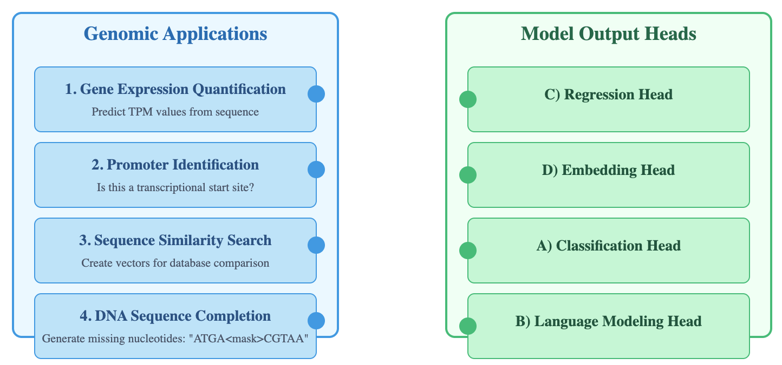
Quick Check: Connect Tasks to Output Heads

Slide 10
Training Strategies for Genomic Foundation Models
Genomic sequences lack explicit grammar — models must learn regulatory syntax and structure from raw sequences
Choice of training objective determines:
What the model learns, e.g., sequence motifs (MLM), positional dependencies (AR)
How well it generalizes to downstream tasks (e.g., enhancer detection, variant effect prediction)
Strategy | Description | Model Type | Example Use Case
Masked Language Modeling (MLM) | Randomly mask parts of the input and train the model to predict them using full context | Transformer Encoder (BERT-style) DNABERT | Promoter prediction
Autoregressive Modeling (AR) | Predict the next token in the sequence based only on previous tokens | Transformer Decoder (GPT-style) HyenaDNA | Genome sequence generation
Notes:
MLM Motif Discovery: Forces model to predict missing nucleotides based on surrounding context
Positional Dependencies: Learns relationships between positions within motifs
AR
Motif spacing: Learning distances between regulatory elements
Sequential dependencies: Understanding motif ordering

Slide 11
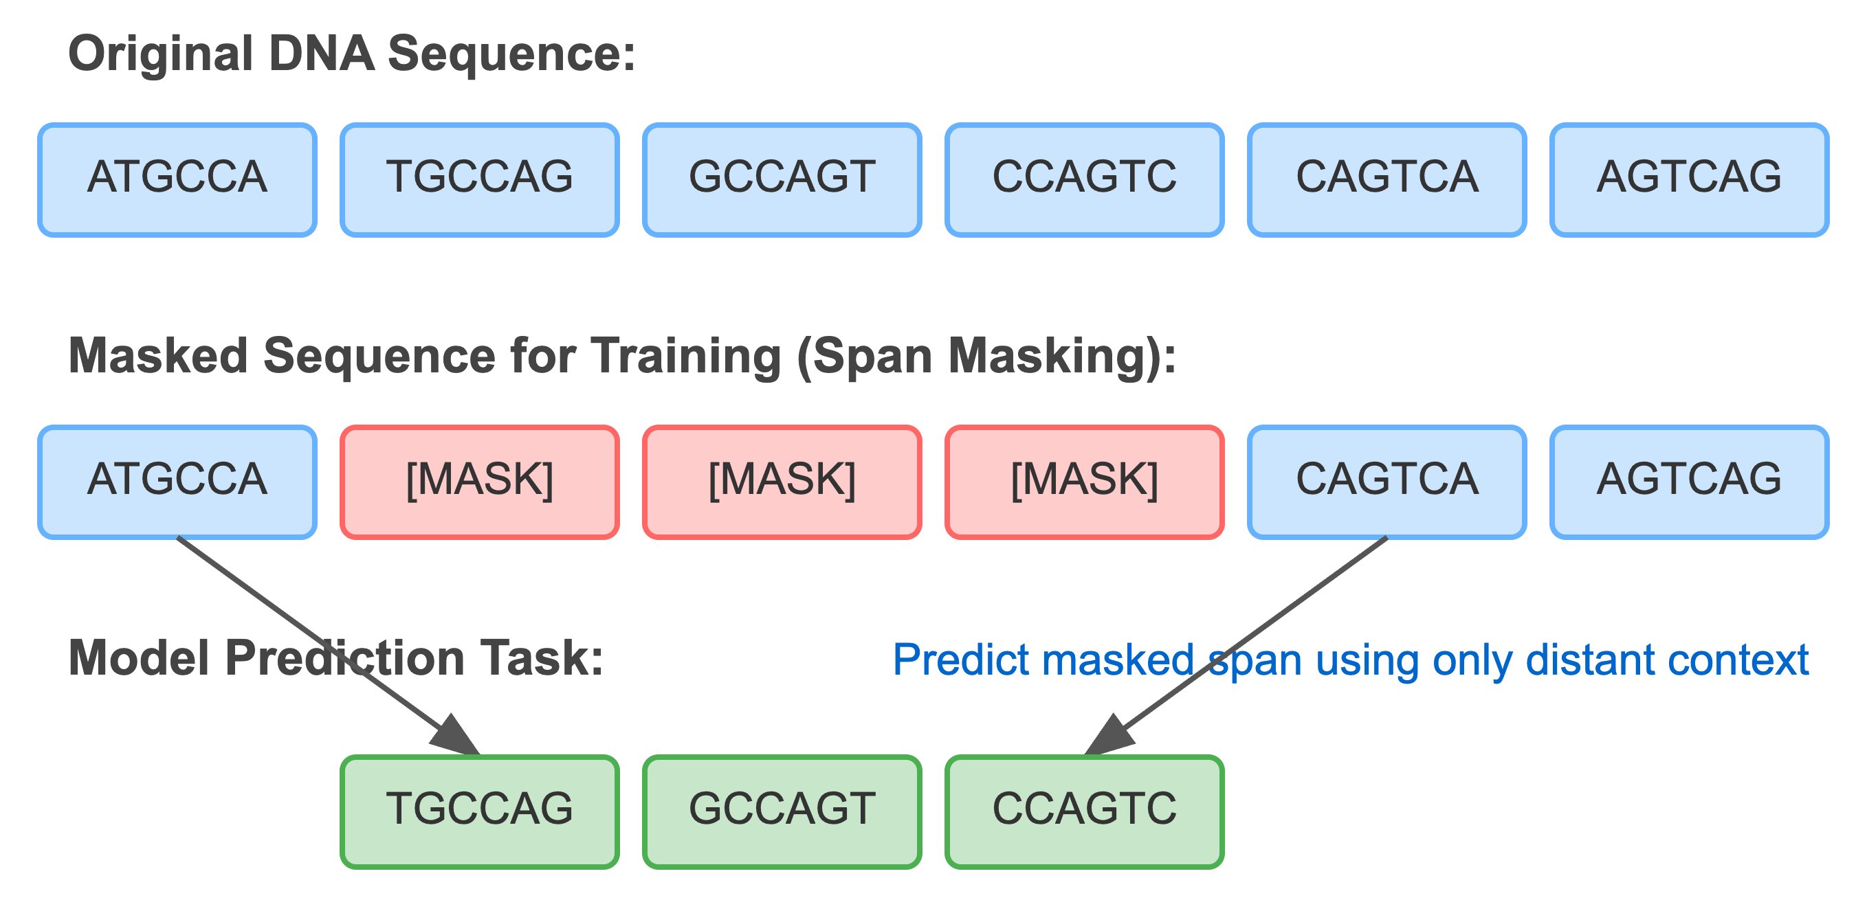
Masked Language Modeling: Capturing Local Regulatory Syntax
How MLM Works
Randomly mask ~15% of tokens in DNA sequences
Train model to predict the masked elements using bidirectional context
Used primarily in transformer encoder architectures (BERT-style)
Key Advantages
Bidirectional context, efficient transfer learning
Downstream Applications
Promoter prediction, variant effect prediction
Predict missing kmer based on surrounding context
from transformers import (
BertTokenizer,
BertForMaskedLM,
DataCollatorForLanguageModeling,
BertConfig,
Trainer,
TrainingArguments
)
Notes:
BertTokenizer/BertTokenizerFast: For handling BERT-style tokenization
BertForMaskedLM: The standard implementation for BERT-based masked language modeling
DataCollatorForLanguageModeling: Handles dynamic masking during batch preparation
BertConfig: Configuration file for BERT-style training, like vocab_size, num_hidden_layers etc
TrainingArguments: Training arguments like output directory, num_epochs, save_steps etc
Trainer: Class used for pre-training models

Slide 12
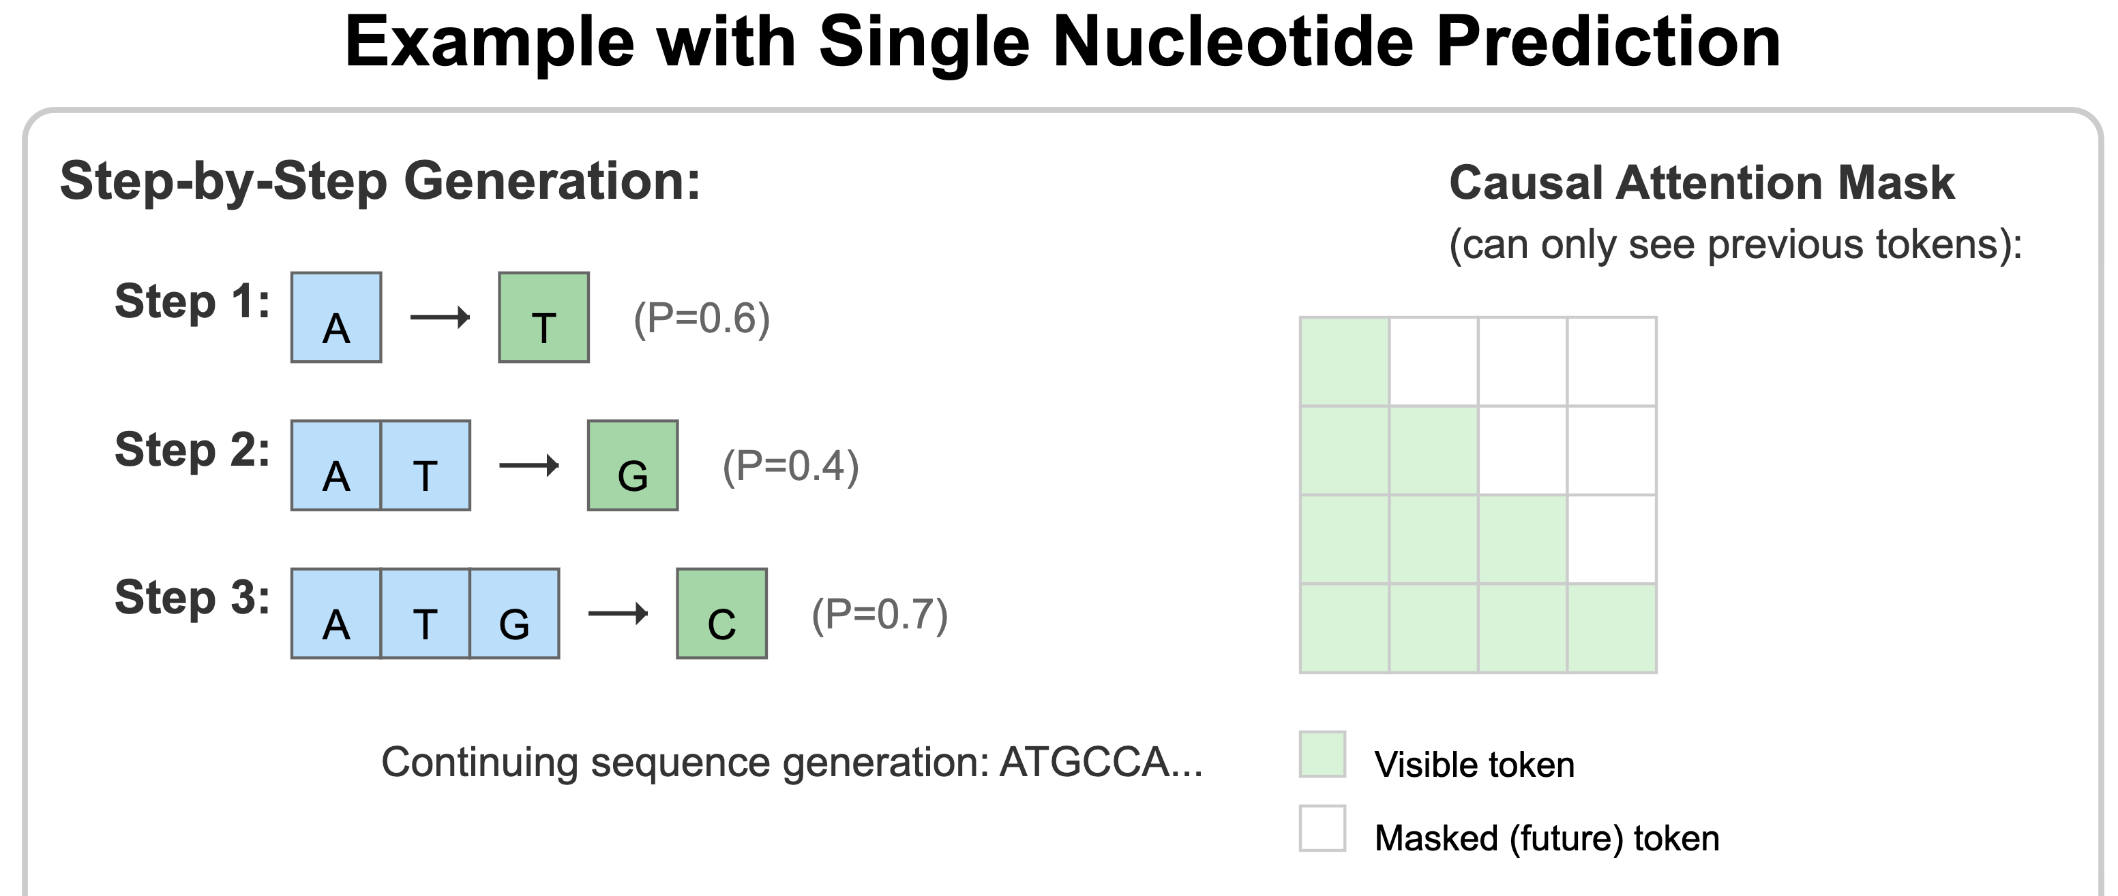
Causal Language (Autoregressive) Modeling Sequence Generation and Contextual Dependencies
How Autoregressive Pre-training Works
Predict each token based only on previous tokens in the sequence
Train model step-by-step to predict the next element in sequence
Used primarily in transformer decoder architectures (GPT-style)
Key Advantages
Sequence generation, conditional synthesis
Applications
Synthetic biology, enhancer design, genome generation
from transformers import AutoModelForCausalLM,
AutoTokenizer
Notes:
GPT2Tokenizer: A tokenizer designed for GPT-2 models

Slide 13
Questions & Comments
Practical: Running a Genomic Foundation Model & Understanding its components

Slide 14
Traditional ML vs Genomic Foundations Models
Concept | Traditional ML in Genomics | Genomic Foundation Models
Model Scope | Task-specific models trained independently for each application (e.g., random forests for enhancer prediction, CNNs for TF binding | Pretrained general-purpose models transferable across tasks and contexts (e.g., HyenaDNA for Chromatin Profile Prediction and Species classification)
Feature Representation | Manual or shallow features (e.g., k-mers, GC content, PWM motif scores) | High-dimensional, context-aware sequence embeddings from genomic data
Data Requirements | Requires labeled datasets per task; often constrained by annotation availability and class imbalance | Leverages large-scale unlabeled sequence data via self-supervised learning; needs minimal labeled data for fine-tuning
Transferability | Limited to trained context (e.g., one tissue, one species); retraining needed for new tasks. | Cross-context generalization across cell types, tissues, and even species
Scalability | Computationally bounded; performance often plateaus without task-specific engineering | Scales to full-genome or multi-modal modeling using distributed transformers
Biological Insight | Interpretation via model coefficients, feature importance, or motif matches | Embeddings uncover regulatory logic, long-range interactions, and evolutionary constraints
Notes:
🧠 Traditional ML Models
Kelley et al., 2016 – Basset: Learning the regulatory code of the accessible genome with deep CNNs. Genome Research.
Ghandi et al., 2014 – Enhanced regulatory sequence prediction using gapped k-mer features. PLoS Comput Biol.
Zhou & Troyanskaya, 2015 – Predicting effects of noncoding variants with deep learning-based sequence model. Nature Methods.
Ernst & Kellis, 2012 – ChromHMM: automating chromatin-state discovery and characterization. Nature Methods.
🧬 Foundation Models
Avsec et al., 2021 – Effective gene expression prediction from sequence using Enformer. Nature Methods.
Ji et al., 2021 – DNABERT: pre-trained bidirectional encoder representations from transformers for DNA-language. Bioinformatics.
Nijkamp et al., 2023 – A survey of foundation models for protein and genomic sequences. arXiv.
Ferruz et al., 2023 – Nucleotide Transformer: building and evaluating robust foundation models for human genomics.
Zou et al., 2023 – Toward species-generalizable genomic foundation models.
Zhou et al., 2023 – Biological insights from foundation models of regulatory genomics.

