Slide 1
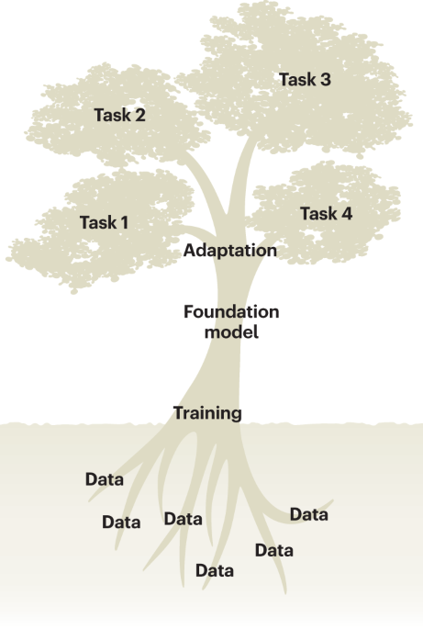
PyTorch & Hugging Face Platform
Ikram Ullah, Staff Scientist
Image taken from – Tang, Lin. "Large models for genomics." Nature Methods 20.12 (2023): 1868-1868.

Slide 2

Agenda
Tensors in PyTorch
Neural Networks: A Quick recap
Core components of Hugging Face Platform
Hugging Face API examples
DNA Sequence Analysis: Minimalistic code walkthrough
UMAP visualization of the pretrained scGPT cell embeddings (emb; a random 10% subset), colored by major cell types
Cui, Haotian, et al. "scGPT: toward building a foundation model for single-cell multi-omics using generative AI." Nature Methods 21.8 (2024): 1470-1480.

Slide 3
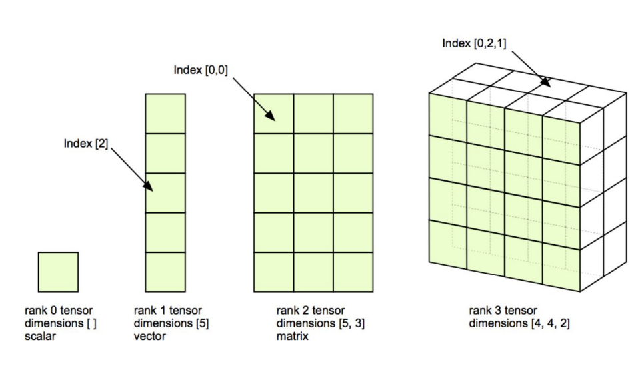
Tensors
A tensor is the fundamental data structure in PyTorch
Multi-dimensional array,
Similar to NumPy’s ndarray but with:
GPU acceleration
Automatic differentiation
In genomic context, it is used to represent
DNA sequences (one-hot encoded)
Expression profiles
Model weights and activations
Dim | Type | Example
0D | Scalar | torch.tensor(3.14)
1D | Vector | DNA sequence → [1,4,3,3,1,5,4]
2D | Matrix | Batch of sequences
3D+ | High-rank Tensors | batch_size × vocabulary × seq length

Slide 4
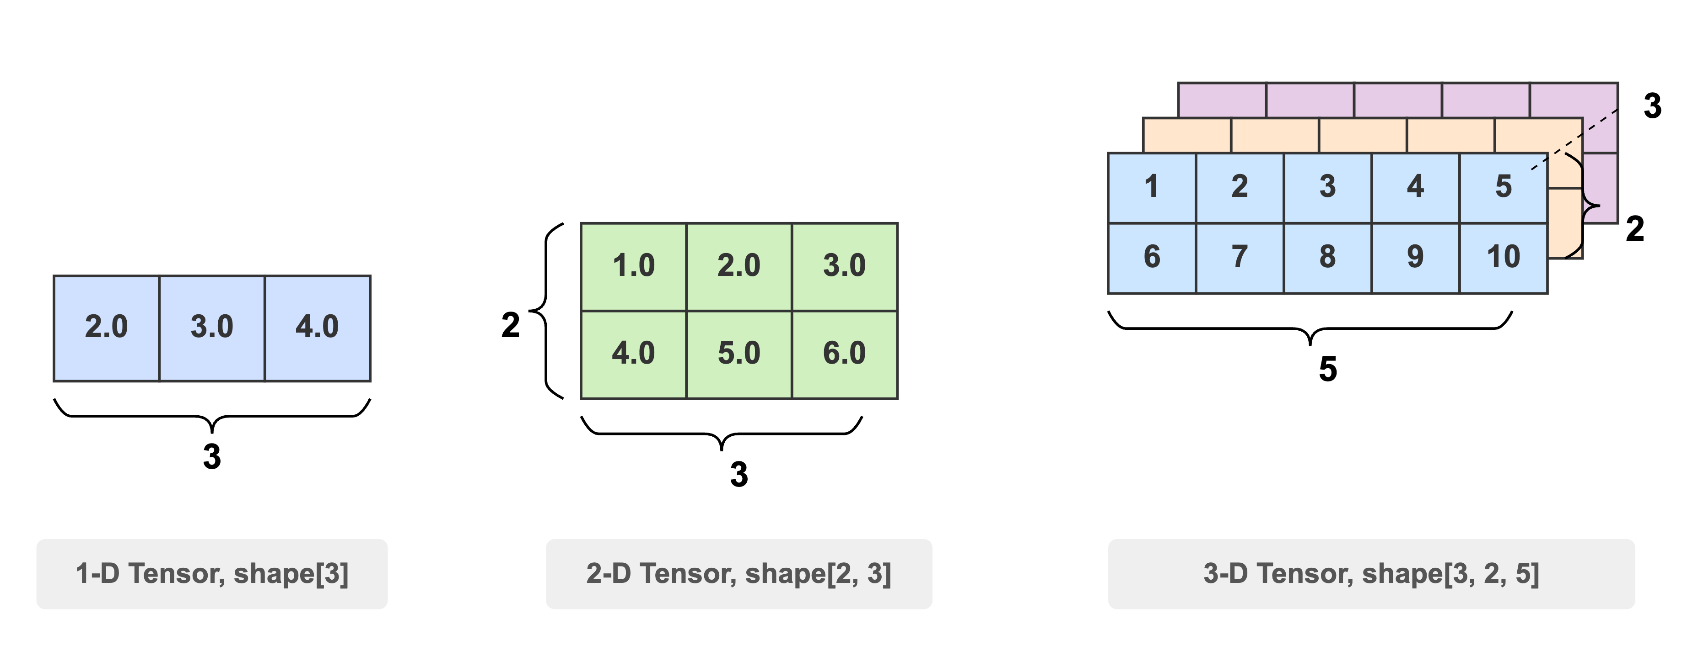
Tensor shapes

Slide 5
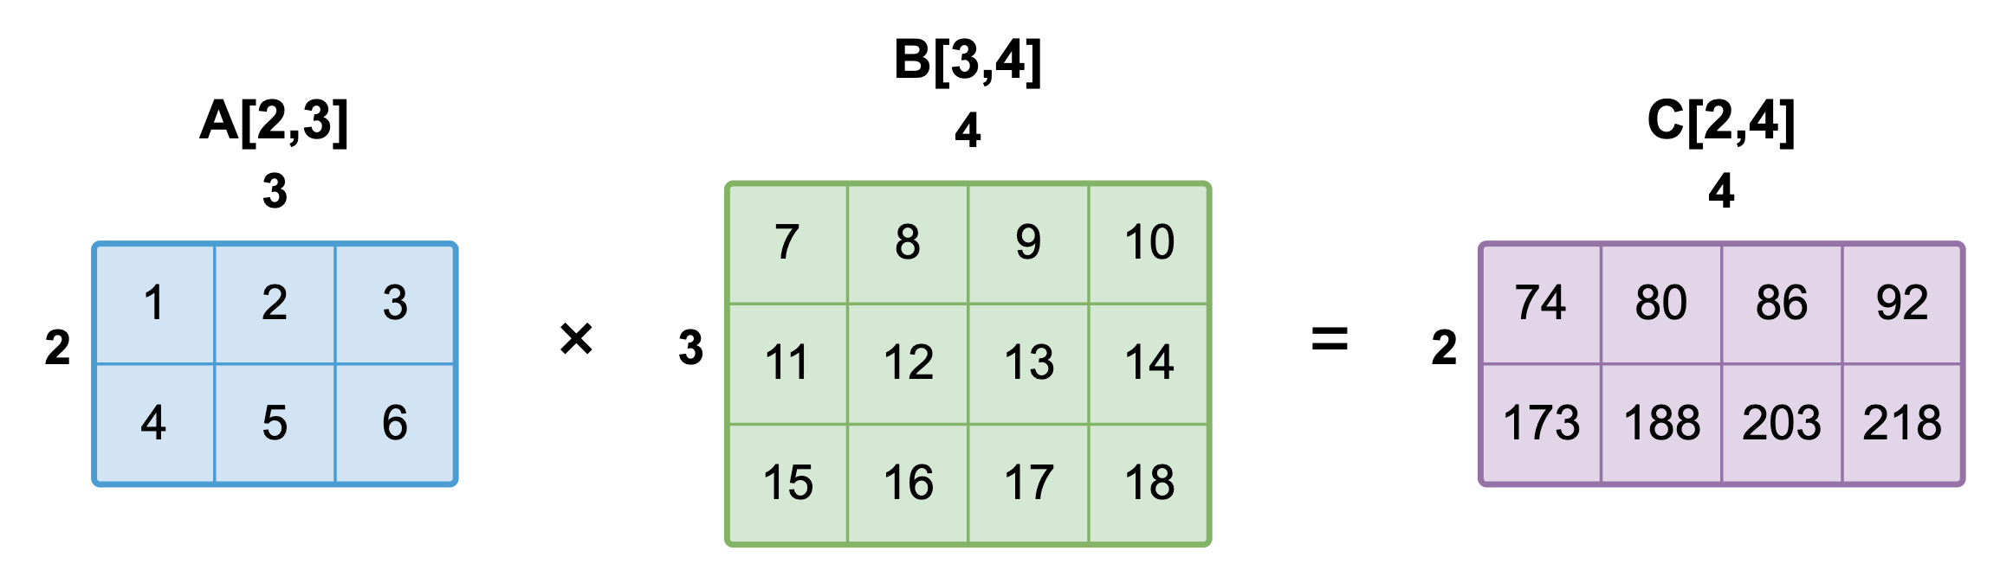
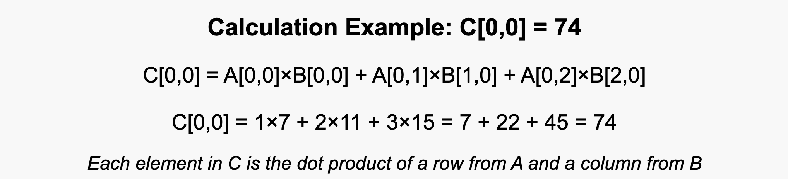
Tensor multiplication: Quick recap
Inner dimensions must match and will be contracted
Outer dimensions remain

Slide 6
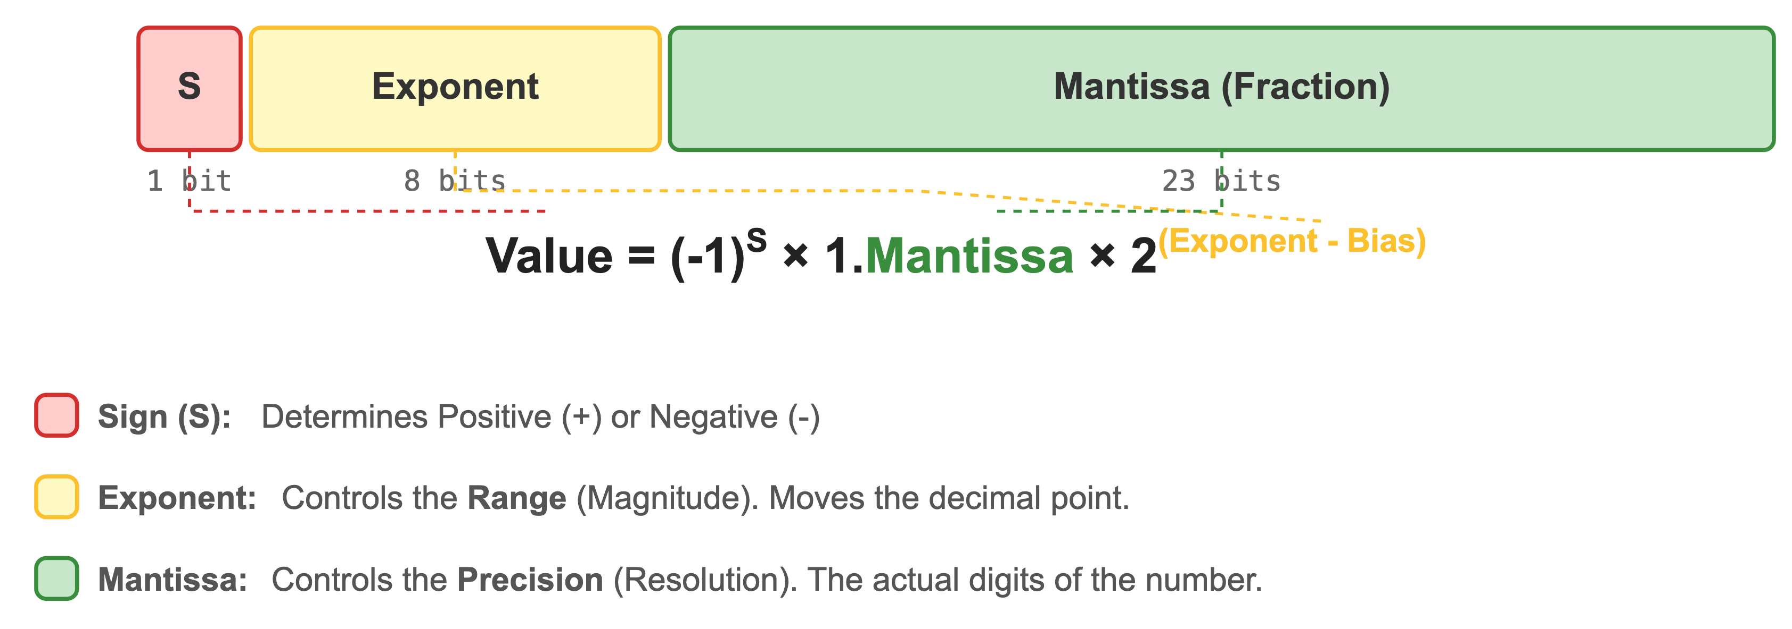
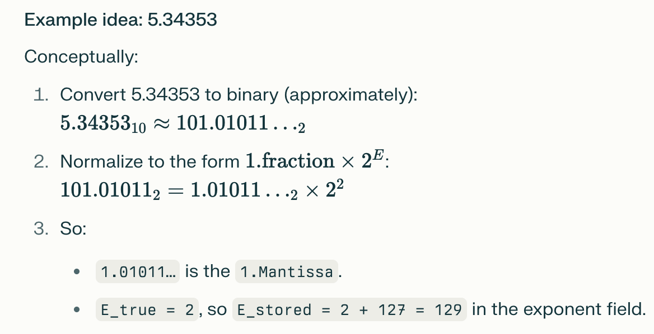
Data Types
Using different data types for model and data will cause errors
Data Type | dtype | Bit Structure
16-bit floating point | torch.float16 | 1 sign + 5 exponent + 10 mantissa
16-bit brain floating point | torch.bfloat16 | 1 sign + 8 exponent + 7 mantissa
32-bit floating point | torch.float32 | 1 sign + 8 exponent + 23 mantissa
8-bit signed integer | torch.int8 | 1 sign + 7 magnitude (two's complement)
Bias is is needed to represent both positive & negative numbers

Slide 7
PyTorch Device Management
By default, tensors are on the CPU
However, you can change this by using the .to() operation
x = x.to(‘cpu’)
x = x.to(‘cuda’)
Training/inference can be slow or infeasible on CPU alone
No need to rewrite model logic, just move the data and model
import torch
# Move tensor to GPU
tensor = tensor.to("cuda")
# Move model to same device
model = model.to(tensor.device)
# Back to CPU
tensor = tensor.to("cpu")

Slide 8
Neural Networks: A Quick recap

Slide 9
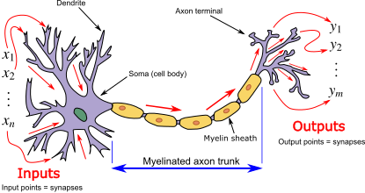
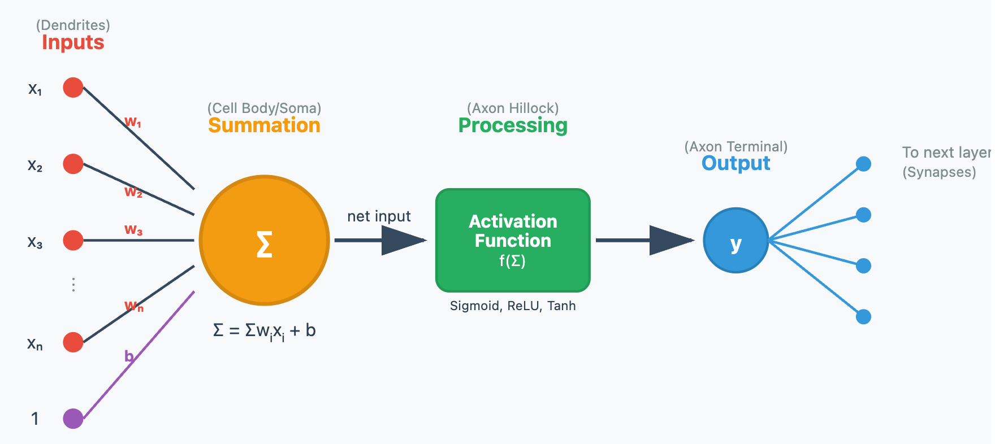
Biological vs Artificial Neuron

Slide 10
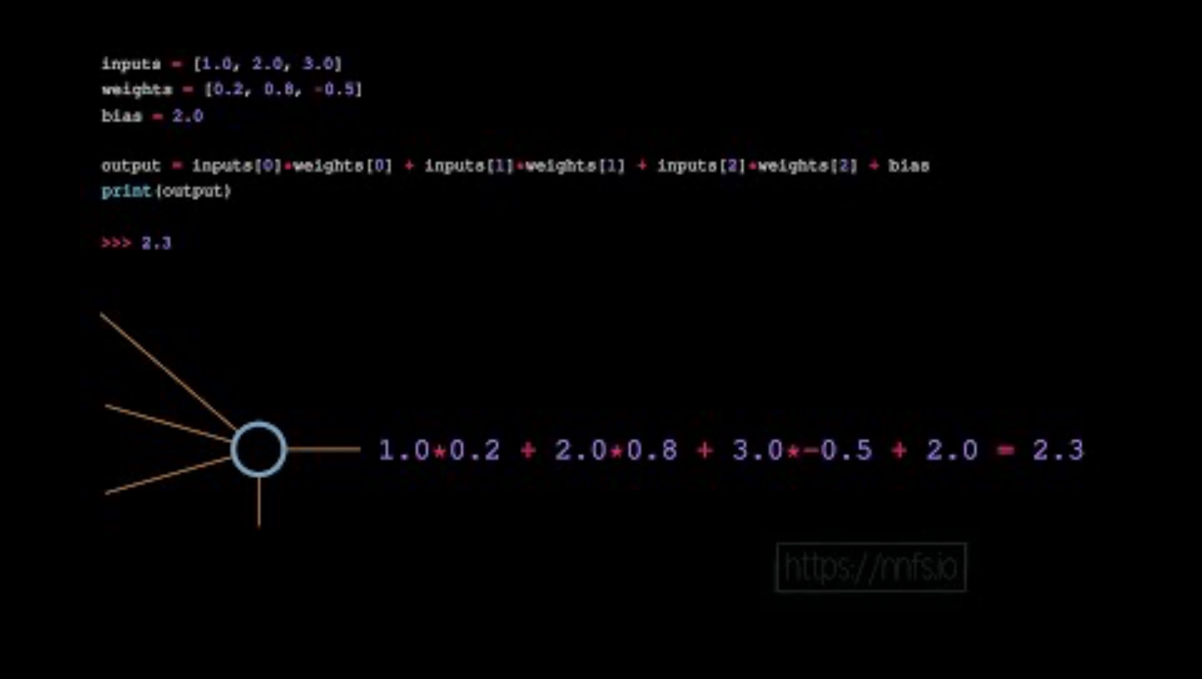
Computation on a single neuron
https://www.youtube.com/watch?v=vbeanwfm0Q4

Slide 11
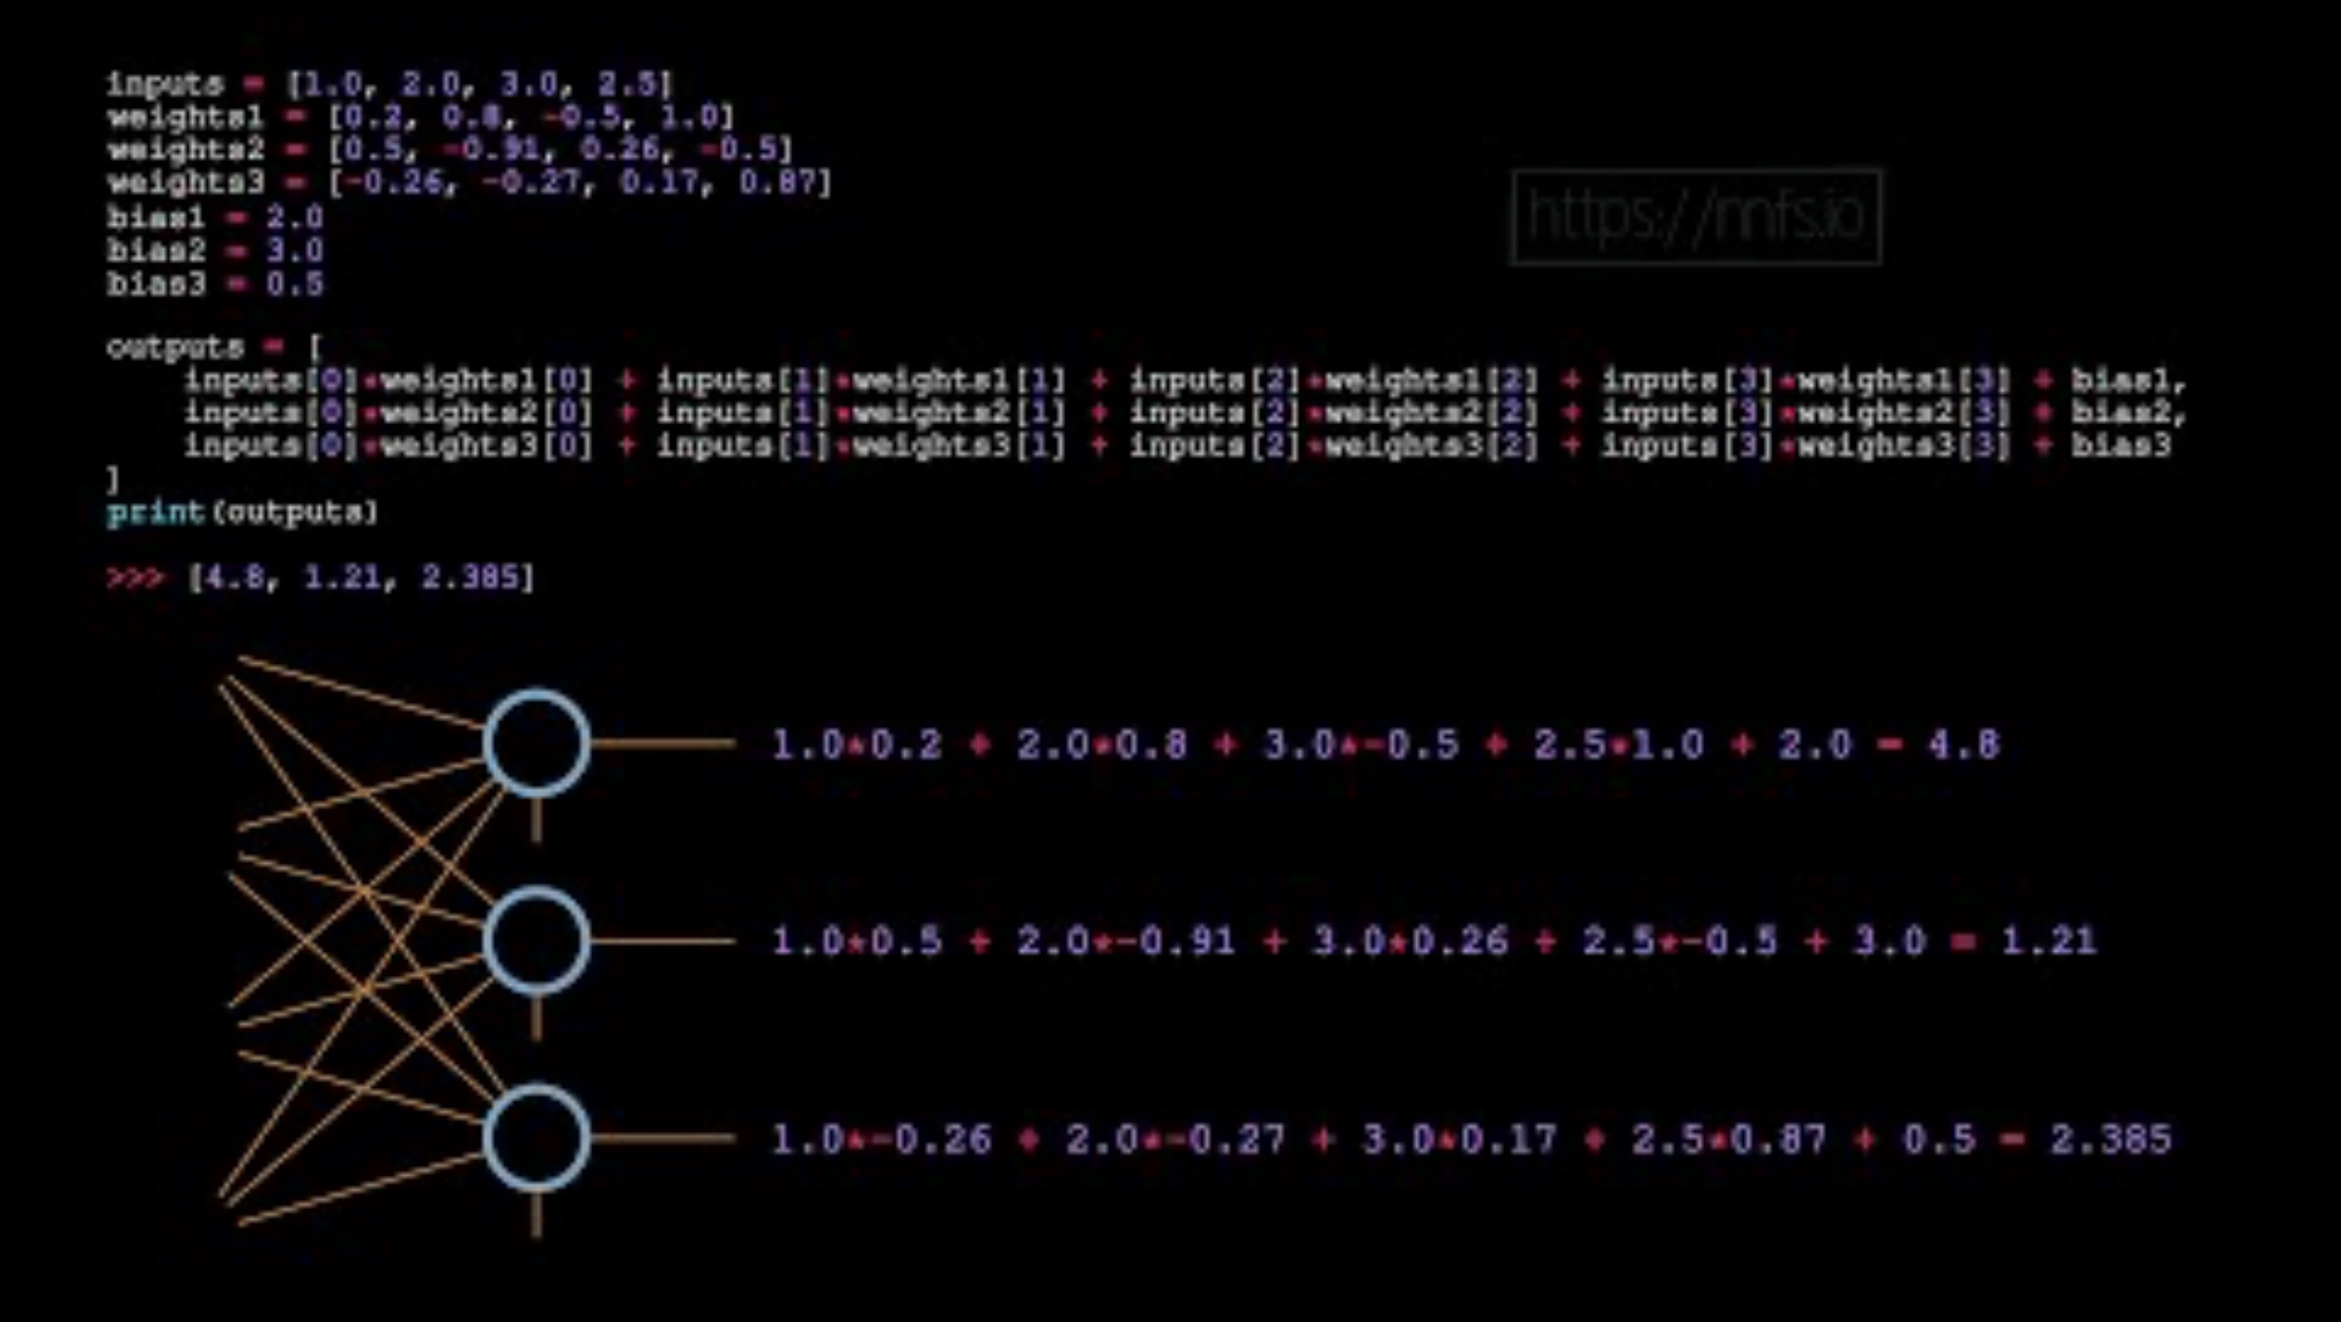
Computation on 3-neuron layer with 4 inputs
https://www.youtube.com/watch?v=Uvngs6sWyBg

Slide 12
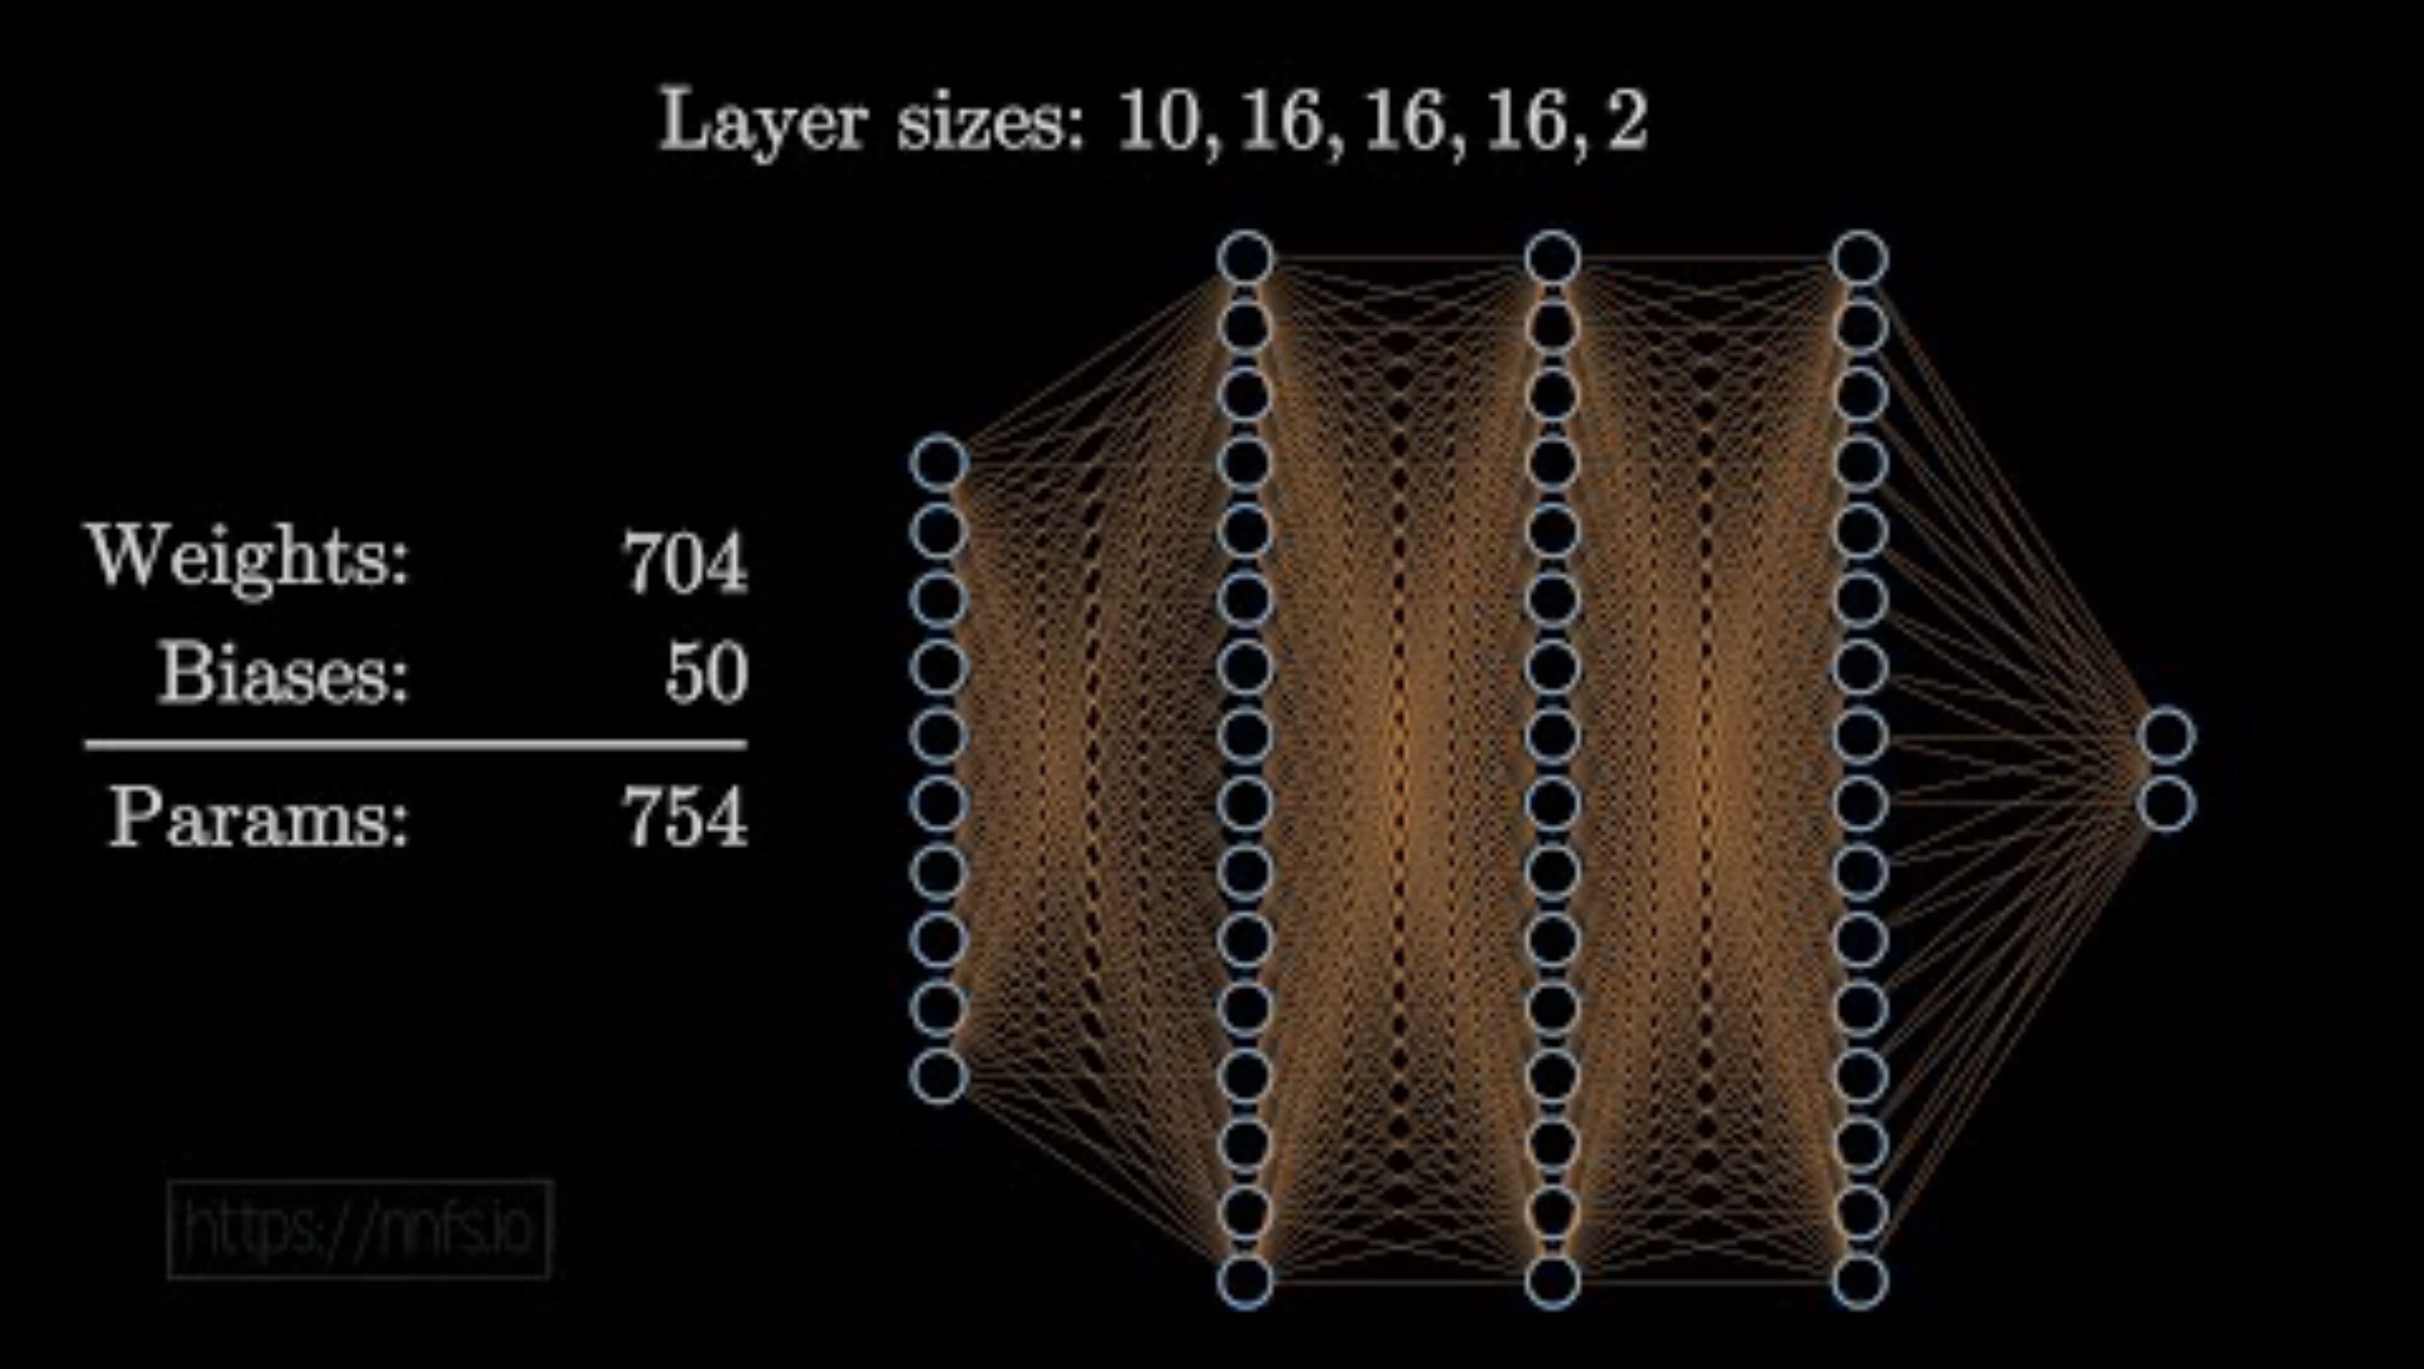
Visualizing Neural Network Sizes
https://www.youtube.com/watch?v=Ls1dJqZtI7w

Slide 13
Neural Network Components
Neural Networks Training
Model
Loss Function
Optimization
Data
Model
Defining the Neural Network
Training Data
Data with Labels
Loss Function
Definition of loss
Optimization
Optimum path to minimize the loss

Slide 14
Data split
The ratio can be use-case specific. Here we show 7:2:1 split
Training Data
Training (70%)
Testing (30%)
Validation (20%)
Testing (10%)

Slide 15
Hugging Face

Slide 16

What is HuggingFace
Hugging Face is an open-source platform for building and sharing AI models including
Foundation model, e.g., zhihan1996/DNABERT-2-117M
Fine-tuned version, e.g., zhangtaolab/dnabert2-promoter
It provides open-source tools and a central hub for pre-trained models, supporting key applications such as sequence classification, variant effect prediction, and regulatory region modeling.
Hugging Face’s Transformers library has been extended to support genomic models like DNABERT and Nucleotide Transformer, with adaptations for domain-specific tokenization (e.g., k-mers) and DNA-based datasets
Notes:
zhangtaolab/dnabert2-promoter: Fine-tuned for predicting active core promoters in plants

Slide 17
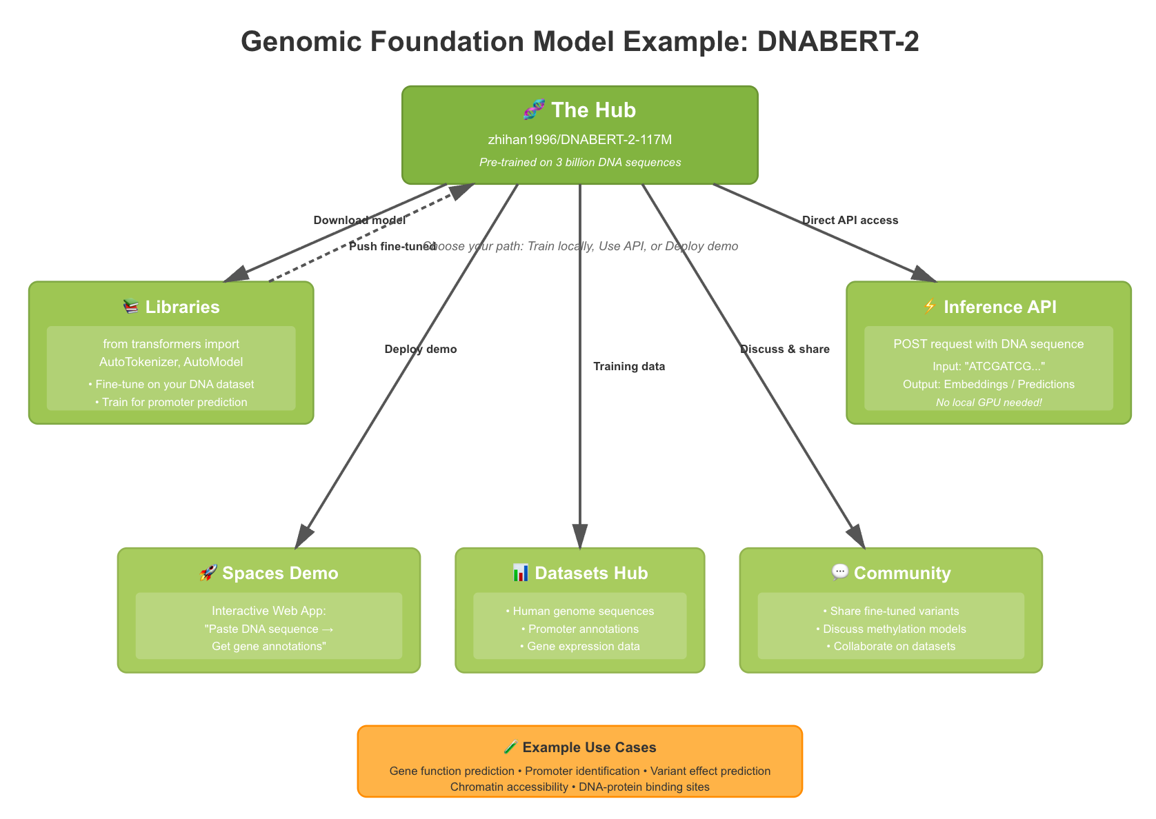
Platform Components
The Hub
Libraries
Inference API
Spaces
Community Features
Central repository for models, datasets, and applications
Transformers, Datasets, Tokenizer, Accelerate etc
Serverless access to models
Platform to build and host interactive demos
Discussions, collaboration tools

Slide 18
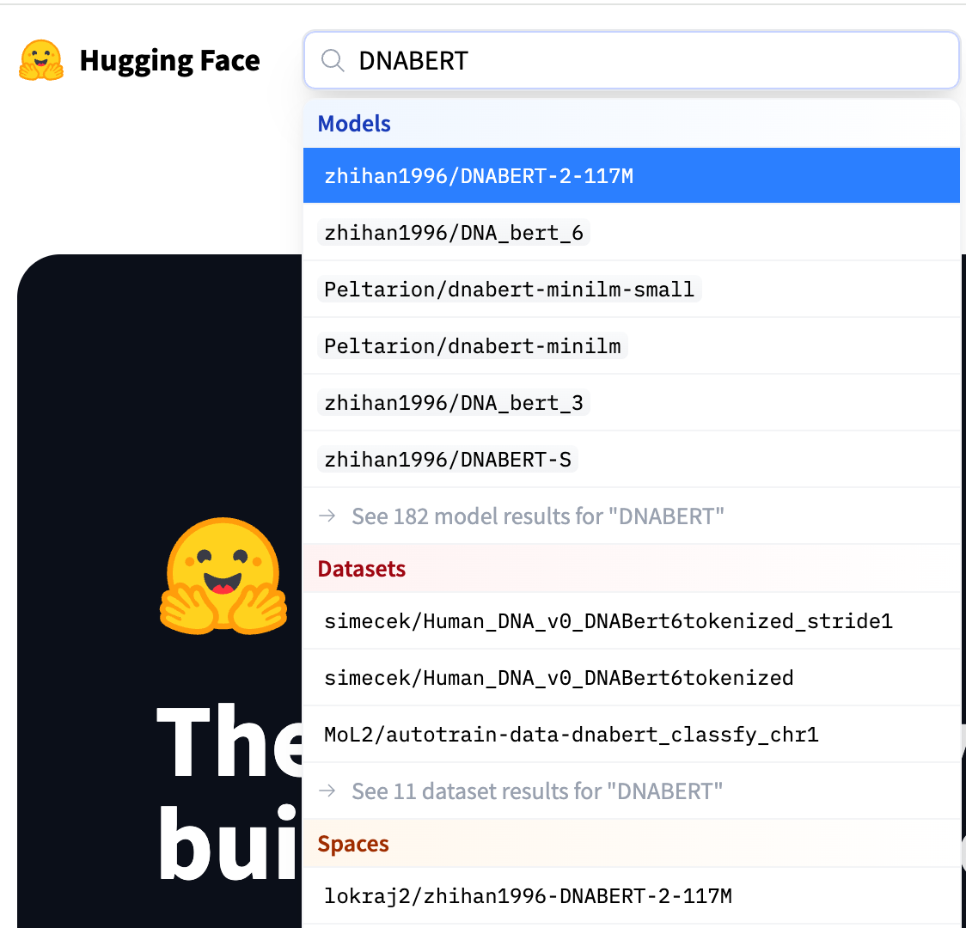
Navigating the Hugging Face Ecosystem
Model Hub
Search for genomic models using tags like "genomics," "biology," or specific model names (e.g., "DNABERT"). Explore model cards for details on training data, intended use, and evaluation metrics.
Datasets
Discover genomic datasets for pre-training or fine-tuning.
Spaces
Find and interact with demos of genomic models.
Documentation
Guides and tutorials accompanying models and other features
Community Forums
Engage with other users, ask questions, and share insights.

Slide 19

Core Components of the Hugging Face Hub
Models
AI models for NLP, computer vision, audio processing, genomics
Model architecture & weights
Datasets
Diverse data collections across domains and modalities
Raw & processed formats optimized for ML
Spaces
Interactive environments for demonstrating models directly in web browsers
No local setup required
Documentation on data collection & pre-processing
Licensing and version control
Documentation describing usecases & limitations
Example code & version history
Customizable User Interfaces for Model Interaction using front-end frameworks like Gradio and Streamlit

Slide 20
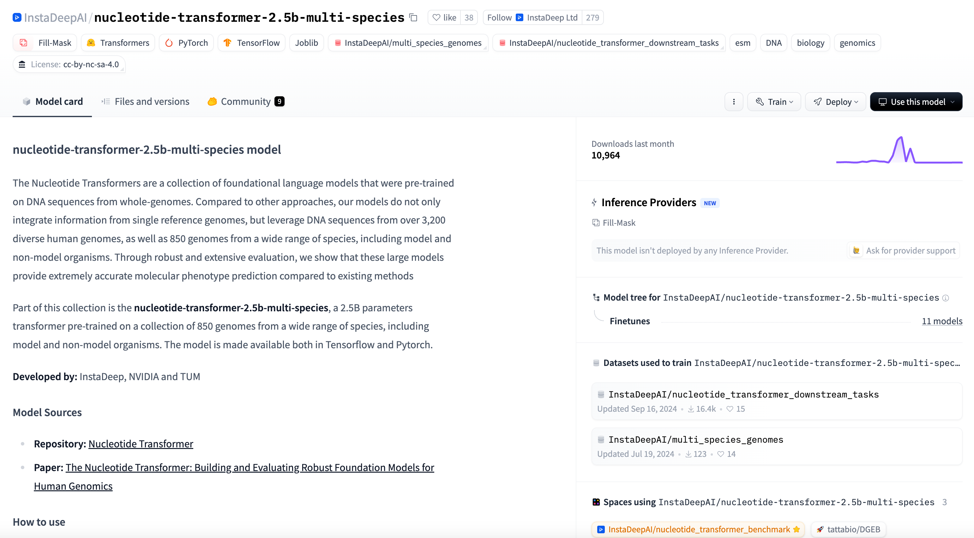
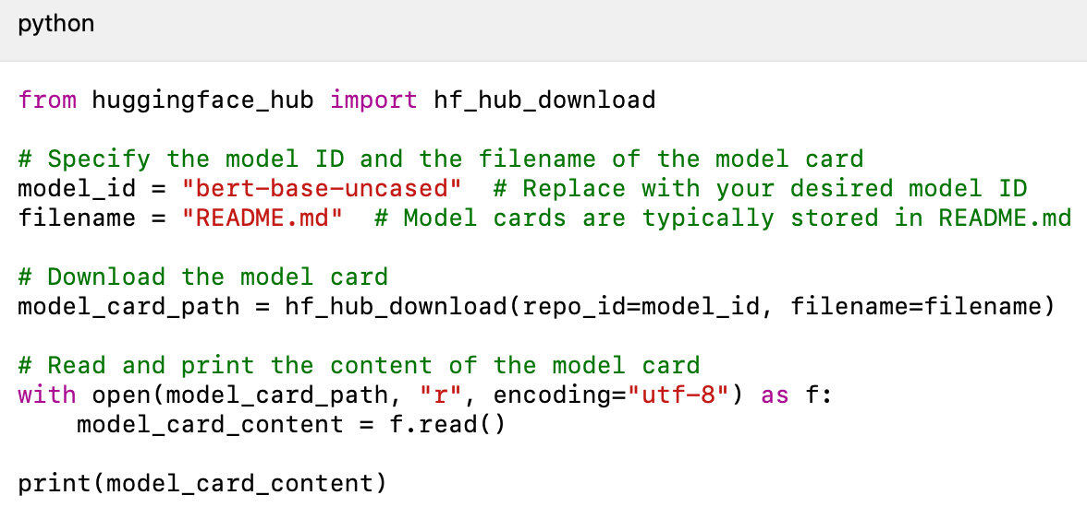
Hugging Face Model Card
A Hugging Face Model Card is a standardized documentation format that provides important details about an AI model’s
Intended use
Training data
Evaluation methods
Ethical considerations
Limitations
Let’s check model card for Nucleotide Transformer model

Slide 21
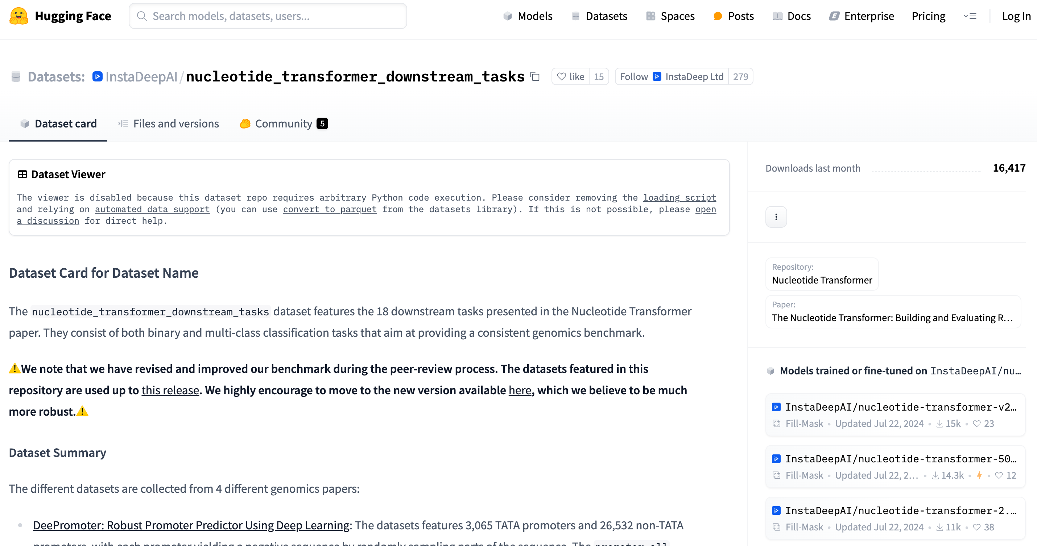
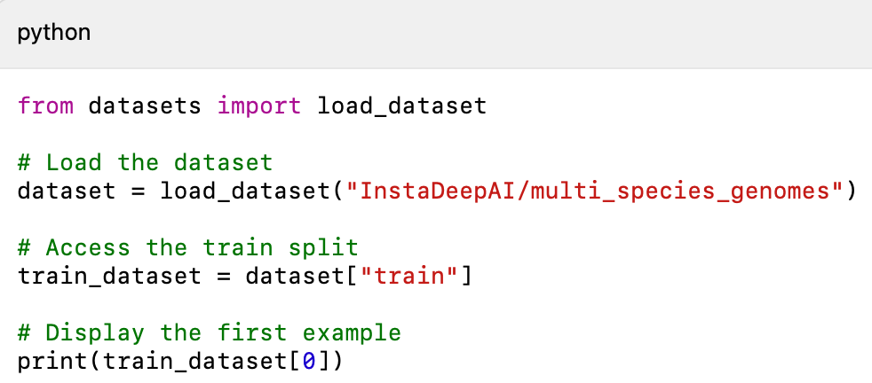
Hugging Face Dataset Card
A Hugging Face Model Card is a standardized documentation format that provides important details about a HuggingFace dataset’s
Purpose, contents, and structure
Data formats, splits, and features
Data collection methods, sources, and processing steps
Intended applications and potential limitations
Known biases or risks associated with the dataset
References for citing the dataset
Let’s check dataset card for genomic downstream task dataset

Slide 22
Hugging Face API
A programmatic interface to access Hugging Face's models and resources
Key Components:
Inference API - For model predictions
Hub API - For interacting with the model repository
Datasets API - For working with datasets
Spaces API - For managing demo applications
Common Use Cases:
1. Research Prototyping
Quickly test models without setup overhead
Experiment with different model architectures
Compare results across multiple models
2. Pipeline Integration
Embed predictions in larger genomic workflows
Chain models for complex analysis tasks
Integrate with existing bioinformatics tools

Slide 23
Inference API Example
import requests
# Step 1: Set your API token (get this from huggingface.co/settings/tokens)
API_TOKEN = "hf_..." # Replace with your token # # Step
2: Define the model endpoint - using Nucleotide Transformer
API_URL = "https://api-inference.huggingface.co/models/InstaDeepAI/nucleotide-transformer-500m-human-ref"
headers = {"Authorization": f"Bearer {API_TOKEN}"}
# Step 3: Define a sample DNA sequence with unknown nucleotides (N) # This is a partial promoter sequence with masked positions dna_sequence = "ACGTGCACGGACTCAGCANNN" print(f"Original sequence: {dna_sequence}")
# Step 4: Create the request payload - replace 'N' with '[MASK]’
masked_sequence = dna_sequence.replace("N", "[MASK]")
payload = {"inputs": masked_sequence}
# Step 5: Make the API call and
response = requests.post(API_URL, headers=headers, json=payload)
results = response.json()
print(results)

Slide 24
Inference API Example
import requests
import os
# Step 1: Set your API token (get this from huggingface.co/settings/tokens)
API_TOKEN = os.getenv('HF_TOKEN') # Replace with your token
# 2: Define the model endpoint - using Nucleotide Transformer
model_id="InstaDeepAI/nucleotide-transformer-500m-human-ref"
API_URL = f"https://router.huggingface.co/hf-inference/models/{model_id}"
headers = {"Authorization": f"Bearer {API_TOKEN}"}
# Step 3: Create the request payload
masked_sequence = "ACGTGCAC<mask>GGACCAGCA"
print(f"Masked sequence: {masked_sequence}")
# Step 4: Make the API call
response = requests.post(API_URL, headers=headers, json=payload)
# Step 5: print top 3 predictions for <mask>
if response.status_code == 200:
results = response.json()
print("\nTop 3 predictions for <mask>:")
for i, pred in enumerate(results[:3]):
print(f" {i+1}. '{pred['token_str']}' ({pred['score']*100:.1f}%)")
Run the example and then answer the following questions
What is kmer size
Based on predicted tokens, do you think NT model uses overlapping or non-overlapping tokens
What was the approx. time to call the inference API

Slide 25
Hub API Example
from huggingface_hub import HfApi, hf_hub_download, list_models
from transformers import AutoTokenizer, AutoModelForMaskedLM
import torch
import pandas as pd
import os
# Step 1: Initialize the Hub API with your token
api = HfApi(token="hf_...") # Replace with your token
# Step 2: Search for genomic models on the Hub
print("Searching for genomic models...")
genomic_models = list(list_models(filter="genomics"))
# Display some basic information about the first 5 models
print(f"Found {len(genomic_models)} genomic models. Here are the first 5:")
for i, model in enumerate(genomic_models[:5]):
print(f"{i+1}. {model.modelId} - {model.downloads:,} downloads")
print(f" Tags: {', '.join(model.tags)}")
print(f" Last modified: {model.lastModified}")
print("-" * 50)

Slide 26
Main steps in Hugging Face model usage
Import required libraries
Load the Pretrained Model and Tokenizer
Prepare your data
Run Inference
Post-process the Output
from transformers import AutoModel, AutoTokenizer
model_name = "your-model-name"
tokenizer = AutoTokenizer.from_pretrained(model_name)
model = AutoModel.from_pretrained(model_name)
inputs = tokenizer(”AGTANNGACTTAC…", return_tensors="pt")
outputs = model(**inputs)
# Extract the last hidden state
last_hidden_state = outputs.last_hidden_state

Slide 27
DNA Sequence Analysis Using HuggingFace
A Code Walkthrough

Slide 28
Open Jupyter notebook

Slide 29
DNA Sequence Analysis with Transformer Models: Code Walkthrough
from transformers import AutoTokenizer, AutoModelForMaskedLM
import torch
import pandas as pd
# 1. Load a popular genomic foundation model: Nucleotide Transformer
print("Loading Nucleotide Transformer model...")
model_name = "InstaDeepAI/nucleotide-transformer-500m-human-ref"
# 500M parameter version # Load tokenizer and model tokenizer = AutoTokenizer.from_pretrained(model_name)
model = AutoModelForMaskedLM.from_pretrained(model_name)
# 2. Display basic model information
print("\nBasic Model Information:")
print(f"Model name: {model_name}")
print(f"Model type: {model.__class__.__name__}")
print(f"Number of parameters: {sum(p.numel() for p in model.parameters()) / 1_000_000:.2f} million")
print(f"Number of layers: {model.config.num_hidden_layers}")
print(f"Hidden size: {model.config.hidden_size}")
print(f"Vocabulary size: {model.config.vocab_size}")
print(f"Maximum sequence length: {model.config.max_position_embeddings}")
# 3. Explore the tokenizer vocabulary
print("\nTokenizer Information:")
print(f"Tokenizer type: {tokenizer.__class__.__name__}")
print(f"Vocabulary size: {len(tokenizer.vocab)}")
print(f"Mask token: {tokenizer.mask_token}")
print(f"Special tokens: {tokenizer.all_special_tokens}")

Slide 30
Questions & Comments

Slide 31
