Slide 1
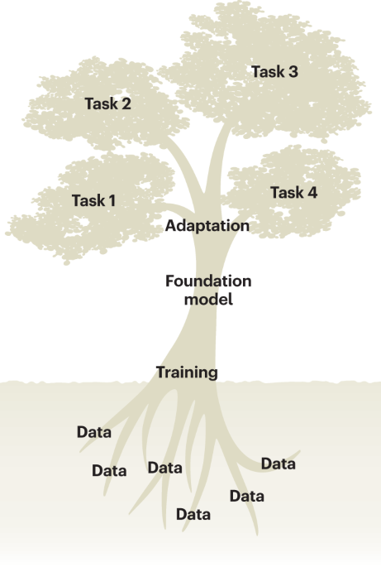
GFM in Practice: Matching Models to Research Goals
Ikram Ullah, Staff Scientist
Image taken from – Tang, Lin. "Large models for genomics." Nature Methods 20.12 (2023): 1868-1868.

Slide 2

Agenda
Framing the genomic problem
Model selection criteria
Data preparation & tokenization
Fine-tuning workflow (Hugging Face)
Evaluation & best practices
Case studies (Human & Microbial)
UMAP visualization of the pretrained scGPT cell embeddings (emb; a random 10% subset), colored by major cell types
Cui, Haotian, et al. "scGPT: toward building a foundation model for single-cell multi-omics using generative AI." Nature Methods 21.8 (2024): 1470-1480.

Slide 3
What’s Special with Using GFMs?
Pretraining Benefits
Captures biological syntax. Transfer learning for downstream tasks
Task Versatility
Same pretrained model can be used for classification, regression, sequence generation
Data Efficiency
Strong performance with limited labeled data
Key Takeaway: GFMs accelerate genomic tasks learning by leveraging large-scale pretraining

Slide 4
Framing Your Genomic Problem for Finetuning
Task
Species Classification
Taxonomic Classification
Input
Raw DNA
Annotated variants (e.g., exon, intron)
Regulatory element prediction
Sequence Design (e.g., promotors, novel peptides)
Kmers
Output
Label (e.g., Promoter, not promoter, taxonomy)
Continuous Score (e.g., gene expression values)
Generated sequences

Slide 5
Criteria for Selecting a GFM
Species Domain
Human/Mouse, Plant, Microbial, non-model organism
Model Architecture & Size
Small (10–100 M) for quick fine-tuning vs. large (100 M– few B) for generation
Tokenization Scheme
Training Corpus
Single Species, Multispecies
k-mers (fixed-length) vs. BPE vs. variant-aware tokens
Accessibility, Licensing, Deployment aspects
Hugging Face availability, MIT/Apache-2.0 licenses, Deployment complexity
Key Takeaway: Align model choice with species, compute resources, and task complexity

Slide 6
Data Preparation & Cleaning
Sequence Retrieval
Quality Control
Length Handling
FASTA, BED, GenBank
Remove Ns, trim low-quality ends
Padding/truncation to model’s max context
Sliding windows for longer contigs
Class Balance
Oversample or weight classes for imbalanced labels
Key Takeaway: Preprocessing bridges raw sequences to model inputs

Slide 7
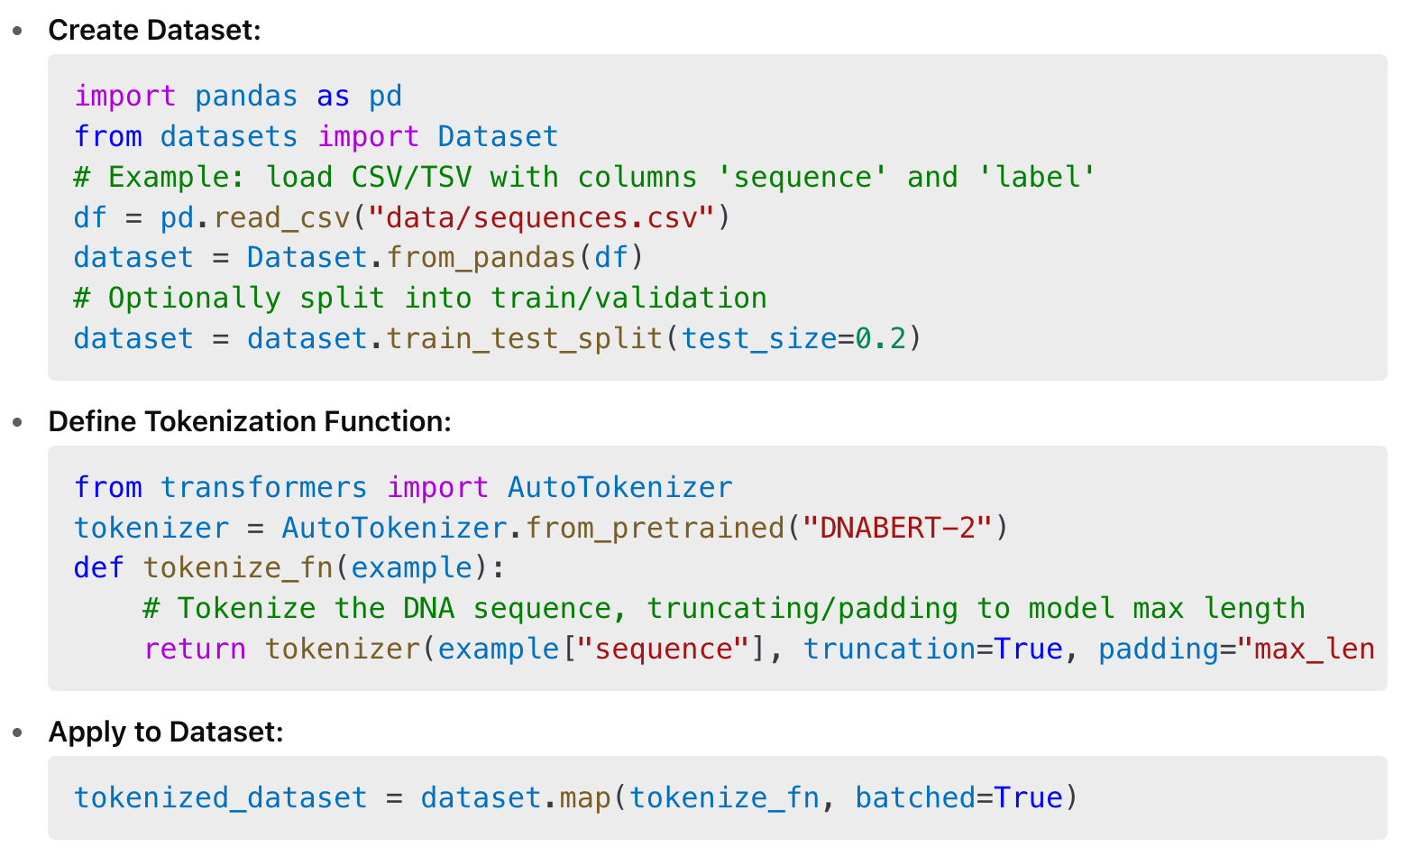
Dataset Assembly
Dataset creation
Convert from sequence format to Hugging Face Dataset format
Hugging Face Dataset with fields input_ids, attention_mask, labels
Collation
Use DataCollatorWithPadding to batch variable-length inputs
Tip
Precompute tokenization if training speed is critical
Notes:
Why DataCollatorWithPadding Is Better
Pads only to the longest sequence in each batch, not the whole dataset
Reduces average padding length dramatically
Saves compute/memory and speeds up training
Ensures padding is applied consistently and correctly (with attention masks)

Slide 8
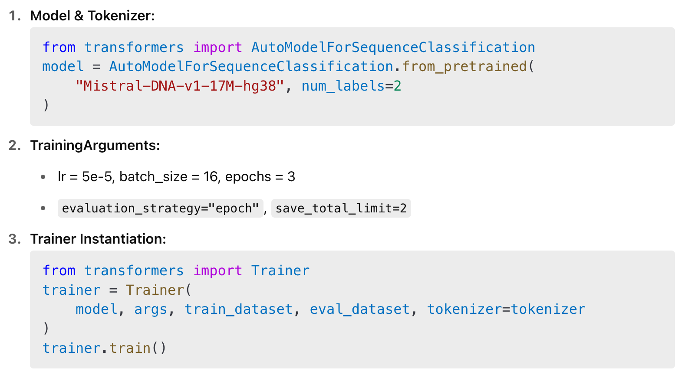
Fine-Tuning Workflow (Hugging Face)
Tokenization
Convert DNA to tokens taking care of truncation and padding as per model max allowed length
Load selected model with weights
This will be pretrained on data from your species of interest
Add classification/regression head
Setup training
Define main training arguments like batch size, learning rate, number of epochs, stopping criteria etc
Optimize training for large models (>100M)
LoRA (via Hugging Face library) allows updating only a small subset of parameters, saving memory and compute

Slide 9

Evaluation & Validation Best Practices
Hold-Out & Cross-Validation
Ensure no overlap of genomic windows
Metrics:
Classification: accuracy, precision/recall, ROC-AUC
Regression: SSE, RMSE, R²
Generation: perplexity, BLAST similarity
Biological Sanity Checks:
BLAST generated sequences against GenBank
Attention maps to highlight important motifs
Key Takeaway: Combine ML metrics with biological validation

Slide 10
Hands on using Human and Microbial Use Cases

Slide 11
Questions & Comments

