Slide 1
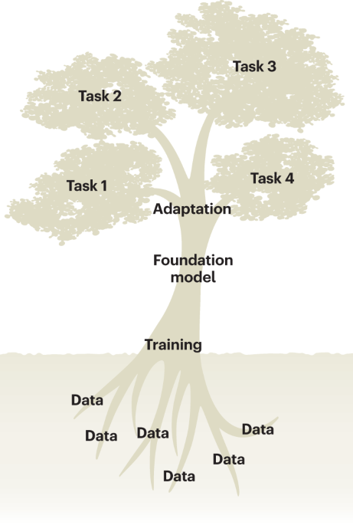
Fine-Tuning Genomic Foundation Models
Ikram Ullah, Staff Scientist
Image taken from – Tang, Lin. "Large models for genomics." Nature Methods 20.12 (2023): 1868-1868.

Slide 2
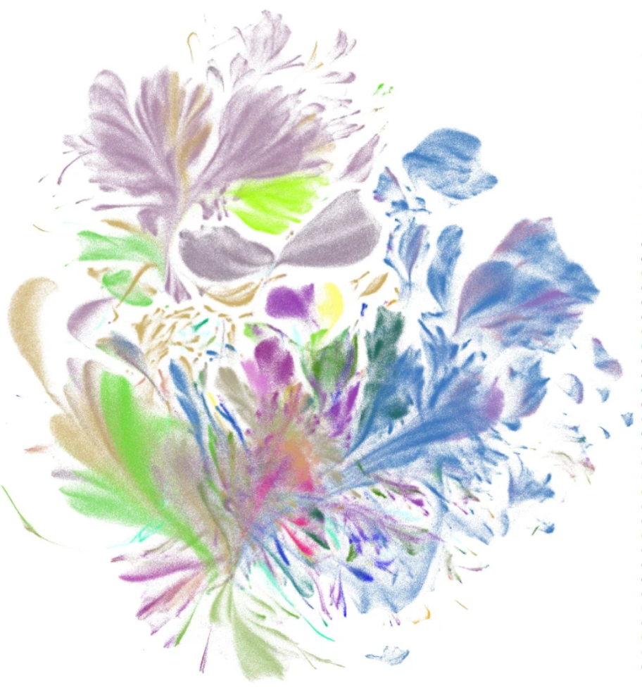
Agenda
Why Fine-Tuning? The Transfer Learning Paradigm
Overview of Fine-Tuning Pipeline
Full Fine-Tuning vs. Parameter-Efficient Fine-Tuning (PEFT)
LoRA: Low-Rank Adaptation
Practical Lab (Transcription Factor Binding Prediction)
Introduction to Pre-Training & Fine-Tuning
UMAP visualization of the pretrained scGPT cell embeddings (emb; a random 10% subset), colored by major cell types
Cui, Haotian, et al. "scGPT: toward building a foundation model for single-cell multi-omics using generative AI." Nature Methods 21.8 (2024): 1470-1480.

Slide 3
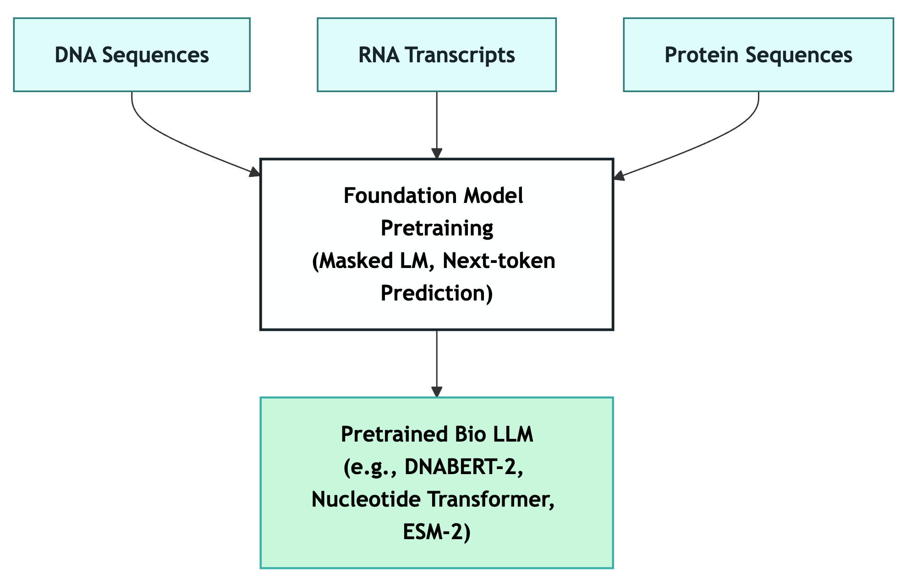
What is Pre-training?
Building General Knowledge
Training on massive unlabeled genomic data to learn patterns
Key Points:
Huge datasets (billions of sequences)
Self-supervised learning
General patterns learned
Compute-intensive (days/weeks on GPUs)
Foundation model as output
Examples
DNABERT pre-trained on Human DNA
NT-v2-500m-multi-species pre-trained on a collection of 850 genomes from a wide range of species, including model and non-model organisms

Slide 4
Quick Check: Pre-training
Which of the following is a realistic example of a pre-trained genomic foundation model?​
A model trained only on pathogenic variants for a single disease
A model trained on DNA sequences from Mouse genome
A model trained on one ChIP-seq experiment
A logistic regression on GC-content and motif scores
Answer: B.
A model trained on whole Mouse genome sequences

Slide 5
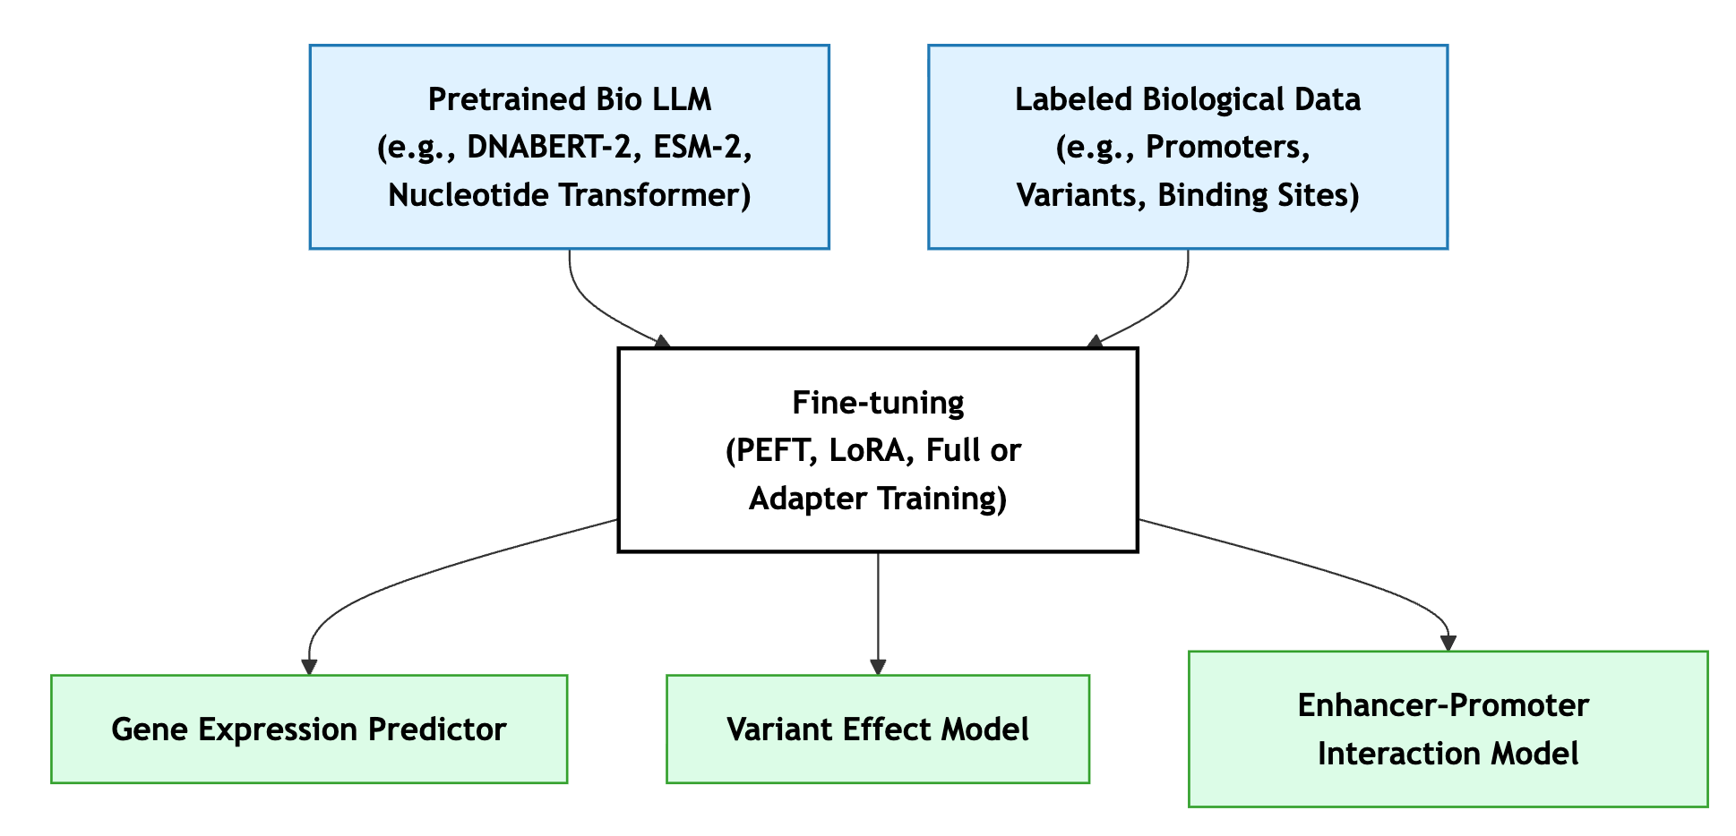
What is Fine-tuning?
Specialization for Your Task
Adapt a pre-trained model to specific tasks using labeled data.
Key Points:
Small datasets (thousands/tens-of-thousand of sequences)
Labels required
Adapts knowledge to your problem
Faster & cheaper compared to pretraining
Task-specific output
Example:
Use pathogenic variants to identify disease mutations
Understanding gene regulation
Synthetic element design

Slide 6
Quick Check: Fine-tuning
Which scenario best illustrates a realistic fine-tuning task in biosciences? ​
Pre-training a model on billions of unlabeled genomes
Adapting a pre-trained model using labeled pathogenic vs non‑pathogenic sequences
Training a model only on random DNA fragments without labels
Compressing a model using 4‑bit quantization
Answer: B.
Adapting a pre-trained model using labeled pathogenic vs non‑pathogenic sequences

Slide 7
Pre-training vs Fine-tuning
Aspect | Pre-training | Fine-tuning
Data Size | Multimillions to Billions of sequence (e.g., genomes, proteomes) | Thousands to hundreds of thousands of labeled samples
Data Type | Unlabeled biological sequences (self-supervised tasks) | Labeled data for specific tasks (e.g., promoters, variants, binding sites)
Objective | Learn general biological representations | Adapt representations to a specific prediction task
Time | Weeks to months | Hours to days
Compute & GPUs | Multi-GPU or TPU clusters (e.g., 10–100s of GPUs) | Single or few GPUs (e.g., LoRA on RTX 3090)
Cost Estimate | 1000s to millions $ | Hundreds to thousands of $
Result | Foundation model | Task-adapted (specialized) model
Pretraining builds “biological intelligence,” fine-tuning channels it for specific task

Slide 8
Fine-Tuning: The Transfer Learning Paradigm
Data Efficiency:
Learn More from Less
Requires only a small labeled dataset to specialize for a new biological task.
Compute & Time Efficiency: Faster by Design
Enables rapid iteration and experimentation across many tasks.
Performance Boost: Smarter Starting Point
Achieves strong accuracy and generalization with minimal additional training.
Sustainability & Reusability: Train Once, Use Many Times
Reuses existing foundation models instead of retraining from scratch.

Slide 9
Full Fine-Tuning vs. Parameter-Efficient Fine-Tuning
Finetuning full model can be very compute-heavy and complex
Let’s take examle of DNABERT-2 model (117 Million parameters)
Aspect | Full Fine-Tuning | Parameter-Efficient Fine-Tuning (PEFT)
Parameters Updated | All model 117M parameters | Only a small subset (e.g., LoRA or adapter weights)
GPU Memory Requirement | High | Low
Training Speed | Slow — hours to days | Fast — minutes to a few hours
Risk of Catastrophic Forgetting | High — overwrites pre-trained knowledge | Low — base model remains frozen
Flexibility / Adaptability | Full flexibility — can adapt all layers | Moderate — only modifies low-rank or adapter components
Best Suited For | Large institutions or foundational model creators | Research labs and applied task fine-tuning
Notes:
GPU Memory Requirement Very high (≈30 GB or more) Low (≈4× less)

Slide 10
Quick Check: Full Fine-Tuning vs PEFT
What is a key difference between full fine-tuning and parameter-efficient fine-tuning (PEFT)?​
Full fine-tuning requires no labeled data, whereas PEFT does
Full fine-tuning updates all model parameters; PEFT updates only a small subset
PEFT always increases GPU memory usage compared to full fine-tuning
PEFT discards the pre-trained weights entirely
Answer: B.
Full fine-tuning updates all model parameters; PEFT updates only a small subset

Slide 11
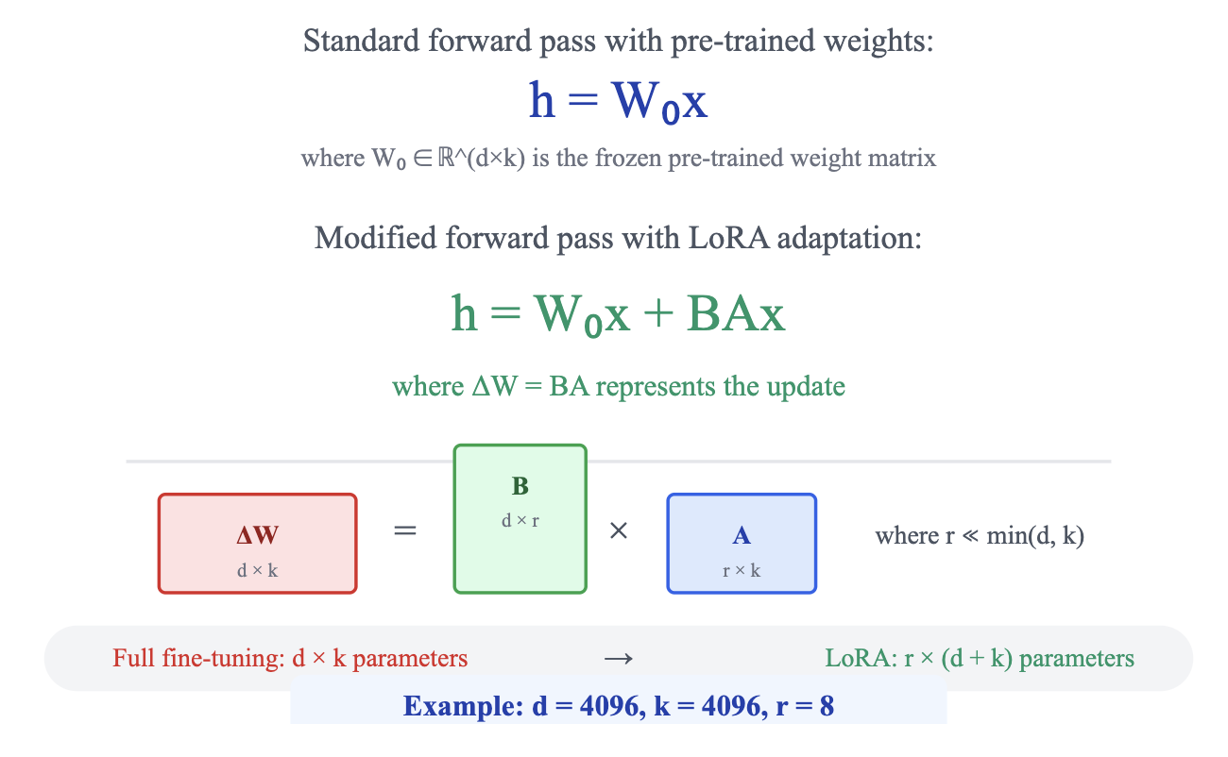
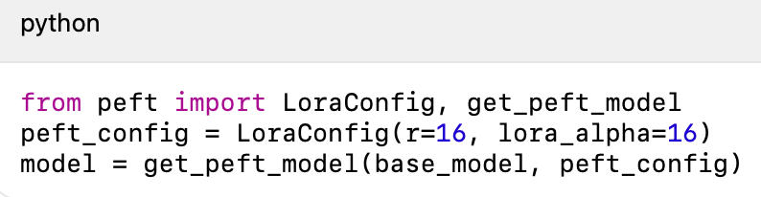
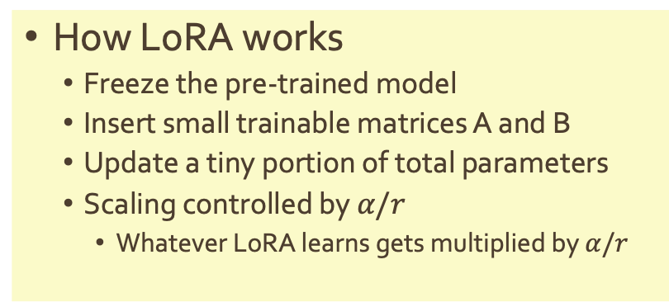
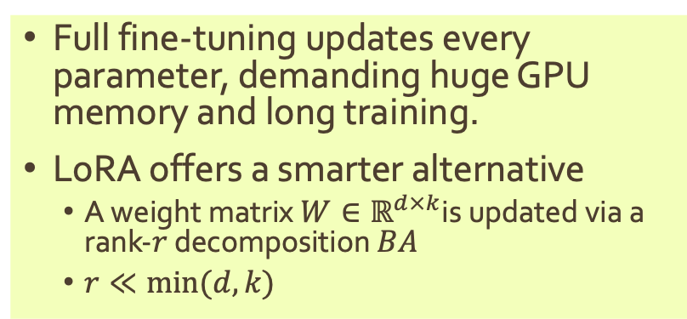
Low-Rank Adaptation (LoRA): Smart Parameter Updates
Full fine-tuning updates every parameter, demanding huge GPU memory and long training.
LoRA offers a smarter alternative
A weight matrix $W∈ℝ^{d×k}$is updated via a rank-$r$ decomposition $BA$
$r≪min⁡(d,k)$
How LoRA works
Freeze the pre-trained model
Insert small trainable matrices A and B
Update a tiny portion of total parameters
Scaling controlled by $α​/r$
Whatever LoRA learns gets multiplied by $α​/r$

Slide 12
LoRA Details
Parameter Saving Calculations
Full fine-tuning: $d × k$parameters to update
Full fine-tuning: 𝑑 × 𝑘 parameters to update
Where LoRA is added usually
Cheap + strong baseline: LoRA on Q and V
Stronger: LoRA on Q, K, V, O
LoRA:$r × (d + k)$parameters to update
LoRA: 𝑟 × (𝑑 + 𝑘) parameters to update
$$d = 4096, k = 4096, r = 8$$
𝑑 = 4096, 𝑘 = 4096, 𝑟 = 8
Full fine-tuning$: 4096 × 4096 = 16,777,216 (16.7 M)$parameters
Full fine-tuning: 4096 × 4096 = 16,777,216 (16.7 𝑀) parameters
LoRA$: 8 × (4096 + 4096) = 8 × 8192 = 65,536 (65.5 K)$parameters
LoRA: 8 × (4096 + 4096) = 8 × 8192 = 65,536 (65.5 𝐾) parameters
Reduction factor: $16,777,216 / 65,536 = 256×$fewer trainable parameters
Reduction factor: 16,777,216 / 65,536 = 256× fewer trainable parameters
%age reduction:$99.6\%$fewer parameters to train
%age reduction: 99.6% fewer parameters to train
Even stronger: LoRA on attention + MLP projections
The output head is also trained
Base model weights (all original Transformer weights) are frozen

Slide 13
Quantization + LoRA → QLoRA
Even LoRA models can be large → compress the frozen base further.
Quantization:
~50% memory reduction when moving from fp16 → 8-bit
~75% reduction from fp16 → 4-bit
Accuracy largely maintained if quantization is applied correctly
QLoRA = Quantization + LoRA:
Quantize the frozen base → smaller memory footprint
Keep LoRA adapters in higher precision for stability
Enables fine-tuning billion-parameter models on consumer GPUs
LoRA shrinks what you train; quantization shrinks what you load
Together, they achieve up to 4×–8× memory savings with relatively smaller in accuracy loss.

Slide 14
Test your knowledge
You have access to a 2B-parameter DNA foundation model and a single 24GB GPU. You want to test 10 different downstream tasks quickly (promoters, enhancers, splice sites, etc.). Which strategy is most sensible?
Full fine-tuning 10 separate copies of the model
One full fine-tuned model shared across all tasks
Parameter-efficient fine-tuning (e.g., LoRA) with a separate adapter for each task
Training 10 small models from scratch
Answer: C.
Modular adapters and practical lab constraints

Slide 15
Test your knowledge
You apply LoRA only to the Q and V projections in self-attention for a genomic model. Intuitively, what kind of adaptation are you prioritizing?
Changing which tokens attend to which others and how strongly
Changing only the output layer’s bias terms
Modifying the loss function but not the model
Changing tokenization of DNA sequences
Answer: A.
Who attends to whom

Slide 16
Test your knowledge
You use QLoRA to fine-tune a 7B-parameter DNA model on 4‑bit weights and LoRA adapters for variant effect prediction. After training, you observe a small drop in performance on extremely rare variant types.
What is the most plausible explanation?
QLoRA always ignores rare variants by design
LoRA cannot be used for classification tasks
Quantization may have slightly reduced representational precision in edge cases, even if average performance is preserved
4‑bit weights guarantee improved performance on rare events
Answer: C.
Quantization reduces model size but also affects precision

Slide 17
Test your knowledge
You have ChIP-seq peaks for a TF across human and mouse. You want to test whether a multi-species pre-trained model transfers better than a human-only pre-trained model.
Which experiment is best aligned with that question?
Fine-tune both models on mouse only and compare human performance
Fine-tune both models on human only and evaluate on mouse TF binding
Fine-tune both on a mixed human+mouse training set and evaluate on human
Train both from scratch on human and compare
Answer: B.
Does multi-species pretraining help generalize to a different species better than human-only pretraining?

Slide 18

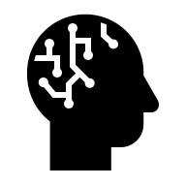
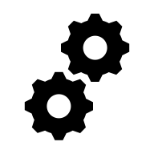


Overview of Fine-Tuning Pipeline
Prepare Dataset
Load Model
Configure Training
Run Training
Evaluate

Slide 19
Prepare Dataset
Get the data
Collect raw biological sequences (e.g., DNA, RNA, or protein) along with task-specific labels such as binding sites, promoters, or variant effects.
Tokenize data
Convert sequences into numerical tokens (e.g., k-mers, BPE, character tokens) so the model can understand and process them efficiently.
Split into Train, Validation and Test set
Divide the dataset to train the model, tune its parameters, and fairly evaluate its performance on unseen examples.
Configure Data Collation
Define how batches are formed during training—padding, truncation, and alignment—to ensure consistent sequence lengths (same for all sequences and efficient GPU use (multiple of 8, 16, 64…)

Slide 20
Load Model
Load pre-trained model
Usually hosted on model hubs (e.g., Hugging Face Hub, GitHub, or lab repositories)
Can also be stored locally or on HPC
Attach PEFT adapters (e.g., LoRA)
Model organization
Architecture – the model’s structure (e.g., transformer layers, attention heads).
Weights / Parameters: Numerical values that capture learned biological relationships.
Tokenizer / Vocabulary: The mapping between biological symbols (A, T, C, G, amino acids) and numerical tokens
Configuration File: Metadata such as model size, layer count, and training setup.

Slide 21
Configure Training
Why configuration matters
Same model + Same data + Different configuration = Totally different outcomes
The Restaurant Analogy
Same ingredients but a change in recipe may drastically change food experience
Bad Configuration
Training: Crashes after 2 days
Memory: OOM errors
Accuracy: 52% (coin flip!)
Cost: $500 wasted
You: "Deep learning is broken!”
Good Configuration
Training: 2 hours done
Memory: 60% utilized
Accuracy: 89% (paper-worthy!)
Cost: $5 total
You: "I'm publishing this!"

Slide 22
Key Training Hyperparameters
Parameter | Description | Typical Value / Range
Learning Rate | Most critical parameter: too high → divergence; too low → no learning. | 1e-5 to 1e-4 (for fine-tuning)
Batch Size | Balances memory usage vs gradient quality. | 8–32 (use gradient accumulation if limited)
Number of Epochs | Number of full passes through the data. | Use early stopping rather than fixed count
Warmup Steps | Gradual lr increase at start to prevent instability. | 5–10% of total steps
Optimizer | Update rule; affects convergence speed and stability. | AdamW (β1=0.9, β2=0.999, ε=1e-8)
Dropout Rate | Randomly zeros activations to regularize; applied to embeddings/attention/MLP. | 0.0–0.2 (often 0.1 in pretrained configs)

Slide 23
Questions & Comments
After Q&A, we will go to hands-on exercise

