Slide 1
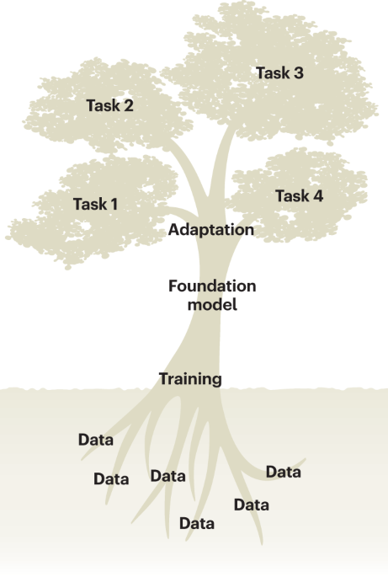
GFM in Practice: Solving biological problems using GFMs
Ikram Ullah, Staff Scientist
Image taken from – Tang, Lin. "Large models for genomics." Nature Methods 20.12 (2023): 1868-1868.

Slide 2
Why This Lecture?
Genomic Foundation Model usage may fail due to misjudgments at different phases
Examples
Mis-specified biological question
Misaligned model choice
Fragile data curation / splitting
Misused tokenizer / preprocessing assumptions
Biologically invalid evaluation
In this lecture, we will go through a suggested workflow to frame a research problem and solve it using a GFM
We will use a running example that we will go through during hands-on session

Slide 3
Suggested Workflow
Translate a biological research question into a GFM task definition
Select an appropriate model and fine-tuning strategy
Prepare and split data in biologically and statistically robust ways
Use the model’s native tokenization + preprocessing correctly
Design experiments with valid metrics and evaluation protocols

Slide 4
Suggested Workflow
Define the biological question
Select the model family & relevant constraints + baselines
Decide on fine-tuning strategy
Select and curate data & splits
Align preprocessing with task & model assumptions
Loop back if needed
Fine-tune, evaluate, interpret
Notes:
Relevant model constraints (tokenizer, max length, alphabet, special tokens)

Slide 5
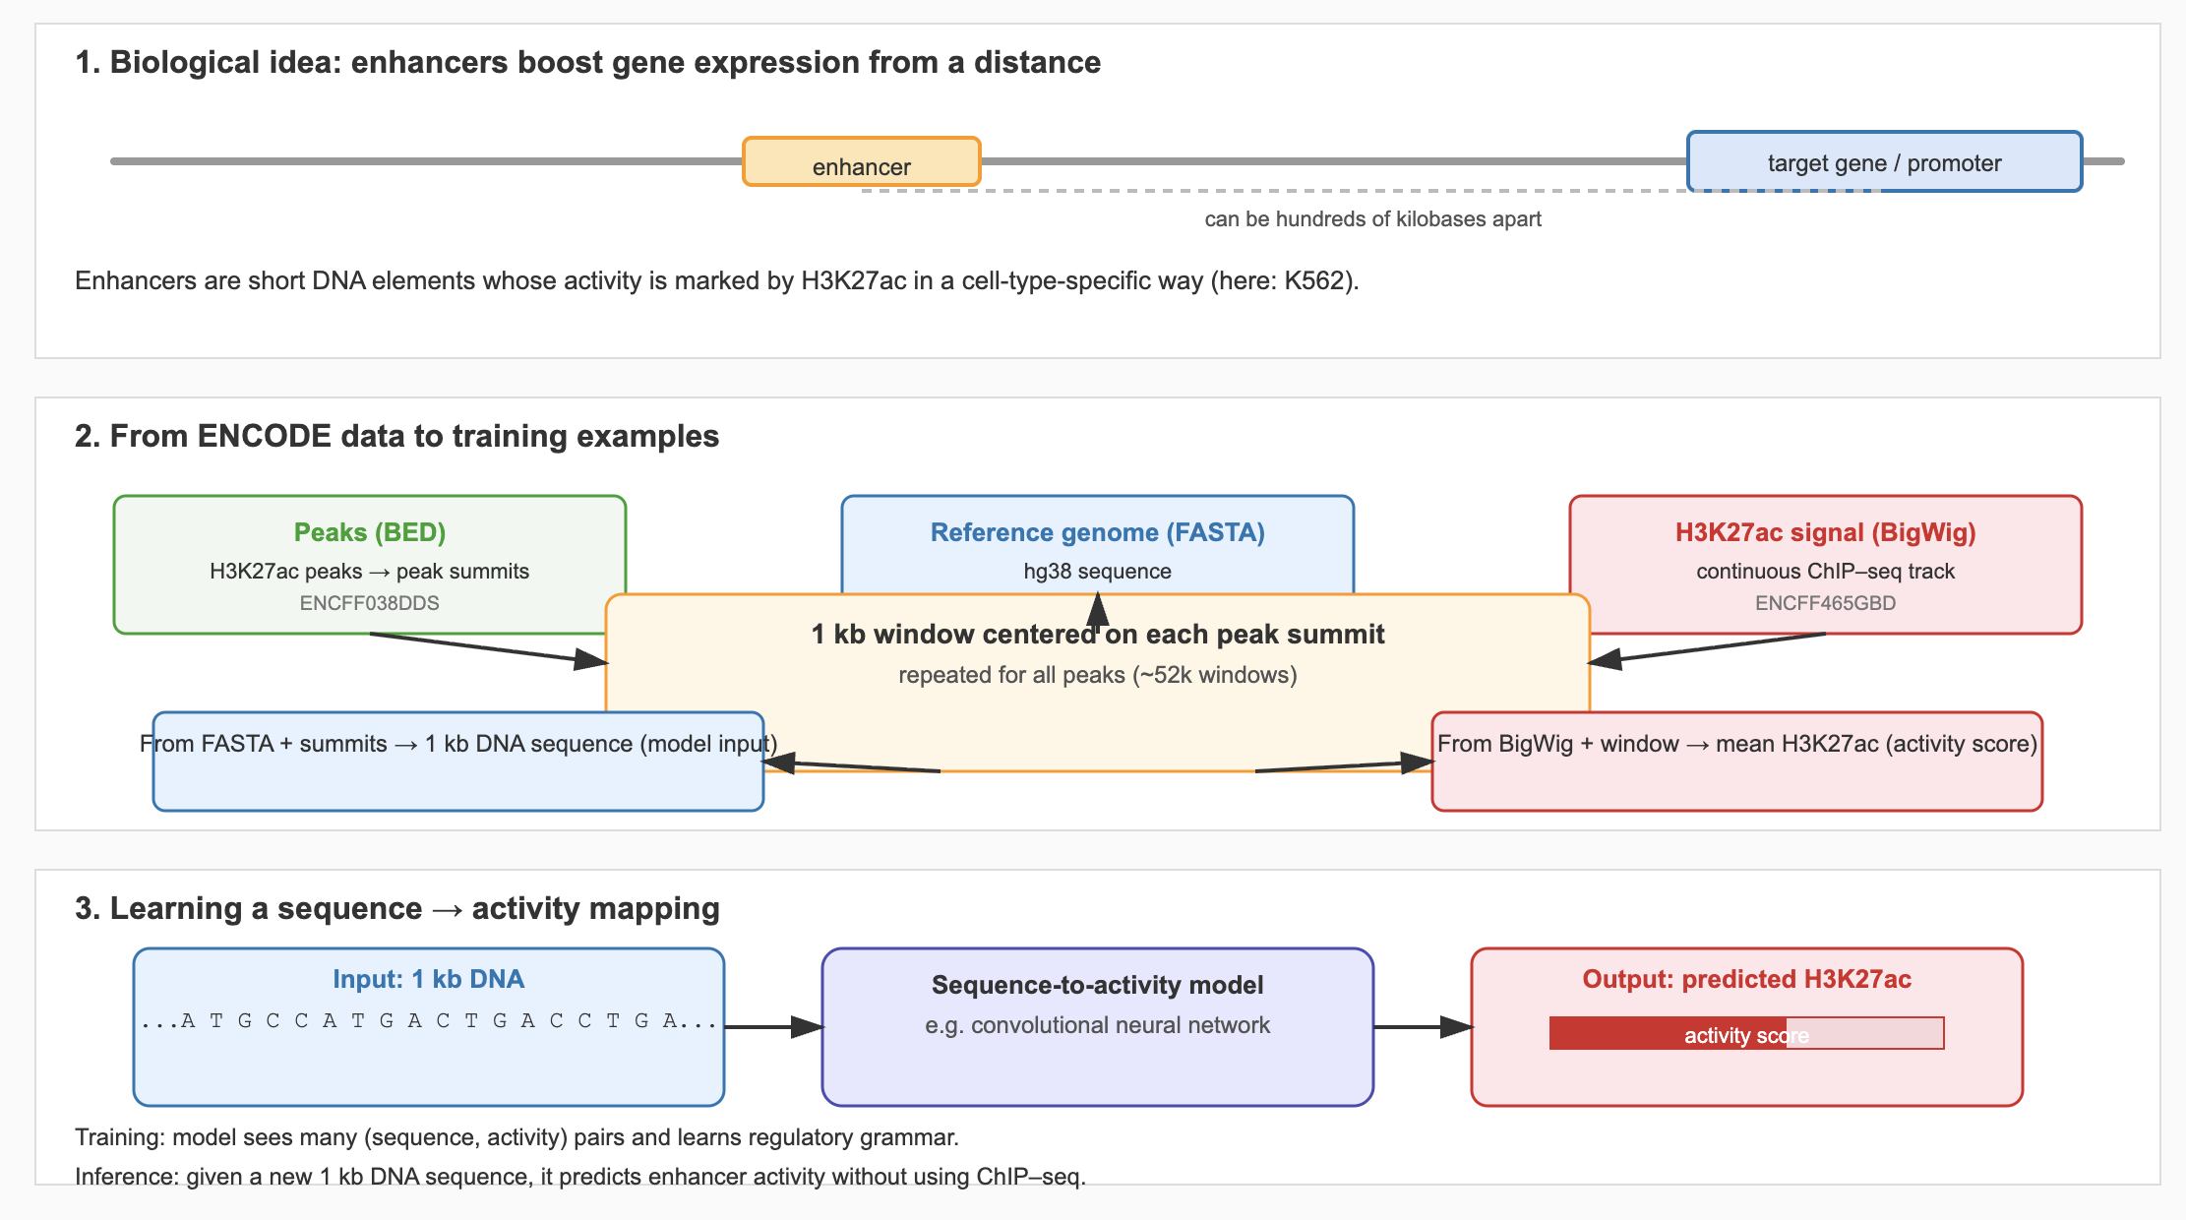
Running Example
Can we predict enhancer activity in K562 cells from DNA sequence alone?
Input: 1 kb DNA sequence windows around candidate enhancers
Output: Continuous enhancer activity signal (from an assay, e.g., H3K27ac)

Slide 6
Step 1: Define the Biological Question
What is the biological object?
DNA, RNA, protein, multiomic?
What is the prediction type?
Classification, regression, generation, ranking, denoising?
What is the resolution?
Locus-level (DNA window, e.g., 500bp/ 1kb, around candidate enhancers)
Genome-wide (scan the genome in sliding windows)
Question | Input | Output
Predict enhancer activity | DNA sequence | Continuous signal
TF binding | DNA sequence | Binary / probability
Protein function | AA sequence | Class / score
Foundation models encode inductive biases — your question must match those biases.

Slide 7
Step 2: Select Model Family
Input modality: DNA / RNA / protein / multi-omics
Architecture: encoder-only, decoder-only, SSM, hybrid (CNN + Transformer)
Pretraining objective: masked LM, autoregressive
Sequence length support & memory footprint
Available baselines: CNNs, simple ML, published benchmarks
Model | Modality | Architecture | Good For
DNABERT | DNA | Encoder-only (BERT) | Motifs, local/regional classification
N. Trans. | DNA | Encoder-only | Broad regulatory / variant tasks
HyenaDNA | DNA | Hyena | Very long sequences, long-range dependencies
Compare your GFM model to a reasonable baseline, not just other FMs.

Slide 8
Architecture → Use Case Mapping
Encoder-only (BERT-like)
Learn contextual representations for downstream tasks
Decoder-only (GPT-like)
Autoregressive generation and likelihood scoring
Hybrid (CNN + Transformer)
Sequence → signal tracks (epigenomics / expression proxies)
Strong for classification/regression with a small task head
Useful for sequence design and long-range dependencies
Designed for genome-wide prediction with long receptive fields
Long-context operators (Hyena)
Efficient modeling of very long DNA sequences (≫10 kb)
Good when regulatory context spans large genomic neighborhoods

Slide 9
Example: Choosing a Model for Our Enhancer Task
Predict enhancer activity in K562 from 1 kb DNA windows.
Nucleotide Transformer + regression head
Strong general-purpose DNA representations, flexible downstream task.
HyenaDNA
Efficiently models very long sequences
Enformer
Designed for sequence-to-signal prediction
Baseline: Small CNN trained from scratch on the same windows.
In the hands-on, we will use NT and HyenaDNA and compare their performance

Slide 10
Verify Model Constraints
With pretrained GFMs, tokenization is usually not a design choice.
It is a constraint inherited from the checkpoint.
You must verify
Tokenizer type: base-level, k-mer, BPE/subword, AA tokens
Alphabet: A/C/G/T/N vs IUPAC ambiguity codes
Max length: truncation, padding conventions
Special tokens: BOS/EOS/CLS/SEP, masking token behavior
Reverse-complement handling: supported, assumed, or absent
If you change tokenization, you are no longer using the pretrained model as intended.
Notes:
IUPAC codes represent these ambiguities with single letters:
Code Meaning Example
R A or G (purine) R at a SNP site
Y C or T (pyrimidine) Y at a methylation site
S G or C S at repetitive regions
W A or T W in enhancer motifs

Slide 11
Example: Constraints for Our Enhancer Task
For 1 kb DNA enhancer windows:
Enformer-like model
Base-level one-hot DNA; fixed input length, context length 393 kb
Nucleotide Transformer
Must use its native PBE like tokenizer, context length is 2-6 kb
HyenaDNA
Uses its base level encoding; context length can be in millions
Your model choice implicitly fixes tokenization, input encoding, and maximum context length

Slide 12
Step 3: Fine-tuning Strategy
Fine-tuning is optional, not mandatory.
Rule-of-thumb (heuristic, not a law)
Approx. labeled dataset size | Typical strategy*
< 1k sequences | Freeze backbone, train head only
1k–50k | Partial fine-tuning (top layers)
50k | Full fine-tuning often beneficial
* Depends on label noise, domain shift, model size, compute budget.
You may overfit by fine-tuning huge backbones on tiny datasets

Slide 13
Fine-Tuning Strategy - [Continued]
Incremental Fine-Tuning strategy
Freeze backbone, train prediction head (helps in sanity check)
Unfreeze top N layers (e.g., 2–4), train with low LR on backbone
Gradually unfreeze deeper layers if:
Data size & quality justify it
Validation metrics improve without overfitting
This reduces catastrophic forgetting and lets you pay for complexity as needed.

Slide 14
Fine-Tuning Strategy - [Continued]
Learning rates:
Lower rates for Backbone compared to Head (task-specific layer)
Regularization:
Gradient clipping (avoid exploding gradients & unstable training)
Weight decay (add a small penalty proportional to the weight magnitude)
Dropout in head (setting random neurons to zero in training)
Validation-centric:
Early stopping on biologically meaningful metric
Hyperparameter search on validation only (don’t touch test set)

Slide 15
Example: Fine-Tuning for Our Enhancer Task
Assume we have ~40k labeled windows for K562:
Start with frozen backbone + regression head
If performance plateaus:
Unfreeze top 2–4 layers of the transformer
Use lower LR for backbone than for head
Only move to full fine-tuning if:
Data are high-quality
Domain closely matches pretraining
You can afford extensive validation

Slide 16
Step 4: Data Splits & Leakage
Common pitfalls:
Random genomic splits → massive sequence similarity leakage
Mixing species / cell types without modeling domain shift
Train–test leakage across variants of the same locus
Better options:
Chromosome level splits (no random window splits).
Homology-aware splits that avoid similar sequences across sets
If evaluation looks too good to be true, suspect leakage

Slide 17
Step 5: Task-aligned, Model-constrained Preprocessing
Preprocessing must match:
The biological question
The model’s pretraining assumptions
The tokenizer + input constraints of the chosen checkpoint
Examples:
Reverse-complement augmentation / consistency
Signal smoothing (e.g., averaging over bins) for regression tasks
Length normalization / padding to expected input size
Handling Ns and ambiguous bases

Slide 18
Example: Preprocessing for Our Enhancer Task
For 1 kb K562 windows:
Sequence:
Extract 1 kb around peaks from reference FASTA
Optionally apply reverse-complement augmentation if assay is strand-agnostic
Signal:
Aggregate H3K27ac BigWig signal over the window (mean, max, or a short profile)
Log-transform or z-score normalize if needed
Input formatting:
Pad/truncate sequences to model’s expected length
Encode using the model’s native tokenizer (not a custom one)
This creates task-aligned inputs/labels consistent with model expectations.
Notes:
Some assays are strand-agnostic: Many enhancer, ATAC-seq, ChIP-seq signals do not depend on which DNA strand the read came from.

Slide 19
Step 6 — Experimental Setup
Make decisions explicit:
Input → output mapping:
1 kb sequence → scalar enhancer activity
Loss function:
Regression (e.g., MSE) vs classification (e.g., BCE)
Metrics:
Pearson / Spearman, plus calibration, error distributions
Validation strategy:
Chromosome/homology-aware splits, early stopping on validation metric
Notes:
Pearson = measures linear agreement (scale matters); Spearman = measures rank/order agreement (scale ignored).

Slide 20
Step 7 — Evaluation & Interpretation
A model must be connected back to original biological question
Motif recovery
Do important positions match known TF motifs / sequence elements?
Cross-cell-type generalization
Train on K562, test on another cell type with related biology
Cross-species or cross-individual transfer
Evaluate robustness to evolutionary or genetic variation
Notes:
Saliency maps
Goal: Identify which input positions (nucleotides or amino acids) most influence the model’s prediction.
How it works (basic idea):
Compute the gradient of the output w.r.t. each input feature:
$${\text{Saliency}}_{i}=\frac{∂y}{∂x_{i}}$$
High magnitude → that nucleotide strongly affects the prediction.
Use case:
Highlight potential TF motifs or regulatory elements in DNA.
Quick, easy to compute, but can be noisy.

Slide 21
Example: Interpreting Our Enhancer Model
For the K562 enhancer model:
Visualize saliency maps across windows:
Do high-saliency regions overlap known enhancer motifs (e.g., AP-1, GATA)?
Test generalization:
Train on K562, evaluate on another myeloid cell type. Does performance degrade gracefully?
Evaluate variant effects:
In silico mutagenesis of high-saliency sites:
Do predicted changes align with experimental variant-effect data (if available)?

Slide 22
Next Step
In the hands-on session,
We will go through the example use case
We will try two different GFMs and compare their performance

Slide 23
Questions & Comments

Slide 24
Suggested Workflow
Define the biological question
Select the model family & relevant constraints + baselines
Decide on fine-tuning strategy
Select and curate data & splits
Align preprocessing with task & model assumptions
Specify experiment & metrics
Fine-tune, evaluate, interpret, Loop back if evaluation failed
Notes:
Relevant model constraints (tokenizer, max length, alphabet, special tokens)

