Slide 1
Metagenomics
Theory and practice

Slide 2
Marker genes, Metagenomics and Metatranscriptomics overview (2 hr)
Definition of relevant terms (e.g. 16S, WGS, ITS, alpha and beta community diversity,
Introduction to metagenomics analysis technologies, advantages and limitations
Sequencing platforms, library preparation protocol and resulting file types
Description of relevant databases (SILVA, greengenes, UNITE) and data repositories (e.g. EBI, NCBI, MG-RAST, QIITA)

Slide 3
Definition of relevant terms (e.g. 16S, WGS, ITS, alpha and beta community diversity
16S
WGS: whole genome shotgun sequencing
ITS: intergenic spacer
Alpha diversity: OTUs, Shannon diversity, Simpson
Beta diversity: shared species, UniFrac metrics

Slide 4
Introduction to metagenomics analysis technologies, advantages and limitations
Leading software packages
QIIME: written in python, runs on linux , ease of install: hard.
Rob Knight, Greg Caporaso, QIIME forum
Mothur: written in C++, runs on win/macos/linux, ease of install: easy
Pat Schloss, runs a quarterly workshop in Detroit.
USEARCH: written in C++. runs on win/macos/linux, easy install
Demo for each tool on the command line

Slide 5
Introduction to metagenomics analysis technologies, advantages and limitations
Humann2
Metaphlann2
These are from Harvard, C Huttenhower group.
Web-based analysis at MG-RAST

Slide 6
Sequencing platforms, library preparation protocol and resulting file types
16S: MiSeq
WGS: MiSeq, NextSeq, HiSeq
TrueSeq (no PCR) and Nextera (cheaper, quicker but PCR dependent)
If you need to sequence > 500 samples
Earth Microbiome Project – Argonne National Lab
https://www.bio.anl.gov/person/sarah-m-owens

Slide 7
Relevant databases (SILVA, greengenes, UNITE) and data repositories (e.g. EBI, NCBI, MG-RAST, QIITA)
Silva – originated from ARB software. Frank Glockner et al.
https://www.arb-silva.de/
Greengenes – originated from Lawrence Berkley lab. Phil Hugenholtz, Todd DeSantis and others.
http://greengenes.lbl.gov/Download/
Differ by alignment length (AL)
Silva : ~ 40, 000 (AL)
Greengenes: ~ 7300 (AL)

Slide 8
Processing and analysis of 16S rRNA sequence data (4 hr)
Overview of open source data analysis tools for 16S data analysis o Exercise 1: Data processing of paired-end sequence data and quality fltering (tools: usearch) o Exercise 2: Clustering of reads into OTUs (de novo), chimera checking
Tools: usearch

Slide 9
Human microbiome
Number of host cells vs microbial cells
Savage, 1977
Gill et al., 2006

Slide 10
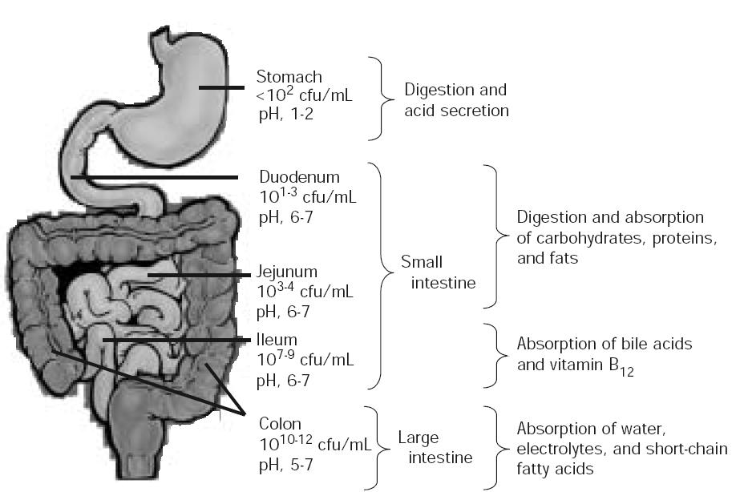
Human Microbiome
Stomach pH ~ 2 < 10² /ml
Duodenum pH 6-7 10² /ml
Jejunum pH 6-7 10⁴ /ml
Ileum pH 6-7 10⁸ /ml
Cecum and colon pH 5-7 10⁹⁻¹² /ml
DiBaise et al, Mayo Clin Proc. 2008

Slide 11
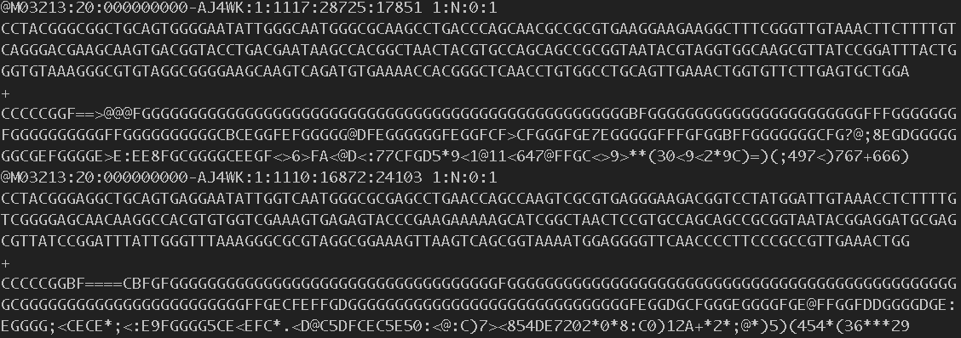
Illumina MiSEQ fastq format

Slide 12
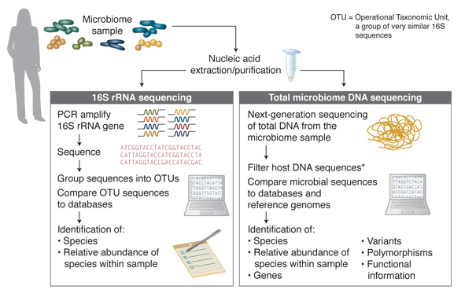
Microbiome Research Workflow
www.neb.com

Slide 13
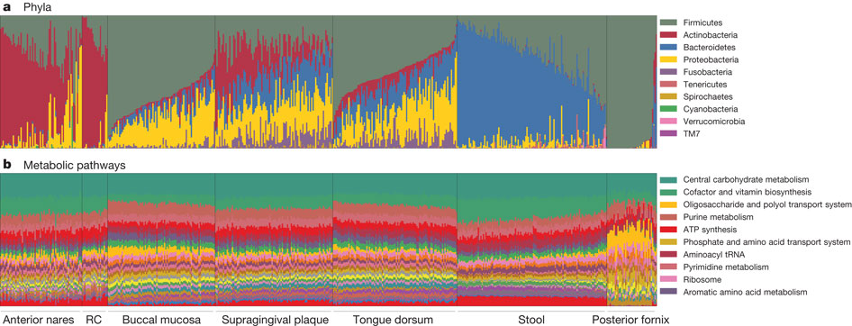
HMP landscape
Huttenhower 2012 Nature

Slide 14
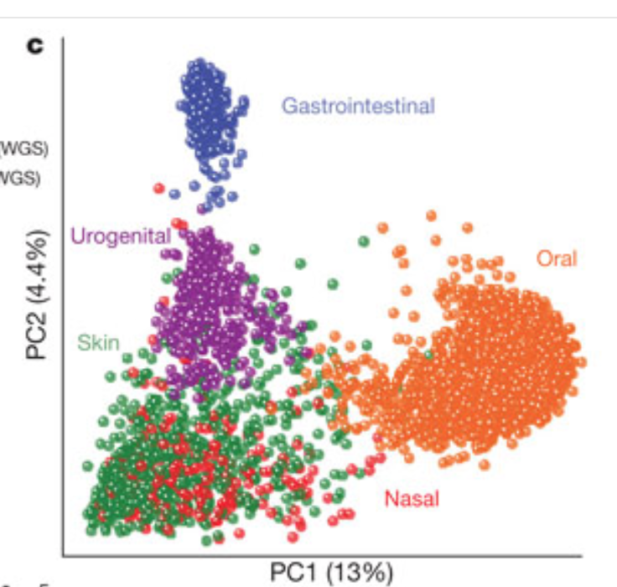
The human microbiome – PCA plot
Huttenhower 2012 Nature

Slide 15
Bioinformatics workflow summary
USEARCH v1831, available on NIH Biowulf computing cluster, is used to process sequences and generate the initial OTUtable. First, paired-end reads are merged then filtered according to expected errors. Second, the filtered reads are de-replicated and clustered to OTUs according to sequence identity cutoffs. Finally, the representative sequences are mapped back to the original set of reads to generate the OTUtable. The downstream sequence alignment and taxonomy classification are performed with QIIME.

Slide 16
Workflow using USEARCH and QIIME
1.Merge paired end reads
Read 1 -------------------
-------------------- Read 2
5. Taxonomy classification
Performed on the OTUcentroids (aka the representative sequences)
2.Filter by sequence quality scores
Merged reads --------------------------
6. Align representative sequences, build a phylogenetic tree.
3.De-replicate sequences
7. Calculate Beta diversities such as UniFrac distances
4.Cluster unique sequences to OTUs based on 97% identity
8. Calculate alpha diversity measures

Slide 17
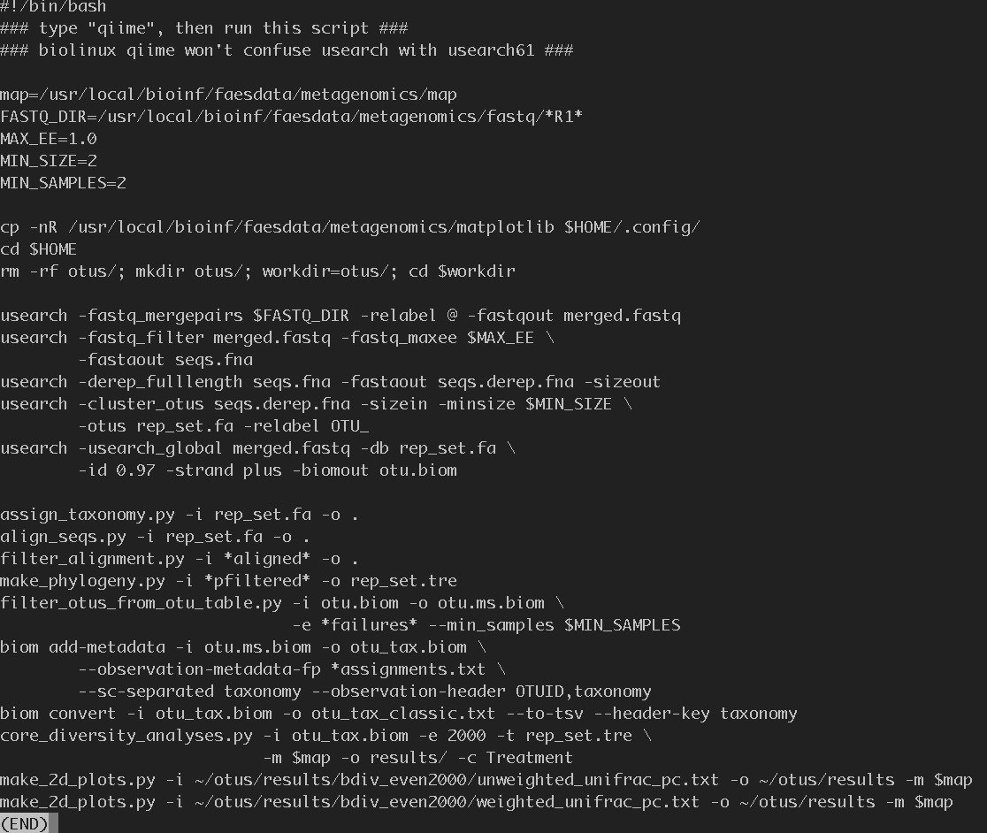
Bioinformatics commands

Slide 18
Join paired ends
Data: paired-end reads, 150bp each direction
Tools: USEARCH: fastq_mergepairs or fastq-join
16S V4 region
R1
R2
Overlap = 49 bp; overall = 252 bp

Slide 19
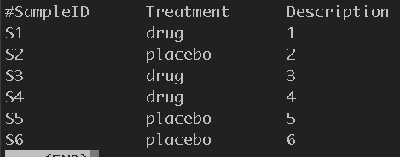
Meta-data mapping file
Tool: QIIME (Quantitative Insights Into Microbial Ecology)

Slide 20
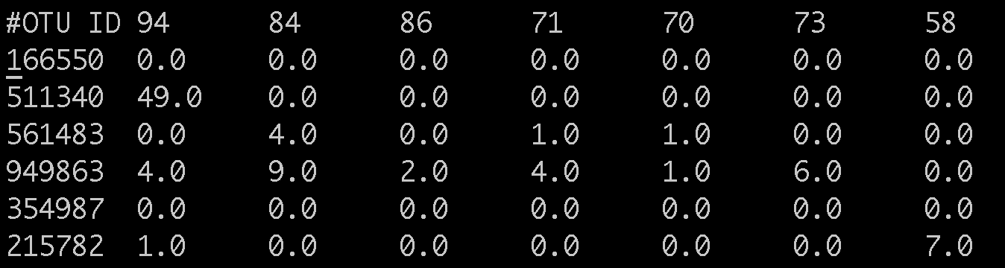
the OTU table
OTUs: Operational Taxonomic Units

Slide 21
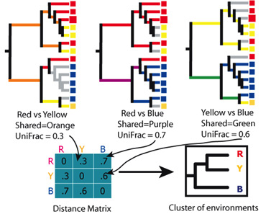
Analyzing biom files: Alpha and beta diversities
Phylogenetic measures: need a tree
align_seqs.py -i rep_set.fa -o
make_phylogeny.py -i aligned.fa -o rep_set.tre
Alpha-diversity
Phylogenetic diversity (PD)
Shannon
Beta-diversity:
UniFrac
Lozupone et al., 2005

Slide 22
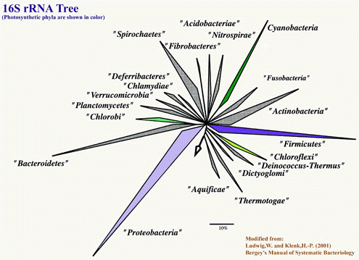
Taxonomy

Slide 23
Run 16S processing pipeline - merge
Data Visualization Example
Type "qiime" without the quote.
usearch -fastq_mergepairs fastq -relabel @ -fastqout out/merged.fastq

Slide 24
Filter
usearch -fastq_filter merged.fastq -fastq_maxee 1.5 -fastqout seqs.fq
usearch -fastq_filter merged.fastq -fastq_maxee 1.5 -fastaout seqs.fna
Open up fastqc program to compare merged.fastq and seqs.fq

Slide 25
Dereplication
usearch -derep_fulllength seqs.fna -fastaout seqs.derep.fna –sizeout
Check results
grep -c seqs.fna
grep -c seqs.derep.fna

Slide 26
Cluster
usearch -cluster_otus seqs.derep.fna -sizein -minsize 5 -otus rep_set.fa -relabel OTU_
Check results
grep -c rep_set.fa

Slide 27
Make otuTable
usearch -usearch_global merged.fastq -db rep_set.fa -id 0.97 -strand plus -biomout otu.biom
Check results
less –S out.biom

Slide 28
Assign bacterial taxonomy
assign_taxonomy.py -i rep_set.fa -o .

Slide 29
Align to reference and filter the alignment
align_seqs.py -i rep_set.fa -o .
filter_alignment.py -i *aligned* -o .

Slide 30
Make a phylogenetic tree
make_phylogeny.py -i *pfiltered* -o rep_set.tre

Slide 31
Remove sequences that do not align well
filter_otus_from_otu_table.py -i otu.biom -o otu.ms.biom -e *failures* --min_samples 2

Slide 32
Add metadata to the otuTable
biom add-metadata -i otu.ms.biom -o otu_tax.biom --observation-metadata-fp *assignments.txt --sc-separated taxonomy --observation-header OTUID,taxonomy
biom convert -i otu_tax.biom -o otu_tax_classic.txt --to-tsv --header-key taxonomy

Slide 33
Last step: run everything
core_diversity_analyses.py -i otu_tax.biom -e 2000 -t rep_set.tre -m data/map.txt -o results/ -c Treatment

Slide 34
Now open up index.html and go through the report details
We need about 15 minutes on this very important slide
Taxa summary
By group
Alpha diversity
Beta diversity
Group_significance

Slide 35
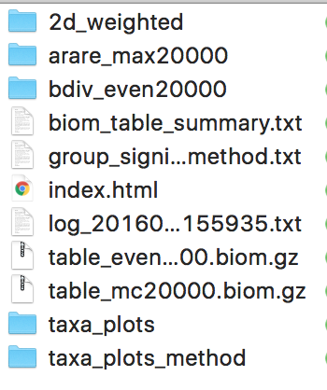
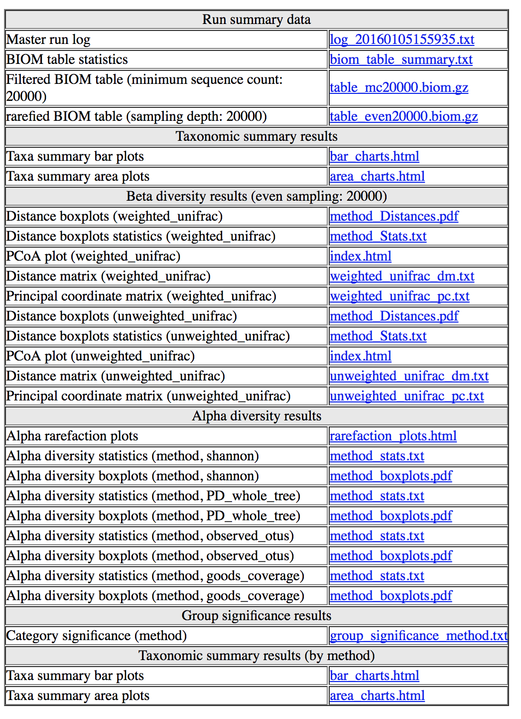
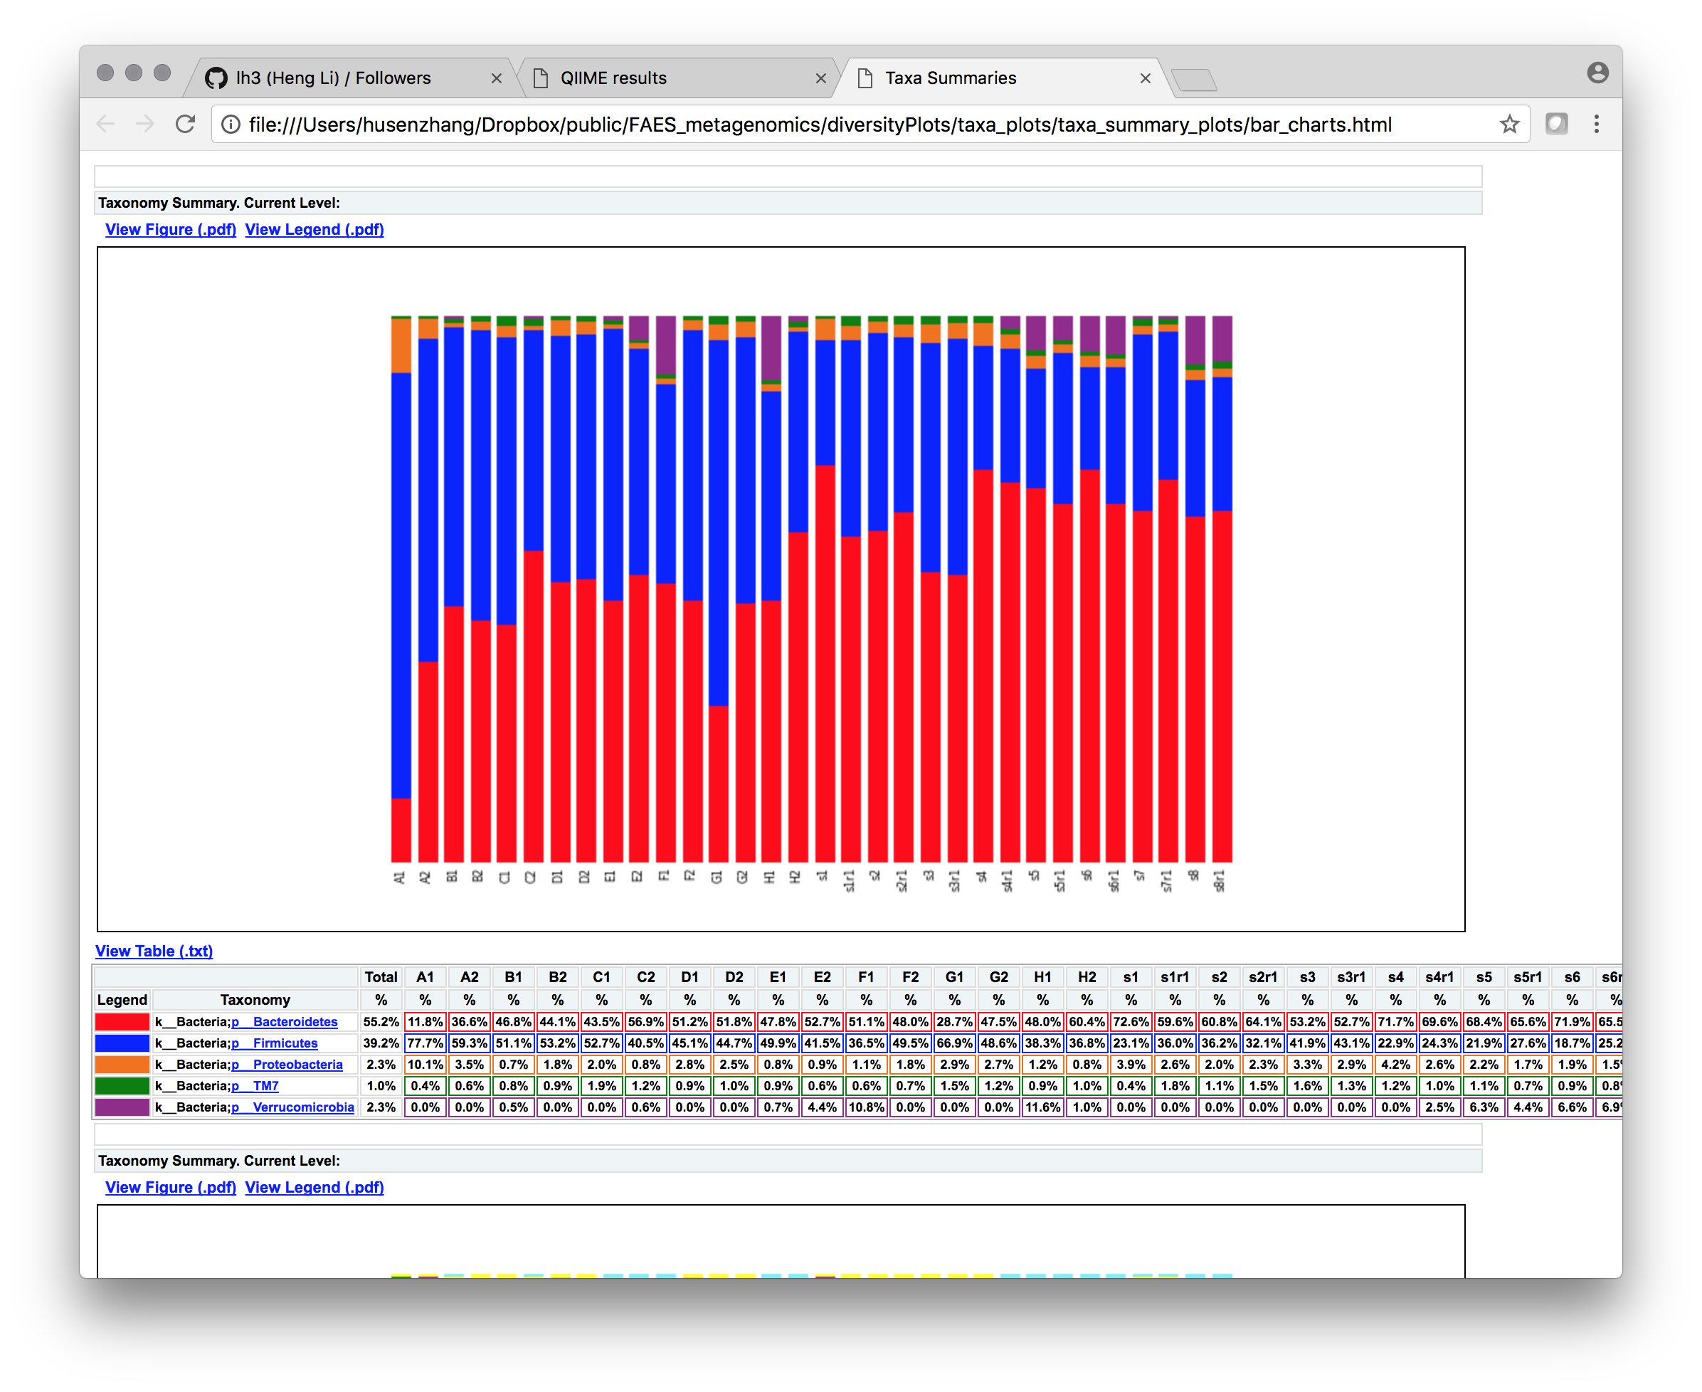
Qiime results dashboard

Slide 36
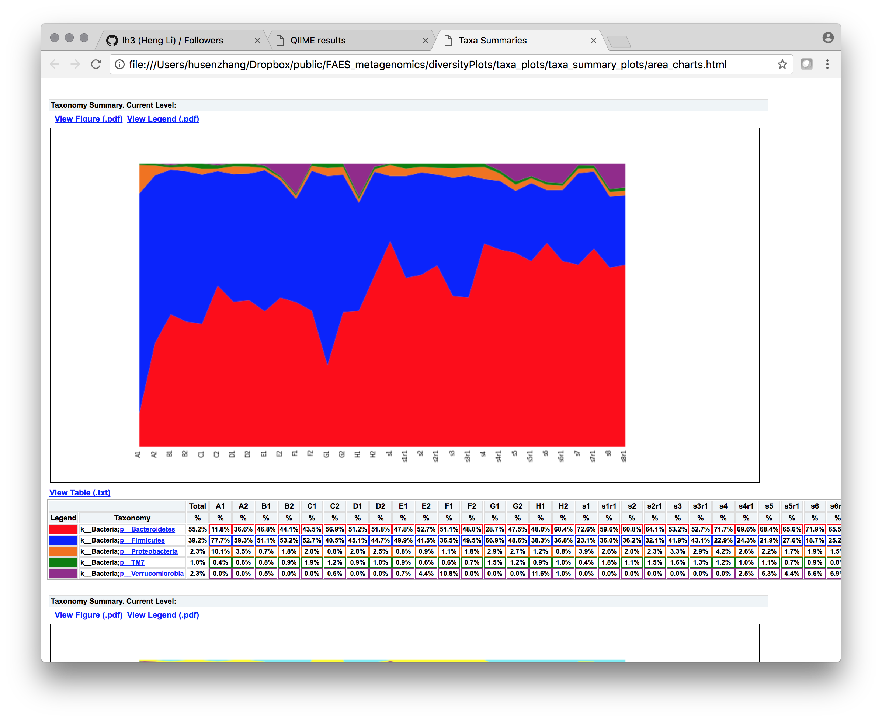
Qiime results - taxonomy

Slide 37
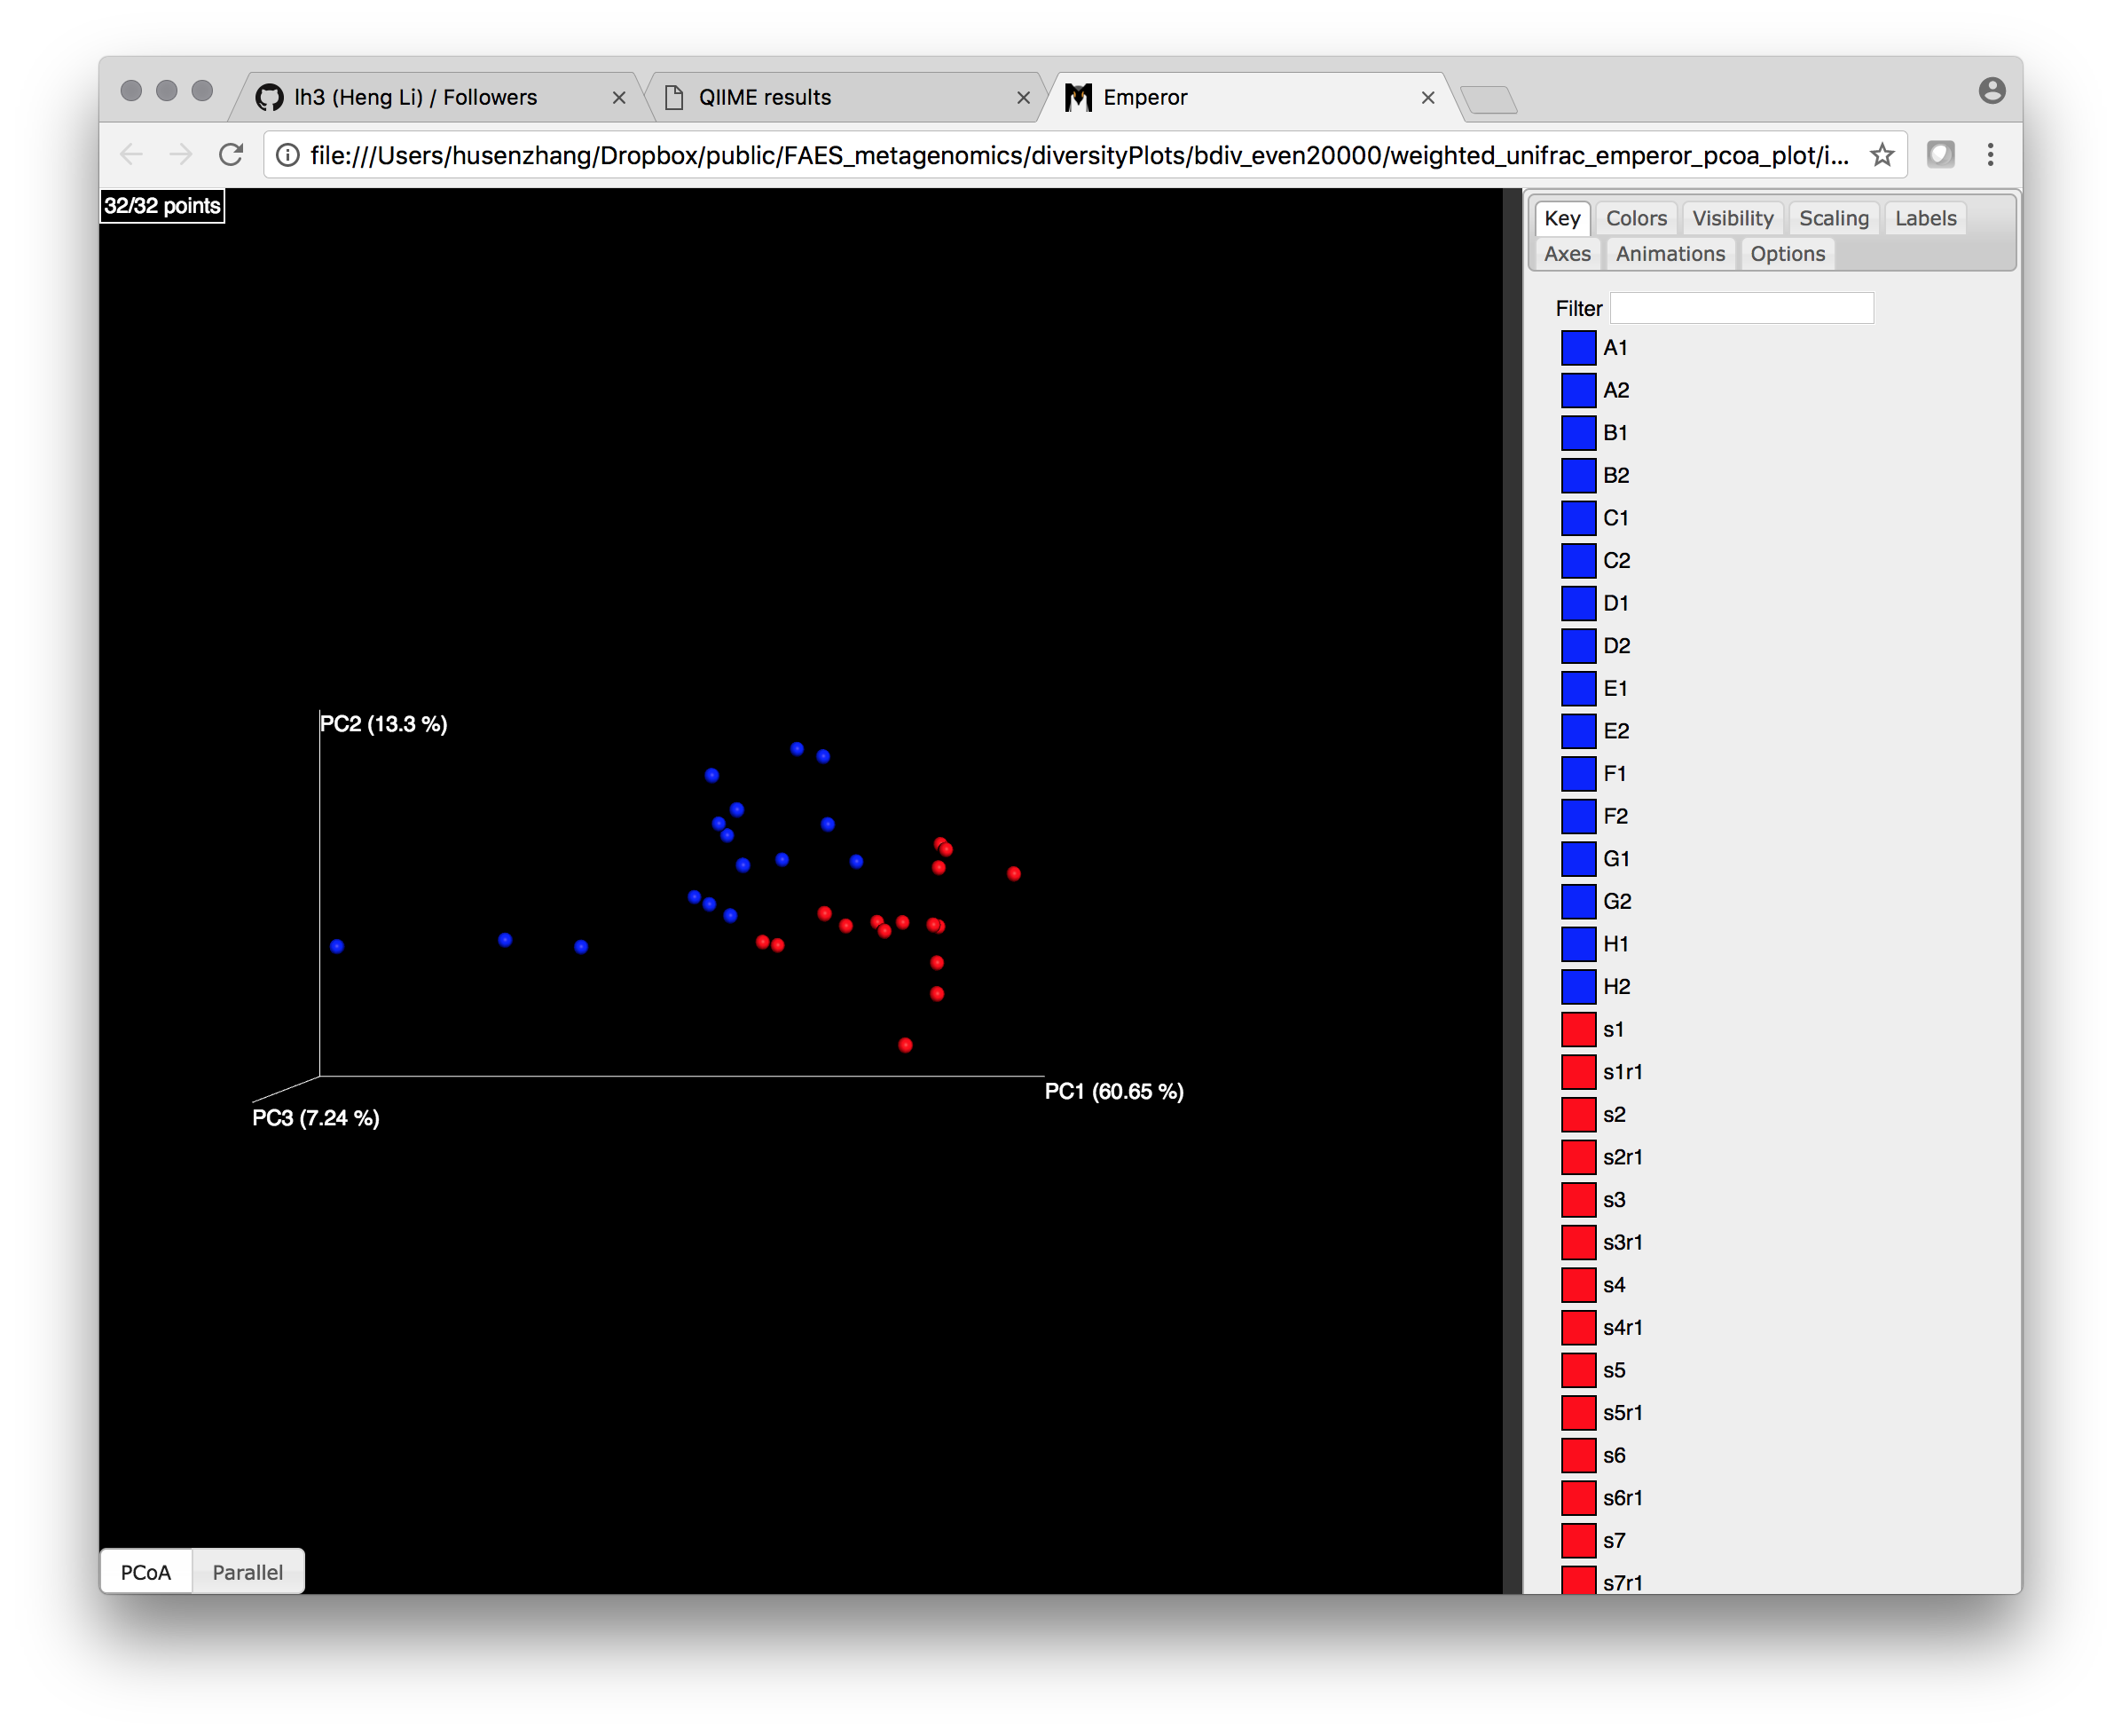
PCA plots

Slide 38
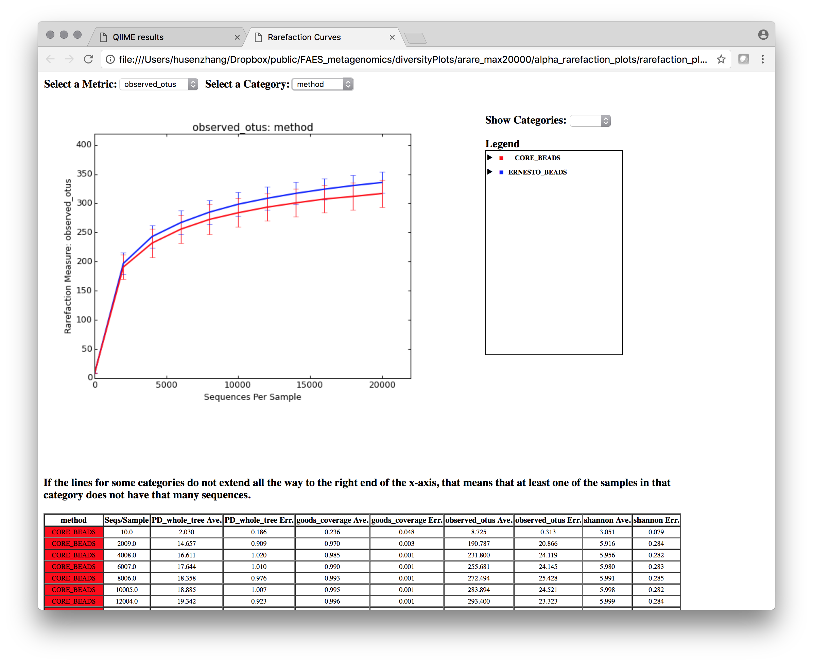
Rarefaction curves

Slide 39
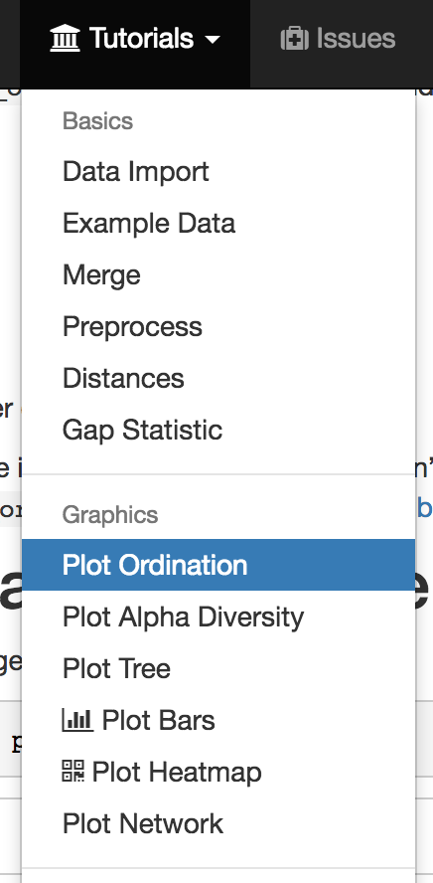
Making pretty graphs – Phyloseq tutorial
https://joey711.github.io/phyloseq/import-data.html
We will go through the entire tutorial - will take two days

Slide 40
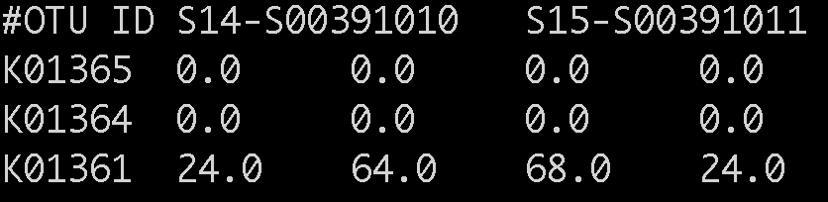
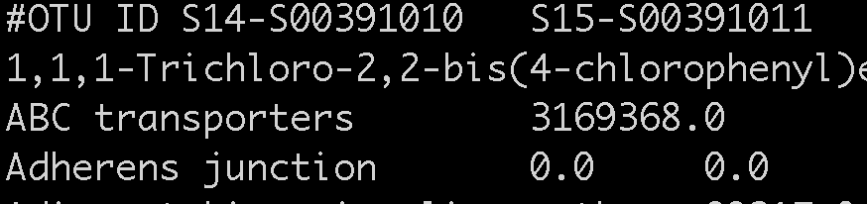
Going beyond 16S rRNA
Inferred metagenomes from 16S
Picrust: Use 16S rRNA gene counts to infer whole genomes
predicted_metagenomes_KO.tsv
predicted_metagenomes.L3.txt

Slide 41
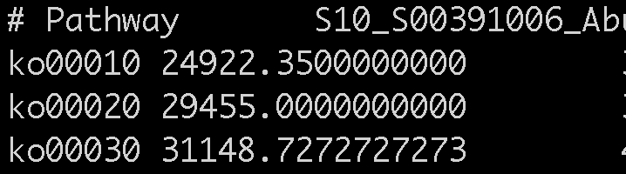
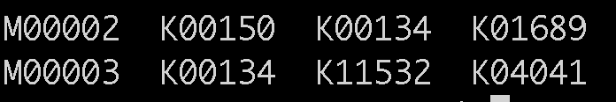
Going beyond 16S rRNA
Metagenome shotgun sequencing
MetaPhlan
lefse
modulec
pathabundance.tsv

Slide 42
Lefse
https://bitbucket.org/biobakery/biobakery/wiki/lefse
Data download:
cd data/
wget http://huttenhower.sph.harvard.edu/webfm_send/129

