Slide 1
RNA-seq variant Calling and allele-specific expression analysis
John Didion, PhD

Slide 2
RNA-seq Variant Calling and Allele-Specific Expression Analysis
OUTLINE
Calling variants from RNA-seq data
Allele-specific expression concepts
Correcting for mappability bias using WASP
Identifying allele-specific expression using ASARP
Interpreting results of allele-specific expression analysis

Slide 3
RNA-seq Variant Calling and Allele-Specific Expression Analysis
OUTLINE
Calling variants from RNA-seq data
Allele-specific expression concepts
Correcting for mappability bias using WASP
Identifying allele-specific expression using ASARP
Interpreting results of allele-specific expression analysis

Slide 4
Variant Calling
The human reference genome is haploid – one nucleotide per position
NGS is (essentially) the process of transforming molecules (e.g. DNA or RNA) in a biological sample into sequence alignments against the reference genome (a BAM file)
Variant calling is (essentially) the process of identifying the positions where one or both parental alleles in the sample differ from the reference genome

Slide 5
Variant Calling is a Two-Step Process
Variant discovery
Identify positions at which there is variation within a population
This has been a primary focus of the genomics field; collectively, global human variant discovery efforts have identified ~150M SNPs
Each new individual that is sequenced harbors a few dozen variants that have never been seen before

Slide 6
Variant Calling is a Two-Step Process
Variant genotyping
Determine the two parental alleles at each potentially variable position
For a bi-allelic SNP, there are three possible genotypes:
Homozygous reference (aa)
Homozygous alternate (AA)
Heterozygous (aA)
Genotypes may be phased. If two alleles are in-phase, the both originated from the same molecule (haplotype).

Slide 7
Sources of Genotype Information
Genotype array
Pros: easy, minimal input requirement
Cons: only types a fraction of sites in the genome
Cost: $
Untyped variants can be imputed using a probabilistic method and a panel of reference haplotypes
Whole-exome sequencing (WES)
Pros: type all variants in coding sequences
Cons: multiple sources of bias
Cost: $$
Whole-genome sequencing (WGS)
Pros: minimal bias
Cons: more complex analysis, large data storage requirements
Cost: $$$

Slide 8
Calling Variants from RNA-seq
If you already have RNA-seq data, it’s (essentially) free. Two-for-one!
Provides similar genotype data to WES
Both false-negative and false-positive variant calls are inflated relative to DNA-derived data

Slide 9
Interlude: Allelic Imbalance (AI)
Unequal transcription rates from the two chromosomal alleles in a cell
Biological sources of AI in a cell:
Chromatin differences between the two chromosomes
Differential transcription factor binding due to genetic variation in binding sites
Differential polymerase efficiency
Differential splicing (differential stability of transcripts)
Temporal (e.g. cell cycle) effects
These effects can be due to genetic differences between alleles, environmental variables, or stochastic variation

Slide 10
Interlude: Allelic Imbalance (AI)
Cell-to-cell variation is averaged out in bulk mRNA sequencing; unless you’re using single-cell RNA-seq, only systematic AI is detectable
However, technical artifacts can either give the false impression of AI or mask true AI. Transcripts from the two alleles can differ in terms of
cDNA conversion efficiency
PCR amplification efficiency
Mappability

Slide 11
Mitigating technical artifacts
Sequencing
Use high-quality reagents, especially for cDNA conversion
Reduce/eliminate PCR amplification (requires large amount of input material)
Use long (100bp or more) paired-end reads
Read mapping
Mark PCR duplicates
Filter alignments for mapping quality (MAPQ)
Downstream analysis
Correct for mappability bias

Slide 12
Sources of Error in RNA-seq Genotypes
Sequencing errors introduce low-frequency false-positive variants
Variant calling algorithms try to reduce false-positives by ignoring low-frequency variants
However, AI (whether true or false) results in unequal representation of alleles
In other words, variant callers make an assumption of equal allelic representation that is violated in RNA-seq
Thus, variant calling parameters must be adjusted to allow for AI when calling heterozygous genotypes
Additional caveats:
RNA editing may introduce false-positive variants
Variant calls will be wrong for genes that are imprinted, i.e. expressed from only one allele

Slide 13
Mitigating RNA-seq Genotype Errors
Variant calling
Ignore duplicate reads
Excluded known RNA-editing sites, variants near splice junctions, and variants at repeat regions
Additional filters can be applied, such as excluding variants with allele frequencies that differ substantially from expectation
Downstream analysis
Exclude known imprinted genes

Slide 14
INTERLUDE: THE COMMAND LINE
Conventions
# Comments preceded by hash
$ Command prompt starts with a dollar sign
VARIABLES_UPPERCASE_ITALICS
Single line command continued \
onto next line by a backslash

Slide 15
INTERLUDE: THE COMMAND LINE
Moving Around the Filesystem
# what directory am I in now?
$ pwd
# navigate to where the example files live within
# your home directory
$ cd ~/rnaseqvariant
# what files are in the current directory?
$ ls –la # -l (long mode), -a (show .files)
# make an output folder
$ mkdir output
# view contents of a file
$ less FILENAME # page through file
$ head -N FILENAME # show first N lines
$ tail –N FILENAME # show last N lines

Slide 16
INTERLUDE: THE COMMAND LINE
More Useful Commands
# <tab> to auto-complete current command
# <up arrow> and <down arrow> to see previous commands
# <Ctrl-r> to search previous commands
# cat concatenates two or more files
# | sends output of one command to another command
# wc -l counts the number of lines
# > sends command output to a file
$ cat FILE1 FILE2 | wc –l > FILE
# read the manual for a command
$ man COMMAND

Slide 17
Exercise: RNA-seq Variant Calling
Software
bcftools is a variant calling toolkit
We will bcftools mpileup to count the occurrence of each allele at each genomic position, and to compute the likelihood of each genotype given the observed allele counts
We will use bcftools call to call genotypes from the likelihoods
We will combine these tools into a “pipeline”

Slide 18
Exercise: RNA-seq Variant Calling
Data
We are using the ASARP demo data, which contains alignments at 3 small regions
A sample pipeline for aligning and filtering the reads can be found in the handout

Slide 19
Exercise: RNA-seq Variant Calling
# variant discovery and genotyping pipeline
$ bcftools mpileup -f ref/hg19.fasta -q 20 --ff DUP \
-a FORMAT/AD,FORMAT/DP input/input.bam | \
bcftools call -c -v -O z -o output/variants.vcf.gz
# here’s what the mpileup options mean:
-f # reference genome FASTA file
-q # only use reads with MAPQ >= 20
--ff DUP # ignore duplicate reads
-a # add additional information fields to VCF output
# some additional mpileup parameters:
-C 50 # recommended for BWA alignments
-d 10000 # may be necessary for very deep sequencing

Slide 20
Exercise: RNA-seq Variant Calling
# variant discovery and genotyping pipeline
$ bcftools mpileup -f ref/hg19.fasta -q 20 --ff DUP \
-a FORMAT/AD,FORMAT/DP input/input.bam | \
bcftools call -c -v -O z -o variants.vcf.gz
# here’s what the bcftools options mean:
-c # use the consensus caller, which assumes
# bi-allelic variants; don’t use for standard
# DNA-seq variant calling!
-v # only output variant sites
-O z # output gzip-compressed output
-o variants.vcf.gz # the output file name

Slide 21
VARIANT CALLING
VCF Header
##fileformat=VCFv4.2
##FILTER=<ID=LowQual,Description="Low quality">
##FORMAT=<ID=AD,Number=R,Type=Integer,Description="Allelic depths for the ref and alt alleles in the order listed">
##FORMAT=<ID=DP,Number=1,Type=Integer,Description=”…">
...
##INFO=<ID=AC,Number=A,Type=Integer,Description="Allele count in genotypes, for each ALT allele, in the same order as listed">
##INFO=<ID=AF,Number=A,Type=Float,Description=”…">
…
FILTER: marker that the variant failed a condition
INFO: information given for each variant
FORMAT: information given in each genotype record

Slide 22
VARIANT CALLING
VCF Variant Rows
#CHROM POS ID REF ALT QUAL FILTER INFO FORMAT SAMPLE1 SAMPLE2...
chr1 51479 rs123 T A 3442.03 PASS AC=5;AF=0.404;AN=20 GT:AD:DP:GQ 0/0:14,0:14:42 0/0:2,0:2:6
ID: If variant is known, it’s database ID (e.g. dbSNP)
REF, ALT: the reference and alternate alleles
ALT may contain more than one allele, comma-separated
QUAL: PHRED-scale probability that there is no variant at this site

Slide 23
VARIANT CALLING
VCF Variant Rows
#CHROM POS ID REF ALT QUAL FILTER INFO FORMAT SAMPLE1 SAMPLE2...
chr1 51479 rs123 T A 3442.03 PASS AC=5;AF=0.404;AN=20 GT:AD:DP:GQ 0/0:14,0:14:42 0/1:2,2:4:6
For each sample:
GT: genotype call; 0 is reference, and 1, 2, … are alternate
0/0 is homozygous reference
0/1 is heterozygous
1/1 is homozygous alternate
‘.’ means no call
If there is a ‘|’ rather than ‘/’, the genotype is phased
GQ: PHRED-scale probability that the call is incorrect

Slide 24
Exercise: RNA-seq Variant Calling
Filtering
We will use bcftools annotate to annotate variants based on whether they are near splice sites or are known RNA editing sites
We will use bcftools filter to remove annotated variants
This annotation file is provided for you (annotations/filter_sites.bed)

Slide 25
Exercise: RNA-seq Variant Calling
# annotate problematic sites
# -c tells what columns to use for matching for BED file
# -m adds a “EXCLUDE” tag in the info field
$ bcftools annotate -a annotations/filter_sites.bed.gz \
-c CHROM,-,POS -m +EXCLUDE -O z \
-o outputs/variants_annotated.vcf.gz \
outputs/variants.vcf.gz
# check that variants have been tagged
$ zcat results/variants_annotated.vcf.gz| grep EXCLUDE
# filter out sites annotated with a “EXCLUDE” tag
# -e gives an expression specifying which sites to exclude
$ bcftools filter -e EXCLUDE -O z \
-o outputs/variants_filtered.vcf.gz \
outputs/variants_annotated.vcf.gz
# check that annotated variants are gone
$ zcat results/variants_filtered.vcf.gz| grep EXCLUDE

Slide 26
RNA-seq Variant Calling and Allele-Specific Expression Analysis
OUTLINE
Calling variants from RNA-seq data
Allele-specific expression concepts
Correcting for mappability bias using WASP
Identifying allele-specific expression using ASARP
Interpreting results of allele-specific expression analysis

Slide 27
Allele-Specific Expression (ASE)
General term for RNA-seq analyses that attempt to identify exons or genes with true allelic imbalance
ASE is always relative to one or more genetic variant(s)
The most common analysis is individual-specific ASE:
Identify coding SNPs with significant AI (ASE SNPs)
Power is increased by aggregating SNP-level information at the exon or gene level (ASE exons/genes)
With multiple samples, can identify ASE SNPs/exons/genes that are common or different among individuals, conditions, and/or tissues

Slide 28
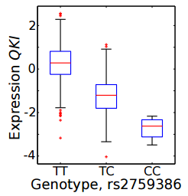
Expression QTL
An expression quantitative trait locus (eQTL) is a variant that is significantly associated with the expression level of a gene
When the associated SNP and gene are nearby (e.g. within 100kb), it is considered a cis-eQTL
When they are far away (e.g. >1MB), it is considered a trans-eQTL
Battle et al. 2013, Fig 3C

Slide 29
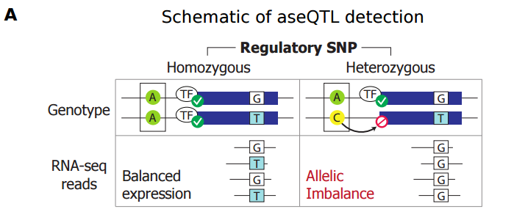
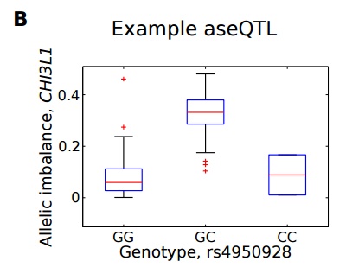
Allele-Specific eQTL
Allele-specific eQTL (aseQTL) are SNPs at which the homzogyous and heterozygous genotypes are associated with significantly different AI at a nearby gene
Many (hundreds) of individuals are required
Battle et al. 2013, Fig 1

Slide 30
Workflow for Individual ASE
Generate RNA-seq data
Map and filter reads to reference genome
For the same sample, either
Genotype DNA (microarray),
Sequence DNA (WGS or WES), or
Call variants from RNA-seq
Filter variants
Correct RNA-seq alignments for mappability bias
Use corrected RNA-seq alignments to test for ASE at variant sets
Optionally, aggregate SNP-level information to identify ASE exons and/or genes

Slide 31
RNA-seq Variant Calling and Allele-Specific Expression Analysis
OUTLINE
Calling variants from RNA-seq data
Allele-specific expression concepts
Correcting for mappability bias using WASP
Identifying allele-specific expression using ASARP
Interpreting results of allele-specific expression analysis

Slide 32
Mappability Bias
NGS reads that map equally well to multiple locations (“multi-mapping”) likely originate from repetitive sequence (e.g. centromeres, LINEs, tandem repeats). These reads will either fail to align, or will have low mapping quality scores (MAPQ) and filtered out.
RNA-seq reads are less likely to be multi-mapping than WGS reads.
Heterozygous variants increase the probability that reads from different alleles will map to different genomic locations.
The read with more reference alleles has a higher probability of mapping to the correct location (mappability bias), and thus reference allele counts are prone to inflation in ASE analysis.

Slide 33
The Problem with RNA-seq Variant Calls
In extreme cases of mappability bias, all reads from one allele will map to a different location than the reads from the other allele.
Thus, the variant caller will see only one allele, and will call a homozygous genotype.
Since mappability bias can only be discovered at heterozygous sites, the bias will be missed and affect downstream ASE analysis.
If ASE is an important part of your experimental design, it is strongly recommended to independently genotype your subjects from DNA samples.

Slide 34
Correcting for Mappability Bias
Software: WASP
Consists of two tools:
Bias correction pipeline
Combined Haplotype Test pipeline for aseQTL analysis
WASP pipelines are run via Snakemake – a general-purpose tool you can use to create your own pipelines. Highly recommended!

Slide 35
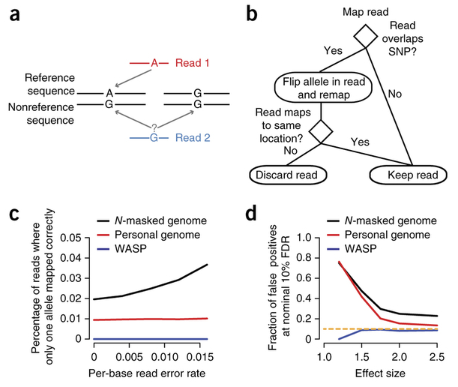
Correcting for Mappability Bias
Van de Geijn et al. 2015, Fig. 1

Slide 36
Correcting for Mappability Bias
Two ways to run mappability bias correction
Using phased genotypes
Requires either:
Known parental genotypes, e.g. in a trio experimental design
A panel of reference haplotypes, e.g. 1000 Genomes Project
Use software such as SHAPEIT or fastPhase to phase your samples based on the reference panel
This is more complicated but leads to more accurate results
Using unphased genotypes: we will use this approach for simplicity, but phasing is recommended for real analysis!

Slide 37
Exercise: Correcting Mappability Bias with WASP
# Execute the pipeline
# If you have phased genotypes, use
# “snakefile.phased” instead.
$ cd ~/rnaseq/variant/WASP
$ snakemake -s snakefile.unphased

Slide 38
Correcting for Mappability Bias
WASP Output
# There will now be several subdirectories in your
# output directory. Most are intermediate files that can
# be deleted.
# remove unsorted files from rmdup dir:
$ ls rmdup/ | grep -v sort | xargs rm
# remove intermediate files and directories:
$ rm -rf map1 map1_sort find_intersecting_snps \
Map2 map2_sort filter_remapped_reads merge

Slide 39
Correcting for Mappability Bias
WASP Output
# The starting input file was
# input/map1_sort/18501.bam
# and the final output file is:
# output/rmdup/18501.keep.merge.rmdup.sort.bam
# Let’s see how many reads were removed.
$ samtools view input1/map1_sort/18501.bam | wc –l
$ samtools view \
output/rmdup/18501.keep.merge.rmdup.sort.bam \
| wc -l

Slide 40
RNA-seq Variant Calling and Allele-Specific Expression Analysis
OUTLINE
Calling variants from RNA-seq data
Allele-specific expression concepts
Correcting for mappability bias using WASP
Identifying allele-specific expression using ASARP
Interpreting results of allele-specific expression analysis

Slide 41
Identifying ASE with ASARP
ASARP tests all heterozygous SNPs for ASE
P-values are controlled for FDR (0.05 by default)
If all heterozygous SNPs in a gene that are above a certain read-count threshold (20 by default) exhibit significant ASE, it is considered an ASE gene
Otherwise, ASARP tests each SNP in the gene for other allele-specific events

Slide 42
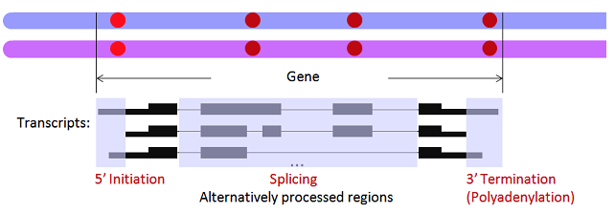
Identifying ASE with ASARP
In addition to ASE, ASARP detects Allele-Specific…
Alternative Splicing (ASAS): SNP in an exon whose splice-in rate differs between alleles
Transcription Initiation (ASTI): SNP in 5’ UTR whose TSS differs between alleles
Alternative Polyadenylation (ASAP): SNP in 3’ UTR whose termination site differs between alleles

Slide 43
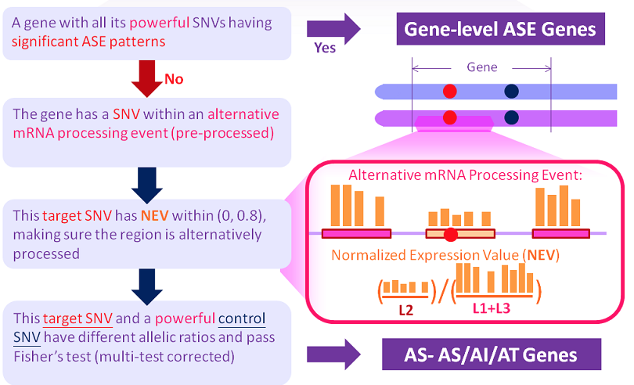
Identifying ASE with ASARP
Powerful = high-coverage (>= 20)
AS = Alternative Splicing; TI = Transcription Initiation; AP = Alternative Polyadenylation

Slide 44
Exercise: Idenify ASE with ASARP
# Step 1: ASARP processes one chromosome at a time and
# reads must be in SAM format and name-sorted
$ for chr in 1 5 10 ; do
samtools view -b input/input.bam \
chr$chr > input/chr$chr.bam
samtools sort -n -O SAM -o input/chr$chr.namesort.sam \
--reference ref/hg19.fasta input/chr$chr.bam
done

Slide 45
Exercise: Idenify ASE with ASARP
# Step 2: Preprocess reads. The last two options tell
# the program that our data is paired-end and
# strand-specific (make sure to set this correctly for
# your library conditions!)
$ for chr in 1 5 10 ; do
perl -I /usr/local/bioinf/ASARP \
/usr/local/bioinf/ASARP/procReads.pl chr$chr \
input/chr$chr.namesort.sam input/dna.snv.list \
output/chr$chr.candidate_snvs \
output/chr$chr.expression.bedgraph 1 2
done

Slide 46
Exercise: Idenify ASE with ASARP
# Step 3: merge SNVs for analysis
$ perl -I /usr/local/bioinf/ASARP \
/usr/local/bioinf/ASARP/mergeSnvs.pl \
output/ .candidate_snvs mono=0 output/rna.snv.lst 1
# Step 4: run ASARP
$ perl -I /usr/local/bioinf/ASARP \
/usr/local/bioinf/ASARP/asarp.pl \
output/asarp_output input/asarp.config \
input/asarp.params

Slide 47
ASARP Results
ASARP generates four output files:
output_file.ase.prediction: the detailed results of (whole-gene-level) ASE patterns (exclusive to other ASARP patterns: AI, AS or AT)
output_file.gene.prediction: the detailed results of ASARP results (ASE patterns excluded) arranged by genes
output_file.snv.prediction: the detailed results of ASARP results (ASE patterns excluded) of each individual SNV
output_file.controlSNV.prediction: the control SNV information of each individual ASARP SNV

Slide 48
RNA-seq Variant Calling and Allele-Specific Expression Analysis
OUTLINE
Calling variants from RNA-seq data
Allele-specific expression concepts
Correcting for mappability bias using WASP
Identifying allele-specific expression using ASARP
Interpreting results of allele-specific expression analysis

Slide 49
Interpreting ASE results
ASE SNP analysis
Annotate SNPs with public datasets using annovar
Annotate SNPs with predicted functional impact using variant effect predictor (VEP)
Intersect SNPs with GWAS catalog to identify possible disease associations
Intersect SNPs with ClinVar to identify known disease-causing variants

Slide 50
Interpreting ASE results
ASE gene analysis
Identify biological processes or pathways enriched in the gene list using Gene Ontology (GO) or KEGG
Intersect genes with known disease genes from OMIM
Intersect genes with results of eQTL analysis (e.g. GTEx); associated eQTL SNPs can independently be analyzed for disease association and potential mechanism (e.g. disrupting TF binding site)

Slide 51
Interpreting ASE results
Remember: ASE predictions are just that: predictions. Any important result should be experimentally validated (e.g. qPCR or ddPCR)!

Slide 52
Alternative Tools
Variant calling: GATK
Allele-specific expression:
Allele-seq, ASEQ
Cancer-specific: MBASED
Datasets: GTEx (http://www.gtexportal.org)

