Slide 1
Haplotype, de novo, and SOMATIC variant calling
John Didion, PhD

Slide 2
GOALS
Identify variants in offspring that were transmitted from parents
Determine which allele was inherited from each parent
Group alleles into haplotypes that were inherited together
Refine haplotypes using sequencing reads and reference panels
Identify de novo variants
Identify somatic mutations in matched tumor/normal samples

Slide 3
GERMLINE VS SOMATIC VARIANTS
Germline variants were present at the zygote stage and exist in most/all cells in the body; these are the variants that will be passed to the next generation
Somatic variants arise later
Can be benign or associated with disease processes
Generally discussed in the context of cancer – mutations present in tumors
Somatic variant calling requires matched somatic and germline samples (e.g. tumor/normal)

Slide 4
PLOIDY
Plants and animals have multiple copies of each autosome
Humans have 2 (diploid)
Some plants have 4 or 8
Sex chromosomes are handled differently
In humans, females have twice as many X chromosomes, and males have a Y chromosome
Many implications for coverage depth, genotype probabilities, and copy number
Mitochondrial DNA is also different – haploid, maternally inherited, high copy (>1k/cell), mosaicism

Slide 5
HAPLOTYPES
The alleles at polymorphic sites on a single chromosome constitute a haplotype
Two alleles on the same chromosome are said to be "in phase"
It is difficult to determine phase from genotypes absent any linkage information
Sequencing data provides linkage information:
Ref: AAGTACATCGACATAGAAACATGATAGAA
Read: AAGCAGATC----------CAGGATAGAC

Slide 6
HAPLOTYPES
Importance
Alleles within the same haplotype "tag" each other
In humans, a relatively small number of variants is required to indicate the haploid sequences of the entire genome (with some level of error)
Disease mechanism may be different depending on whether mutations are on the same or different chromosomes
Phasing enables allele-specific analyses of gene expression and epigenetics

Slide 7
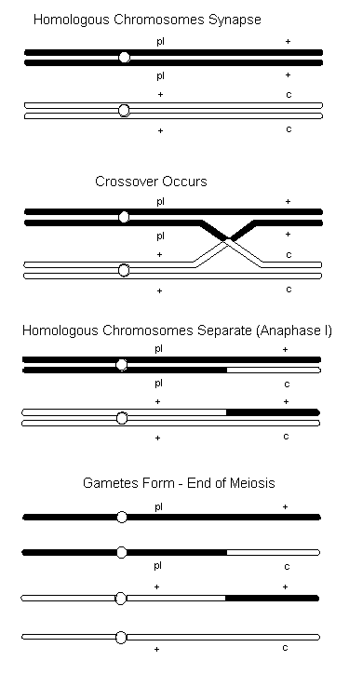
RECOMBINATION
Imagine two hypothetical ancestors of all humans ("Adam and Eve")
Meiotic recombination generates unique haplotypes
Haplotypes combine uniquely in each mating
Offspring establish their own lineages (populations) with some haplotypes more frequent than others
Haplotype diversity is maintained through outbreeding
http://cockatiels4u.tripod.com/algenetics9.htm

Slide 8
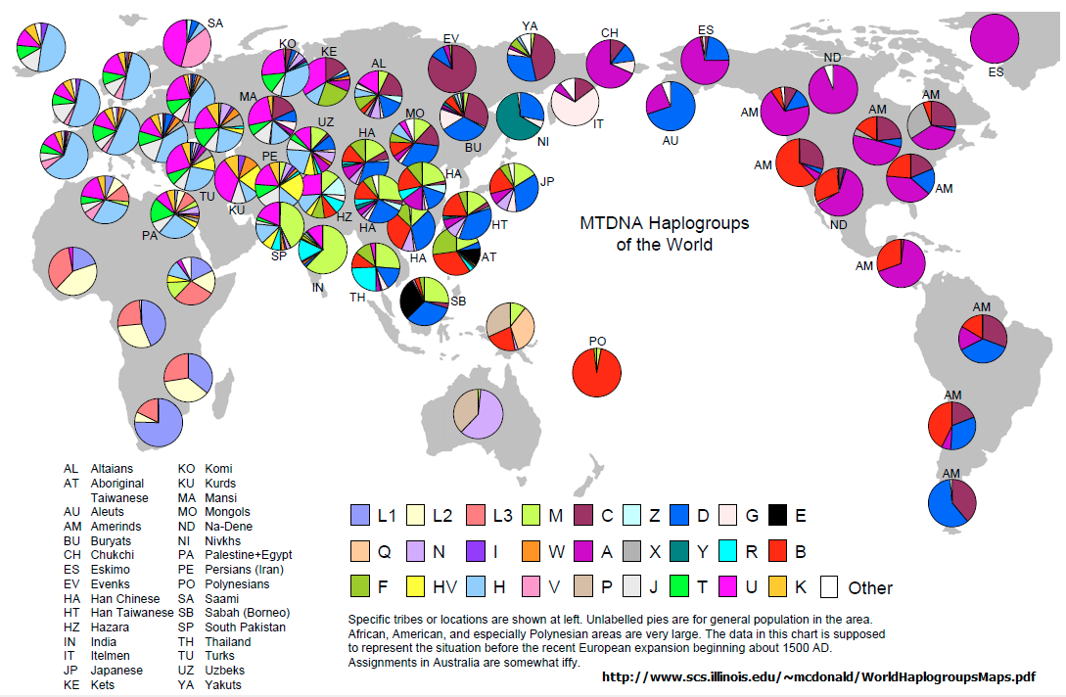
RECOMBINATION
Example: mtDNA Haplogroups

Slide 9
LINKAGE DISEQUILIBRIUM (LD)
Non-random association of two alleles due to co-inheritance
Expressed in terms of correlation coefficient (r²) between 0-1, where 1 means alleles are always inherited together
Generally, the closer two sites are on the same chromosome, the higher their LD
LD extends over fairly long distance in humans – on average, sites 50 kb apart have r² > 0.8

Slide 10
DETERMINING HAPLOYPTES (PHASING)
Three methods
Transmission: given genotypes of multiple individuals in a pedigree, offspring haplotypes can be determined from parents.
Read-backed: identify alleles co-occurring in sequencing reads. Some cutting-edge sequencing methods/technologies enable phase to be determined over long distances (10s to 100s of kb).
Statistical: given a large number of reference sequences, identify patterns of co-occurring alleles; match new samples to these patterns.

Slide 11
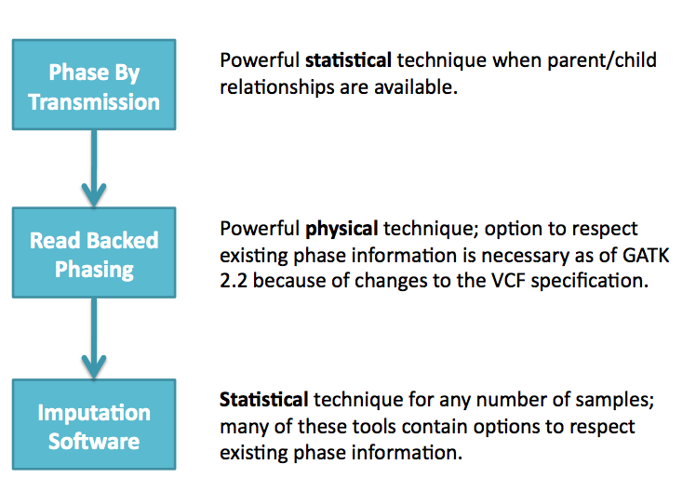
DETERMINING HAPLOYPTES (PHASING)
Broad Institute

Slide 12
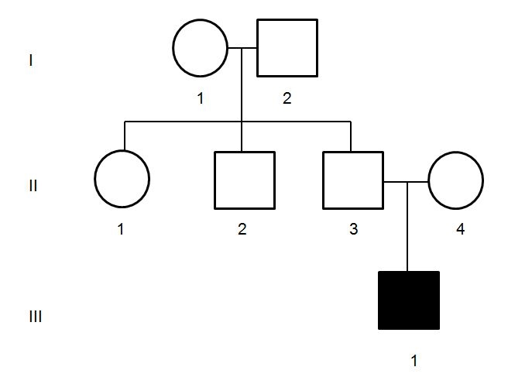
PHASING BY TRANSMISSION
Pedigrees
Unaffected
Female
Unaffected
Male
Affected
Male Offspring
Is affected status of III.1 due to de novo mutation, recessive condition, or something more complex?

Slide 13
PHASING BY TRANSMISSION
For each variant, determine genotypes of mother, father, and offspring
Some combinations will have only one possible phase, e.g.
Mother: 0/1 Father: 1/1 Child: 0|1
Others will be ambiguous, e.g.
Mother: 0/1 Father: 0/1 Child: 0|1 or 1|0?
Mendelian errors can be due to artifacts, loss of heterozygosity, or de novo mutations, e.g.
Mother: 0/0 Father: 1/1 Child: 0/0

Slide 14
TRIO CALLING WORKFLOW
Beginning workflow is same as germline calling
Call all samples using HaplotypeCaller, or
Call each sample separately in GVCF mode, then genotype jointly
Variant recalibration and filtering
Initial phasing by transmission
Read-backed phasing and/or statistical phasing to resolve ambiguities and switching errors
Calculate genotype posterior probabilities
Genotype filtering
Annotate possible de novo variants

Slide 15
TRIO CALLING WORKFLOW
Exercise: Variant Calling in Trio
# NA12891 is the father, NA12892 is the mother, and
# NA12878 is the child
$ java -jar GenomeAnalysisTK.jar -T HaplotypeCaller \
-R resources/human_g1k_v37.fasta \
-I input/trio2/NA12891_chr22.bam \
-I input/trio2/NA12892_chr22.bam \
-I input/trio2/NA12878_chr22.bam \
-o output/ceu_trio_chr22_jointcalls.vcf \
-L 22:24260000-24270000

Slide 16
TRIO CALLING WORKFLOW
Exercise: Variant Calling in Trio
Open the file in IGV and browse to 22:24262450-24262500
Variant at 24262476: Parents are both T/T, but offspring is A/T – is this a de novo mutation?

Slide 17
TRIO CALLING WORKFLOW
Exercise: Hard Filtering
# Normally we would filter variants using VQSR.
# Today we'll use a hard filter.
$ java -jar GenomeAnalysisTK.jar \
-T VariantFiltration \
-R resources/human_g1k_v37.fasta \
-V output/ceu_trio_chr22_jointcalls.vcf \
--filterExpression "QD < 2.0 || \
SOR > 3.0 || MQ < 40.0 || MQRankSum < -12.5 || \
ReadPosRankSum < -8.0" \
--filterName "HARD_FILTER" \
-o output/ceu_trio_chr22_jointcalls_filtered.vcf

Slide 18
TRIO CALLING WORKFLOW
Exercise: Hard Filtering
Open the filtered file in IGV
Browse to 22:24268730-24268750
Right-click on the filtered variant call track and choose "Suppress Filtered Sites" – notice the variants at 24268739 and 24268743 go away

Slide 19
TRIO CALLING WORKFLOW
Pedigree Files
Format is taken from Plink .fam file
Six columns, whitespace-separated:
Family ID
Individual ID
Father ID (or 0 if missing)
Mother ID (or 0 if missing)
Individual Sex (1=male, 2=female, 0=unknown)
Phenotype (1=control, 2=case, 0/-9/non-numeric=missing; any other value = quantitative trait)
Use only alphanumeric + underscore in IDs, and don't start an ID with a number

Slide 20
TRIO CALLING WORKFLOW
Exercise: Phase By Transmission Using GATK
$ java -jar GenomeAnalysisTK.jar \
-T PhaseByTransmission \
-R resources/human_g1k_v37.fasta \
-V output/ceu_trio_chr22_jointcalls_filtered.vcf \
-ped input/trio2/trio.fam \
-o output/ceu_trio_chr22_jointcalls_phased.vcf

Slide 21
TRIO CALLING WORKFLOW
Exercise: Phase By Transmission Using GATK
# Look at the results
$ tail output/ceu_trio_chr22_jointcalls_phased.vcf
# '|' in genotype indicates phasing

Slide 22
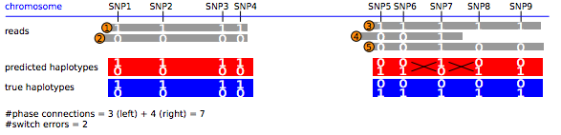
READ-BASED PHASING
WGS and WES data provides more accurate phasing due to linkage information in reads
Artifacts – sequencing errors, misalignment, allelic bias, gaps – can create switching errors
Martin et al., bioRxiv, 2017

Slide 23
READ-BASED PHASING
WhatsHap
Read-based phasing software that can optionally utilize pedigree information
Takes VCF and BAM files as input, outputs phased VCF
Can also output
Phased reference genomes
Haplotype blocks (in GTF format)
Martin et al., bioRxiv, 2017

Slide 24
TRIO CALLING WORKFLOW
Exercise: Read-Based Phasing Using WhatsHap
# Run WhatsHap on chr22 with pedigree
# Another important option is '--distrust-genotypes',
# which allows WhatsHap to change low-quality genotypes
# to resolve Mendelian errors
$ whatshap phase --ped input/trio2/trio.fam \
-o output/ceu_trio_chr22_jointcalls_wh.vcf \
-r resources/human_g1k_v37.fasta --chromosome 22 \
--indels output/ceu_trio_chr22_jointcalls_phased.vcf \
input/trio2/NA12878_chr22.bam \
input/trio2/NA12891_chr22.bam \
input/trio2/NA12892_chr22.bam

Slide 25
TRIO CALLING WORKFLOW
Exercise: Read-Based Phasing Using WhatsHap
# Look at a few results and compare them to the GATK
# output. Notice that WhatsHap only labels heterozygous
# genotypes as phased.
$ tail -5 output/ceu_trio_chr22_jointcalls_wh.vcf
$ tail -5 output/ceu_trio_chr22_jointcalls_phased.vcf

Slide 26
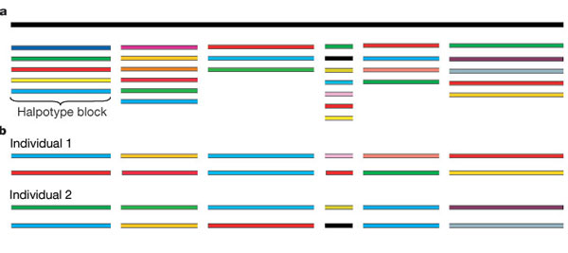
STATISTICAL PHASING
Reference haplotypes from many populations have been generated by large consortium efforts
Phasing algorithms break the genome into blocks in which # haploypes << # sequences
Pääbo, Nature, 2003

Slide 27
STATISTICAL PHASING
SNP arrays (e.g. Illumina, Affymetrix) provide enough information to match a sample to a pair of haplotypes across a large fraction of the genome
Switching errors can occur, especially at heterozygous SNPs
Does not detect de novo mutations
Admixture (recent mating between diverse populations) can confound phasing, especially if some populations are poorly represented in the reference haplotypes
Error rate increases with effective population size

Slide 28
IMPUTATION
Assigning genotypes at "missing sites" – i.e. sites not including on genotyping array or having low coverage/quality in WES/WGS
Logical next step after phasing – "fill in the blanks" using alleles from haplotypes that match at tag SNPs

Slide 29
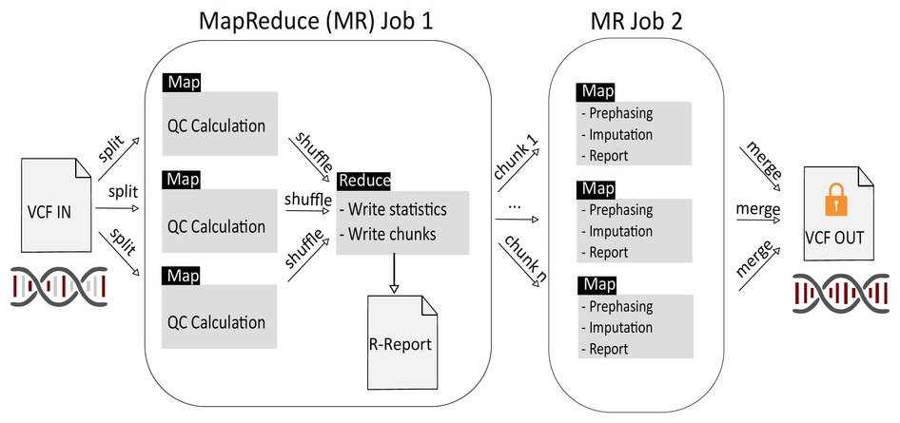
STATISTICAL PHASING AND IMPUTATION
The Michgan Imputation Server
Das et al., Nat Genet, 2016

Slide 30
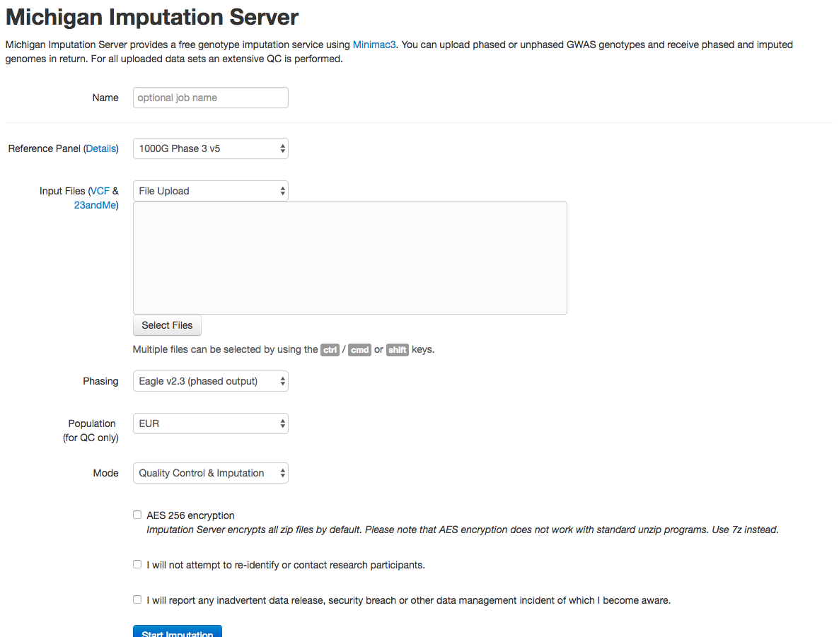
STATISTICAL PHASING AND IMPUTATION

Slide 31
STATISTICAL PHASING AND IMPUTATION
Michigan Imputation Server Workflow
Create account or login
Select reference panel
Haplotype Reference Consortium: large panel (>32k samples), mostly European ancestry
1000 Genomes: Smaller (~2500), multi-population (26) panel, 10M more sites than HRC, better for cosmopolitan populations
CAAPA: Small (~900) African American panel

Slide 32
STATISTICAL PHASING AND IMPUTATION
Michigan Imputation Server Workflow
Compress VCF file using bgzip (WhatsHap does this)
$ bgzip output/ceu_trio_chr22_jointcalls_phased.vcf
Upload VCF file
Leave other choices as default unless you have good reason to change them
Check AES 256 if you want extra security
Check remaining boxes
No re-identification of research participants
Promise to report any data breaches
Start imputation and wait – you'll get an email when it's done

Slide 33
EXPERIMENTAL DESIGN
De Novo Variation
When parents and offspring are differentially affected by a condition, a key question is whether the condition is inherited (recessive or incomplete penetrance) or is due to a de novo mutation
Generally, the parent-child trio must be sequenced at a minimum; sequencing additional affected and/or unaffected 1st and 2nd degree relatives may also help

Slide 34
EXPERIMENTAL DESIGN
De Novo Variation: Leverage prior knowledge
Is the phenotype known, or similar to one that is known?
Does the phenotype have characteristics that indicate a genetic cause?
Likelihood of being a protein-coding variant
Likelihood of being Mendelian
Is there family history (pedigree)?

Slide 35
EXPERIMENTAL DESIGN
De Novo Variation: Strategies
WGS is least biased but most expensive
Low-coverage screening of trios/pedigrees, followed by deep sequencing of candidate panel; if nothing turns up, you have the option of sequencing more deeply
WES or amplicon sequencing if you already have gene candidates
Gene expression (qPCR, RNA-Seq) can diagnose complex causes (e.g. splice variants)

Slide 36
TRIO CALLING WORKFLOW
Genotype Refinement
Use pedigree and population allele frequencies from high-confidence, multi-population reference (1000 Genomes) as priors for computing genotype probabilities for each sample at each site
Depending on your sample population, a different reference callset or a subset of 1000G might be better
Mendelian errors are penalized using a probability of de novo mutation (1 x 10⁻⁶ by default)

Slide 37
TRIO CALLING WORKFLOW
Exercise: Identify De Novo Variants
# Genotype refinement step 1: refine calls using 1000G
# priors
$ java –jar GenomeAnalysisTK.jar \
-R resources/human_g1k_v37.fasta \
-T CalculateGenotypePosteriors \
--supporting resources/1000G_22_sites.vcf \
-ped input/trio2/trio.fam \
-V output/ceu_trio_chr22_jointcalls_phased.vcf \
-L 22:24260000-24270000 \
-o output/ceu_trio_chr22_jointcalls_postCGP.vcf

Slide 38
TRIO CALLING WORKFLOW
Exercise: Identify De Novo Variants
# Genotype refinement step 2: filter out low-quality
# genotypes
$ java –jar GenomeAnalysisTK.jar \
-T VariantFiltration \
-R resources/human_g1k_v37.fasta \
-V output/ceu_trio_chr22_jointcalls_postCGP.vcf \
-L 22:24260000-24270000 \
-G_filter "GQ < 20.0" -G_filterName lowGQ \
-o output/ceu_trio_chr22_jointcalls_postCGP_filter.vcf

Slide 39
TRIO CALLING WORKFLOW
Exercise: Identify De Novo Variants
# Genotype refinement step 3: annotate possible de novo # variants
$ java –jar GenomeAnalysisTK.jar \
-T VariantAnnotator \
-R resources/human_g1k_v37.fasta \
-V output/ceu_trio_chr22_jointcalls_postCGP_filter.vcf \
-L 22:24260000-24270000 \
-A PossibleDeNovo \
-ped input/trio2/trio.fam \
-o output/ceu_trio_chr22_jointcalls_postCGP_deNovos.vcf

Slide 40
SOMATIC VARIANT CALLING
Somatic calling is similar to trio calling:
The germline tissue is the "parent"
The tumor is the "offspring"
We're looking for the variant calls that are different between in the tumor versus the germline (or normal) tissue...easy, right?

Slide 41
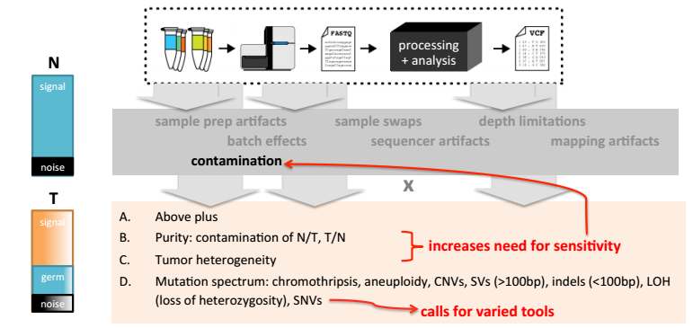
SOMATIC VARIANT CALLING
Somatic Calling Challenges
Broad Institute

Slide 42
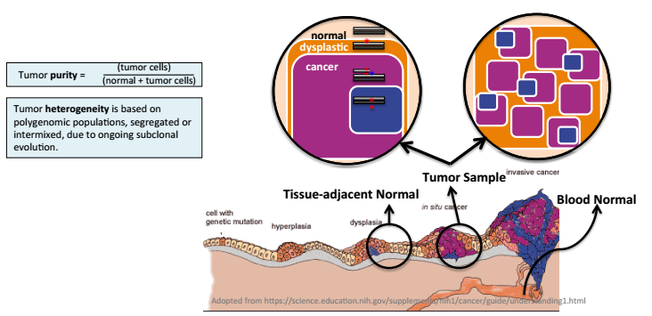
SOMATIC VARIANT CALLING
Somatic Calling Challenges: Purity and Heterogeneity
Broad Institute

Slide 43
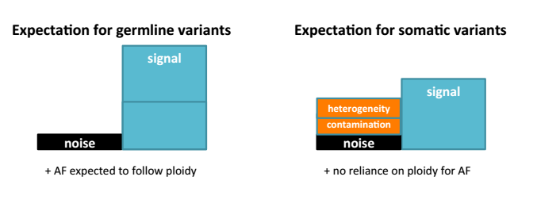
SOMATIC VARIANT CALLING
Somatic Calling Challenges: Signal to Noise
Broad Institute

Slide 44
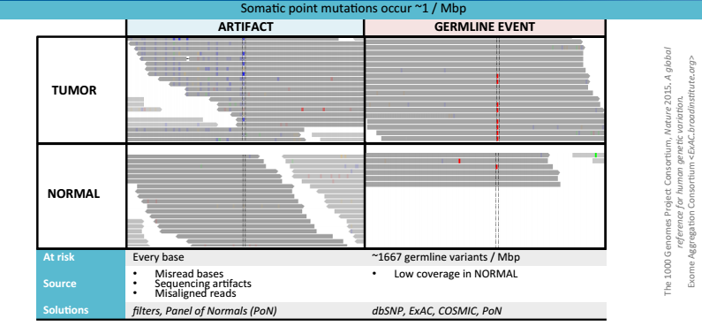
SOMATIC VARIANT CALLING
Somatic Calling Challenges: Artifacts and Uncalled Germline Events
Broad Institute

Slide 45
SOMATIC VARIANT CALLING
The good news: GATK has a new somatic variant caller, MuTect2, that is based on HaplotypeCaller and is reported to be very accurate
The bad news: It's not ready yet
Until then: We'll use a different tool, FreeBayes

Slide 46
VARIANT CALLING
FreeBayes
Bayesian variant caller – leverages base quality, alignment metrics, read depth, local sequence context, and population information
Performs haplotype-based calling
Designed to run on many individuals simultaneously
More samples == better accuracy
Sequencing errors detected as unique haplotypes
Performs local realignment across overlapping reads
https://github.com/ekg/freebayes

Slide 47
SOMATIC VARIANT CALLING
Exercise: Call Somatic Variants with FreeBayes
# We need two BAM files – one from normal
# tissue and one from a matched tumor sample.
$ freebayes -r 1:16899000-16920000 \
-f resources/human_g1k_v37.fasta \
--genotype-qualities --min-alternate-count 2 \
--pooled-discrete --min-alternate-fraction 0.05 \
input/somatic/normal.bam \
input/somatic/tumor.bam \
| scripts/somatic_filter 1e-5 18 0 \
| bgzip > output/somatic.vcf.gz \
&& tabix output/somatic.vcf.gz

