Slide 1
Population genetics and association studies
John Didion, PhD

Slide 2
POPULATION GENETICS
We can only learn so much studying individuals in isolation
For our data to be useful, we must
Compare to reference sequence and annotate with databases of known variants: predict/diagnose traits and diseases, identify causal mutations, precision medicine
Compare to other genomes (usually relative to pedigrees): kinship, de novo variation
Compare to reference populations: ancestry, admixture

Slide 3
POPULATION GENETICS
Population genetics is concerned with variation within and between populations
At the genetic level, populations are defined by allele frequencies
Each possible allele occurs at between 0-100%
Allele frequencies define genotype expectations: Hardy Weinberg principle
p² + 2qp + q² = 1
Allele frequencies change (and thus populations evolve) by four processes: selection, mutation, drift, gene flow

Slide 4
POPULATION GENETICS
Four Processes
Selection: relative advantage of one allele over another; often dependent on environment; e.g. sweep of lactase in European dairy farming populations
Mutation: new alleles arise in each generation and provide variation to be acted upon by selection
Genetic Drift: random changes in allele frequencies; effect is inversely correlated with population size
Gene flow: movement of alleles between populations; historically, nearby populations interbreed more, and are thus more similar; changing due to mobility of modern humans

Slide 5

POPULATION GENETIC STUDIES
WES/WGS are ideal, and often necessary, for clinical and many research applications
However, for population studies – hundreds to hundreds-of-thousands of samples – they are still too expensive
Instead, genotyping arrays are used

Slide 6
GENOTYPING ARRAYS
Rapid, cost-effective genotyping of a subset of known SNPs
Tend to be variants with common (>1%) frequency in European populations
Illumina BeadChip most widely used
Many designs, some disease-focused
Most popular: Omni (2.5 and 5M)
New Global Screening Array (GSA): ~660k, multi-ethnic, multi-disease, allows for custom content; ~$40/sample

Slide 7
GENOTYPING ARRAYS
Processing
More straight-forward than WES/WGS – software from Illumina generates VCFs
QC and data cleaning still important
Remove low-quality markers
Remove low-quality samples
Check for sample mix-ups (sex, ethnicity markers)

Slide 8
GENOTYPING ARRAYS
Imputation
Increases resolution of population studies
Quite accurate for most ancestries
Michigan Imputation Server will work for array genotypes; WhatsHap will not
Also available for laboratory mouse studies (GigaMUGA and upcomming multi-species array from NeoGen)

Slide 9
ASSOCIATION STUDIES
Binary Traits
To discover the genetic factors involved in diseases (especially complex diseases), we must study affected populations
In an association study, we are looking for statistically significant correlation between alleles and disease status (affected/unaffected)
Heterozygotes may or may not be affected (dominant/recessive traits)

Slide 10
ASSOCIATION STUDIES
Binary Traits (Case/Control Studies)
Case/Control studies require matched populations of affected and unaffected individuals
Matched means: as similar as possible in all aspects except the trait being studied
Many potential confounding factors: kinship, shared ancestry, correlated traits, genetic heterogeneity, pleiotropy

Slide 11
ASSOCIATION STUDIES
Quantitative Traits
Association can also be used to study continuous (quantitative) traits (e.g. height) – different alleles associated with larger or smaller trait values
Heterozygotes may have intermediate trait values, or they may have higher/lower than expected values (over/underdominance)

Slide 12
ASSOCIATION STUDIES
Quantitative Traits
Quantitative trait studies require genetically similar individuals with wide range of phenotypic values
These studies work for some human traits, e.g. morphology; however, they tend to require very large sample sizes (>100k)
More commonly applied to model organisms, in which genetic background can be controlled

Slide 13
ASSOCIATION STUDIES
Experimental Design
Know whether you're generating or testing hypotheses
Sample size and power
Estimate the frequency of the trait
Estimate the effect size of the trait
Determine the acceptable error rate
Compute the minimum necessary sample size (power analysis): http://powerandsamplesize.com/Calculators/
If you can't get close to the required sample size, either change your expectations or don't do the study!

Slide 14
ASSOCIATION STUDIES
Experimental Design
Eliminate any biases you can
Randomize in blocks when possible
Random rather than selective enrollment
Don't confound phenotype with enrollment site
Randomize sample batches
Recognize that non-biological variation is introduced at every step
Be cognizant of any biases you can't eliminate, and correct for them in the data

Slide 15
ASSOCIATION STUDIES
Types of Analyses
Single marker
Chi-Squared test
Multi-marker (epistasis)
Regression
Test all or subset of pairwise combinations
Haplotype
Regression
Uses known/observed haplotypes rather than individual markers
Family-based
Incorporate parental genotype/phenotype information

Slide 16
ASSOCIATION STUDIES
Types of Analyses
Phenotype
Significance of
association
aa aA AA
Single-Marker
ab aB
Epistasis
abcD aBDc AbCd
Haplotype

Slide 17
ASSOCIATION STUDIES
Covariates
Association studies can be confounded (false positives and false negatives) by factors that are correlated with the phenotype of interest
Sex
Relatedness
Ethnicity
Age
Co-morbidities
Environment

Slide 18
ASSOCIATION STUDIES
Covariates
If you can identify and quantify these covariates, you can correct for them, i.e. remove their effect from the association signal
Your experimental design should consider possible covariates and measure them ahead of time
Shared ancestry can be estimated using a sample covariance matrix
Principal Components Analysis (PCA) can identify hidden sources of variation

Slide 19
ASSOCIATION STUDIES
Rare Variants
Most association studies only investigate common variation – defined anywhere between 0.5-5%, depending on power
Rare variants may explain "missing heritability"
Thousands of samples required – low-coverage WGS, WES, or targeted sequencing
Gene- or region-based statistical testing
Targeted validation in large, independent cohorts

Slide 20
ASSOCIATION STUDIES
Plink
Complete genome association toolset
Originally developed by Purcell lab
Major update by Christopher Chang (BGI) – v1.9
Provides tools for data management, data cleaning, basic population genetics, LD, covariate correction, clustering, and association (single-marker, family-based, epistasis)

Slide 21
ASSOCIATION STUDIES
Plink Workflow
If starting from VCF, convert to Plink binary format
Create pedigree
Sample IDs must be unique
It's okay if your samples are unrelated (or relationships are unknown), just make up a family ID and put '0' for mother and father
Family ID can also be used to differentiate populations
If you don't know sexes, just put '0' – you can try to figure them out from sex chromosome markers
Phenotype information is critical!

Slide 22
ASSOCIATION STUDIES
Plink Workflow
Filter SNP and sample outliers (high missingness)
Basic statistics
Allele frequencies
Hardy-Weinberg
QC
Sexes
Relationship
Clustering

Slide 23
ASSOCIATION STUDIES
Plink Workflow
Case/control association
Single-marker
Logistic regression, correcting for covariates
Conditional analysis

Slide 24


ASSOCIATION STUDIES
Example Data
89 Asian (Chinese and Japanese) individuals from HapMap 1 populations
80k SNPs
Simulated phenotype with causal variant on chromosome 2
Causal variant: rs222162

Slide 25
ASSOCIATION STUDIES
Exercise: Association Study with Plink
# Steps 1 and 2 are already done for you.
# Example to convert from VCF to Plink binary;
# Use --vcf-min-gq to set low-quality genotypes
# to missing (or pre-filter).
$ plink --vcf hapmap1.vcf --vcf-min-gq 10 \
--out hapmap1
# This creates two files: hapmap1.bed
# (genotypes) and hapmap1.bim (genetic map).
# Now created the pedigree (hapmap1.fam) in
# your favorite text editor.
$ nano input/hapmap1/hapmap1.fam

Slide 26
ASSOCIATION STUDIES
Exercise: Association Study with Plink
# Step 3: Filtering. First, we'll look at rates
# of missing genotypes per-SNP and per-sample.
$ plink --bfile input/hapmap1/hapmap1 \
--missing --out output/hapmap1
# We can look at the output in text format...
$ less output/hapmap1.lmiss
$ less output/hapmap1.imiss
# ...but it's much more useful to plot

Slide 27
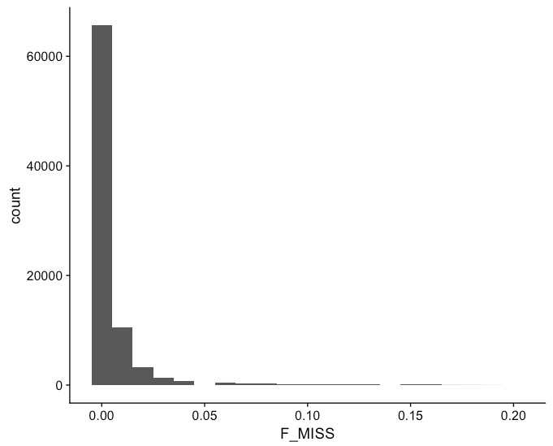
ASSOCIATION STUDIES
SNP Missingness
Only ~1% genotypes with
Missingness > 0.1

Slide 28
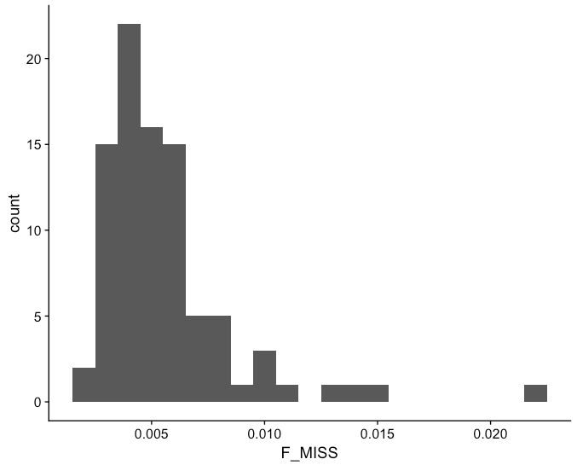
ASSOCIATION STUDIES
Individual Missingness
All individuals < 3%
missingness

Slide 29
ASSOCIATION STUDIES
Exercise: Association Study with Plink
# Step 3: Filtering. Let's remove the 1% of
# SNPs with > 10% missingness.
$ plink --bfile input/hapmap1/hapmap1 \
--geno 0.1 --make-bed \
--out output/hapmap1_filtered

Slide 30
ASSOCIATION STUDIES
Exercise: Association Study with Plink
# Step 4: Basic statistics
# Allele frequency: we'll compare frequencies
# between Japanese and Chinese populations. # For this, we use a phenotype file that codes
# population as a phenotype.
$ plink --bfile output/hapmap1_filtered \
--freq --within input/hapmap1/pop.phe

Slide 31
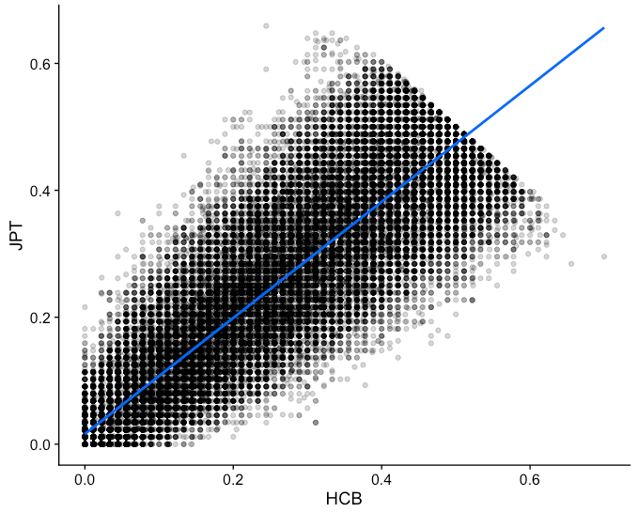
ASSOCIATION STUDIES
Allele Frequencies

Slide 32
ASSOCIATION STUDIES
Exercise: Association Study with Plink
# Step 4: Basic statistics
# Hardy Weinberg: we'll see if there are any
# SNPs that deviate from expectations within
# the case and control groups.
$ plink --bfile output/hapmap1_filtered \
--hardy --within input/hapmap1/pop.phe

Slide 33
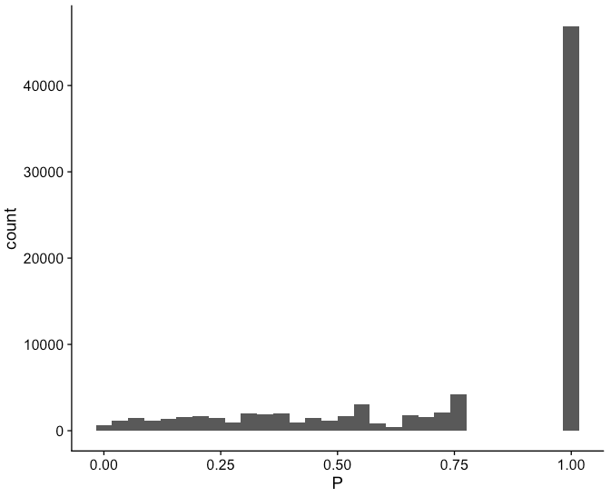
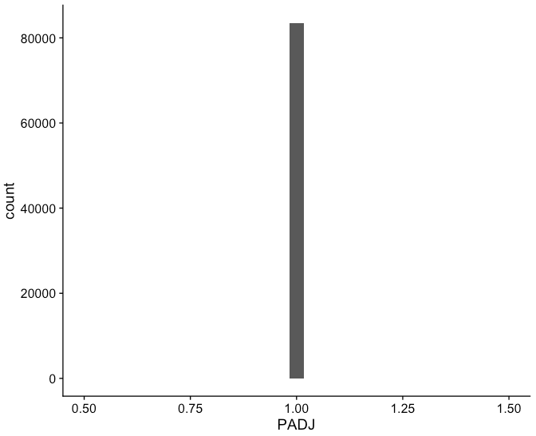
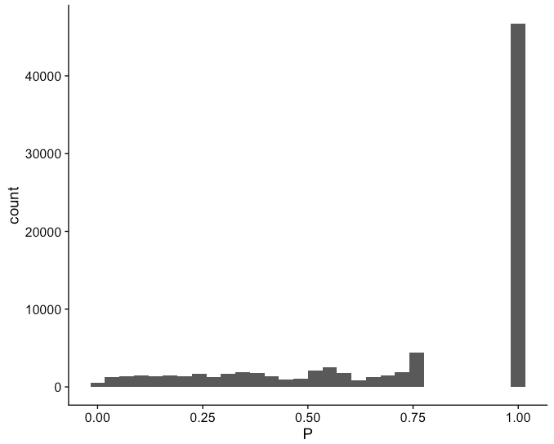
ASSOCIATION STUDIES
Hardy Weinberg
Cases
Controls

Slide 34
ASSOCIATION STUDIES
Exercise: Association Study with Plink
# Step 5: QC
# Now we'll check the sample sexes to make sure
# they are correct in the phenotype file.
$ plink --bfile output/hapmap1_filtered \
--check-sex --out output/hapmap1
# Uh oh, there's a problem

Slide 35
ASSOCIATION STUDIES
Exercise: Association Study with Plink
# Step 5: QC
# Two options: 1) remove the sample
$ plink --bfile output/hapmap1_filtered \
--remove invalid.txt --make-bed \
--out output/hapmap1_good
# 2) change the sex manually or using impute
$ plink --bfile output/hapmap1_filtered \
--impute-sex --make-bed \
--out output/hapmap1_good

Slide 36
ASSOCIATION STUDIES
Exercise: Association Study with Plink
# Step 5: QC
# Now we'll look at sample relatedness
# This command generates a covariance matrix,
# which is useful for visual representation
$ plink --bfile output/hapmap1_good \
--make-rel square --out output/hapmap1

Slide 37
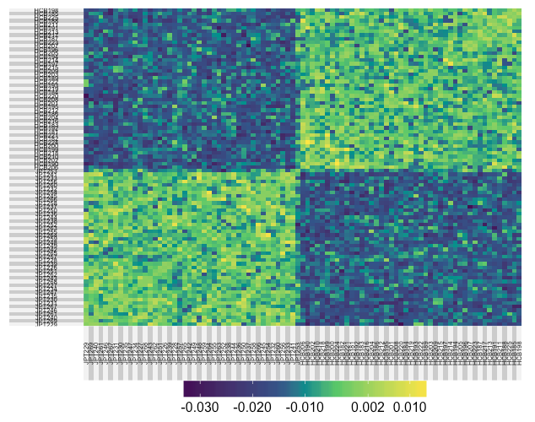
ASSOCIATION STUDIES
Exercise: Association Study with Plink

Slide 38
ASSOCIATION STUDIES
Exercise: Association Study with Plink
# Step 5: QC
# It doesn't look like there are any relateds
# but just to make sure, we'll look at the
# pairwise identity-by-state
$ plink --bfile output/hapmap1_good --genome \
--out output/hapmap1

Slide 39
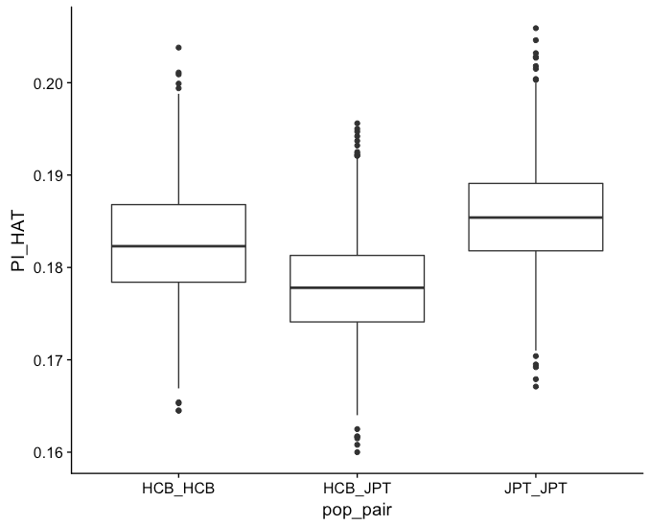
ASSOCIATION STUDIES
Identity By Descent

Slide 40
ASSOCIATION STUDIES
Exercise: Association Study with Plink
# Step 6: Clustering
# Now we'll cluster individuals based on
# genetic similarity, and we'll use
# Multidimensional Scaling to explore
# population structure.
$ plink --bfile output/hapmap1_good --cluster \
--cc --ppc 0.01 --mds-plot 5 \
--out output/hapmap1
# Let's look at the clustering
$ nano output/hapmap1.cluster1

Slide 41
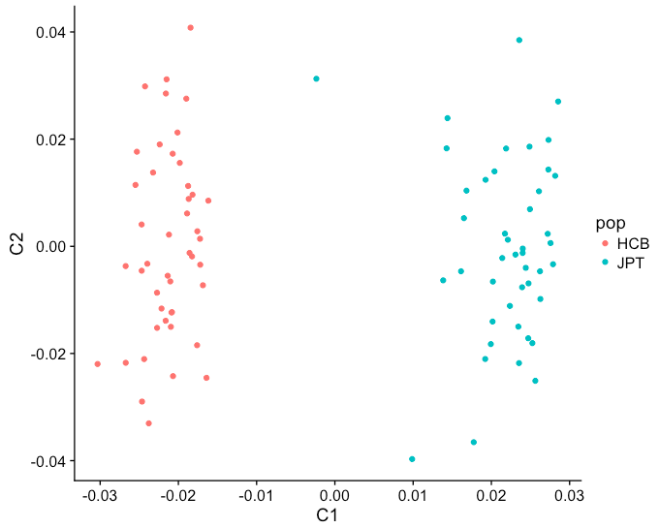
ASSOCIATION STUDIES
Multidimensional Scaling

Slide 42
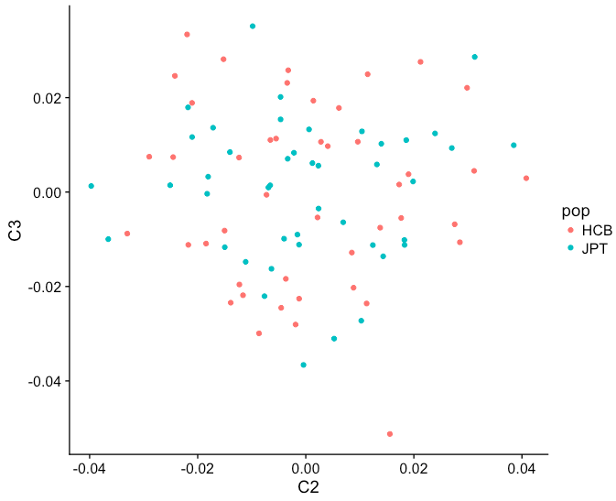
ASSOCIATION STUDIES
Multidimensional Scaling

Slide 43
ASSOCIATION STUDIES
Exercise: Association Study with Plink
# Step 7: Association
# First we'll perform basic single-marker
# analysis. We'll also perform multiple-test
# adjustment and permutation testing.
$ plink --bfile output/hapmap1_good \
--assoc perm --adjust --out output/hapmap1
# Sort the results by significance
$ sort --key=7 -nr hapmap1.assoc | head

Slide 44
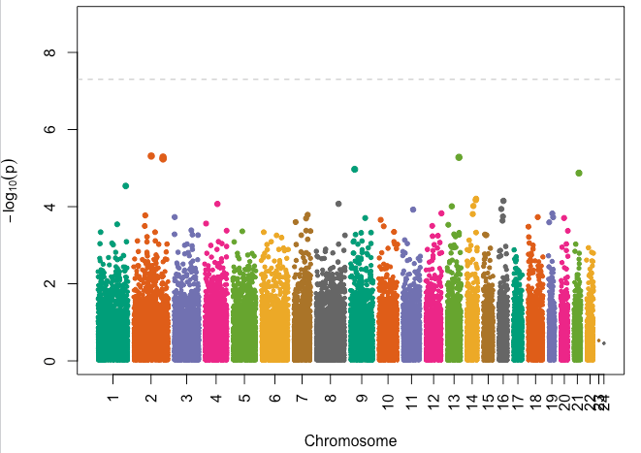
ASSOCIATION STUDIES
Manhattan Plot

Slide 45
ASSOCIATION STUDIES
Multiple Testing Correction
Each test we perform (e.g. single marker Chi-Squared test) increases the chance of seeing significant results by chance
Most popular way to correct for this is False Discovery Rate (FDR) control - this is what the '--adjust' option does
FDR tends to be overly conservative when there is LD; two better methods
LD pruning - remove SNPs that are in high linkage with other SNPs
Permutation testing - randomize the data and measure the frequency of observing same or larger effect size (OR)

Slide 46
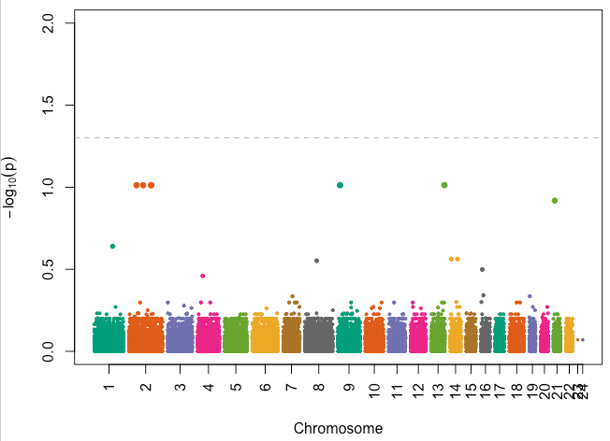
ASSOCIATION STUDIES
Manhattan Plot: FDR Adjusted

Slide 47
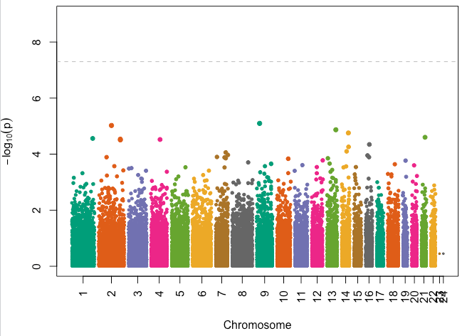
ASSOCIATION STUDIES
Manhattan Plot: Permutations

Slide 48
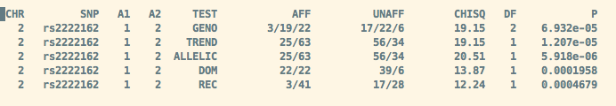
ASSOCIATION STUDIES
Exercise: Association Study with Plink
# Step 7: Association
# We can also test different models of the
# genotype-phenotype association. We'll just
# test one SNP.
$ plink --bfile output/hapmap1_good --model \
--cell 0 --snp rs2222162

Slide 49
ASSOCIATION STUDIES
Conditional Association
Simple association models can be made more realistic by adding terms to account for known covariates (sex, kinship, etc.)
"Conditioning" on a variable means to remove its effect from the association signal
Two examples:
Remove effect of genetic similarity within case and control groups
Remove effect of lead SNP to identify secondary (independent) association signals in high LD

Slide 50
ASSOCIATION STUDIES
Exercise: Association Study with Plink
# Step 7: Association
# Association conditional on clusters. Here
# we'll use the clusters generated earlier.
$ plink --bfile output/hapmap1_good --mh \
--within output/hapmap1.cluster2 \
--adjust --out output/hapmap1_cond

Slide 51
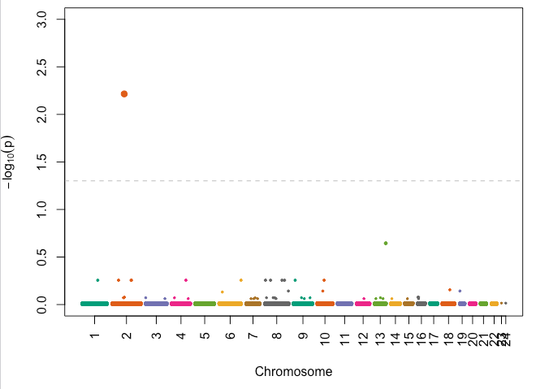
ASSOCIATION STUDIES
Manhattan Plot: Conditional Association

Slide 52
ASSOCIATION STUDIES
Exercise: Association Study with Plink
# Step 7: Association
# Alternatively, we could just condition on
# the known ancestry.
$ plink --bfile output/hapmap1_good --mh \
--within input/hapmap1/pop.phe \
--adjust --out output/hapmap1_cond2

Slide 53
ASSOCIATION STUDIES
Quantitative Traits
In our example, the actual (simulated) phenotype is quantitative -- think BMI or blood pressure rather than obese/not-obese; we just converted it to binary by splitting at the median value.
We can perform an association study directly on the quantitative phenotype using linear modeling (e.g. regression).

Slide 54
ASSOCIATION STUDIES
Exercise: Association Study with Plink
# Step 7: Quantitative trait association
# Plink chooses the association method
# automatically based on whether the phenotype
# is binary or continuous.
$ plink --bfile output/hapmap1_good --assoc \
--pheno input/hapmap1/qt.phe --adjust \
--out output/hapmap1_qt
# We can also do conditional analysis and
# permutations
$ plink --bfile output/hapmap1_good \
--assoc perm --pheno input/hapmap1/qt.phe \
--within input/hapmap1/pop.phe \
--out output/hapmap1_qt_cond

Slide 55
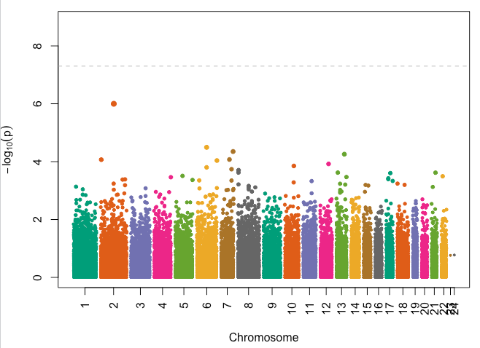
ASSOCIATION STUDIES
Manhattan Plot: Quantitative Trait, Permutations

Slide 56
ASSOCIATION STUDIES
Exercise: Association Study with Plink
# Another question we might want to ask is
# whether the association signal is stronger in
# one population versus the other. Here we'll
# treat ethnicity like an environmental factor
# and perform gene x environment (GxE) analysis
$ plink --bfile output/hapmap1_good \
--pheno input/hapmap1/qt.phe --gxe \
--covar input/hapmap1/pop.phe \
--snp rs2222162 --out output/rs2222162_diff
.

Slide 57
FINE MAPPING
A Manhattan plot gives an overview of your results, but you want to know which are the most likely to be causal for your trait of interest
Fine mapping is a general term to describe identifying the most likely causal variants within each locus (gene or LD block)
You then prioritize this subset of likely causal variants for functional analysis (knock-down/out, overexpression, CRISPR)

Slide 58
FINE MAPPING
Locus Prioritization
Filter results by some minimal significance threshold and then sort by effect size
Case/control: the Odds Ratio (OR) is the effect size
Effect > 1 means the variant allele is correlated with the trait; effect < 1 means anti-correlated
More useful to first convert effect < 1 (1/OR) before sorting
Quantitative: the Beta is the effect size
Direction of effect indicated by Beta > or < 0

Slide 59
FINE MAPPING
Locus Prioritization
Group results by region
Genes (WES data)
Size windows (50 kb)
SNP windows (25-50 SNPs, depending on density)
LD blocks - only works for single population; Plink can do this (--blocks option)
Sort by max effect size in each region
Select some number of regions to investigate

Slide 60
FINE MAPPING
PAINTOR
More sophisticated fine-mapping method that incorporates functional information, e.g.
Gene expression
Chromatin state
Conservation
Based on per-SNP or per-region summary statistics
Ideally, you'll have multiple studies on the same phenotype in different populations (meta-analysis)

Slide 61

FINE MAPPING
PAINTOR
Z-score is the summary statistic
For case/control, computed as where f⁺ and f⁻ are the frequencies in the case and control populations, and f = f⁺ + f⁻.
For quantitative traits, it's Beta / SE

Slide 62
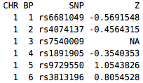
FINE MAPPING
PAINTOR Workflow
Perform association study (or studies)
Compute summary statistics (example code in cookbook)
Divide data into regions
Later we'll see how to do this with bedtools

Slide 63
FINE MAPPING
PAINTOR Workflow
Prepare annotations
LD between SNPs in each loci
PAINTOR provides a tool based on 1000 Genomes data
Plink can also do this
SNP functional annotation: PAINTOR provides a tool, as well as a database of functional annotations
Run analysis
Use CANVIS to plot each locus

Slide 64
ASSOCIATION STUDIES
Generate LD Matrix
# For this example we'll just use the first
# 10 SNPs. You'll want to run this command
# for each region.
$ plink --bfile output/hapmap1_good --chr 1 \
--r2 square --snps rs6681049-rs3128342

Slide 65
ASSOCIATION STUDIES
Annotate Loci
# For locus annotation, we use the
# AnnotateLocus tool supplied with PAINTOR.
# You need to download the database which is
# quite large (link in cookbook).
$ python AnnotateLocus.py \
--input annotation_paths \
--locus Locus1 \
--out Locus1.annotations \
--chr CHR \
--pos POS

Slide 66
ASSOCIATION STUDIES
Exercise: PAINTOR Analysis
# Run PAINTOR on all the loci
$ paintor -input input/paintor/input.files \
-in input/paintor -LDname ld -Zhead Zscore \
-out output

Slide 67
ASSOCIATION STUDIES
Exercise: PAINTOR Analysis
# Now we'll visualize the output. We'll use a
# more interesting example here. We'll use a
# liver histone mark as the functional
# annotation.
$ python scripts/CANVIS.py \
-o output/canvis_output.svg \
-l input/CANvis_Sample/chr4.rs6831256.post \
-z ldl.Zscore \
-r input/CANvis_Sample/chr4.rs6831256.ld \
-a input/CANvis_Sample/chr4.rs6831256.annot \
-s E066.H3K27ac.narrowPeak.Adult_Liver

