Slide 1
Haplotypes, Somatic and de novo variant calling
John Didion, PhD

Slide 2
PLOIDY
Plants and animals have multiple copies of each autosome
Humans have 2 (diploid)
Some plants have 4 or 8
Sex chromosomes are handled differently
In humans, females have twice as many X chromosomes, and males have a Y chromosome
Many implications for coverage depth, genotype probabilities, and copy number
Mitochondrial DNA is also different – haploid, maternally inherited, high copy (>1k/cell), mosaicism

Slide 3
HAPLOTYPES
The alleles at polymorphic sites on a single chromosome constitute a haplotype
Two alleles on the same chromosome are said to be "in phase"
It is impossible to determine phase from genotypes absent any linkage information
Sequencing data provides linkage information:
Ref: AAGTACATCGACATAGAAACATGATAGAA
Read: AAGCAGATC----------CAGGATAGAC

Slide 4
HAPLOTYPES
Importance
Alleles within the same haplotype "tag" each other
In humans, a relatively small number of variants is required to indicate the haploid sequences of the entire genome (with some level of error)
Some phenotypes are dependent on two or more alleles occurring on the same chromosome
Enable allele-specific analyses of gene expression and epigenetics

Slide 5
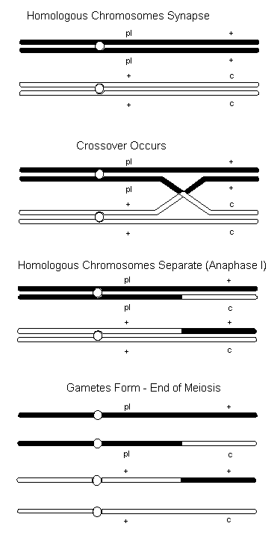
RECOMBINATION
Imagine two hypothetical ancestors of all humans ("Adam and Eve")
Meiotic recombination generates unique haplotypes
Haplotypes combine uniquely in each mating
Offspring establish their own lineages (populations) with some haplotypes more frequent than others
Haplotype diversity is maintained through outbreeding

Slide 6
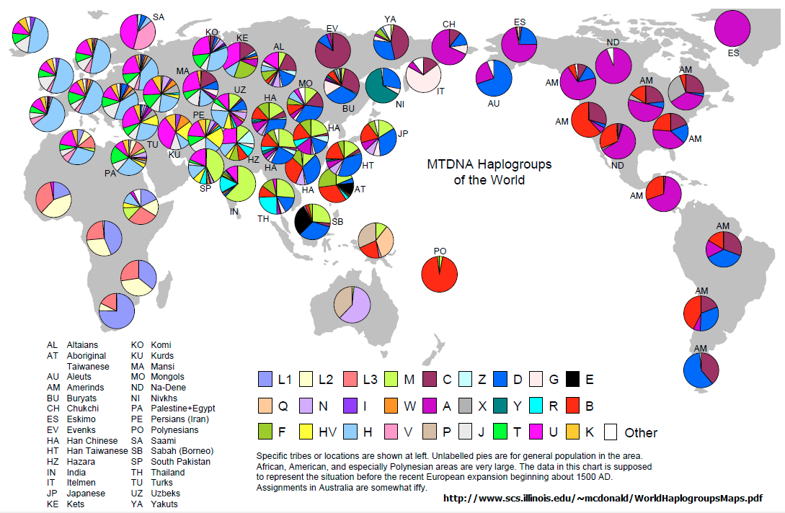
RECOMBINATION
Example: mtDNA Haplogroups

Slide 7
LINKAGE DISEQUILIBRIUM (LD)
Non-random association of two alleles due to co-inheritance
Expressed in terms of correlation coefficient (r²) between 0-1, where 1 means alleles are always inherited together
Generally, the closer two sites are on the same chromosome, the higher their LD
LD extends over fairly long distance in humans – on average, sites 50 kb apart have r² > 0.8
This fact is key to the success of human genomic studies

Slide 8
DETERMINING HAPLOYPTES (PHASING)
Three methods
Probabilistic: given a large number of reference sequences, identify patterns of co-occurring alleles; match new samples to these patterns
Semi-deterministic: given genotypes of multiple individuals in a pedigree, offspring haplotypes can be determined from parents (except when both parents are heterozygous)
Direct: some cutting-edge sequencing methods/technologies enable phase to be determined over long distances (10s to 100s of kb)

Slide 9
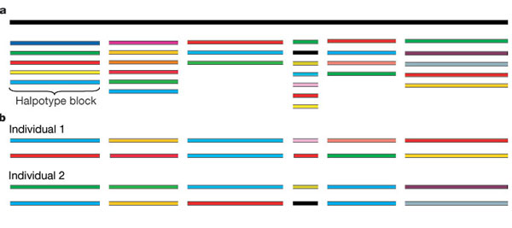
PROBABALISTIC PHASING
Reference haplotypes from many populations have be generated by large consortium efforts
Phasing algorithms break the genome into blocks in which # haploypes << # sequences

Slide 10
PROBABALISTIC PHASING
Low-density SNP arrays (e.g. Illumina, Affymetrix) provide enough information to match a sample to a pair of haplotypes across a large fraction of the genome
Switching errors can occur, especially at heterozygous SNPs
Does not detect de novo mutations
Admixture (recent mating between diverse populations) can confound phasing, especially if some populations are poorly represented in the reference haplotypes
Error rate increases with effective population size

Slide 11
IMPUTATION
Assigning genotypes at "missing sites" – i.e. sites not including on genotyping array or having low coverage/quality in WES/WGS
Logical next step after phasing – "fill in the blanks" using alleles from haplotypes that match at tag SNPs

Slide 12
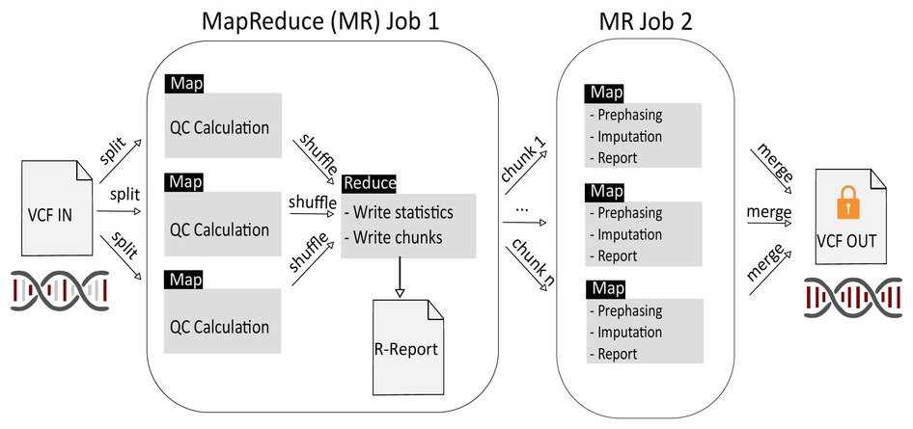
PROBABALISTIC PHASING AND IMPUTATION
The Michgan Imputation Server

Slide 13
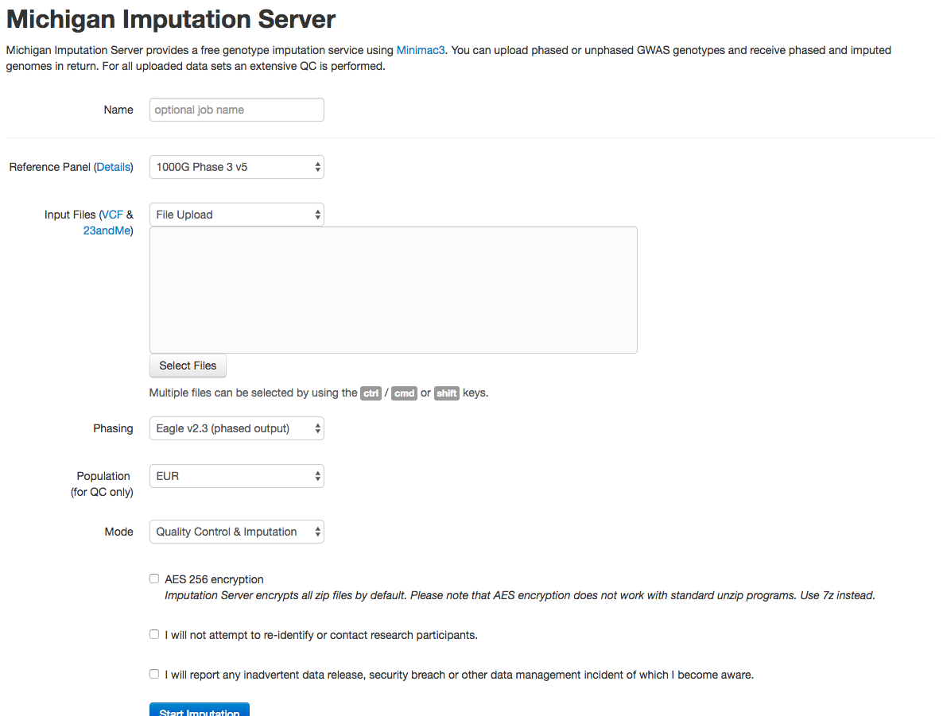
PROBABALISTIC PHASING AND IMPUTATION

Slide 14
PROBABALISTIC PHASING
Michigan Imputation Server Workflow
Select reference panel
Haplotype Reference Consortium: large panel (>32k samples), mostly European ancestry
1000 Genomes: Smaller (~2500), multi-population (26) panel, 10M more sites than HRC, better for cosmopolitan populations
CAAPA: Small (~900) African American panel

Slide 15
PROBABALISTIC PHASING
Michigan Imputation Server Workflow
Compress VCF file using bgzip
$ bgzip output/NA12878_wgs_20_HC_jointcalls.vcf
Upload VCF file
Leave other choices as default unless you have good reason to change them
Check AES 256 if you want extra security
Check remaining boxes
No re-identification of research participants
Promise to report any data breaches
Start imputation and wait – you'll get an email when it's done

Slide 16
PROBABALISTIC PHASING
Whole-genome and whole-exome data provides more accurate phasing due to linkage information in reads

Slide 17
GERMLINE VS SOMATIC
Germline variants were present at or before the zygote stage and exist in most/all cells in the body; these are the variants that will be passed to the next generation
Somatic variants arise later
Typically associated with a disease process
Generally discussed in the context of cancer – mutations present in tumors
Somatic variant calling requires matched somatic and germline samples (e.g. tumor/normal)

Slide 18
EXPERIMENTAL DESIGN
De Novo Variation
When parents and offspring are differentially affected by a condition, a key question is whether the condition is inherited (recessive or incomplete penetrance) or is due to a de novo mutation
Generally, the parent-child trio must be sequenced at a minimum; sequencing additional affected and/or unaffected 1st and 2nd degree relatives may also be necessary

Slide 19
EXPERIMENTAL DESIGN
De Novo Variation: Leverage prior knowledge
Is the phenotype known, or similar to one that is known?
Does the phenotype have characteristics that indicate a genetic cause?
Likelihood of being a protein-coding variant
Likelihood of being Mendelian
Is there family history (pedigree)?

Slide 20
EXPERIMENTAL DESIGN
De Novo Variation: Strategies
WGS is least biased but most expensive
Low-coverage screening of trios/pedigrees, followed by deep sequencing of candidate panel; if nothing turns up, you have the option of sequencing more deeply
WES or amplicon sequencing if you already have gene candidates
Gene expression (qPCR, RNA-Seq) can diagnose complex causes (e.g. splice variants)

Slide 21
EXPERIMENTAL DESIGN
De Novo Variation: Variant Calling
Beginning workflow is same as germline calling
Call all samples using HaplotypeCaller, or
Call each sample separately in GVCF mode, then genotype jointly
After recalibration and filtering, perform additional refinement to identify candidate de novo variants

Slide 22
EXPERIMENTAL DESIGN
Exercise: Variant Calling in Trio
# NA12878 and NA12877 are the parents; NA12882 is the
# child
$ java -jar GenomeAnalysisTK.jar -T HaplotypeCaller \
-R $DATA/ref/human_g1k_b37_20.fasta \
-I $DATA/bams/trio-calling/NA12878_wgs_20.bam \
-I $DATA/bams/trio-calling/NA12877_wgs_20.bam \
-I $DATA/bams/trio-calling/NA12882_wgs_20.bam \
-o output/wgs_20_HC_jointcalls.vcf \
-L 20:10,000,000-10,200,000

Slide 23
EXPERIMENTAL DESIGN
Exercise: Variant Calling in Trio
Open the file in IGV and browse to 20:10,024,000-10,024,500
Variant at 10,024,300: Parents are both CTT/CTT, but offspring is C/CTT – is this a de novo mutation?

Slide 24
EXPERIMENTAL DESIGN
Exercise: Variant Calling in Trio
# Normally we would filter variants using VQSR.
# Today we'll use a hard filter.
$ java -jar GenomeAnalysisTK.jar \
-T VariantFiltration \
-R $DATA/ref/human_g1k_b37_20.fasta \
-V output/wgs_20_HC_jointcalls.vcf \
--filterExpression "QD < 2.0 || \
SOR > 3.0 || MQ < 40.0 || MQRankSum < -12.5 || \
ReadPosRankSum < -8.0" \
--filterName "HARD_FILTER" \
-o output/wgs_20_HC_joint_filtered_snps.vcf

Slide 25
EXPERIMENTAL DESIGN
Exercise: Variant Calling in Trio
Open the filtered file in IGV
Right-click on variant call track and choose "Suppress Filtered Sites" – notice our suspect variant goes away

Slide 26
EXPERIMENTAL DESIGN
Genotype Refinement
Use pedigree and population allele frequencies from high-confidence, multi-population reference (1000 Genomes) as priors for computing genotype probabilities for each sample at each site
Depending on your sample population, a different reference callset or a subset of 1000G might be better
Mendelian errors are penalized using a probability of de novo mutation (1 x 10⁻⁶ by default)

Slide 27
EXPERIMENTAL DESIGN
Exercise: Variant Calling in Trio
# Genotype refinement step 1: refine calls using 1000G
# priors
$ java -jar SNPGenomeAnalysisTK.jar \
-R $DATA/ref/human_g1k_b37_20.fasta \
-T CalculateGenotypePosteriors \
--supporting $DATA/vcfs/1000G_20.sites.vcf \
-ped $DATA/bams/trio-calling/trio.ped \
-V output/wgs_20_HC_joint_filtered_snps.vcf \
-L 20:10000000-10200000 \
-o output/wgs_20_HC_joint_postCGP.vcf

Slide 28
EXPERIMENTAL DESIGN
Exercise: Variant Calling in Trio
# Genotype refinement step 2: filter out low-quality
# genotypes
$ java -jar SNPGenomeAnalysisTK.jar \
-T VariantFiltration \
-R $DATA/ref/human_g1k_b37_20.fasta \
-V output/wgs_20_HC_joint_postCGP.vcf \
-L 20:10000000-10200000 \
-G_filter "GQ < 20.0" -G_filterName lowGQ \
-o output/wgs_20_HC_joint_postCGP_filtered.vcf

Slide 29
EXPERIMENTAL DESIGN
Exercise: Variant Calling in Trio
# Genotype refinement step 3: annotate possible de novo # variants
$ java -jar SNPGenomeAnalysisTK.jar \
-T VariantAnnotator \
-R $DATA/ref/human_g1k_b37_20.fasta \
-V output/wgs_20_HC_joint_postCGP_filtered.vcf \
-L 20:10000000-10200000 \
-A PossibleDeNovo \
-ped $DATA/bams/trio-calling/trio.ped \
-o output/wgs_20_HC_joint_postCGP_filtered_deNovos.vcf

