Slide 1
Beyond SNPs: indels, copy number variants, and structural variants
John Didion, PhD

Slide 2
INDEL CALLING
InDel is detected as a loss or gain relative to the reference
Reference: ACCATAGC ACC--ATAGC
Allele A: ACC--AGC ACCGGATAAC
Allele B: ACC--AGC ACCGGATAAC
SNV callers generally also detect indels from 1 bp up to about the length of a sequencing read

Slide 3
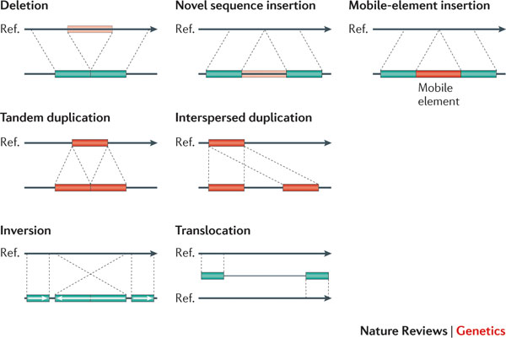
SV CALLING

Slide 4
SV CALLING
The ability to detect SVs depends on several factors:
Duplications: size, age, number of copies
Deletions: size, hemi- or homozygous, uniqueness of deleted sequence
Translocations and inversions: number of reads spanning breakpoint(s), ability of aligner to map split reads
SV calling requires specialized tools – SNV callers won't do this
SV callers don't agree well; generally best to take consensus of multiple tools

Slide 5
GERMLINE VS SOMATIC
Germline variants were present at or before the zygote stage and exist in most/all cells in the body; these are the variants that will be passed to the next generation
Somatic variants arise later
Typically associated with a disease process
Generally discussed in the context of cancer – mutations present in tumors
Somatic variant calling requires matched somatic and germline samples (e.g. tumor/normal)

