Slide 1
Beyond SNPs, Part 2: copy number and other structural variation
John Didion, PhD

Slide 2
VARIANT CALLING
Types of Variants
SNP: Single Nucleotide Polymorphism
Small insertions and deletions (indels)
Large (>100 bp) Structural Variants (SVs)
Copy-variable: Duplications, Deletions
Copy-neutral: Inversions, Translocations
Complex combinations of events
Germline versus somatic

Slide 3
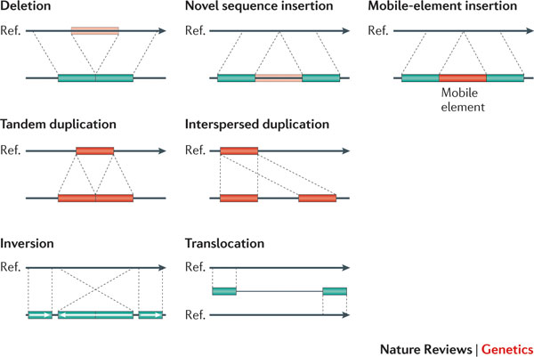
SV CALLING

Slide 4
SV CALLING
Importance
Account for < 1% of variants
In terms of bp, are responsible for a larger share of differences between genomes than are SNPs and indels combined
Many genes subject to loss/gain; most are redundant, but some are associated with disease
Translocations can also cause loss or gain of function; can lead to mono/trisomy in offspring
SV is commonly associated with cancer

Slide 5
SV CALLING
Detection
SVs are by definition longer than Illumina read lengths (hundreds to millions of bp)
Strategies
Paired-end Illumina
Reads can span SV boundaries
Discordant reads indicate deletions
CNV detection by read depth
Long read technologies
Optical mapping (BioNanno)

Slide 6
LONG READ SEQUENCING
Benefits
PacBio and Nanopore can generate reads of 10kb and longer (average is more in the 1-5 kb range)
PacBio increasingly used to:
Detect/resolve “difficult” regions
Assemble genomes of non-model organisms
Nanopore is compact, “real time” – increasingly used “in the field”
Can detect DNA modifications (e.g. methylation)
Soon will be possible to sequence RNA directly (i.e. without cDNA conversion)

Slide 7
LONG READ SEQUENCING
(Current) Drawbacks
More expensive (but rapidly dropping)
Higher error rates; however:
These are also rapidly dropping
PacBio errors are random and thus correctable; software-corrected accuracy > 99%
Less tool support (but rapidly increasing)

Slide 8
LONG READ SEQUENCING
Synthetic Long Reads
Paired-end sequencing of long inserts
Used for:
Cheaper genome assembly
Genome phasing (i.e. resolving haplotypes)
Resolving large structural variants
Three options:
Manual: TruSeq long-read, Nextera mate-pair, HiC
Automated: 10X Chromium
Outsourced: Dovetail Genomics

Slide 9
SV CALLING
Detection
Depends on several factors:
Duplications: size, age, number of copies
Deletions: size, hemi- or homozygous, uniqueness of deleted sequence
Translocations and inversions: number of reads spanning breakpoint(s), ability of aligner to map split reads
GATK and other small variant callers won't detect SVs; specialized tools are required

Slide 10
SV CALLING
SV Calling Strategies
Four strategies
Read pair (RP): evaluate paired-end read fragment size and orientation
Read count (RC): detect CNVs as regions of significantly higher/lower coverage than a regional or genome-wide average
Split-read (SR): breakpoint identification within read sequences; requires a split-read aligner such as BWA
Assembly (AS): assemble genome from sequencing reads, compare to reference to identify SVs; requires long reads

Slide 11
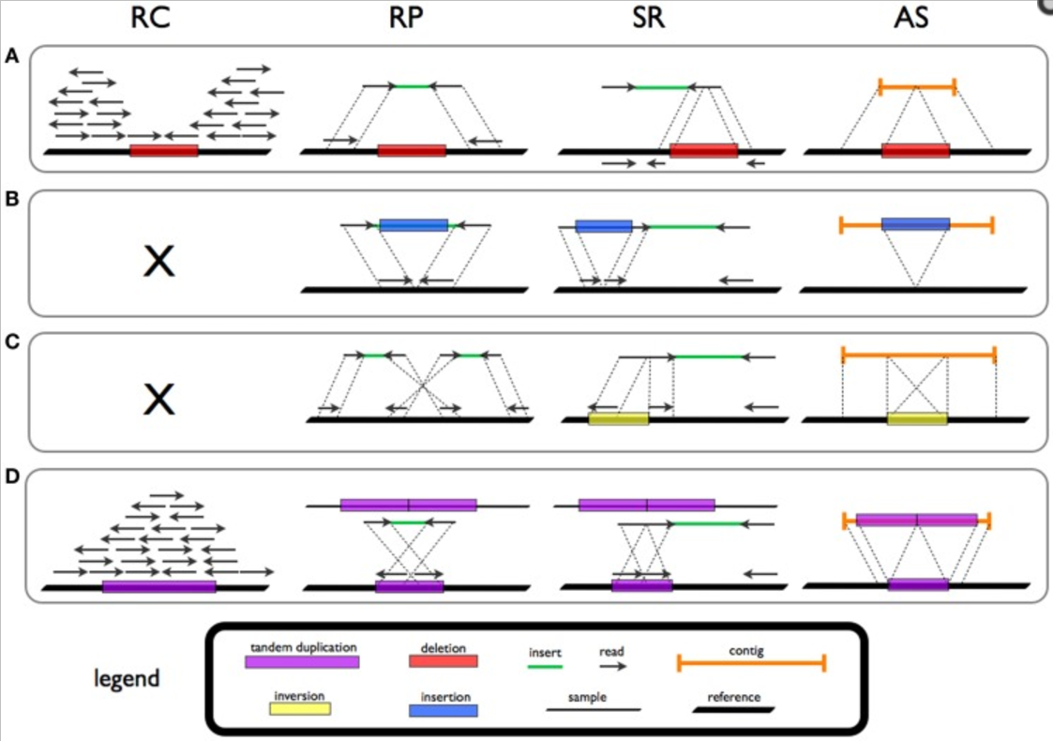
SV CALLING
SV Calling Strategies
Deletion
Insertion
Inversion
Duplication
Tattini et al., Front. Bioeng. Biotech., 2015

Slide 12
SV CALLING
SV Calling Tools
Most require whole-genome sequence; only a few work with exomes
SV calling is challenging – different tools don’t agree well; the best strategy is consensus of multiple tools
Some tools able to integrate short read (for CNV) and long read (for breakpoint discovery) data
Validate any important findings (Array CGH, targeted sequencing)

Slide 13
SV CALLING
SV Calling Tools
Today we'll use two tools:
Delly2: detects SVs using a combination of paired-end and split-read approaches; provides visualization tools
Canvas: CNV caller used in Illumina pipeline; can work on exome data
Both detect germline and somatic SVs
Well also use a tool (SURVIVOR) to merge results from Delly2 and Canvas and perform consensus calling

Slide 14
SV CALLING
Exercise: SV Calling with Delly2
Delly2 can call 5 types of events
DEL (deletion)
DUP (duplication)
INV (inversion)
BND (translocation)
INS (small insertions)
Each event must be called separately, i.e. run Delly2 up to 5 times per BAM
Rather than discover SVs, Delly2 can also genotype a set of known SVs (-v option).

Slide 15
SV CALLING
Exercise: Germline SV Calling with Delly2
# Call events in for loop; exclude problem regions.
$ for $TYPE in DEL DUP INV BND ; do
delly call -t $TYPE -o output/sv_$TYPE.bcf \
-g resources/Homo_sapiens_assembly38.fasta \
-x resources/sv_exclude_regions.txt \
input/sv/lumpy_input.bam \
done
# Output is in BCF (binary VCF) format. Use
# bcftools to convert (don't show header).
$ bcftools view -H output/sv_DEL.bcf

Slide 16
SV CALLING
Exercise: Somatic SV Calling with Delly2
Somatic SV calling is similar - just provide two BAM files instead of one (tumor first, then normal)
After SV calling, it's a good idea to genotype controls at discovered sites to eliminate false-positives (if you find a tumor SV in a control sample, then it's not tumor-specific)

Slide 17
SV CALLING
Exercise: Somatic SV Calling with Delly2
$ for $TYPE in DEL DUP INV BND ; do
delly call -t $TYPE \
-o output/sv_$TYPE_somatic.bcf \
-g resources/human_g1k_v37.fasta \
-x resources/sv_exclude_regions.txt \
input/somatic/tumor.bam \
input/somatic/normal.bam \
done

Slide 18
SV CALLING
Exercise: Somatic SV Calling with Delly2
# Regenotype controls
$ delly call -t DEL -o output/ctrl.bcf \
-g resources/human_g1k_v37.fasta \
-x resources/sv_exclude_regions.txt \
-v output/sv_DEL_somatic.bcf
input/sv/somatic_control.bam

Slide 19
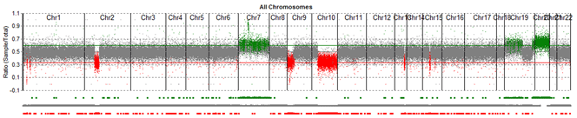
SV CALLING
Comprehensive CNV Calling
SV Callers detect segmental duplications
However, in cancer, very large (even whole-chromosome) gains and losses can occur; SV callers may not detect these

Slide 20
SV CALLING
Comprehensive CNV Calling
CNV callers first estimate the mean genome coverage, then scan in windows to identify regions that are significantly above/below average
This is a time-consuming process that can't be run on a small subset of the genome; thus not well suited to our workshop
Canvas is a CNV caller from Illumina; example usage in the cookbook

Slide 21
SV CALLING
Merging SV Calls
SV callers are highly discordant
Best strategy: run 2-3 callers and take a consensus of the results
We'll use SURVIVOR, a useful SV toolkit

Slide 22
SV CALLING
Exercise: Merge SV Calls
# Consensus of SV calls from two programs
# Arguments are:
# file with list of vcfs (1 per line)
# max distance for merging SVs
# minimum callers required to support a SV
# consider SV types
# consider strand information
# estimate distance based on SV size
# <ignored>
# output prefix
$ survivor 5 input/sv/sample_files \
1000 2 1 1 0 30 output/sample_merged.vcf

