Slide 1
Lecture 1 — Introduction to Statistics & Exploratory Data Analysis
Michal Kolář
IMG
Prague, 06/2026
Notes:
Companion theory lecture for
Practical Session 1 (`01_exploratory_data_analysis.ipynb`).
Structured as slide content + speaker notes.
Part I is the general introduction (3 slides);
Part II walks through the concepts students will use in the notebook.

Slide 2
Why we do statistics?
Exploratory Data Analysis (EDA)
Notes:
Companion theory lecture for
Practical Session 1 (`01_exploratory_data_analysis.ipynb`).
Structured as slide content + speaker notes.
Part I is the general introduction (3 slides);
Part II walks through the concepts students will use in the notebook.

Slide 3
Why statistics? (motivation)
The core problem: the world is variable, and we only ever see part of it
Statistics is the discipline for learning from data under uncertainty: describing what we see, quantifying how sure we can be, and deciding what the data do (and don't) support.
Measure the same thing twice — two cells, two patients, two towns — and you get different numbers.
That variability is not error to be wiped away; it is the signal.
We almost never observe the whole population; we work from a sample and want to say something about the whole.
The goal of exploratory data analysis is to be surprised by your data now in private,
rather than later, in front of reviewers ☺
Notes:
Pose the two framings the course is built on
the **descriptive** question ("what does this dataset look like?") and
the **inferential** question ("what does it tell me about the world beyond it?").
Session 1 is entirely descriptive (EDA); sessions 2–4 build inference on top.
EDA is where you *look before you leap*: get a feel for the data before testing anything.
A good throwaway line — "the goal of EDA is to be surprised by your data *now*, in private, rather than later, in front of reviewers."

Slide 4

The central abstraction: the random variable
A random variable is a quantity whose value is set by the outcome of a random process
Convention: uppercase for the random variable (X), lowercase for a value it takes (x). A coin toss: X = 1 for heads, 0 for tails.
A probability distribution is the rulebook — which values X takes and how often: its location, scale and shape.
A dataset is a stack of observed values of random variables.
Data have a distribution behind them — EDA sketches it.
Notes:
Resist over-formalizing — no measure theory, no sample spaces. The one intuition that earns its keep: data have a distribution behind them, and EDA (histograms, boxplots, summary statistics) is how we sketch that hidden distribution from a finite sample. Everything in sessions 2–4 is about reasoning back from the sample to that distribution.

Slide 5

A short history
From gambling tables to the lab bench
1654 — Blaise Pascal & Pierre de Fermat trade letters on the problem of points; probability theory — and expected value — is born.
18th–19th c. — Gauss & Legendre develop least squares and the normal (Gaussian) distribution; Quetelet applies statistics to people.
Early 20th c. — Gosset (“Student”) derives the t-distribution at Guinness (1908); Pearson gives correlation and chi-squared; Fisher builds ANOVA and the p-value.
Describing the state → modelling chance → deciding in experiments
Notes:
Tie the names to the syllabus — Student's t (session 2), Pearson correlation and Fisher/ANOVA (sessions 3–4) all appear by name in the notebooks. The arc: statistics went from describing the state, to modelling chance, to deciding in experiments — exactly the path these four sessions follow.
Optional aside, the problem of points: two players stake a pot; first to 3 wins takes all; the game stops at 2–1. Splitting by the current score (Pacioli's old answer) is wrong. Pascal and Fermat's insight: divide by each player's probability of eventually winning. Playing out the at-most-two remaining rounds, the leader wins in 3 of 4 equally likely futures, so the fair split is 3/4 to 1/4, not 2/3 to 1/3. This is the first appearance of expected value.

Slide 6
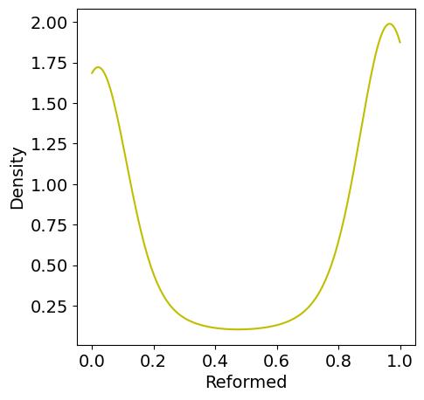
What is a dataset?
A table where rows are observations and columns are variables
Observation (row) = one individual or sample — a town, a patient, a cell.
Variable (column) = one measured quantity — height, sex, expression level.
Population vs. sample: a census gives the whole population; usually we hold only a sample.
First habit: scan for impossibilities — negative values, missing entries.
Look before you leap — get a feel for the data before testing.
Notes:
The notebook opens with a census — the rare case where population parameters are known exactly — which later lets students see how a sample mean deviates from the truth. Flag the first health-check habit: run describe() and scan for impossibilities (negative ages, etc.); that is how data-entry errors and missing values surface before they poison an analysis.

Slide 7
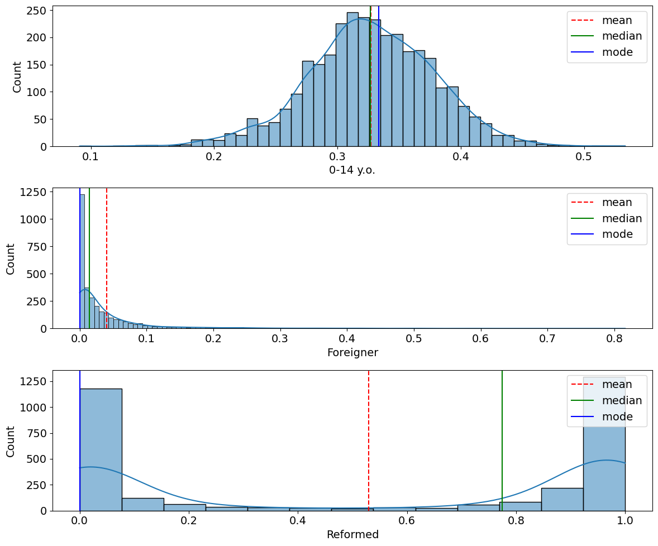
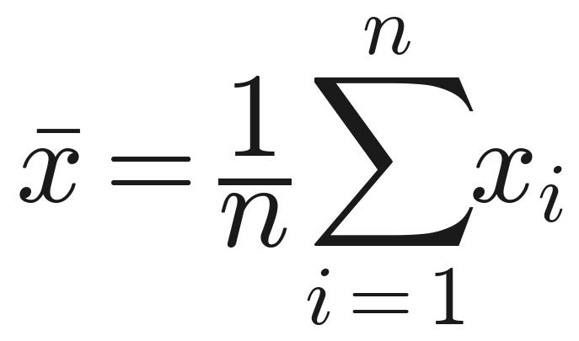
Summary statistics I: central tendency
Where is the distribution centred?
Mean — the arithmetic average
Median — the middle value (Q2); robust to outliers.
Mode — most frequent value (discrete) or peak of the density (continuous).
Symmetric & unimodal → all three coincide; skewed → they separate (income: mean ≫ median).
No single number is the whole story.
Notes:
For symmetric, single-peaked data the mean, median and mode coincide; for skewed data they separate (income is the classic case: mean far above median). The mean is pulled by extreme values; the median is not — that single fact motivates much of robust statistics. Tease the trap on the next slide: these summaries quietly assume the data have one peak.

Slide 8
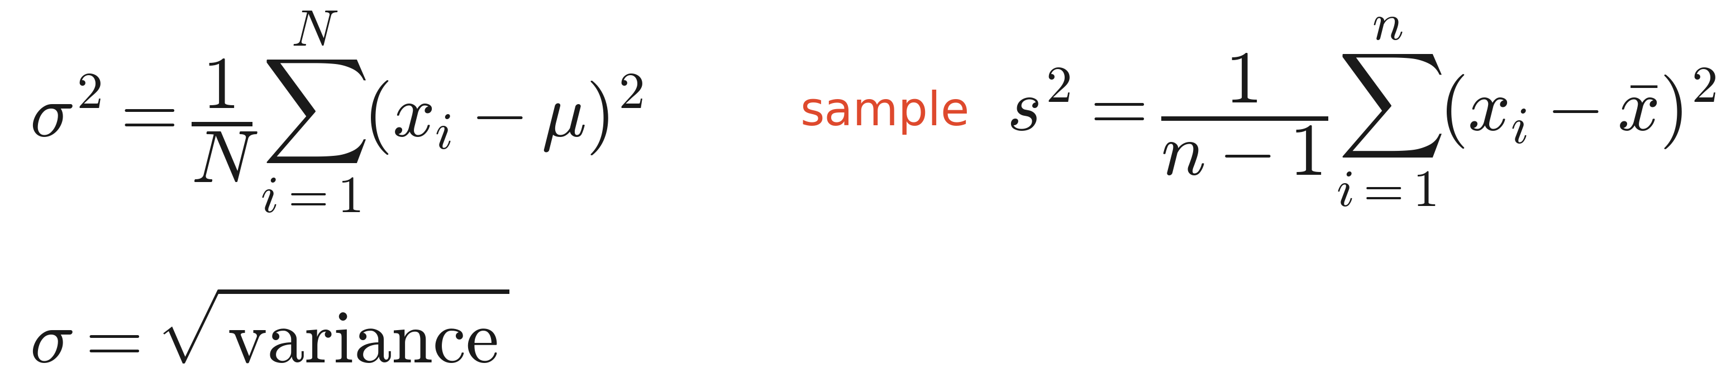
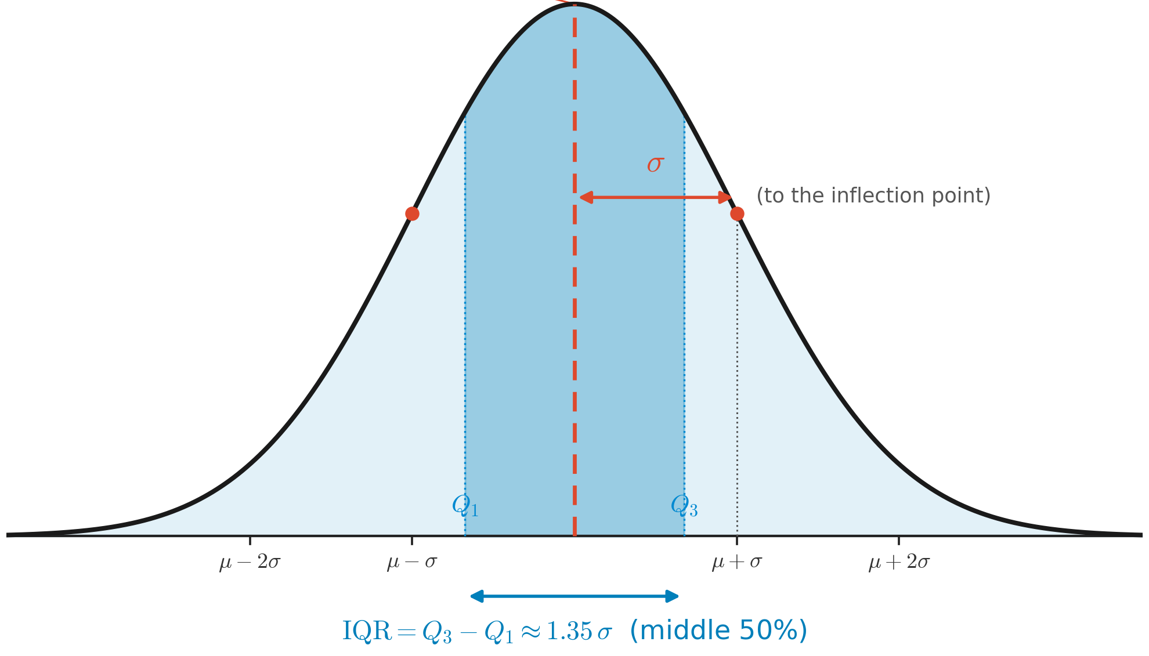
Summary statistics II: spread
How much do values vary?
Variance — population
Standard deviation —
Quartiles & IQR – inter quartile range
min / max for a quick outlier check
sample
Notes:
Spend a real minute on the n−1; students always ask, and there are three ways in.
(1) The sample mean cheats. Variance should measure spread around the true mean mu, but we don't know it, so we use x-bar, computed from the same data. And x-bar is exactly the value that makes the sum of squared deviations as small as possible — smaller than around any other point, including mu. So spread around x-bar comes out systematically too small; dividing by n−1 instead of n inflates it back by just the right amount. This is Bessel's correction, and it makes the variance estimate unbiased: E[sum (xi − x-bar)^2] = (n−1) sigma^2.
(2) Degrees of freedom. Once x-bar is fixed, the deviations are forced to satisfy sum(xi − x-bar) = 0 — one constraint. Know any n−1 of them and the last is determined, so only n−1 carry independent information about spread.
(3) The n=1 sanity check. One point says nothing about spread: n−1 = 0 gives 0/0 (honest), whereas dividing by n = 1 claims zero spread (a lie).
Why the population divides by N, not N−1: there mu is known, not estimated from the data — no cheating, no constraint, nothing spent. So the two formulas are one rule: divide by (number of values) minus (number of parameters estimated from those same values) — population N−0, sample n−1, and later regression n−p. One honesty footnote: the correction is exact for the variance; taking the square root for the SD reintroduces a tiny bias everyone ignores. In code: np.var(x, ddof=1); the default ddof=0 silently gives the biased version. Quartiles and IQR are robust spread measures, mirroring the median.

Slide 9
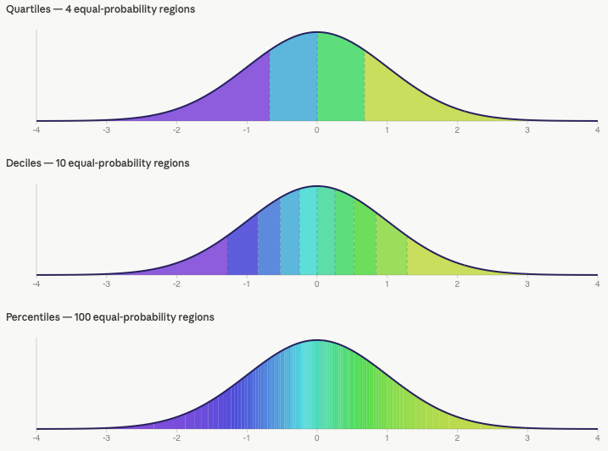
Quantiles, quartiles, and the median
Cut points that split ordered data by proportion.
Quantile — the value below which a given fraction of the data falls (the 0.1 quantile has 10% below).
Median — the 0.5 quantile: the middle value, half the data on each side; robust to outliers.
Quartiles — the 0.25 / 0.5 / 0.75 quantiles (Q1/Q2/Q3); Q2 is the median, and IQR = Q3 − Q1.
Percentiles are the same idea on a 0–100 scale (the 25th percentile = Q1).
Quartiles, median, percentiles — all just quantiles at particular fractions.
Notes:
The one sentence that ties it together: quartiles, the median, and percentiles are all just quantiles at particular fractions — there's only one underlying idea. Order the data, then ask 'what value sits at this proportion?' The median answers it at one-half; the quartiles at the quarters. Worth drawing on a sorted strip of points, marking the value with 25% / 50% / 75% of the points to its left — this grounds the boxplot (box = Q1–Q3, line = median) and the IQR that follow. Robustness point: because quantiles depend on rank, not magnitude, a single extreme value barely moves the median or quartiles, unlike the mean.

Slide 10
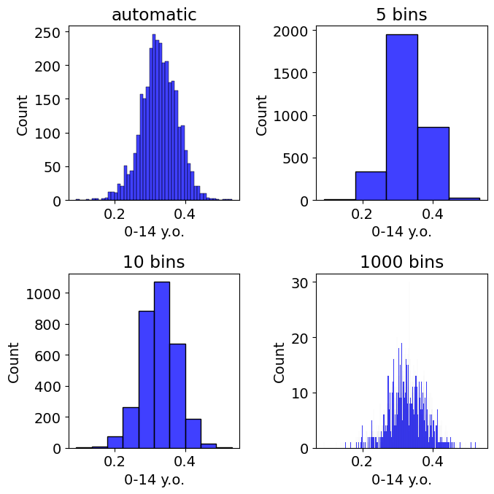
Seeing the distribution: histograms & density
Bin the data and count.
Histogram — x-axis = value, y-axis = count of values per bin.
Density curve (KDE) — a smooth estimate; switches the y-axis from count to density.
Pitfall: the number of bins changes the apparent shape — too few hides structure, too many shows noise. No single correct count.
Pitfall: KDE can leak past the true min / max of bounded data unless cut off.
Always visualise — never trust one number or one view.
Notes:
Demonstrate live if you can: the same data under 5 vs 50 bins tells two different stories. This is the first concrete instance of the lecture's recurring moral — always visualise, never trust one number or one view. A histogram is the empirical shadow of the random variable from the earlier slide.

Slide 11
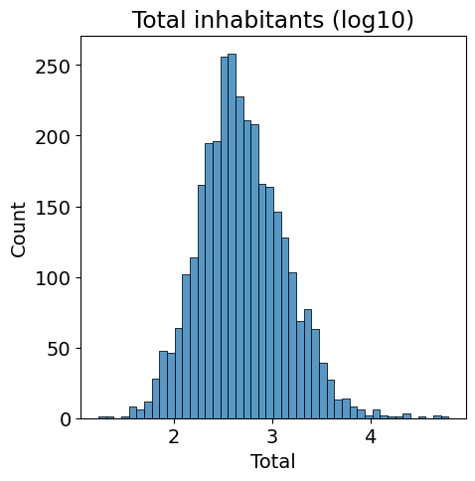
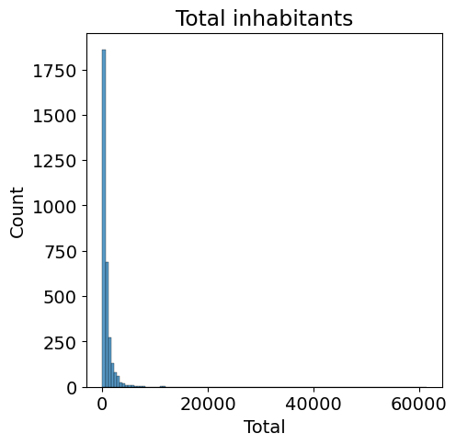
Transformations for visualisation
When data span many orders of magnitude, change the axis.
Log transform (log₂ or log₁₀) spreads out right-skewed, wide-range data — town sizes, expression counts.
A variable whose logarithm is normal is log-normal.
Pitfall: log₁₀(0) = - Inf — with zeros, add a pseudo-count: log₁₀(x + 1).
Caveat: transformations here are for exploration only.
Try a log axis when a histogram is crushed against the left edge.
Notes:
This previews the idea (formalized in session 2) that real data often aren't normal but become well-behaved after a transform. Keep it light — the point is the habit of trying a log axis when a histogram is crushed against the left edge.

Slide 12
Transformations for visualisation
When data span many orders of magnitude, change the axis.
Log transform (log₂ or log₁₀) spreads out right-skewed, wide-range data — town sizes, expression counts.
A variable whose logarithm is normal is log-normal.
Pitfall: log₁₀(0) = - Inf — with zeros, add a pseudo-count: log₁₀(x + 1).
Caveat: transformations here are for exploration only.
Try a log axis when a histogram is crushed against the left edge.
Notes:
This previews the idea (formalized in session 2) that real data often aren't normal but become well-behaved after a transform. Keep it light — the point is the habit of trying a log axis when a histogram is crushed against the left edge.

Slide 13
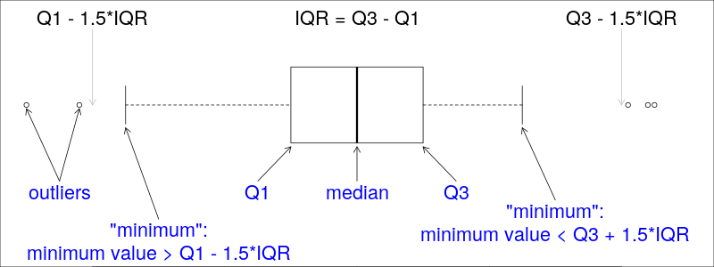
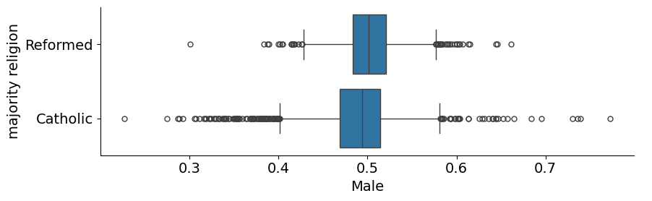
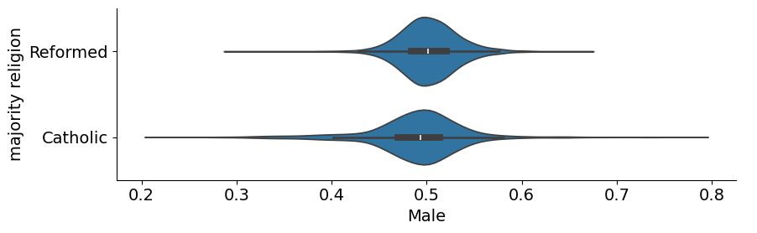
Boxplots and violin plots
Compact summaries of a distribution — and how they mislead.
Boxplot: box spans quartiles Q1–Q3, line = median; whiskers reach the furthest point within 1.5 × IQR; points beyond = outliers.
Violin plot: replaces the box with a mirrored density curve — more shape.
Pitfall: boxplots hide multimodality — overlay a strip / swarm plot to check.
Pitfall: violins need a decent sample and misbehave on bounded data unless cut off.
Notes:
Show a bimodal example where the boxplot looks unremarkable but a swarm plot reveals two clusters — this lands the summary-is-not-truth message hard. A violin is the boxplot's more informative cousin, at the cost of needing more data and more care at boundaries.
On the whiskers (pre-empt the inevitable question): the default everywhere — matplotlib boxplot, seaborn, base R boxplot(), ggplot2 geom_boxplot() — is Tukey's 1.5 x IQR rule (whis=1.5, R range=1.5, coef=1.5). Two things students misremember: the whisker is not drawn at Q +/- 1.5*IQR itself — that's just a fence; the whisker stops at the last real data point inside it. And whiskers are not min/max and not a multiple of the SD. So the rule is identical across Python and R.
The one genuine divergence is one level down — how the quartiles are computed: base R boxplot() uses Tukey hinges (fivenum), while Python (numpy/matplotlib/seaborn) and ggplot2 use type-7 interpolated percentiles. So it's really base R vs everything else, not Python vs R. The two definitions agree for some n and differ for others (on 1..n they differ at n=6,8,10,12 but match at 7,9,11); differences are small and shrink with n, so real-data boxes look nearly identical, but a small-n teaching example can give slightly different boxes — and occasionally a different outlier — in matplotlib vs base R. Both are configurable: matplotlib whis also takes a percentile pair, e.g. whis=(5,95), and whis=(0,100) (or R range=0) extends whiskers to the data extremes.

Slide 14
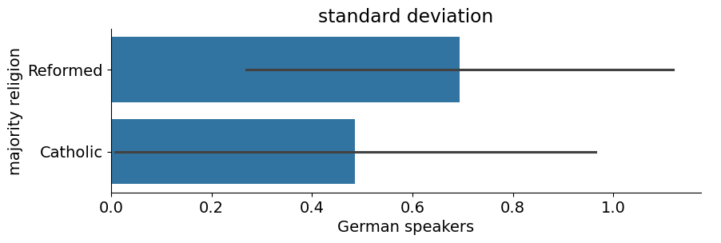
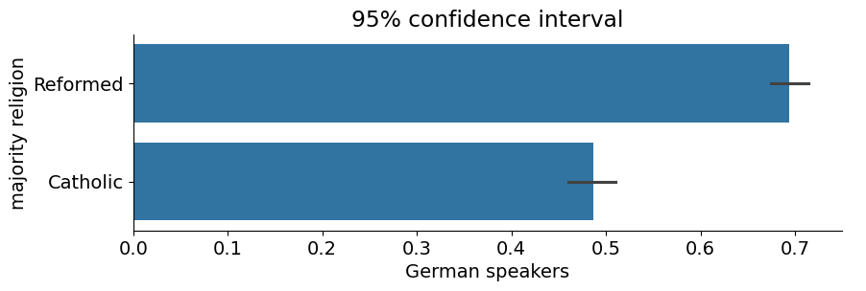
Barplots and error bars
The most-used and most-misused chart in biology — a bar shows only a mean plus an error.
Standard deviation (SD) — variability in the data.
Standard error (SEM) — precision of the estimated mean.
95% confidence interval — plausible range for the true mean.
( )
Pitfall: SD and SEM are not interchangeable; prefer showing the points over a bar.
SD describes the data; SEM, how well you've pinned down the mean.
Notes:
This is the single most valuable slide for a lab audience. Make them say out loud which quantity answers 'how variable are my cells?' (SD) versus 'how sure am I of the average?' (SEM). The square-root-of-n is the hinge: more data doesn't reduce the SD of the data, but it does sharpen the estimate of the mean. Cite the Nature Methods / Weissgerber et al. 2015 critiques of bar charts if you want a reference.

Slide 15
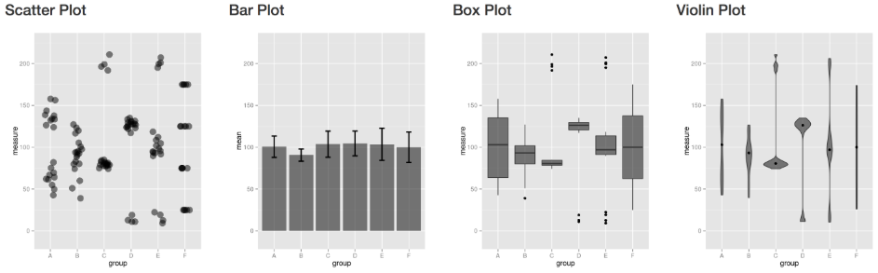
The EDA mindset
Five habits to carry into every dataset:
Look before you test — plot first; statistics second.
No single number is the whole story — mean, median and mode can disagree.
Know what your spread measure means — data variability (SD) vs estimate precision (SEM).
Choose the view deliberately — bins, transforms, box vs violin.
Data have a distribution behind them — EDA sketches it; the course reasons about it.
Notes:
Land the bridge to Session 2: today we described a sample; next we ask what a sample tells us about the population it came from — which needs probability distributions, the random variable made precise, and the first formal tests. End on the recurring theme: the degrees of freedom (n−1) met today will reappear everywhere.

