Slide 1
Lecture 2 — Probability Distributions & Statistical Hypothesis Testing
Michal Kolář
IMG
Prague, 06/2026

Slide 2
Part I — From data to distributions

Slide 3
Random variables
A random variable takes a value determined by the outcome of a random process.
A plain variable holds any value (x, y); a random variable (X, Y) gets its value from a random experiment — a coin toss: X = 1 heads, X = 0 tails.
The Session 1 dataset was a stack of observed values of random variables; now we model the mechanism behind them.
That model is a probability distribution — which values X can take, and how likely each is.
We described data; now we model the process that generated it.
Notes:
This is the conceptual hinge between the two sessions — say it explicitly. In Session 1 we looked at data; here we posit that an unseen random process with a distribution generated it, and everything that follows (estimation, testing) is reasoning back to that process. Keep the coin example concrete; resist formal probability-space machinery.

Slide 4
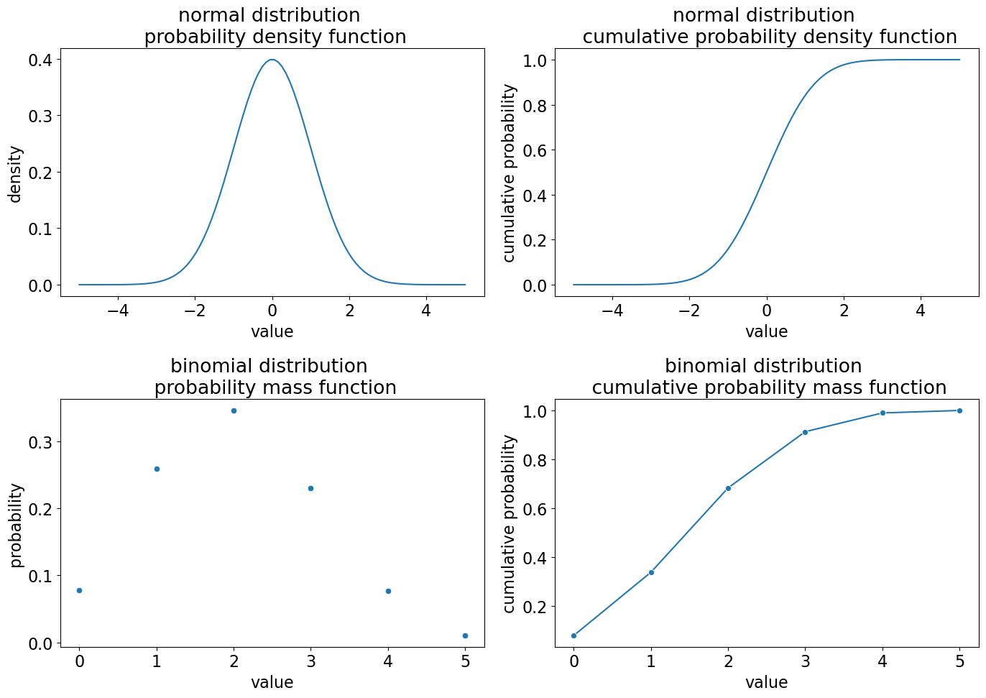
Probability distributions: PMF, PDF, CDF
Three views of the same object.
PMF (probability mass function) — discrete variables; the y-axis is a genuine probability, and the bars sum to 1.
PDF (probability density function) — continuous variables; the y-axis is density, not probability. Probability = area under the curve; total area = 1.
CDF (cumulative distribution function) — probability of a value ≤ x; runs from 0 to 1.
On a PDF it's area, not height, that gives the probability.
Notes:
The single most common confusion is reading a PDF's height as a probability — hammer 'density, area, not height.' A density can even exceed 1 (narrow distributions) without contradiction, because it's area that must total 1. The CDF is worth dwelling on: it's what every p-value calculation secretly uses. Tie back to Session 1 — a histogram estimates the PMF/PDF, the empirical cumulative curve estimates the CDF.

Slide 5
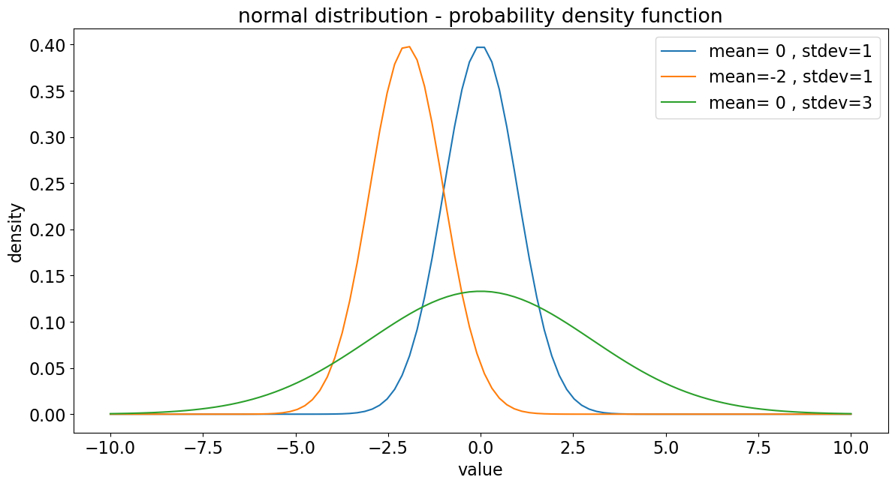
Parameters and notation
A distribution is pinned down by its parameters.
Parameters set location, scale, and shape. The normal has mean μ (location) and standard deviation σ (scale).
Notation: X ~ N(μ, σ) — “X follows a normal distribution with mean μ and standard deviation σ.”
Changing a parameter slides, stretches, or reshapes the same family of curves.
One functional form, many shapes — set by the parameters.
Notes:
Two levers worth showing live: shifting μ slides the whole curve along the axis; changing σ stretches or compresses it without moving the centre. Read X ~ N(μ,σ) aloud the first time. Caveat to flag: parameterisation conventions differ — some references and software specify the normal by its variance σ² rather than the SD σ, so always check whether a formula or function wants the SD or the variance.

Slide 6
Part II — From a sample to an estimate

Slide 7
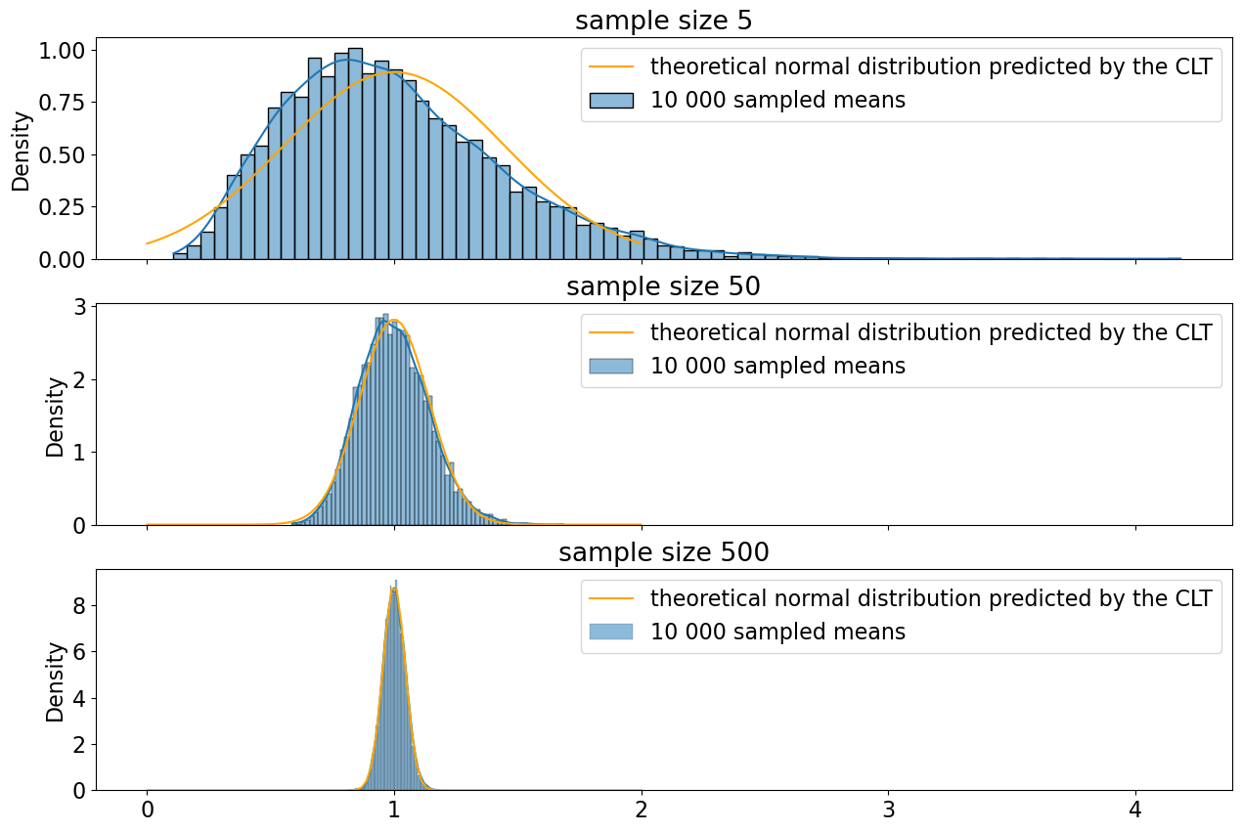
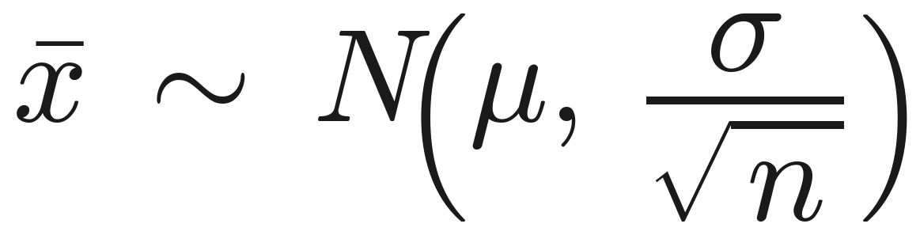
The Central Limit Theorem
The sample mean is itself a random variable — and it's nearly normal.
Across many samples, the distribution of their means is approximately normal, even when the data are not.
Result: the sample mean is approximately normal, with spread shrinking as the sample grows.
So we can reason about means without knowing the data's true distribution.
— the SEM from Session 1, reappearing.
Notes:
The CLT is the engine of the whole session — without it, none of the mean-based tests would be justified for non-normal data. The σ/√n is the SEM from Session 1 reappearing; make that link. Caveats/pitfalls: the famous 'n ≥ 30' is a rule of thumb with no universal threshold — heavy-tailed distributions (e.g. Pareto) need far larger n, and the notebook demonstrates this failing. When you actually know the generating distribution, use it directly rather than leaning on the CLT approximation.

Slide 8
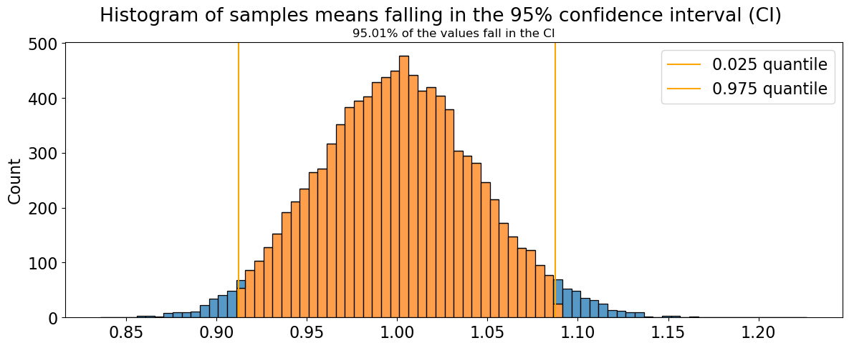
Quantiles & confidence intervals
Turn a distribution into a range of plausible values.
A quantile is the value below which a given fraction lies: 0.5 = median; 0.025 and 0.975 cut off the bottom and top 2.5%.
A 95% confidence interval for the mean is bounded by the 0.025 and 0.975 quantiles of the sampling distribution.
Over many repeated samples, 95% of such intervals contain the true mean.
It quantifies how precisely the sample has located the true mean.
95% lives in the procedure, not in any single interval.
Notes:
Define the terms explicitly while quantiles are on screen: the median is the 0.5 quantile (half the data below); the quartiles Q1/Q2/Q3 are the 0.25/0.5/0.75 quantiles, the same Q1/Q3/IQR from Session 1, now seen as special cases of the general quantile. Then pre-empt the universal misinterpretation: a 95% CI does NOT mean '95% probability the true mean is in this interval.' The correct reading is about the procedure — over many repeated samples, 95% of such intervals contain the true mean. For a fixed interval the truth is either in or out; the 95% lives in the method. This returns when interpreting p-values.

Slide 9
Part III — The logic of hypothesis testing

Slide 10
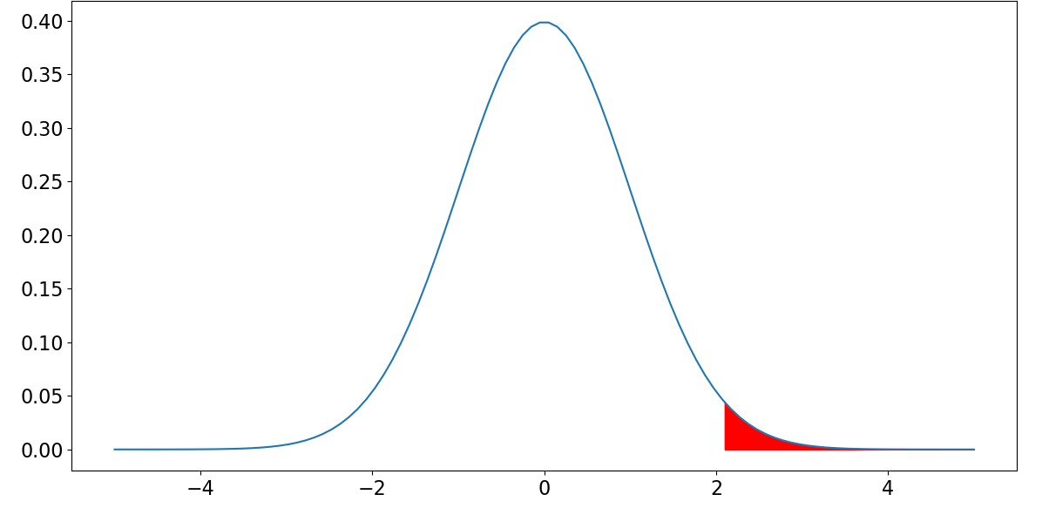
Anatomy of a hypothesis test
Four steps, always the same.
State a null hypothesis H₀ and an alternative H₁ — claims about the real world.
Pick a test statistic whose distribution under H₀ is known.
Compute the statistic from your data.
Ask how extreme it is relative to that null distribution.
PDF under H₀
statistics
Every test: a number whose behaviour we can predict if nothing is going on.
Notes:
Stress that the whole edifice rests on step 2 — a number whose behaviour we can predict if nothing is going on. The p-value is just step 4 made quantitative. Frame H₀ as the boring 'no effect / no difference' claim we try to disprove; we never prove H₀, we only fail to reject it. This scaffolding is identical for every test in Sessions 2–3.

Slide 11
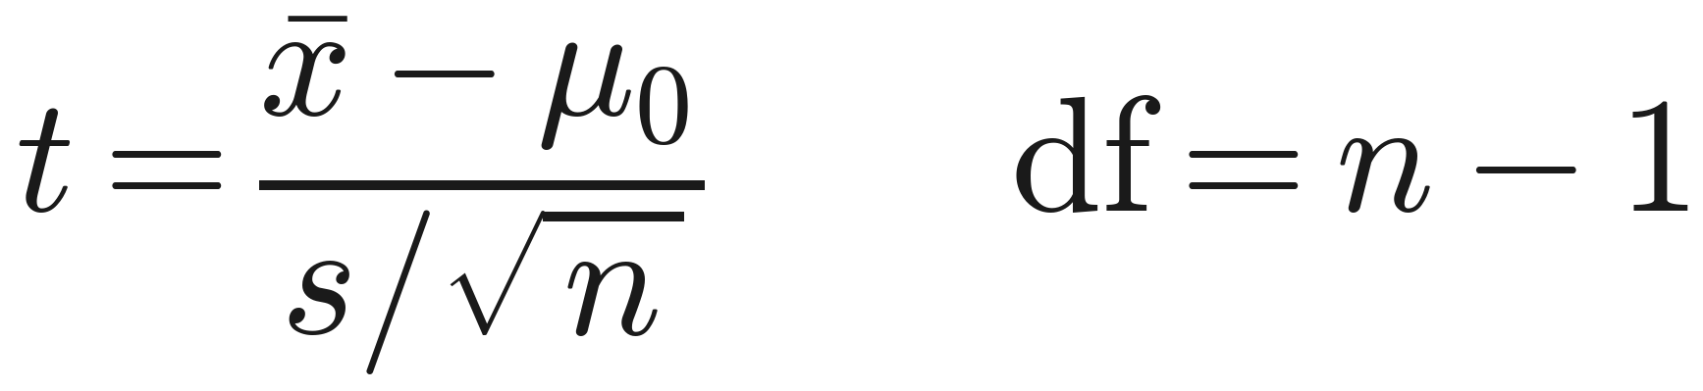
Motivation: is the true mean different from μ₀?
We have a sample; we want to judge the population mean behind it.
Is the true mean μ different from a reference μ₀? (e.g. a batch's mean weight vs the labelled 500 g.)
We only see the sample mean x̄ — it almost never equals μ₀ exactly.
Is the gap x̄ − μ₀ real, or just sampling noise?
The CLT gives the noise yardstick
Standardising the gap against it is the one-sample Student t-test.
x̄ ≠ μ₀ isn't enough — is the gap bigger than sampling noise?
Notes:
This slide answers 'why bother with a test at all?' before the machinery. The concrete framing: we have a reference value μ₀ (a label claim, a baseline, a historical mean) and a sample; the sample mean x̄ almost never lands exactly on μ₀, so the question is whether the gap is signal or noise. The CLT from the previous part gives the noise yardstick, σ/√n. Standardising the gap by that yardstick is the one-sample test; because we estimate σ from the sample, the standardised gap follows a t-distribution with n−1 df — that is the Student t-test. This sets up the worked example and the t-distribution slides that follow, and generalises on the next slide to comparing two groups (Welch).

Slide 12
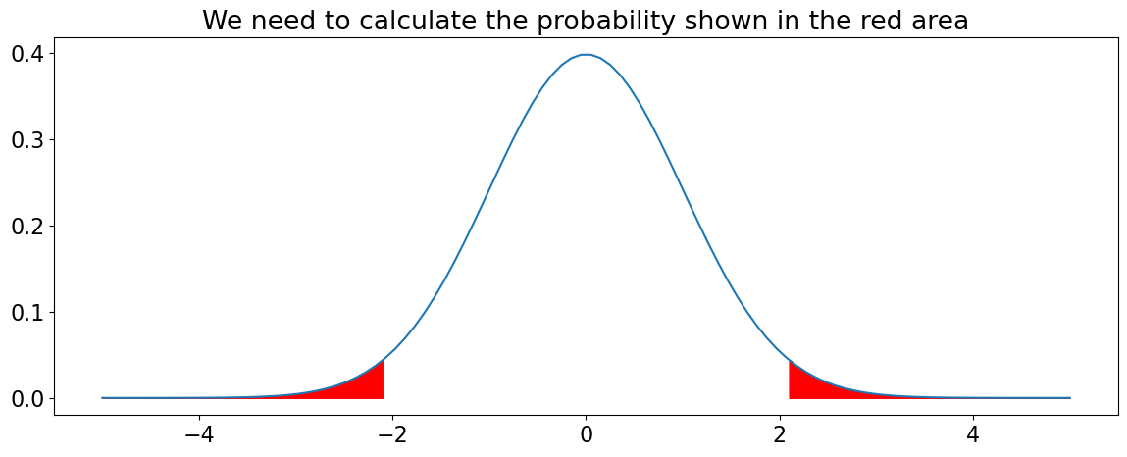
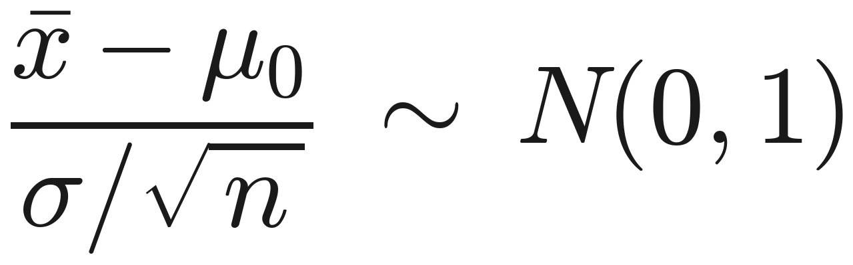
A worked test, one- vs two-sided
Centre and scale the sample mean.
If σ is known, the centred-and-scaled sample mean is a standard normal under H₀: μ = μ₀ — easy to read probabilities off.
Two-sided (H₁: μ ≠ μ₀) counts extremes in both tails; one-sided (H₁: μ > μ₀) counts only one.
For a symmetric statistic, the two-sided p-value is twice the one-sided.
Commit to one- vs two-sided before seeing the data.
Notes:
The centring-and-scaling move is the template every test reuses — make it visible once. Pitfall: choosing one-sided after seeing which way the data went is p-hacking; the direction must be committed to in advance, on subject-matter grounds. Default to two-sided unless there's a genuine prior reason. This is also where 'known σ' is a fiction we drop on the next slide.

Slide 13
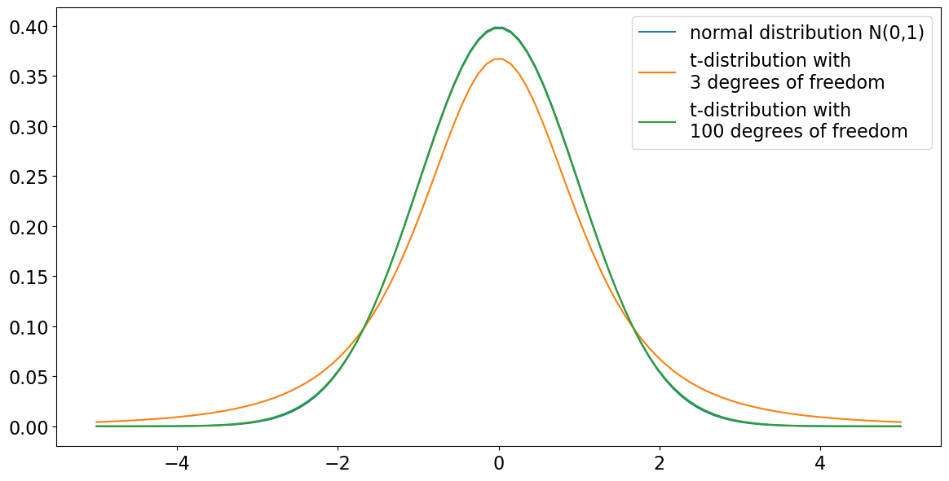
The t-distribution & degrees of freedom
We never really know σ — so we estimate it, And pay for it.
Using the sample SD makes the statistic follow a t-distribution with n−1 DF, not a normal — fatter tails for the extra uncertainty.
Degrees of freedom (DF): independent information left after estimating the mean — the same n−1 from Session 1.
As DF grow, t converges to the normal (indistinguishable beyond ~100 DF).
Small samples → fatter tails → a bigger effect needed for significance.
Notes:
This is the n−1 payoff promised in Lecture 1 — estimating the centre from the same data costs one degree of freedom, and the t-distribution is the visible consequence. The fatter tails mean larger critical values for small samples: with little data you must see a bigger effect to call it significant. Good place to show t vs normal for df = 2, 5, 30 if you have a figure.

Slide 14
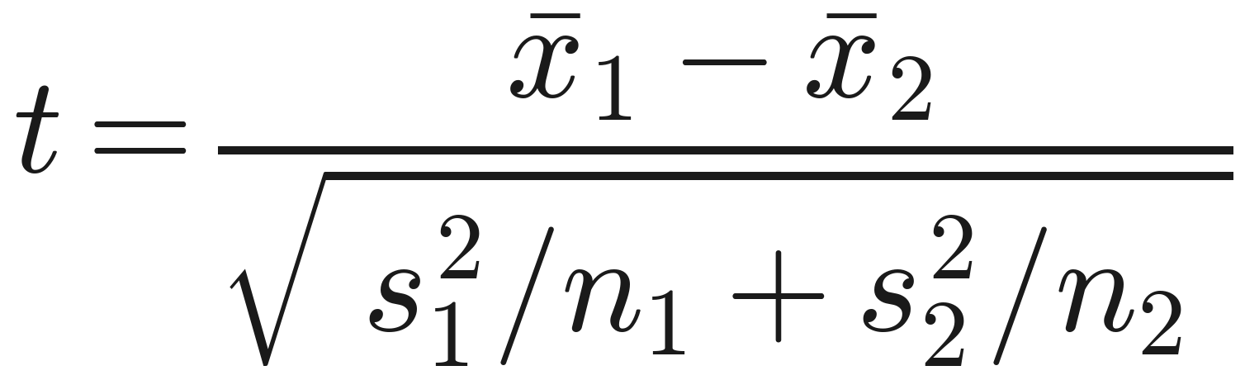
Welch's t-test
Comparing the means of two independent groups.
H₀: μ₁ = μ₂ vs H₁: μ₁ ≠ μ₂ — the test statistic is
Student vs. Welch: Student's assumes one pooled variance; Welch's uses each group's own variance + adjusted DF, so it needs no equal-variance assumption.
Welch is the safe default
a paired t-test fits matched observations (before/after).
When assumptions fail, the p-value stops meaning anything.
Notes:
Make the Student-vs-Welch distinction crisp. Student's adds a third assumption — homoscedasticity (equal variances) — and pools both groups into one variance, buying a little power when it truly holds. Welch drops that: it keeps the two variances separate and shrinks the degrees of freedom (Welch–Satterthwaite) to compensate. When variances or sample sizes differ, Student's gives misleading p-values while Welch stays valid; when variances are equal, Welch costs almost nothing — so default to Welch, use Student's only if you've tested equal variances (Session 3, Bartlett/Levene). Other assumptions: each group's mean is normal (CLT covers it for reasonable n) and the groups are independent. Central pitfall: when assumptions fail the p-value is meaningless — the notebook shows this by drawing two groups from the same Pareto distribution, after which the test loses its 5% false-positive rate.

Slide 15
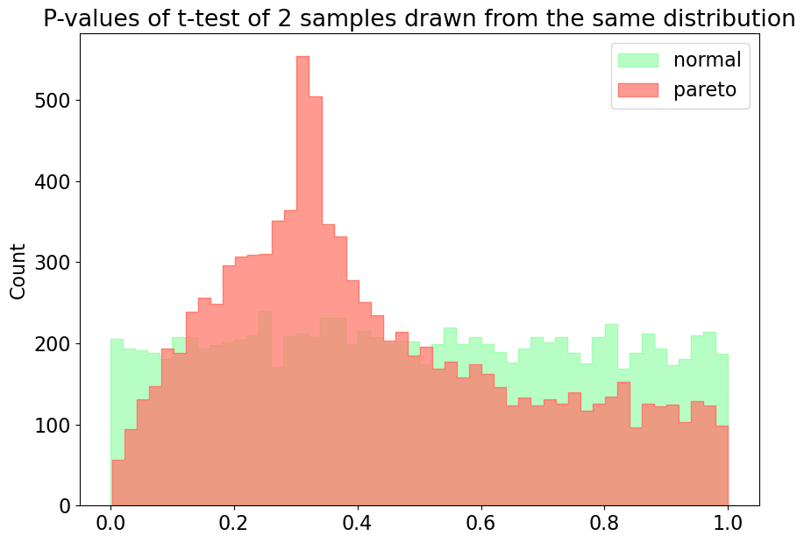
P-value distribution
When assumptions fail, the p-value stops meaning anything.
Notes:
Make the Student-vs-Welch distinction crisp. Student's adds a third assumption — homoscedasticity (equal variances) — and pools both groups into one variance, buying a little power when it truly holds. Welch drops that: it keeps the two variances separate and shrinks the degrees of freedom (Welch–Satterthwaite) to compensate. When variances or sample sizes differ, Student's gives misleading p-values while Welch stays valid; when variances are equal, Welch costs almost nothing — so default to Welch, use Student's only if you've tested equal variances (Session 3, Bartlett/Levene). Other assumptions: each group's mean is normal (CLT covers it for reasonable n) and the groups are independent. Central pitfall: when assumptions fail the p-value is meaningless — the notebook shows this by drawing two groups from the same Pareto distribution, after which the test loses its 5% false-positive rate.

Slide 16
P-value distribution
When assumptions fail, the p-value stops meaning anything.
Notes:
Make the Student-vs-Welch distinction crisp. Student's adds a third assumption — homoscedasticity (equal variances) — and pools both groups into one variance, buying a little power when it truly holds. Welch drops that: it keeps the two variances separate and shrinks the degrees of freedom (Welch–Satterthwaite) to compensate. When variances or sample sizes differ, Student's gives misleading p-values while Welch stays valid; when variances are equal, Welch costs almost nothing — so default to Welch, use Student's only if you've tested equal variances (Session 3, Bartlett/Levene). Other assumptions: each group's mean is normal (CLT covers it for reasonable n) and the groups are independent. Central pitfall: when assumptions fail the p-value is meaningless — the notebook shows this by drawing two groups from the same Pareto distribution, after which the test loses its 5% false-positive rate.

Slide 17
Part IV — Checking assumptions & alternatives

Slide 18
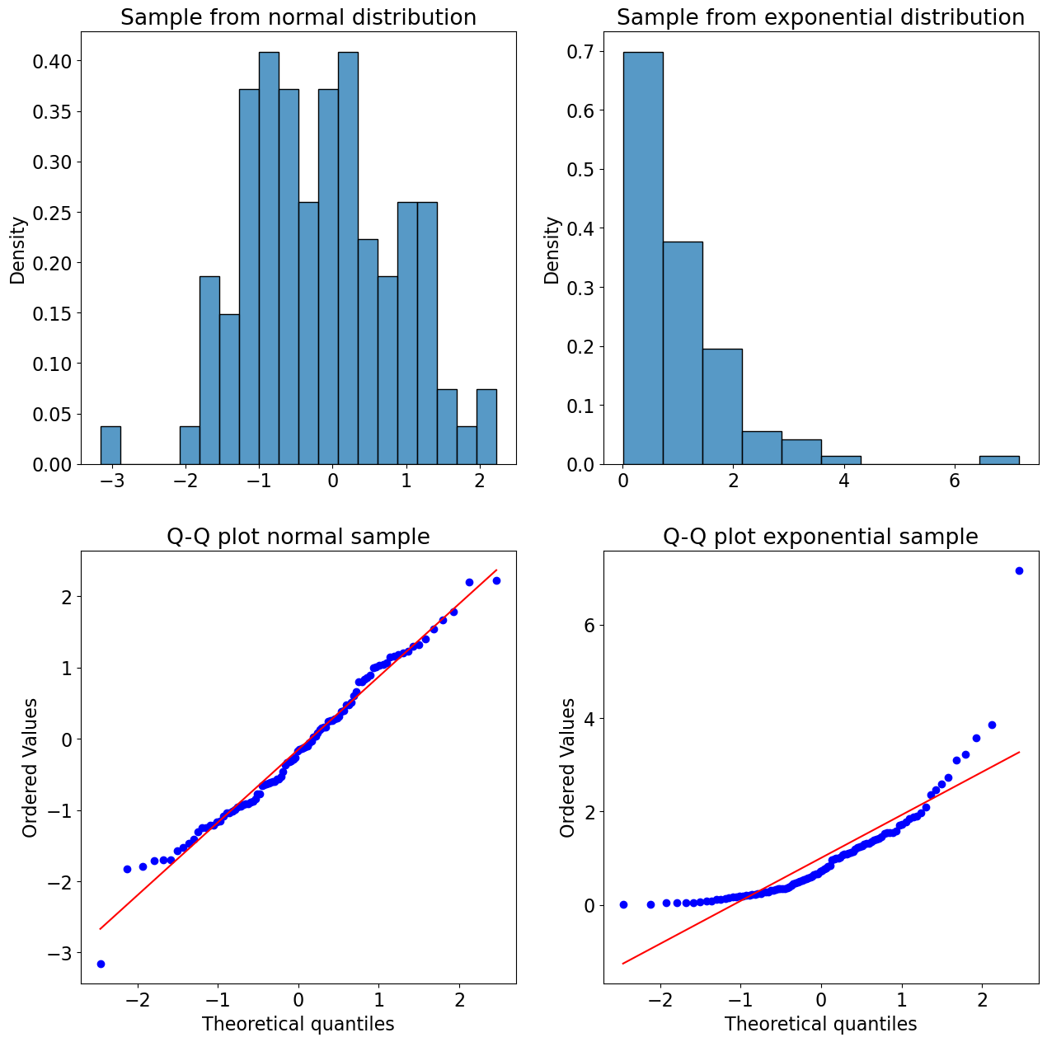
Is it normal? Q–Q plots & Shapiro–Wilk
Check the assumption rather than hoping.
Q–Q plot — sample vs theoretical normal quantiles; normal data fall on a straight diagonal, and the way points peel off shows how it deviates.
Shapiro–Wilk — a formal test, H₀: “the data are normal”; a small p-value rejects normality.
Best practice: use both — the picture and the test together.
Here a significant result is the bad news — non-normal.
Notes:
Note the inverted logic that trips everyone up: here a significant result is the bad news (non-normal), the opposite of most tests. Caveats: Shapiro–Wilk is reliable up to a few thousand points; beyond ~5000 use D'Agostino's normaltest. With very large n, trivial deviations become 'significant' — which is why the Q–Q plot matters: it shows whether non-normality is big enough to care about, not just detectable.

Slide 19
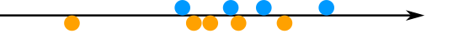
When normality fails: Mann–Whitney U
A distribution-free alternative to the t-test.
Nonparametric methods assume no distribution family — for when normality is genuinely violated and n is too small for the CLT.
Mann–Whitney U works on ranks: H₀ — a random value from one group is equally likely above or below one from the other.
A different H₀ from the t-test — the two can legitimately disagree.
Notes:
The crucial subtlety, widely gotten wrong: Mann–Whitney is NOT simply a 'median test.' Strictly it tests whether the two distributions are identical, and it can fire when the groups differ only in spread, not location (Fagerland 2012). It behaves as a location/median comparison only if the two distributions share the same shape and scale. So its H₀ is fundamentally different from the t-test's — the two can legitimately disagree on the same data. Don't reach for it reflexively: it answers a different question.

Slide 20
Part V — Reading results honestly

Slide 21
p-values and what they are not
The probability of data this extreme, if H₀ were true.
Formally: P(statistic as or more extreme than observed | H₀ true). Tied to a specific H₀.
It is not: the probability H₀ is true, the probability of an effect, or your error rate.
“Fail to reject H₀” is not “accept H₀.”
Report the exact p-value — and pair it with an effect size.
Notes:
Spend real time here — misuse of p-values is the single biggest source of bad inference (Goodman's 'Dirty Dozen', 2008). Two demonstrations land it: with a true effect, p-values shrink as n grows; with no effect, p-values are uniform on [0,1] at any n — so a big study isn't 'more likely to be right', it's better powered. Push the habit of reporting the exact p-value, not just 'p < 0.05', paired with an effect size.

Slide 22
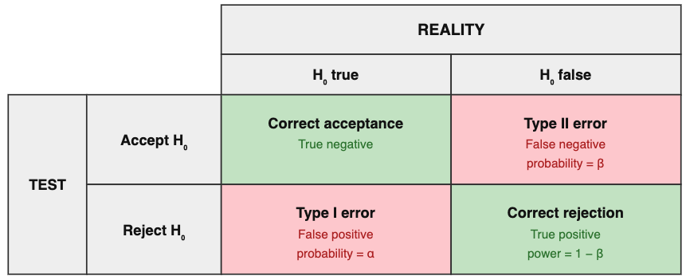
Two ways to be wrong
Type I and Type II errors.
Type I (false positive) — rejecting H₀ when it's true. Probability α, the threshold you set (often 0.05).
Type II (false negative) — failing to reject H₀ when it's false. Probability β.
They trade off: tightening α raises β, for fixed n.
α is a choice, not a fact of nature; 0.05 is convention.
Notes:
A 2×2 truth table (reality vs decision) is the clearest visual. Emphasise that α is a choice, not a fact of nature, and 0.05 is convention, not law. The trade-off is the bridge to power: the only way to reduce both error rates at once is more data. Also foreshadows Session 3's multiple-testing problem — run many tests at α = 0.05 and false positives accumulate.

Slide 23
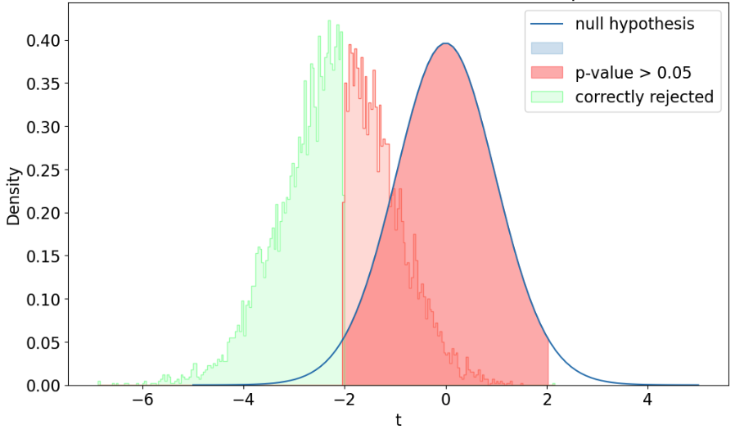
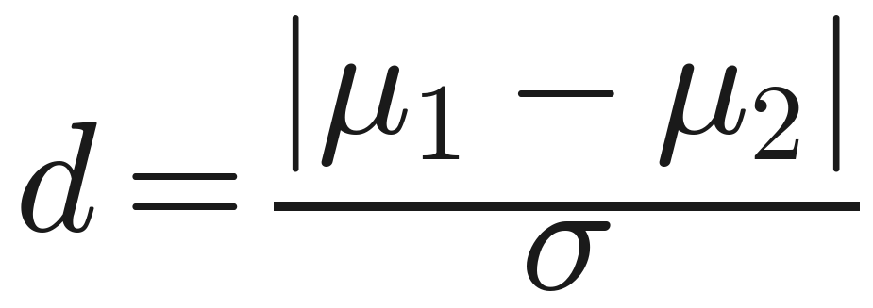
Power & effect size
Could the study even have detected the effect?
Power = 1 − β — the chance of detecting a real effect; a design question, settled before data.
It rises with sample size and true effect size; a study can “fail” simply by being underpowered.
Effect size (Cohen’s ) measures how big the difference is, independent of n.
Significance ≠ biological relevance — always report an effect size.
Notes:
Key message: significance ≠ relevance. A tiny, useless effect becomes significant with enough data; a large, important one can be missed with too little. Always report an effect size alongside the p-value. Power is computed by simulation, or for the t-test via statsmodels.stats.power.TTestIndPower (.power(...) and .solve_power(...) to back out the n you need). Frame power analysis as the responsible thing to do before an experiment, not an autopsy after.

Slide 24
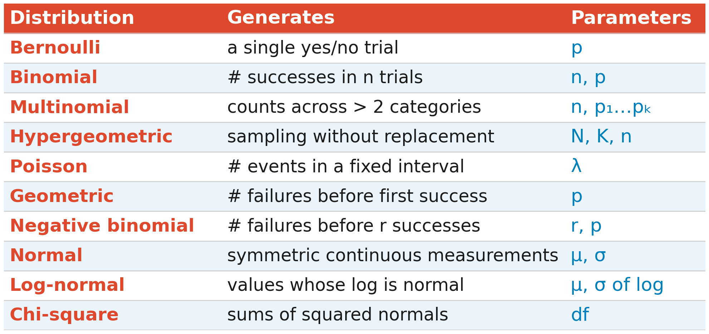
A field guide to common distributions
Match the distribution to the data-generating process.
Ask what process generated the data — that picks the distribution.
Notes:
Don't read the table aloud — use it as a choosing tool: ask what process generated the data and let that pick the distribution. Highlight the relationships the notebook draws: the Poisson is the binomial's limit (many trials, tiny p); the hypergeometric is the without-replacement cousin of the binomial (the basis of gene-set enrichment tests in Session 3); the negative binomial is a Poisson with a varying rate (why it models overdispersed counts like RNA-seq). The chi-square reappears in Session 3's categorical tests.

