Slide 1
Lecture 3 — Statistical Testing, continued
Michal Kolář
IMG
Prague, 06/2026
Notes:
Companion theory lecture for
Practical Session 1 (`01_exploratory_data_analysis.ipynb`).
Structured as slide content + speaker notes.
Part I is the general introduction (3 slides);
Part II walks through the concepts students will use in the notebook.

Slide 2
Part I — Associations between categories
Notes:
Companion theory lecture for
Practical Session 1 (`01_exploratory_data_analysis.ipynb`).
Structured as slide content + speaker notes.
Part I is the general introduction (3 slides);
Part II walks through the concepts students will use in the notebook.

Slide 3

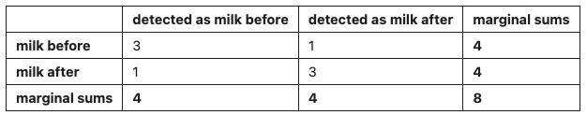
The contingency table
Are two categorical variables associated?
Cross-classify the counts into a contingency table with row and column marginal sums (the Lady tasting tea: guessed vs. actual).
Shared null hypothesis: the two variables are not associated (independent).
Two routes: an exact combinatorial test (Fisher) or a large-sample approximation (chi-squared).
Counts in a table — is the pattern more than chance?
Notes:
Introduce the contingency table as the categorical analogue of comparing groups. The Lady tasting tea is the hook: Fisher gave a colleague who claimed she could taste whether milk or tea was poured first eight cups (four of each) to sort. The margins are fixed (four of each), which is exactly what makes the exact computation possible. The null is always no association / independence.

Slide 4
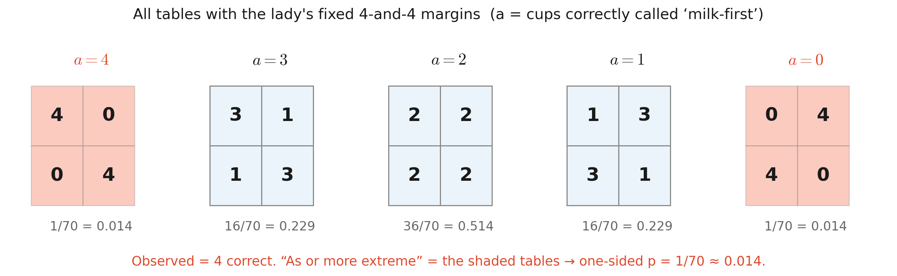
Fisher's exact test
Count the tables, exactly.
p-value = the fraction of all tables with the same margins that are as or more extreme than observed — pure combinatorics, no approximation.
Reports an odds ratio summarising the strength of association.
Exact for any sample size — but it doesn't scale.
Notes:
Its appeal: exact for any sample size, including tiny ones — no distributional assumption beyond the fixed margins. The pitfall is cost: computationally expensive as the table grows, because the number of possible tables explodes with more cells. So it's the tool for small, roughly 2x2 tables. The odds ratio is the product of the row-wise odds. The next slide makes 'as or more extreme' concrete by laying out every possible table.

Slide 5
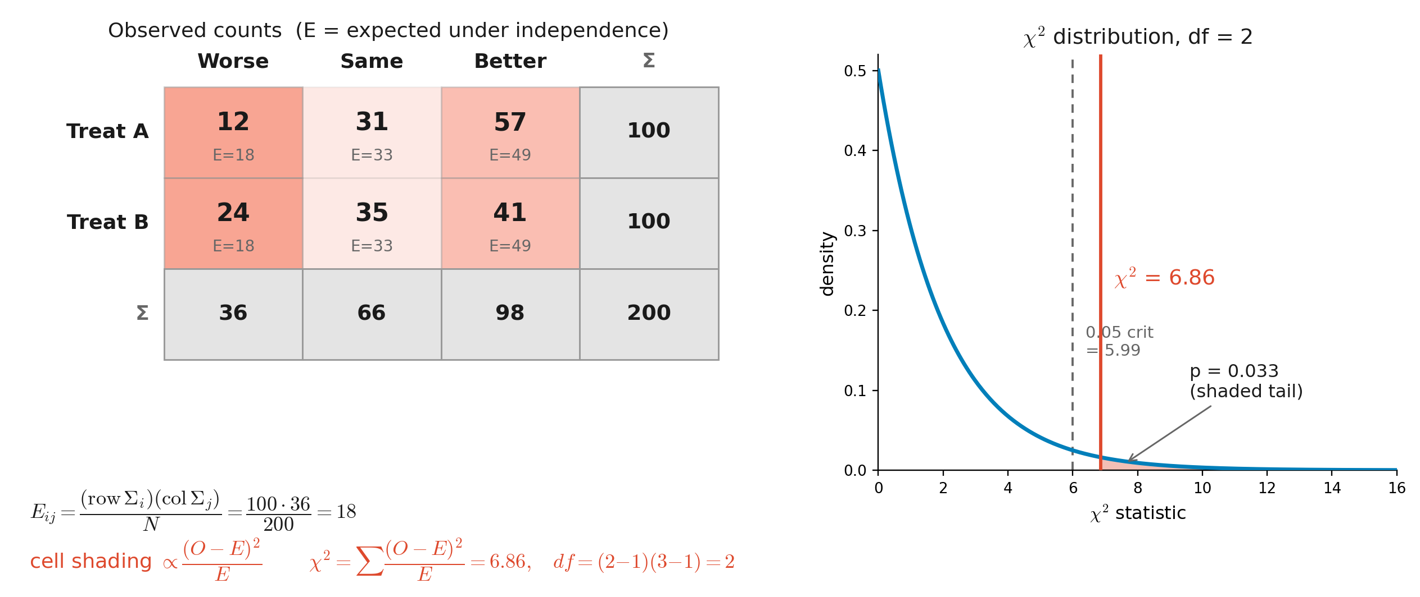

Chi-squared test of independence
Compare observed counts to what independence predicts.
Expected count from the margins
Statistic
Fisher's large-sample cousin — an approximation that scales.
Notes:
The expected-count formula E_ij = R_i C_j / N is exact and worth deriving: under independence P(row i, col j) = (R_i/N)(C_j/N), times N gives the expected count. Frame chi-squared as Fisher's large-sample cousin. Caveat: the approximation needs expected counts per cell above ~5; for small counts use Yates's correction. Teaching point: on the small tea table Fisher and chi-squared differ; enlarge the counts and they converge.

Slide 6
Chi-squared test of independence
Compare observed counts to what independence predicts.
Fisher's large-sample cousin — an approximation that scales.
Notes:
The expected-count formula E_ij = R_i C_j / N is exact and worth deriving: under independence P(row i, col j) = (R_i/N)(C_j/N), times N gives the expected count. Frame chi-squared as Fisher's large-sample cousin. Caveat: the approximation needs expected counts per cell above ~5; for small counts use Yates's correction. Teaching point: on the small tea table Fisher and chi-squared differ; enlarge the counts and they converge.

Slide 7
Part II — Comparing whole distributions

Slide 8
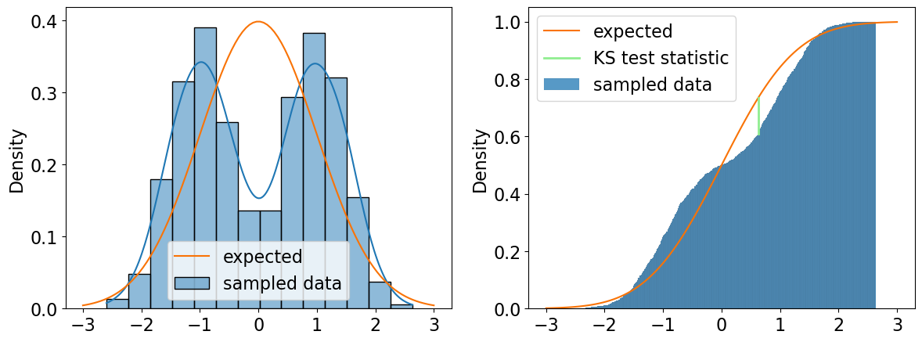
The Kolmogorov–Smirnov test
Do two samples come from the same distribution?
Nonparametric; compares entire CDFs
a sample against a reference (1-sample)
or two samples against each other (2-sample).
Statistic = the largest vertical gap between the two cumulative curves.
Unlike the t-test (location only), it detects diﬀerences in location, scale, or shape.
A generalist: sees any difference, but weakly.
Notes:
The image is two CDFs climbing from 0 to 1; the statistic is the single widest vertical distance between them (the figure marks it). Caveat: breadth costs power — weaker than the t-test at a location shift, weaker than Shapiro–Wilk at non-normality. Reach for it when you care whether two distributions differ in any way, not just in their means.

Slide 9
Part III — Comparing more than two groups

Slide 10
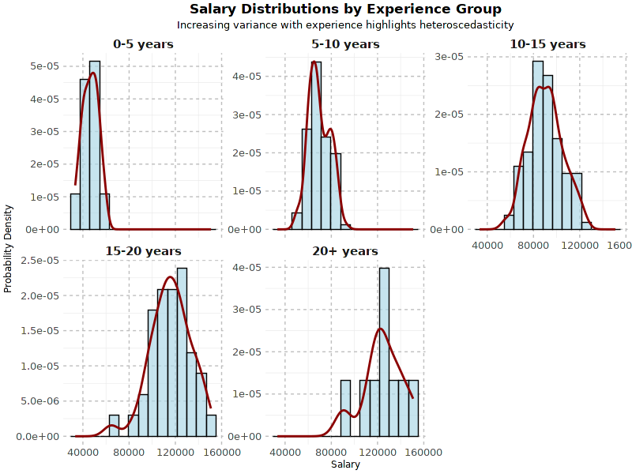
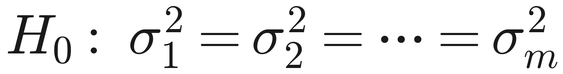
First, check the variances: Bartlett (and Levene)
The tools ahead assume equal variances — test that first.
Bartlett's test tries to reject the null hypothesis of homoscedasticity = equal variances across the m groups
statistic ~ χ² with m−1 df
Bartlett assumes normal data; if normality is doubtful, use Levene's test (more robust).
C.f. heteroscedasticity
Equal variances? The answer picks which ANOVA to run.
Notes:
The hinge into ANOVA — the answer decides which ANOVA to run. Pitfall: Bartlett is itself sensitive to non-normality and can reject equal variances simply because the data aren't normal, so on real data Levene is the safer default. Mirrors the Student-vs-Welch logic from Session 2, one level up.

Slide 11
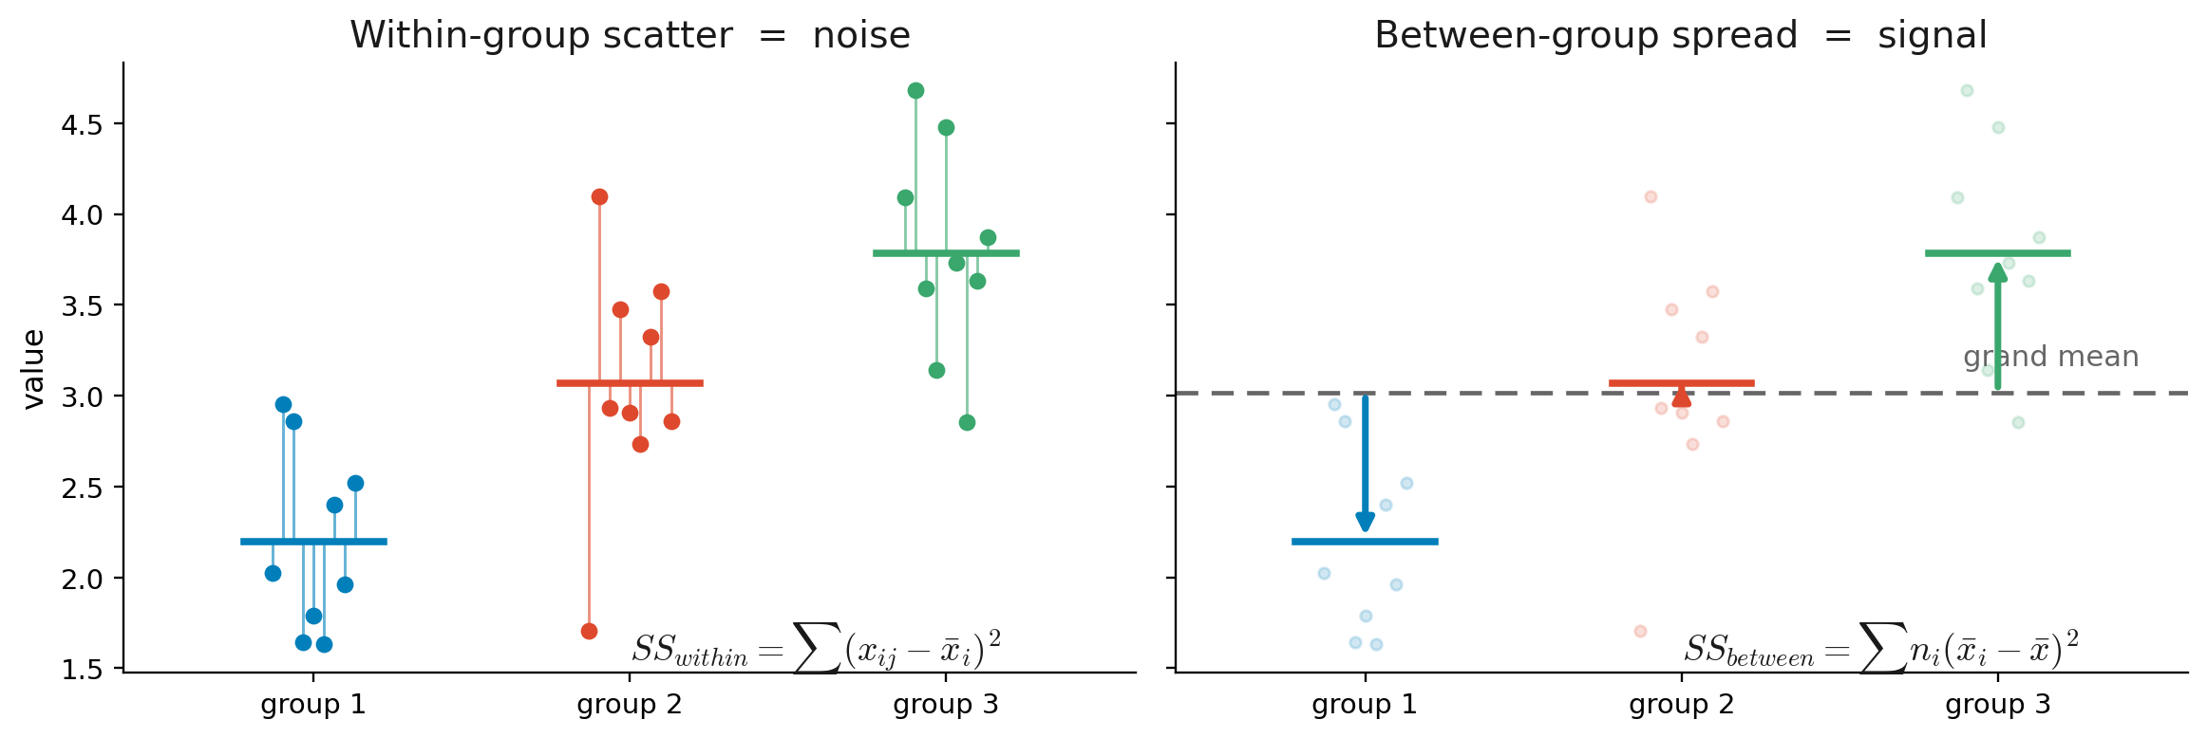
One-way ANOVA
The t-test, generalised to many groups.
Compares the means of a numerical variable across groups set by one categorical variable.
Signal / noise: between-group spread over within-group scatter.
Notes:
Open with 'why not run all the pairwise t-tests?' — that inflates error (the Part IV cliff-hanger). Walk the decomposition with the figure: subtract the grand mean and square-sum to get SS_total; it splits into how far group means sit from the grand mean (SS_between, signal) plus how far points sit from their own group mean (SS_within, noise). Dividing by degrees of freedom gives mean squares; their ratio is F. For two groups, ANOVA = the t-test (F = t²).

Slide 12
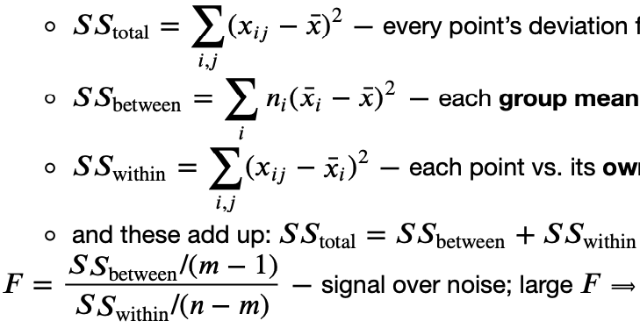
One-way ANOVA
Compares the means of a numerical variable across groups set by one categorical variable.
H₀: 𝑚 group means are equal
Splits the total variation into between-group and within-group parts:
Total variation: every point’s deviation from the grand mean
Between group: each group mean vs. the grand mean (signal)
Within group: each point vs. its own group mean (noise)
Signal / noise: between-group spread over within-group scatter.
Notes:
Open with 'why not run all the pairwise t-tests?' — that inflates error (the Part IV cliff-hanger). Walk the decomposition with the figure: subtract the grand mean and square-sum to get SS_total; it splits into how far group means sit from the grand mean (SS_between, signal) plus how far points sit from their own group mean (SS_within, noise). Dividing by degrees of freedom gives mean squares; their ratio is F. For two groups, ANOVA = the t-test (F = t²).

Slide 13
One-way ANOVA
Compares the means of a numerical variable across groups set by one categorical variable.
H₀: 𝑚 group means are equal
The statistic is the signal over noise ratio
Large F ⟹ groups diﬀer
Follows F-distribution.
Signal / noise: between-group spread over within-group scatter.
Notes:
Open with 'why not run all the pairwise t-tests?' — that inflates error (the Part IV cliff-hanger). Walk the decomposition with the figure: subtract the grand mean and square-sum to get SS_total; it splits into how far group means sit from the grand mean (SS_between, signal) plus how far points sit from their own group mean (SS_within, noise). Dividing by degrees of freedom gives mean squares; their ratio is F. For two groups, ANOVA = the t-test (F = t²).

Slide 14
ANOVA assumptions & alternatives
Three assumptions — and a backup for each failure.
Assumes normal subpopulations, equal variances, and independent observations.
Normal but unequal variances → Welch's ANOVA or Alexander–Govern test.
Non-normal → Kruskal–Wallis H test, a rank-based test of median equality.
Match the test to the assumptions that actually hold.
Notes:
The Session-2 decision tree one level up: t-test→Welch/Mann–Whitney becomes ANOVA→Welch-ANOVA/Kruskal–Wallis. Use the Bartlett/Levene result to pick the branch. Pitfalls: the classic F-test misbehaves under unequal variances with unequal group sizes (the Behrens–Fisher problem from the Mann–Whitney example); and Kruskal–Wallis inherits Mann–Whitney's caveat — a clean median test only when group shapes match.

Slide 15
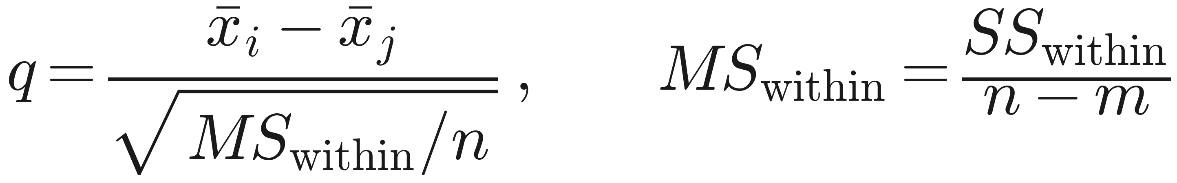
Which groups differ? Tukey's HSD
ANOVA says “someone differs” — Tukey says who, without inflating error.
Run after a significant ANOVA: all pairwise differences at once, holding the false positives at α using family-wise error rate.
Yardstick is MS within — ANOVA's pooled estimate of the common noise σ² over all n−m residual df, so it is stable and on the same scale.
𝑞 is compared to Studentized Range distribution 𝑞_{𝛼, 𝑚, 𝑛−𝑚} — the distribution of the largest difference among 𝑚 means (, which is what makes the FWER correction automatic).
Honestly Significant Diﬀerence (HSD) = the smallest mean gap that clears that critical value; pairs farther apart than the HSD are significant.
It reuses ANOVA's MS_within as the common yardstick (same equal-variance assumption)
Notes:
As important as ANOVA — it answers the actual scientific question. The pitfall it solves: a significant F says some mean differs, not which, and uncorrected pairwise t-tests re-create the multiple-testing problem (5 groups = 10 comparisons). The clever bit is the Studentized Range: each gap is compared to the distribution of the largest gap among m means under the null, so the family-wise error stays at α by construction. It reuses ANOVA's MS_within as the common yardstick (same equal-variance assumption); Tukey–Kramer handles unequal n via the harmonic mean. Read results off the per-pair CIs: 0 inside → not significant.

Slide 16
Part IV — Running many tests at once

Slide 17
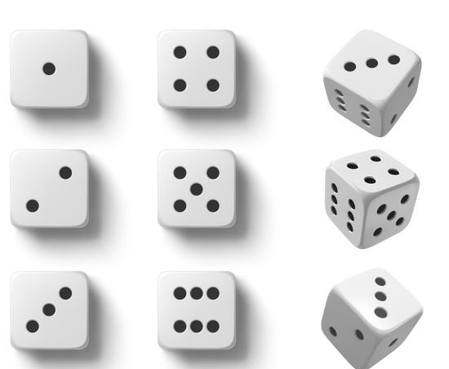
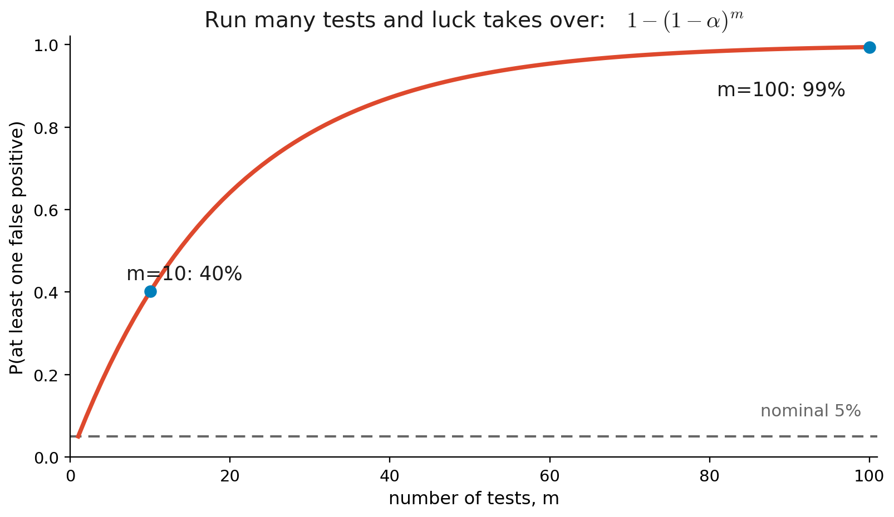
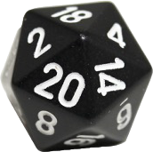
The multiple-testing problem
Run enough tests and you'll be “significant” by luck.
5% per test ≠ 5% overall.
Notes:
Where Session 2's per-test α breaks down at scale. The 1−(1−α)^m curve (figure) climbs to 40% by ten tests. Test 20,000 genes at 0.05 under a global null and you expect ~1,000 hits by chance. Tukey on the previous slide was a first taste of the fix.

Slide 18
Controlling error: FWER vs FDR
Two different things you might choose to control.
FWER (family-wise error rate)
Controls Prob(any false positive).
Bonferroni-Šidák: call significant only below p < α/N
FWER is strict (few false positives, many misses)
FDR (false discovery rate)
Expected proportion of false positives among hits.
Benjamini–Hochberg.
FDR keeps power for large screens
Bonferroni for certainty; Benjamini–Hochberg for discovery.
Notes:
Frame as a choice of which error you fear. Bonferroni (FWER) is simple and very conservative — fine for a handful of tests, brutal across thousands. Benjamini–Hochberg (FDR) tolerates a controlled fraction of false discoveries to keep power — the genomics standard. q-value plainly: q=0.05 means 'if I call this and everything more significant a hit, ~5% of those hits are expected false.' Pitfall: a q-value is not a p-value.

